Slide 1
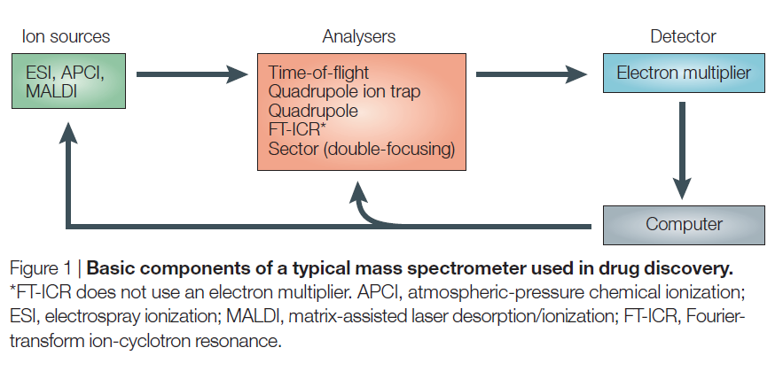
Mass spectrometry
Glish et al., Nature Reviews Drug Discovery 2, 140, 2003

Slide 2
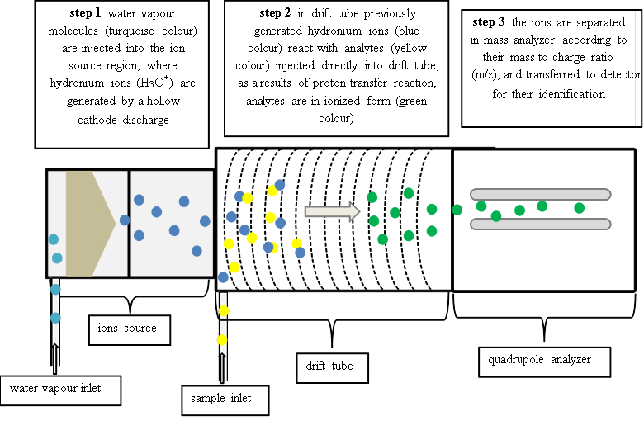

Mass spectrometry
Proton transfer mass spektrometry (PTR-MS)
Proton affinity of water is 691 KJ/mol

Slide 3
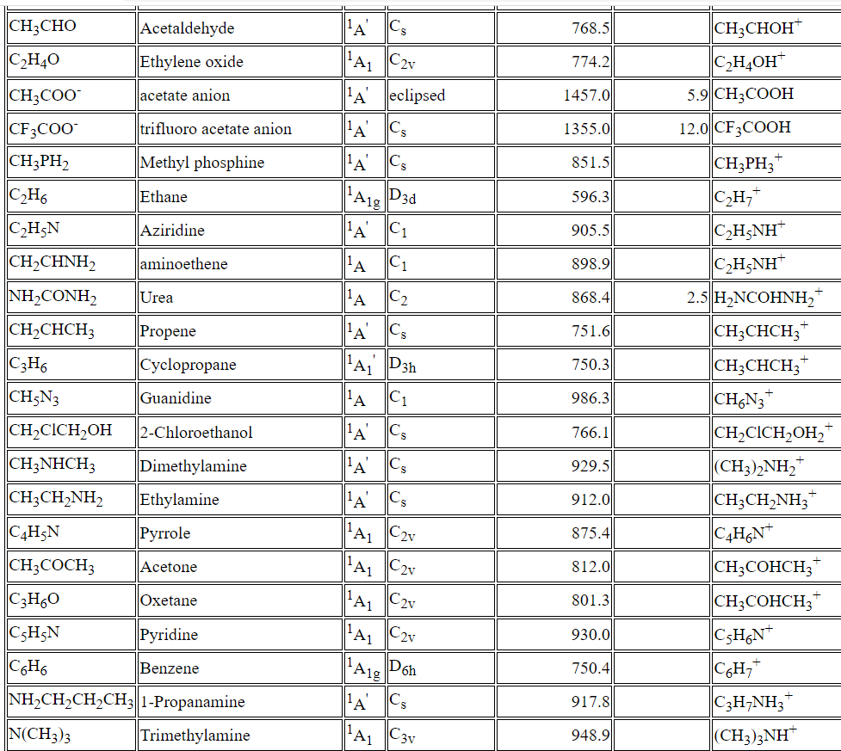
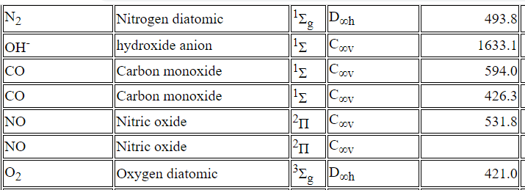
Proton affinities from NIST Chemistry Webbook
Proton affinity of water is 691 KJ/mol

Slide 4
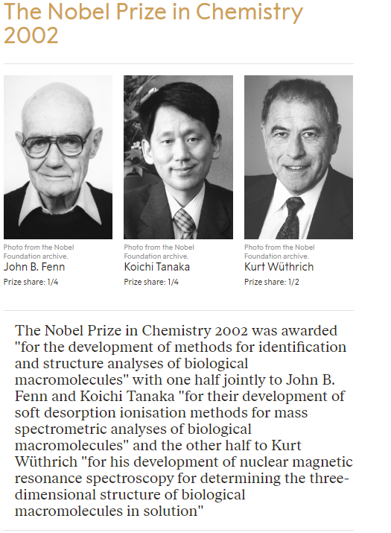
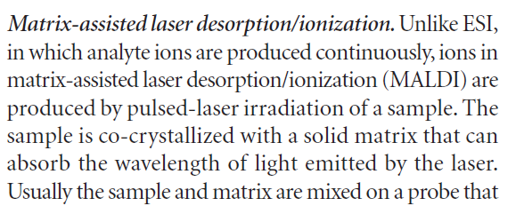
Mass spectrometry
For liquids etc:
ESI – Electron Spray Ionisation
ACPI – Atmospheric Pressure Chemical Ionisation
MALDI – Matrix Assisted Laser Desorption/Ionisation
Glish et al., Nature Reviews Drug Discovery 2, 140, 2003

Slide 5
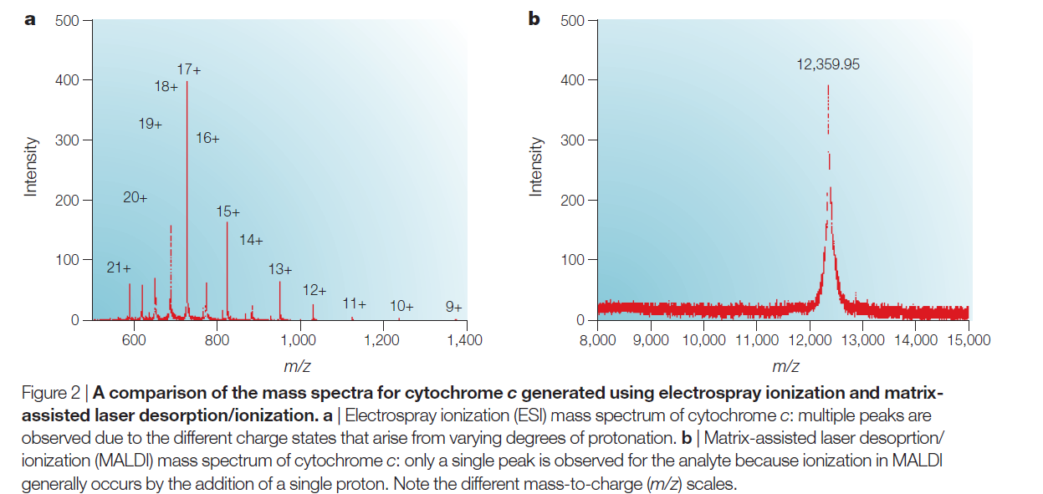
Mass spectrometry

Slide 6
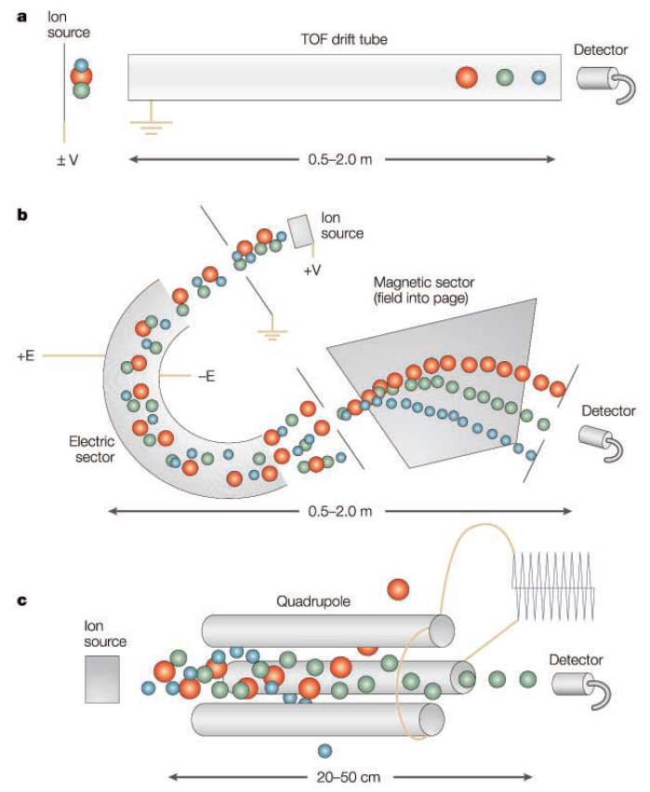
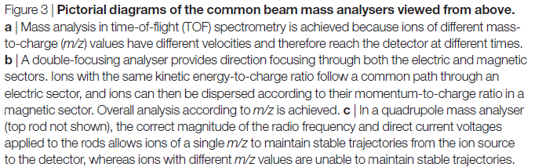
Mass spectrometry
Glish et al., Nature Reviews Drug Discovery 2, 140, 2003

Slide 7
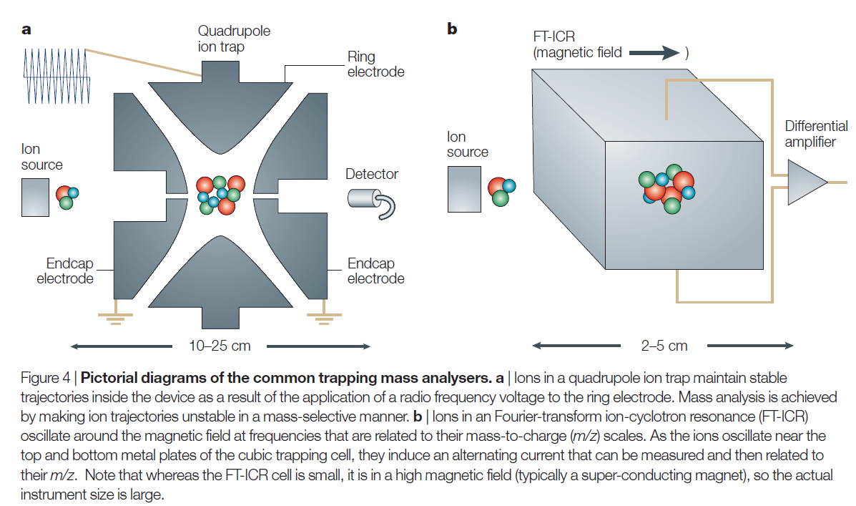
Mass spectrometry

Slide 8
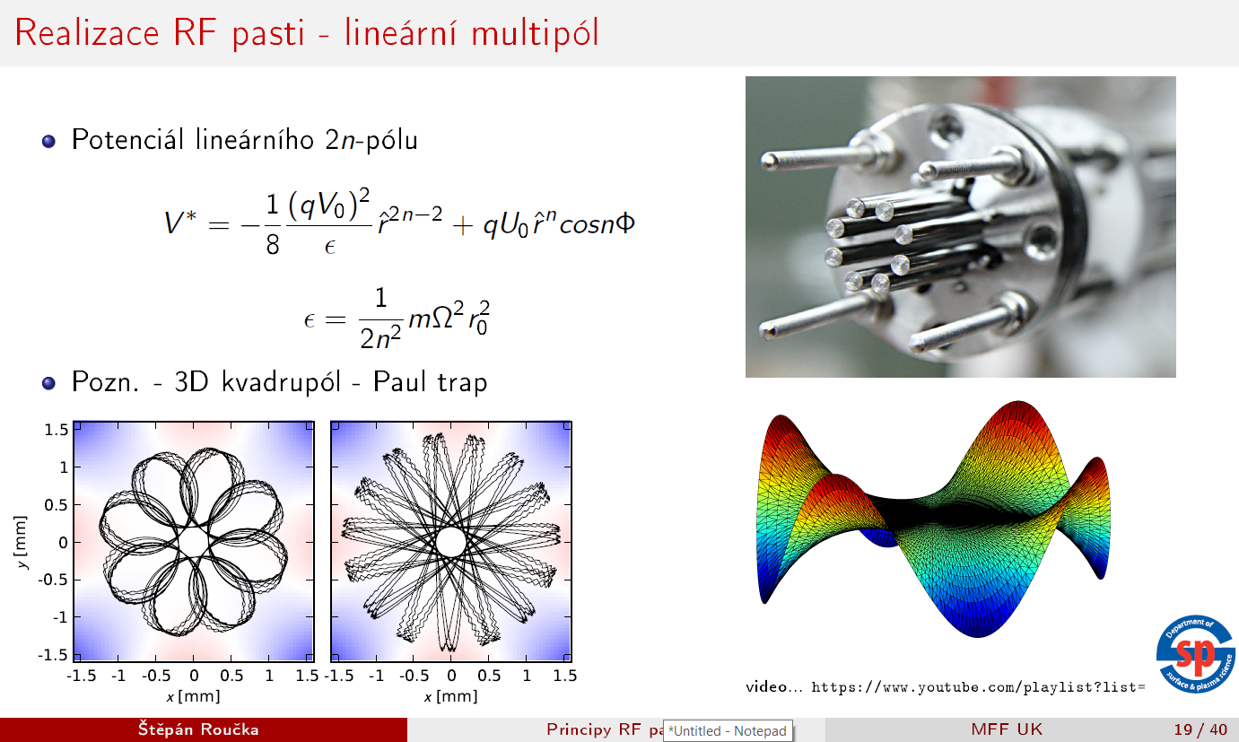

Slide 9
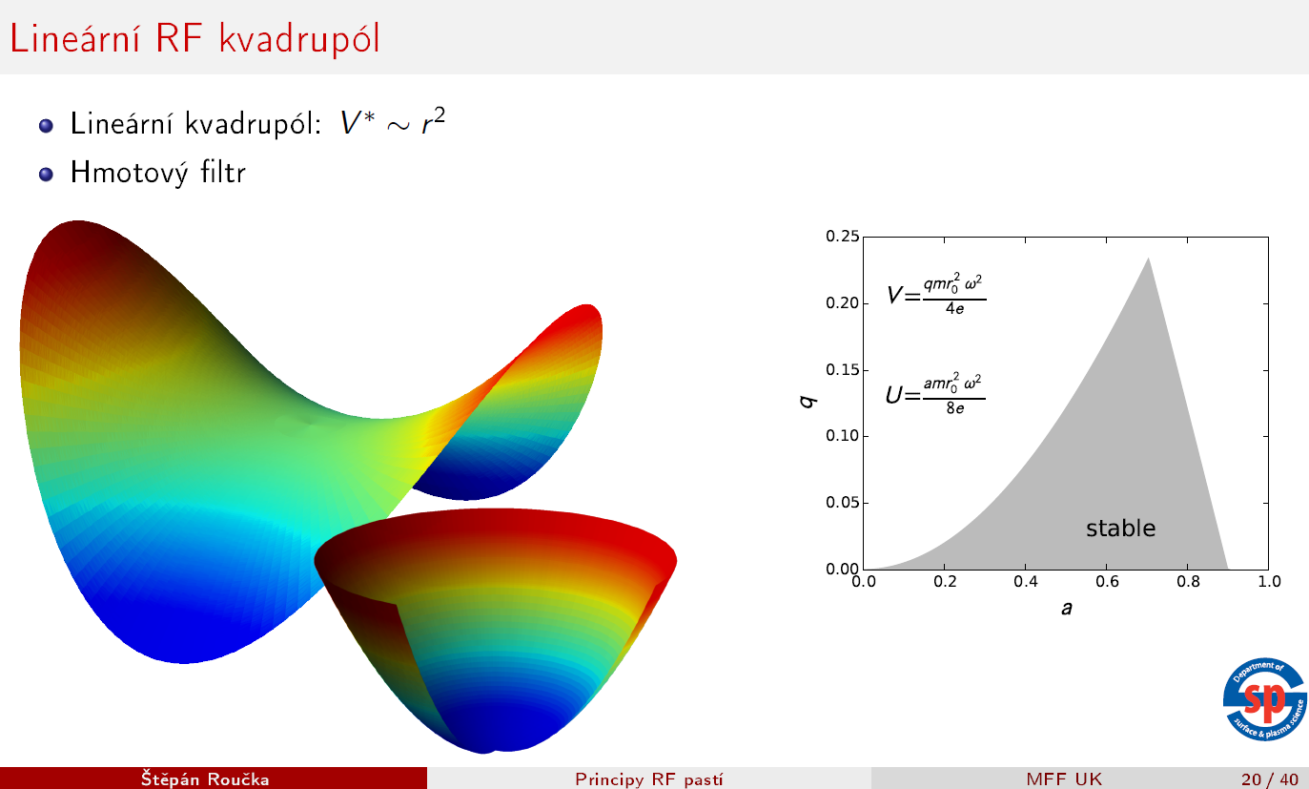
Mathieau (stability) diagram

Slide 10
Microwave diagnostics of plasma
Plasma permitivity

Slide 11


Microwave diagnostics of plasma
Collisionless plasma
$$n=\sqrt{ε_{r}μ_{r}}$$
$$ε_{r}=ε_{1}+iε_{2}$$
Real part non-zero for any non-zero ε₂ (collisions). With collisions some propagation still exists but with strong atenuation under the theoretical cut off frequency
Jan Faltýnek, Microwave diagnostics of plasma and materials, Ph.D. Dissertation

Slide 12

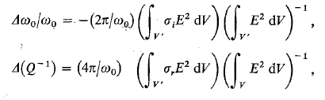

Microwave diagnostics of plasma
Plasma conductivity
Change of resonant frequency and resonator quality:
Plasma frequency

Slide 13
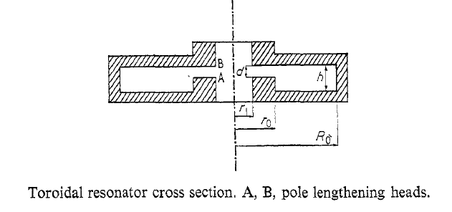
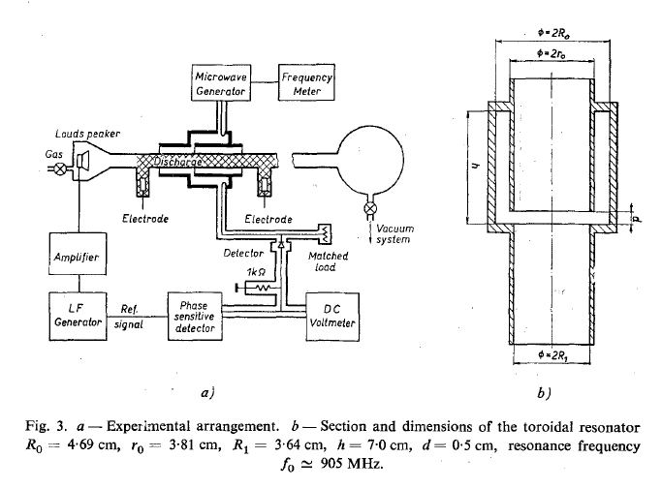
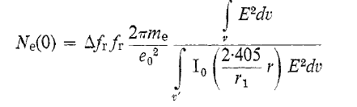
Microwave diagnostics of plasma
From the shift of resonant frequency we can get electron number density
Sicha et al., Czech. J. Phys. B 20, 684, 1970

Slide 14
Microwave diagnostics of plasma
Electron number density measurement

Slide 15
Microwave interferometry
Phase shift induced by plasma is measured
Jan Faltýnek, Microwave diagnostics of plasma and materials, Ph.D. Dissertation

Slide 16
Microwave reflectometry
Utilising reflection of microwaves to find cut off frequency

