Slide 1
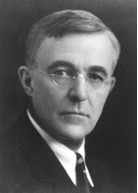


Plasma I ZS 2014 L10
Plasma Diagnostics
The Nobel Prize in Chemistry 1932
Surface Chemistry
Irving Langmuir was born in Brooklyn, New York, on January 31, 1881, as the third of four sons of Charles Langmuir and Sadie, neé Comings. His early education was obtained in various schools and institutes in the USA, and in Paris (1892-1895). He graduated as a metallurgical engineer from the School of Mines at Columbia University in 1903. Postgraduate work in Physical Chemistry under Nernst in Göttingen earned him the degrees of M.A. and Ph.D. in 1906.
Irving Langmuir
Notes:
poznamka

Slide 2
Plasma
Definition of a plasma
Although a plasma is loosely described as an electrically neutral medium of positive and negative particles, a more rigorous definition requires three criteria to be satisfied:
The plasma approximation
Charged particles must be close enough together that each particle influences many nearby charged particles, rather than just the interacting with the closest particle (these collective effects are a distinguishing feature of a plasma). The plasma approximation is valid when the number of electrons within the sphere of influence (called the Debye sphere whose radius is the Debye (screening) length) of a particular particle is large. The average number of particles in the. Debye sphere is given by the plasma parameter Λ.
Bulk interactions
The Debye screening length (defined above) is short compared to the physical size of the plasma. This criterion means that interactions in the bulk of the plasma are more important than those at its edges, where boundary effects may take place
Plasma frequency
The electron plasma frequency (measuring plasma oscillations of the electrons) is large compared to the electron - neutral collision frequency (measuring frequency of collisions between electrons and neutral particles). When this condition is valid, plasmas act to shield charges very rapidly (quasineutrality is another defining property of plasmas)

Slide 3
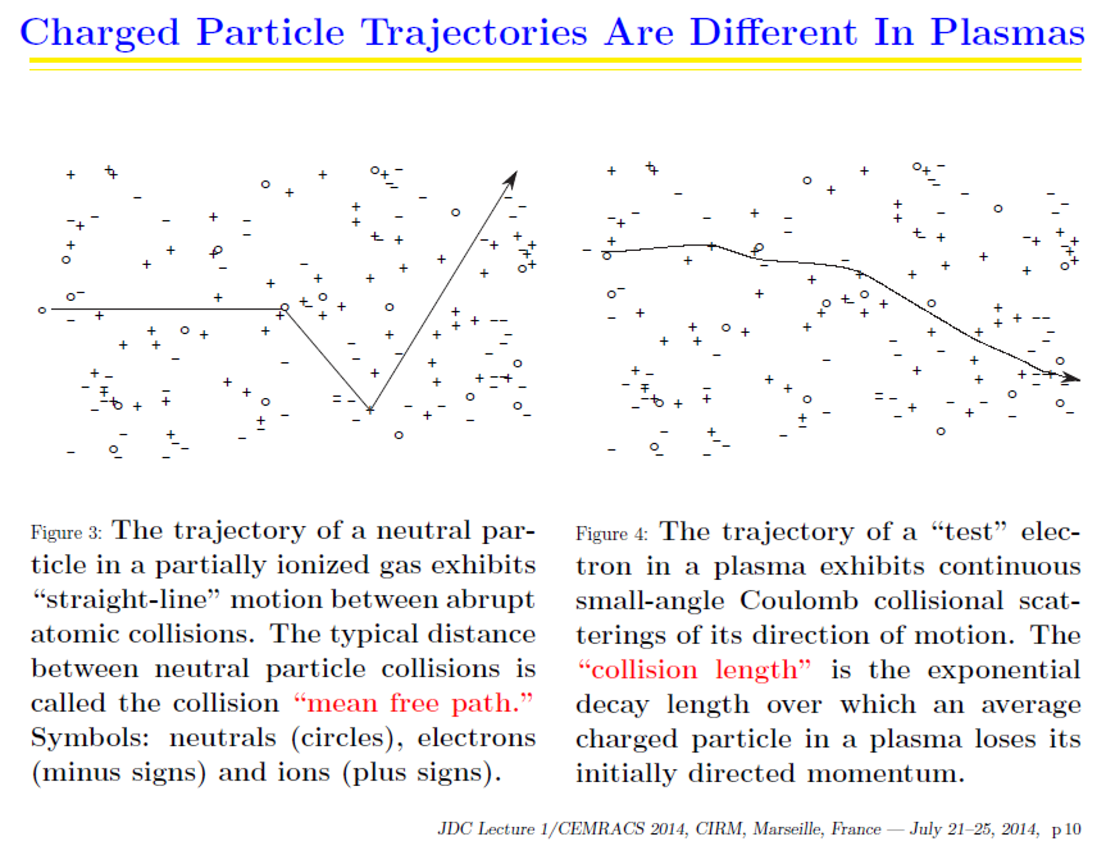

Slide 4
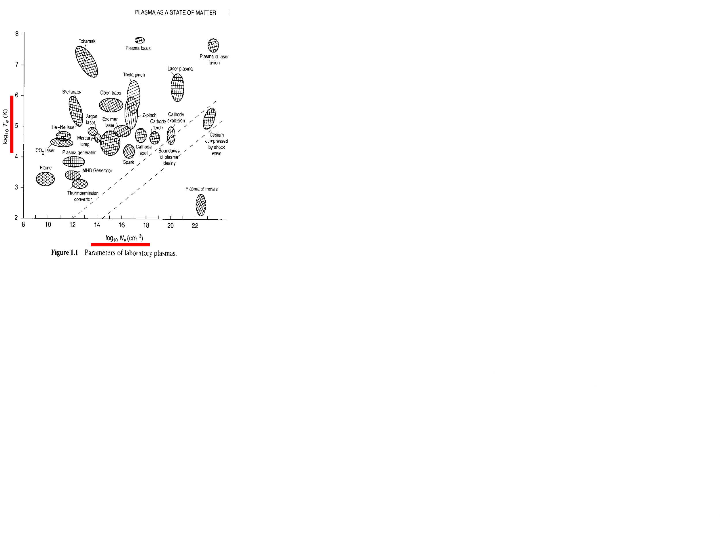

Slide 5
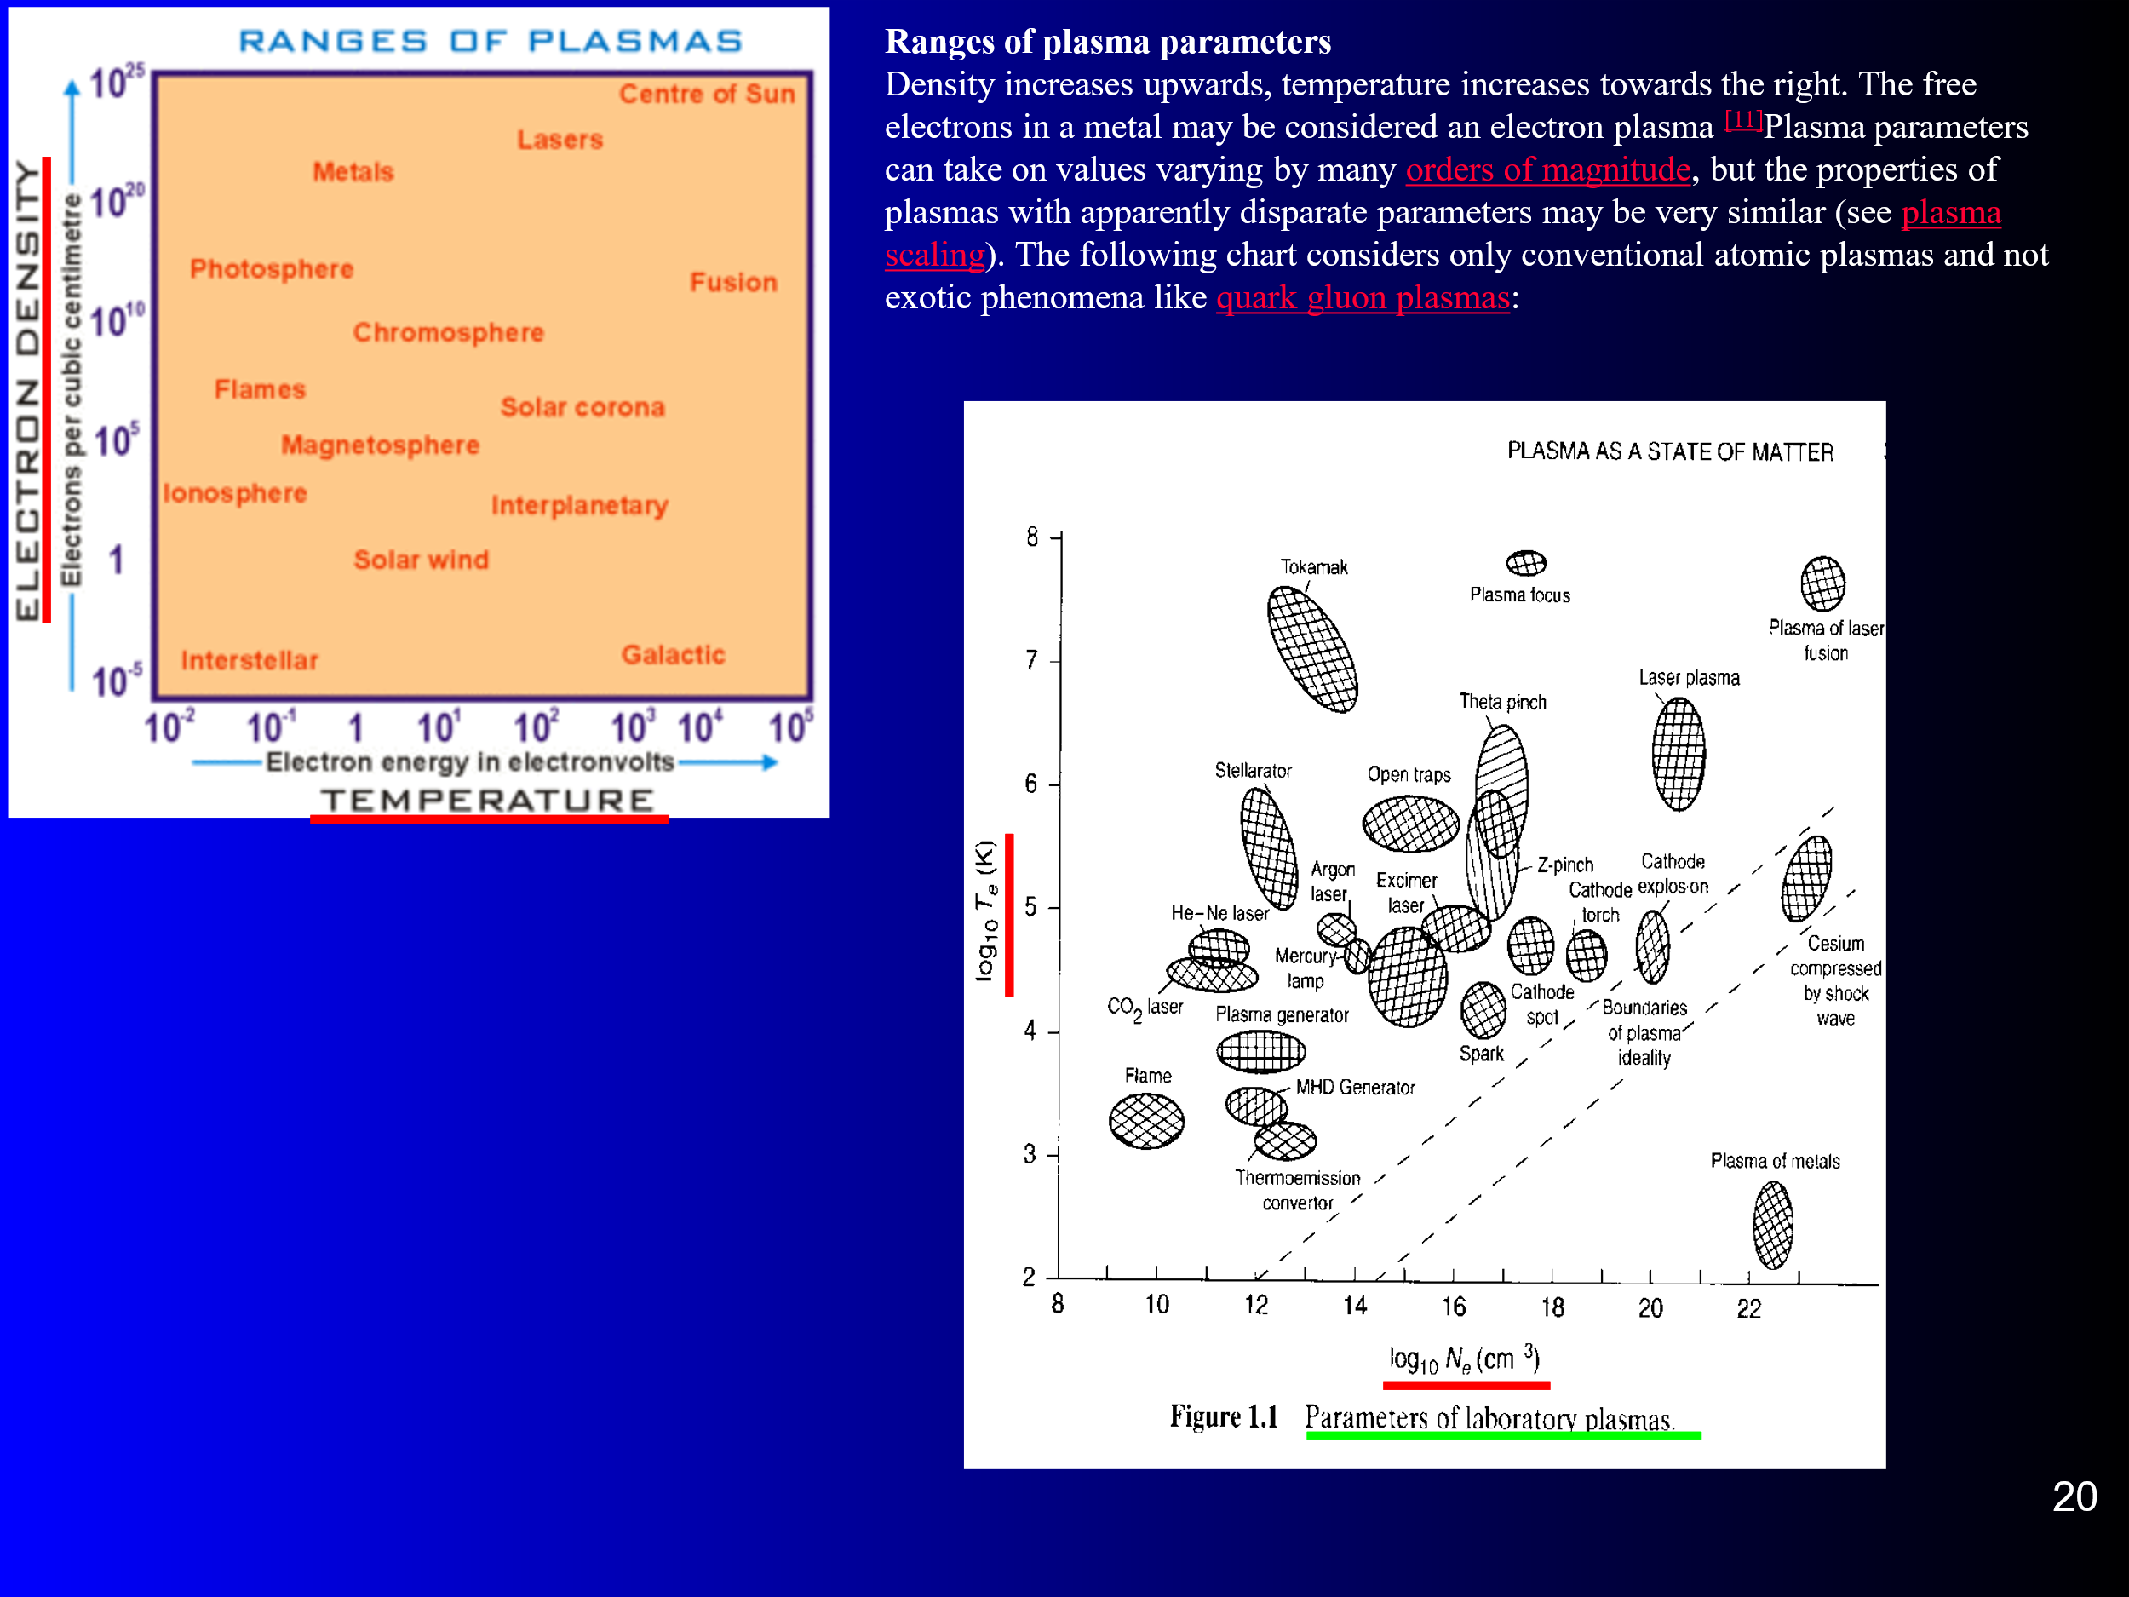

Slide 6
Debye shielding 1
In Cartesian coordinates,
The effect of potential – perturbing charge in a plasma are generally much shorter- range than in vacuum because the charges in plasma tend to distribute themselves so as to shield the plasma from the electric field the perturbing charge generates.
The effect can be deduced readily from Poisson’s equation by assuming, for example, that ions do not move but that electrons adopt a thermal equilibrium distribution in which electron distribution is determined by the Boltzmann factor:
A⁺
e⁻
n∞ is electron density far from the perturbing charge where potential V is taken as a zero. Poisson’s equation is:
n_{i}
n_{e∞}=n_{i∞}=n∞
n_{e}
V=0
V
If we suppose that eV<<kT_{e} exponential term can be expressed by 1+eV/ kT_{e}
And we obtain:

Slide 7
Debye shielding 2
eV<<kT_{e,}, exponential can be approximated by linear term➔
In one dimension
λ_{D}
n_{i}
n_{e∞}=n_{i∞}=n∞
λ_{D}
V=0
n_{e}
V
In one dimension the solution indicates exponential decrease of potential
➔ perturbing effect of a charge will tend to penetrate into the plasma only
to the distance of the order of the Debay length λ_{D}

Slide 8
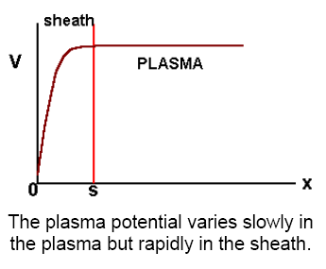
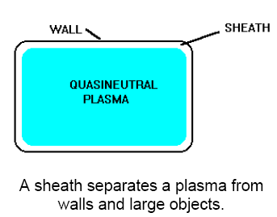
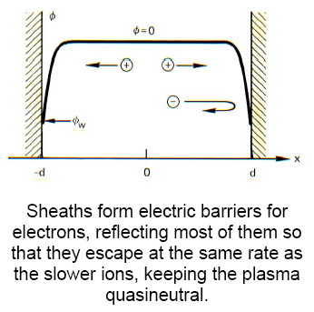
Debye shielding 3
For laboratory plasma with T_{e}=1eV and n_{e}=10¹¹cm⁻³ ➔ λ_{D}=20μm
For afterglow 100K plasma with T_{e}~0.001eV and n_{e}=10¹⁰cm⁻³ ➔ λ_{D}=2μm
n_{e}=10¹¹cm⁻³ ➔ “distance between particles ~ 2μm; λ_{D}=20μm
Thus the plasma potential tends to be positive relative to the walls or to any electrically isolated object, such as a large piece of dust or a floating probe.
Plasma in metal cylinder and plasma in glass cylinder…..??!!!

Slide 9
Debye shielding 4
In spherical symmetry Poisson’s equation gives (not in SI!):
λ_{D}
n_{i}
- -
n_{e∞}=n_{i∞}=n∞
λ_{D}
V=0
n_{e}
V
In one dimension the solution indicates exponential decrease of potential
➔ perturbing effect of a charge will tend to penetrate into the plasma only
to the distance of the order of the Debay length λ_{D}

Slide 10
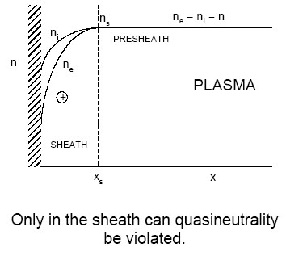
Debye shielding 5
Rewritten to another form:
N – number of particles in Debye sphere
λ_{D}
n_{i}
- -
n_{e∞}=n_{i∞}=n∞
λ_{D}
n_{e}
V
V=0

Slide 11
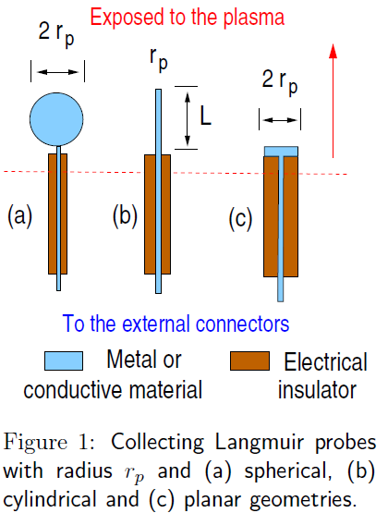
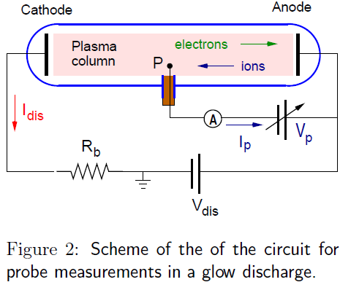
Cylindrical probe
V_{Pl}
V_{p}
Potential
V_{a}
Reference electrode
A
V_{a}

Slide 12
Langmuir probe Plasma Diagnostics
Conventional Langmuir probe theory assumes collisionless movement of charge carriers in the space charge sheath around the probe. Further it is assumed that the sheath boundary is well-defined and that beyond this boundary the plasma is completely undisturbed by the presence of the probe. This means that the electric field caused by the difference between the potential of the probe and the plasma potential at the place where the probe is located is limited to the volume inside the probe sheath boundary.
The general theoretical description of a Langmuir probe measurement requires the simultaneous solution of the Poisson equation, the collision-free Boltzmann equation, and the continuity equation with regard to the boundary condition at the probe surface and requiring that, at large distances from the probe, the solution approaches that expected in an undisturbed plasma.
I.H. Hutchinson
Principle of plasma diagnostics
Cambridge, second edition 2002
Langmuir Probe in Theory and Practice
by Evgeny V. Shun'ko
Notes:
poznamka

Slide 13
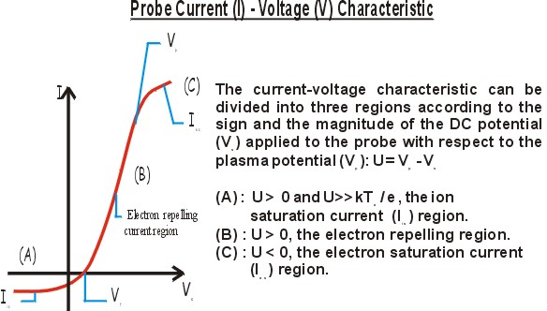
Particle flux
Number of particles of a given species crossing unit area per unit time (from one side) is:
In TD equilibrium
For Ar⁺ v_{e}/v_{i} > 280
Electric current
from the plasma to surface A:
plasma
Floating potential – V_{f}
Plasma potential – V_{p}
Probe potential – V_{pr}

Slide 14
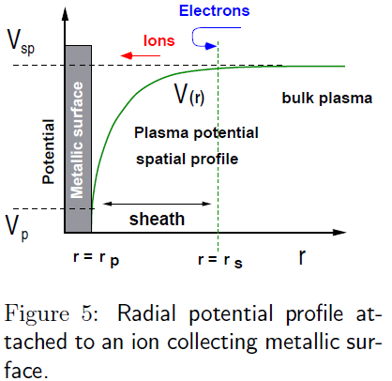
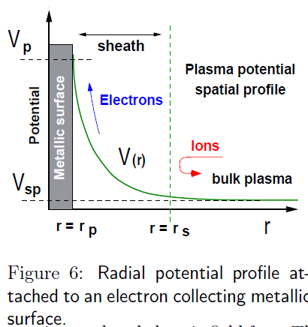
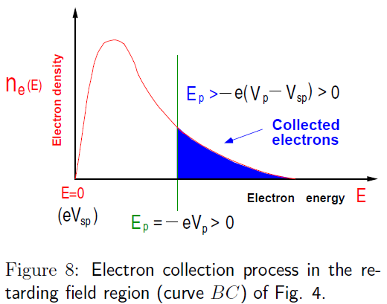
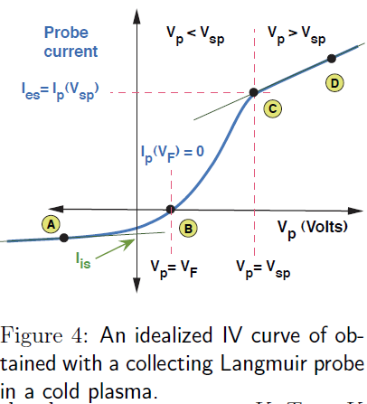

Slide 16
Working regimes for Langmuir probe

Slide 17
Single probe method
Integration over velocity distribution – depends on geometry
In spherical coordinates

Slide 18
Single probe method
For particles that fall on the probe surface, following equation holds:
Leading to integration limits:

Slide 19
Single probe method

Slide 20
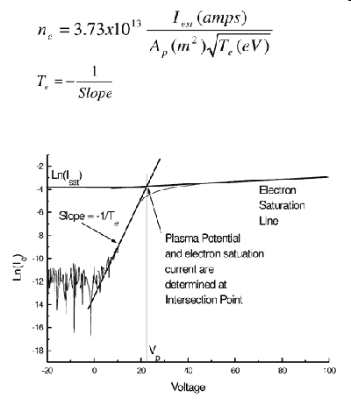
Langmuir probe electron current density in retarding region
For Maxwell distribution

Slide 21
Single probe method
Temperature of the charged particles (usually electrons) is obtained from the first derivative of the probe current:
Number density (of electrons) can be evaluated from the value of probe current at plasma potential:

Slide 22
Single probe method
Probe is attracting the charged particles

Slide 23
Single probe method
Probe is attracting the charged particles

Slide 24
Single probe method
Probe is attracting the charged particles

Slide 25
Cylindrical probe
Probe characteristic
V_{p}
-I_{P}
-
V_{p}=V_{a} - V_{Pl}
V_{a}

Slide 26
Probe circuit

Slide 27
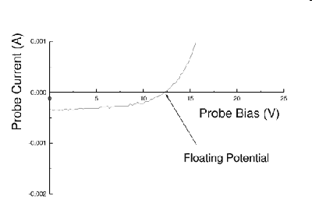
Floating potential
At floating potential, V_{f}, I_{e}=-I_{i} and we obtain:
For Ar⁺ plasma m_{e}/m_{i} =1/80 000

Slide 28
Probe characteristic
Linear scale
V_{p}
-I_{P}
V_{Pl}
Potential
V_{a}
Reference electrode
Semilogarithmic scale
A
-
V_{a}
+

Slide 29
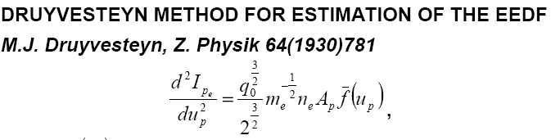
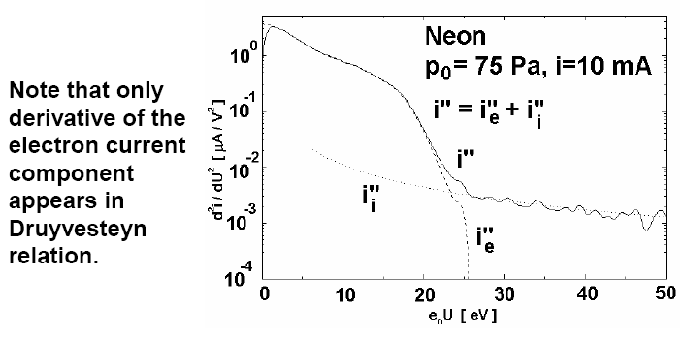
Retarding region for general EEDF
The second derivative necessary for the estimation of the EEDF can be either directly measured (on-line methods) or computed numerically from the experimental data (off-line methods).
Direct calculation

Slide 30
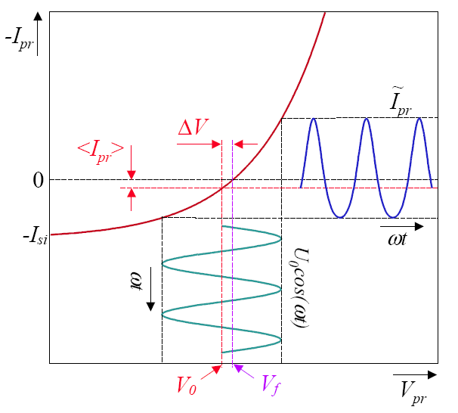
Retarding region for general EEDF, approximation
Second harmonic method
Digital methods

Slide 31
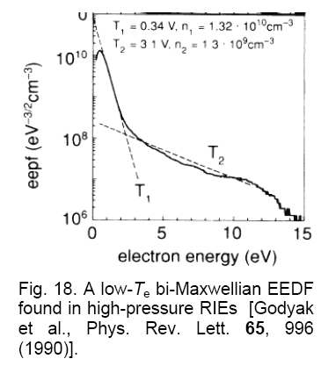
Measured EEDF, low temperature afterglow
Linear scale

Slide 32
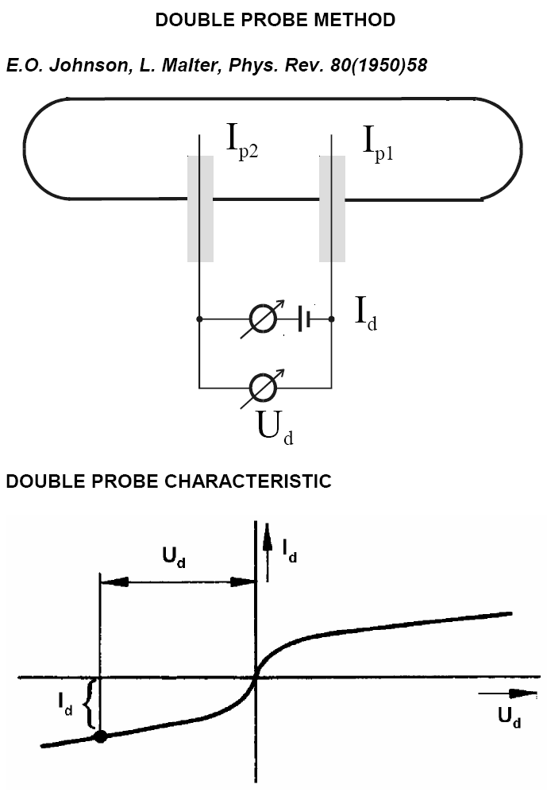



Double probe method
The double probe technique is usually applied to measure the electric field in a discharge plasma, but it can also be applied to determine the electron temperature and, at certain experimental conditions, the plasma density.
Denoting the first and second probe by the subscripts 1 and 2, respectively, we can write down the following equations based on Kirchhoff’s laws:
Here U_{1;2} denotes the probe voltage with respect to the space potential, and U_{d} is the voltage between the two probes.
The great advantage of this method is its insensitivity to the effect of collisions in the space
charge sheath around the probe.

Slide 33
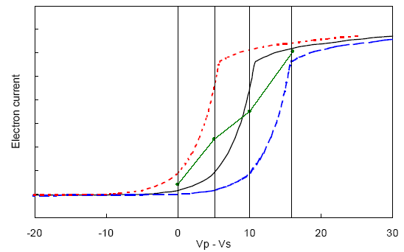
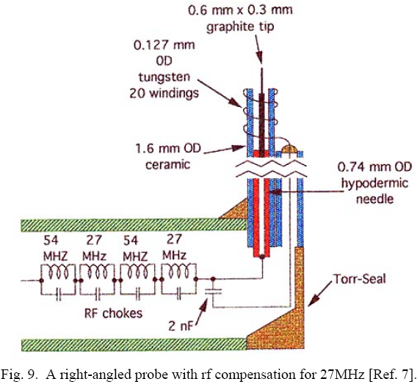
RF compensated probe
The center curve is the correct I . V curve. The dashed ones are displaced by ±5V, representing changes in Vs. At the vertical lines, the average Ie between the displaced curves is shown by the dot. The line through the dots is the time-averaged I . V curve that would be observed, differing greatly from the correct curve.

Slide 34
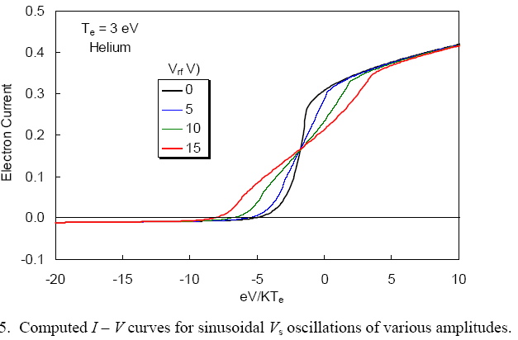
Probe characteristic measured in oscillating plasma
– sinusoidal oscillation of plasma potential
T_{e}
T_{e}*
T_{e}*
False temperature can be measured

Slide 35
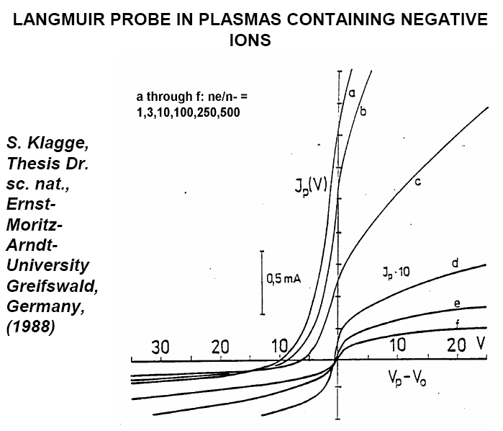
Langmuir probe in plasma containing electronegative gases
e⁻
+
-
-
90% of ions Cl⁻
+
100% of ions Ar⁺
e⁻
10% of electrons

Slide 36
Langmuir probe in magnetized plasma

Slide 37
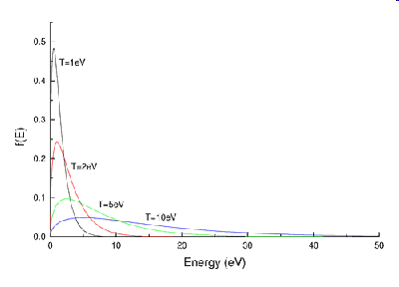
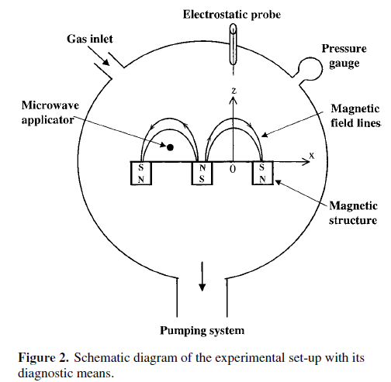
Current-voltage characteristic in presence of magnetic field

Slide 38
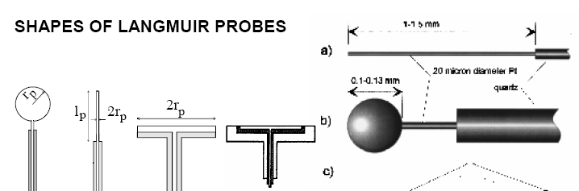
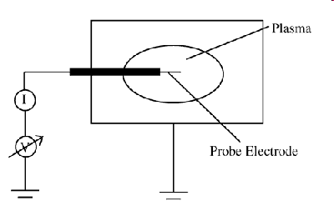
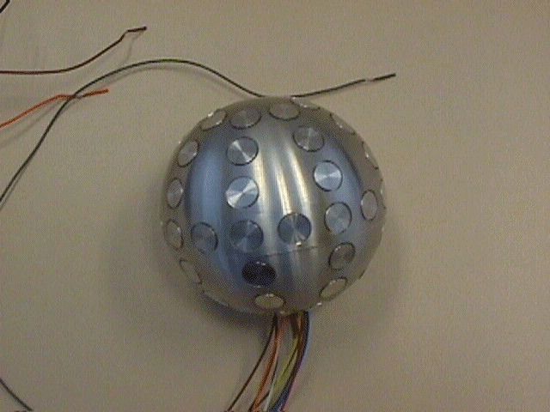
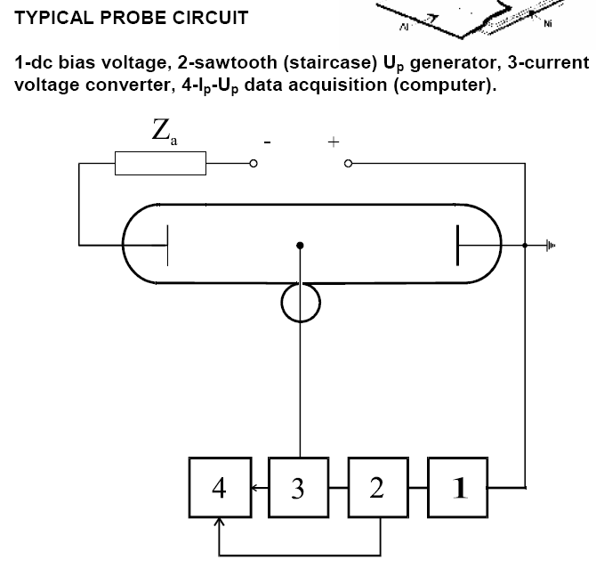
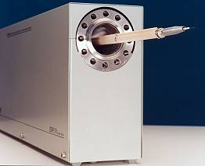
Langmuir probe setup
ESPion, an Advanced Langmuir
Probe for Plasma Diagnostics

Slide 39
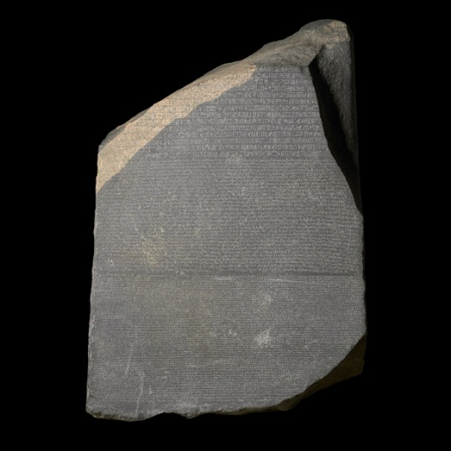
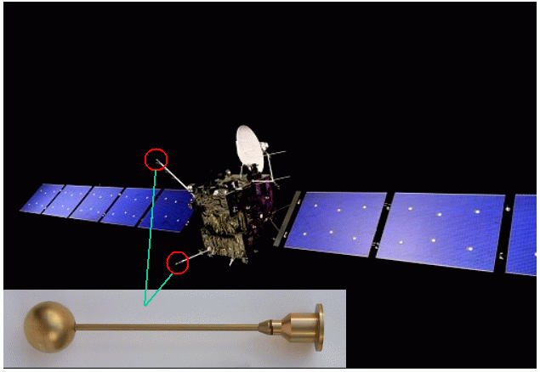
Rosetta using Langmuir probe
ESA's Rosetta mission was launched on 2 March 2004. It has spent ten years in space, passed by two asteroids (2867 Steins in 2008 and 21 Lutetia in 2010) and will reach Comet 67P/Churyumov-Gerasimenko in 2014. Rosetta will follow the comet as it orbits around the Sun, and will be the first mission to attempt a landing onto a comet nucleus.
Rosetta using Langmuir probe
The picture below shows Rosetta in space. The large bluish "wings" are the solar panels which provide electricity for all systems onboard the spacecraft. The red circles show the locations of the two sensors of the Langmuir probe instrument, LAP. One of the two sensors is enlarged at the bottom of the picture. The sensor itself is a titanium sphere 50 mm in diameter, looking goldish because of its titanium nitride coating.

Slide 40
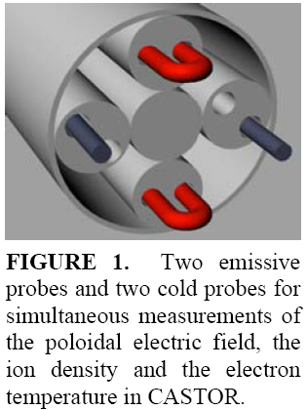
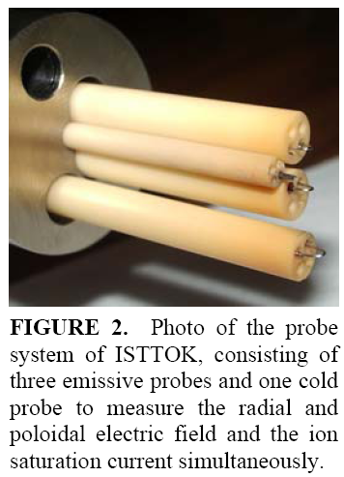
Langmuir probe applications
Rosetta using Langmuir probe
Rosetta using Langmuir probe
The picture below shows Rosetta in space. The red circles show the locations of the two sensors of the Langmuir probe instrument, LAP. The sensor itself is a titanium sphere 50 mm in diameter.
Notes:
poznamka

Slide 41
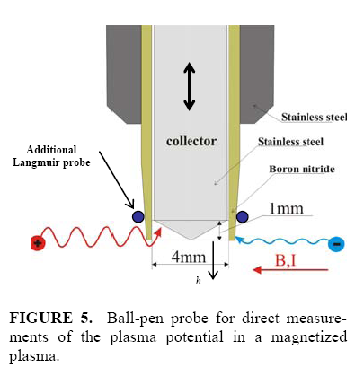
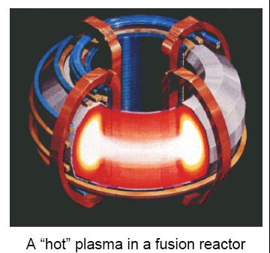
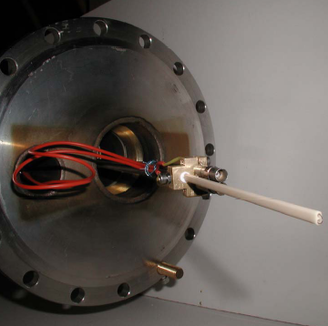
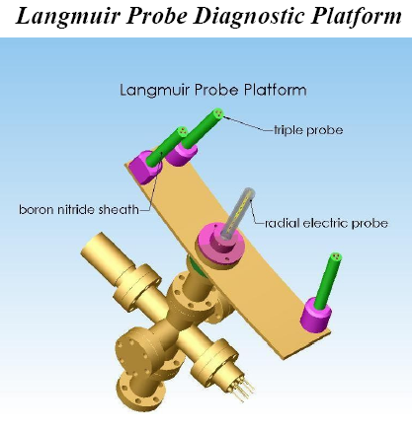
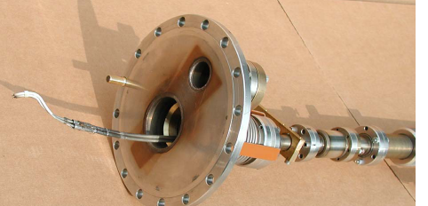
Langmuir probe in magnetic field
The measurement of the plasma potential Φpl by means of the ball-pen probe utilizes the different electron and ion gyroradii in a magnetized plasma.

Slide 42
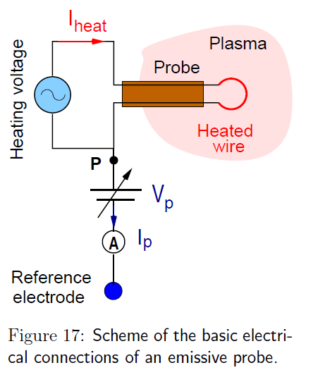
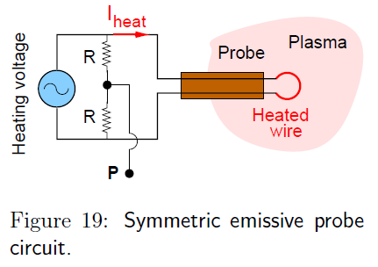
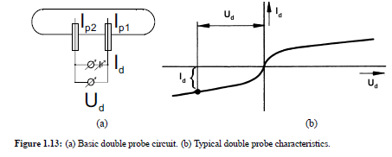
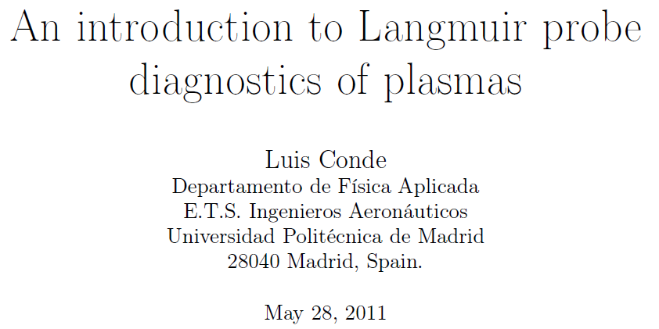
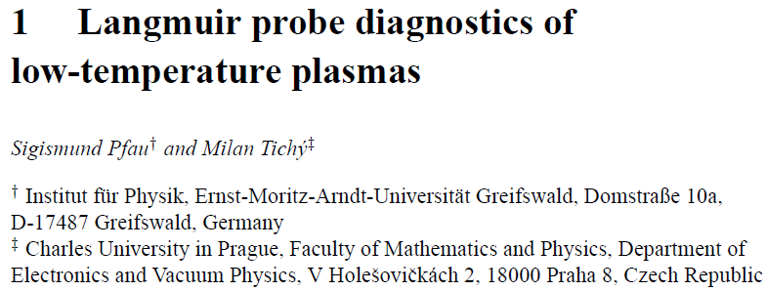

Slide 43
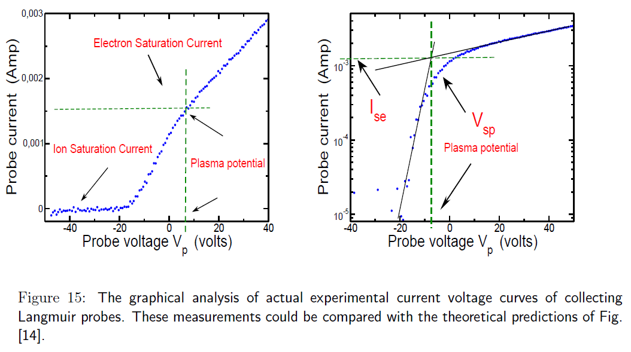

Slide 44
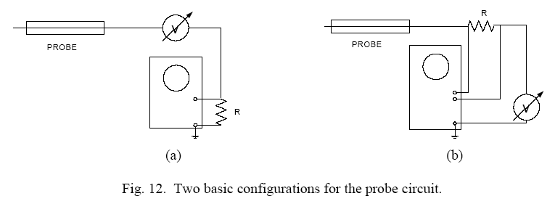
Probe circuit
How is the current flowing?

Slide 45
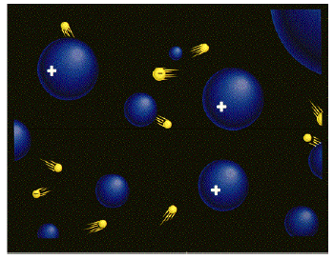


Langmuir probe setup, reference electrode, closed loop
-
V_{p}
V_{p}=V_{a} - V_{Pl}
V_{Pl}
Potential
+
V_{a}
Reference electrode
reference electrode
A
V_{a}

Slide 46
EEDF

Slide 47
Retarding region for general EEDF
The second derivative necessary for the estimation of the EEDF can be either directly measured (on-line methods) or computed numerically from the experimental data (off-line methods).
Direct calculation

Slide 48
Retarding region for general EEDF, approximation
Second harmonic method
Digital methods

Slide 49
Langmuir probe -plasma parameters

Slide 50
Langmuir probe NH₄⁺

Slide 51
Measured EEDF, high electron temperature

Slide 52
Measured EEDF, low temperature afterglow
Linear scale

Slide 53
Current-voltage characteristic in presence of magnetic field

Slide 54
Variation of the probe characteristics along the flow tube
L
He⁺
Ar⁺
L
The decay time is correlated
with the position in the flow tube.

Slide 55
Evolution of the probe characteristics along the flow tube
Study of H₃⁺ and H₅⁺recombination
I_{e}² ~n_{e}A_{Pr}(V_{probe}-V_{plasma})

Slide 56
Langmuir probe FALP - HCOH - formation and recombination

Slide 57
Langmuir probe setup
Obr 3: Vrchní panel: Průběh elektronové koncentrace po přidáni Ar do rozpadající se plazmy v proudícím He.
Dolní panel: Odpovídající pokles koncentrace metastabilů He(2³S).
Vypočtená rychlostní konstanta k = 7×10⁻¹¹ cm³ s⁻¹, tato hodnota je v dobré shodě s výsledkem Lindingera et al
Obr 4: Vrchní panel: Průběhy potenciálu plazmatu, plovoucího potenciálu a intenzity axiálního elektrického pole. Plné body odpovídají rozpadu v čistém He, který je ovlivňován přítomností metastabilů He(2³S).
Otevřené symboly označují data odpovídající směsi He s Ar. V oblasti 0-1 cm probíhá Penningova ionizace.
Dolní panel: Odpovídající průběhy elektronové teploty.

Slide 58
Langmuir probe - after penning ionization, EEDF
He^{m} + Ar ➔Ar⁺ + He + e⁻

Slide 59
AISA diagnostics systems
LANGMUIR PROBE

Slide 60

VT - AISA
dn_{i}/dt=-αn_{i}n_{e}
He/Ar/H₂
AISA
α(T)
H₃⁺
T
e⁻
40 cm diameter
UHV - 10⁻⁹ Torr
External magnetron
2 Torr of He/Ar/H₂
PULSED STATIONARY AFTERGLOW
20-100ms decay
n_{e}(τ), n_{i}(τ)
τ

Slide 61
Langmuir probe FALP Ar⁺ dominated plasma

Slide 62
Probe calibration using recombination of O₂⁺
Decays of the electron number density
measured in afterglow with three different dominated ions : He₂⁺, Ar⁺, O₂⁺
10
10
He
+
diffusion
2
Langmuir probe measurements
He
2
+
-3
]
+
[cm
10
9
Ar
n
e
O
+
O
2
+
10
8
2
diffusion
0
10
20
30
40
time [ms]
Influence of impurities
H₂O number density, [H₂O] ≈ 6×10⁹cm⁻³

Slide 63

Langmuir probe Plasma Diagnostics
Notes:
poznamka

Slide 64

EEDF FALP experiment
Notes:
poznamka

Slide 65
EEDF
Notes:
poznamka

Slide 66
Cylindrical probe
Probe characteristic
V_{p}
-I_{P}
-
V_{Pl}
Potential
V_{p}=V_{a} - V_{Pl}
Detail of ion current
V_{a}
+I_{P}
Reference electrode
+
+
A
V_{a}

Slide 67
Double probe method
The double probe technique is usually applied to measure the electric field in a discharge plasma, but it can also be applied to determine the electron temperature and, at certain experimental conditions, the plasma density.
Denoting the first and second probe by the subscripts 1 and 2, respectively, we can write down the following equations based on Kirchhoff’s laws:
Here U_{1;2} denotes the probe voltage with respect to the space potential, and U_{d} is the voltage between the two probes.
The great advantage of this method is its insensitivity to the effect of collisions in the space
charge sheath around the probe.

Slide 68
RF compensated probe
The center curve is the correct I . V curve. The dashed ones are displaced by ±5V, representing changes in Vs. At the vertical lines, the average Ie between the displaced curves is shown by the dot. The line through the dots is the time-averaged I . V curve that would be observed, differing greatly from the correct curve.

Slide 69
Probe characteristic measured in oscillating plasma
– sinusoidal oscillation of plasma potential
T_{e}
T_{e}*
T_{e}*
False temperature can be measured

Slide 70
Langmuir probe in plasma containing electronegative gases
e⁻
+
-
-
90% of ions Cl⁻
+
100% of ions Ar⁺
e⁻
10% of electrons

Slide 71



THEORIES OF ION COLLECTION
Adjacent to the surface is the Child-Langmuir (CL) sheath, where the electron density n_{e} is negligible. Next is the Debye sheath, in which the electron density n_{e} drops exponentially with V. At the sheath edge x = x_{s} (usually set as the origin), quasineutrality holds, so that ne ≈ni. Here the electron distribution is isotropic (except for the few energetic ones that reach the probe), but the ion distribution is unidirectional, since the probe absorbs all the incoming ions. To reach this state, a presheath region must exist, in which a small electric field accelerates the ions to a velocity c_{s}, giving rise to the Bohm current
Comparison of the slopes of the I₂/V curve from various theories
with data from a high-density (n ≈10¹³ cm⁻³) helicon plasma

Slide 72

Reference electrode - Hiden analytical

Slide 73
Langmuir probe in magnetic field
The measurement of the plasma potential Φpl by means of the ball-pen probe utilizes the different electron and ion gyroradii in a magnetized plasma.

