Slide 1
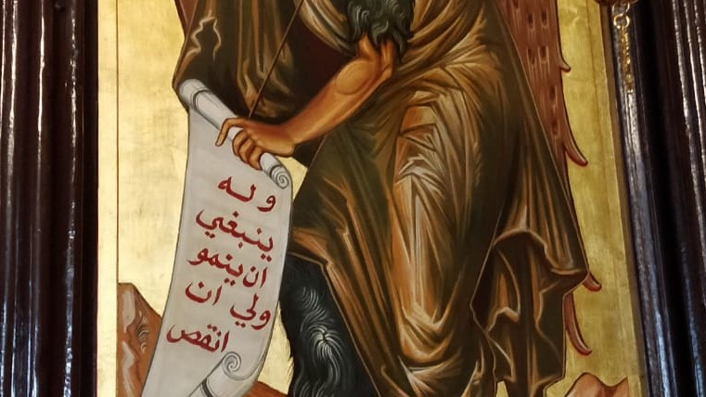
Ethnography and Theology

Slide 2
Pandolfo’s initial formulation:
Islamic eschatology & political theology are a ‘conceptual framework’ and ‘ethical horizon’ within which ‘subjectivity’ and ‘despair,’ the de facto exclusion from citizenship, and the ‘existential struggle of life and death’ are ‘understood and creatively reconfigured.’

Slide 3
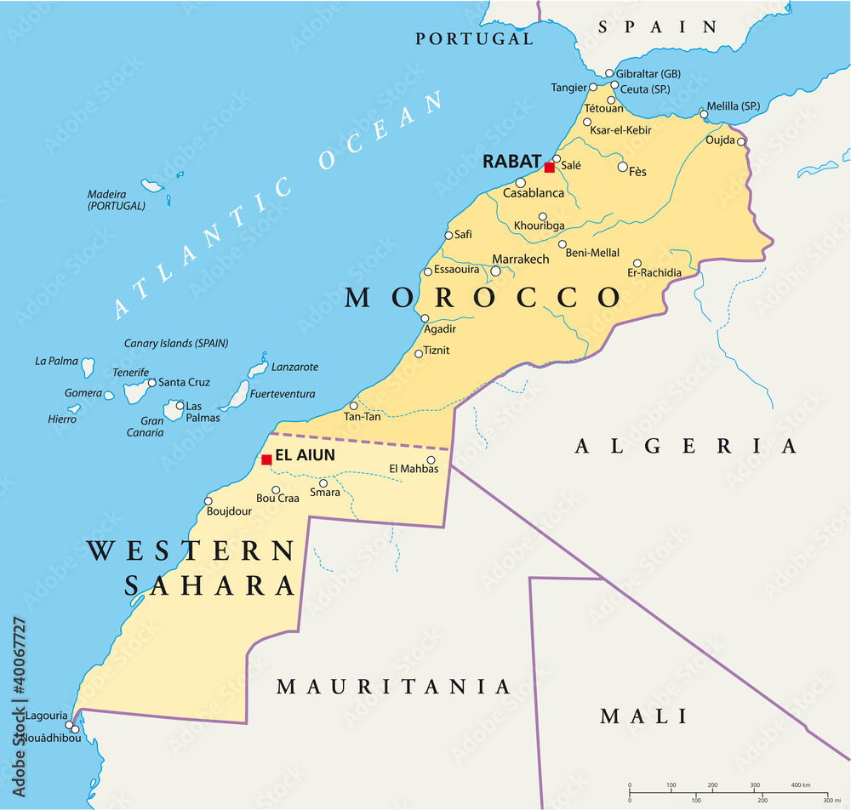
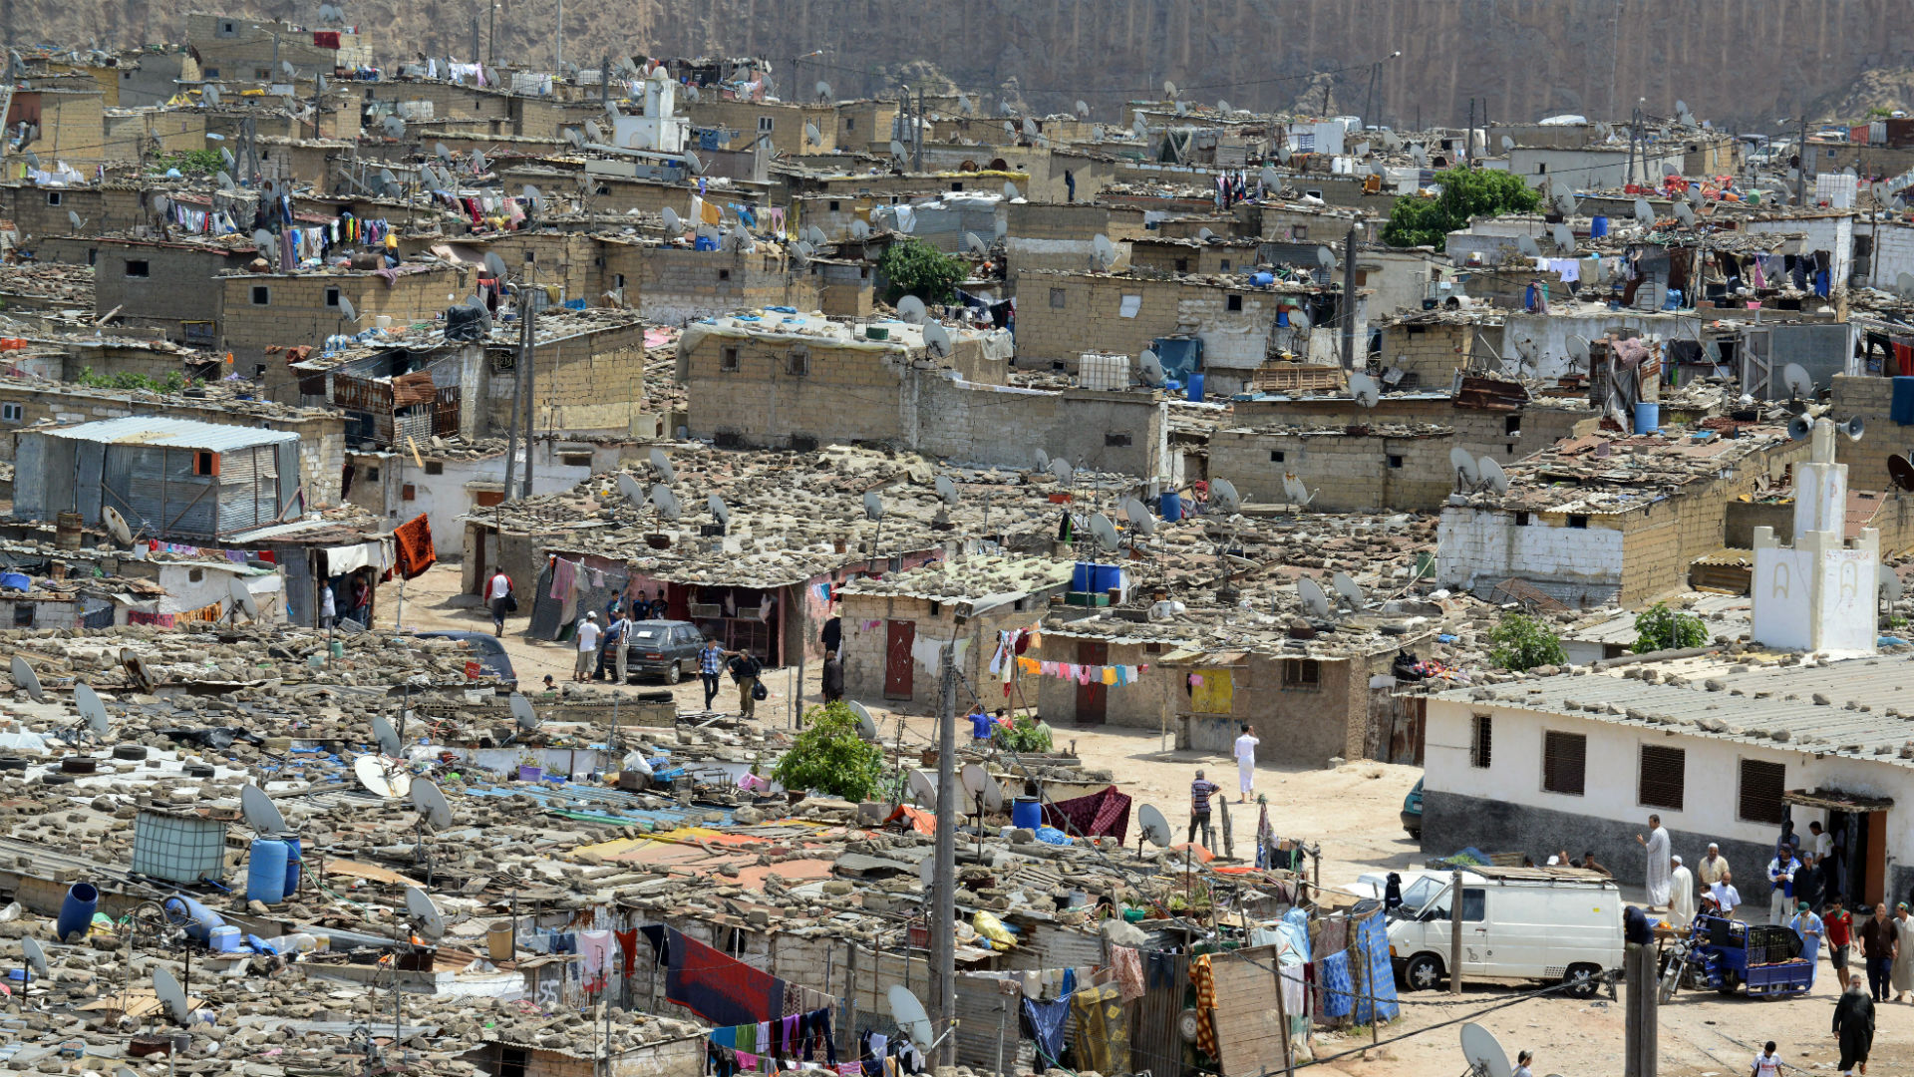
Context: Morocco and clandestine migration

Slide 4
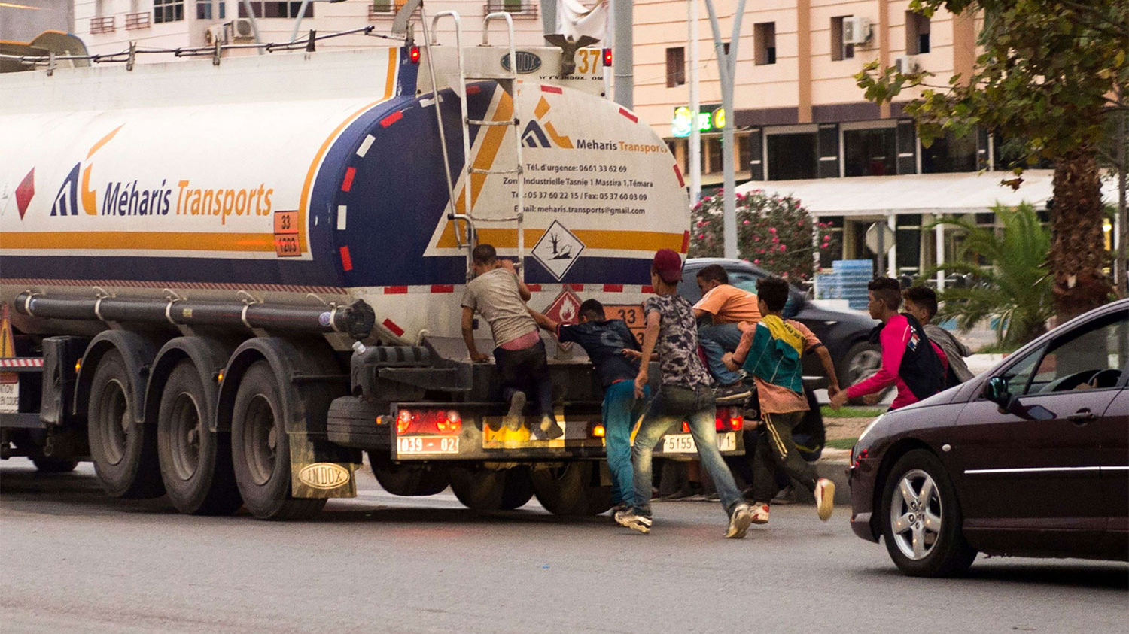

Slide 5
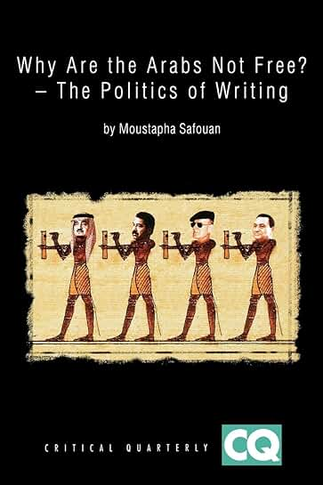
Moroccan Psychoanalysis and its secular methodology
-a pronounced “anxiety” referenced in Casablanca bombings of 2003, the US invasion of Iraq, the Islamic revival
-the supposed “con-fusion” of religious and political coercion
-Islam figures the death drive, and subjectivity (a ‘true’ or ‘free’ self) is compatible with religion
Impossible to recognize this form of life in its singularity

Slide 6
“whether to restore intelligibility is necessary to postulate coherence is an open question for me”
Discontinuity of experience
“‘a time for comprehending’ (le temps pour comprendre)” versus “the advent of resolution and utterance, which he calls ‘the moment of concluding.’”
“It is not just the fact of ‘comprehending’ the other – assimilating it into a pre-existing discourse and thus restituting coherence”
-a conceptualization of incommensurability (non-linear); what is anthropology in such a space of discontinuity?

Slide 7
Islamic eschatology & political theology are a ‘conceptual framework’ and ‘ethical horizon’ within which ‘subjectivity’ and ‘despair,’ the de facto exclusion from citizenship, and the ‘existential struggle of life and death’ are ‘understood and creatively reconfigured.’
As
Where anthropological and ethnographic practice is an experience of discontinuity.

Slide 8
Conceptual framework & ethical horizon
Structure of time: spaces of experience & horizons of expectation
“It makes sense to say that experience based on the past is spatial since it is assembled into a totality, within which many layers of earlier times are simultaneously present, without, however, providing any indication of the before and after…”
“It is different with the temporal structure of expectation which, in the absence of experience, is not to be had. When they are fulfilled, expectation that are founded upon experience may no longer involve any degree of surprise. Only the unexpected has the power to surprise, and this surprise involves a new experience. The penetration of the horizon of expectation, therefore, is creative of new experience”
Reinhart Koselleck, Futures Past.
Tradition
“a theoretical location for raising questions about authority, time, language use, and embodiment…”
“….an empirical arrangement in which discursivity and materiality are connected through the minutiae of everyday living”
Talal Asad “Thinking About Tradition, Religion, and Politics in Egypt Today” Critical Inquiry 42, 2025.

Slide 9
Conceptual framework and horizon
Jihad al-nafs
Kufr
Dhikr al-mawt
Rihla
Hijra
“mobilized” and “debated” by the Moroccan youth and so part of the tradition that includes al-Ghazali and Shariati.
Grammar of concepts (Wittgenstein )
Struggle of the soul
Infidelity to God
Remembrance of death
Journey, adventure
Prophetic community’s movement

Slide 10
These concepts are “understood and creatively reconfigured”
-neither a functionalism nor a hermeneutic but a Lebensform (form of life) in fragment. Where forms cannot be fully inhabited. That is, life in a burning; ḥarg
“what becomes of ‘bare life’ when death is understood as ‘awakening’, the beginning rather than the end, as is the case in Islam and in other religious traditions…?”

Slide 11
Rehearsing a debate as ethnographic method
Stefania: How does one understand death in the crossing according to the teachings
of Islam?
Jawad: It is a suicide, intihar.
Kamal: Why suicide? I disagree with you brother, it is not a suicide . . .
Jawad: Ghadi mghamar b rasek – You go gambling with your life, in other words, you
have chosen to die, in full awareness (katdir f-belek ghadi tmut). The one who died
at sea, we say, mghamar b-hayatu, he’s taking a gamble with his life. Either he will live
or he will die, and if he died, he had already chosen death, without waiting for the
time appointed (met bla khat.ar). He throws himself into a dream, an illusion, he is
in error.
Kamal: What else could he do?
Jawad: This is the problem, this is what happened to you and caused you [Kamal] to
‘burn’ (hadi hia l-mushkila lly ja‘ala lek hetta h. argti).
Kamal: What else could I do, become a thief?

Slide 12
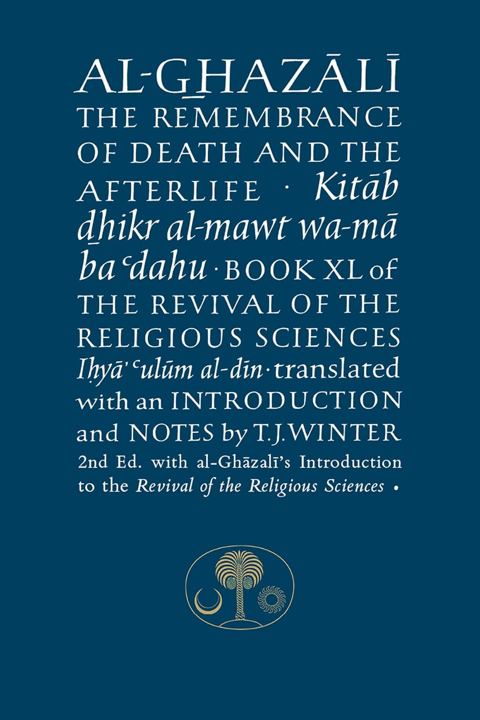
“Yet this ethical sense of ‘parting’ and ‘departing’ is also intimately related to another crossing, different in nature: the separation of death”
Kamal and Jawad alongside al-Ghazali

Slide 13
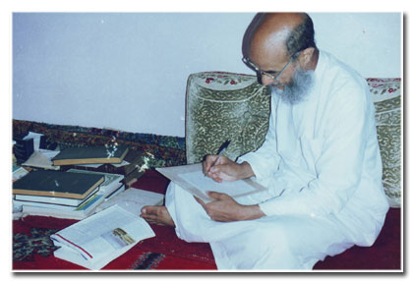
Sheikh Abdessalam Yassine

Slide 14
‘migration from the self ’; the trial of the burning; migration as a form of jihad al-nafs (Kamal’s position)
“Yes, there is a resemblance; I mean war in the sense of harb nefsek, ‘be at war with yourself ’. One struggles against one’s nafs, the worldly desires of one’s soul/self.”
“Were the traits of character not susceptible to change there would be no value in counsels, sermons and discipline, and the Prophet would not have said, ‘Improve your character’” (al-Ghazali, 1995: 25).

Slide 15
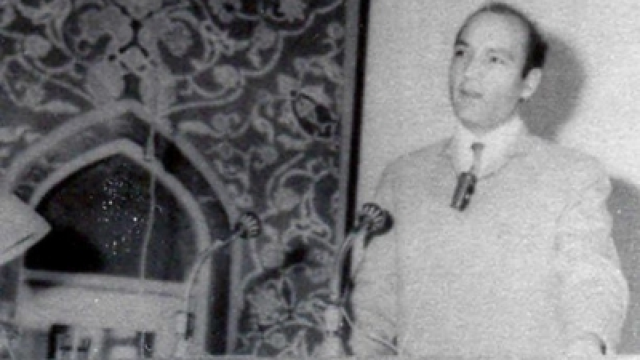

Slide 16

The Ideal Man and self-authorization
‘a man of jihhad and ijtihad, of poetry and the sword, of solitude and commitment, of emotion and genius, of strength and love, of faith and knowledge. He is a man uniting all the dimensions of true humanity’
Yet Kamal is not the ideal man; the figure of the heretic

Slide 17
al-qanat, despair
the slow death, the wretched of the earth
the risk of the burning (the place of the jinn; madness)

Slide 18
One night at Aswak Assalam [a supermarket] we were ‘risking’ (kanriskiw), just by the freeway, there is a thicket, it is a haunted place (ghaba mskuna). And a girl went by, she was beautiful, wore a long white dress, and was all covered with gold, and we were sitting there, waiting [waiting to see whether they could climb inside a cargo truck]. I got up, wanted to check out her beauty from close up, verify her true being [jinn or human], and my friends held me down. I am not afraid of Them, even if they materialize right here in front of me. If you are afraid of them, they strike you. I am checking her out carefully, she is walking very slowly, I check her feet, she has camel feet – they don’t have feet like us humans. The other kids were hiding or calling for help, I kept looking at her, and our gaze met, my eye met her eye, she made a sign and I replied with a sign, she turned her face around, started walking very slowly, and I followed her, she put some distance between us, and I followed her at that distance, and kept looking at here. I had wandered a long way from people. Then she disappeared, and I returned to my friends.

Slide 19
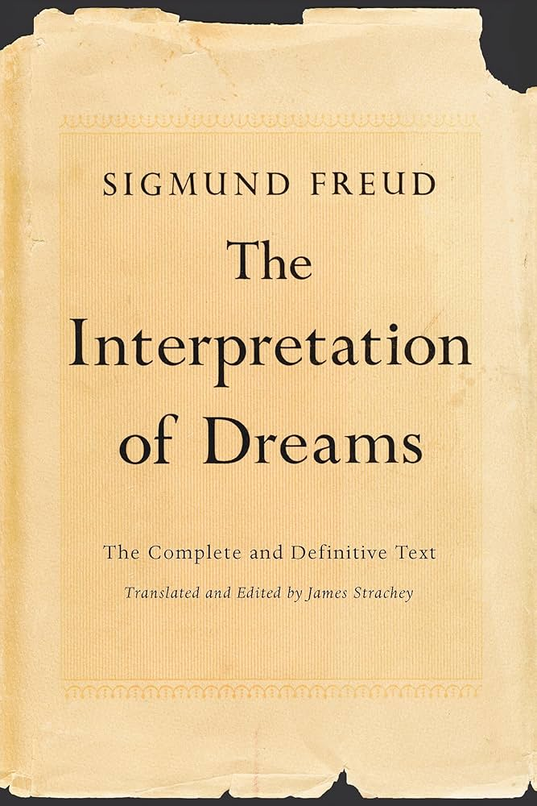
“The preliminaries to this model dream were as follows. A father had been watching beside his child’s sick-bed for days and nights on end. After the child had died, he went into the next room to lie down, but left the door open so that he could see from his bedroom into the room in which his child’s body was laid out, with tall candles standing round it. An old man had been engaged to keep watch over it, and sat beside the body murmuring prayers. After a few hours’ sleep, the father had a dream that his child was standing beside his bed, caught him by the arm and whispered to him reproachfully: “Father, don’t you see I’m burning?” He woke up, noticed a bright glare of light from the next room, hurried into it and found that the old watchman had dropped off to sleep and that the wrappings and one of the arms of his beloved child’s dead body had been burned by a lighted candle that had fallen on them.”
Sigmund Freud, Interpretation of Dreams

Slide 20
‘Between what occurs as if by chance, when everybody is asleep—the candle that overturns and the sheets that catch fire, the meaningless event, the accident, the piece of bad luck —and the element of poignancy, however veiled, in the words Father, can’t you see I'm burning—there is the same relation to what we were dealing with in repetition. It is what, for us, is represented in the term neurosis of destiny or neurosis of failure. What is missed is not adaptation, but tuché, the encounter…That is why it is necessary to ground this repetition first of all in the very split that occurs in the subject in relation to the encounter. This split constitutes the characteristic dimension of analytic discovery and experience; it enables us to apprehend the real, in its dialectical effects, as originally unwelcome. It is precisely through this that the real finds itself; in the subject, to a very great degree the accomplice of the drive—which we shall come to last, because only by following this way will we be able to conceive from what it returns.;
Jacques Lacan, Four Fundamental Concepts

Slide 21
The theological question concerning contingency
Τύχη (tuché)
-the act of God/the act of a human being
-what happens to occur
-(divine) fate, fortune

Slide 22
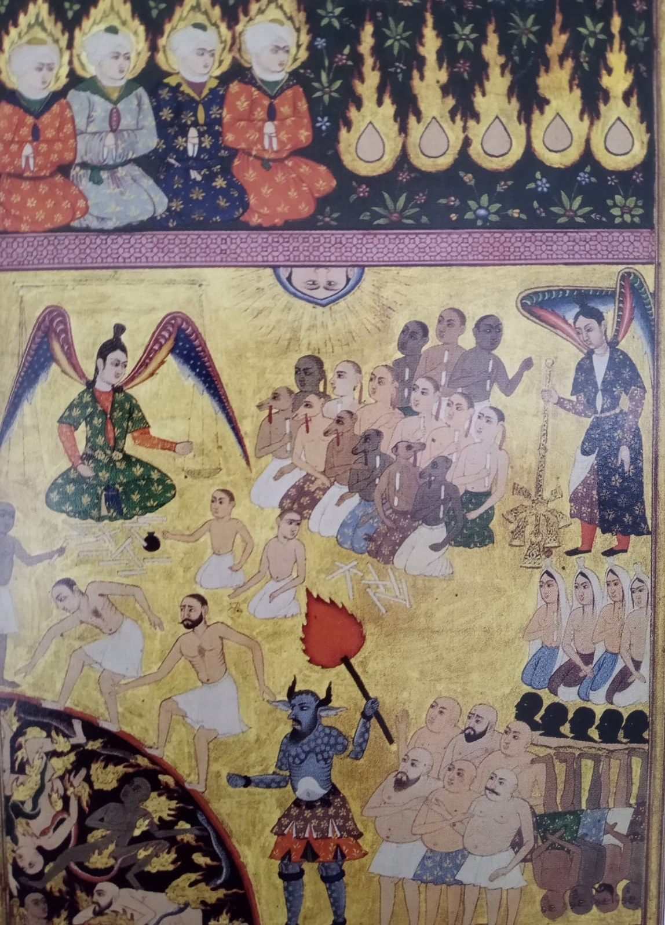
The crossing, sirat
You see the world, it is like a glass of tea, you drink it and it is empty. You ask me what life is, what the meaning of life is in this (lower) world, dunya. Life, you enter from one door, and come out from another, dakhal fi-bab u kharj fi-bbab. L-Akhera, the Afterlife, life on the side of death, is something else. It is an unveiling, you become aware. And the point is becoming aware of the Afterlife in this life.

