Slide 1
Intercultural marketing

Slide 2
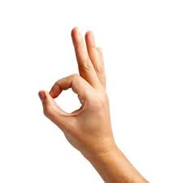

Slide 3
Verbal communication
je zapotřebí porozumění jak oběma zapojeným kulturám, tak oběma jazykům
Sapir-Whorf hypothesis
lingua Franca

Slide 4
Verbal communication

Slide 5
Verbal communication

Slide 6
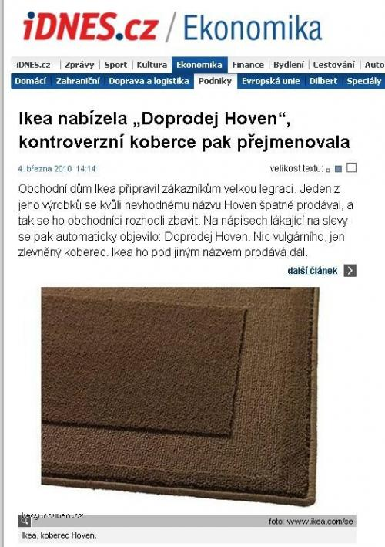
Verbal communication

Slide 7
Nonverbal communication
all communication expressed without words
facial expressions, postures, eye gaze, proxemics, gestures, tone of voice, haptics, chronemics…
influenced by cultural environment (kinesics, proxemics, artifacts, haptics, colors, silence)
some components are genetically determined

Slide 8
Intercultural communication
communication etiquette (greetings, introductions, conversational topics, humor, gifts)
within the framework of intercultural communication, the phenomenon of confusion can often be observed. It can also occur in monocultural communication (if the communication is incomprehensible and leaves the individual in a state of uncertainty / misunderstanding). In intercultural communication, this phenomenon occurs more often, and people tend to solve this situation by explanation based on the experience of their own culture. This often deepens the misunderstanding.
intercultural competence (langue + cultural specifics)

Slide 9
Intercultural aspects of nonverbal communication
communication differences between cultures are more a matter of degree rather than absolute difference
some facial expressions are universally readable across cultures, the difference between cultures lies in whether people are willing to express their emotions externally and to what extent (Ekman, 2007).
universally readable expressions include those that express emotions: happiness, anger, disgust, and sadness; fear and surprise?
universatility of a smile (silent smile, loud laughter)

Slide 10
Intercultural aspects of nonverbal communication
some gestures are universal across cultures – pointing, shrugging, head-nod, clap, backon, wave, halt sign, tap on the back, thumbs down, female body gesture.
come to me gesture is also considered universal; Some gestures are considered inborn (shrugging).

Slide 11
Intercultural aspects of nonverbal communication
several areas of nonverbal communication are directly culturally conditioned. - gestures, eye contact, interpersonal space, posturics, differences in color perception, chronemics.
the biggest difference within cultures is the degree of overall expressiveness

Slide 12
Intercultural aspects of nonverbal communication
Areas of non-verbal communication that are directly culturally conditioned: symbolic gestures (emblems)
1. A difference in the form of an emblem across cultures in relation to the same verbal message. Insults, for instance, occurred in all regions and likely serve the same function, conveying offensive or aggressive messages to another.
2. A difference in meaning to the same forms. The ‘‘ring,’’ for instance, in which a circle is made with the thumb and index finger and the other three fingers are open, can mean ‘‘A-OK,’’ ‘‘money,’’ or a variety of other messages.
3. Culturally unique emblems. The emblem for ‘‘apology,’’ for instance, occurred only in South Asia; the emblem for ‘‘hunger’’ occurred only in East Asia; and the emblem for ‘‘day after tomorrow’’ occurred only in the Middle East, despite the fact that these are clearly universal concerns.

Slide 15
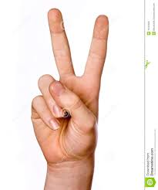

Slide 16
Intercultural aspects of nonverbal communication
Areas of non-verbal communication that are directly culturally conditioned: differences in eye contact - some cultures consider making direct eye contact aggressive, rude, or a show of disrespect - other cultures and some religious groups consider eye contact between men and women inappropriate and either as threatening or flirtatious - in many Asian cultures, avoiding eye contact with a member of the opposite sex or a superior is seen as a show of respect - however, in the United States and most of Europe, making eye contact is not only seen as appropriate but is necessary for establishing yourself as a powerful business professional

Slide 17
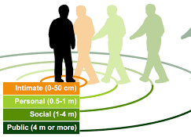
Intercultural aspects of nonverbal communication
Areas of non-verbal communication that are directly culturally conditioned: proxemics - personal space varies from culture to culture - in the Middle East, social distance is closer than it is in the United States, so as you back up, your conversational partner may attempt to close the gap once again. It’s easy to imagine an awkward dance down a sidewalk, with one party retreating and the other advancing as the conversation progresses.

Slide 20
Intercultural aspects of nonverbal communication
Areas of non-verbal communication that are directly culturally conditioned: differences in the rules of expressing emotions
- frequency and intensity - display rules (Ekman) - who can show their emotions to whom and when - interpretation of expressions - individualistic cultures encourage the expression of happiness, but limit the sharing of sorrow. In collectivist cultures, the opposite phenomenon occurs.

Slide 21
Intercultural aspects of nonverbal communication
Areas of non-verbal communication that are directly culturally conditioned: other differences - colors perception - perception of time

Slide 22
Geert Hofstede
"Culture is more often a source of conflict than of synergy. Cultural differences are a nuisance at best and often a disaster" (Geert Hofstede).
Culture’s Consequences: Comparing Values, Behaviors, Institutions and Organizations Across Nations (1980)

Slide 23
Dimensions of National Culture
how values in the workplace are influenced by culture
because of intrinsic cultural differences between nations, no universal management method exists
for each dimension, the value is set on a scale from 0 to 100 for each country

Slide 24
Six dimensions of national culture

Slide 25
Power distance index (PDI)
beliefs about the appropriate distribution of power in society
High PDI – stark hierarchies, less powerful are taught to “know their place” and respect authority
Low PDI – individuals expect more democratic and more counseling power relations

Slide 26
PDI in marketing
people belonging to high power distance index cultures tend to prefer products that provide them with certain social status and allow highlighting this status or prestige (status symbols, celebrities)
in low PDI, the main role is played by the actual consumption parameters of the products, their ability to appeal to all customers at once and to fulfill the widest range of goals

Slide 28
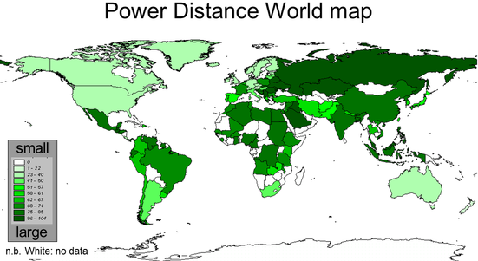
GEERT HOFSTEDE – cultural dimensions
Power Distance Index, PDI

Slide 29
Individualism (IDV)
focuses on the degree the society reinforces individual or collective, achievement and interpersonal relationships
a society’s position on this dimension depends on whether people’s self-image is defined in terms of “I” or “we.”
weak interpersonal connection among those who are not part of a core "family." x people are supposed to be loyal to the group to which they belong, the group itself is normally larger, and people take responsibility for one another's well-being.

Slide 30
IND in marketing
For countries with high individualism, it is recommended to target customers by emphasizing how the company’s products will benefit them. Appealing to individual freedom, saving time and personal rewards would be very effective.
For low individualism markets, marketers are advised to market to the whole community and explain which benefits the community might get if its members buy a company‟s products.

Slide 32
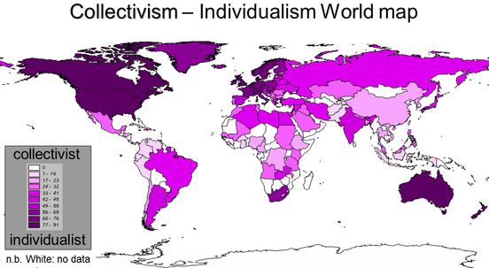
GEERT HOFSTEDE – cultural dimensions
Individualism Index, IDV

Slide 33
Example: Honda transcreation

Slide 34
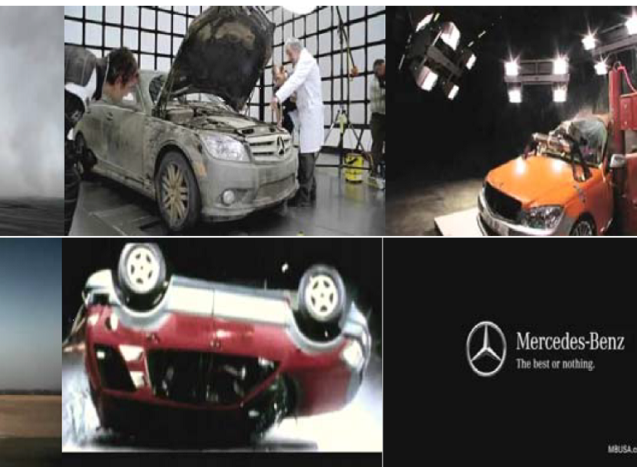
Individualistic vs. Collectivist cultures

Slide 35
Masculinity (MAS)
role delineation prevalent in masculine cultures and less prevalent in feminine cultures
when we talk about masculine or feminine cultures, we’re not talking about diversity issues. It’s about how a society views traits that are considered masculine or feminine.
A high MAS ranking - achievement, heroism, money, assertiveness and material rewards for success, showing off possessions; competition
A low MAS ranking – cooperation, modesty, caring for the weak and quality of life; consensus

Slide 36
MAS in business environment
High MAS:
Strong egos – feelings of pride and importance are attributed to status.
Money and achievement are important.
Low MAS:
Relationship oriented/consensual.
More focus on quality of life.

Slide 37
MAS in marketing
MAS – interactive, dynamic marketing, succes, achievement (status brands), competition
FEM – colaboration, benefits of society, quality of social life, esthetic pleasure
Prestigious x caring positioning
Products for men x women x family, gender-oriented promotion

Slide 39
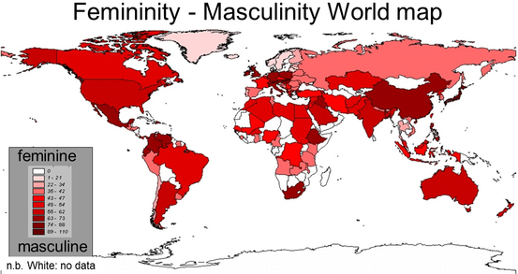
GEERT HOFSTEDE – cultural dimensions
Masculinity, MAS

Slide 40
Uncertainty Avoidance (UAI)
focuses on the level of tolerance for uncertainty and ambiguity within the society
High UAI - rule-oriented society, trust in experts
Low UAI - less rule-oriented, accept changes

Slide 41
UAI in marketing
it is recommended, in cultures with high uncertainty avoidance, to spell clearly product characteristics with guaranteed advantages and specific features.
Cultures with low uncertainty avoidance prefer lifestyle promotions, generalizations about the company‘s products, suggested benefits and references to change.

Slide 43
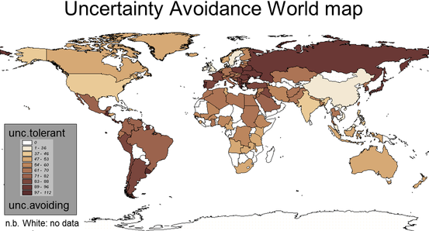
GEERT HOFSTEDE – cultural dimensions
Uncertainty Avoidance , UAI

Slide 44
UK vs. Germany

Slide 45
Long- versus Short-Term Orientation (LTO)
the extent to which members of a society perceive a consistent, interconnected thread running through the past, present, and future
countries with a long-term orientation tend to be pragmatic, modest, and more thrifty
in short-term oriented countries, people tend to place more emphasis on instant results, immediate gratification

Slide 47
Indulgence versus Restraint (IVR)
extent to which people try to control their desires and impulses
countries with a high IVR score allow or encourage relatively free gratification of people's own drives and emotions, such as enjoying life and having fun
in a society with a low IVR score, there is more emphasis on suppressing gratification and more regulation of people's conduct and behavior, and there are stricter social norms

Slide 48
IVR in business environment
High IVR:
Optimistic.
Importance of freedom of speech.
Focus on personal happiness.
Low IVR:
Pessimistic.
More controlled and rigid behavior.
No work-life balance

