Slide 1
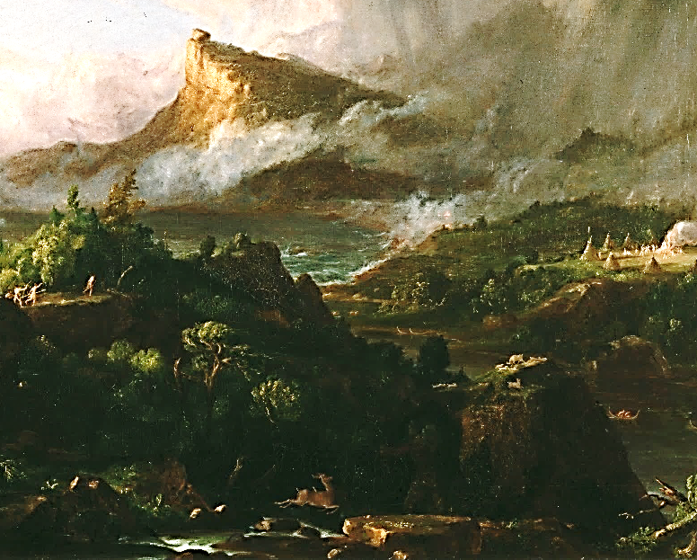
Inventing the Indians:
Ambiguous Policy and Representations: Jefferson and Bryant
Thomas Jefferson compared the Native Americans to the Europeans who lived north of the Alps at the time of the Roman Empire: Germans, Celts… In contrast to the “Barbarians” of the Antiquity, he thought them to have a potential to live as civilized people and to be absorbed by the regenerated American society. What puzzled him, was the absence of ancient monuments, which could prove the antique origin and consequently historical value of Indian culture.
When Jefferson became President in 1800, he designed a philantropic scheme which should make farmers of Native Americans. He financed a network of stations supplying the Indians with agricultural tools. The scheme was applied indiscriminately to hunter or agricultural tribes, to those who were nomadic as well as those already settled. The result was a failure of the scheme, which lead to the first expulsions of Native Americans from their lands and later to the removals of whole tribes to the western territories beyond the Mississippi. This forced migration had disastrous effects, close to genocide.
In “The Prairies” (1834), a poem by one of the first U.S. Romantics, William Cullen Bryant (1794-1878), Native Americans are represented in most ambiguous terms: both as “the mound-builders,” a highly developed ancient civilization (at that time the Native American monuments in Mexico and Peru became known thanks to the English translation of the travelogue of Alexander von Humboldt, 1769-1859, which appeared in 1814 under the title Researches) and as “the roaming hunter-tribes, warlike and fierce,” who destroyed the high culture of the past.
Thomas Cole: The Savage State, or, The Commencement of the Empire (1834) – a detail.
From a cycle of paintings entitled
The Course of the Empire (1834-6)

Slide 2
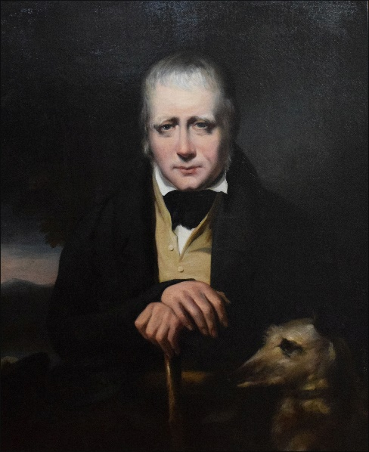
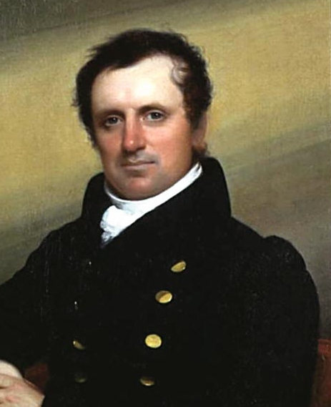
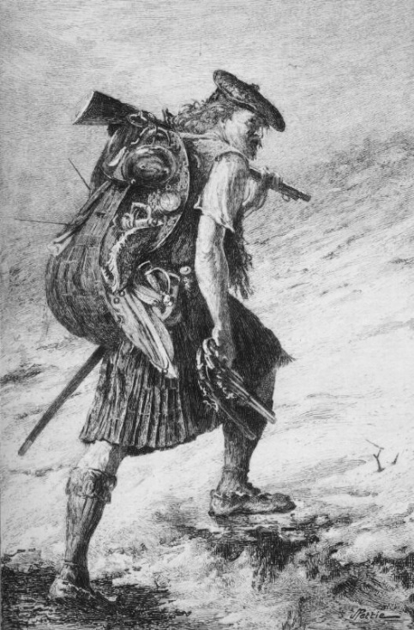
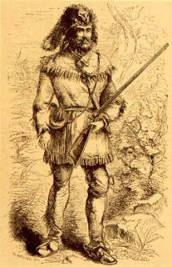
Historical Romance: James Fenimore Cooper
Expelled from their own lands, and reduced to a chaotic and cataclysmic element, the Indians had finally become a theme for an artist who intended to integrate them into a new American myth. J.F. Cooper (1789-1851) accomplished this feat in his Leatherstocking Series, five novels covering the period between 1740 and 1806 and featuring Natty Bumppo (or Hawkeye, Deerslayer, Pathfinder and Leatherstocking), an intrepid trapper and mediator between the colonists and the Native Americans.
Cooper was an attentive disciple of Walter Scott, whom he met in Scotland. He decided to represent the Indians in a similar way to how Scott had depicted the Highlanders in Waverley (1814) and other Scottish novels.
Like the Indians, the Celtic inhabitants of the Scottish Highlands were driven out of their native territories. In Scott’s days, the Highlanders practically disappeared from their native grounds, having been driven to Scottish and English industrial towns and often forced to emigrate to America or Australia.
Both Scott and Cooper understood that this was a suitable time for the construction of nostalgic images of such natives who, unlike the living aboriginal people, would add glory to the past.
Above: Sir Walter Scott, J.F. Cooper; below:
Waverley in a Highland dress; Natty Bumppo

Slide 3
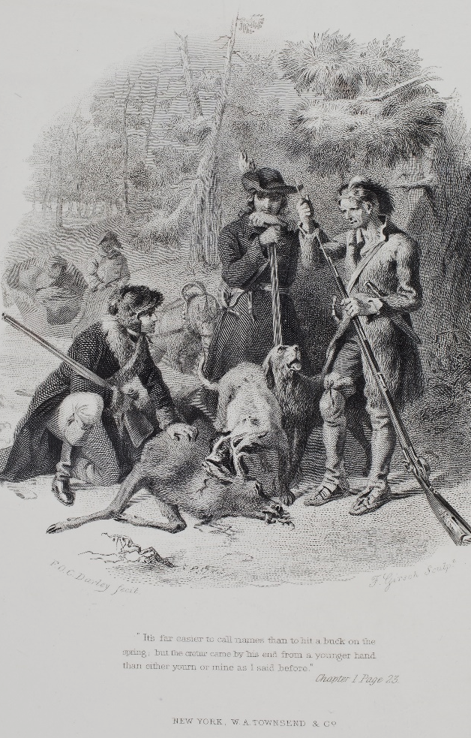
Political Meaning of Historical Romance
Richard Slotkin: “Both Scott and Cooper had used the genre [of historical romance] to create a literary basis for the nascent nationalism of their middle-class audiences. Their practice was to recover some crisis period from the nation’s past and show in the resolution a definitive step realizing the destined and glorious present. Typically, political resolution was mirrored in the romantic alliance or marriage between hero and heroine representing the different cultures or parties.”
In Scott‘s and Cooper‘s novels, a “reflector character“ ensures that the manners and the ways of life of the parties in conflict are depicted without prejudices and unnecessary detachment.
In The Spy (1821), Harvey Birch operates, during the War of Independence, on the neutral ground between the British and the American Patriots and generously helps people on both sides, while conveying strategic information to George Washington‘s headquarters. He is an embodiment of American democratic values and refuses all honours offered by the President.
The Pioneers (1823), set in the post-Revolutionary period in Cooperstown, which was founded by his father in upstate New York, explore the clash between the colonists and the Indians, which refocuses the underlying political theme: the post-revolutionary conflict between the old Loyalist aristocracy and the new republican upper class who displaced the old landlords. This conflict was also dormant in Cooper’s own family. In the novel, a demented and expropriated Loyalist, Major Effingham, is hiding in the forest, and his grandson, Oliver Edwards, is courting the daughter of Judge Marmaduke Temple, a representative of the new regime. Natty Bumppo, who rescues the Mohican chief Chingachgook from the forest fire, also helps to reveal that Oliver is not an Indian, as people think, and thus makes possible his marriage to Temple‘s daughter, which would otherwise be impossible because of the fear of racial misalliance.
F.O.C. Darley, an illustration
to the 1859 edition of The
Pioneers. Judge Marmaduke
Temple, Oliver Edwards, and
Natty Bumppo (right) over a
deer shot out of hunting
season.

Slide 4
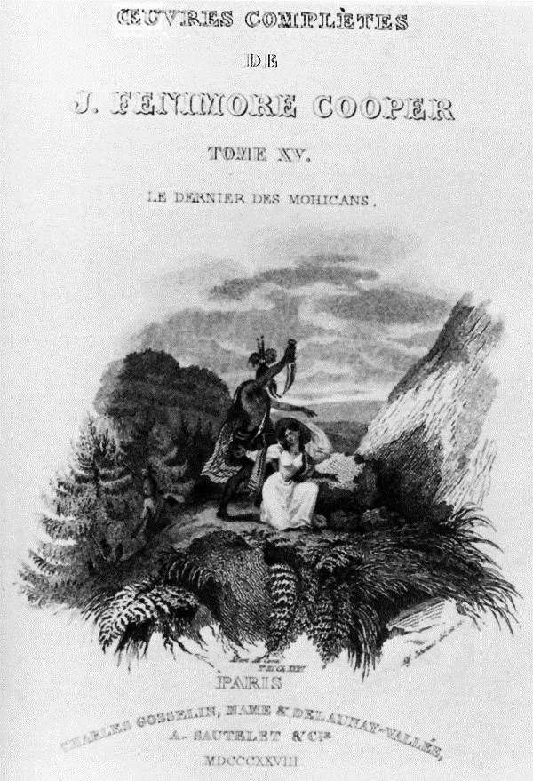
The Last of the Mohicans (1826)
The most important novel from The Leatherstocking Series focuses on Bumppo‘s relationship with Native Americans and their role in the first global conflict, the Seven Years‘ War (Anglo-French War). Delaware Indians fight on the side of the British, the Iroquois support the French.
Cora and Alice, daughters of Colonel Munro, the British commander of Fort William Henry, are on their way through wilderness to join their father. The protection offered to them is insufficient: they have to rely on their Indian guide, the treacherous Magua, who plans to betray them to the Iroquois in revenge for a cruel treatment he received from their father.
Fortunately, Magua’s designs are foiled by Natty Bumppo, a scout in the service of the British, and by his two companions - the Mohican chief Chingachgook and his son Uncas. Magua escapes claiming Cora as his property, and Uncas, the last of the Mohicans, follows him trying to rescue her.
Uncas’s love for Cora has drawn the sympathy of the entire Delaware tribe as the fulfilment of the prophecy of old Chief Tamenund that Uncas will marry a white woman and save the tribe from extinction. However, Uncas and Cora are killed by Magua and a Huron Indian, and thus the utopian dream of a cross-marriage as the union of all American races collapses (Cora has a trace of African American blood).
Bumppo remains the only unvanquished hero: not only because of his capabilities, principles and beliefs, but especially because of his racial purity: “I am a man without a cross.”
“Cooper substantially altered and reinvented [John] Heckewelder’s account of Indian historyˮ(Richard Slotkin). Heckewelder - a minister of the Moravian Brethren, who published his History, Manners and Customs of the Indian Nations in 1818 - maintained that it was the Delawares, not the Mohicans, who were the original, “unmixed” race.
Frontispiece of the first French
translation of The Last of the
Mohicans (1828). A Huron
Indian killing Cora.

Slide 5
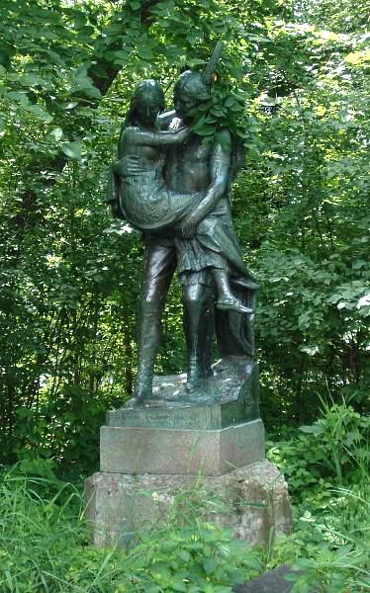
Cooper’s Followers: Simms and Longfellow
In Cooper’s time the Indian novel also flourished in South Carolina, where William Gilmore Simms (1806-1870) published a series of border romances. One of his most popular books, named The Yemassee (1835) after the local tribe of the Seminole nation, describes the tribe’s uprising in 1715, fomented by Spaniards.
The novel lacks a “reflector” character similar to Natty Bumppo who would become the mediator between the Indians and the whites. Contrary to Cooper, the most important part in the story is given to an Indian, Occonestoga, who is the son of the chief of the rebel tribe.
Occonestoga is sent by his master Gabriel Harrison to spy on his own tribe. He is discovered and killed by his mother who thus saves him from the worst of fates, expulsion from the tribe. Only later it becomes evident that Harrison was the disguised governor of the state. Thus, the sacrifice of the young Indian helps the whites to regain their power.
The Indians are not figured as noble savages and mythical predecessors of the whites but as the allies of a hostile power and culture, the Spanish empire and Catholicism.
Henry Wadsworth Longfellow (1807-1882), a Harvard professor of modern languages, was inspired by the form of allegedly oral, yet mostly invented, Finnish epic, the Kalevala (1834), to write The Song of Hiawatha (1855), an epic about a semi-fictional Indian hero. The historical Hiawatha was a Mohawk chief who founded the Iroquois confederacy in the 1570s. Thanks to the translation of J.V. Sládek, the poem became popular in Czech culture (boy scouts between the wars).
The poem draws from available ethnographic sources (writings of John Heckewelder, 1743-1823, Henry Schoolcraft, 1793-1864, and the paintings of George Catlin, 1796-1872). It idealizes Hiawatha not only as a powerful and vigorous hero, gentle lover and generous husband, but also as an introducer of agriculture and the inventor of the wampum script. Thus, Hiawatha resembles “cultural heroes” of old myths.
Like Cooper’s heroes, Hiawatha cedes stage to the Europeans and leaves in a canoe for wilderness after encountering the first Christian missionaries. But in contrast to Cooper, Hiawatha is not involved in any reconciliation with the whites, as he lives before the British colonization.
Jacob Fjelde, Hiawatha and Minehaha
(1912). Near Minehaha Falls in
Minneapolis, MN.

