Slide 1
CROSS-CULTURAL STUDIES
Reading and Understanding
Scientific Texts about Culture
Dr. Ulrike Notarp
Faculty of Social Sciences
Media and Communication
Charles University Prague

Slide 2
Goals of the seminar
Get familiar with some theoretical concepts in cross-cultural studies
Cultural Dimensions (Geert Hofstede)
Modernization theory (Ronald Inglehart)
Collective Memory (Maurice Halbwachs)
Get familiar with the process of investigation in cross-cultural studies

Slide 3
Theory in Cross-cultural studies
Theoretical knowledge about culture
Get aware of cultural differences
Observe and describe cultures
Compare cultures

Slide 4
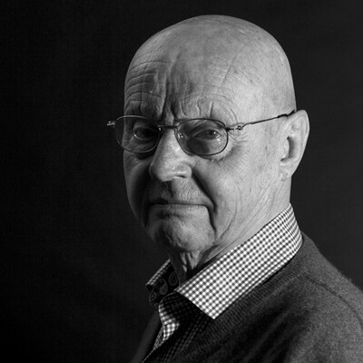
Geert Hofstede
* October 2, 1928 Haarlem, Netherlands
† February 12, 2020 (aged 91) Ede, Netherlands
Social psychology, Cross-cultural studies, Psychology, Anthropology
Hofstede, Geert & Hofstede, Gerd Jan, Minkov, Michael (2010). Cultures and Organizations. Software of the mind. Intercultural Cooperation and its Importance for Survival. New York. Mc Graw-Hill.

Slide 5
CULTURE – class definition

Slide 6
CULTURE Culture definition by Hofstede
mental program or software of the mind: collective patterns of thinking, feeling and acting
values shared by the community
shared with people who live within the same social environment
unwritten rules of the social game
learned not innate

Slide 7
Three Levels of Uniqueness in Mental Programming
specific to individual
PERSONALITY
specific,
individual
inherited & learned
CULTURE
education, language, behaviour, norms, values, rituals, religion, work culture, perception of time&space, society
learned
specific to group or category
HUMAN NATURE
birth, hunger, joy, aggression, mourning, need for surviving, hope for care and love, death
universal
inherited

Slide 8
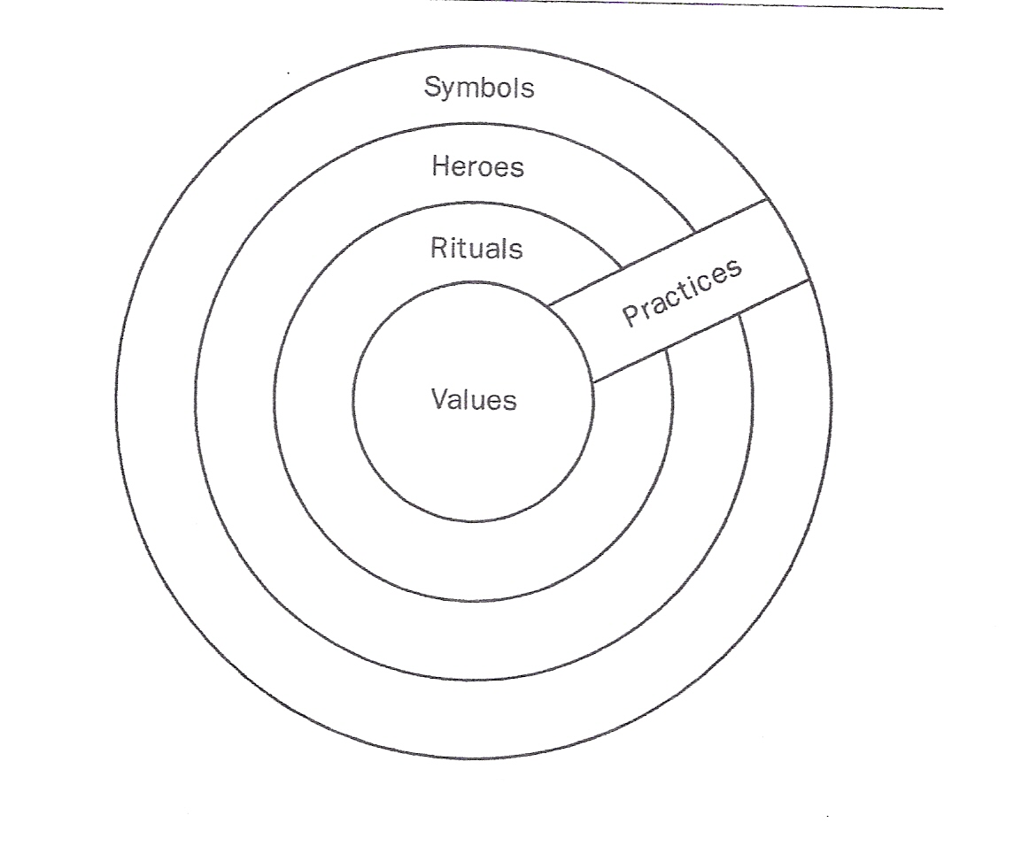
The „Onion“: Manifestations of Culture at different levels of depth

Slide 9
Cultural Values
In every situation we act on the basis of values and norms we acquired in our early lifetime.
Values are the basis of our thinking, feeling and acting.
The value-set of one social community (its culture) differs from the value-set of another community according to the conditions the communities live under

Slide 10
Cultural Values What are the top 5 values in your country?
Age/seniority
Authority
Belonging
Group membership
Certainty
Competition/challenge
Cooperation/Compromise
Caring
Democracy
Devotion
Directness
Efficiency
Equality
Family, family harmony
(Personal) Freedom
Friendship
Group harmony/consensus
Honesty/Truthfulness
Hospitality
Humanity
Independence
Indirectness
Individualism
National pride
Openness
Pride
Privacy
Quality of life
Recognition
Respect
Rule of law
Self-determination
Time
Tolerance
To save face
Work, having a job

Slide 12
Culture Theory – Concept of Cultural Dimensions by Geert Hofstede
Etic approach
Culture as a systematic whole – national culture, subcultures
Not the individual, the particular but the general, the universal
Value concept – capture basic cultural values that are essential to the social community
Description of basic value patterns with the help of the cultural dimensions tool

Slide 13
CULTURAL DIMENSION
pool of values and norms, strategies and possibilities
from this pool the social community selects values and norms which they consider to be essential
is a scientific construct that allows scientists to describe the value-set of a society

Slide 14
Age/seniority
Authority
Belonging
Group membership
Certainty
Competition/challenge
Cooperation/Compromise
Caring
Devotion
Directness
Efficiency
Equality
Family harmony
Personal Freedom
Group harmony/ consensus
Honesty/Truthfulness
Hospitality
Independence
Indirectness
Individualism
Openness
Privacy
Quality of life
Recognition
Respect
Time
Tolerance
To save face

Slide 15
5 Cultural Dimensions – 10 Synthetic Cultures
Identity
Hierarchy
Gender
Truth
Virtue
Individualism
Collectivism
2. Small Power Distance
2. Large Power Distance
3. Feminin
3. Masculin
4. Uncertainty Tolerance
4. Uncertainty Avoidance
Short Term Orientation
Long Term Orientation

Slide 16
Five basic problems of society
Problem 1 – The relationship between the individual and the group Identity
Problem 2 – Social inequality, including the relationship with authority Hierarchy
Problem 3 – Concepts of the gender roles: the social and emotional implications of having been born as a boy or a girl Gender

Slide 17
Five basic problems of society
Problem 4 – Ways of dealing with uncertainty and ambiguity, related also to the control of aggression and expression of emotions Uncertainty avoidance
Problem 5 – Orientation on time : oriented towards present and past or to the future Virtue

Slide 18
1. IDENTITY
The basic problem is identity – the relationship between the individual and the group.
Individualism: Tendency to look after oneself and your immediate family
dominant values: personal freedom, individual autonomy, self-actualization
Collectivism: Tendency to belong to groups or collectives and to look after each other
dominant values: the in-group, group-harmony, respect for elder people, obedience, tradition, religion

Slide 19
IDENTITY – INDIVIDUALISM
Individual freedom - Independent self
Private opinion
Speaking one´s mind
Low-context communication
Learning how to learn
Management of individuals
Equality – laws and rights are supposed to be the same for all

Slide 20
IDENTITY – COLLECTIVISM
Group Identity – Interdependent self
Opinions determined by the group
Harmony
High-context communication
Learning how to do
Management of groups
Inequality - laws and rights differ by groups

Slide 21
Identity
A Individualism
B Collectivism
5., 6., 7., 8., 9., 11.
1., 2., 3., 4., 10., 12.
__ Friendship is predetermined.
__ Students speak up in class when sanctioned by the group.
__Disabled persons are a shame on the family and should be kept out of sight.
__The state holds a dominant role in the economic system.
__Trespassing leads to guilt and loss of self-respect.
__The role of the state in the economic system is restrained.
__Disabled persons should participate as much as possible in day-to-dayactivities..
__Diplomas increase economic worth and/or self-respect.
__Friendships are voluntary and should be fostered.
__Trespassing leads to shame and loss of face for self and group.
__Students are expected to individually speak up in class.
__Diplomas provide entry to higher-status groups.

Slide 22
2. HIERARCHY
Power Distance: The degree of social inequality that is assumed to be a natural state of affairs.
Extent to which less powerful members of a group or society accept that power is distributed unequally.
Large Power Distance
Small Power Distance

Slide 23
HIERARCHY – Large Power Distance
Inequalities are expected and desired
Large emotional distance
Respect
Obedience parents - children
Existential inequality higher and lower levels at work
Privileges

Slide 24
HIERARCHY – Small Power Distance
Inequalities should be minimized
Emotional nearness parents - children
Equality higher and lower levels at work
Inequality of roles, established for convenience, consultation
Equal rights

Slide 25
Hierachy
A Large Power Distance
B Small Power Distance
1., 2., 4., 5., 6., 9.
3., 7., 8., 10., 11., 12.
__ Students give teachers respect even outside the class.
__ Teachers are gurus who transfer personal wisdom.
__ Student treat teachers as equals.
__ Centralization is popular.
__ Priviliges and status symbols are normal and popular.
__ Skills, wealth, power, and status should go together.
__ Power is based on formal position, expertise, and ability to give rewards.
__ Teachers are experts who transfer impersonal knowledge.
__ Power is based on tradition or family, charisma and the ability to use force.
__ Decentralization is popular.
__ Skills, wealth, power, and status need not go together.
__ The use of power should be legitimate and follow criteria of good and evil.

Slide 26
3. GENDER
The basic problem centers on gender roles and control of aggression.
Masculinity: emotional gender roles are clearly distinct.
dominant values: success, money, things, and winning
Femininity: emotional gender roles overlap.
dominant values: caring for others, quality of life

Slide 27
GENDER – Masculin
Challenge, earnings, recognition, achievement
Men: responsible, decisive, and ambitious
Women: caring and gentle
Family: fathers deal with facts, mothers deal with feelings
Education: best student is the norm
Work: job choice – career opportunities management – decisive aggressive

Slide 28
GENDER – Feminin
Relationships and quality of life
Men and women: responsible, decisive, ambitious, caring, and gentle
Family: fathers and mothers deal with facts and feelings
Education: average student is the norm
Work: job choice – intrinsic interest management – intuition and consensus

Slide 29
Gender
A Feminine
B Masculine
1., 4., 5., 7., 9., 10.
2., 3., 6., 8., 11., 12.
___ Relationship and quality of life are important.
___ Boys play to compete, girls to be together.
___ Taboo on explicit discussion of sex but implicit erotic symbolism.
___ Friendliness in teachers is appreciated.
___ Explicit discussion of sex, less implicit symbolism.
___ Challenge, earnings, recognition, and advancement are important.
___ Women´s liberation means that men and women take equal shares both at home and at work.
___ Women´s liberation means that women have access to positions so far occupied by men.
___ Boys and girls play for the same reason.
___ Jealousy of those who try to excell.
___ Competition in class; trying to excell.
___ Brillance in teachers is admired.

Slide 30
4. TRUTH
Fear of the unknown and search for truth
Extent to which people feel threatened by ambiguous situations
High uncertainty avoidance (one-truth orientation)
high need for security strong belief in experts
more written rules less risk taking by managers
Low uncertainty avoidance (many-truths orientation)
accept risks more risk taking by managers
fewer written rules higher employee turnover
more ambitious employees

Slide 31
TRUTH – UNCERTAINTY AVOIDANCE
Uncertainty is a continuous threat
High stress and high anxiety
One truth orientation
strict distinction between true and false, right and wrong, clean and dirty
Time is money, hard work
Many precise laws or unwritten rules
What is different is dangerous

Slide 32
TRUTH – UNCERTAINTY TOLERANCE
Uncertainty is a normal feature of life
Low stress and low anxiety
Many truths orientation
no strict distinction between true and false, right and wrong, clean and dirty
Time is a framework for orientation
Few and general laws or unwritten rules
What is different is curious

Slide 33
Truth
A Uncertainty Tolerance
B Uncertainty Avoidance
1., 3., 7., 8., 9., 11.
2., 4., 5., 6., 10., 12.
___ People have less worries about health and money.
___ There is an emotional need to be busy and an inner urge to work hard.
___ Citizens trust politicians, civil servant´s, and the legal system.
___ More religious, political, and ideological intolerance and fundamentalism.
___ Teachers are supposed to have all the answers.
___ Students are comfortable with structured learning situations and concerned with right answers.
___ Teachers may say „I don´t know“.
___ Hard-working only when needed.
___ Students are comfortable with open-ended learning situations and good discussions.
___ Citizens are negative toward politicians, civil servants, and the legal system.
___ Human rights: nobody should be persecuted for their beliefs.
___ In religion there is only one Truth and we have it.

Slide 34
5. VIRTUE
Confucian Dynamism – anchoring in the Confucian value system
The society´s search for Virtue
Eastern thinking: Virtue is key
Western thinking: Virtue is secondary to Truth
Eastern religions – Western religions
Important is what you do not what you believe in
VIRTUE → thrift, persistence, working hard, being patient and persevering, being modest, humble, undemanding

Slide 35
VIRTUE – LONG-TERM-ORIENTATION
Orientation towards future rewards
Values: Honesty, adaptiveness, accountability, self-discipline
Thrift – sparing with resources
Perseverance
sustained efforts towards slow results,
working hard,
being patient, modest
Willingness to subordinate oneself for a purpose
Having a sense of shame

Slide 36
VIRTUE – SHORT-TERM-ORIENTATION
Orientation towards the present and the past
Values: Freedom, rights, achievement, thinking for oneself
Respect for traditions
Efforts should produce quick results
Concern with social and status obligations
social pressure towards spending
Protecting one´s face → personal steadiness and stability

Slide 37
Virtue
A Short Term Orientation
B Long Term Orientation
1., 2., 4., 5., 8., 9.
3., 6., 7., 10., 11., 12.
___ Marriage is a moral arrangement.
___ Old age is an unhappy period but it starts late.
___ If A is true, its opposite B can also be true.
___ Leisure time is important.
___ Concern with possessing the Truth.
___ Old age is a happy period and it starts early.
___ Marriage is a pragmatic arrangement.
___ Children get gifts for fun and love.
___ If A is true, its opposite B must be false.
___ Concern with respecting the demands of Virtue.
___ Children get gifts for education and development.
___ Leisure time is not important.

Slide 38
5 Cultural Dimensions – 10 Synthetic Cultures
Identity
Hierarchy
Gender
Truth
Virtue
Individualism
Collectivism
2. Small Power Distance
2. Large Power Distance
3. Feminin
3. Masculin
4. Uncertainty Tolerance
4. Uncertainty Avoidance
Short Term Orientation
Long Term Orientation

Slide 39
Homework – Case studies
Wedding Guest
Half a Greek
Who pays for the Drink?
Fernando and the Napkin
George Bush in Japan

Slide 42
Thank you!

Slide 43
Basic Literature
Hofstede, Geert & Hofstede, Gerd Jan, Minkov, Michael (2010). Cultures and Or­ganizations. Software of the mind. Intercultural Coopera­tion and its Importance for Survival. New York. Mc Graw-Hill.

Slide 44
Web-links
Hofstede about Culture
https://www.youtube.com/watch?v=wdh40kgyYOY
Identity
https://www.youtube.com/watch?v=zQj1VPNPHlI&list=PLQvFZ16QYK_ovcyej9kTjCrsg0mnS3oaJ&index=2
Power Distance
https://www.youtube.com/watch?v=DqAJclwfyCw
Gender
https://www.youtube.com/watch?v=Pyr-XKQG2CM&list=PLQvFZ16QYK_ovcyej9kTjCrsg0mnS3oaJ&index=3
Truth
https://www.youtube.com/watch?v=fZF6LyGne7Q&index=4&list=PLQvFZ16QYK_ovcyej9kTjCrsg0mnS3oaJ
Virtue
https://www.youtube.com/watch?v=H8ygYIGsIQ4&index=5&list=PLQvFZ16QYK_ovcyej9kTjCrsg0mnS3oaJ
Indulgence/Restraint
https://www.youtube.com/watch?v=V0YgGdzmFtA

