Slide 1
CROSS-CULTURAL STUDIES
INTRODUCTION
Ulrike Notarp
Department of Communication and Media Studies

Slide 2
Objectives of the Seminar
Get familiar with some theoretical concepts of culture
  Communication – Discourse – Culture – Society
    Concept of culture by G. Hofstede
    Concept of the Third Reality (Culture) by M. Fleischer
    Concept of Cultural Remembrance by M. Halbwachs
Get familiar with Linguistic Discourse Analyse
Create research in the field of cross-cultural studies

Slide 3
Program
Cultural Theory I – Definitions of culture
Cultural Theory II – Culture and discourse
Concepts of cultural remembrance
Conducting research in cross-cultural studies
Introduction to Linguistic Discourse Analysis (LDA)
Exercising LDA
Finding topics for our research projects
Conduct LDA in our research projects (teamwork)
Work on research projects
Presentation of results

Slide 4
CULTURE – CLASS DEFINITION

Slide 5
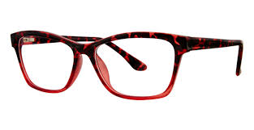

Intercultural Competence
We all look through our cultural glasses.
Intercultural competence means to be aware of this.

Slide 6
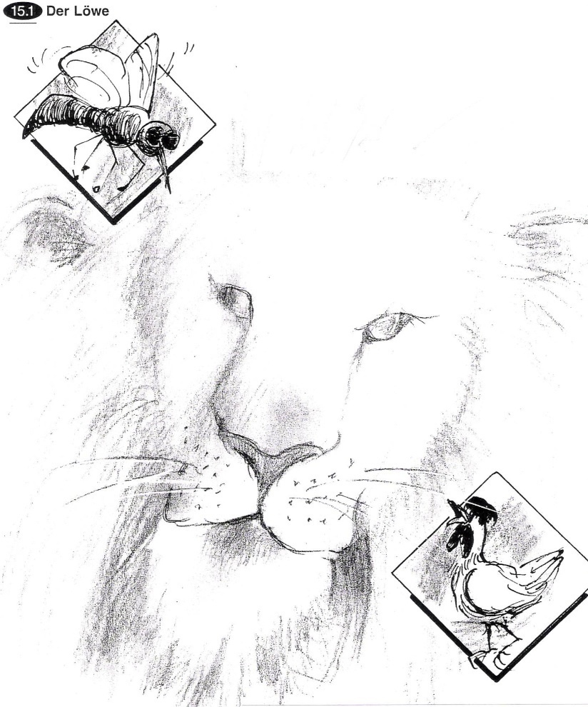
The Lion
When the bee heard the lion roar for the first time, it said to the hen:
„Its buzzing is really strange“.
„Buzzing is nice“ answered the hen.
„So what is it?“ asked the bee.
„It´s cackling! It cackles, however, in a really strange way.“
(G. Anders: Blick vom Turm)

Slide 7
CULTURE
Definition by Geert Hofstede
mental program or software of the mind: collective patterns of thinking, feeling and acting
based on values and norms that are shared by the community
shared with people who live within the same social environment
unwritten rules of the social game
learned not innate

Slide 8
Three Levels of Uniqueness in Mental Programming
specific to individual
PERSONALITY
specific,
individual
inherited & learned
CULTURE
education, language, behaviour, norms, values, rituals, religion, work culture, perception of time&space, society
learned
specific to group or category
HUMAN NATURE
birth, hunger, joy, aggression, mourning, need for surviving, hope for care and love, death
universal
inherited

Slide 9
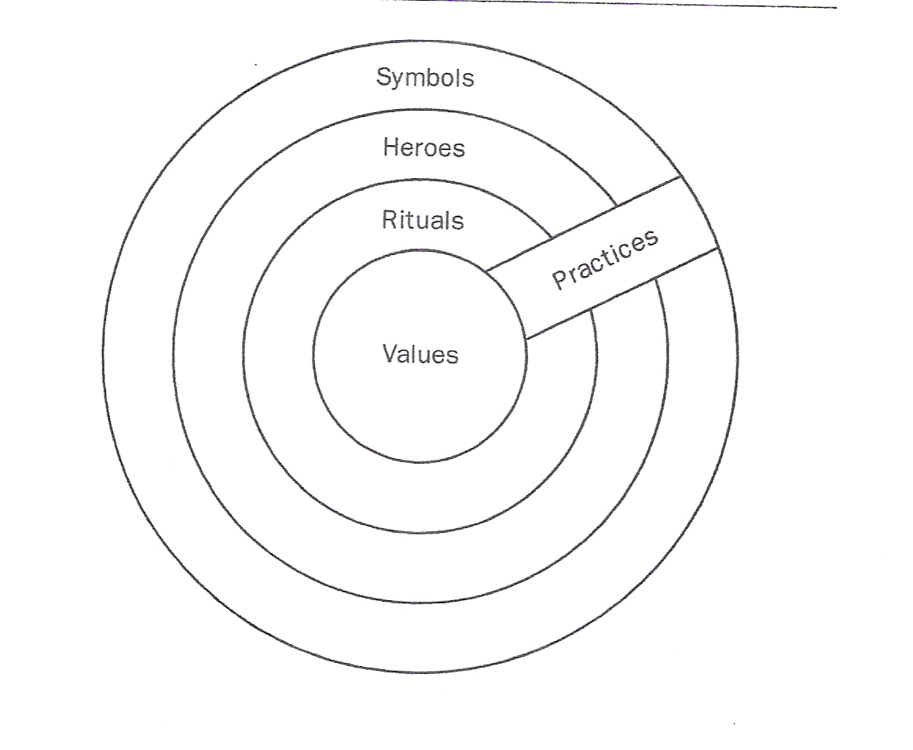
The „Onion“: Manifestations of
Culture at different levels of depth

Slide 10
Cultural Values
In every situation we act on the basis of values and norms we acquired in our early lifetime.
Values are the basis of our thinking, feeling and acting.
The special value-set of a social community or society – makes its culture.
The value-set of one social community (its culture) differs from the value-set of another community according to the conditions the communities live under

Slide 11
Cultural Values
What are the top 10 values in your country?
Age/seniority
Authority
Belonging
Group membership
Certainty
Competition/challenge
Cooperation/Compromise
Caring
Democracy
Devotion
Directness
Efficiency
Equality
Family, family harmony
Friendship
Personal Freedom
Group harmony/consensus
Honesty/Truthfulness
Hospitality
Humanity
Independence
Indirectness
Individualism
National pride
Openness
Pride
Privacy
Quality of life
Recognition
Respect
Rule of law
Self-determination
Time
Tolerance
To save face
Work, having a job

Slide 12
Communicative model of CULTURE
(Jírak/Köpplová 2009, 26-35)
CULTURE
represents a semantic environment
communication phenomenon - a system of shared meanings, ideas, values, judgments and beliefs
Members of a given society continuously shape this system by means of communication
(media) communication can be seen as a culturally conditioned environment

Slide 13
Culture as a mode for orientation
framework for orientation in the social world
based on (linguistic) signs and communication
general mechanism that normatively regulates social life through communication (cultural values, norms, standards)
product of communication, permanently negotiated
a social community´s adaptation to their living conditions.
(Notarp, 2020, 24-25)
Notes:
structuring and organizing mode of social systems

Slide 14
culture as third reality
M. Fleischer 2006
semiotic, semantic and thus communicative third reality
hierarchically structured system of discourses that is based on the second, social (social groups, supra-groups, society) and first reality (physical and biological world)
each society has its own system of discourses – the interdiscourse, discourses and special discourses
Notes:
product of the second – the social reality with its mode of communication

Slide 15
Third Reality (≈ Culture)
Society +
Interdiscourse
Subculture
Subculture
Discourse
Social group
Social group
Discourse
Social group
Social group
Discourse
Special discourse
Special discourse
Interdiscourse
M. Fleischer 2006

