Slide 1
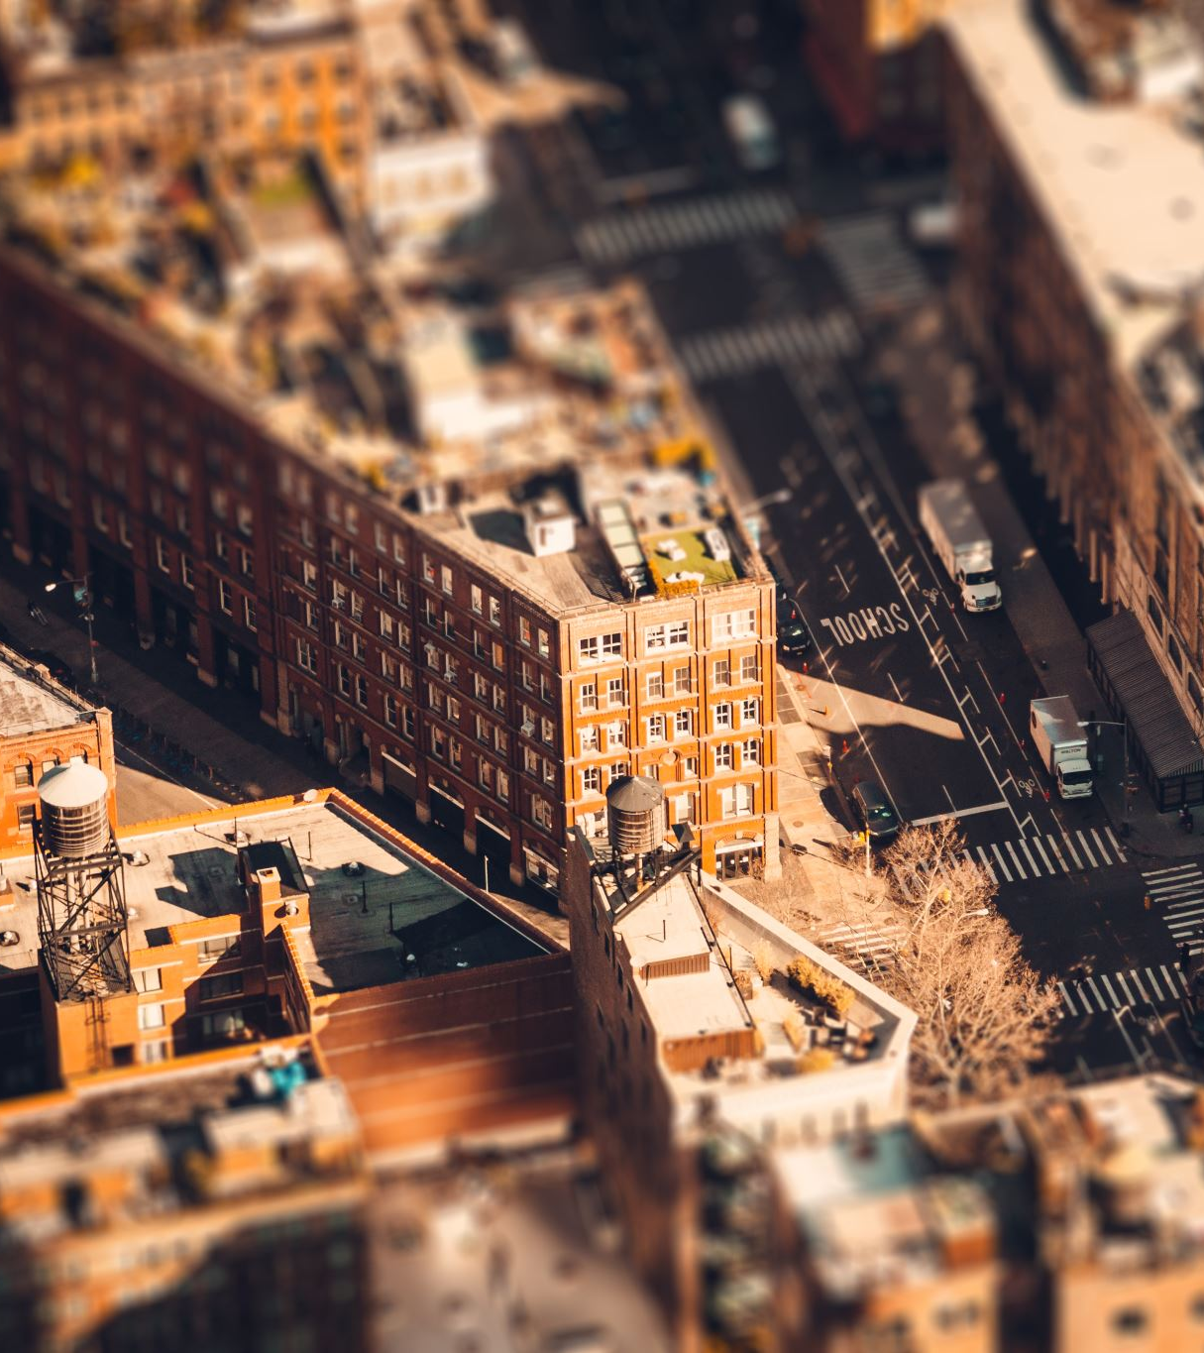
Conceptualization of urban space. The historicizing European approach, the Chicago, New York, and Los Angeles schools. The Chicago School in more detail.

Slide 2
Three schools that interpret the city differently
Chicago School - laid the foundations for urban sociology
New York School - emphasized the cultural unity of the city and only became important contextually
Los Angeles School - profiled in the 1980s and built on the negation of the Chicago School

Slide 3
Chicago School - conceptualizes the city as a single organism, as a specific unit similar to a biotope
New York School - conceptualizes the city as a settlement unit of great diversity, but which has its own centre, a specific spirit
LA School describes the city as an urban sprawl, an unrestrained avalanche that cannot be directed and gradually absorbs its surroundings

Slide 4
Chicago School and Theory of Social Ecology, Concept of Urban Growth, Disorganization, Zoning, Acculturation and Marginalization.
Literature
Hannerz Ulf, Exploring the City. Columbia University Press 1980.
Park Robert Ezra, The City. Suggestions for the Investigation of Human Behavior in the Urban Environment. New York 1926.

Slide 5
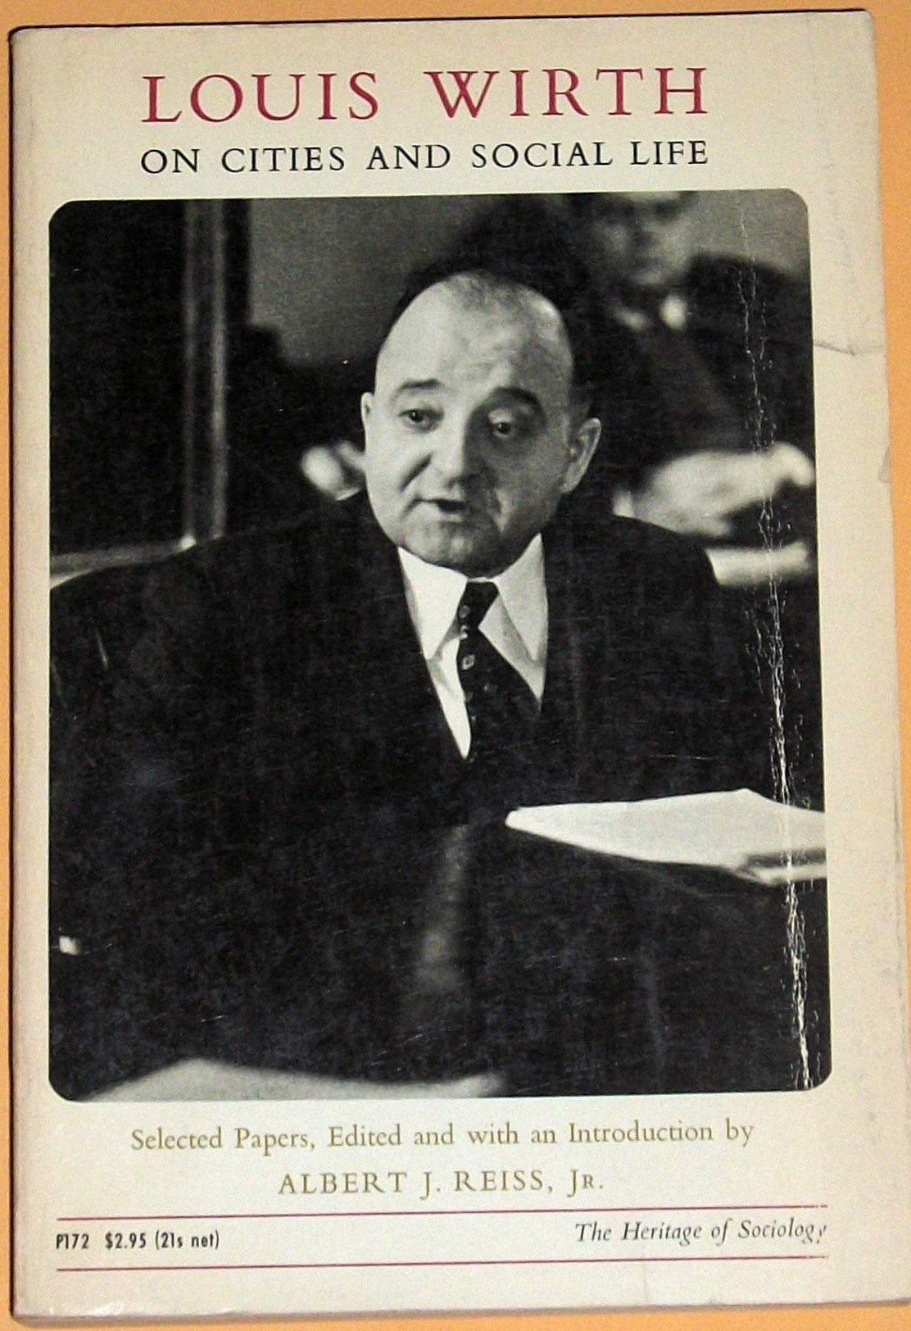
Social Ecology
You should consider that Louis Wirth was a social Ecologist.
What does it mean?
Louis Wirth 1897 – 1952 American sociologist of German origin, his family removed to the United States in 1911.
He was of Jewish origin and Jewish communities were also his primary field of interest. PhD thesis: Ghetto

Slide 6

Louis Wirth, Urbanism as a Way of Life American Journal of Sociology 1938
Urbanism as a characteristic mode of life may be approached empirically from three interrelated perspectives:
as a physical structure comprising a population base, a technology, and an ecological order;
as a sytem of social organization involving a characteristic social structure, a series of social institutions, and a typical pattern of social relationships; and
as a set of attitudes and ideas, and a constellation of personaities engaging in typical forms of collective behavior and subject to characteristic mechanisms of social control.

Slide 7
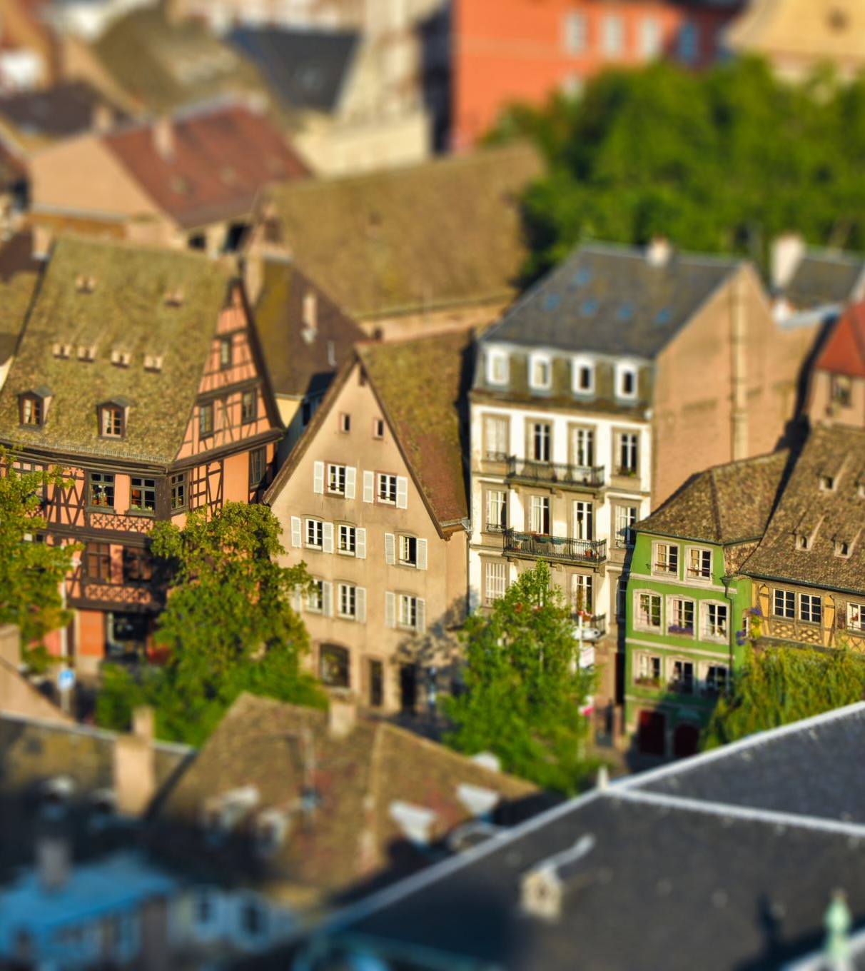
Louis Wirth: Social Ecologist
1. What primarily characterizes the city?
Large number of inhabitants on a small area.
--------
Note of lecturer:
A city can be defined primarily:
on the basis of its characteristics or those of its inhabitants, or
on the basis of its legal status.
Europe: frequently second alternative

Slide 8

Louis Wirth
Louis Wirth formulates the task of finding the forms of social action that are typical of the city.
"The more populous, the greater the population density, the greater the heterogeneity of lifestyles."
Potential heterogeneity as the size of the city increases, brings increased probability of atomization, segregation, and ethnic neighborhoods.

Slide 9
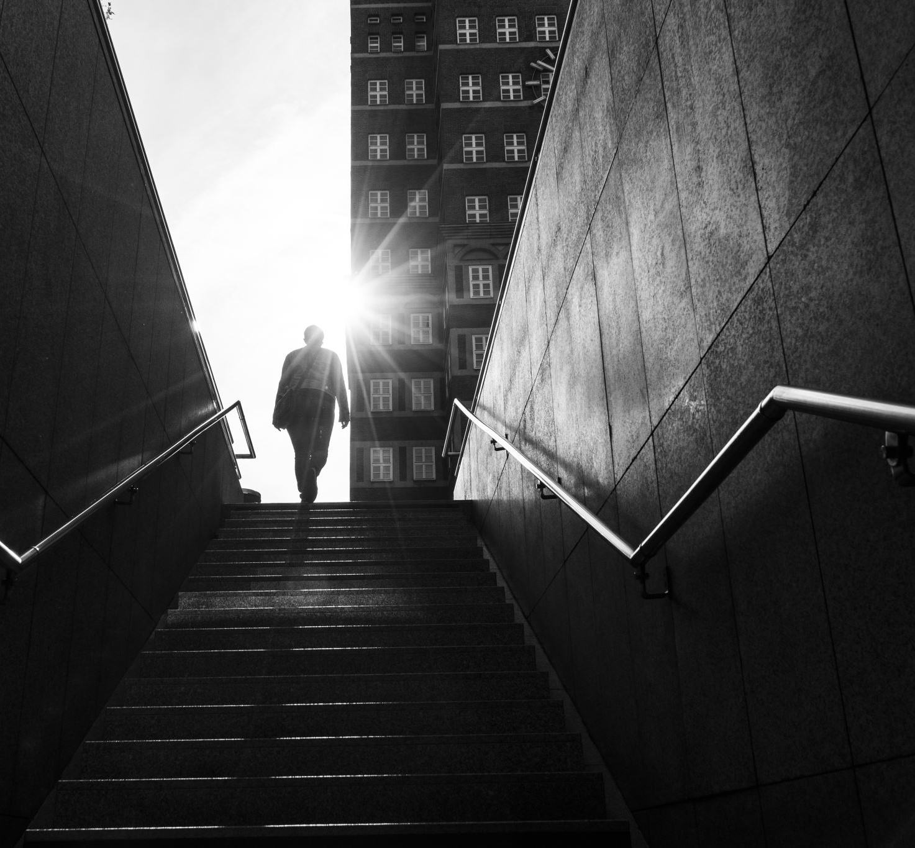
Adaptability, rationality, incompleteness, large number of interactions, loneliness, impersonality and secularization of urban population behavior.
„The contacts of the city may indeed be face to face, but they are nevertheless impersonal, superficial, transitory, and segmental.“

Slide 10
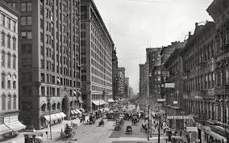
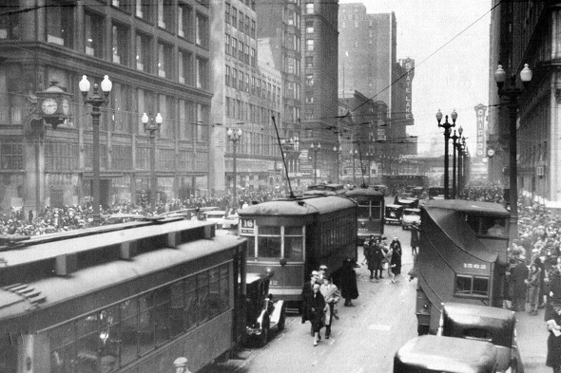
Chicago of 1920s

Slide 11
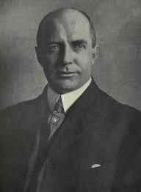
John Hopkins University
Department of Sociology established 1892 (might be first department of sociology in the US)
1894 - William Isaac Thomas (1863 – 1947);
Positivism – symbolic interactionism
(also close to study human evolution)

Slide 12
William Isaac Thomas, Florian Znaniecki, The Polish Peasant in Europe and America.
Study migration in source and destination countries.
Study of the primary and secondary social relations.
Disorganization - reorganization of social relations.
The theme of American individualism.

Slide 13
Robert Ezra Park 1864 - 1944
Robert Ezra Park, Ernest Burgess, Introduction to the Science of Sociology. Chicago University Press 1921.
Robert Ezra Park, Ernest Burgess, Roderick McKenzie, The City. Chicago Univ. Press 1924.
Robert Ezra Park, Race and Culture. 1950

Slide 14
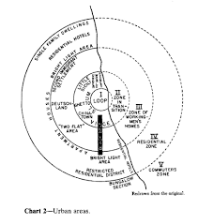
Ernest Burgess, Theory of the City Growth; (urban land use model)

Slide 15
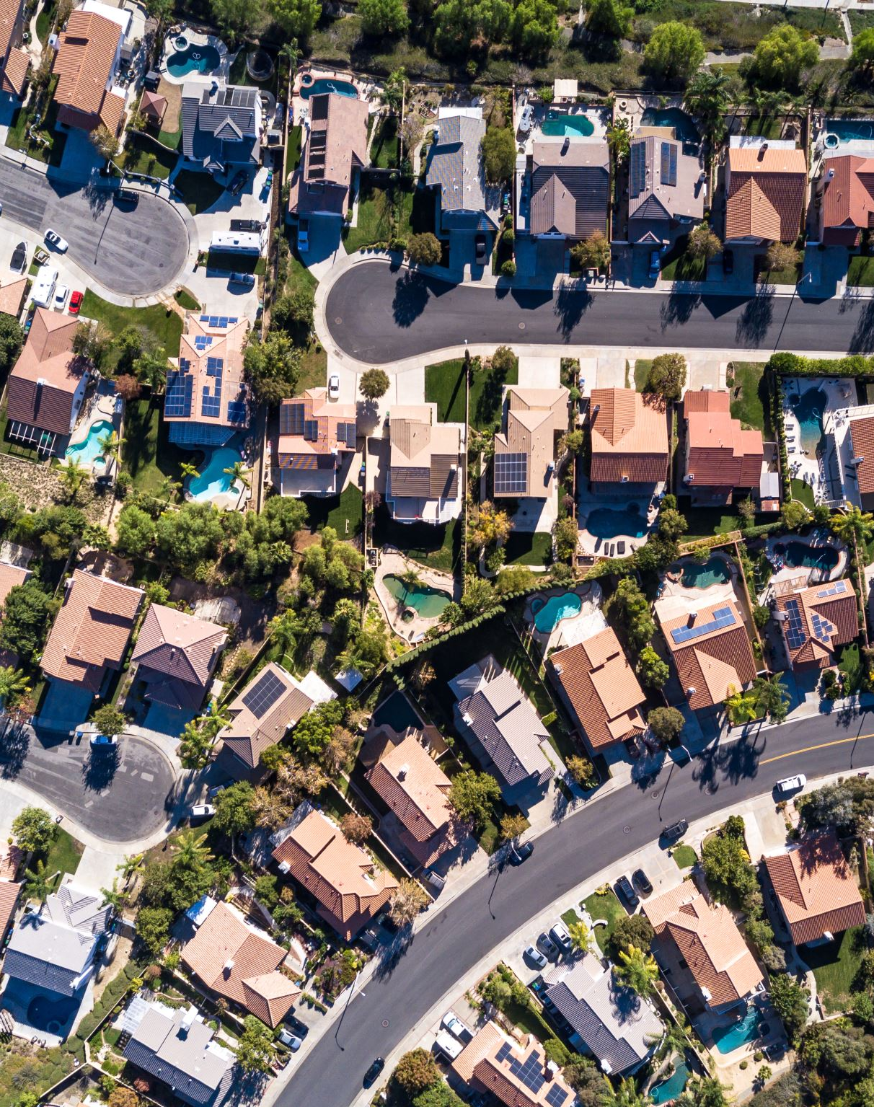
Zoning at the City – Ernest Burgess
Loop
Zone of Transition
Zone of Workmen´s Homes
Residential Zone
Commuters Zone

Slide 16
Chicago monographs
Nels Anderson, The Hobo (1923)
Fredric Thrasher, The Gang (1927)
Harvey W. Zorbaugh, The Gold Coast and the Slum (1929)
Paul G. Cressey, The Taxi-Dance Hall (1932)
William Foote Whyte, Street Corner Society. Chicago: University of Chicago Press 1943.

Slide 17
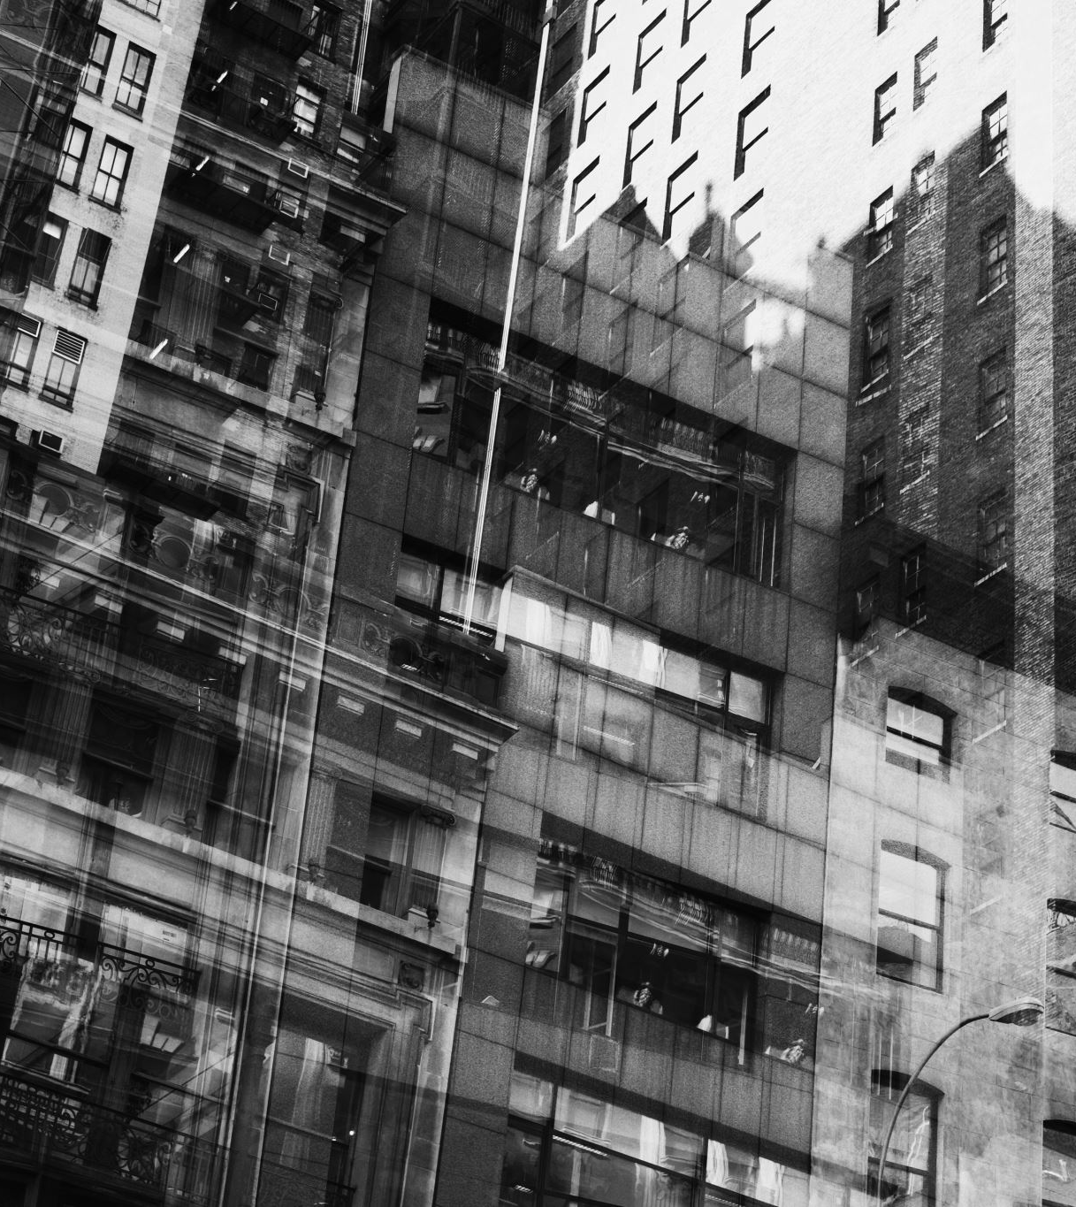
William Foote Whyte Street Corner Society: The Social Structure of Italian Slum. University of Chicago Press 1943.
"Cornerville„
Drisorganisation is going hand by hand with firm organization.
Harvad and Chicago graduate monograph about the Italian slum.
Main informant Docovi.

Slide 18
Do you find concentric zones in Prague?

Slide 19
Concentric zones in discussion
Clifford R. Shaw,
Maurice Davie,The Patterns of Urban Growth (1938) – dpt sociology in Yeale (1893 – 1964)
Davie published numerous articles, reviews, and chapters in books. Among his books are: A Constructive Immigration Policy ( 1923); The Evolution of War ( 1929); Problems of City Life: A Study in Urban Sociology (1932); World Immigration, with Special Reference to the United States ( 1936); "What Shall We Do About Immigration ?„ A Public Affairs Pamphlet (1946); Refugees in America (1947), and Negroes in American Society ( 1949). He also authored The Case Book, Vol. IV of The Science of Society (1927) with Sumner and Keller, and The Refugees Are Now Americans (1945) with Samuel Koenig, and edited eight other books.

Slide 20
Homer Hoyt, (theory of sectors)
Walter Firey, Sentiment and Symbolism as Ecological Variables. American Sociological Review 10, 1945.
v(Beacon Hill X Black Bay

Slide 21
Walter Firey
Social ekology predominantly builds on economic premises.
Since the space is the object of competition, its price is growing and thus it is better used.
How it is with estate usage in Boston?

Slide 22
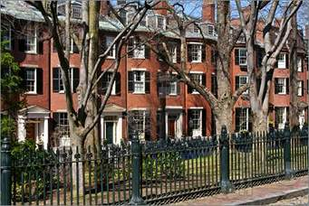
Beacon Hill (retentive, attractive, resistive)

Slide 23
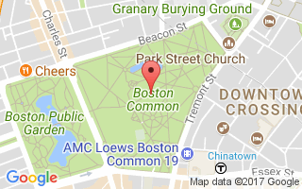
Boston Common

Slide 25
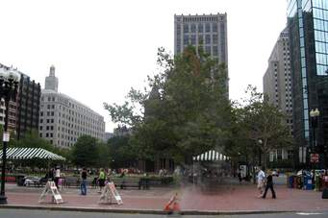
Black Bay

Slide 26
Decline and Rise Beacon Hill;
Beacon Hill Association
After the second rise of Beacon Hill – big interest for local estates, goals of developers to build here a big hotel.
Rise: initiative of locals to modernize but preserve the spirit of place. Enhace quality – less economize estates that the demand needs.

Slide 27
Boston

Slide 28
North End
Italian model of housing - close to matrifocality, family solidarity instead of institutions.
Leaving the young generation out of this neighborhood, Firey sees it as a rejection of original values, not as a contest for a better place in urban space.
„It is reasonable to suggest, then, that the slum is much more than "an area of mini- mum choice."

