Slide 1
Measurement of absorption spectra in ion traps

Slide 2
22-pole radiofrequency trap

Slide 3
22-pole radiofrequency trap
Beam of atoms

Slide 4
Meinel Band
reaguje
Velmi pomalá reakce

Slide 8


Again reaction with argon
$$H_{3}^{+}+Ar→ArH^{+}+H_{2}$$
$${HD}_{2}^{+}+Ar→ArH^{+}+D_{2}$$
$$→ArD^{+}+HD$$

Slide 11
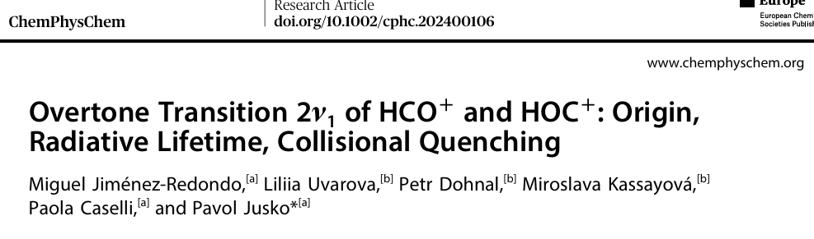
Zero Background LIR

Slide 12
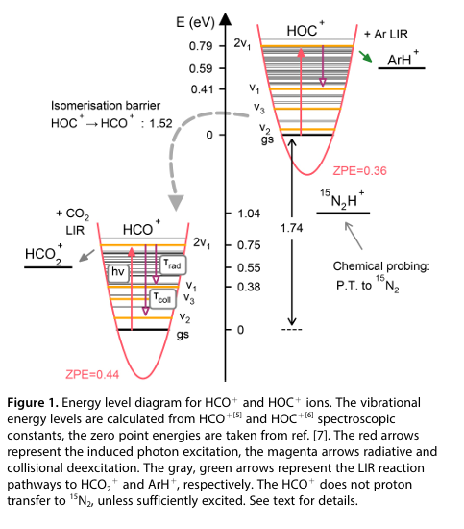
Zero Background LIR

Slide 13
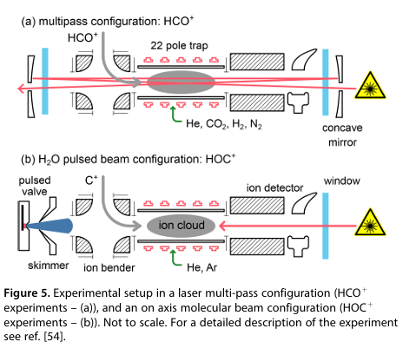



Slide 14
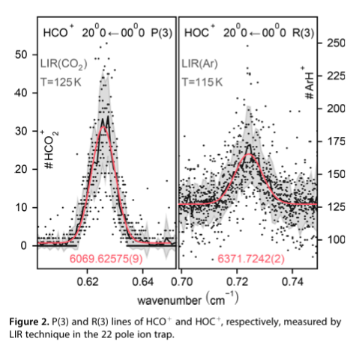

Slide 15
Lifetime and quenching of vibrational excitation

Slide 16
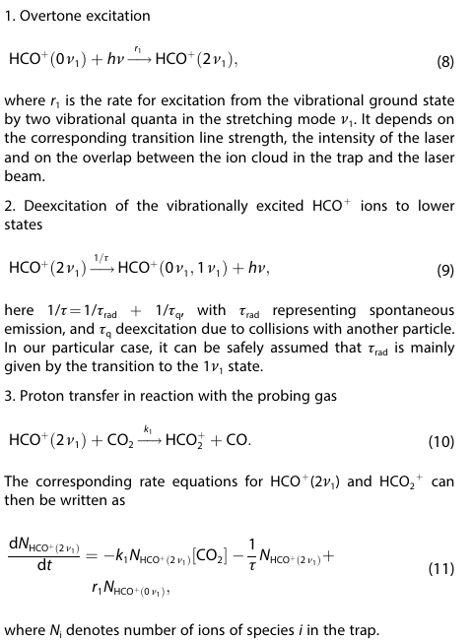
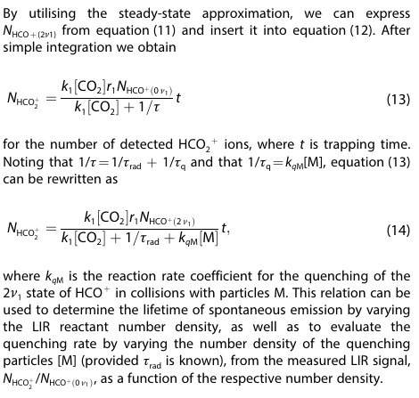

Slide 17
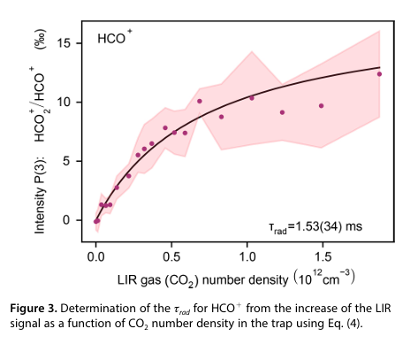
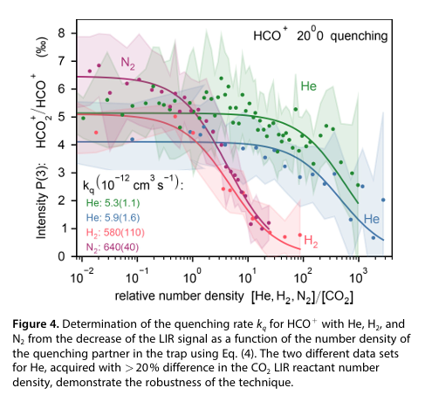

Slide 18
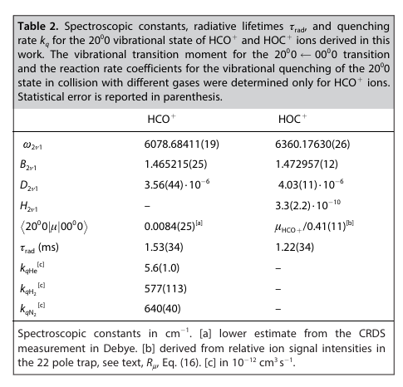
Lifetime and quenching of vibrational excitation

Slide 19
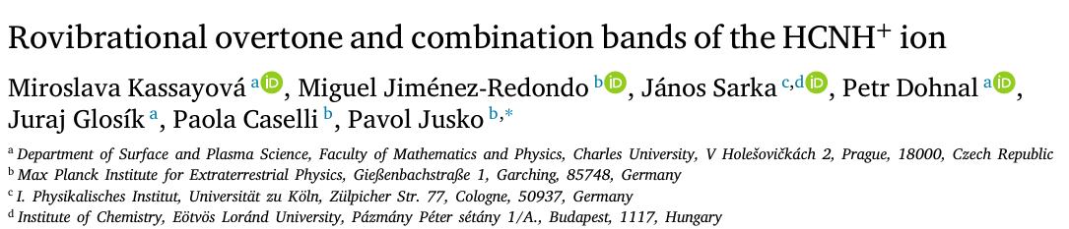
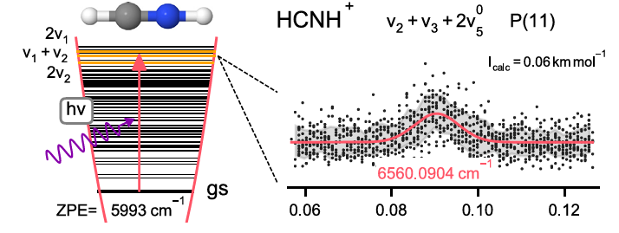
Multistep LIR

Slide 20
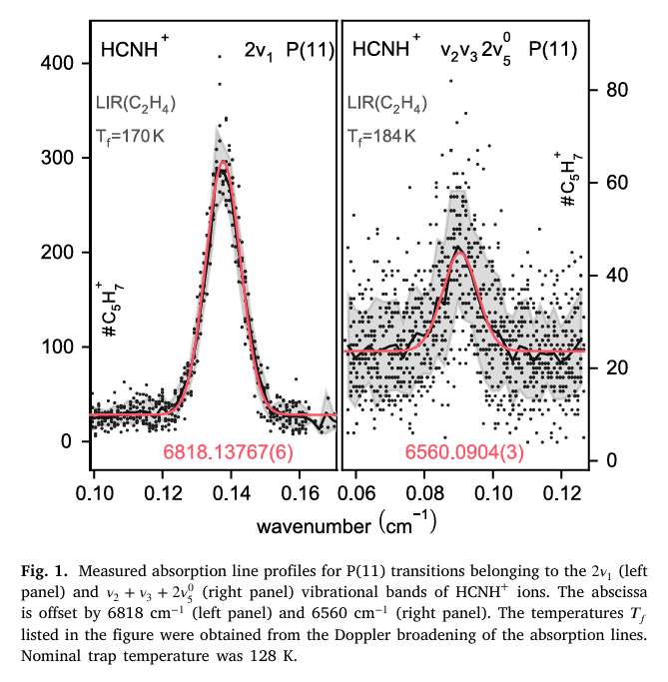
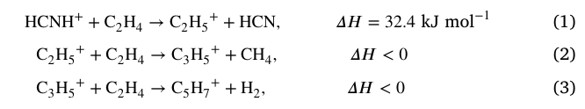
Multistep LIR

Slide 21
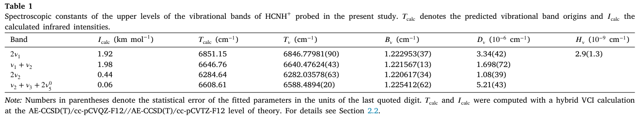
Multistep LIR

Slide 22
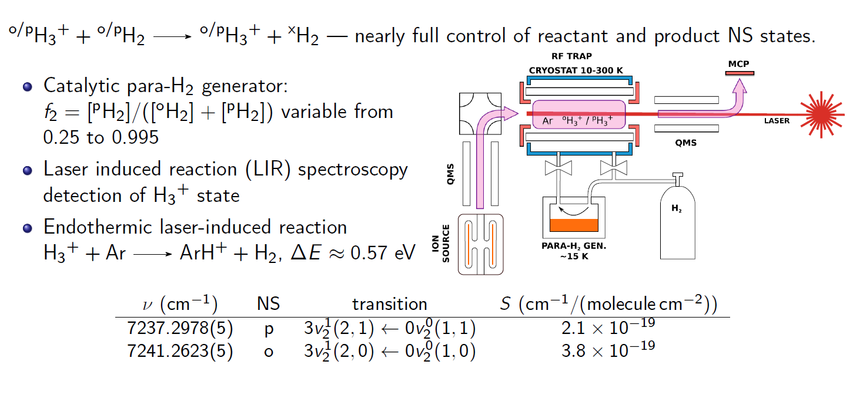
Time resolved absorption spectroscopy

Slide 23
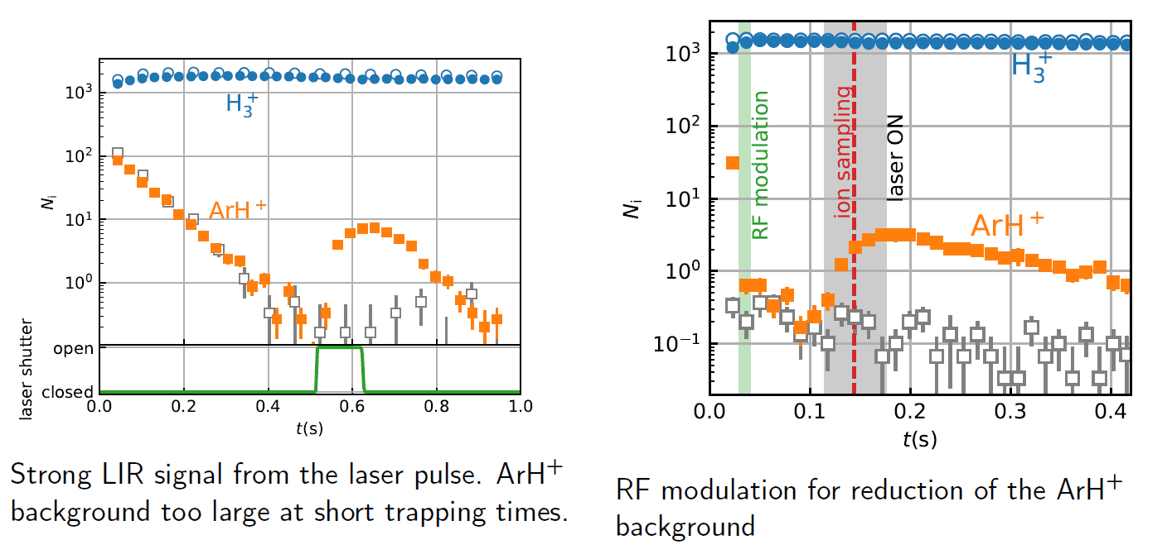

Slide 24
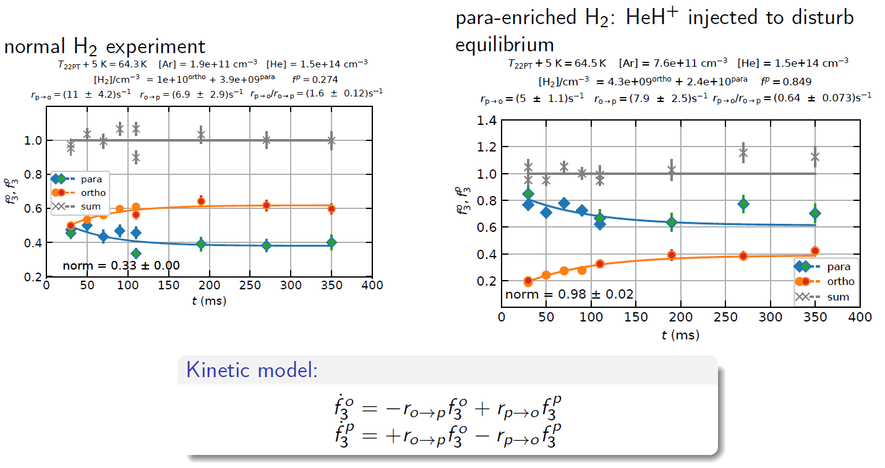

Slide 25
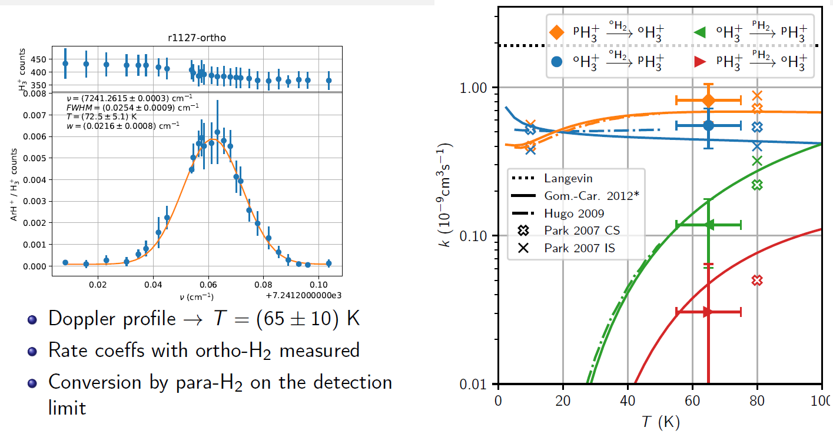

Slide 26
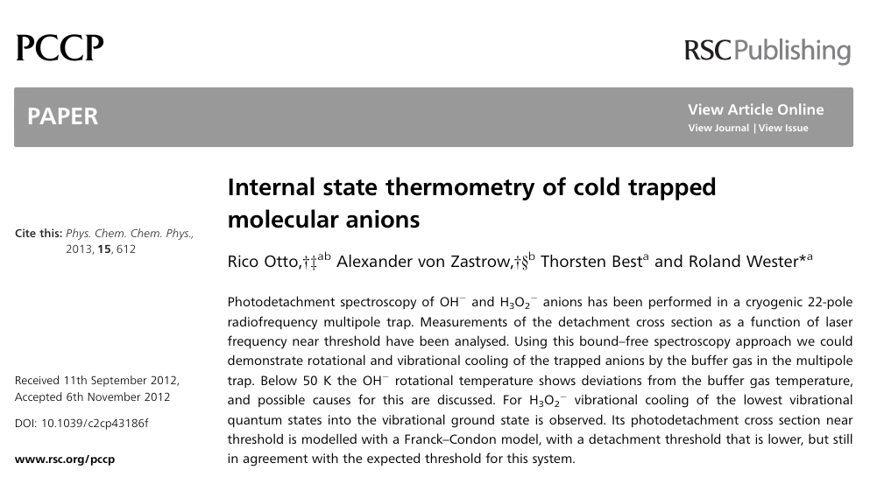
Photodetachment

Slide 27
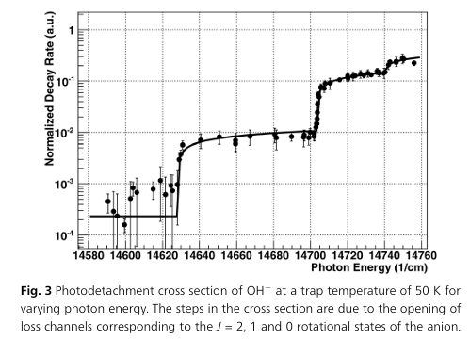

Near threshold photodetachment in 22 pole ion trap
OH⁻ + hv → OH + e⁻

Slide 28
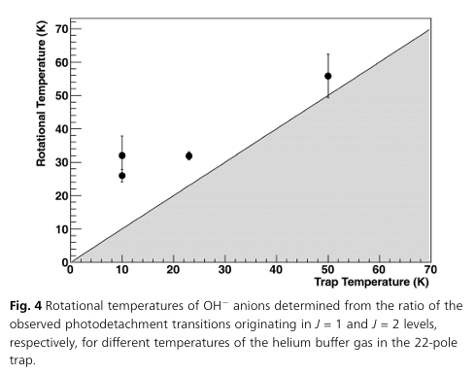
Near threshold photodetachment in 22 pole ion trap
OH⁻ + hv → OH + e⁻

Slide 29
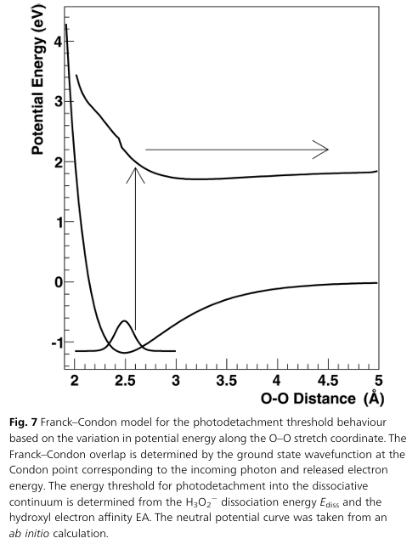
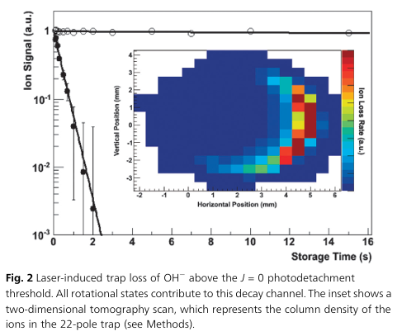

Slide 30
Ion tagging with He or other gases

Slide 31
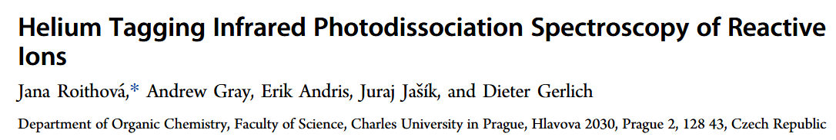
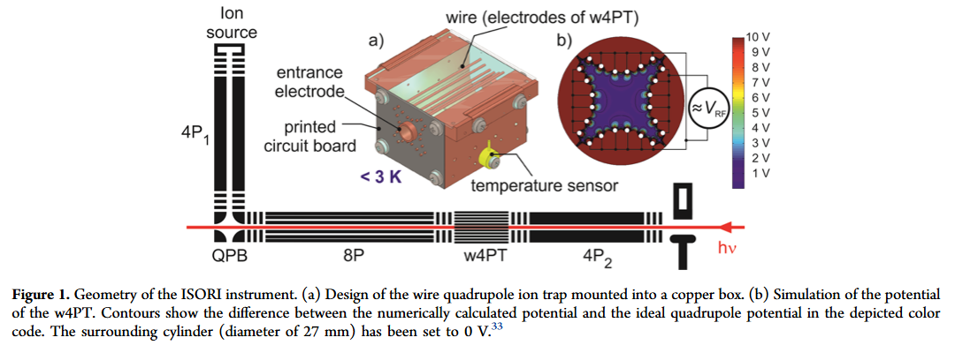

Slide 32
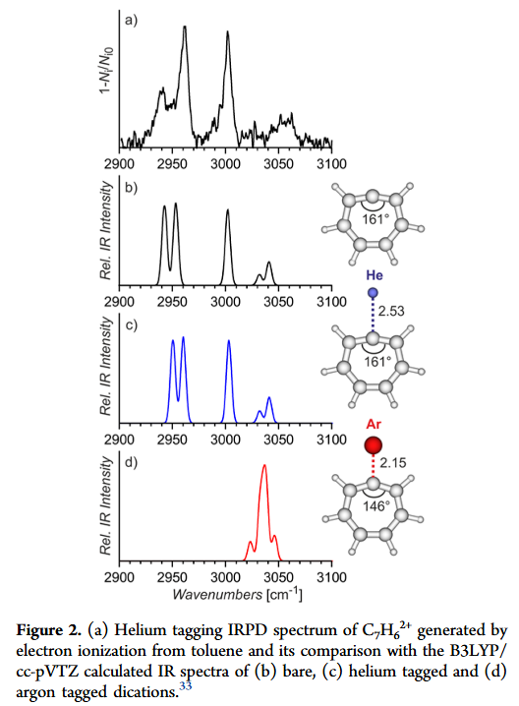
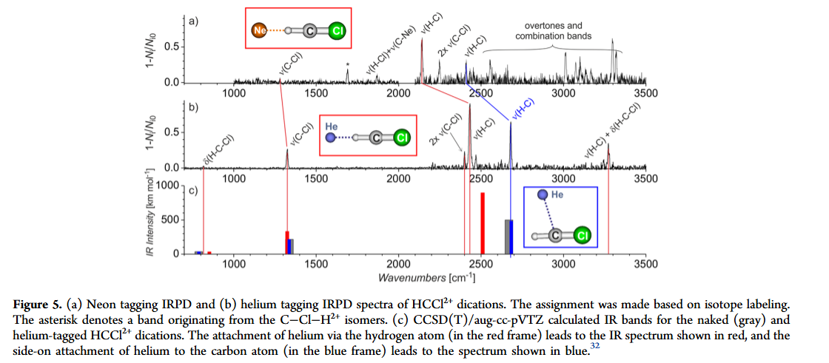

Slide 33
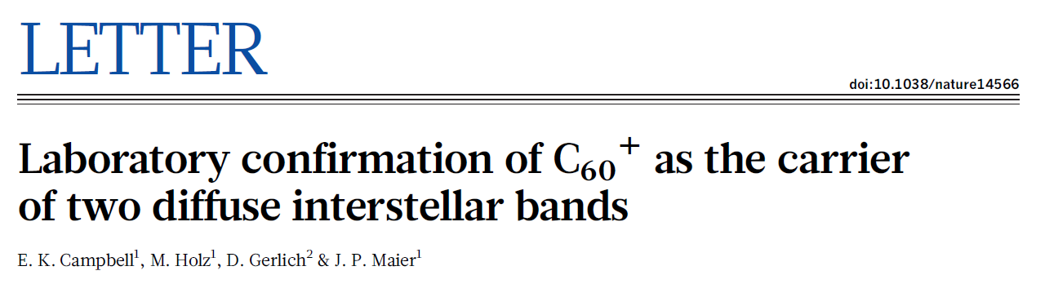
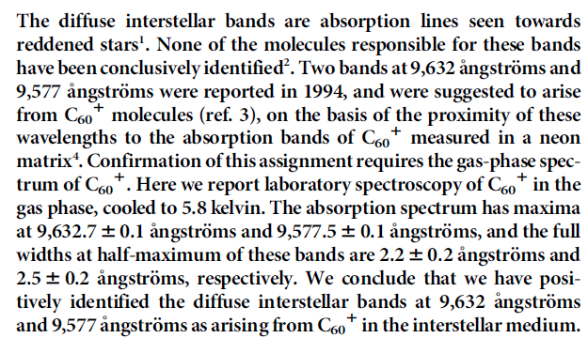

Slide 34
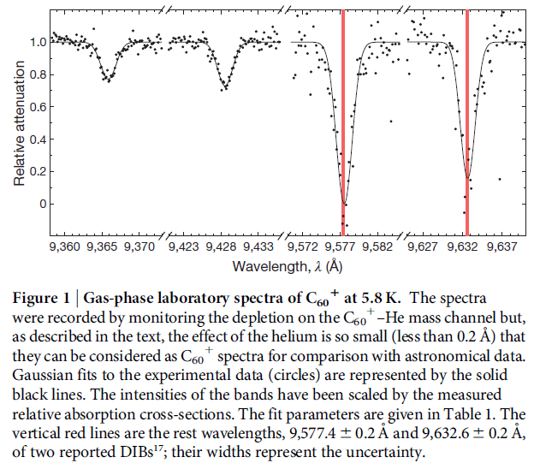
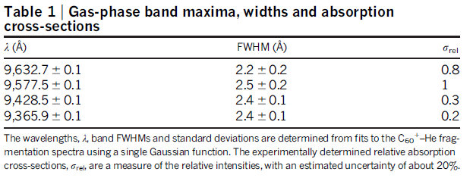

Slide 35
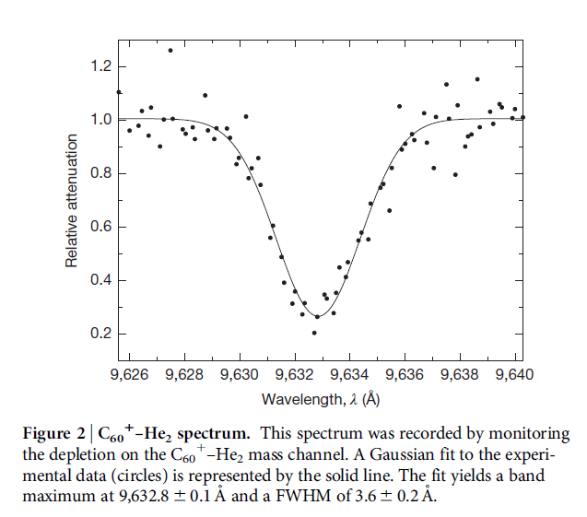
Cluster with 2 He atoms, 0.1 A difference with respect to 1 He cluster

Slide 36
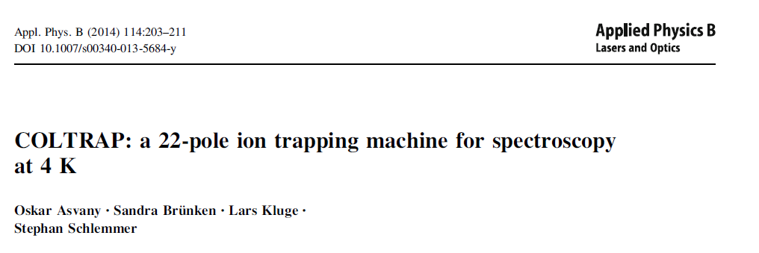
LIICG – Laser Induced Inhibition of Cluster Growth
Practically at the same time the same technique (suggested by D. Gerlich) was used by Maier group in Basel for measurement of N₂⁺ electronic spectra at 4 K.

Slide 37
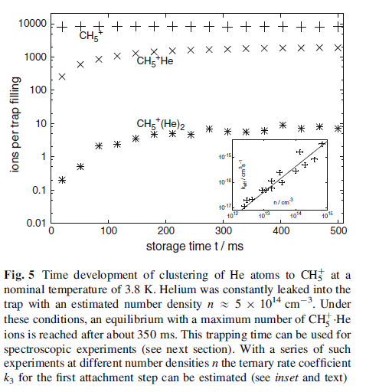
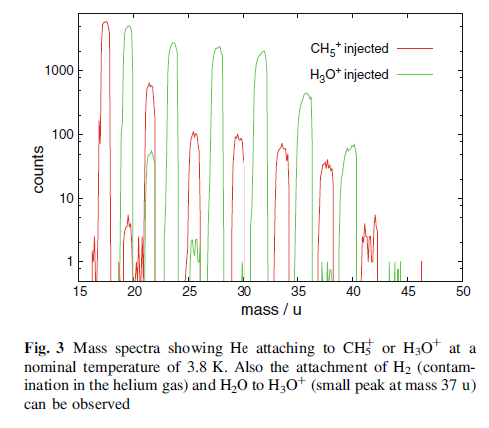
LIICG – Laser Induced Inhibition of Cluster Growth

Slide 38
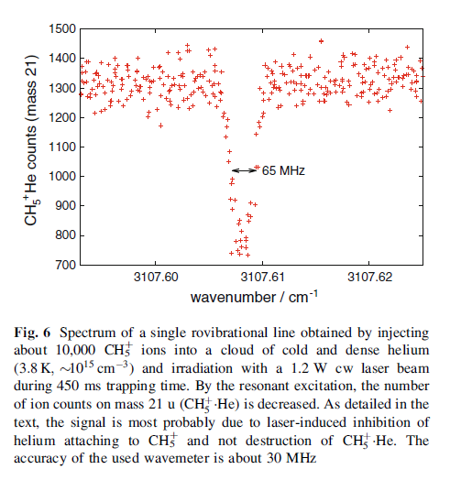
LIICG – Laser Induced Inhibition of Cluster Growth
Number of produced cluster ions is decreasing when parent ion is vibrationally excited.
Note the high power of the used laser source.

Slide 39
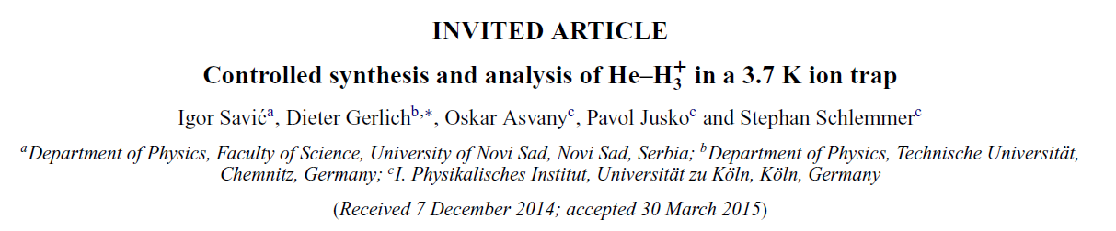
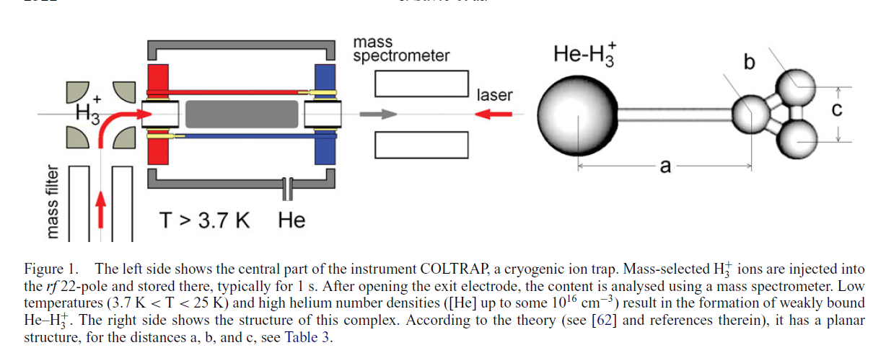
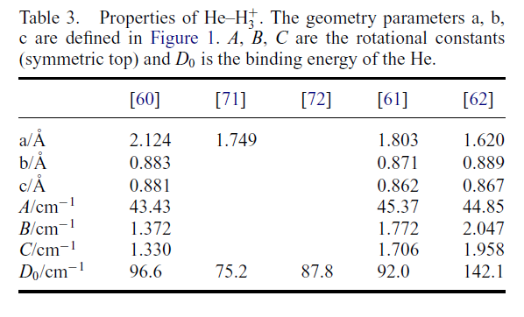

Slide 40
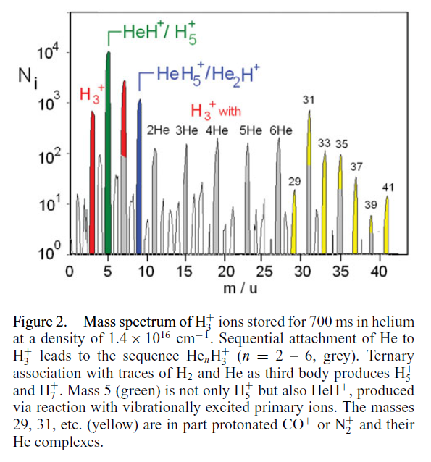
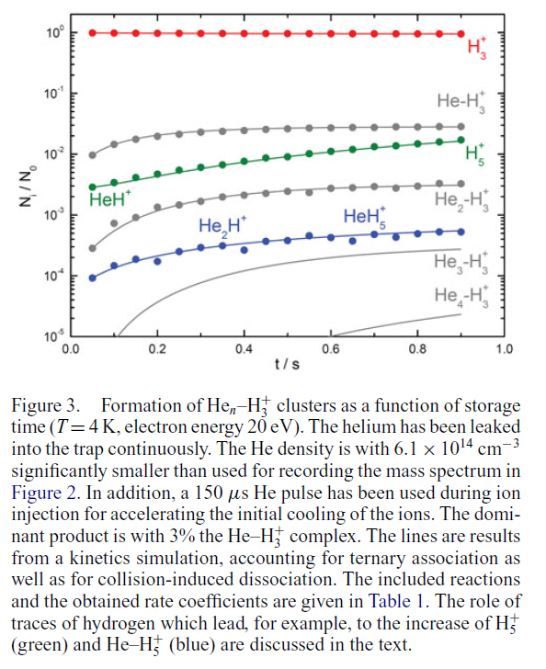

Slide 41
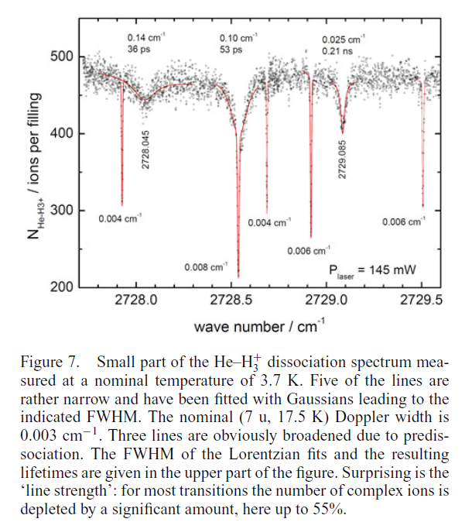
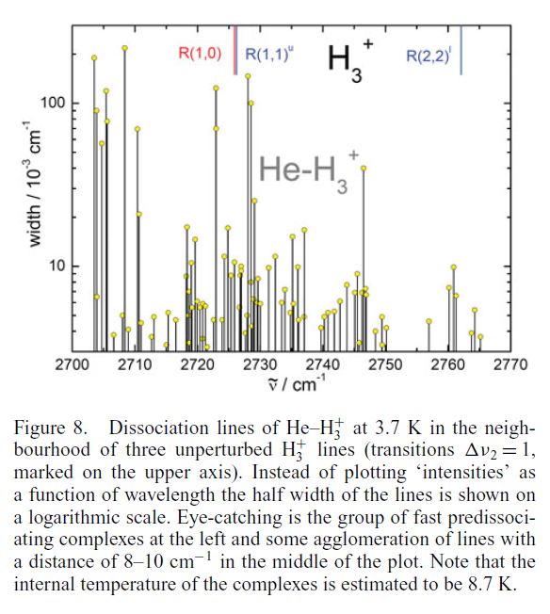

Slide 42
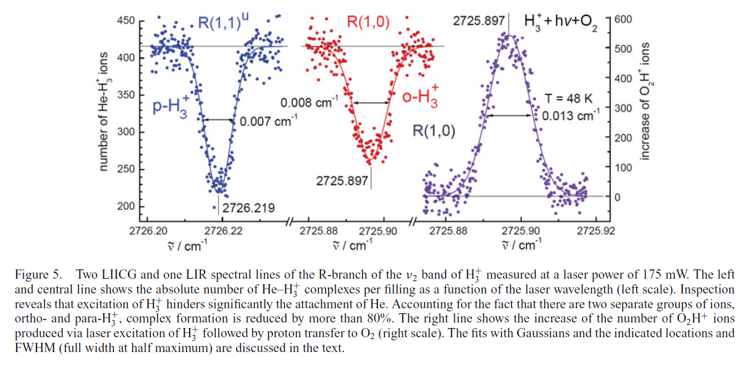

Slide 43

Leak out spectroscopy

Slide 44
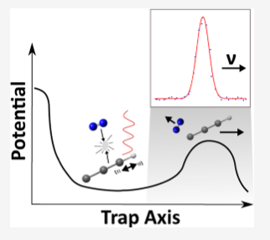
Leak out spectroscopy
Molecular ion is vibrationally excited by photon and collidies with other atom or molecule. The vibrational excitation is then transferred to kinetic energy of colliding particles. If the potential on the trap axis is low enough, this energy is sufficient for the ion to leave the trap.

Slide 45
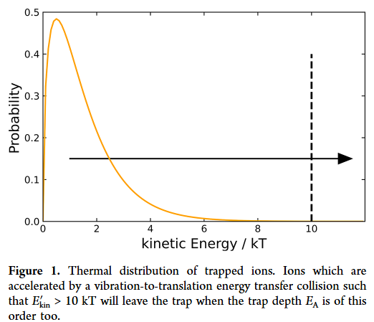
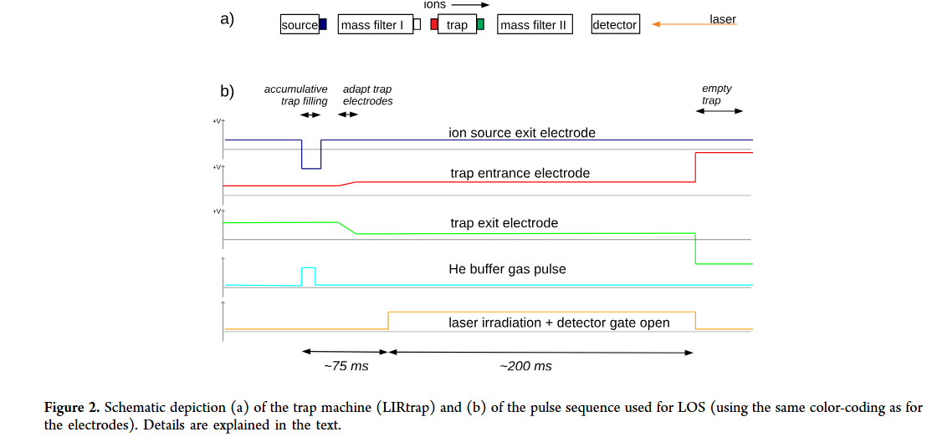
Leak out spectroscopy

Slide 46
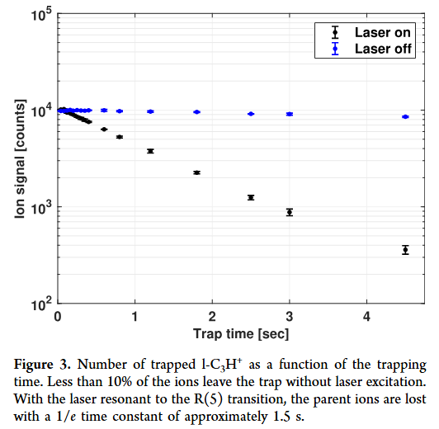
Leak out spectroscopy
It is possible to remove specific state(s) of the ion from the trap
Or to probe internal state of ions, isomer composition
Applicable to almost any ionic system, no need for complicated LIR scheme.
Sensitivity probably lower than LIR

Slide 47
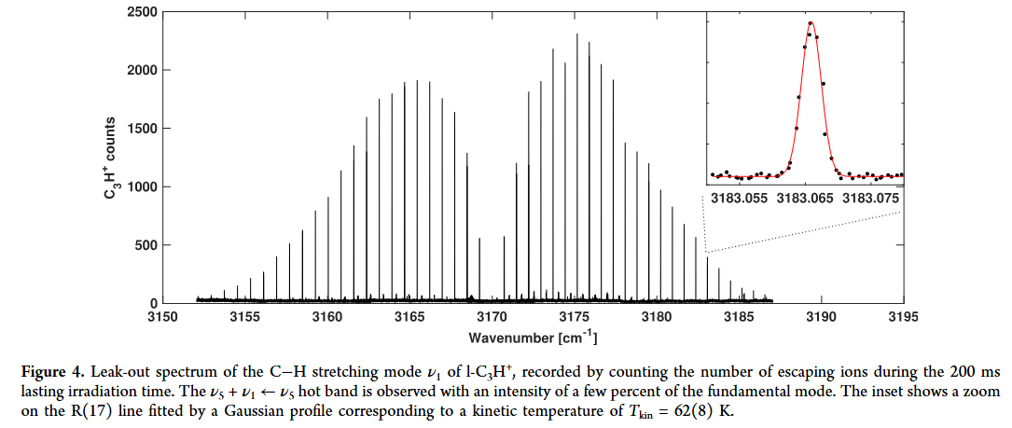
Leak out spectroscopy

Slide 48
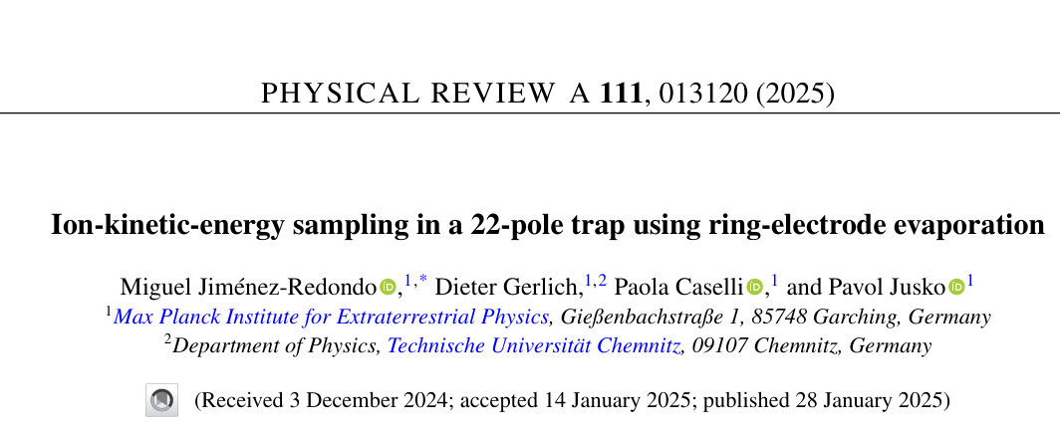
Measurement of ion energy in 22 pole trap

Slide 49



Slide 50



Slide 51

Energy distribution of ions produced in reaction of H₂⁺ with H₂
Ions produced in SIS and thermalized by helium pulse at the beginning of the trapping period

Slide 52
Thank you for your attention

