Slide 1
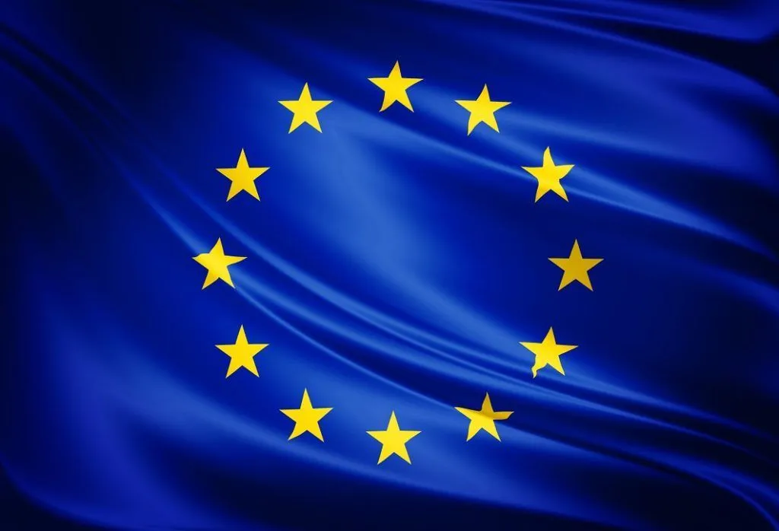
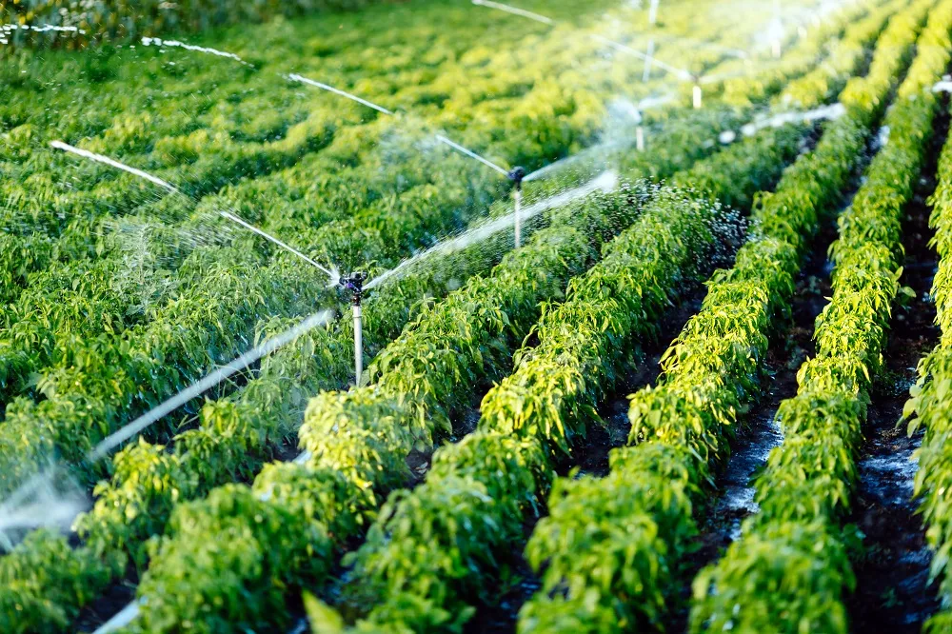
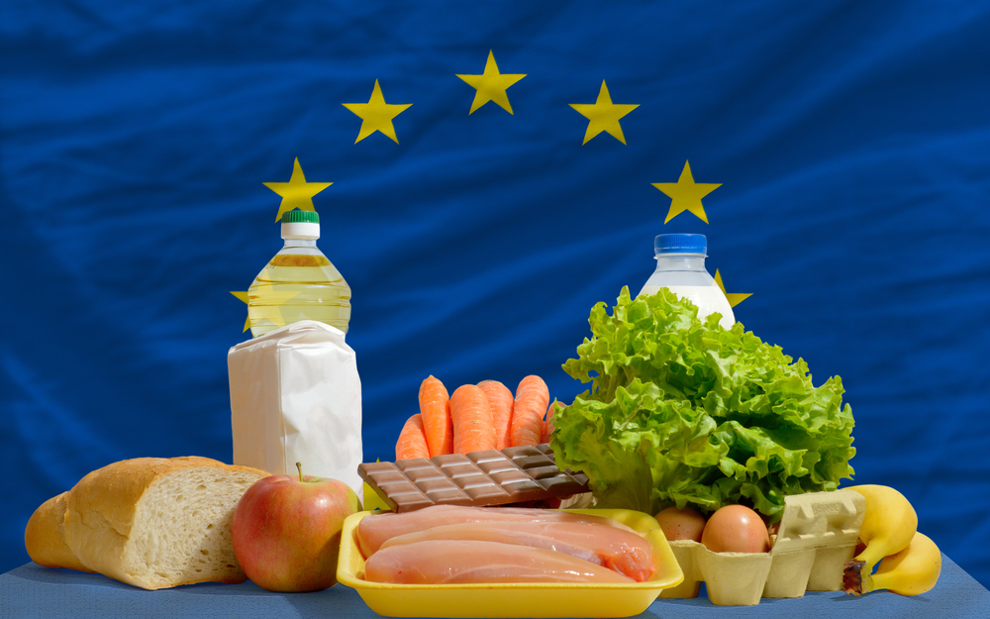
"Food Quality and Safety in the EU

Slide 2
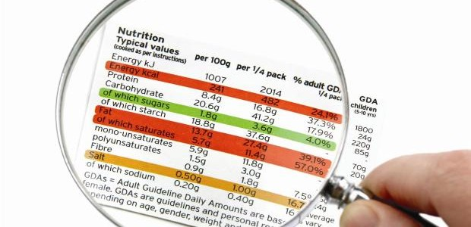
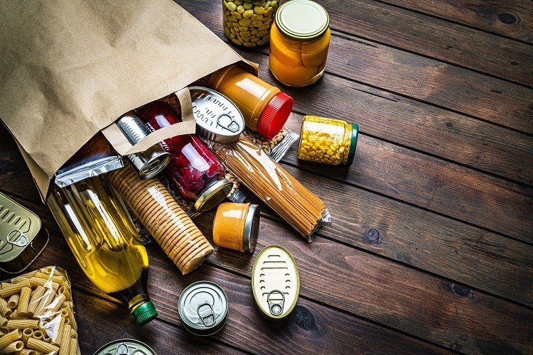
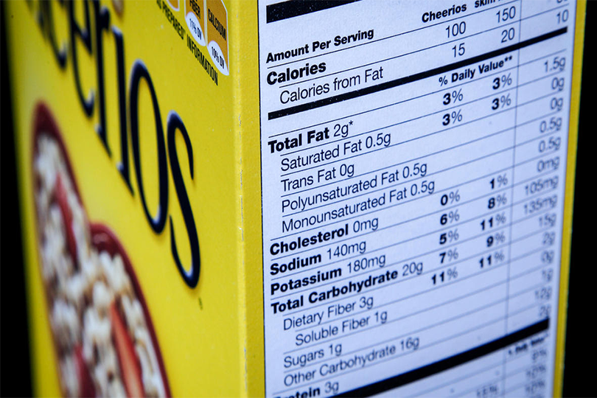
Food Labelling and Packaging In The EU

Slide 3
Objective: High level of consumer protection in relation to food information while ensuring the smooth functioning of the internal market
The food labelling and packaging in the EU is regulated under the food information to consumer regulation 1169/2011
Mandatory food information when required by food information law must concern information that falls within 3 categories:
a) Information on the identity/composition/properties/ other characteristics of the food
b) Information on the protection of consumers' health and the safe use of a food. That could concern compositional attributes that may be harmful to the health of certain groups of consumers, durability, storage and safe use as well as the health impact of a food
c) Nutrition information.

Slide 4
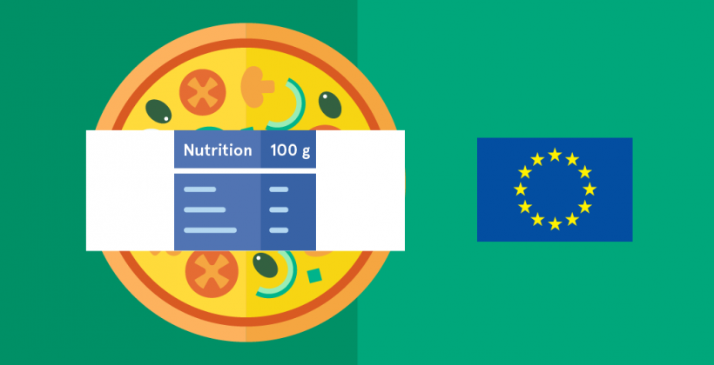
Labelling and Nutritional Information
The information required must be:
accurate
easy to see and understand
not misleading
indelible
or packaging surface of less than 10 cm², you must list:
name of the food
any substances or products causing allergies or intolerances used during manufacture or preparation and present in the finished product
net quantity of the food
'best before' or the ‘use by' date

Slide 5


FIC Directives and Regulations
Since 2016, The FIC Regulation requires food labels to include the following mandatory nutrition information:
Energy value (kJ, kcal)
Fat
Saturates
Carbohydrates
Sugars
Protein
Salt
The mandatory nutrition declaration may be supplemented with details on mono-unsaturates, polyunsaturates, polyols, starch, fiber, and vitamins and minerals.
Labels of foodstuffs, according to the general rules laid down by Regulation (EU) 1169/2011
The name under which the product is sold
The net weight of pre-packaged products
The date of minimum durability
Any special conditions for keeping or use
The name or business name and address of the manufacturer, packager or seller established in the EU
Lot marking on pre-packaged product with the marking preceded by the letter 'L'

Slide 6
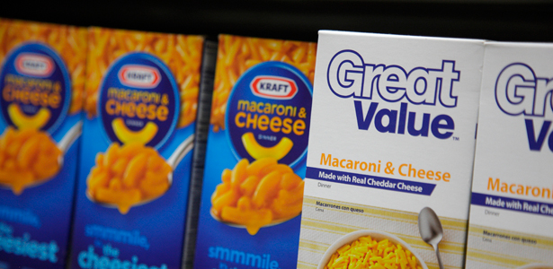
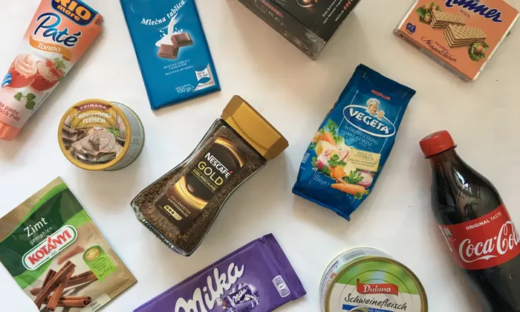
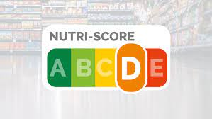
Order of Labelling: The list must be preceded by a heading that includes the word ‘ingredients' and must include all the ingredients of the food:
in descending order of weight
designated by their legal name
Vitamins and minerals must be expressed as a percentage of the daily reference intake value and should only be displayed when present in significant amounts. Generally, the concentration of a vitamin or mineral per 100g or 100ml should be at least 7.5 % in beverages or 15 % in other products.

Slide 7
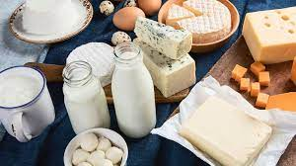
In case of Ingredients prone to allergies: If a food or beverage contains a substance that causes allergies or intolerances, the label must state this either explicitly or by emphasizing the substance in the list of ingredients, such as by using a bold font or different color text. food Items such as:
Cereals containing gluten
Crustaceans
Eggs
Fish
Peanuts
Soybeans
Milk

Slide 8

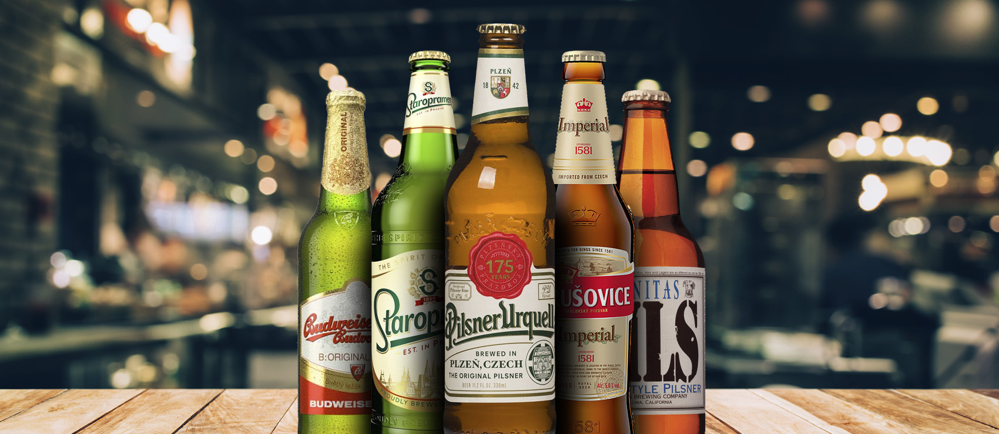
Beverages Consisting of Alcohol: If beverages contain more than 1.2 % alcohol by volume, they must be labeled with the actual alcoholic strength by volume but are exempt from the FIC Regulation mandatory listing of ingredients and nutrition declaration.
Note: European alcoholic beverage industries have self-regulated to provide energy, nutrition, and ingredient information on their products

Slide 9
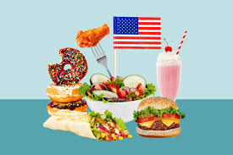
"Contrasting Approaches: Food Labeling Regulations in the US and EU"
US food labels identify milligrams of sodium in foods whereas EU labels list salt content in grams. Although they are related, salt and sodium are not identical—sodium is a mineral, while table salt (or sodium chloride) contains sodium (about 40% by weight).
US labels tend to be easier to read and understand. More information is placed in bold text, fonts are larger, and there is more spacing. EU labels tend to use a much smaller font; lines are spaced more closely; and there is no requirement for bold text.
In the US, nutritional labels must base calories on the number of servings. For instance, a US food label on a box of crackers might indicate that a serving of five crackers has 100 calories.

Slide 10
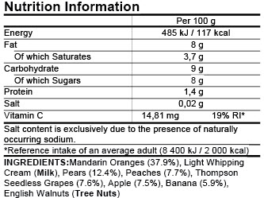
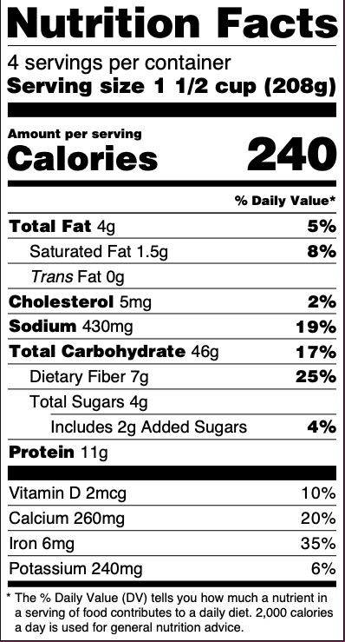



Slide 11
Requires materials that do not release harmful levels of their constituents into foods.
The regulation requires materials that do not change the taste, odor or composition of food in an unacceptable way.
It also requires that businesses involved in food packaging must establish a system that traces food contact materials (FCMs) at every step from production to distribution.
Regulation (EC) No 1935/2004
Food Packaging In the EU
The regulation allows the EU to set specific measures pertaining to certain types of materials, such as plastics;
Following adoption of such measures, manufacturers using those materials must submit a written Declaration of Compliance (DoC).
For example: PET
Regulation (EU) No 10/2011

Slide 12
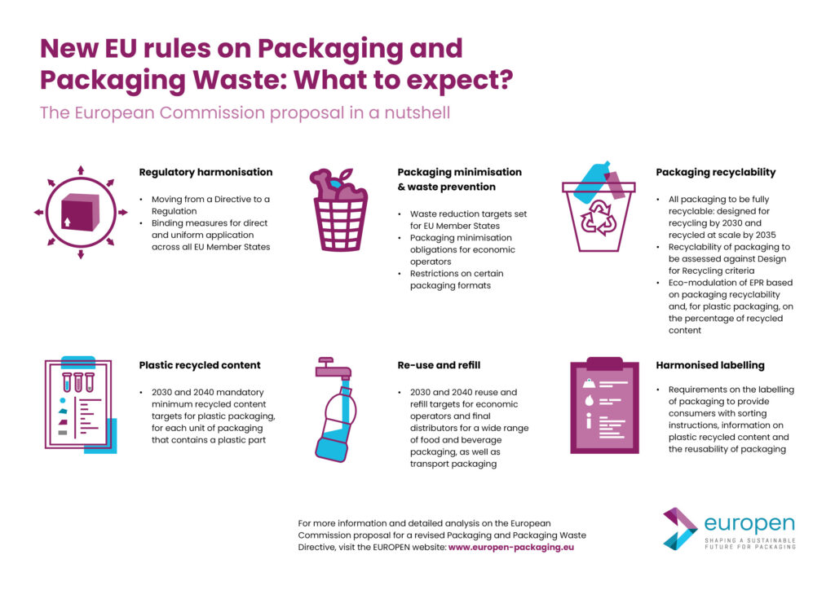

Slide 13
Achieving recyclability and increased recycling: All packaging must be recyclable by 2030, with “at scale” recycling expected by 2035.
Encouraging the use of recycled materials: By 2030 and 2040, new plastic packaging must incorporate recycled material to contribute to a circular economy.
Promoting reuse and refill: Certain types of packaging must be reusable or enable refill options by 2030 and 2040.
Banning specific packaging: Some forms of packaging will face bans to reduce waste.
Reducing packaging waste: A 15% reduction per capita in packaging waste is targeted by 2040, compared to a 2018 baseline.
Packaging and Packaging Waste Regulation (PPWR)

Slide 14
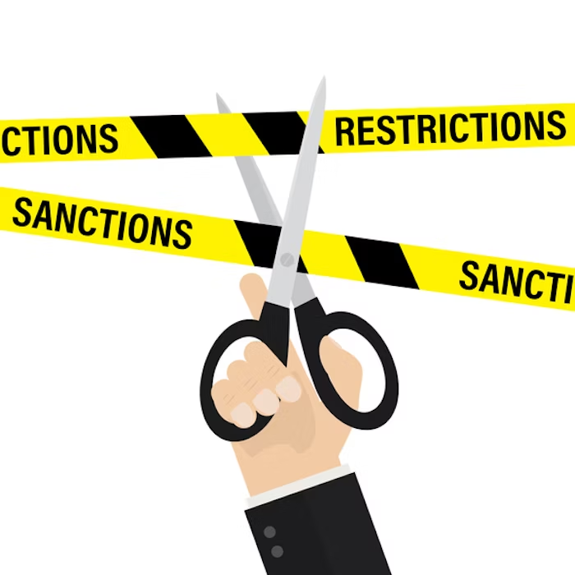

Slide 15
Examination of Discrepancies: Food Products Permitted in the US but Restricted in the EU"
The European Union prohibits or severely restricts many food additives that have been linked to cancer that are still used in American-made bread, cookies, soft drinks and other processed foods
Farm Animal Drugs
Potassium bromate
BHA and BHT
Brominated Vegetable Oil

Slide 16
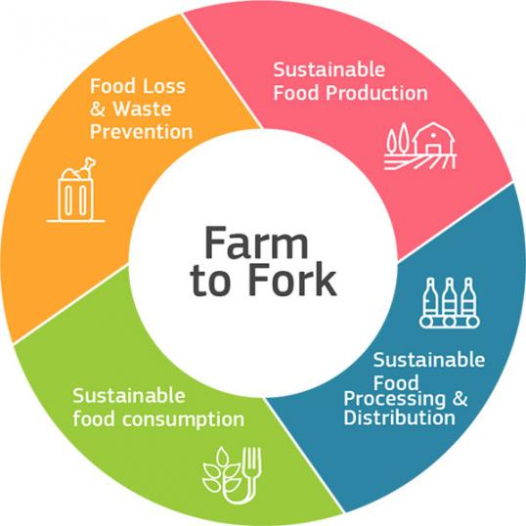
Farm to fork strategy
Objectives
Ensure that food production has a neutral or positive environmental impact.
Help mitigate climate change
Reverse the loss of biodiversity.
Guarantee food security
Maintain the affordability of food while generating fairer economic returns

Slide 17
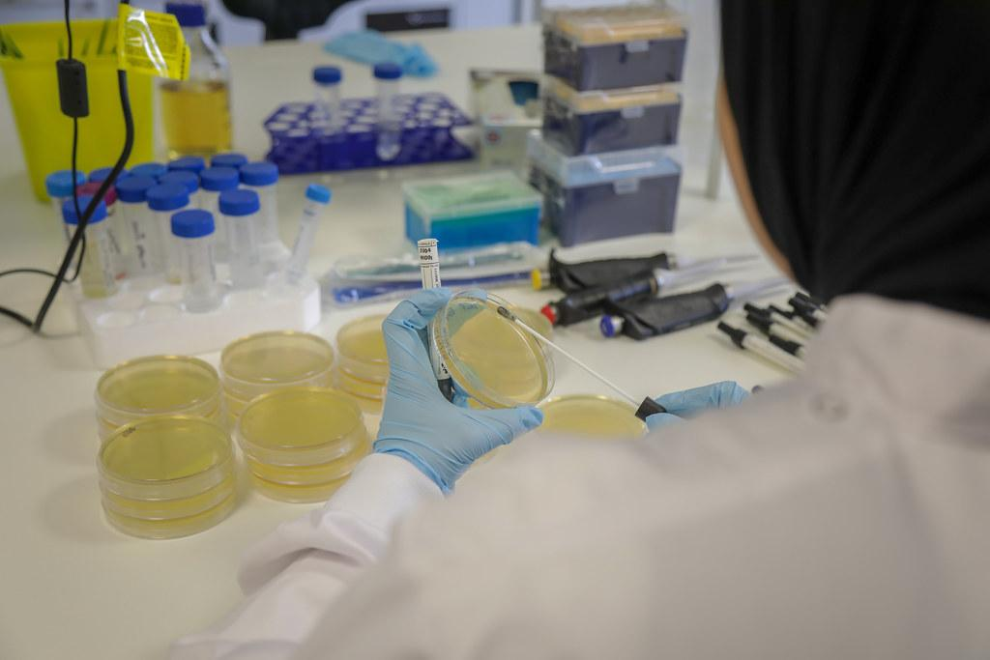
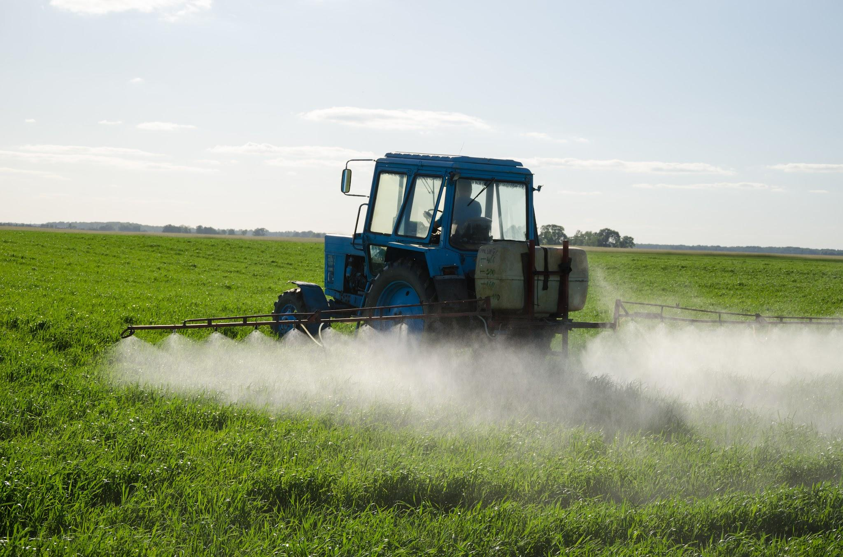
What are the concrete targets?
By 2030 EU countries should:
Increase the area under organic farming to 25% of total farmland
Reduce the use of chemical pesticides by 50%
Cut the sales of antimicrobials for farmed animals and agriculture by 50%

Slide 18
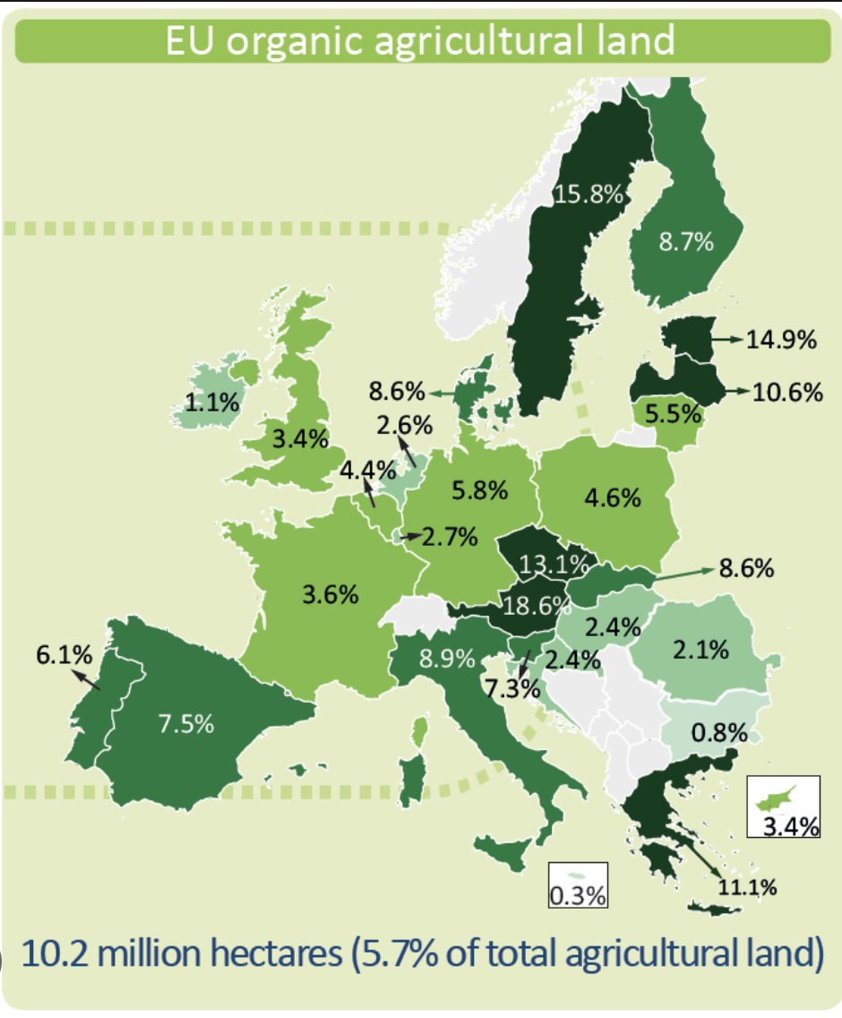
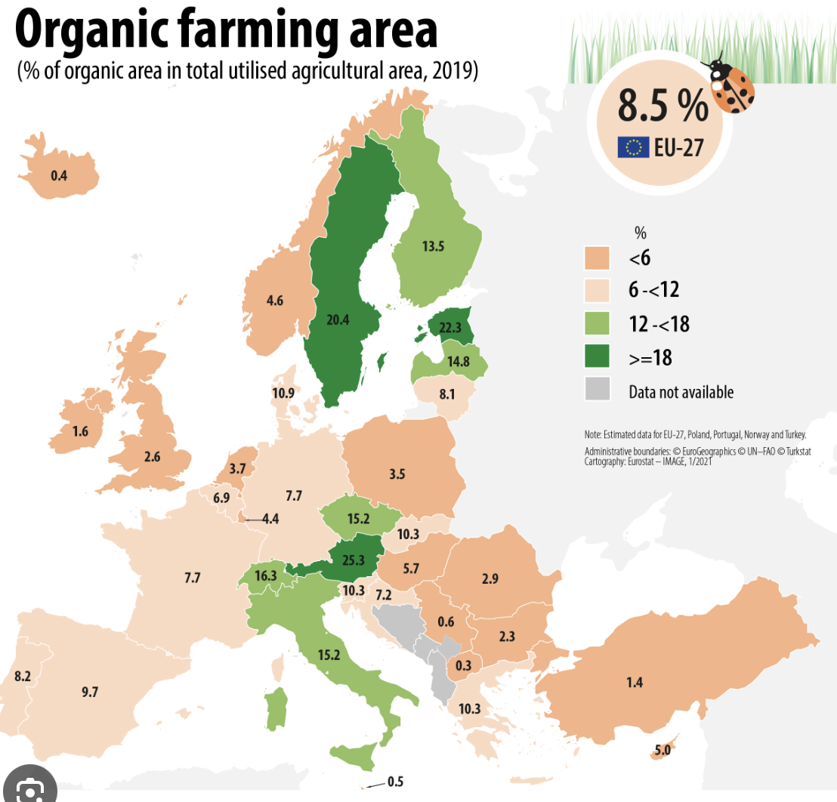
Where are we now?

Slide 19
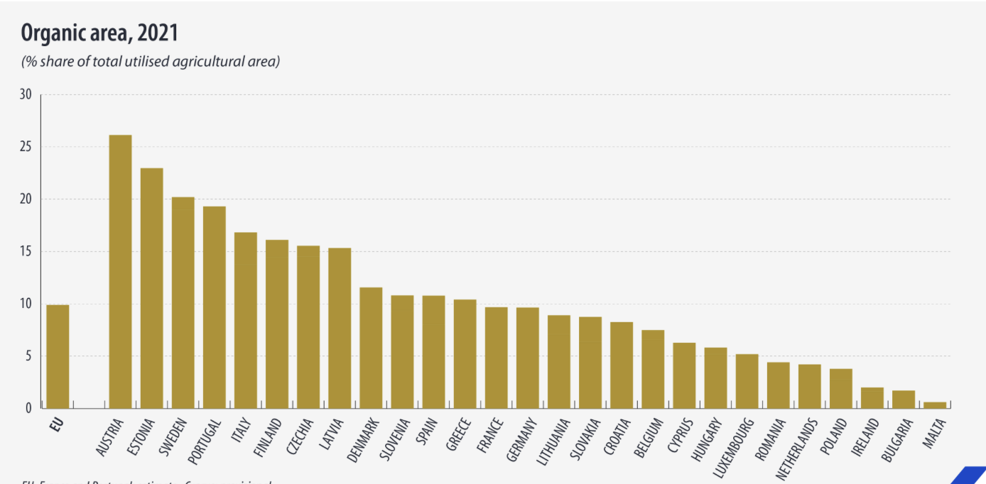

Slide 20

Why is it important?
Organic farming contributes in protecting the environment
It helps mitigate the environmental footprint
It leads to the production of safer and healthier food
Reduces the use of fertilizers

Slide 21
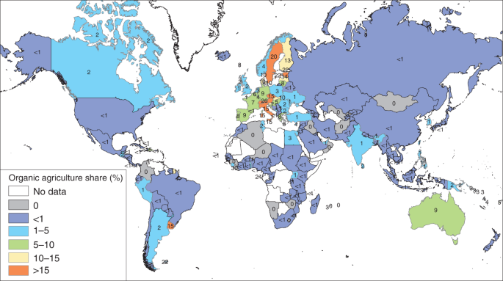
What is the situation in the rest of the world?
Only 2% of the world farmland was farmed organically as of 2022
Australia by itself contributes to 70% of the world farmland
Organic food consumption worldwide in 2020 increased by 14 billion $

Slide 22
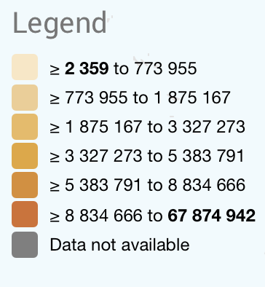
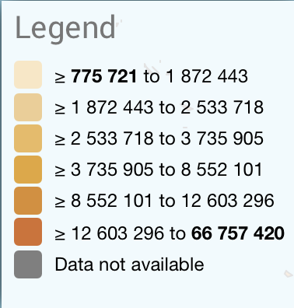
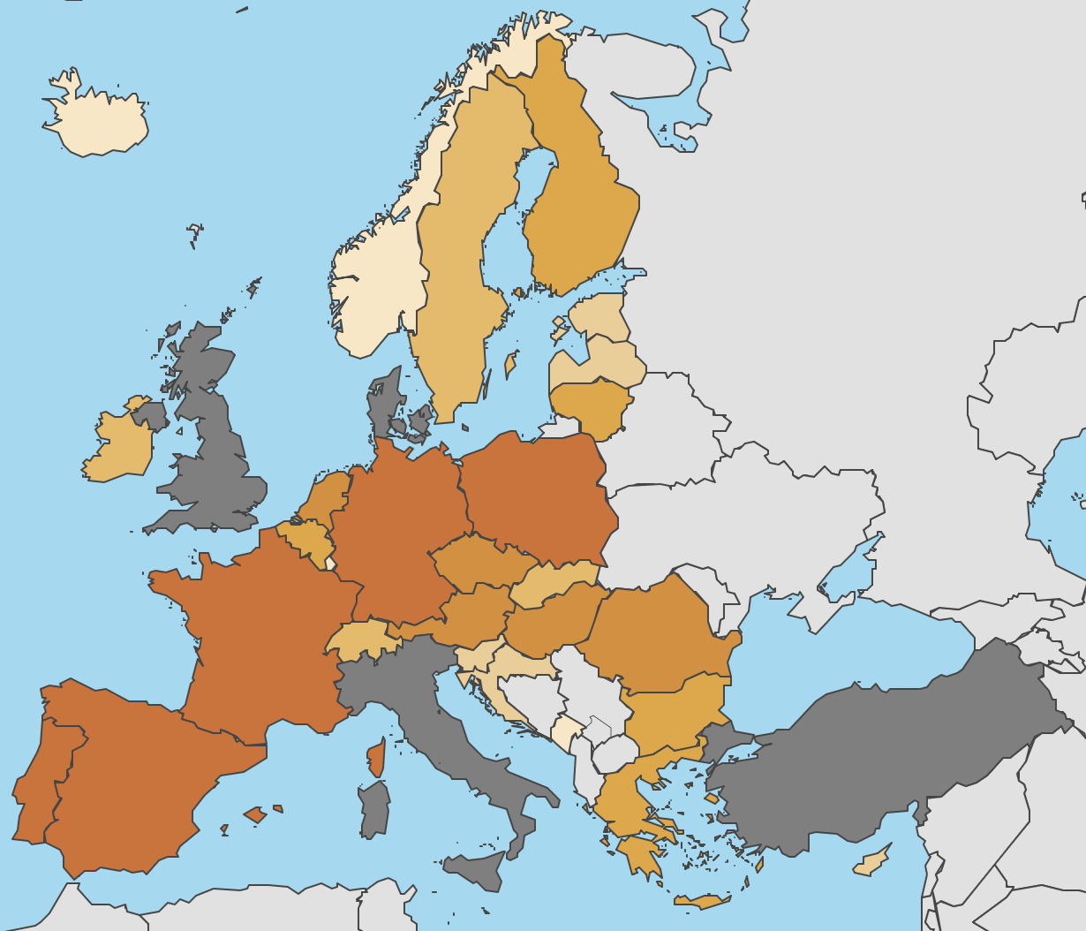
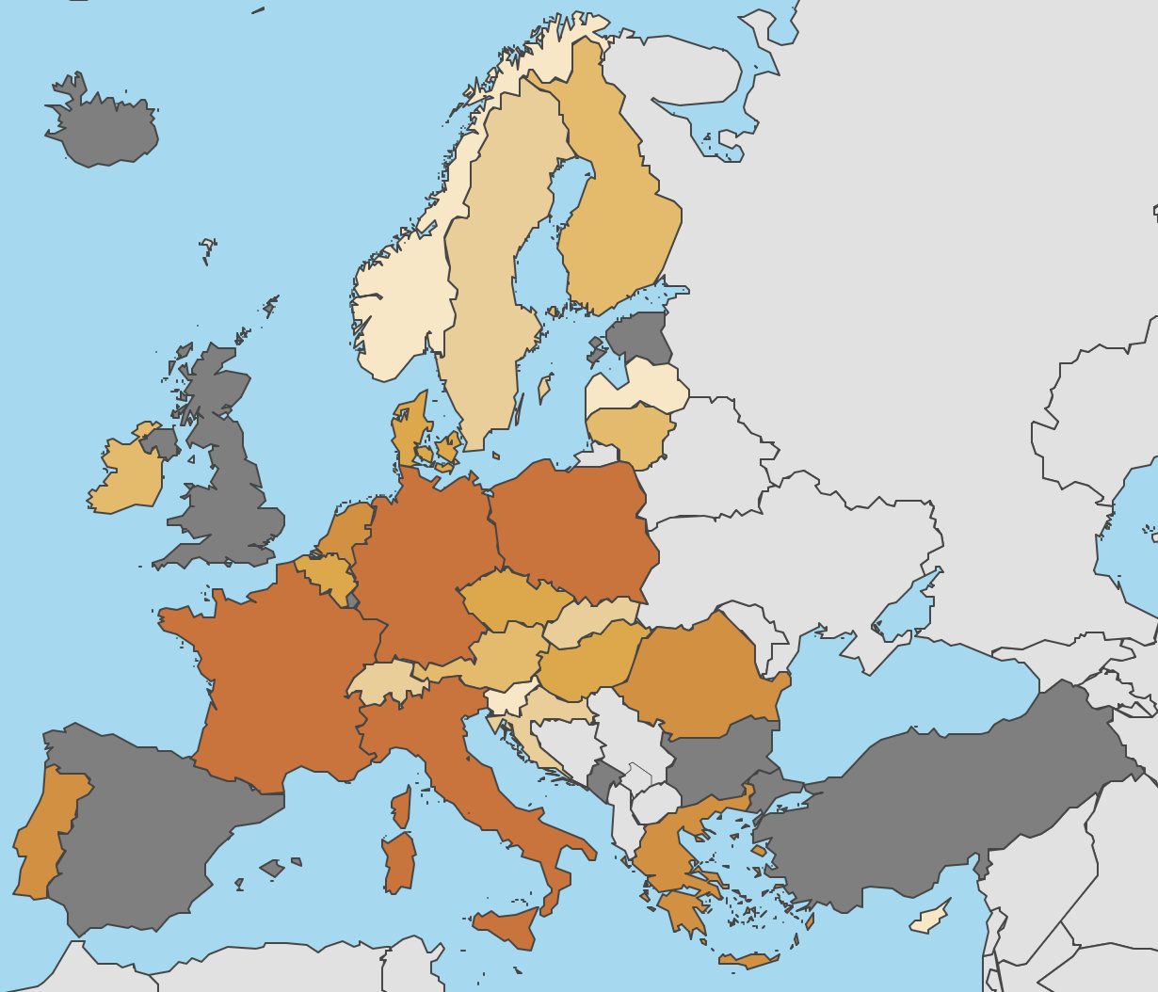
Pesticide sales compared
2022 VS 2013

Slide 23
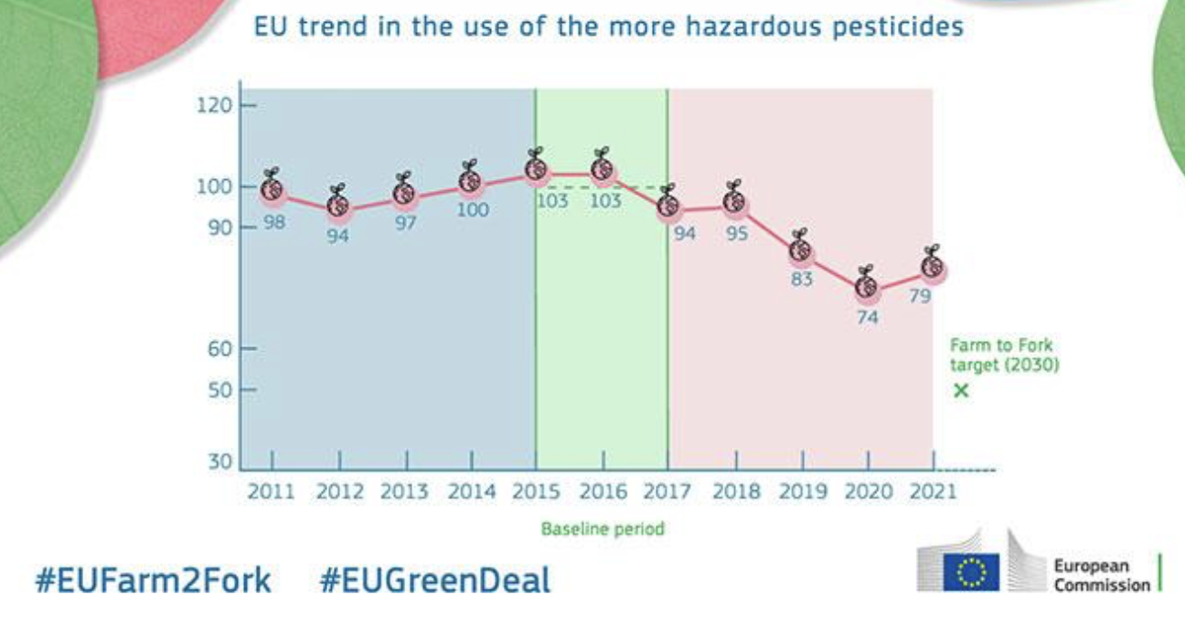

Slide 24
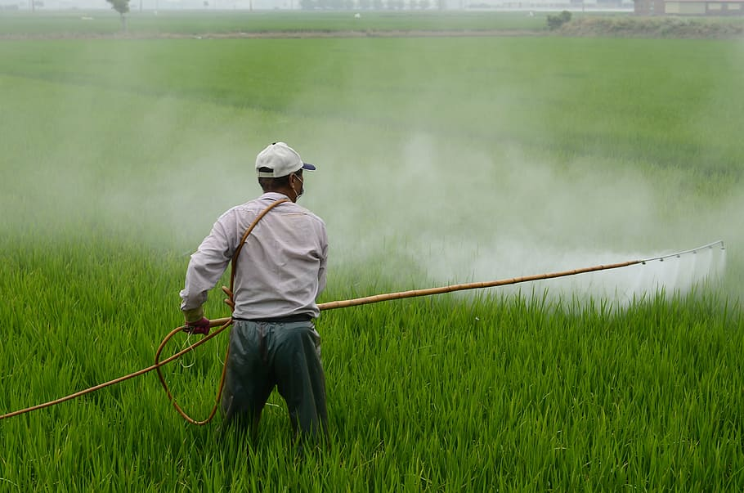
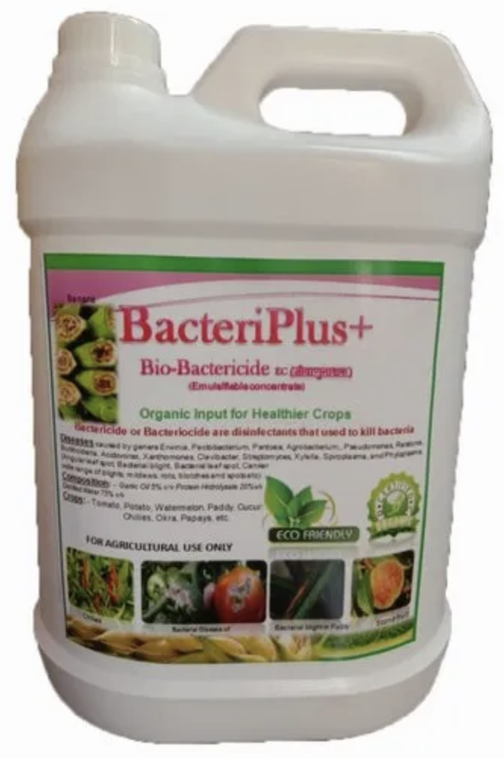
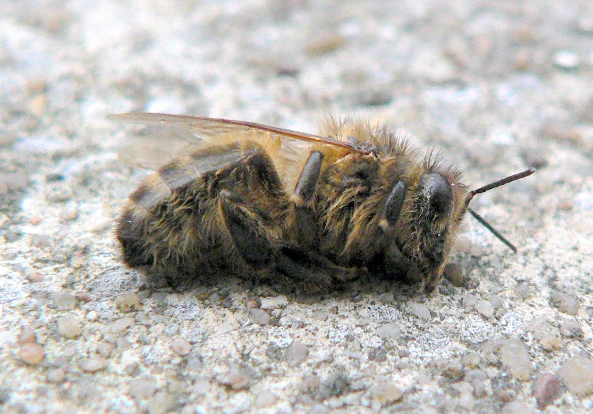
Most used pesticides
In 2021 the most used pesticides in the EU where:
44% fungicides and bactericides
34% herbicides
14% insecticides

Slide 25
The dangers of pesticides
Since 1990 the population of farmland birds has reduced by 30%
At least 1 in 10 bee species face extinction
All the previously mentioned pesticides used in the EU can cause cancer
Fungicides can cause chronic obstructive pulmonary disease (COPD)
Can affect hormone balance
Some insecticides may harm fetal development

Slide 26
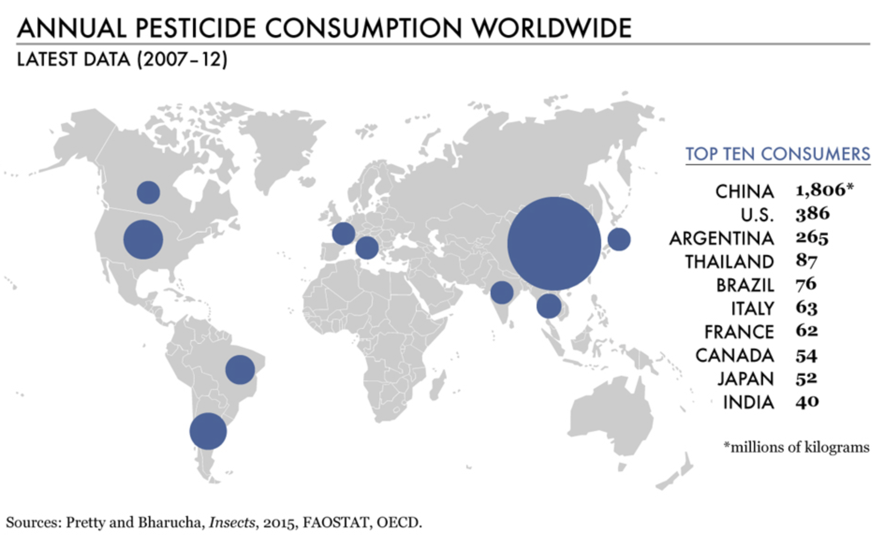
Use of pesticides outside the EU

Slide 27
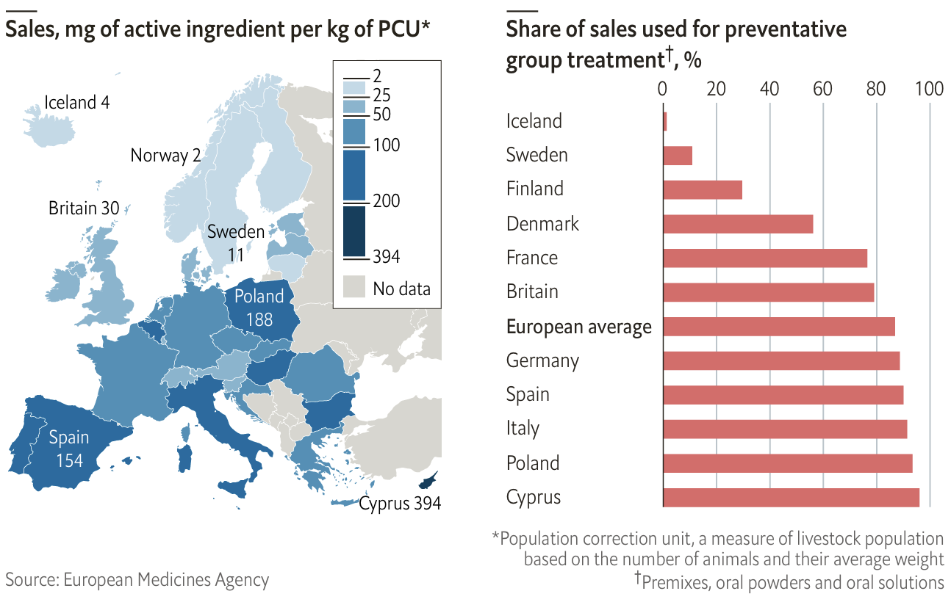
Use of antimicrobials

Slide 28
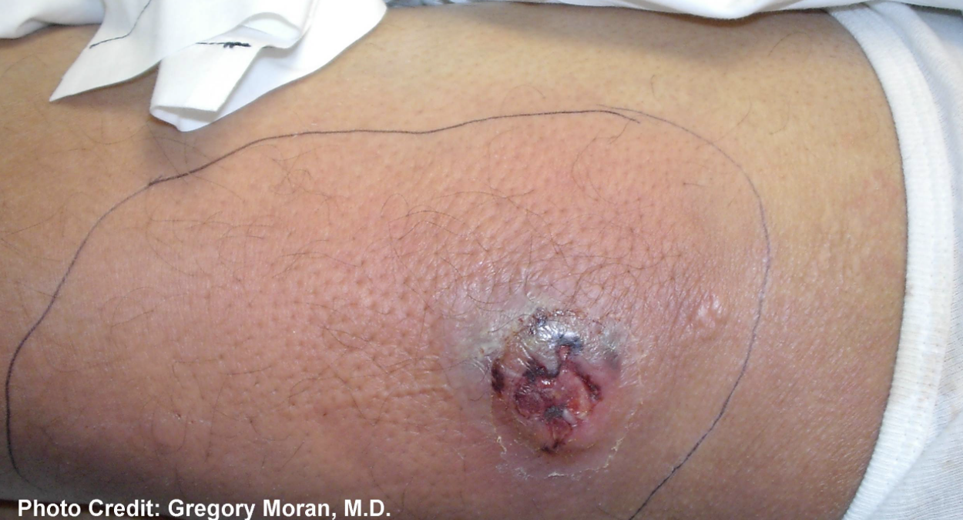
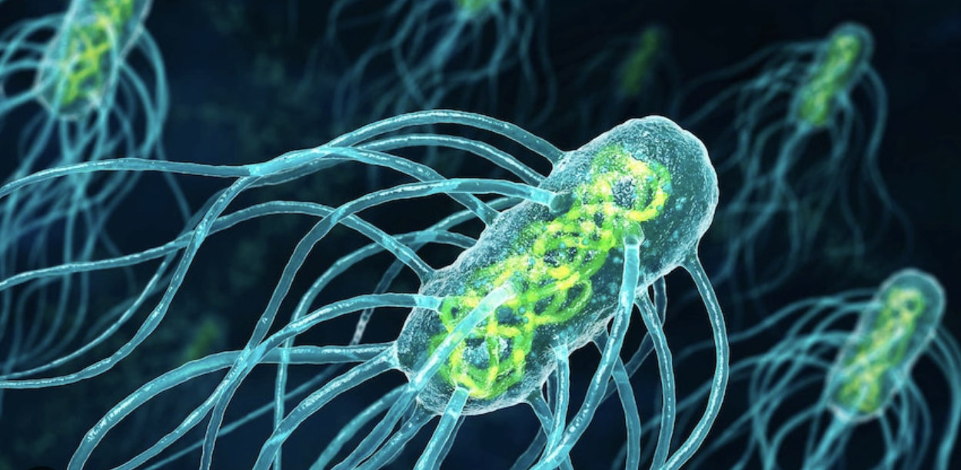
What can an excessive use cause?
Antimicrobial resistance
Transfer of resistance genes
Loss of efficacy
Some examples are:
MRSA
VRE
Q-Fever
Salmonellosis

Slide 29
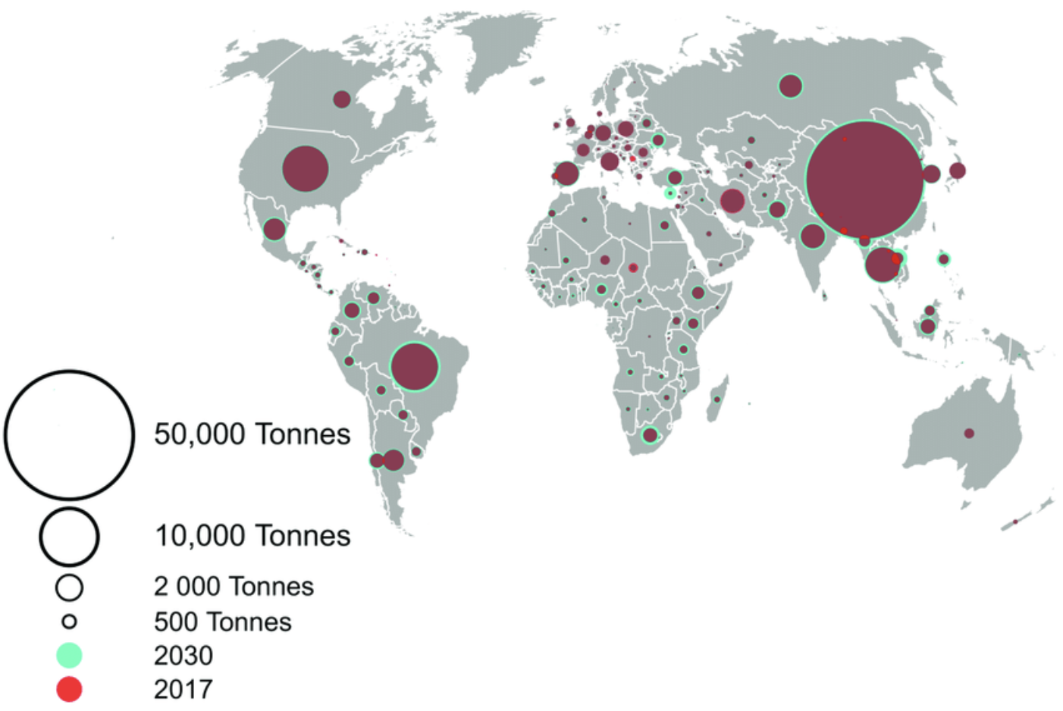
And in the rest of the world?

Slide 30
Farmers’ Protests in the EU
Paris, Rome, Brussels, Berlin, Prague, Warsaw…
Farmers’ costs – notably for energy, fertilizer and transport – have risen in many EU countries
Governments reducing prices of necessity goods, taxes on agricultural vehicles and reduced subsidies on diesel
Farm-gate prices – the base price farmers receive for their produce – dropped by almost 9% throughout 2023
The problem of cheap imports

Slide 31
Institutional limits
The common agricultural policy (CAP), the €55bn-a-year subsidy system
the number of farms in the EU has fallen by more than a third since 2005
FTF targets include halving pesticides by 2030, cutting fertilizer use by 20%, devoting more land to non-agricultural use – for example, by leaving it fallow or planting non-productive trees – and doubling organic production to 25% of all EU farmland.
COPA-COGECA vs ECVC
What is being done to satisfy the needs of the farmers? National governments have taken steps: Berlin watered down its plans to cut diesel subsidies; Paris scrapped a diesel tax increase, delayed other measures and pledged €150m in help, prompting farmers’ unions to call on members to suspend their protest. Trade deals with countries outside of the EU have been postponed, or either reduced by the imposition of taxes and quotas.

Slide 32
Politics of the protests
In the Netherlands, farmers’ anger was exploited by the right-wing Farmer-Citizen Movement party (BBB)
Prague demonstrations
According to protest organizers, the profit of agricultural companies in Czechia crashed to CZK 8.7 billion from CZK 22 billion in 2023. In 2024, the agricultural industry will receive CZK 800 million less in subsidies.

Slide 33
Works Cited
https://www.reuters.com/world/europe/protesting-farmers-jam-brussels-with-tractors-ministers-meet-2024-02-26/
https://www.aljazeera.com/amp/opinions/2024/2/25/farmers-protests-in-europe-and-the-deadend-of-neoliberalism
https://amp.theguardian.com/environment/2024/feb/26/farmers-protests-brussels-eu-agriculture-leaders-riot-police
https://www.expats.cz/czech-news/article/prague-to-be-hit-again-by-mass-farmers-protest-here-s-what-you-need-to-know
https://www.packaging-gateway.com/news/eus-packaging-regulations-transform-industry/
https://www.tilleydistribution.com/food-regulations-in-europe-vs-the-us/
https://www.daymarksafety.com/news/some-fundamental-differences-between-food-labeling-in-the-us-and-europe/#:~:text=More%20information%20is%20placed%20in,compared%20to%20US%20food%20labels.

Slide 34
https://food.ec.europa.eu/horizontal-topics/farm-fork-strategy_en
https://epthinktank.eu/2015/05/20/organic-food/
https://ec.europa.eu/eurostat/web/products-eurostat-news/-/ddn-20210127-1
https://ec.europa.eu/eurostat/web/products-eurostat-news/-/ddn-20230622-1
https://www.nature.com/articles/s43016-021-00288-8
https://ec.europa.eu/eurostat/databrowser/view/tai02/default/map?lang=en
https://food.ec.europa.eu/plants/pesticides/sustainable-use-pesticides/farm-fork-targets-progress/eu-trends_en
https://ensia.com/features/developing-world-pesticides/

