Slide 1
Experimental methods for studies of ion – molecule reactions and of ion – electron recombination

Slide 2
Time dependence of the value of recombination rate coefficient for H₃⁺ ions with electrons
Not a simple problem

Slide 3
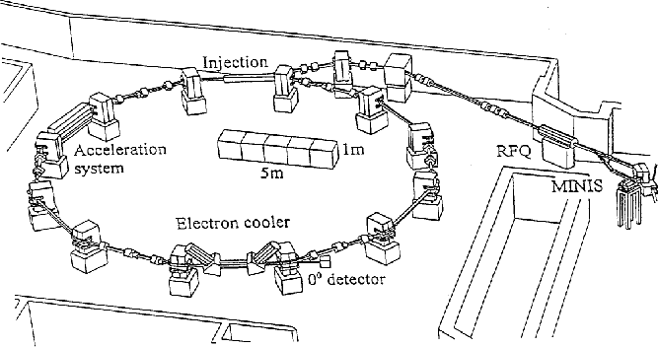
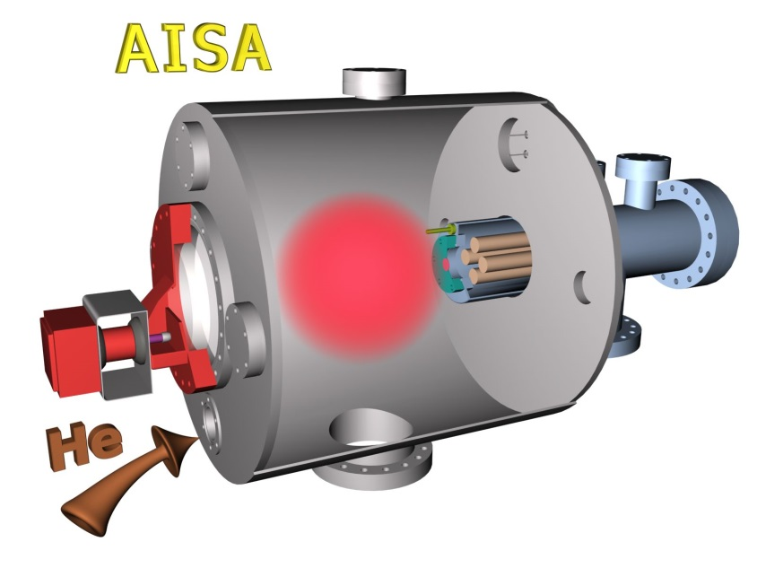
Different experiments
Ion Storage Ring
Afterglow plasma
+ No buffer gas
+ Excellent energy resolution
Complicated estimation of cross section from measured data
Rotational temperature of ions in the ring can be >= 300 K
+ Many collisions of ions with buffer gas particles – effective thermalization
+ The measured quantity is thermal rate coefficient
Complicated chemical kinetics
Presence of third bodies can influence the recombination

Slide 4
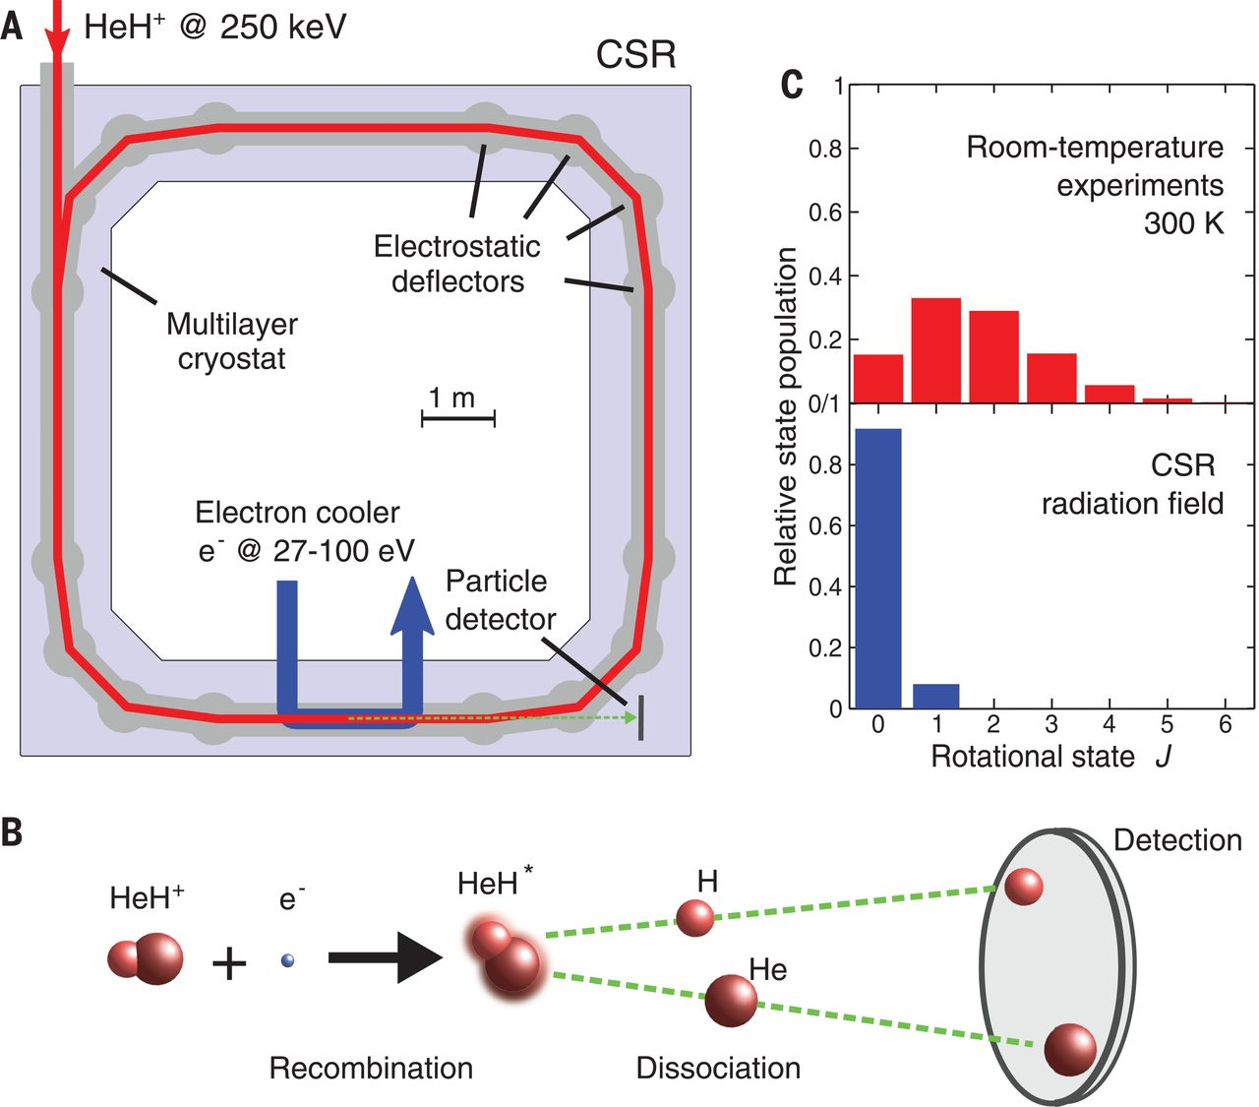
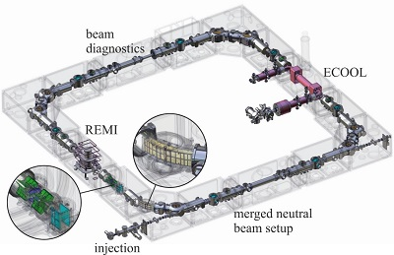
Ion storage ring
(A) Scheme of the CSR ring structure with the injected and stored HeH⁺ ion beam (red), merged electron beam (blue), reaction products (green), and particle detector. (B) Reaction scheme and position-sensitive detection of coincident fragments. (C) Equilibrium rotational state populations of HeH+ for previous studies (300 K) and the estimated radiation field in the CSR.
Figure 1: Design model of the CSR showing the electrostatic ion optical elements (enlarged in circuits), the injection line, the electron cooler (straight section at the right side) and the reaction microscope (straight section at the left side)

Slide 5
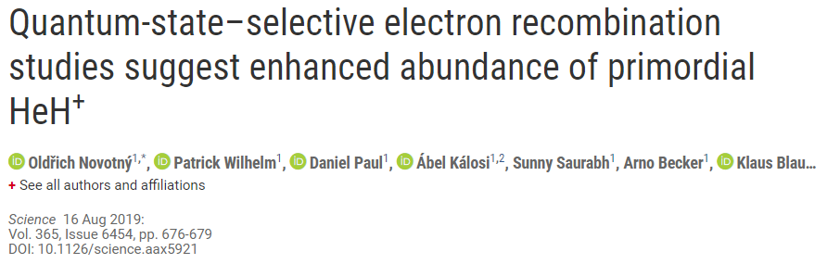
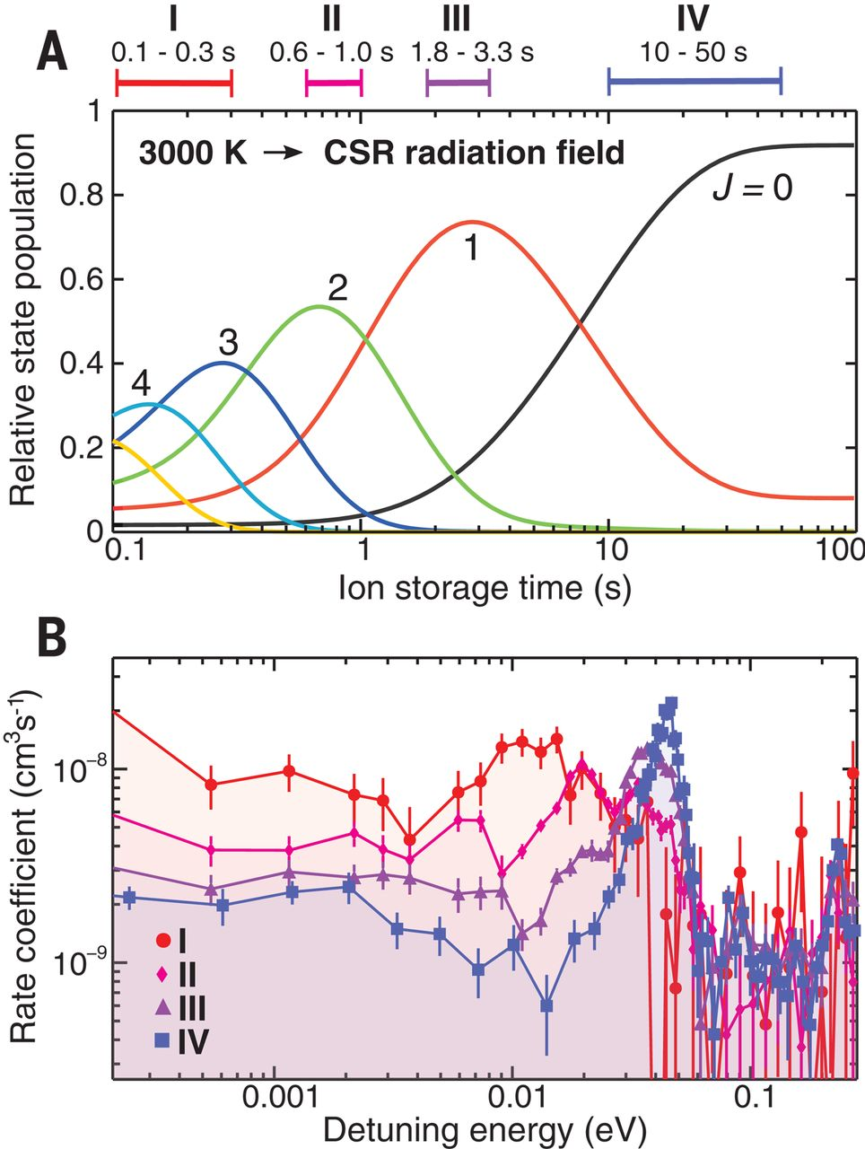
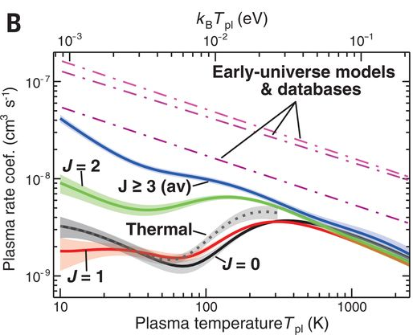
Recombination of ions in specific quantum state

Slide 6
Rekombination of H₃⁺ ions with electrons
Neutral assisted ternary recombination:
Electron assisted ternary recombination:
Formation of H₅⁺ and its subsequent recombination with electrons:
Glosík J., Dohnal P. et al., Plasma Sources Sci. Technol. 24(6), 065017, 2015

Slide 7
Stationary afterglow plasma
Combination of Stationary afterglow and absorption spectroscopy

Slide 8
Stationary afterglow plasma
AISA – Advanced Integrated Stationary Afterglow
Mass spectrometer + Langmuir probe diagnostics
Phys. Rev. Lett., 88 (4): Art. No. 044802 (4 pages), 2002.

Slide 9
Stationary afterglow plasma
Microwave diagnostics + mass spectrometry

Slide 10
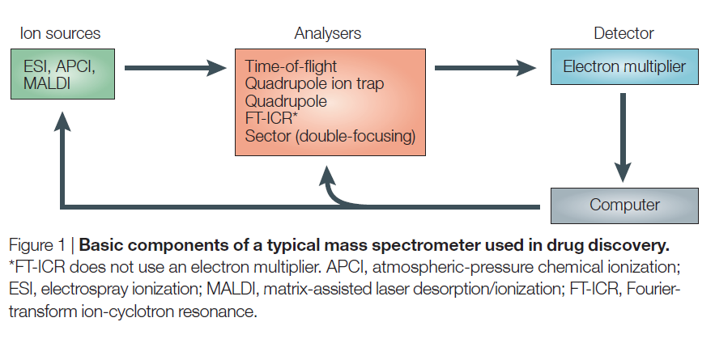
Mass spectrometry
Glish et al., Nature Reviews Drug Discovery 2, 140, 2003

Slide 11
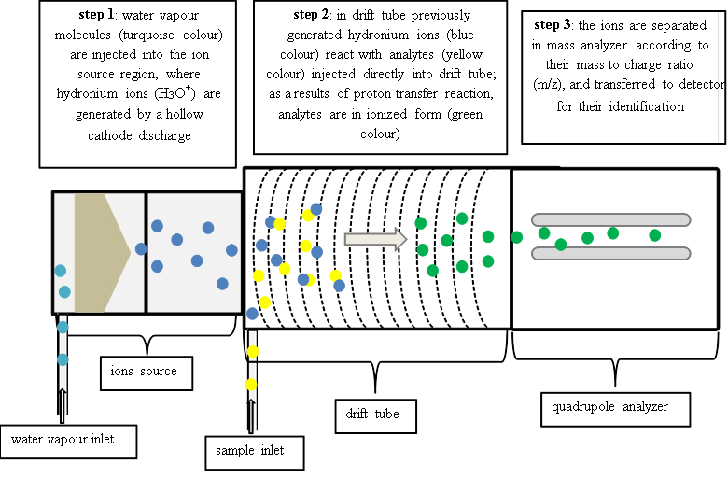

Mass spectrometry
Proton transfer mass spektrometry (PTR-MS)
Proton affinity of water is 691 KJ/mol

Slide 12
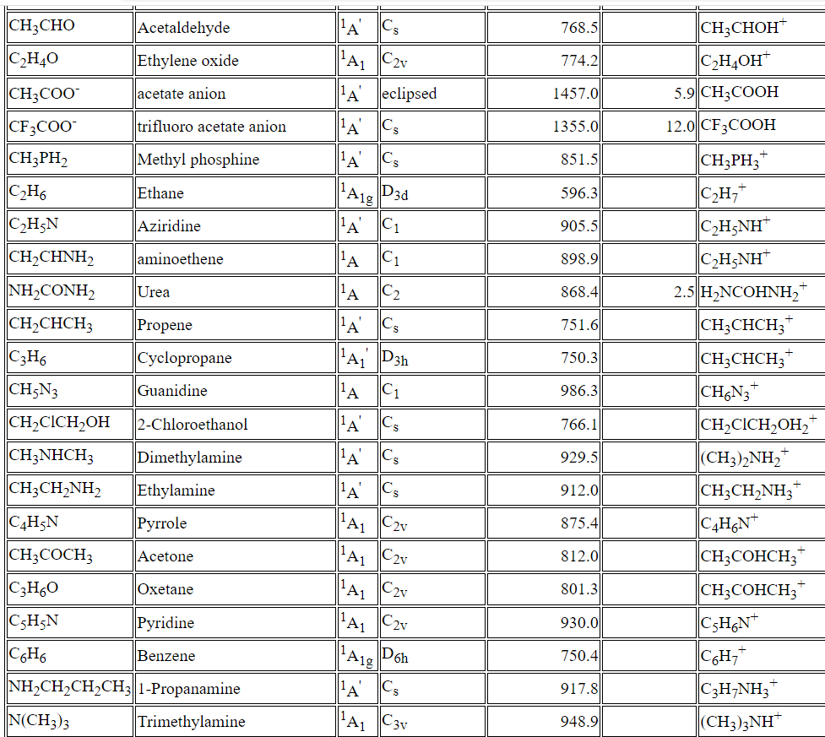
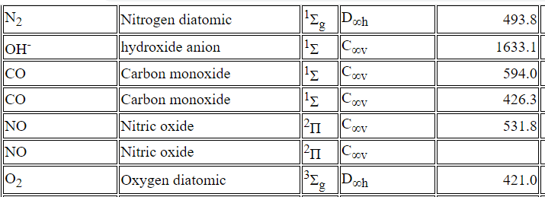
Proton affinities from NIST Chemistry Webbook
Proton affinity of water is 691 KJ/mol

Slide 13
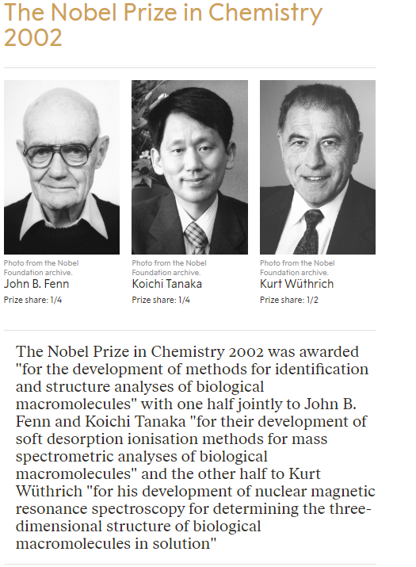
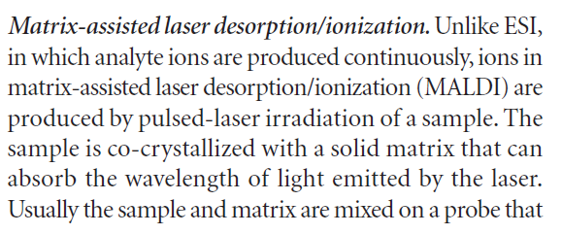
Mass spectrometry
For liquids etc:
ESI – Electron Spray Ionisation
ACPI – Atmospheric Pressure Chemical Ionisation
MALDI – Matrix Assisted Laser Desorption/Ionisation
Glish et al., Nature Reviews Drug Discovery 2, 140, 2003

Slide 14
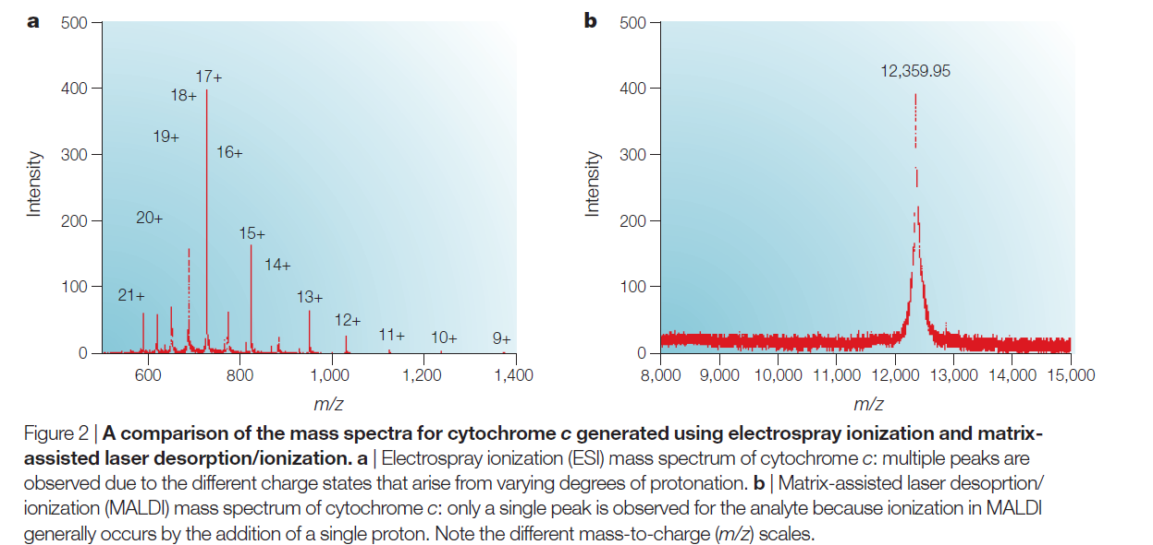
Mass spectrometry

Slide 15
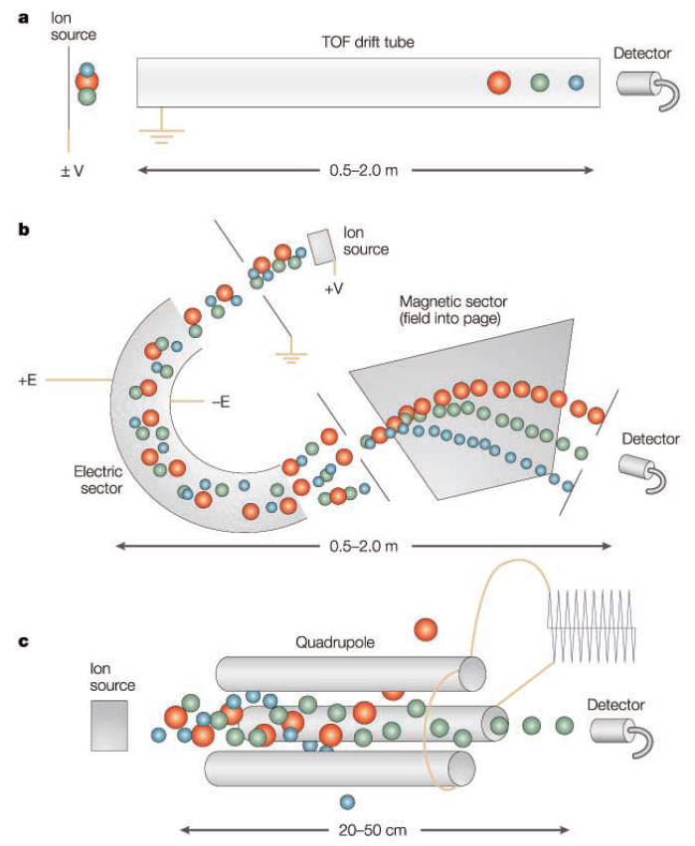
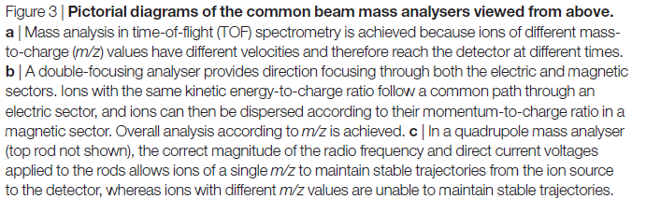
Mass spectrometry
Glish et al., Nature Reviews Drug Discovery 2, 140, 2003

Slide 16
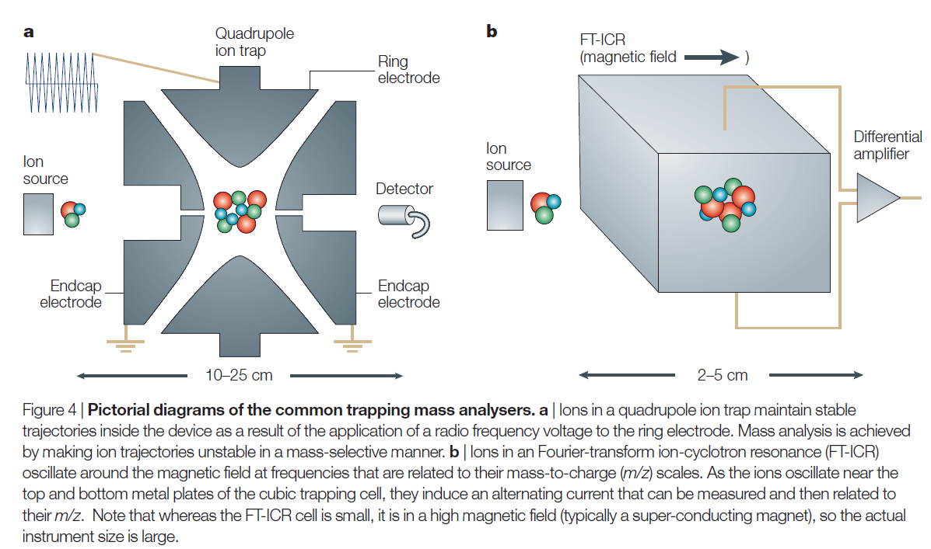
Mass spectrometry

Slide 17
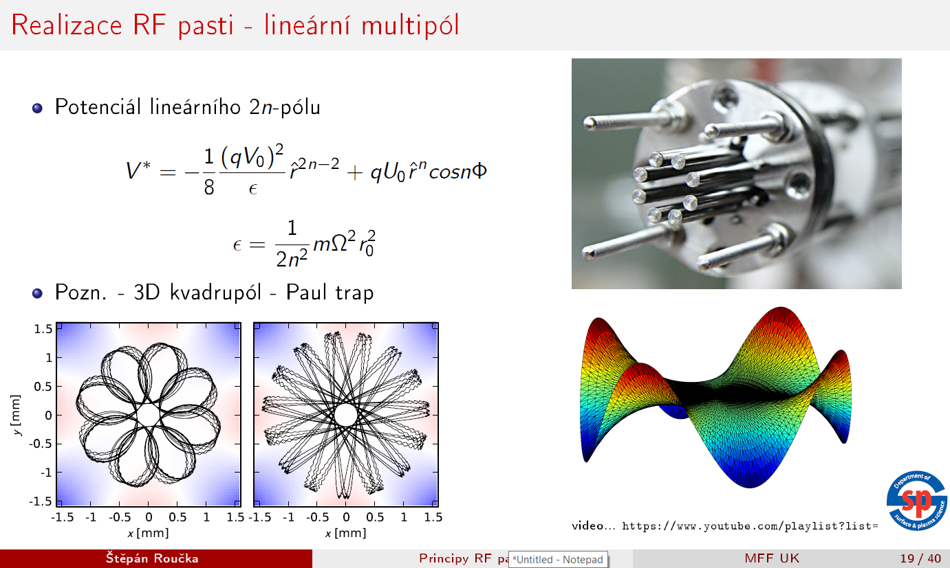

Slide 18
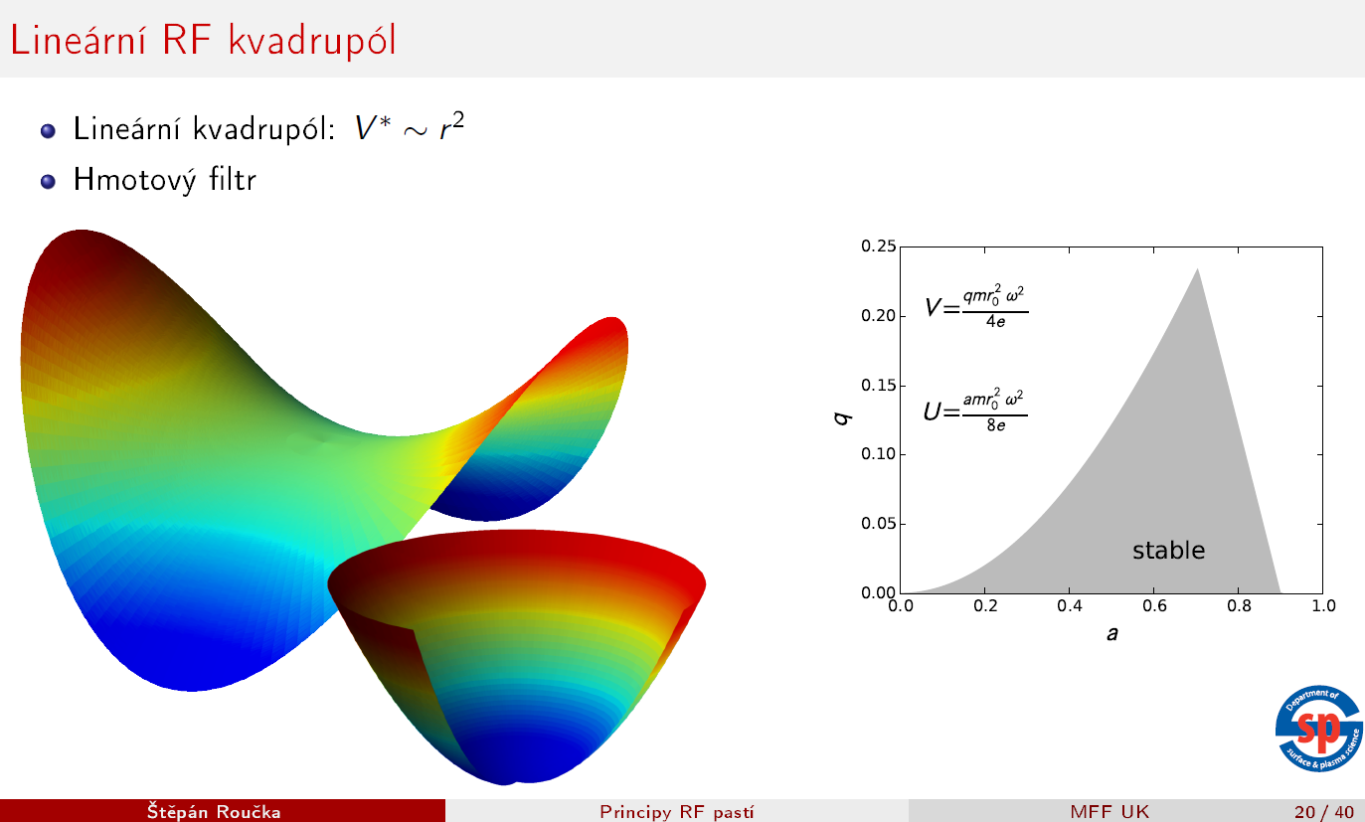
Mathieau (stability) diagram

Slide 19
Microwave diagnostics of plasma
Plasma permitivity

Slide 20


Microwave diagnostics of plasma
Collisionless plasma
$$n=\sqrt{ε_{r}μ_{r}}$$
$$ε_{r}=ε_{1}+iε_{2}$$
Real part non-zero for any non-zero ε₂ (collisions). With collisions some propagation still exists but with strong atenuation under the theoretical cut off frequency
Jan Faltýnek, Microwave diagnostics of plasma and materials, Ph.D. Dissertation

Slide 21

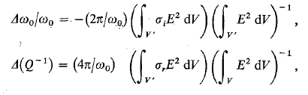

Microwave diagnostics of plasma
Plasma conductivity
Change of resonant frequency and resonator quality:
Plasma frequency

Slide 22
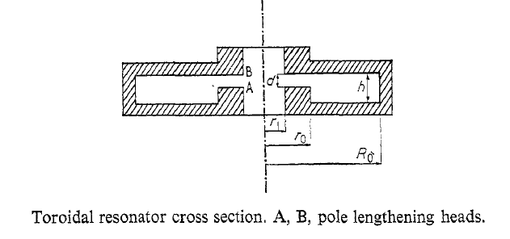
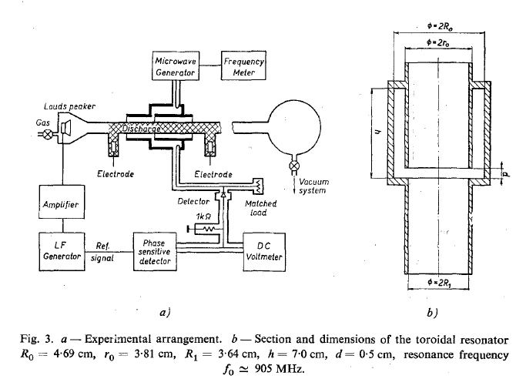
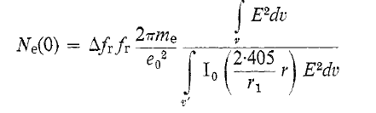
Microwave diagnostics of plasma
From the shift of resonant frequency we can get electron number density
Sicha et al., Czech. J. Phys. B 20, 684, 1970

Slide 23
Microwave diagnostics of plasma
Electron number density measurement

Slide 24
Microwave interferometry
Phase shift induced by plasma is measured
Jan Faltýnek, Microwave diagnostics of plasma and materials, Ph.D. Dissertation

Slide 25
Microwave reflectometry
Utilising reflection of microwaves to find cut off frequency

Slide 26
SA-CRDS apparatus
CRDS – Cavity Ring Down Spectroscopy
SA – Stationary Afterglow
  Discharge tube diameter– 1.5 cm
  He buffer gas flow ~ 400 – 1600 sccm
  Pressure ~ 200 – 1500 Pa
  Temperature range ~ 77 – 300 K
Highly reflective mirror

Slide 27

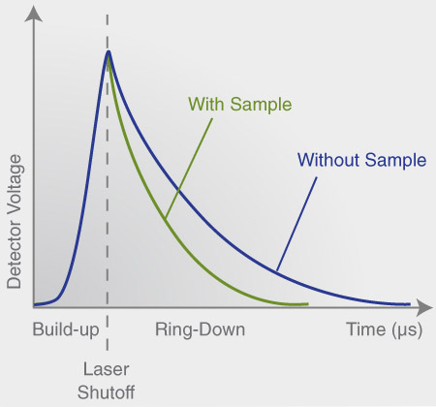
Cavity ringdown spectroscopy
First used for mirror reflectivity determination (Herbelin et al. 1980).
Later, the dependence of ring-down time on absorption between the mirrors was observed (O‘Keefe et al. 1988)
Highly reflective mirrors by Layertec (diameter 6.3 mm, reflectivity R = 99.99 %)
Herbelin et al., Appl. Opt. 19, 144, 1980.
O‘Keefe et al., Rev. Sci. Instrum. 59, 2544, 1988.

Slide 28
SA-CRDS
The time evolution of ion number density is measured (of particular quantum states)
Kinetic temperature can be determined from Doppler broadening of absorption lines
Rotational temperature is given by relative populations of rotational states

Slide 29
Cryo-SA-CRDS

Slide 30
Cryo-SA-CRDS

Slide 31
Cryo-SA-CRDS
Plašil, R; Dohnal, P; Kálosi, Á; Roučka, Š; Shapko, D; Rednyk, S; Johnsen, R; Glosík, J, Rev. Sci. Instrum., 89: 063116, 2018.

Slide 32
H₃⁺ (again)
The lowest rotational states of the vibrational ground state
Para
I = 1/2
Ortho
I = 3/2

Slide 33
Cryo-SA-CRDS
At 30 K, we can change the population of the of the lowest state of H₃⁺ from 40% to 80% of all ions. The rest of the ions are mainly in the (1,0) state.

Slide 34
Rekombination of H₃⁺ ions in specific quantum state

Slide 35
Combination of CRDS and microwave diagnostics

Slide 36
Studied ion is not dominant in plasma

Slide 37
Flowing afterglow plasma

Slide 38
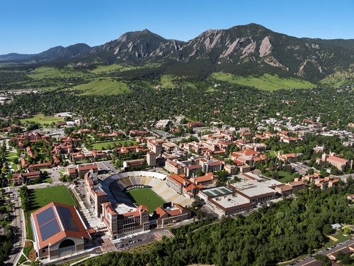
Flowing afterglow plasma

Slide 39
FALP, SIFT, SIFDT
FALP – Flowing Afterglow with Langmuir Probe
SIFT – Selective Ion Flow Tube
SIFDT – Selective Ion Flow Drift Tube

Slide 40
FALP, SIFT, SIFDT
FALP – study of electron – ion recombination
SIFT – study of ion – molecule reactions
Measurement of ion mobility

Slide 41
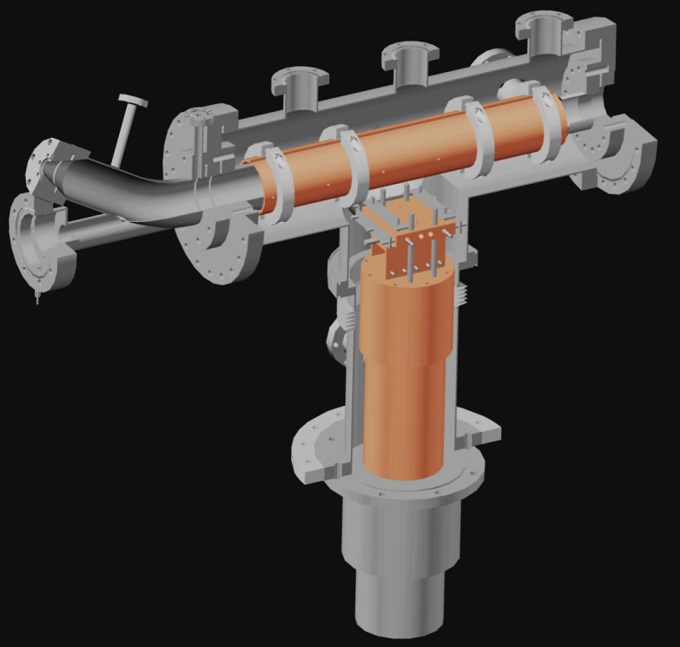
Cryo-FALP II
  Cryogenic Flowing Afterglow with Langmuir Probe
  Flowtube diameter – 5 cm
  He buffer gas flow ~ 2500– 6000 sccm
  Pressure ~ 200 – 2000 Pa
  Temperature range ~ 40 – 300 K

Slide 42
Cryo-FALP II
The evolution of electron number density along the flowtube (i.e. in time) is measured
It is possible to determine the electron energy distribution function and their temperature

Slide 43
Recombination of Ar⁺ ions with electrons, dependence on n_{e}
Kotrík T., Dohnal P., Roučka Š., Jusko P., Plašil R., Glosík J., Johnsen R., Phys. Rev. A 83, 032720, 2011.
Kotrík T., Dohnal P., Rubovič P., Plašil R., Roučka Š., Opanasiuk S., Glosík J., Eur. Phys. J.-Appl. Phys. 56, 24011, 2011.

Slide 44
Recombination of Ar⁺ ions with elekcrons, dependence on helium pressure
Dohnal P., Rubovič P., Kotrík T., Hejduk M., Plašil R., Johnsen R., Glosík J., Phys. Rev. A 87, 052716, 2013.

Slide 45
Calibration of Langmuir Probe
Rekombination of O₂⁺ ions with electrons is a well known process (many studies in last 50 years)
Three body (helium assisted) recombination is at given conditions negligible
The goal is to determine the electron number density with the best possible precision

