Slide 1
What’s wrong with globalization?: Contra ‘flow speak’ – towards an existential turn in the theory of
globalization
Heinz Bude Jörg Dürrschmidt

Slide 2
reformulation of the globalization theory
Introduction
AIM OF THE TEXT
identifying 2 major limitations in it:
“flow speak” “flattened ontology” of the social
Page no. 2

Slide 3
phenomenologically inclined repositioning of the main concepts
Introduction
SOLUTION
turn towards issues of belonging commitment rhythmicity of social relations

Slide 4
HOMECOMER
Introduction
S/he embodies the ambivalence between the lure of global options and the need for commitment to lasting bonds.

Slide 5
Why is ‘flow speak’ important?
Setting out the problem
certain arguments within globalization theory use ‘flow speak’ as a convenient short-hand for
globalization ‘problématique’

Slide 6
PARADIGMATIC SHORTCOMINGS IN ‘FLOW SPEAK’
Setting out the problem
gives “impoverished understanding of human life”
include people via ‘ethnoscapes’ they are consumers and choosers of destinations, objects, localities
exclude questions of social participation, deeper meaning of social existence
spatialization of the social and social theory
deporting from linear universal narrative
emphasis on extention/connectivity, favoring presentism
ignoring complex rhythmicity of social and temporalization of the local

Slide 7
LOST TRACK OF THE IDEA OF LIMITS
Setting out the problem
constant availability, omnipresence, all-at-onceness
distance compressed into co-presence unlimited options

Slide 8
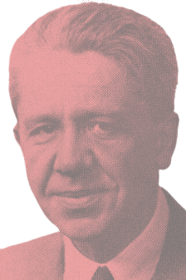
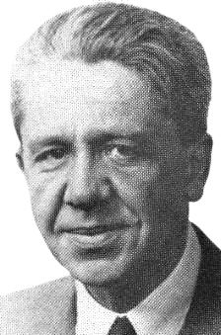
ANTHROPOLOGICAL + PHENOMENOLOGICAL SHIFT
Setting out the problem
basic provided by
Alfred Schütz

Slide 9
Setting out the problem
Concept of “RELEVANCY“ that guides ours action is driven by latent primordial awareness of moving towards death. It generates our system of hopes and fears, wants and satisfactions, chances and risks which enforce us to participate, to over-come obstacles, to
draft projects, and to realize them.
In comparison to the picking and choosing of consumer in global culture.

Slide 10
GLOBALIZATION
= GROWING MOBILITY
Logic of total mobilization
‘rapid mobility over long distance’ enabled by ‘new forms of long-distance transportation and travel’

Slide 11
AGE OF MIGRATION
Logic of total mobilization
or
AGE OF MIGRATION DREAMS?

Slide 12
Migration paradox in the age of globalization
-Düvell
Logic of total mobilization
Growing discepancy between mobility as a technical possibility and attempts at political political governance that effectively immobilize
unwanted migrants.

Slide 13
Existential dimension of migration
Logic of total mobilization
limited transferability of human and social capital
option and choice are not always enabling
language limitations
attachment to the land of origin

Slide 14
‘spatialization of social theory’
globalization is overambitious notions of deterritorialization vertical dimension horizontal dimension
The territoriality of thin relevance(s)

Slide 15
RELEVANCY OF ACTION
The territoriality of thin relevance(s)
-A. Schütz
it is the system of practical relevances that structures the spatial and social layering of the life world

Slide 16
‘relevance’
vs.
The territoriality of thin relevance(s)
‘reach’
motivational/thematic ‘relevancy’ provides limits to ‘reach’
‘flow speak’ and its emphasis on technological ease of mobility provide us with a territoriality of thin relevance

Slide 17
The territoriality of thin relevance(s)
TIME-SPACE BRIDGING CAPACITY OF SOCIAL RELATIONSHIPS
marriages/partnerships
easier to be part in each other lifes because of technology, but still is not an adequate substitute

Slide 18
DEBATE ON HOME AND BELONGING
from rutes to roots
conservative from point of view of globalization theory
reducing this debate to nostalgia
issues of ‘home, belonging’ and ‘place’ has emerged from cultural and social anthropology
Page no. 18

Slide 19
from rutes to roots
NOSTALGIA
HOMESICKNESS
Page no. 19

Slide 20
NOSTALGIA
from rutes to roots
Implies backwards-directed ‘longing for’ bygone times and situations
Page no. 20

Slide 21
from rutes to roots
HOMESICKNESS
refers to future-directed urge of belonging to a specific context with its attached commitments and responsibilities
Page no. 21

Slide 22
HOMECOMER
from rutes to roots
figure of growing up, not of backwards nostalgia
symbolizes that
a global player needs a place to rest
embodies limits of global omnipresence
prepared to entangle in networks of commitment and responsibility
Page no. 22

Slide 23
EXISTENTIAL ISSUES
Agency between opportunity and responsibility
‘global environment’ is not the ideal resting place for the fragmented self
all existential questions add up to:
HOW SHALL I LIVE?
Page no. 23

Slide 24
Agency between opportunity and responsibility
HOW SHALL I LIVE
when, structurally, I live in an open horizon of possibilities, pressured to solidify some of them into existence
Page no. 24

Slide 25
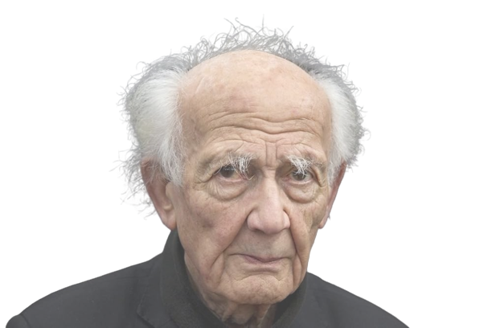
ZIGMUNT BAUMAN (1925-2017)
Agency between opportunity and responsibility
world with many choices but no clear proof that we have made the right
precious freedom turns into the less valuable need
Page no. 25

Slide 26
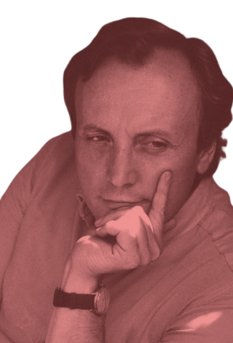
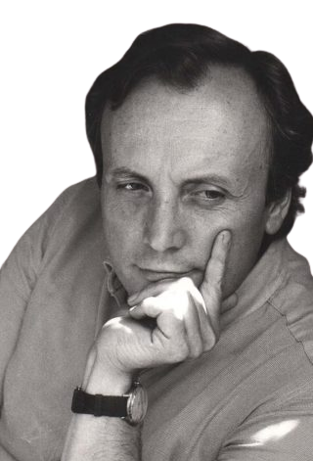
Agency between opportunity and responsibility
ALBERT MELUCCI (1943-2001)
choosing is the ultimate fate of our time
Page no. 26

Slide 27
Agency between opportunity and responsibility
it is impossible not to choose, so our range of opportunities has turned choice into an obligation or ‘new destiny of choice’
‘NOMADS OF THE PRESENT’
all this make us ‘nomads of the present’, who are aimlessly traveling the planet in search for anchors that hold
Page no. 27

Slide 28
two strategies of living
Agency between opportunity and responsibility
taking up the ‘authorship’ of actions
-> taking responsibility
escape attempts of the ‘absentee landlord’
Page no. 28

Slide 29
CONCLUSION
Conclusion
RETURNING TO ROOTS: ‘THE SOCIAL BOND’
‘RECONSTRUCTION OF THE SOCIAL BOND ON THE BASIS OF THE ACTORS’ DEMAND’
FOCUSED ON THE SOCIAL FIGURE OF THE ‘HOMECOMER’
Page no. 29

Slide 30
THANK YOU FOR YOUR ATTENTION!
Natalija Ćojbašić
Page no. 30

