Slide 1
POST-COMMUNISM
Taylar Del Brocco & Nasha Patranavik
Notes:
Nasha

Slide 2
01
DEFINITION
02
HISTORICAL CONTEXT
03
NOTABLE SCHOLARS
04
RELATED THEORIES & DISCOURSE
05
IMPLICATIONS FOR SOCIAL THEORY
06
CONCLUSION & DISCUSSION
OUTLINE
Notes:
Nasha

Slide 3
HOW IS POST-COMMUNISM DEFINED?
Study of social transformations of post-soviet states as well as the continued global transformations in the decades following the the fall of the Soviet Union. Post-communism places emphasis on the global convergence of societies under the Western neoliberal framework.
Notes:
Taylar
Postcommunist social theory is heavily concerned with post-communist transition of not only former soviet states, but the entire world order as well
Looks at the influences of change (agents, institutions, etc.) as well as the consequences of a capitalist world system with no evident alternative
Issues of path dependency - Western archetypes being the only stable framework available for transition

Slide 4
THE “HEYDAY OF HAPPY GLOBALIZATION”
Fall of the Soviet Union in 1989
Preceded by period of intense ideological dichotomy: East (communism) vs. West (capitalism)
Prevailing concept of the West “winning” the ideological war
Spread of democratization and capitalism, especially into post-Soviet states
1989-2001: “The long post-communist decade” and the “heyday of happy globalization”
Francis Fukuyama’s “The End of History and the Last Man”
Notes:
Taylar
On EU accession - process requires democratization and a convergence (or rather a transformation) into Western European values and governance

Slide 5
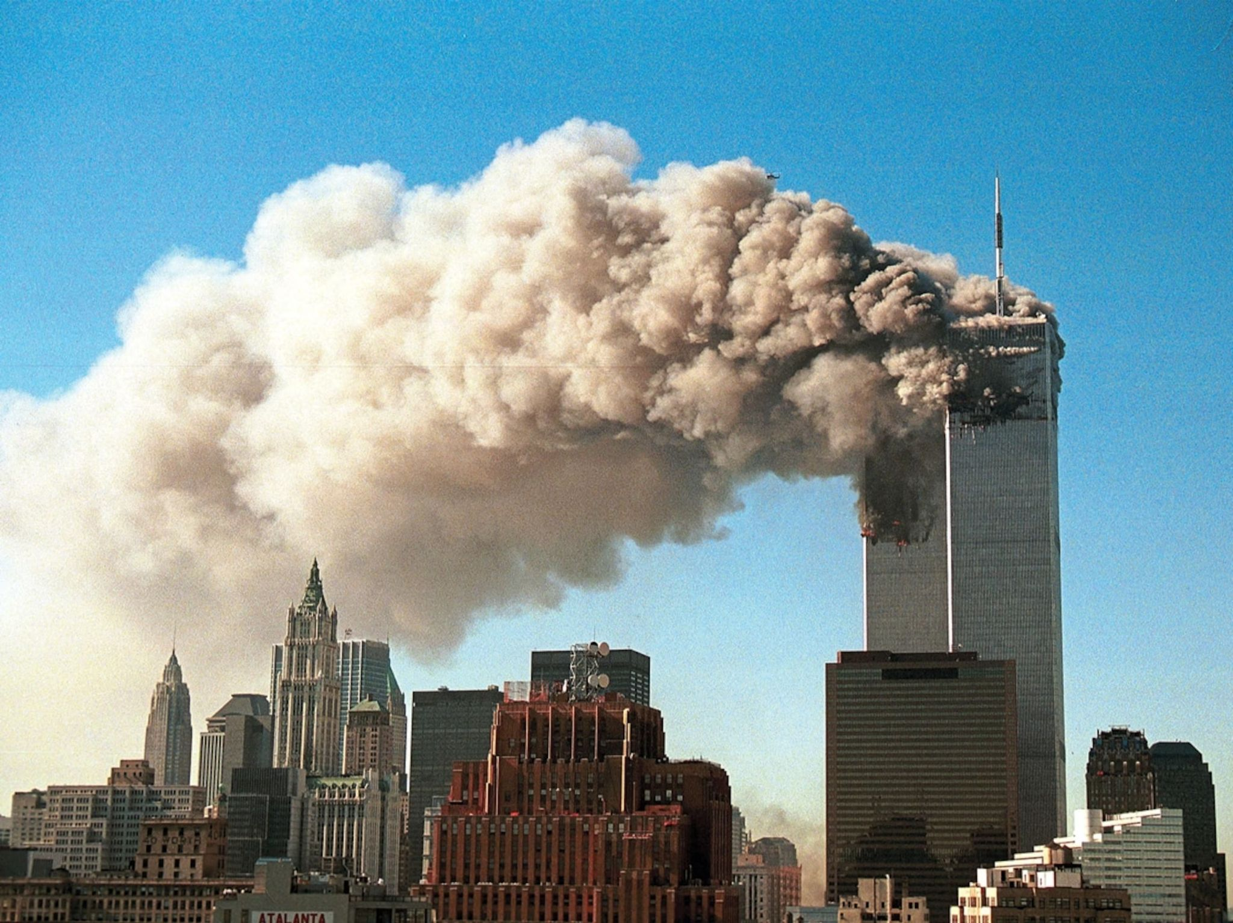
THE NEW MILLENIUM
Transition and transformation in former Soviet states
EU Accession, economic liberalization
New challenges for the converged world system
9/11 attacks and changing sentiments on rapid globalization and interconnectedness
Steady increase in protectionism, both economically in the decrease in trade liberalization and politically in the steady return of hard borders.
Emergence of identity politics - fragmentation of society along identity lines
Notes:
Taylar
On EU accession - process requires democratization and a convergence (or rather a transformation) into Western European values and governance

Slide 6
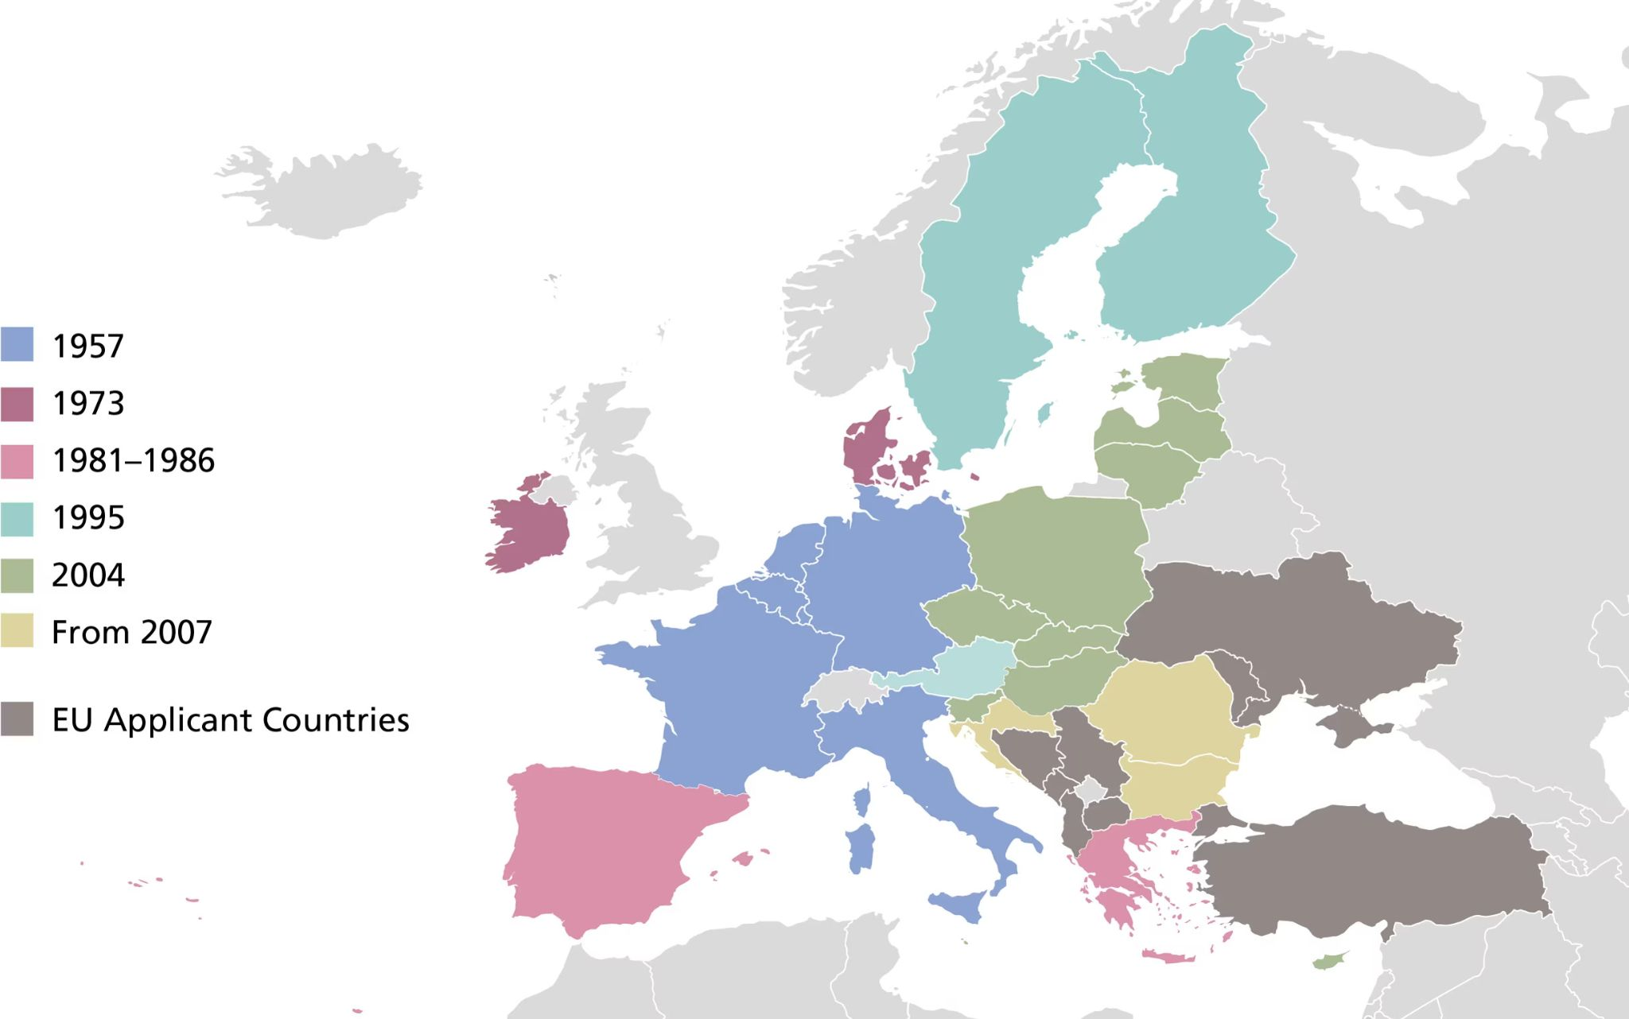
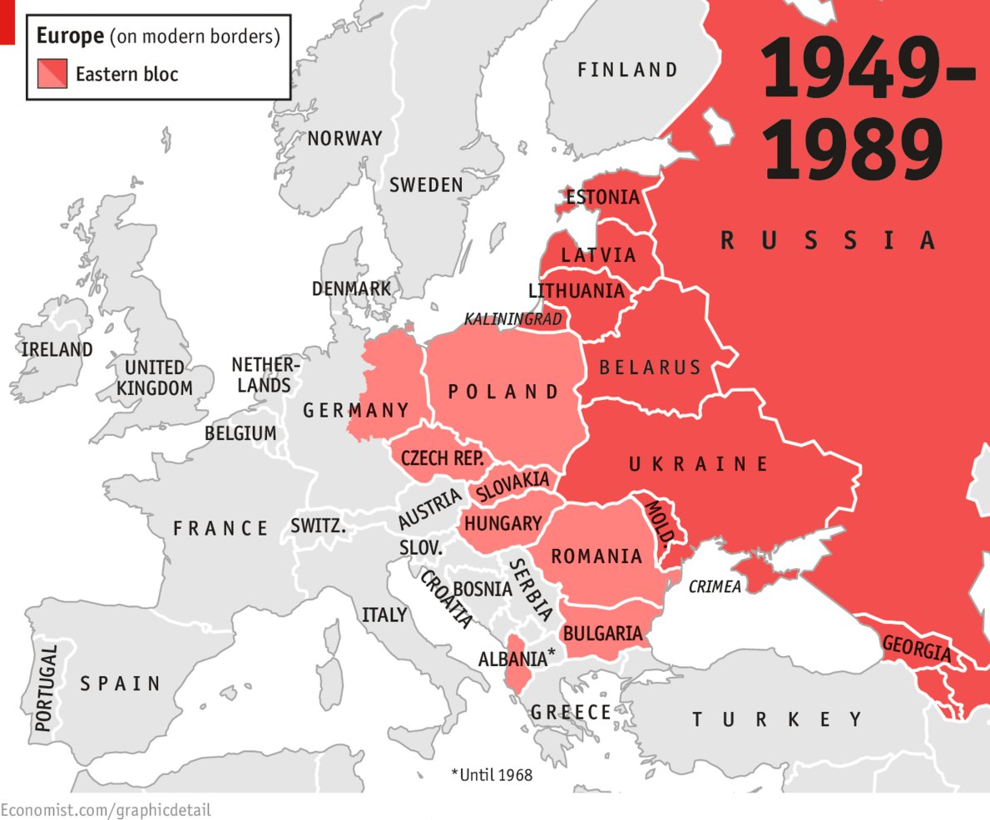
Notes:
Taylar
On EU accession - process requires democratization and a convergence (or rather a transformation) into Western European values and governance

Slide 7
CONTEMPORARY SOCIETIES IN THE POST-COMMUNIST ERA
Contemporary societies tend to share common features including:
decentralization of the state and decoupling from economics
post-welfare societies that favor identity, lifestyle, and consumption rather than redistributive policy
the erosion of the public/private boundary and transformation of class and gender relations
the erosion of scientific authority
(Outhwaite & Ray, 2008)
Notes:
Taylar

Slide 8
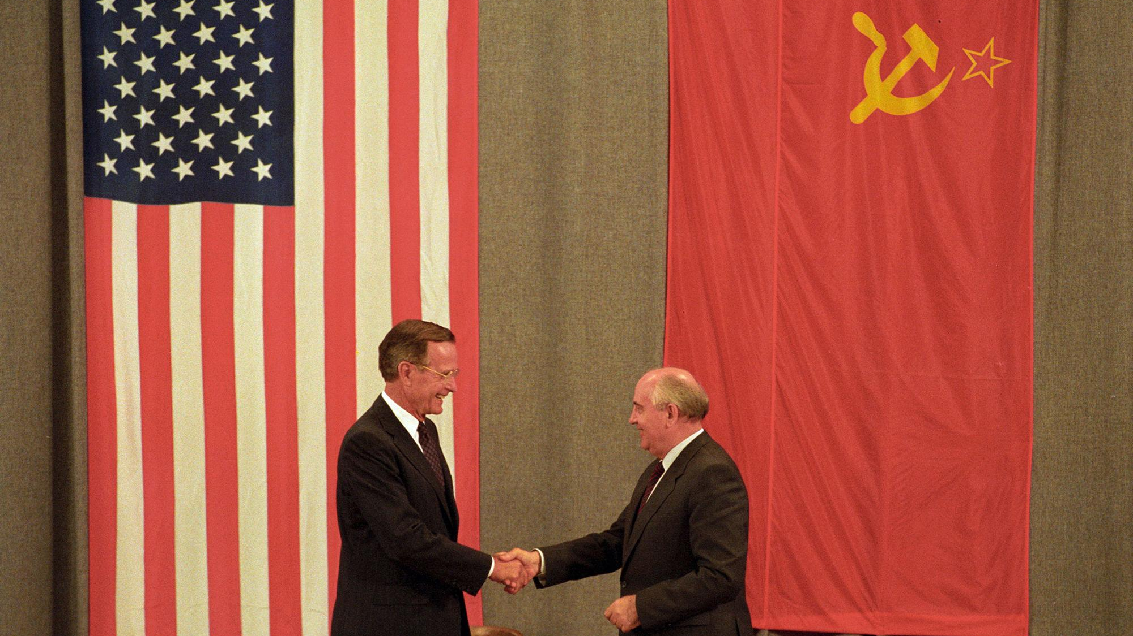
POST-COMMUNISM
IN SOCIAL THEORY
Notes:
Nasha

Slide 9
NOTABLE SCHOLARS
Paul Blokker
Influences of Western ideology on postcommunist transition studies
Larry Ray
Role of globalization and convergence under neoliberal economics in transition of postcommunist states
Notes:
Nasha

Slide 10
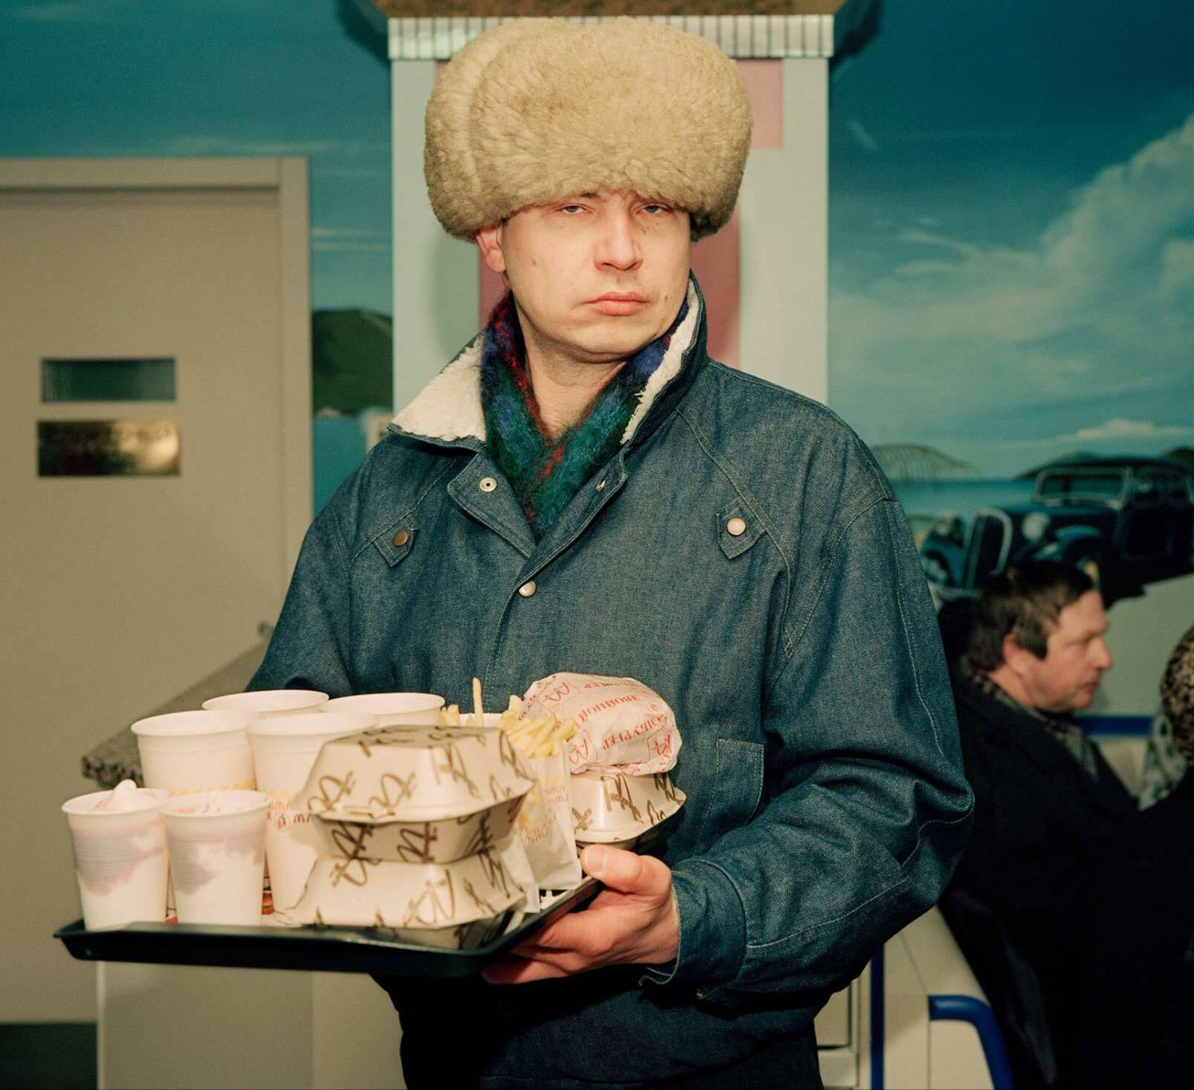
MODERNIZATION THEORY
“Transition should be regarded as a recurrent project of modernization, which implies that emancipation is at the centre of post-communist social change, i.e. emancipation from the closed order of communism, and, by the same token, consisting of a fundamental opening up of society for alternative proposals.” (Blokker, 2005)
Influenced by classical theories of Marx, Durkheim, and to some extent Weber
Concerned primarily with underdevelopment
Modernization as a permanent process - Western Europe and North America also continually modernizing
Developing countries “catching up” to the modernizing West
Soviet Union was a version of modernity that lacked essential elements for stability (e.g. substantial middle class)
Notes:
Taylar

Slide 11
POSTMODERNISM
Characterized by the rejection of “grand narratives”
Emphasis on fallibility and uncertainty of individual experiences
Opposition to modernity
Soviet model was the ultimate realization of modernity in practice
Fall of the Soviet Union was proof of the failure of modernity
Weakening of social relationships and community in contemporary society
Identity in, ideology out
Identity politics has replaced ideological divisions in postcommunist era
Notes:
Taylar

Slide 12
GLOBALIZATION & GLOBAL PROBLEMS
Post-communist convergence under Western neoliberalism
Democratization and decentralization
Free trade
Limitations of globalization
Global North vs. South: underdevelopment, poverty, and migration
Democratic transitions and democratic backsliding
Criticisms of path dependency in post-Soviet transitions
Heterogeneity in democratic consolidation processes among post-Soviet states
Notes:
Taylar

Slide 13
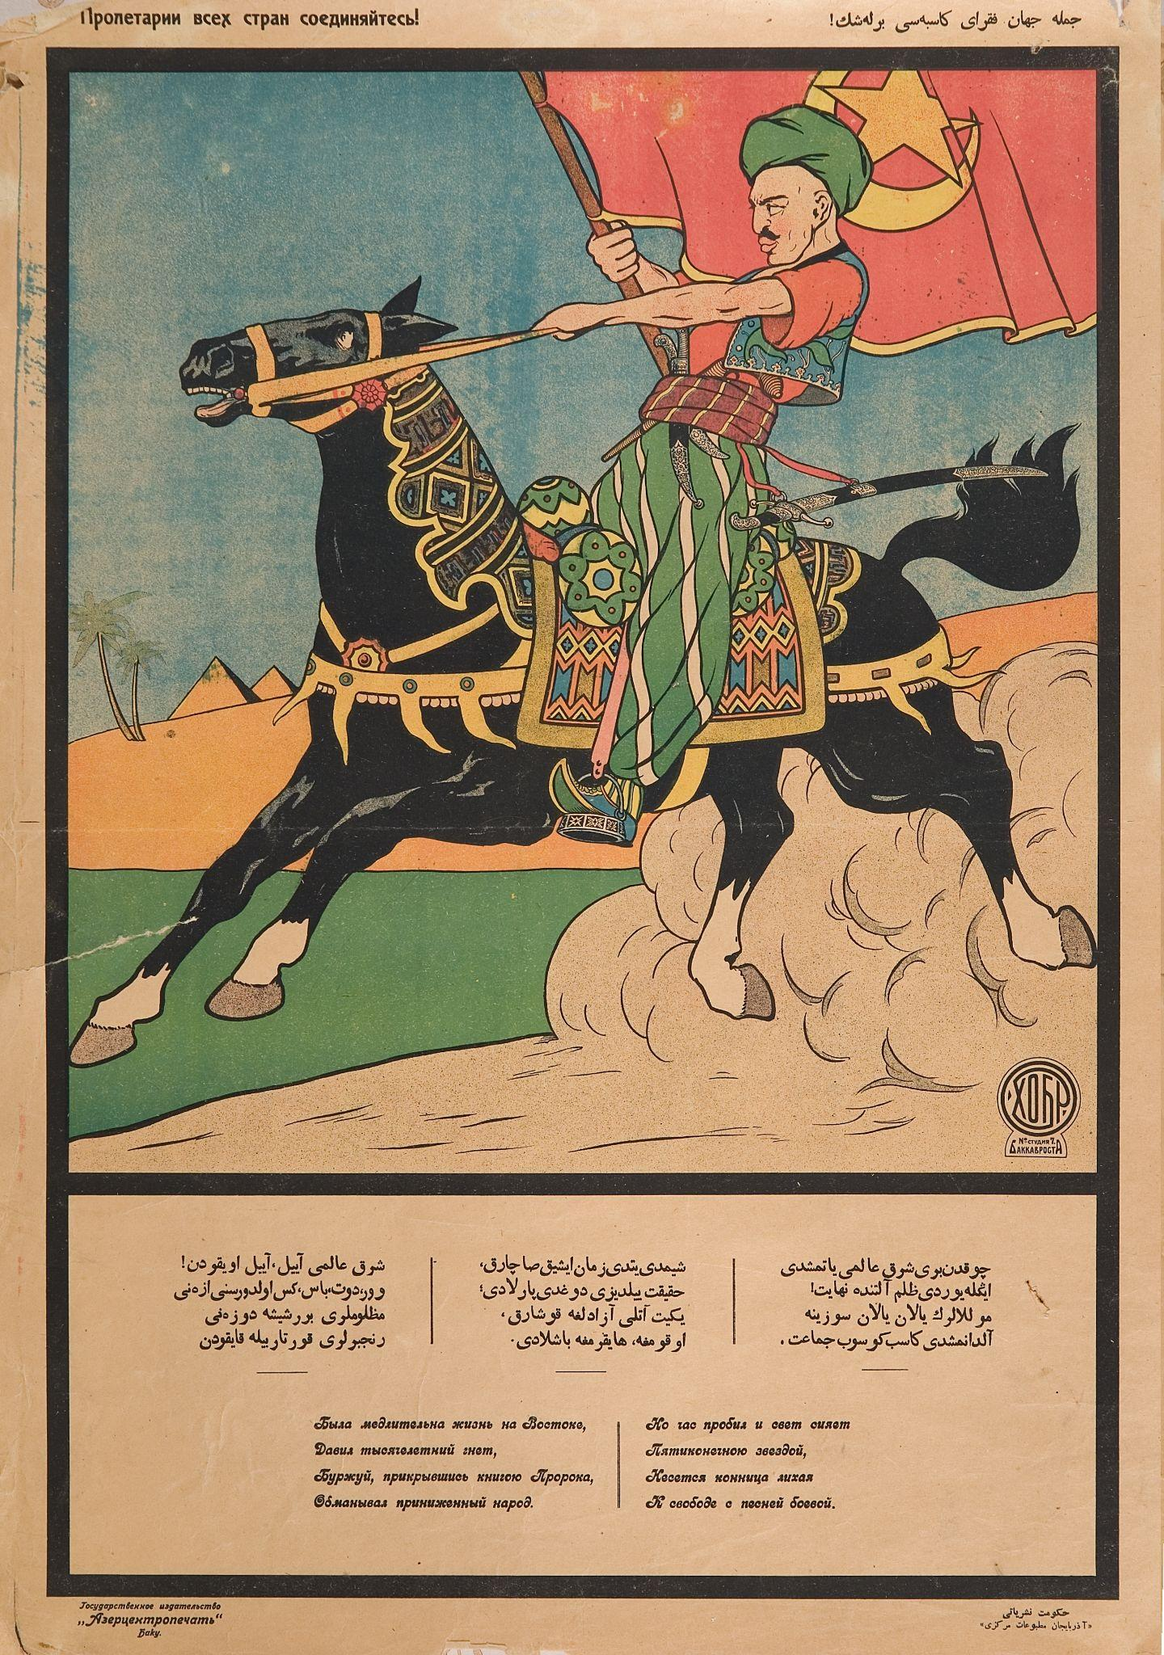
POST-COMMUNISM IN CENTRAL ASIA
Transitologist School holds that all the post-communist cases have been in a process of ‘transition’ from communism to democracy or some sort of democracy (Bingol, 2010)
Although in Central Asia, it was the revival of nationalism, not of democracy (Western idea)
Trade-offs between nationalism and democracy; as nationalism develops the likelihood of democracy diminishes
Economic hardship in the post-Soviet era has set aside concerns over identity, fostering a shared experience among different ethnic groups
Notes:
Nasha

Slide 14
POST-COMMUNISM IN EAST ASIA: CHINA
“A communist society is a socioeconomic order structured upon the common ownership of the means of production and the absence of social classes, money, and the state.” (Kurian and Boryczka, 2010)
China: no longer strictly under communist ideologies
Still governed by the Chinese Communist Party (CCP) since 1949
The economic reforms initiated by Deng Xiaoping in the late 20th century bring China through economic growth and development.
Political system remains communist but the economic structure has shifted toward a socialist market economy
Notes:
Nasha

Slide 15
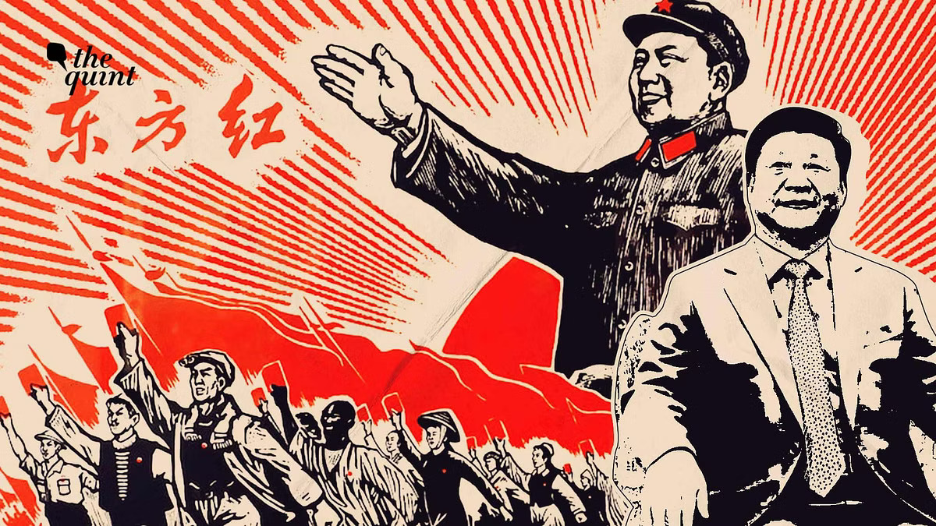
POST-COMMUNISM IN EAST ASIA: CHINA
In contrast to the eventual collapse of communist power structures , China made a major institutional innovation by introducing the market economy under communist rule
Problems faced were different
States under the Soviet Union: gave up all the socialism elements and embrace capitalism
China: still conceptualise the change in terms of socialism
CCP employed nationalism to strengthen its legitimacy and maintain social cohesion
Similar to Central Asia, it was the revival of nationalism
foreign policy has become more assertive to secure China's interests on the global stage → advance economic development
Notes:
Nasha

Slide 16
IMPLICATIONS FOR SOCIAL THEORY
“Sociology needs a renewed comparative grasp of specific processes and their local effects rather than over-generalized concepts such as global civil society, cosmopolitan democracy, liquid modernity, or second modernity.” (Outhwaite & Ray, 2008)
Sociology and social theory have been dominated by Western intellectual paradigm
Assessments of social transformations largely framed within the experiences of North America and Western Europe
Post-communism studies tend to be overly Eurocentric: does not typically include analysis of Central Asian or East Asian relationship with communism or their post-communist transitions
Differentiation in transformative experiences between East and West
Notes:
Taylar

Slide 17
Has communism remained a defeated alternative to capitalism?
Can democracy and capitalism be mutually exclusive or is one dependent on the other?
Can you identify any differences between Eastern and Western sentiments on communism today?
QUESTIONS FOR DISCUSSION:
Notes:
Taylar & Nasha

Slide 18
REFERENCES
Bingol, Y. (2004). Nationalism and democracy in post‐communist Central Asia. Asian Ethnicity, 5(1), 43–60. https://doi.org/10.1080/1463136032000168899
Blokker, P. (2005). Post-Communist Modernization, Transition Studies, and Diversity in Europe. European Journal of Social Theory, 8(4), 503–525. https://doi.org/10.1177/1368431005059703
Kollmorgen, R. (2013). Theories of Postcommunist Transformation. Approaches, Debates, and Problems of Theory Building in the Second Decade of Research. Studies of Transition States and Societies, 5, 88–105.
Lánczi, A. (2007). What Is Postcommunism? Society and Economy, 29(1), 65–85.
Melichar, B. (2017). Karl Marx versus Max Weber: The Forefathers’ Heritage As a Social History Constant. Prager Wirtschafts- Und Sozialhistorische Mitteilungen - Prague Economic and Social History Papers, 2016, 24, 2, 87-97. https://dspace.cuni.cz/handle/20.500.11956/96806
Outhwaite, W., & Ray, L. (2008). Social Theory and Postcommunism. John Wiley & Sons.
Ray, L. (2009). At the End of the Post-Communist Transformation? Normalization or Imagining Utopia? European Journal of Social Theory, 12(3), 321–336. https://doi.org/10.1177/1368431009337349
Roland, G. (2018). The evolution of post-communist systems. Economics of Transition, 26(4), 589–614. https://doi.org/10.1111/ecot.12164
Wang, X. (2002). The Post-Communist Personality: The Spectre of China’s Capitalist Market Reforms. The China Journal, 47, 1–17. https://doi.org/10.2307/3182071

