Slide 1
Civil Society
Presented by Idar O. Vallersnes
Faculty of Social Sciences
Charles University
21st November, 2023

Slide 2
Agenda
What is civil society?
Conceptual confusion
A typology over Civil Society Organisations
Civil society and democracy
Civil Society in Norway
Talking points
References

Slide 3
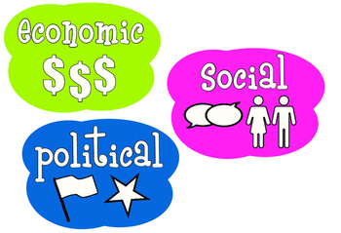
What is civil society?
Dense network of groups, communities, networks, and ties that stand between the individual and the modern state.
–Britannica
History of the concept

Slide 4
Conceptual confusion

Slide 5
A typology over Civil Society Organisations
Common cause
Shared voice
Research-oriented
Commercially oriented

Slide 6
Civil society and democracy
The right of association
Overthrow of communism
Mediating space
Neoliberal revolution, «disaster capitalism»

Slide 7
Civil society in Norway
Diversity
Political orientation
Organisational structure

Slide 8
Talking points
Is a strong, independent civil society necessary for a healthy democracy?
How is the civil society in your country?

Slide 9
References
Bourdieu, P. (2000). A Literature From Below. The Nation 271(1), 25. https://link-gale-com.ezproxy.uio.no/apps/doc/A62858890/AONE?u=oslo&sid=bookmark-AONE&xid=05ab0e3a
Britannica, T. Editors of Encyclopaedia (2023, September 26). Velvet Revolution. Encyclopedia Britannica. https://www.britannica.com/topic/Velvet-Revolution
Kenny, M. (2023, November 3). civil society. Encyclopedia Britannica. https://www.britannica.com/topic/civil-society
Powell, F. (2008). Civil Society, Social Policy and Participatory Democracy: Past, Present and Future. Social Policy & Society 8(1), 49-58. https://doi.org/10.1017/S1474746408004570
Rainey, S., Wakunuma, K. & Stahl, B. Civil Society Organisations in Research: A Literature-Based Typology. Voluntas 28(5), 1988-2010. https://doi.org/10.1007/s11266-016-9816-y
Sivesind, K. H. & Selle, P. Det sivile samfunn i Norge. Stat & Styring 18(3), 30-31. https://doi-org.ezproxy.uio.no/10.18261/ISSN0809-750X-2008-03-12

