Slide 1
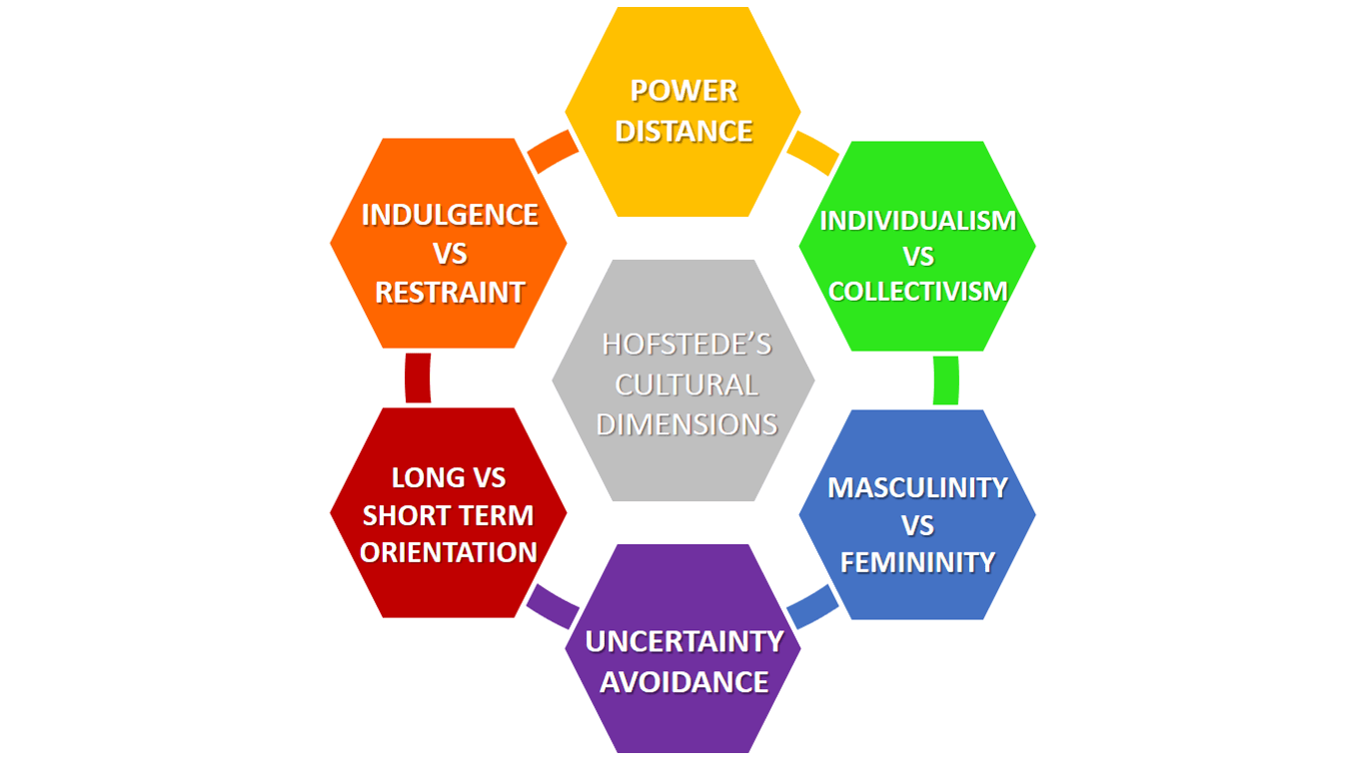
Six dimensions of national culture

Slide 2
Power distance index (PDI)
beliefs about the appropriate distribution of power in society
High PDI – stark hierarchies, less powerful are taught to “know their place” and respect authority
Low PDI – individuals expect more democratic and more counseling power relations

Slide 3
PDI in marketing
people belonging to high power distance index cultures tend to prefer products that provide them with certain social status and allow highlighting this status or prestige (status symbols, celebrities)
in low PDI, the main role is played by the actual consumption parameters of the products, their ability to appeal to all customers at once and to fulfill the widest range of goals

Slide 4
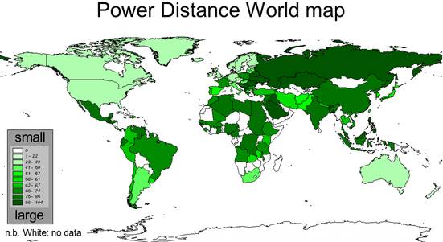
GEERT HOFSTEDE – cultural dimensions
Power Distance Index, PDI

Slide 5
Individualism (IDV)
focuses on the degree the society reinforces individual or collective, achievement and interpersonal relationships
a society’s position on this dimension depends on whether people’s self-image is defined in terms of “I” or “we.”
weak interpersonal connection among those who are not part of a core "family." x people are supposed to be loyal to the group to which they belong, the group itself is normally larger, and people take responsibility for one another's well-being.

Slide 6
IND in marketing
For countries with high individualism, it is recommended to target customers by emphasizing how the company’s products will benefit them. Appealing to individual freedom, saving time and personal rewards would be very effective.
For low individualism markets, marketers are advised to market to the whole community and explain which benefits the community might get if its members buy a company‟s products.

Slide 7
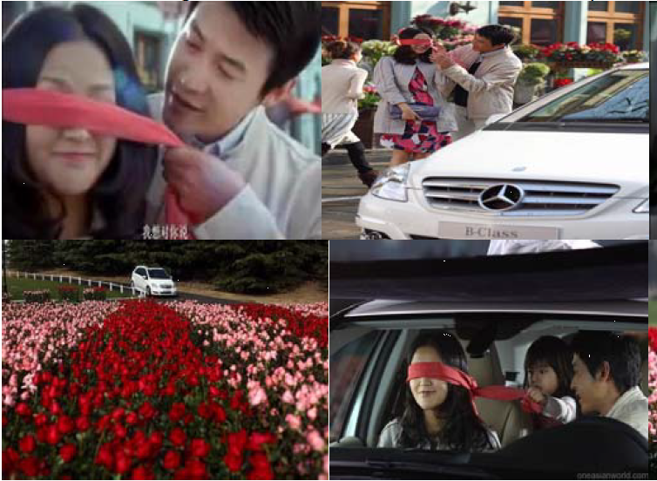
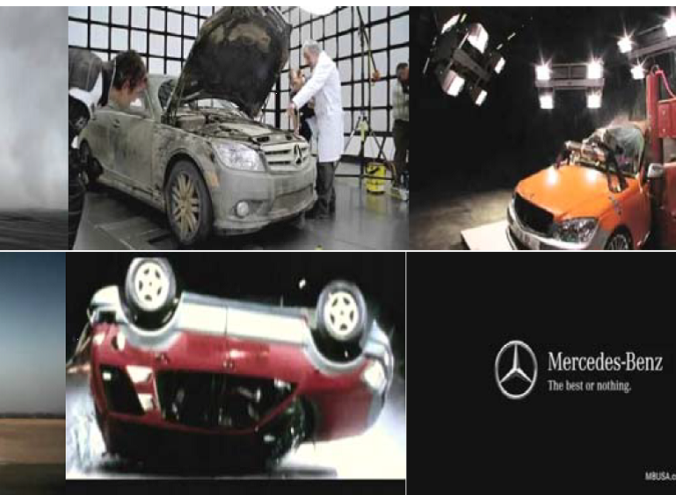
Individualistic vs. Collectivist cultures

Slide 8
Masculinity (MAS)
role delineation prevalent in masculine cultures and less prevalent in feminine cultures
when we talk about masculine or feminine cultures, we’re not talking about diversity issues. It’s about how a society views traits that are considered masculine or feminine.
A high MAS ranking - achievement, heroism, money, assertiveness and material rewards for success, showing off possessions; competition
A low MAS ranking – cooperation, modesty, caring for the weak and quality of life; consensus

Slide 9
MAS in business environment
High MAS:
Strong egos – feelings of pride and importance are attributed to status.
Money and achievement are important.
Low MAS:
Relationship oriented/consensual.
More focus on quality of life.

Slide 10
MAS in marketing
MAS – interactive, dynamic marketing, succes, achievement (status brands), competition
FEM – colaboration, benefits of society, quality of social life, esthetic pleasure
Prestigious x caring positioning
Products for men x women x family, gender-oriented promotion

Slide 11
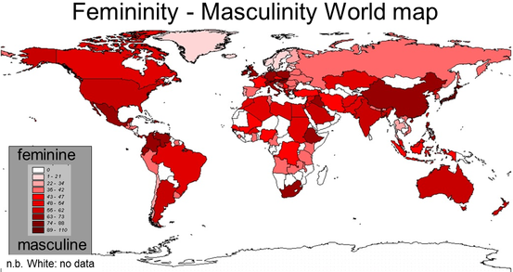
GEERT HOFSTEDE – cultural dimensions
Masculinity, MAS

Slide 12
Uncertainty Avoidance (UAI)
focuses on the level of tolerance for uncertainty and ambiguity within the society
High UAI - rule-oriented society, trust in experts
Low UAI - less rule-oriented, accept changes

Slide 13
UAI in marketing
it is recommended, in cultures with high uncertainty avoidance, to spell clearly product characteristics with guaranteed advantages and specific features.
Cultures with low uncertainty avoidance prefer lifestyle promotions, generalizations about the company‘s products, suggested benefits and references to change.

Slide 14
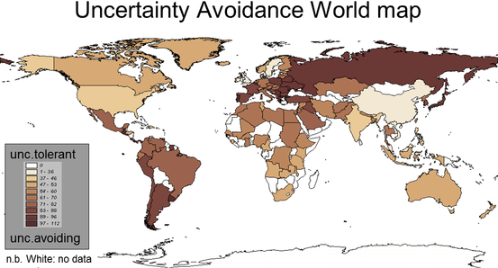
GEERT HOFSTEDE – cultural dimensions
Uncertainty Avoidance , UAI

Slide 15
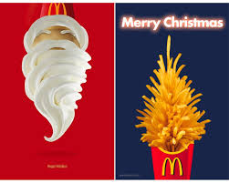
INTERKULTURNÍ MARKETING

Slide 16
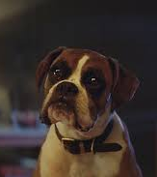
Velká Británie
Vánoční reklamy John Lewis
“I can’t quite put my finger on it, but in 2011 after ‘The Long Wait,’ something definitely changed, (…) Before that there was a lot of celebrity glitz and glamour at Christmas, but it wasn’t such a big deal. ‘The Long Wait,’ with its simple story, captured the public imagination. It didn’t sell people anything other than the notion of Christmas and thoughtful gifting.” (Richard Brim Adam&eveDDB)
“It’s a part of popular culture in a way that every brand strives to be,”
“Captivating and effective, without any follow up ads selling turkey crowns or prawn rings (2 for £10.99). Now it’s a yearly race to be the most emotional and meaningful brand of the year. It’s taken on a life of its own.”
https://www.youtube.com/watch?v=DShEAPKV0EU (Elton John, 2018)
https://www.youtube.com/watch?v=IBtHj0674Is (Long wait, 2011)

Slide 17
John Lewis adverts are so well-liked that they have teaser trailers and 'release dates', like theatrical blockbusters. The pre-release hype for this year's advert was so strong that The Sun created a 2000-word webpage to answer fans' questions. People were so anxious to see what John Lewis would come up with this year that they mistook the work of a student for the real thing.
With this amount of excitement, it's reached the point where John Lewis shouldn't really have to pay to air their adverts on TV any more. The TV channels should be paying them.
2014's John Lewis Christmas advert--the classic #MontythePenguin--reached 16.3 million online views just four days after its launch. Compare that to the same year's X Factor viewership (9.1 million) and it's a wonder Simon Cowell didn't cancel the show and take up work as a lovelorn arctic seabird.

Slide 18
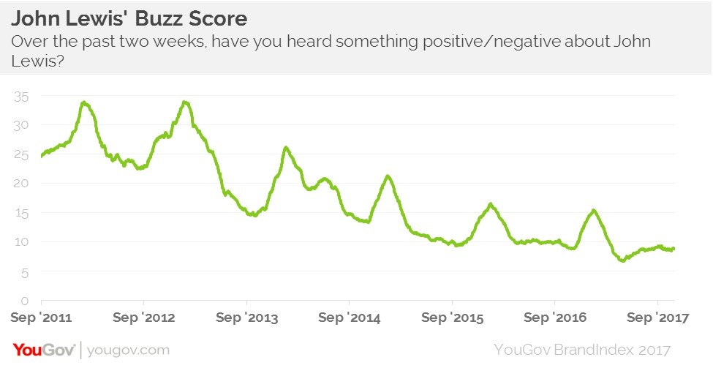
Velká Británe

Slide 19
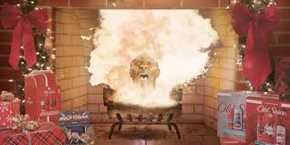
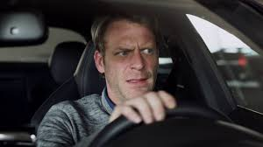
USA
Old spices (2018)
Audi (2018)
https://www.youtube.com/watch?v=A0aJfz_tQME
https://www.youtube.com/watch?v=zUaAHLa8O3M

Slide 20
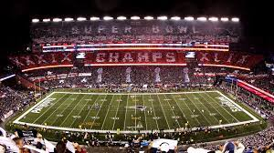
Velká Británie vs USA
Thanksgiving
Boxing Day
SuperBowl
https://www.youtube.com/watch?v=1TgqEjOz9zs

Slide 21
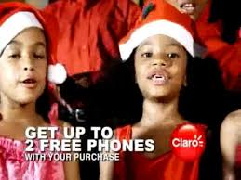
Jamajka
https://www.youtube.com/watch?v=ntJBsHDQlgI

Slide 22
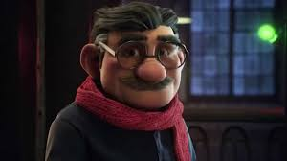
Španělsko
22. 12. – 6. 1.
Reklama není o Vánocích takovou tradicí jako v některých jiných zemích. Dvě značky dělají velké kampaně, o kterých se mluví, ale nejsou tak očekávané jako například ve VB – Christmass National Lottery a Freixenet Champagne
https://www.youtube.com/watch?v=aB8s6Ulp6PE
https://www.youtube.com/watch?v=aB8s6Ulp6PE

Slide 23
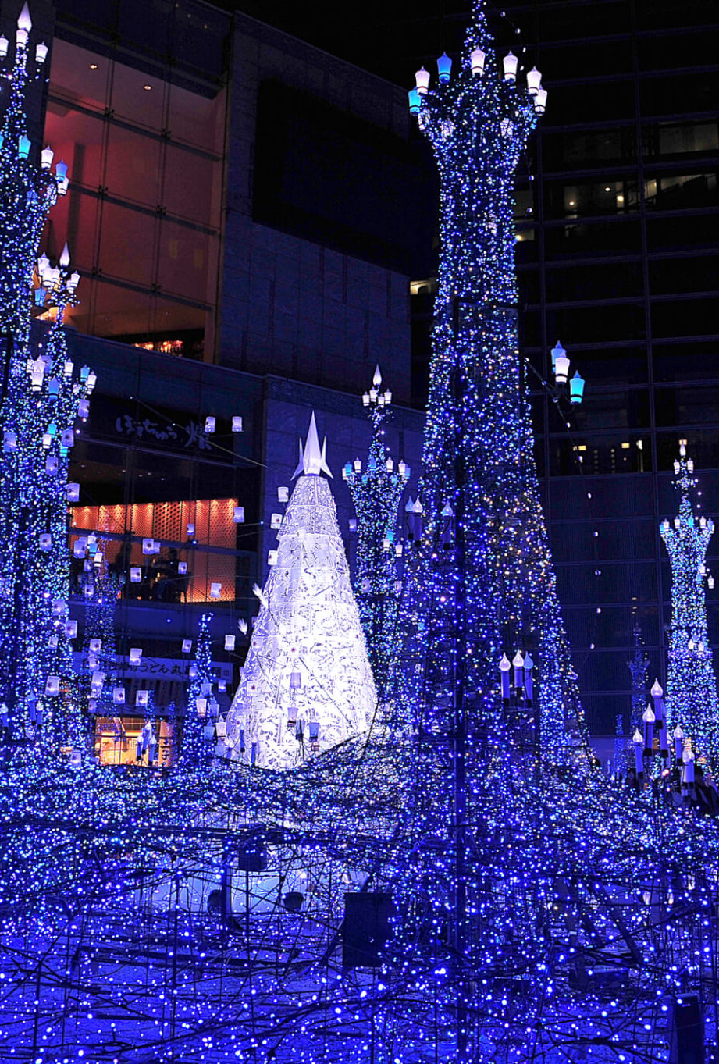
Japonsko
inspirace západní kulturou
nejsou oficiálními svátky (jen 1 % japonské populace jsou křesťané)
komerční úspěch Vánoc je obrovský, utrácejí zejména mladé páry, které si vyměňují dárky a večeří v den Vánoc venku.
Coca-Cola dominantní se svou vánoční kampaní
KFC – rituál, “fried chicken barrels to eat home on Christmas night”

Slide 24
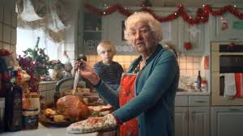
Tesco
Tesco - We know that everyone’s Christmas is unique
různé způsoby, jak lidé slaví vánoce
“However you do Christmas” (2018) – kampaň se snaží rozpoutat národní debatu o tradičních rozdílech, které jsou charakteristické pro toto období roku
https://www.youtube.com/watch?v=UFEcBc_9t9E

Slide 25
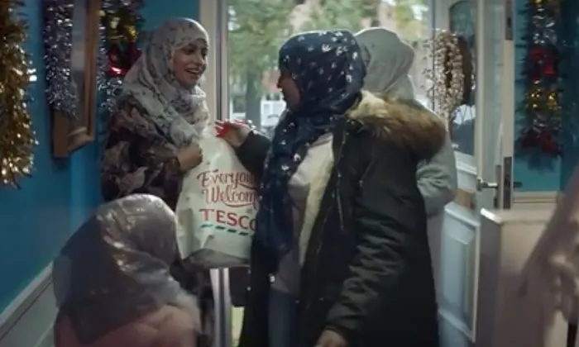
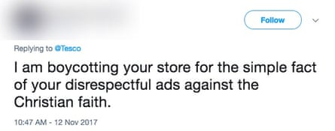
Tesco
2017 – zobrazení muslimské rodiny (hrozby bojkotem)

Slide 26
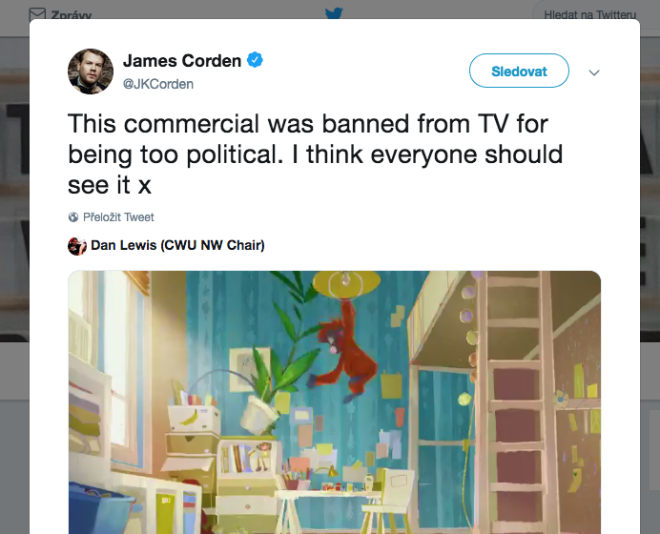
Kontroverzní vánoční reklamy
Iceland 2018 – palmový olej
https://www.youtube.com/watch?v=JdpspllWI2o

Slide 27
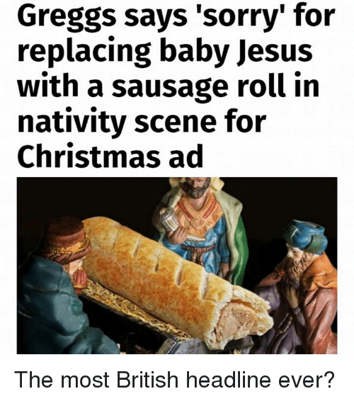
Kontroverzní vánoční reklamy
Greggs 2017

Slide 28
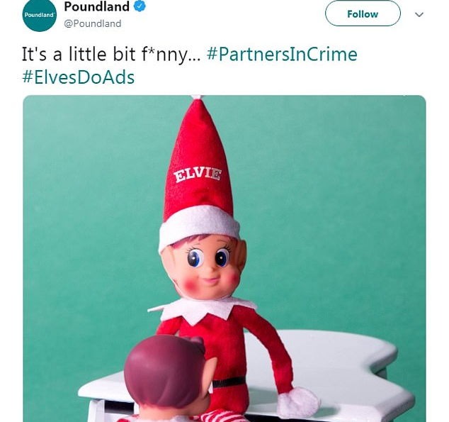
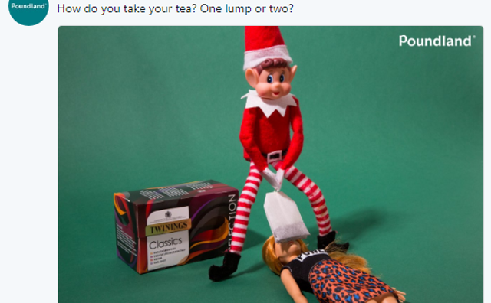
Kontroverzní vánoční reklamy
Poundland 2017

Slide 29
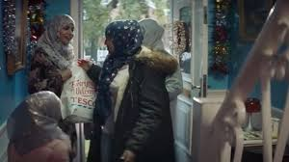

Kontroverzní vánoční reklamy
Sainsbury 2016 – nejlepším dárkem, který můžete dát, je vaše přítomnost o vánocích x zaměstnanci pracují celé svátky
Sainsbury 2014 – vánoční příměří
https://www.youtube.com/watch?v=NWF2JBb1bvM

Slide 30
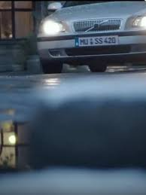
Kontroverzní vánoční reklamy
Edeka – Německo, 2016
https://www.youtube.com/watch?v=jjFtbNq9svw

Slide 31
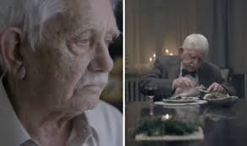
Kontroverzní vánoční reklamy
Edeka – Německo, 2015
https://www.youtube.com/watch?v=Dxfcp2D8hmM

Slide 32


