Slide 1
Depression
Nowadays
Social media
Mental health

Slide 2
Obrázek č. 1

Slide 3
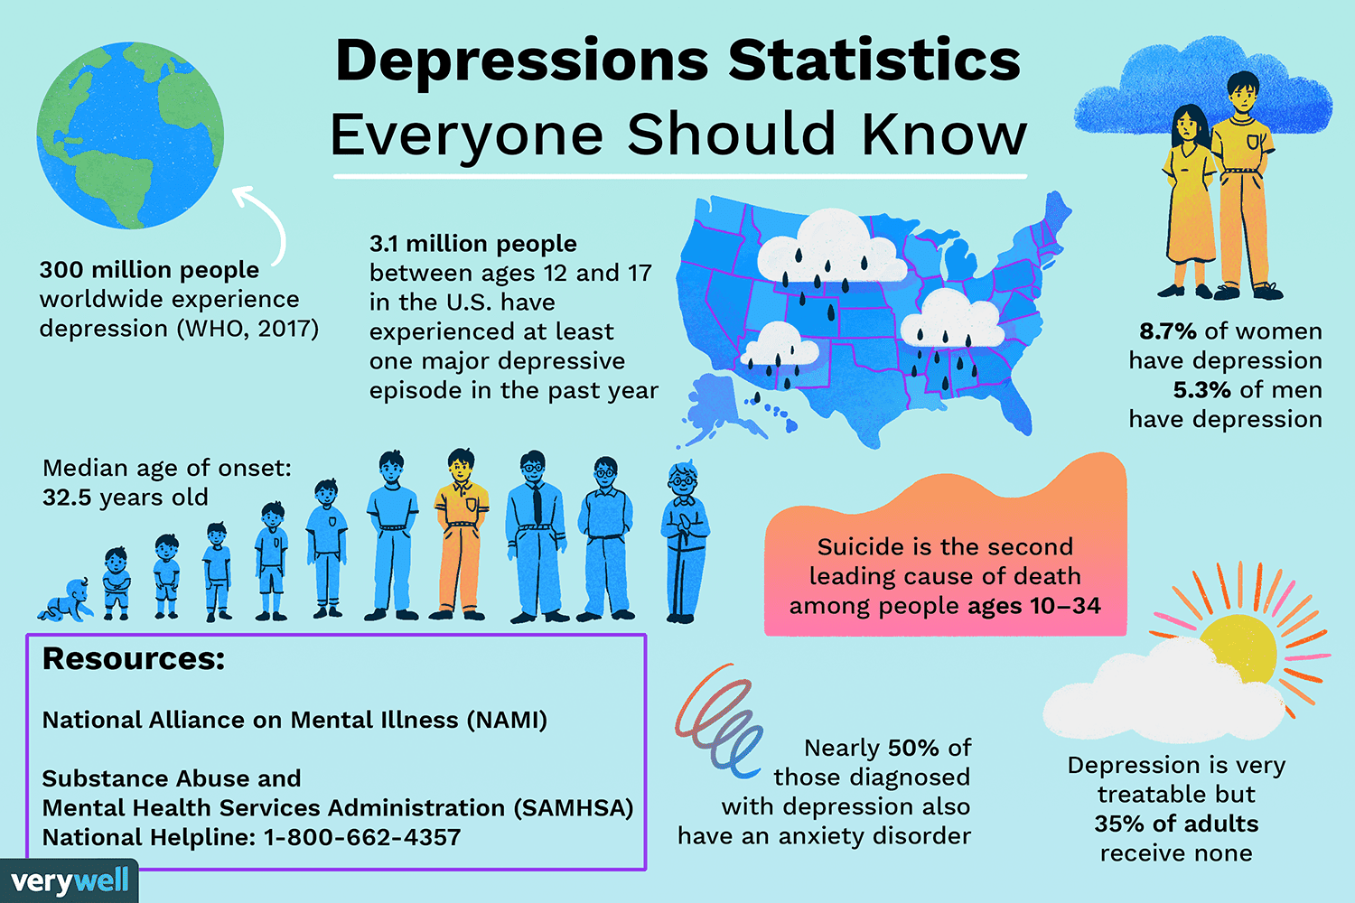
Obrázek č. 2

Slide 4
Social media
- minuses ☹
Standards of beauty, life standards
everyone looks happy, everyone is living their dreams, everyone looks beautiful and skinny
Social sites have negative influence on our mental health also because of all the colours, notifications
- pluses ☺
Contacts, useful info to read about/follow, useful tips and advice what to do in anxiety/depression, apps focused on mental health

Slide 5
Good and useful accounts to follow on social networks
Why is useful going to therapy?
(good tip what to follow on IG for your mental health @drjulie)
Video č. 1

Slide 6
What is depression?

Slide 7
Worst things to say | Things to say instead of it
„It is all in your head.“ | „Don‘t worry, it‘s okay to feel sad.“
„I know how you feel.“ | „Would you like to talk about it? I can be your company for these hard times.“
„Man up!“ | „It‘s okay that men cry too, you are only human.“
„We all have bad days now and then.“ | „Is there anything I can do?“
„You don‘t have a reason to be depressed. Others have it worse than you.“ | „I am here for you and you matter to me.“
„Just think positive.“ | „You don‘t have to be happy all the time. It‘s not even possible.“
„You are lazy.“ | „It‘s okay if everything what you did today is that you woke up.“

Slide 8
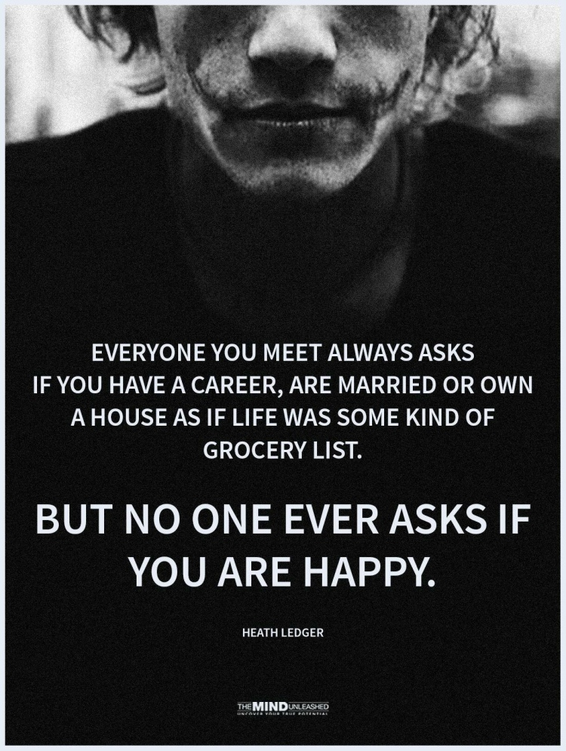
Obrázek č. 3

Slide 9
help
Insurance company – psychological help for free
Czech Republic
Linka první psychické pomoci – 116 123
Linka bezpečí – 116 111
Nevypusť duši, Nepanikař – App Store

Slide 10
citace
Videa
Video č. 1
Psychologist [online]. [cit. 2023-11-09]. Dostupné z: https://www.instagram.com/drjulie/
Obrázky
Obrázek č. 1
Atticus citát. Pinterest [online]. [cit. 2023-11-09]. Dostupné z: https://cz.pinterest.com/pin/850969292062485235/
Obrázek č. 2
Statistics about depression. Very well mind [online]. [cit. 2023-11-09]. Dostupné z: https://www.verywellmind.com/depression-statistics-everyone-should-know-4159056
Obrázek č. 3
Heath Ledger citát [online]. [cit. 2023-11-09]. Dostupné z: https://amommasview.wordpress.com/tag/heath-ledger/

