Slide 1
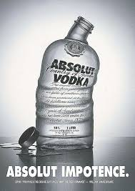
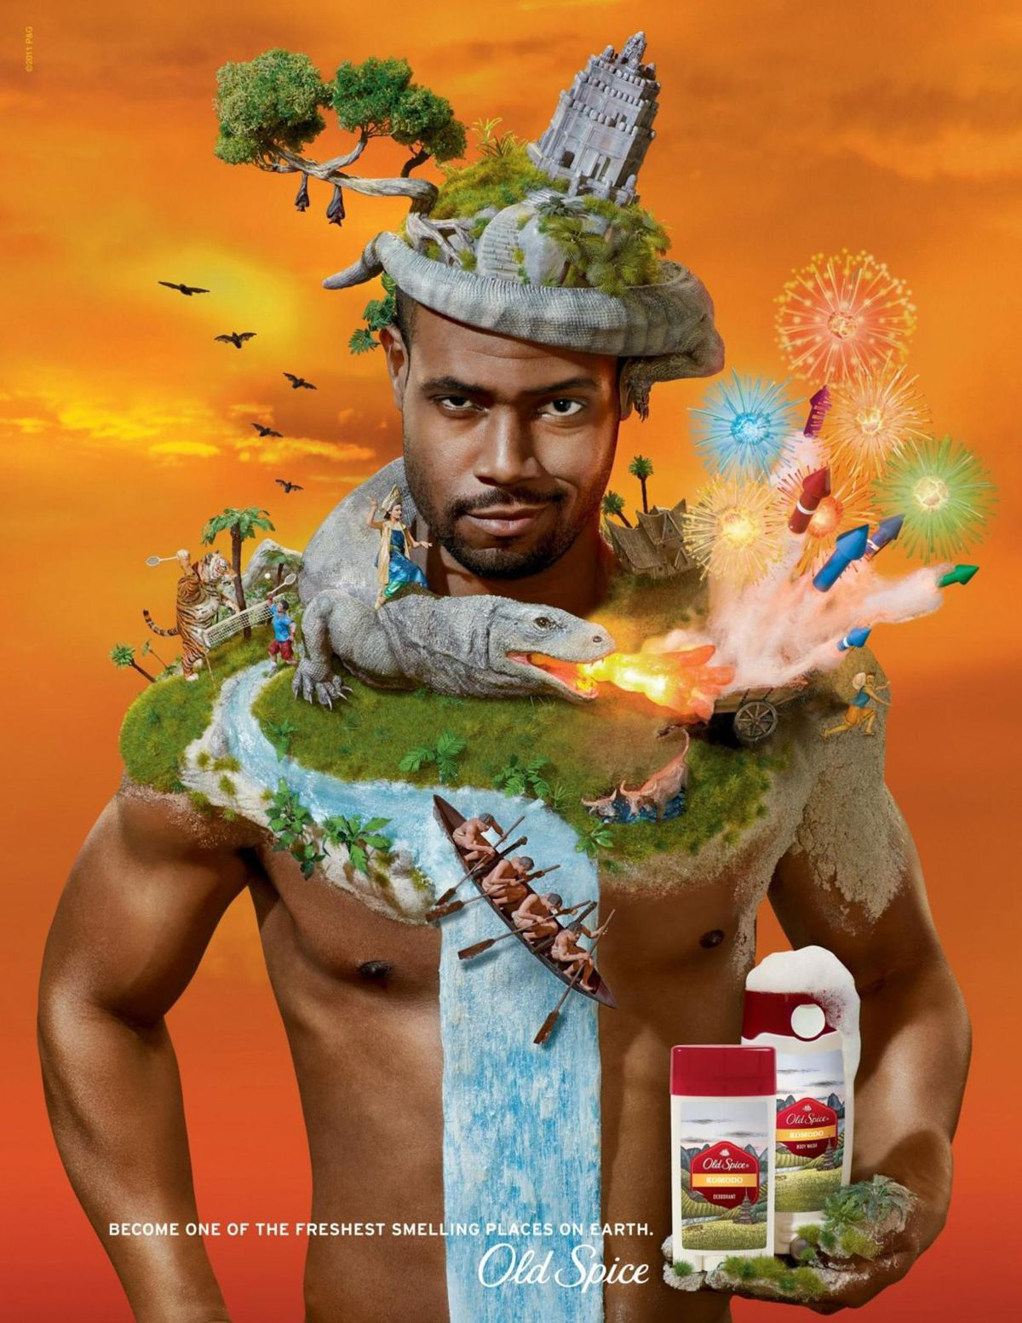
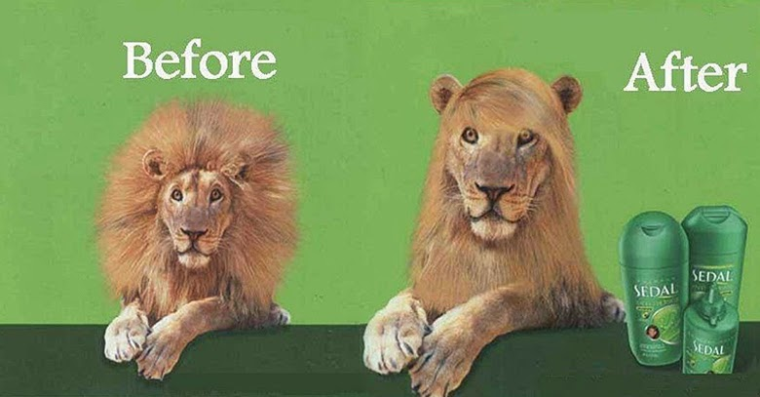

Slide 2
cultural aspects of humor

Slide 3
cultural aspects of humor
humor is one of the most commonly used emotional appeals in advertising (Beard 2005)
humorous advertising is used extensively throughout the world. However, like in every aspect of international advertising, the standardization/adaption-question arises.
Humor is a universal human activity that most people experience many times over the course of a typical day and in all sorts of social contexts. At the same time, there are obviously important cultural influences on the way humor is used and the situations that are considered appropriate for laughter (Martin, Ford, 2018)

Slide 4
Humor in history
the term derives from the humoral medicine of the ancient Greeks; the balance of fluids in the human body, known as humours (Latin: humor, "body fluid"), controlled human health and emotion
the word humor was not used in its current sense of funniness until the 18th century and so traditional discussions were about laughter or comedy
1900 – Laughter (Henri Bergson) – first book by a notable philosopher on humor

Slide 5
Humor definition
Humor is . . . all pervasive; we don't know of any culture where people don't have a sense of humor, and in contemporary societies, it is found everywhere – in film, on television, in books and newspapers, in our conversations, and in graffiti. Joking behavior has even been observed in primates (Fry 1987).
The faculty of observing what is ludicrous or amusing or of expressing it; jocose imagination or treatment of a subject (Oxford English Dictionary).

Slide 6
Three theories of humor
Superiority theory of humor (disparagement) - theory articulating the view of laughter that started in Plato and the Bible and dominated Western thinking about laughter for two millennia. In the 20th century, this idea was called the Superiority Theory. Our laughter expresses feelings of superiority over other people or over a former state of ourselves. In this theory, humor is seen as a negative phenomenon.
Relief Theory of Humor - laughter results when psychological tension is reduced. Homeostatic (Arousal-safety) mechanism from release of nervous energy or hysteria (overcoming sociocultural inhibitions, revealing suppressed desires, barely escaping danger) – Spencer, Freud

Slide 7
Three theories of humor
Incongruity Theory of Humor (Cognitive stimulus) - it is the perception of something incongruous—something that violates our mental patterns and expectations. This approach was taken by James Beattie, Immanuel Kant, Arthur Schopenhauer, Søren Kierkegaard. It is now the dominant theory of humor in philosophy and psychology.
https://www.youtube.com/watch?v=ysSgG5V-R3U

Slide 8
Does humor sells?
The basic question is not whether the humor in marketing is effective, but rather when and under what conditions or for what types of products it should be used.

Slide 9
Effectivity of humor in advertising
humor in advertising helps primarily to attract the attention (BUT humorous message should coincide with ad objectives, be well-integrated with those objectives, and should be viewed as appropriate for the product category)
humor is a successful tool especially for products, services and events that can be somehow associated with pleasure or joy.
humor can also affect the period of time that consumers remember ads -> enhance recall, brand evaluation (Marc C. Weinberger and Charles S. Gulas, 1992)

Slide 10
Effectivity of humor in advertising
humor suppresses negative responses to advertising messages
BUT can reduce the credibility of an advertising message
vampire effect - occurs when the consumer’s attention is sucked away, by one factor or another, from the most crucial piece of the ad – the brand itself.

Slide 11
Effectivity of humor in advertising
The success of humorous advertising is significantly influenced by:
Type of humor
Product category
Audience

Slide 12
Types of humor
irony, sarcasm, pun, satire, absurdity, parody, slapstick; sexual or black humor
choice has to be done with regard to the target group
very effective is humor, which does not cause the recipient to laugh, yet entertains him and brings a smile to his face. In this case, the recipient is more open to the advertising message and receives it

Slide 13
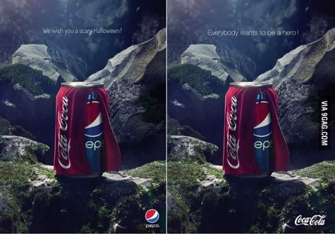
Types of humor
Irony - a type of usually humorous expression in which you say the opposite of what you intend
https://www.youtube.com/watch?time_continue=16&v=8goDVjYr5g4

Slide 14
Types of humor
Puns – tied with language
Satire - criticizes and condemns negative social phenomena, human qualities or relationships through humor, irony, exaggeration, and derision.

Slide 15
Types of humor
Black humor finds comic in situations that are not comic in themselves. Their context is usually serious, most often unfortunate, tragic or sad situations. The use of humor in such cases then helps relieve the accumulated stress
https://www.youtube.com/watch?v=UYGUaUSEiHE
https://www.youtube.com/watch?v=x98vIn9QwKs

Slide 16
Types of humor
Erotic humor - another risky type that often encounters negative responses. Linking humor and eroticism can be a very powerful tool, as both techniques are guaranteed ways to attract customer attention. However, as well as humor, eroticism in advertising should also relate in some way to the promoted product

Slide 17
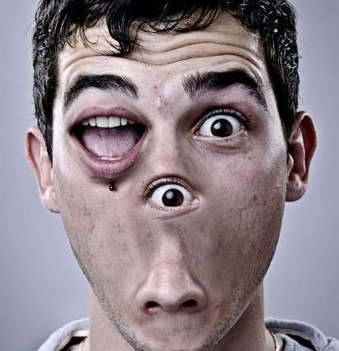
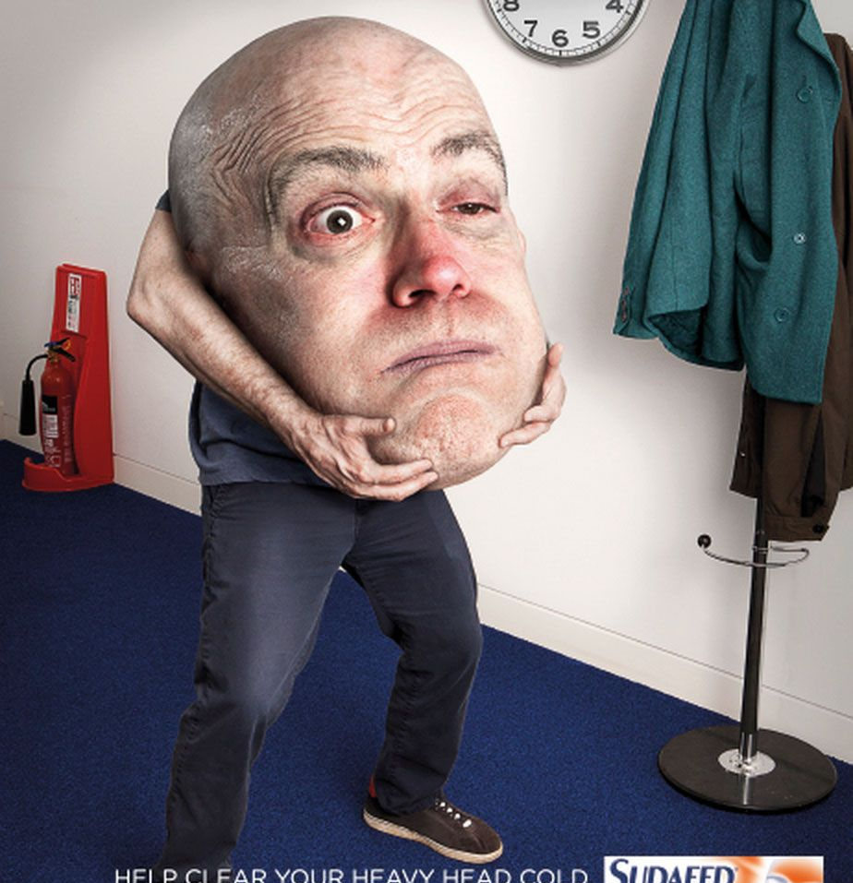
Types of humor
Absurdity

Slide 18
Types of humor
Parody

Slide 19
Which products and services?

Slide 20
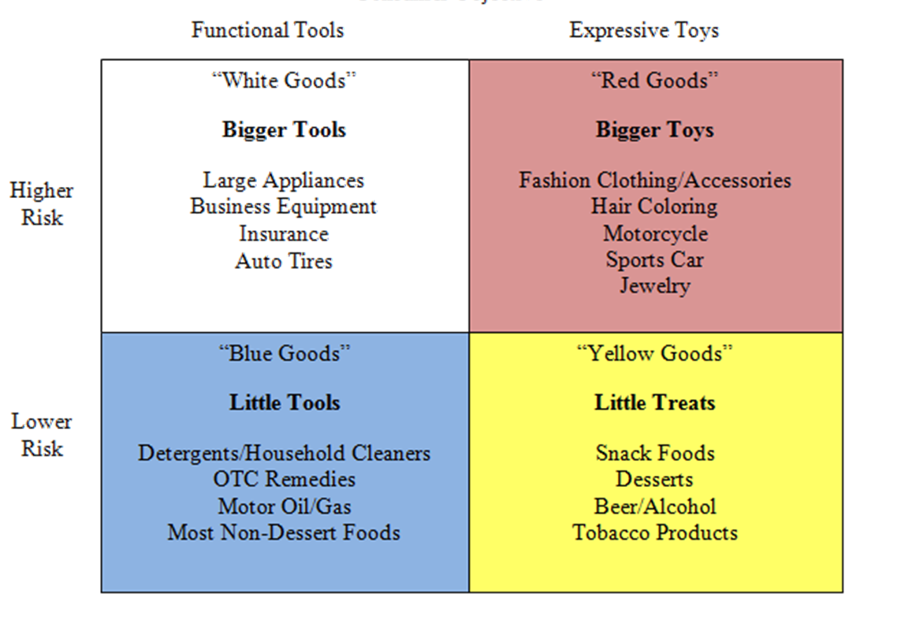
Product Colour Matrix
Four groups of products based on their function and the risk that the consumer must take when purchasing them

Slide 21
Product Colour Matrix
White category – high risk to consumers, usually a financial risk; a lot of effort, enough time searching for the necessary information, buying decisions are more rational than emotional; mostly necessary products of a durable nature.
Red category - high financial risk to consumers, not necessary; rather than a functional need, they fulfill the need for self-expression; mostly luxury products such as designer fashion, jewelry or expensive cars

Slide 22
Product Colour Matrix
Blue category – daily consumption products that do not pose a high risk to the consumer; products that can be consumed or help to fulfill everyday minor necessities such as cleaning, cooking or personal hygiene.
Yellow category – very low risk, not expensive; routine purchases that give the consumer some form of reward or satisfaction; alcoholic beverages, coffee, sweets and savory snacks

Slide 23
When to use it?
In general, humor is more effective in the case of products that do not pose a high risk to consumers; small purchases that are not expensive and bring a sense of satisfaction to a person
Higher risk products are products that require more time and effort to buy because they are more expensive.

Slide 24
When to use it?
Many studies show that FMCG is the most suitable for the use of humor in promotion. These are fast-moving, low-cost goods that do not pose a high risk to consumers.
Similarly, humor is more effective in promoting an existing product than in launching new products.
It‘s little more difficult to use humor to promote services

Slide 25
What about audience?

Slide 26
What about audience?
Perception of humor depends on age, gender, values, attitudes, opinions, nationality, ethnicity or culture
Differences in the perception of humorous messages are also shown in terms of gender.
The sense of humor is an individual characteristic often dependent on the culture in which we grow up. Jokes may not only serve to entertain the audience, but sometimes they also provide important information about a particular culture, subculture.
On the one hand, culture influences the sense of humor, on the other hand, humor has become largely global.

Slide 27
Cultural differences
Members of a nation have a distinctive sense of humor that may be different from other nationalities
Hall and Hall’s (1990) cultural theory of low- and high-context cultures

Slide 28
Some research
evaluation of humor effectiveness along individualistic dimension – only half of the entertaining commercials viewed in collectivist cultures were considered humorous; aggressive humor scored higher in engagement among highly individualistic cultures; collectivist cultures may see aggressive humor as offensive
evaluation of humor effectiveness along masculinity dimensions – samples from feministic cultures also showed more preference to non-humorous forms of entertainment
evaluation of humor effectiveness along power distance dimensions – viewers from cultures of high PDI show far less engagement and viewing of commercials featuring disparagement (e.g. putdowns).
In some countries, ads can persuade consumers more efficiently by providing information, while consumers in other countries prefer emotional advertising appeals.

Slide 29
Some reseach...
It has been noted that there are four different types of humor styles: affiliative humor (tendency to tell jokes in order to laugh with others), self-enhancing humor (finding amusement in life’s hardships to cheer oneself), self-defeating humor (making fun of oneself for the enjoyment of others), and aggressive humor (a hostile form used to enhance oneself at the expense of others).
collectivistic cultures (such as India and Hong Kong) use affiliative and self-enhancing humor and not aggressive and self-defeating humor. Individualistic cultures use more aggressive humor.

Slide 30
Among the humor types that consistantly score above average across most cultures are those based on incongruity theory (e.g. absurdity, irony and surprise). Many of the cultural distinctions fall along the lines of negative or aggressive humor. This implies that marketers should be sensitive to a culture’s receptivity to humor that is deemed disparaging or socialy inappropriate.

Slide 31
Some research...
The percentage of advertisements intending to be humorous varies across countries. There is for example a significantly higher percentage of humorous advertisements in television commercials in the UK than in the United States whereas French commercials use humor about as frequently as US spots but clearly more often than German spots.

Slide 32
Some reseach...
Although the incongruity principle can be found in the advertising of different countries, the relative importance of such humour varies. The kind of humour preferred by each target culture differs: while English people are known for their black humour, Germans seem to prefer humour based on gloating (Huth and Unger, 1988).
The latter would not be much appreciated in Japan where slapstick or demeaning humour is seldom seen in advertising. Instead the Japanese make humorous dramatizations of situations involving family members, colleagues, neighbours, etc., to create a bond of mutual feelings between the advertiser and the viewer (Hanna et al. , 1994).

Slide 33
LaughLab
British University in Hertfordshire (since 2001)
The LaughLab experiment conducted by psychologist Dr Richard Wiseman attracted more than 40,000 jokes and almost two million ratings.
identify the joke which appealed most to people around the world
revealed wide humour differences between nations.
The joke which received the highest global ratings was submitted by 31-year-old psychiatrist Gurpal Gosall, from Manchester ->

Slide 34
LaughLab
Two hunters are out in the woods when one of them collapses. He doesn't seem to be breathing and his eyes are glazed. The other guy whips out his phone and calls the emergency services. He gasps: "My friend is dead! What can I do?" The operator says: "Calm down, I can help. First, let's make sure he's dead." There is a silence, then a shot is heard. Back on the phone, the guy says: "OK, now what?" "Also, we find jokes funny for lots of different reasons. They sometimes make us feel superior to others, reduce the emotional impact of anxiety-provoking situations or surprise us because of some kind of incongruity. The hunters joke contained all three elements."

Slide 35
LaughLab
Germans - did not express a strong preference for any type of joke.
Ireland, the UK, Australia and New Zealand – jokes involving word plays. Patient: "Doctor, I've got a strawberry stuck up my bum." Doctor: "I've got some cream for that!"
Americans and Canadians – jokes with a strong sense of superiority - either because a character looks stupid or is made to look stupid by someone else.

Slide 36
LaughLab
Many European countries, such as France, Denmark and Belgium, displayed a penchant for off-beat surreal humour. An Alsatian went to a telegram office, took out a blank form and wrote: "Woof. Woof. Woof. Woof. Woof. Woof. Woof. Woof. Woof." The clerk examined the paper and politely told the dog: "There are only nine words here. You could send another Woof for the same price." "But," the dog replied, "that would make no sense at all."
Europeans also enjoyed jokes that involved making light of topics that make people feel anxious, such as death, illness and marriage.

Slide 37
What is universal?

Slide 38
What is universal?
Some types of humor are more commonly used in international and multicultural conditions – such as airports.
In terms of entertainment, especially airlines like humor that goes beyond cultural and linguistic boundaries for obvious reasons.
grotesque humor and gentle but almost universally tolerable social misconduct and the faux pas of Mr Bean
"Hidden Camera" television show has long been a fundamental choice for airlines.
Of course, an important component of their wide range is that they are not really based on language.

