Slide 1
Review of the Paper “Transgressive Desires: New Enterprising Selves in the New Capitalism”
Presented by:
Nabil Niaz

Slide 2
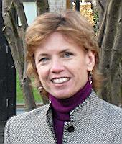
Author
Tara J. Fenwick
Emeritus Professor at University of Stirling
Research Areas: Professional Work and Knowledge, Sociomaterial Theories of Practice and Learning

Slide 3
New Capitalism
Economic Competition
Capital Accumulation
Acquisition
Employee Performance and Productivity
Profit, Size, and Growth

Slide 4
Fenwick’s Paper
Discusses Changing Concepts of “Enterprising Self”
Configuring Possibilities for New Alternatives in Enterprise
Analysis of the Changing Concepts through the Lens of Psychoanalytic Theories “Desire”
Introduces New Models of Entrepreneurism
Challenges Conventional Models of Business Development
Transgressive Desires

Slide 5
Research Context and Limitations
Qualitative Study
109 Women Interviewed Across Canada
Women Who Left Organizational Employment to Pursue Self-Employment
Self-Reliant on Own Business Venture
Not a Proper Representation of Women’s Self-Employment
Pertains to Certain Canadian Culture and Economic Structure

Slide 6
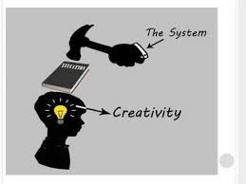
Enterprising Selves
Self-Discovery and Reflection
Individuals are Compelled to Pursue Self Development and Creativity
Autonomous, Self-Reliant, and Innovative
Constructing Own Human Capital
Corporate Regulate Enterprising Ideals of Individuals
Refusal of Corporate Subjugation

Slide 7
Desire: Psychoanalytic Perspective
Desire is Learned and Implicated in the Learning Process
Conflicting Desires
Individual’s Relations between the Outside World and the Inside World

Slide 8
Findings of the Study
Lack of Recognition and Creative Opportunity in Organizational Employment
Fundamental Desire for Freedom
Desire for Control
Contradictory Desires
Self Employment Prevent Work-life Balance
Self Employment Results in Lack of Control

Slide 9
Findings of the Study (Contd.)
“Challenge” is a Prominent Desire
Serving Through Relationships
Contribution to Broader Community
Desires Change and Shift over Time

Slide 10
Findings of the Study (Contd.)
Traditional Approaches of Business Incongruent with Women’s Preferred Approach
More Fluid and Personal
Emphasis on “Self-Knowing”
Resistant to Pre-Planned and Linear Approach
Inclined towards Spontaneity

Slide 11
Transgressive Desires in New Capitalism
Alternative Models Opposed to Corporate Entrepreneurism
Post-Corporate Conditions
Sustainability before Expansion
Right Relationships before Competition
Ethical Integrity before Profit
Emphasis on Quality of Life Personal Gratification

Slide 12
Reference
Fenwick, T. J. (2002). Transgressive desires: New enterprising selves in the new capitalism. Work, employment and society, 16(4), 703-723.

