Slide 1
Collisions
Ellastic, inellastic, cross section, rate coefficient, collisional frequency

Slide 2
Collisions
Elastic – total kinetic energy of reactants is conserved
Inealastic – part of the reaction energy is transformed into the internal energy of reactants (rotation, vibration)
Reactive (a special case of inelastic) – upon collision, chemical bonds are broken or created

Slide 3





Collisions
relative velocity:
determines the energy available in the collision and usable, for example, to overcome the activation energy of the reaction
Total kinetic energy of reactants:
Center of mass velocity
Reduced mass

Slide 4



Collisions
Total impulse is conserved during the collision:
The kinetic energy associated with the center of mass must be conserved during the collision
Only the kinetic energy arising from the relative velocity of the particles is usable, for example, to overcome the activation energy of a reaction, internal excitation, etc.
Srážková energie

Slide 5

Collisions
Total energy is conserved - before the collision it is kinetic energy + internal energy of reactants
Reaction enthalpy change at 0 K
positive if energy is consumed during the reaction (endoergic reaction)
negative if energy is released during the reaction (exoergic reaction)
When we talk about individual reactive collisions, the terms endoergic and exoergic are used instead of endothermic and exothermic

Slide 6
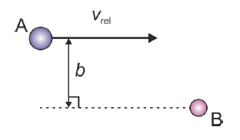
Impact parameter
The response probability as a function of the collision parameter is called the opacity function

Slide 7
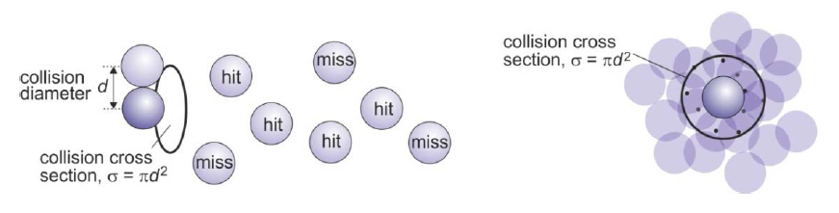
Cross section (collisional)
In the case of attractive interactions between reactants, collision parameters larger than d can lead to collision - in which case the collision effective cross-section will be larger than in the case of this "billiard" sphere model

Slide 8

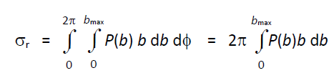
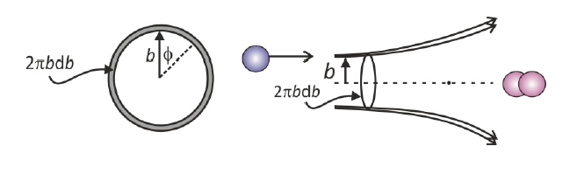
Cross section (reaction)
Not every collision leads to a reaction
For solid ball model

Slide 9
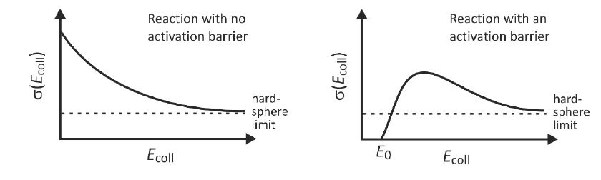


Dependence on collision energy
the greater the speed of the reactants, the less time they have for mutual attractive action, the limit is
Often a very small value – the effective cross-section decreases with increasing energy

Slide 10
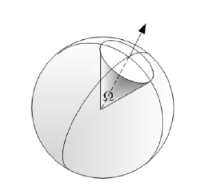
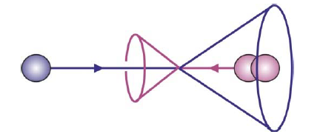

Differencial cross section
Probability of scattering into a given cone
Effectively the probability of scattering to a given angle to the relative velocity vector

Slide 11
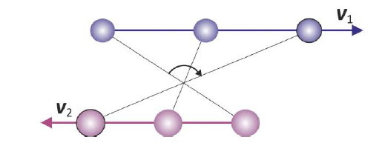



Impulse moment
Orbital angular momentum
For large b
The total angular momentum (orbital + rotational) is conserved during the reaction

Slide 12
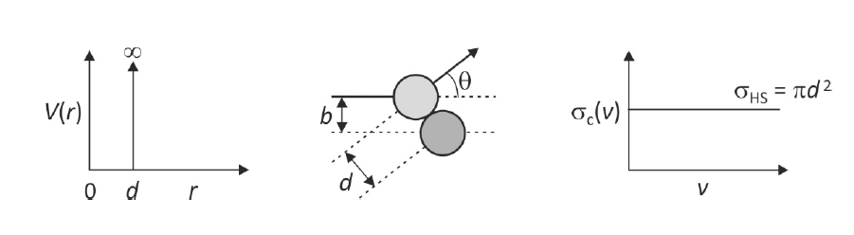
PES – Potential Energy Surface
billiard ball model

Slide 13

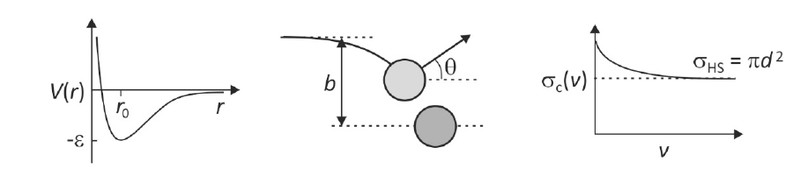

PES – Potential Energy Surface
Lenard - Jones potential
Atractive potential
Repulsion

Slide 14

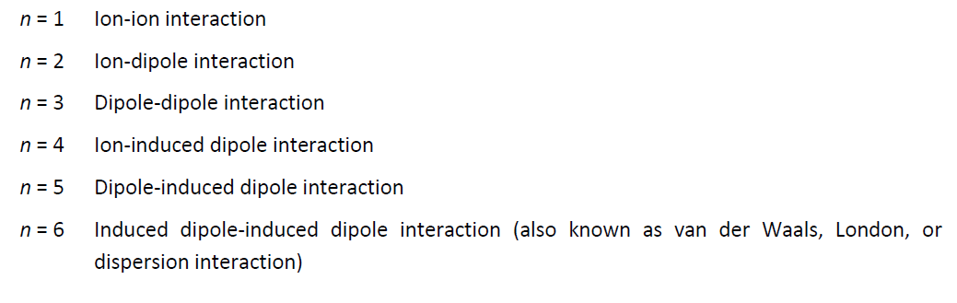
Interactions between atoms, molecules and ions

Slide 15
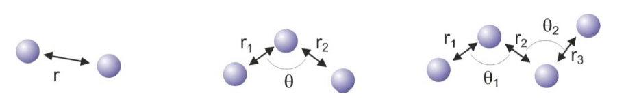
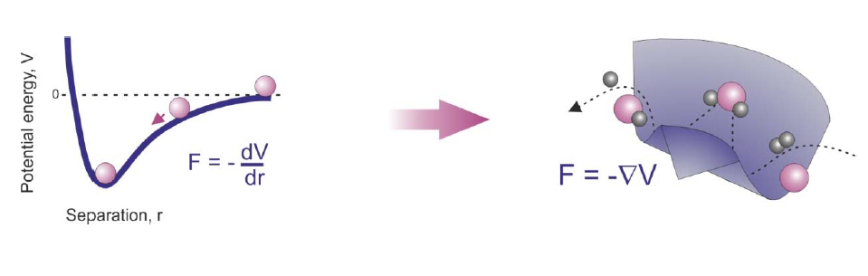
PES – polyatomic systems
3N-6 (3N-5) souřadnic

Slide 16
Rate coefficient (reaction rate constant)
Temperature dependent,
Langevin (collisional) rate coefficient – independent of temperature (reactions of ions with non polar molecules)
Arhenius dependence (reactions with barriers)

Slide 17
Rate constants of reactions – chemical kinetics
Rate of reaction
Stochiometric number

Slide 18
Rate constants of reactions – chemical kinetics
Example:
Rate of reaction
Reaction rate coefficient (reaction constant)
Obecně:
Stochiometric number

Slide 19
Reaction order
First order reaction in [A] and first order in [B], together second order reaction.
Overall order of reaction:
The reaction does not have to have an integer order. There are also zero-order reactions (does not depend on the concentration of the reactant)
But, it is not always possible to determine the order of the reaction:
Experimentálně zjištěno

Slide 20
First order reactions
A second-order reaction, if number density of one reactant practically does not decrease, behaves as a first-order reaction (pseudo first-order reaction)
The time it takes for the concentration to drop to half
The time constant of the exponential decay

Slide 21
Second order reaction
Can you imagine what process in plasma this describes?
It depends on the initial number density
(For similar higher order reactions)

Slide 23
Reaction equilibrium
First order reaction
Forward and backward reaction at the same time
At the beginning [B] = 0
Equilibrium constant of the reaction
In equilibrium

Slide 24

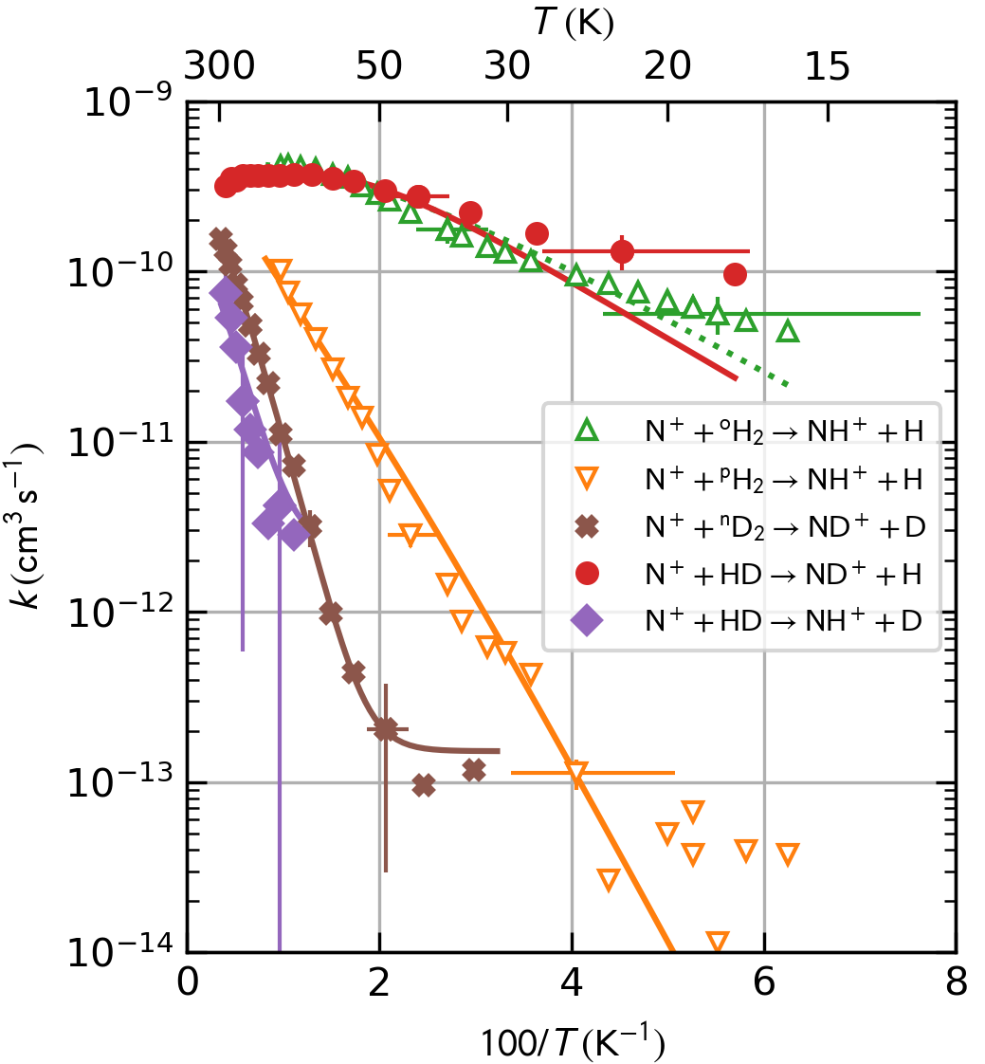
Temperature dependence of reaction rate coefficient (example)
Arrhenius equation
Activation energy
Svante Arrhenius
(1859-1927)
Nobel price 1902
Figure 12. Arrhenius plot of the reaction rate coefficients k^{HDa}_{N+}, k^{HDb}_{N+}, k^{D2}_{N+} obtained in the present work in comparison with k^{pH2}_{N+} and k^{oH2}_{N+} derived from the data by [Zymak 2013]. The corresponding rate coefficients obtained from the fitted global model (model C in Table 2) are indicated by the solid curves (only the model values of k^{oH2}_{N+} are indicated by a dotted line to differentiate them from the nearly identical k^{HDa}_{N+} curve).

Slide 25
Arrhenius equation
activation energy is the minimum kinetic energy of reactants required to form products

Slide 26
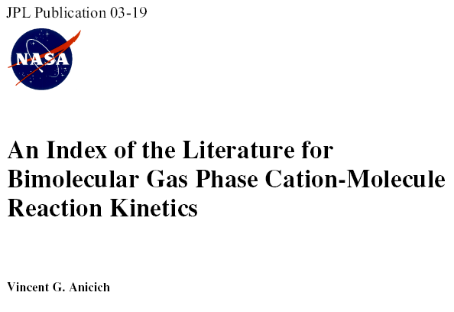
Reaction rate coefficients
Typical values of at 300K (approximate values)
reactants products rate coefficient
Electron atomic ion rec. A⁺ + e⁻ ➔ A + hν ~10⁻¹¹cm³s⁻¹
Electron - ion recomb. O₂⁺ + e⁻ ➔ O + O 2x10⁻⁷cm³s⁻¹
Electron – cluster ion recomb. H₅⁺ + e⁻ ➔ products 3.5x10⁻⁶cm³s⁻¹
Ion – ion recombination Ar⁺ + Cl⁻ ➔ Ar + Cl 2x10⁻⁸cm³s⁻¹
Ion – molecule reactions H₂⁺ + H₂, ➔ H₃⁺ + H 2x10⁻⁹cm³s⁻¹
H₃⁺ + H₂ + He ➔ H₅⁺ + He k_{eff BIN}= k₃x[He]
k₃<2x10⁻²⁹cm⁶s⁻¹
Attachment CCl₄ + e⁻ Cl⁻ +CCl₃ ~10⁻⁷cm³s⁻¹
Penning ionization He* + Ar Ar⁺ + e⁻ + He 7x10⁻¹¹c .

