Slide 1
Plasma frequency, plasma classification, Saha equation

Slide 2
Plasma frequency
- Fundamental time scale for plasma physics
- each specie has its own plasma frequency
- this frequency for electrons is usually most important
- typical electrostatic oscillation frequency of a given species in response to a small charge separation

Slide 3
Plasma frequency – simple model
Electron layer displaced by δ
Effectively two capacitor plates with surface charge
P. Gibbon, Introduction to plasma physics

Slide 4
Plasma frequency – simple model
Electron layer displaced by δ
Effectively two capacitor plates with surface charge
P. Gibbon, Introduction to plasma physics

Slide 5
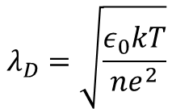
Plasma frequency – simple model
Plasma oscillations visible only on timescales longer than τ_{P} and if external action do not change the system at a rate faster than ω_{p}
Likewise, observations over length-scales L shorter than the distance v τ_{p} traveled by a typical plasma particle during a plasma period will also not detect plasma behaviour - particles will exit the system before completing a plasma oscillation.
$$λ_{D}=\sqrt{\frac{ε_{0}kT}{ne^{2}}}$$
$$vτ_{p}=\sqrt{\frac{8kT}{πm}}\sqrt{\frac{ε_{0}m}{ne^{2}}}≈λ_{D}$$
Usualy electron plasma frequency is most important and is denoted ω_{pe}

Slide 6
Plasma parameter
Average distance between particles:
$$r_{c}=\frac{e^{2}}{4πε_{0}kT}$$
Distance of the closest approach:
Distance at which the Coulomb energy of charged particle in the lectrostatic field of another one vanishes

Slide 7
Plasma parameter
R. Fitzpatrick, Plasma Physics, The University of Texas at Austin

Slide 8

Plasma parameter
$$\frac{r_{d}}{r_{c}}≪1$$
Strongly coupled plasma
$$\frac{r_{d}}{r_{c}}≫1$$
Weakly coupled plasma
Number of particles in Debye Sphere
Plasma parameter:
$$r_{c}=\frac{e^{2}}{4πε_{0}kT}$$
$$λ_{D}=\sqrt{\frac{ε_{0}kT}{ne^{2}}}$$
Note that:
$$Λ=\frac{λ_{D}}{r_{c}}=\frac{1}{\sqrt{4π}}{\left(\frac{r_{d}}{r_{c}}\right)}^{3/2}=\frac{4πε_{0}^{3/2}}{e^{3}}\frac{{(kT)}^{3/2}}{n^{1/2}}$$

Slide 9
Plasma parameter
$$Λ=\frac{λ_{D}}{r_{c}}=\frac{1}{\sqrt{4π}}{\left(\frac{r_{d}}{r_{c}}\right)}^{3/2}=\frac{4πε_{0}^{3/2}}{e^{3}}\frac{{\left(kT\right)}^{3/2}}{n^{1/2}}$$
Debye sphere sparsely populated – strongly coupled plasma
$$Λ≪1$$
$$Λ≫1$$
Debye sphere densely populated – weakly coupled plasma
Strongly coupled plasmas – „cold“ and dense (laser ablation, high pressure arc plasma, atmosphers of white dwarfs and neutron stars)
Weakly coupled plasmas – „hot“ and diffuse (interstellar plasma, ionosphere)

Slide 10
Plasma parameter

Slide 11
Plasma classification
In some literature, weakly coupled plasma is called ideal plasma
P. Gibbon, Introduction to plasma physics

Slide 12
Collisions
Binary collision process can be defined only for weakly coupled plasma
$$υ_{ss′}$$
Rate at which the particles of species s are scattered by those of species s’
Total collision rate for species s
Mean free path (mean velocity divided by collisional frequency)

Slide 13
Collisions
Characteristic observation length
Collision dominated (collisional) plasma:
Large mean free path
Collisionless plasma
The magnitude of collision frequency is typically:
In weakly coupled plasma so the collisions do not influence much the plasma oscillations
In strongly coupled plasma - system dominated by coulombic interactions
$$ν\sim \frac{e^{4}lnΛ}{4πε_{0}^{2}m^{1/2}}\frac{n}{{\left(kT\right)}^{3/2}}$$
diffuse, high temperature plasmas tend to be collisionless, whereas dense, low temperature plasmas are more likely to be collisional

Slide 14
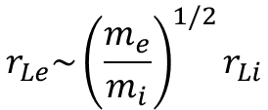
Magnetised plasmas
- if the magnetic field is strong enough to significantly alter charged particles trajectories – magnetised plasmas are anisotropic – they respond differently to forces that are parallel and perpendicular to the direction of the magnetic field
- charged particles are subject to Lorentz force:
- they move freely along the magnetic field lines and executing circular (gyro-) orbits in a plane perpendicular on a magnetic field line
- at high magnetic field intensities, the particles are effectively closely tied to the magnetic field line
$$Ω_{c}=\frac{eB}{m}$$
For comparable temperatures of electrons and ions:
$$r_{L}=\frac{v_{t}}{Ω_{c}}$$
$$r_{Le}\sim {\left(\frac{m_{e}}{m_{i}}\right)}^{1/2}r_{Li}$$
Cyclotron frequency
Larmor radius

Slide 15
Magnetised plasmas
- process/plasma system is considered magnetised if characteristic length L is large compared to the gyroradius
- if $r_{L}≫≫L$ charged particles have almost straight line trajectories
- magnetisation parameter:
Characterizes ability of the magnetic field to significantly affect particle trajectories
$$δ=\frac{r_{L}}{L}$$
Both species (electrons and ions) have to be magnetised, so
$$δ_{i}=\frac{r_{Li}}{L}≪1$$

Slide 16
Magnetised plasma
β parameter – characterizes ability of plasma to influence the magnetic field
- ratio of the thermal energy density n k T (pressure in ideal gas ) to the magnetic energy density
For each specie
Total

Slide 17
Thermal and non – thermal plasma (izotermické a neizotermické plazma)

Slide 18
From lecture of Milan Hrabovsky IPP AS CR

Slide 19
From lecture of Milan Hrabovsky IPP AS CR

Slide 20
Discharge and afterglow plasma
- afterglow – after switchin off the discharge – no external soures of energy
- electrons and ions can have the same temperature (LTE)
- recombination, ambipolar diffusion – number densities of charged particles decay in time
- ionisation degree is not corresponding to temperature

Slide 21
Saha equation (for proper derivation see NEVF169)
Gibbs free energy
Partition function
Chemical potential
Consider reaction:

Slide 22
Saha equation (for proper derivation see NEVF169)

Slide 23
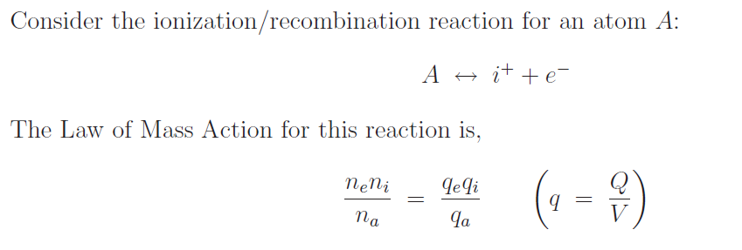
Saha equation – ionisation equilibrium

Slide 24
Saha equation – ionisation equilibrium

Slide 25
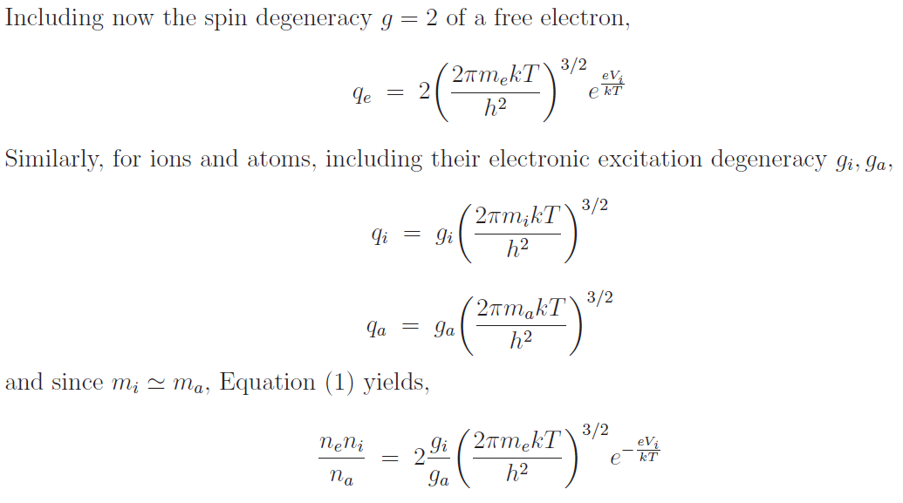
Saha equation – ionisation equilibrium
Saha equation for ionisation equilibrium

Slide 26
Saha equation – ionisation equilibrium
This is for atoms, molecules have other degrees of freedom – rotation, vibration – leading to different g

Slide 27
Saha equation – ionisation equilibrium

