Slide 1
Postmodernism and the Consumer Society
Presented by:
Lukas Motta
Ahmad Abu-Hmeidan

Slide 2
Agenda
Origination
Postmodern Stance
The Opposition
Support/Critique
Why we see growth
The Consumer Society

Slide 3
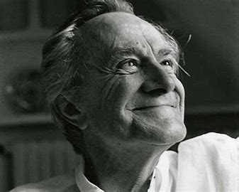
The birth of Postmodernism
Postmodernism as a term was first introduced into the philosophical community in 1979 by Jean-Francois Lyotard.
A response or reaction to 17th-19th century values in Western Philosophy.
Societies Grand Narratives are myth.
Thus, shattering a narrative produces an opportunity for people to create their own meaning.

Slide 4
What is postmodernism
Post - modern - ism
it's a more complicated idea than just saying "after" in terms of time.
The word "modern" originated from Latin and means "just now" or "this moment."
“ism”
This part comes from Greek and Latin and often implies adopting habits or behaviors of a particular group, sometimes in a misleading or superficial way.
Notes:
Post: such a work is not composed in accordance with any previous universal rules
Imagine you have a jigsaw puzzle that represents human understanding of the world. In the past, people tried to put all the pieces together to create one big, clear picture it was like saying, "This is the complete and only way to understand everything. Now, Postmodernism comes along and says Maybe there's not just one right way to put this puzzle together. Maybe there are multiple ways to arrange the pieces, and they can create different, equally valid pictures."
For example, in literature, traditional storytelling followed a linear, chronological pattern. Postmodern literature might play with time, using flashbacks and multiple perspectives to challenge the idea that there's only one way to tell a story.
So, Postmodernism questions the idea of a single, universal truth or explanation for everything and suggests that there can be many valid interpretations and understandings of the world. It's like embracing the idea that there are multiple ways to solve the puzzle of understanding.

Slide 5
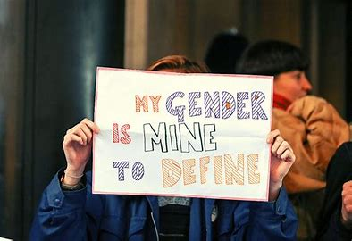
The Postmodern Movement
Based heavily on subjectivity and personal belief.
Belief that science/technology and reason/logic are destructive and oppressive.
Adamant that there is no universal truth.
“Anything goes, mix it up.”

Slide 6
Key Words and Important values
Deconstruct
Dismantle
Question the “truth”
Objectivity is not good
Feminism

Slide 7
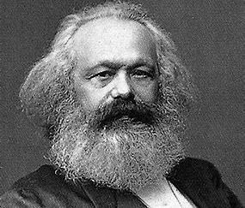
The Modernist approach
Construct a coherent world-view.
The search for objective realities through science, logical thinking, and reason.
There are truths and reality.
The search for universalism (Marx).
"I Can Identify As A Black Lesbian!" Piers Morgan On Gender Identity – YouTube
2:08-2:52

Slide 8
Support for Postmodernism
Provides different ideas related to societies in the developing world.
Deconstruction of modern western culture where there are binary opposites such as male/female, black/white, Christian/non-christian.
One group is privileged, the other forced into a marginal role.
Creates a strong community of believers prevalent today where their ideas and voices can be heard.

Slide 9
Critique
Critics believe that postmodernism is susceptible to mistakes due to their lack of interest in objectivity and truth.
The Postmodernists disregard of science is a step backward.
“Modernity and Post Modernity do not work well at the societal level” (Thomas Osborne).
Critics view 21st century postmodernism as an infringement on the modern coherent society.

Slide 10
The Role of Social Media
The 21st century has seen postmodern ideals and movement explode.
X(Formerly Twitter), Instagram, Facebook etc. are tools used by postmodernists to gain traction.
Postmodernism is very event-based and reacts to social conflicts and social developments.

Slide 11
For example…
Black Lives Matter Movement in the USA.
-Started as a Twitter Hashtag.
-Response to the death of Trayvon Martin. A major social conflict involving race.

Slide 12
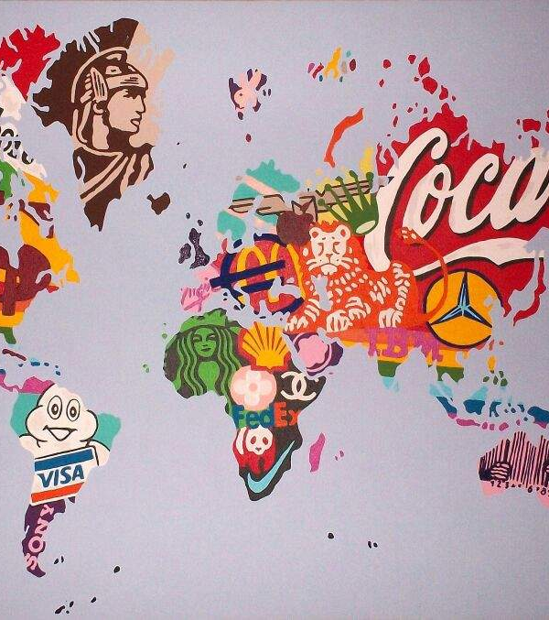
Consumer Culture in Postmodernism
The consumer culture in postmodernism represented a change in how individuals usually interact with the marketplace.
This Photo by Unknown author is licensed under CC BY-SA.
Notes:
this shift can be identified by the idea that consumption of goods and services is no longer about acquiring goods but it became a way of constructing identity or meaning to the person who is consuming these goods and services.

Slide 13
Consumer Culture in Postmodernism example
Apple marketing campaign "I'm a Mac, I'm a PC" ad campaign which portrayed Mac users as young, cool, creative and modern while the PC user were portrayed as old fashioned and outdated (https://www.youtube.com/watch?v=0eEG5LVXdKo)
This Photo by Unknown author is licensed under CC BY-NC-ND.
Notes:
Coca-Cola's "Share a Coke" campaign where Coca-Cola managed to personalize the product and shift it from just a beverage to a personal experience with the act of sharing and connecting with other people.

Slide 14
Cultural Appropriation in postmodernism
In postmodern consumer society elements of other cultures are often used for profits without fully understanding their cultural significance or importance.
This Photo by Unknown author is licensed under CC BY-ND.
Notes:
Some companies around the world tries to create a product to satisfy a certain need in a niche market which is from another culture and they see an opportunity so they create a product without fully understanding the cultural depth or meaning of what they are creating. This process of commercializing cultural symbols can turn peoples cultures into products which might create some kind of stereotyping of these cultures.

Slide 15
Cultural Appropriation in postmodernism example
Urban Outfitters, a clothing and lifestyle retail company, has faced multiple controversies for selling products that appropriate Native American culture.

Slide 16
Thank you for your attention!
Questions?
Personal Experiences?

Slide 17
References
https://www.britannica.com/topic/Black-Lives-Matter
https://thesocialthings.wordpress.com/2016/12/06/social-media-the-perfect-depiction-of-postmodernism/
https://pressbooks.online.ucf.edu/introductiontophilosophy/chapter/what-is-postmodernism/
https://www.britannica.com/topic/postmodernism-philosophy
Fournier, S. (1998). Consumers and Their Brands: Developing Relationship Theory in Consumer Research. Journal of Consumer Research, 24(4), 343-373. doi:10.1086/209515
hooks, bell. (1992). "Eating the Other: Desire and Resistance." In "Black Looks: Race and Representation." South End Press.
https://www.pdcnet.org/8525737F00588A37/file/6EF2AE9BDE8660AE852577CA006476C3/$FILE/harvardreview_1992_0002_0001_0003_0006.pdf

