Slide 1
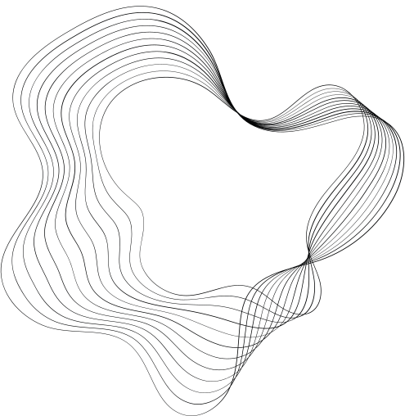

The End of Sociological Theory:
The Postmodern Hope
Steven Seidman
Week 3 Postmodernism
Yue Qiu

Slide 2

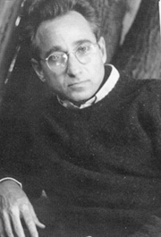
Steven Seidman
  American Sociologist
  Currently a professor at State University of New York at Albany
  Field: Social Theory / Culture / Sexuality / Comparative Sociology / Theory of Democracy / Nationalism / Globalization

Slide 3


Social Theory
  tends to offer a comprehensive framework of social phenomena
  related to social conflicts and public debates
  interpreting social phenomena ➡ actively shaping our understanding and impact on society
  by adopting pragmatic narratives, social theories go beyond theoretical abstraction, aiming instead to have practical moral implications.

Slide 4
Sociological Theory
  grand theory
  tends to discover the logic of society ➡ establish a meta-theoretical discourse which focuses on the interpretation and abstraction of social structures
  aims to find a universal understanding that transcends specific social contexts, applying it as an analytical tool across diverse cases

Slide 5
Main Arguments
  Critique to sociological theory - as an isolated, hollow meta-theory.
  No one single reality and truth - rejecting grand theories, the importance of postmodernist narratives is rooted in events and individual accounts. The historical perspective with specificity and complexity highlights the significance of individual experiences.
  The development of social theories grounded in social reality that serve practical, morality-oriented purposes, and encourages scholars not to avoid specific narratives with moral judgments in social conflicts.
  Promotion of public debates through social theory, as a platform of the understanding of social issues.

Slide 6
Discussion
Can you identify some examples from his work that demonstrate his persepctive on critique of sociological theory?
How might his emphasis on postmodernist narratives influence the way we understand social issues?

