Slide 1
Post-Colonialism
31.10.2023
Helena Christensen and Lazha Taha

Slide 2
Post-colonialism
What is it?
Notes:
Helena: Ask the other students: have you heard it before? what is it? Where do you know this term from?

Slide 3
Table of contents
Colonialism
Postcolonialism
1
2
Main thinkers
Key concepts
3
4
Post-colonialism today
Critique
5
6
Discussion
References
7
8
A brief introduction
Definitions of postcolonialism
Notes:
Lazha

Slide 4
Colonialism
Colonialism is defined as full or partial control by one power over another country, area or people.
Colonialism in the Antiquity
Europeans colonized large parts of the world
In search of new markets
By 1900, controlled 75% of the world
The ideology of colonialism
A justification for the colonization
“Civilize the uncivilized”
Superiority and inferiority
-
The effects of colonialism
Notes:
Lazha

Slide 5
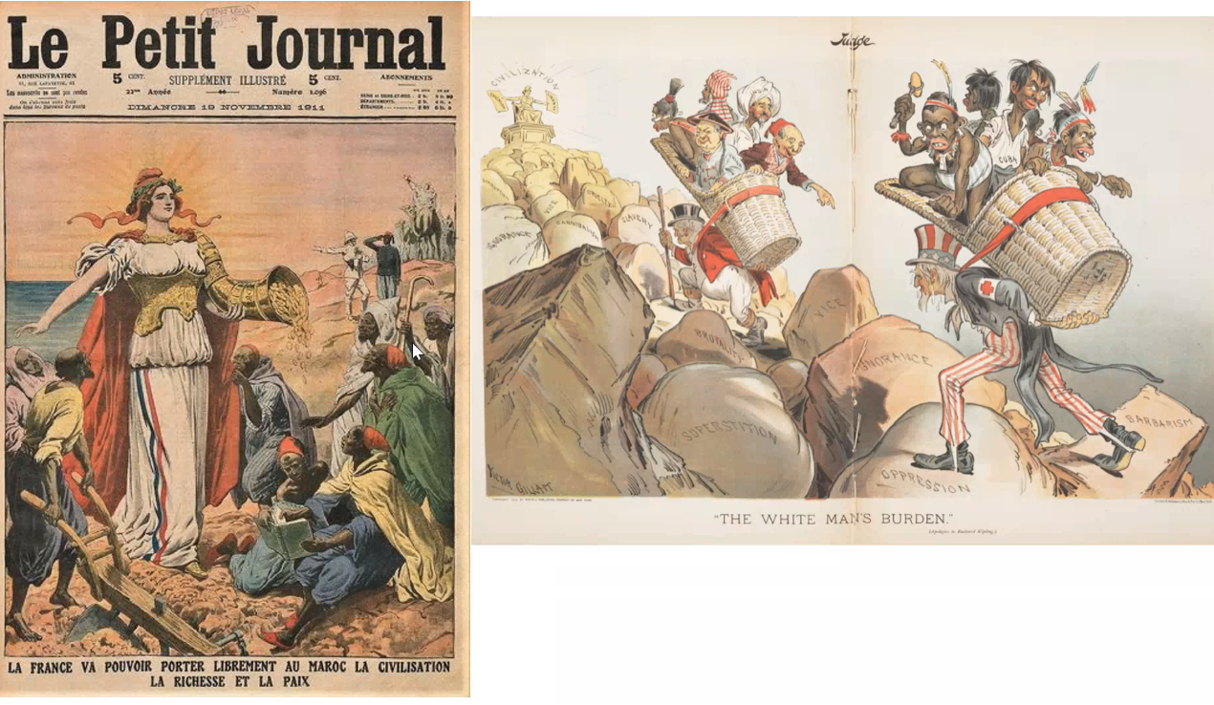
333,000
is Jupiter's rotation period

Slide 6
Post-colonialism
“Postcolonialism, the historical period or state of affairs representing the aftermath of Western colonialism”
“the term can also be used to describe the concurrent project to reclaim and rethink the history and agency of people subordinated under various forms of imperialism”
Postcolonialism does not mean after in terms of the world being free from colonial legacies
Notes:
Helena

Slide 7
Two main ideas
i
ii
The period of time after a country or population group is no longer governed by a colonial power
Large, heterogeneous body of art, literature, political, academia addressing the long lasting consequences of colonialism

Slide 8
Post-colonialism
A critical approach to study the relationship between pre-colonial powers and post-colonial countries
Postcolonialism explores the legacies of colonialism in the present day
It seeks to uncover colonial structures
It focuses on the exploitation of colonized people and their lands

Slide 9
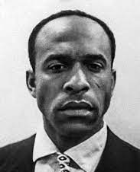
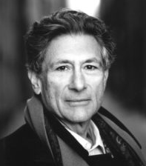
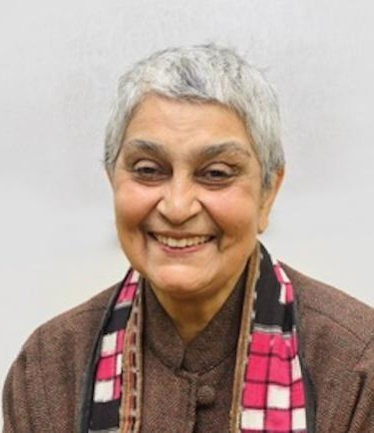
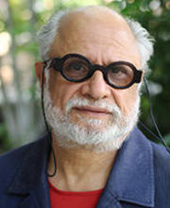
Key Thinkers
Frantz Fanon
Edward Said
Gayatri C. Spivak
Homi K. Bhabha
(1925-1961)
Afro-French Psychiatrist & philosopher
Cultural assimilation, white racism
(1935-2003)
Palestinian-American academist & literary critic
Was Professor at Columbia University
Founder of postcolonial theory
Otherness
(1942-present)
Indian scholar
Professor at Columbia University
Subaltern
(1949-present)
Indian-british scholar
Professor at Harvard University
Mimicry, ambivalence, hybridity

Slide 10
Postcolonialism Key Concepts
Decolonization
Neocolonialism
Orientalism
Othering
Hybridity
Subaltern Studies
Cultural Imperialism
Consequently, it is time to learn to free ourselves from the Eurocentric mirror where our image is always, necessarily, distorted. It is time, finally, to cease being what we are not (Quijano, 2000: 574).

Slide 11
Postcolonialism today
Cultural identity
Human Rights
Political and economical independence
Art and literature
promotion of unique heritage & access to cultural legacy.
International solidarity
≠ complete autonomy
Reflection personal of unique perspective

Slide 12
Critiques of postcolonialism
Writing mostly in English
Essentializing culture
Outdated
Too focused on the past instead of the present

Slide 13
Discussion
Do you think we have gotten rid of colonial structures and are truly post-colonial?
Have you ever had an experience where you thought something was a legacy of colonial structure?
Why do you think it is so difficult to change colonial structures?

Slide 14
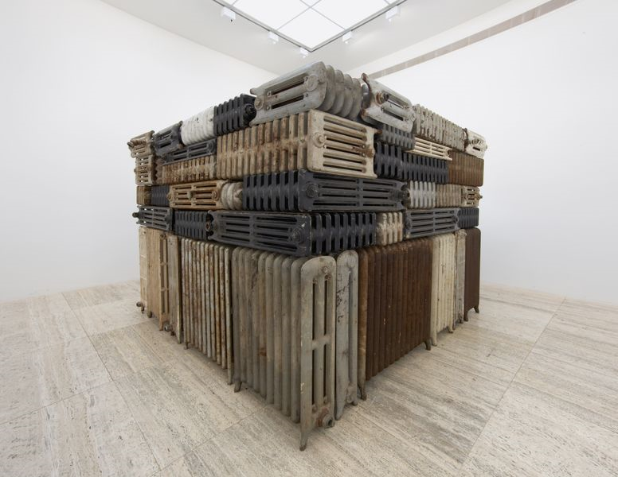
Bharti Kher
The Hot Winds that Blow from the West

Slide 15
Resources
Brown, Owen. “Rights from the other side of the line.” Politikon: The IAPSS Journal of Political Science, vol. 25, 2014, pp. 5–26, https://doi.org/10.22151/politikon.25.1.
Dirlik, Arif. “Rethinking colonialism: Globalization, postcolonialism, and the nation.” Interventions, vol. 4, no. 3, 2002, pp. 428–448, https://doi.org/10.1080/1369801022000013833.
Drabinski, John. “Frantz Fanon.” Stanford Encyclopedia of Philosophy, Stanford University, 14 Mar. 2019, plato.stanford.edu/entries/frantz-fanon/.
Encyclopædia Britannica, Encyclopædia Britannica, Inc., 28 Oct. 2023, https://www.britannica.com/biography/Edward-Said. Accessed 30 Oct. 2023.
Ivison, Duncan. "postcolonialism". Encyclopedia Britannica, 20 May. 2023, https://www.britannica.com/topic/postcolonialism. Accessed 28 October 2023.
Mishra, Pankaj. “The Reorientations of Edward Said.” The New Yorker, 19 Apr. 2021, www.newyorker.com/magazine/2021/04/26/the-reorientations-of-edward-said.
Nicholas, Tom, director. Postcolonialism: WTF? An Intro to Postcolonial Theory. 24 Oct. 2018, https://www.youtube.com/watch?v=jbLyd0mQwIk.
Quijano, Anibal & Ennis, Michael. Coloniality of Power, and Latin America. Duke University press. Nepantla:Views from South,vol. 1 no. 3, 2000, p. 533-580. Project MUSE.
YouTube, Christopher Flynn, 17 Sept. 2014, https://www.youtube.com/watch?v=TG1HL8h8aMM&t=10s. Accessed 30 Oct. 2023.
YouTube, YouTube, 28 Oct. 2012, https://www.youtube.com/watch?v=fVC8EYd_Z_g. Accessed 30 Oct. 2023.

Slide 16
