Slide 1
GLOBALIZATION
Contemporary Social Theory - Week 4
Ayse Ece Er
Taleja Schulze

Slide 2
DEFINITIONS
01
HISTORICAL OVERVIEW
02
03
CONTEMPORARY THEORISTS
TABLE OF CONTENTS
THEORIES & CONCEPTS
04
APPROACHES
05
06
THOUGHTS & ISSUES
07
CRITICAL THINKING QUESTIONS & REFERENCES

Slide 3
BEFORE WE START
We want to know your associations on the topic of “GLOBALIZATION”
Please scan the QR-Code and share your ideas!
Notes:
https://www.mentimeter.com/app/dashboard

Slide 4
01 DEFINITIONS
Globalization refers to time- and space- compression.
(Harvey, 1989)
“Globalization is a transplanetary process or set of processes involving increasing liquidity and the growing of multidirectional flows of people, objects, places and information as well as the structures they encounter and create that are the barriers to, or expedite, those flows.”
(Ritzer, 2010, 2)

Slide 5
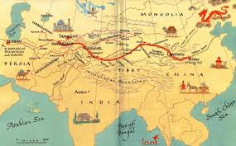
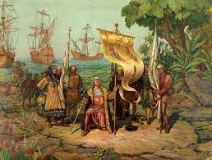
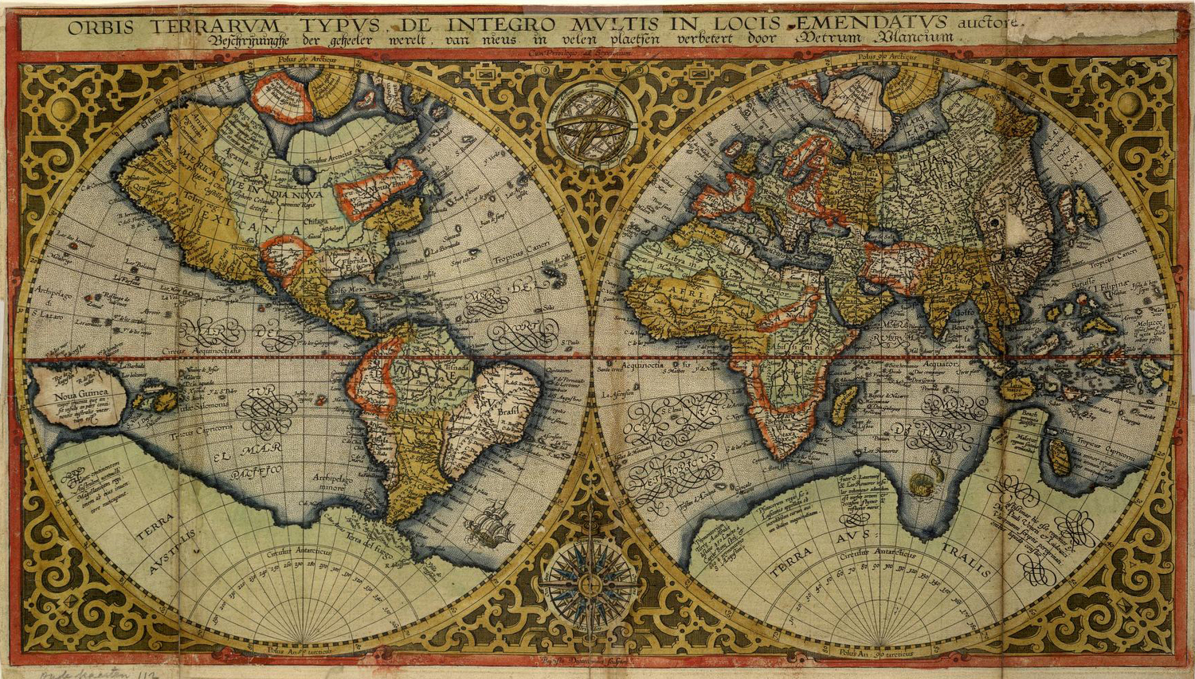
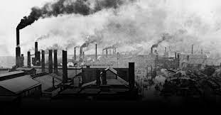
02 HISTORICAL BACKGROUND
WHEN DID GLOBALIZATION BEGIN?

Slide 6
02 HISTORICAL BACKGROUND
3 periods of globalization (Friedman, 2005)
Globalization 1.0
1492 to 1800
globalizing for resources and imperial conquest
dynamic force: countries globalizing
Globalization 2.0
1800 to 2000
companies globalizing for markets and labor
Globalization 3.0
starting with 2000s
individuals and small groups globalizing
driven by non-Western people
Globalization 4.0 (World Economic Forum, 2019)

Slide 7
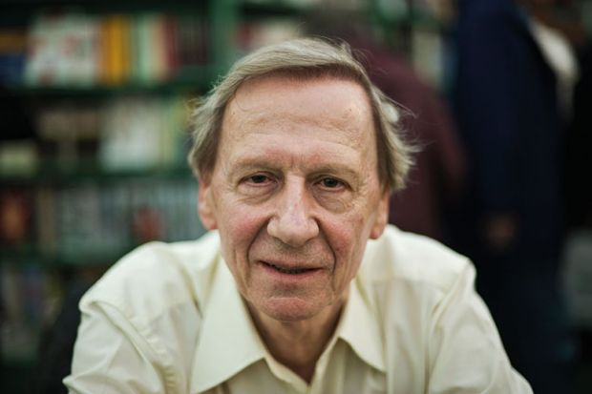
03 CONTEMPORARY THEORISTS
ANTHONY GIDDENS
Source: https://www.timeshighereducation.com/news/lord-giddens-accidental-academic-who-reached-top
British Sociologist (*1938)
“the intensification of worldwide social relations which link distant localities in such a way that local happenings are shaped by events occurring many miles away and vice versa” (Giddens,1990,64)
risk consciousness & detraditionalization

Slide 8
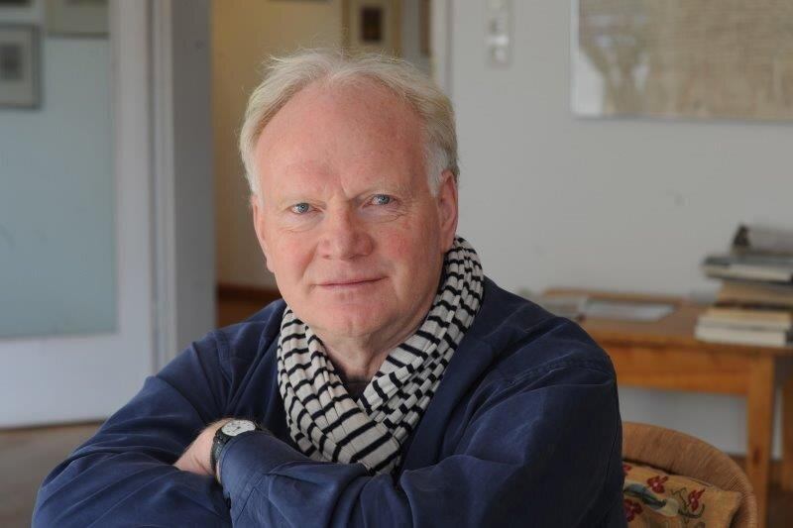
03 CONTEMPORARY THEORISTS
Ulrich Beck
German sociologist
…the advent of globalization challenges the territoriality and sovereignty of the nation-state, reduces the authority of the state and its citizens to act unilaterally or independently, and compromises economic sovereignty by forcing states to act in ways and adopt policies broadly commensurate with the whims of highly mobile capital”(Jarvis, 2008 5)
Source: https://www.timeshighereducation.com/news/lord-giddens-accidental-academic-who-reached-top

Slide 9
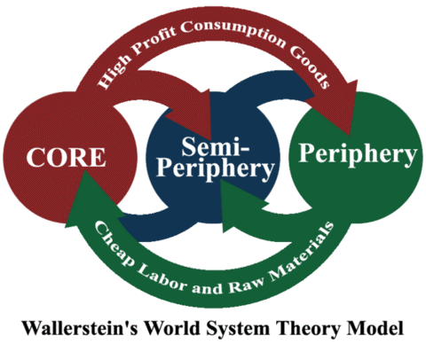
04 THEORIES & CONCEPTS
Source: https://medium.com/@kendallgrace15/periphery-role-in-the-world-systems-theory-fa5d291cac55
WORLD SYSTEMS THEORY (WALLERSTEIN)
Capitalist economy
Core Countries: high-skill, capital-intensive industries
(Semi-) Periphery Countries: low-skill, labor-intensive industries, raw materials
Certain countries become hegemon (temporary)

Slide 10
04 THEORIES & CONCEPTS
MODERNIZATION THEORY
- Emerged in 1960, USA
-Setting standards all over the world for economic, social and cultural development (Freire & Lima, 2018)
-Transition from traditional to modern society by development
-Talcott Parsons→ traditions set barrier for undeveloped countries to progress
-Modern practices will affect traditional societies (Parsons, 1964)

Slide 11
HYPERGLOBALIST
SKEPTICAL
05 APPROACHES
TRANSFORMATIONAL
new epoch in human history
economic growth
increasing prosperity
spread of democracy
process more fragmented and regionalized
block building
increasing inequality
complex set of interconnecting relationships
outcomes of the process are not determined

Slide 12
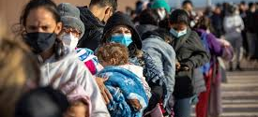
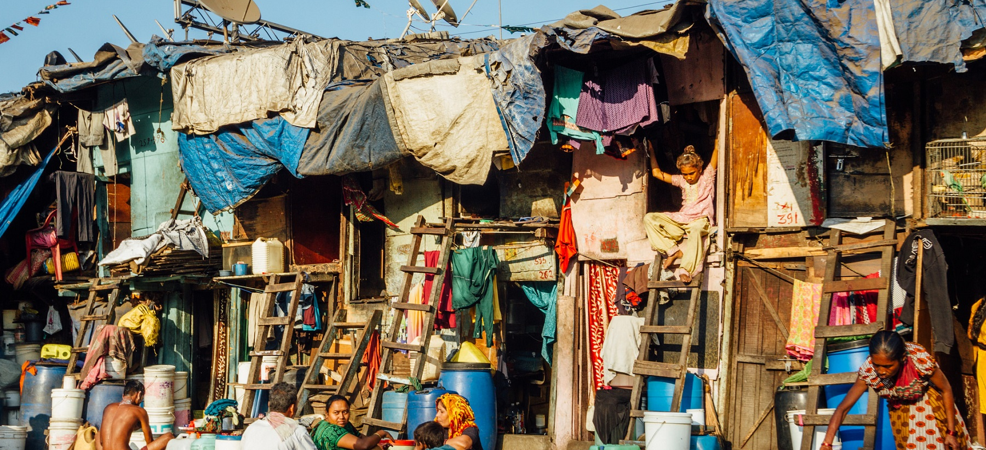
IMMIGRATION
06 THOUGHTS & ISSUES
INEQUALITY
People who migrate to new countries bring their ideas, knowledge and expertise to the new country.
Source: https://www.google.com/url?sa=i&url=https%3A%2F%2Fwww.politico.com%2Fnews%2F2022%2F07%2F21%2Fsupreme-court-biden-immigration-enforcement-plans-00047298&psig=AOvVaw29LZsarscaLjImC3G-SsC-&ust=1698133444241000&source=images&cd=vfe&opi=89978449&ved=0CBEQjRxqFwoTCLD3rpjWi4IDFQAAAAAdAAAAABAE
-Wage inequality
-Global North and South
-Global North take advantage of the cheap production in the Global South
Source: https://ideas4development.org/en/end-poverty-changing-rules-economy/

Slide 13
NEO IMPERIALISM?
06 THOUGHTS & ISSUES
AMERICANIZATION
“...it is strategy of control or dominance where big states tend to develop hold over small states not by capturing any area but through different economic means and approaches.” (Ejaz, 2019 86)
Source:https://quizlet.com/243809363/new-imperialism-1850-1914-diagram/
-Cultural Impact because of the American products and brands
Source: https://www.google.com/url?sa=i&url=https%3A%2F%2Fen.wikipedia.org%2Fwiki%2FCulture_of_the_United_States&psig=AOvVaw0B7QhKhgD3HK37ut6cfUxN&ust=1698134393725000&source=images&cd=vfe&opi=89978449&ved=0CBEQjRxqFwoTCMjB-tzZi4IDFQAAAAAdAAAAABAE

Slide 14
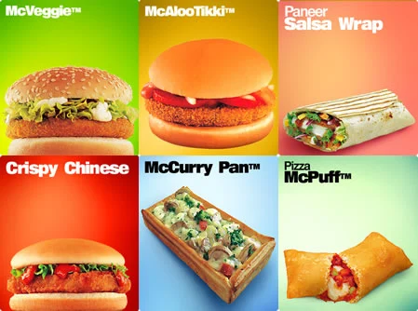
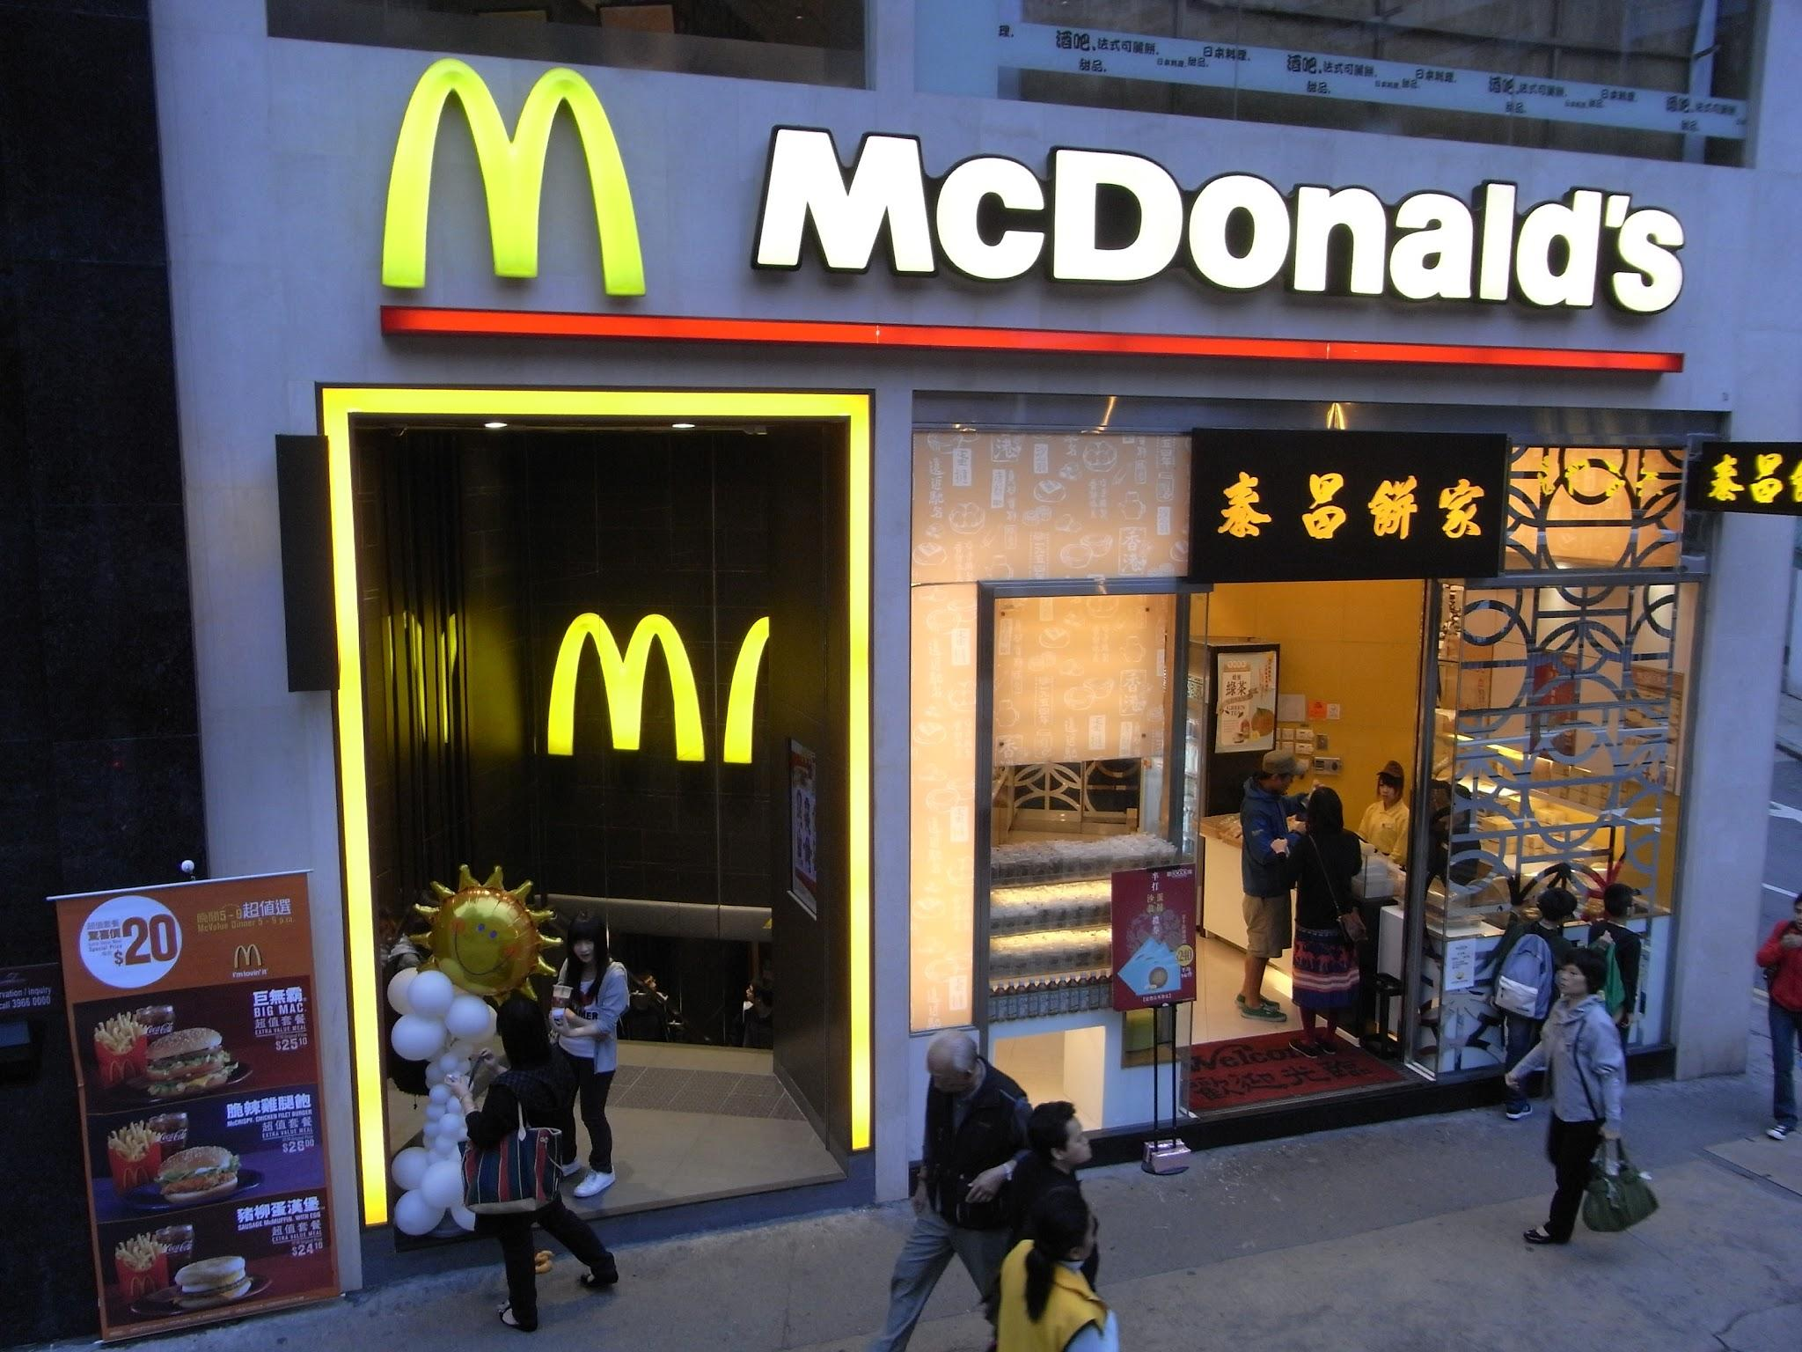
06 THOUGHTS & ISSUES
GLOCALIZATION

Slide 15
07 REFERENCES
Chase-Dunn, C. (2001). World-Systems Theorizing. In: Turner, J.H. (eds) Handbook of Sociological Theory. Handbooks of Sociology and Social Research. Springer, Boston, MA . https://doi.org/10.1007/0-387-36274-6_27
Giddens, A. (2007). The consequences of modernity. 1990.
Harvey, D. (1989). The Condition of Postmodernity: An Enquiry Into the Origins of Cultural Change. Wiley.
Mondal, P. (n.d.). Opposing Camps over Globalization: Skeptics and Hyper-globalizers. Your Article Library. Retrieved October 18, 2023, from https://www.yourarticlelibrary.com/globalization/opposing-camps-over-globalization-skeptics-and-hyper-globalizers/30735
Ritzer, G. (2010). Globalization: A Basic Text. Wiley.
Thompson, K. (2015, September 19). The Hyper Globalist View of Globalisation. ReviseSociology. Retrieved October 18, 2023, from https://revisesociology.com/2015/09/19/optimist-globalization-hyper-globalism-neoliberalism/?utm_content=cmp-true
Thompson, K. (2015, September 24). The Transformationalist View of Globalisation. ReviseSociology. Retrieved October 18, 2023, from https://revisesociology.com/2015/09/24/transformationalist-globalization/
Thompson, K. (2016, August 21). Runaway World by Anthony Gidden: A Summary. ReviseSociology. Retrieved October 23, 2023, from https://revisesociology.com/2016/08/21/anthony-giddens-runaway-world-summary/
A brief history of globalization. World Economic Forum. (2019). https://www.weforum.org/agenda/2019/01/how-globalization-4-0-fits-into-the-history-of-globalization/
Ejaz, K. (2019). Neo-Imperialism:A Case Study of China Pakistan Economic Corridor. Journal of Politics and International Studies, 5(1), 85–96.
Encyclopædia Britannica, inc. (2023, October 3). Globalization. Encyclopædia Britannica. https://www.britannica.com/money/topic/globalization
Encyclopædia Britannica, inc. (n.d.). Glocalization. Encyclopædia Britannica. https://www.britannica.com/money/topic/glocalization
Freire, F. M., & Lima, D. da C. B. P. (2018). The 1960s modernization theory updated: The role of the evaluative state in today’s Brazilian education. Universal Journal of Educational Research, 6(10), 2373–2378. https://doi.org/10.13189/ujer.2018.061036
Friedman, T. L. (2005, April 3). It’s a flat world, after all. The New York Times Magazine. Retrieved October 21, 2023, from https://www.nytimes.com/2005/04/03/magazine/its-a-flat-world-after-all.html.
Jarvis, D. S. (2008). Ulrich Beck, globalization and the rise of the Risk Society: A Critical Exegetic Analysis. SSRN Electronic Journal. https://doi.org/10.2139/ssrn.1162662
Parsons, T. (1964). Evolutionary universals in society. American Sociological Review, 29(3), 339. https://doi.org/10.2307/2091479
Thompson, A. K. (2023, May 23). Modernization theory. ReviseSociology. https://revisesociology.com/2017/09/19/modernization-theory/
Slides done with: https://slidesgo.com/

Slide 16
EXPERIENCE
CULTURE / POLITICS
07 CRITICAL THINKING QUESTIONS
Would you like to share your own experiences with globalization?
Would you consider the effect of globalization positive or negative?
In what ways does globalization impact (your) cultural identity and diversity?
To what extent does globalization exacerbate or alleviate global challenges like climate change, inequality and human rights abuses?
Notes:
Would you consider the effect of globalization in culture is positive or negative?

Slide 17
GLOBALIZATION
Contemporary Social Theory - Week 4
Ayse Ece Er
Taleja Schulze

