Slide 1
Rotační spektroskopie
Diatomické a lineární molekuly, výběrová pravidla atd.

Slide 2
Literatura
Peter F. Bernath, Spectra of Atoms and Molecules , 2nd ed., Oxford University Press, N.Y., 1995.
Excellent lecture notes on rotational spectroscopy at University of Oxford on http://mackenzie.chem.ox.ac.uk/teaching.html
JAVA applet na rotaci molekul na http://www.chemtube3d.com/spectrorotcd0-CE-TEST-ROTATE-ALL.html

Slide 3
Electronic terms of atoms - notation
S – total spin quantum number
J – total angular momentum quantum number
L – total orbital quantum number in spectroscopic notation:
L = 0, 1, 2, 3, 4, 5... -> S, P, D, F, G, H...
Sometimes a subscript u or g is added to indicate parity.
Example: the ground state of a carbon atom 1s²2s²2p² ³P₀

Slide 4
Electronic terms of atoms - notation
The combination of S and L is called a term and has a statistical weight (number of possible microstates) (2S+1)(2L+1)
The combination of S, L and J is called a level and has a statistical weight of (2J+1)
The combination of L, S, J and M_{J} determines one state
Example:
For S = 1, L = 2 there are 15 different microstates – ³D term. 7 of them belong to the ³D₃ level

Slide 5
Notation for elektronic states of molecules
S – total spin quantum number
Λ – projection of the orbital angular momentum L along the axis of the molecule
Ω – projection of the total angular momentum along the internuclear axis
(Max L + S)
u/g – parity
+/- mirror symmetry along the plane containing the axis of the molecule
Λ = 0, 1, 2, 3... -> Σ, Π, Δ, Φ...

Slide 6
Notation for elektronic states of molecules
X denotes ground state.
States with the same multiplicity (2S+1) as the ground state are denoted A, B, C...
States with different multiplicity are denoted by small letters a, b, c…
example – transition from the ground state of O₂ (triplet) in to the first excited state (singlet):

Slide 7
Rotational spectroscopy

Slide 8
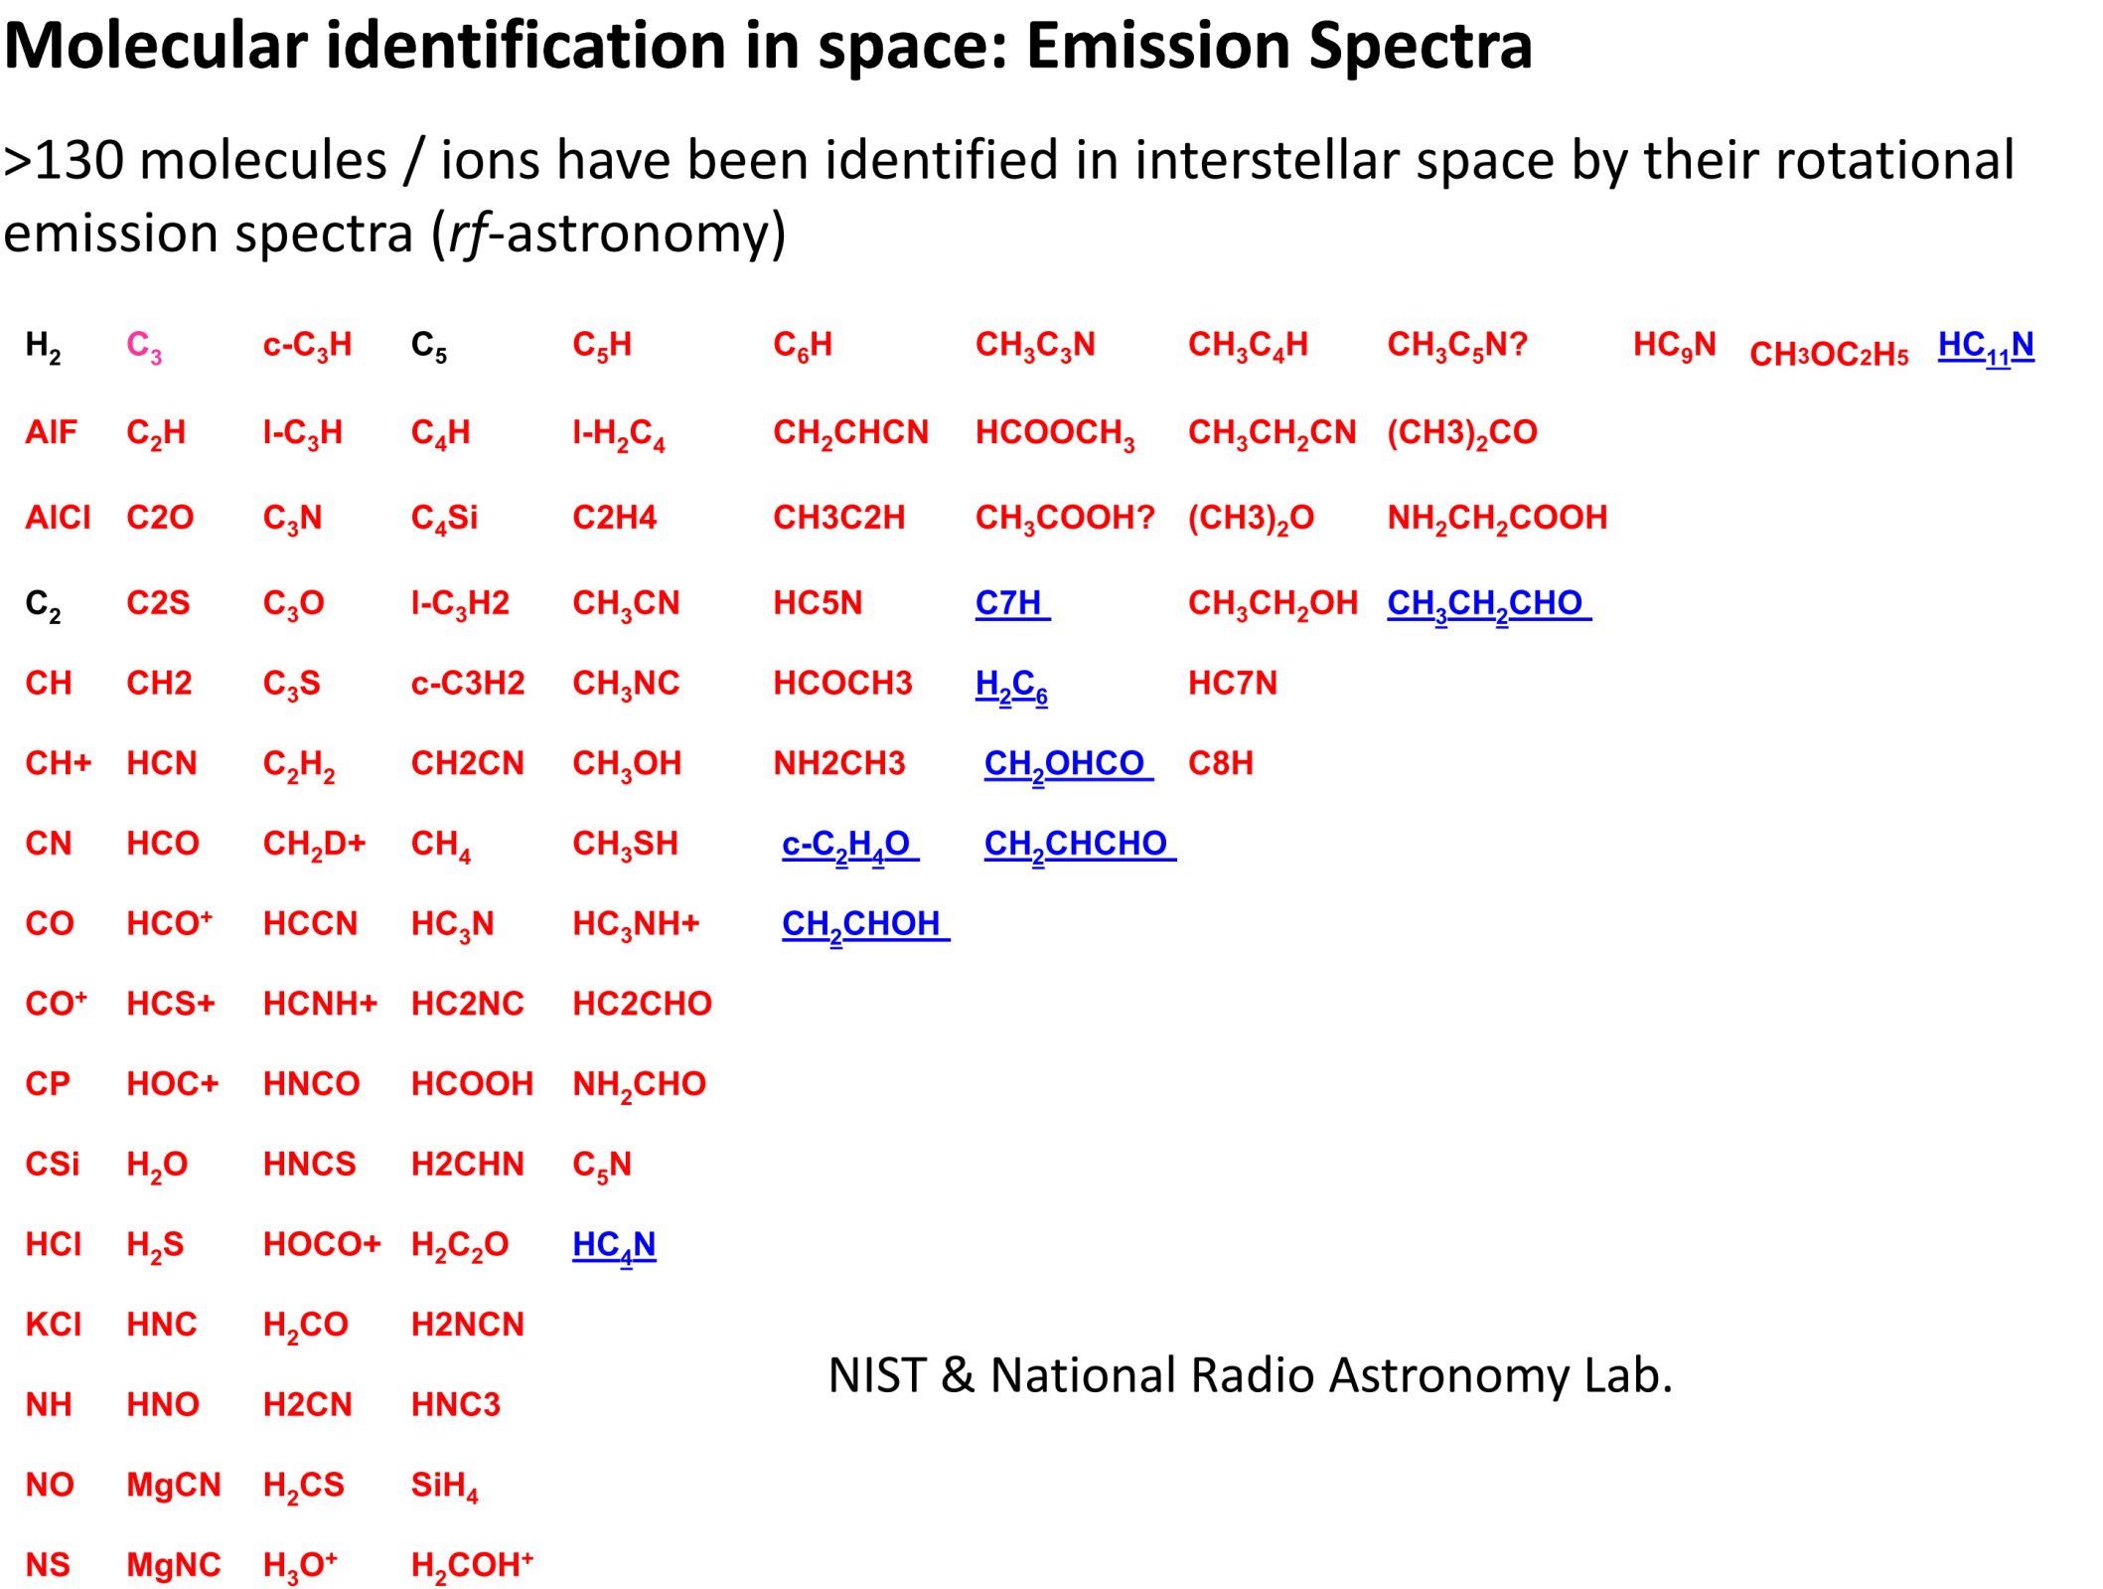

Slide 9
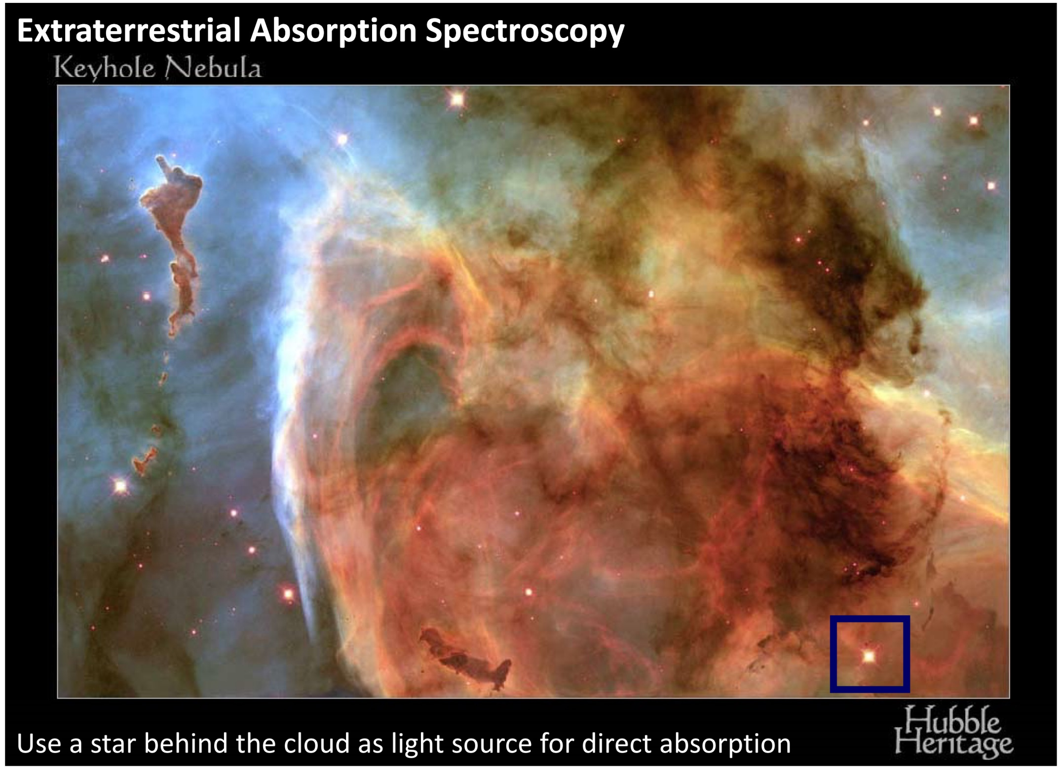

Slide 10
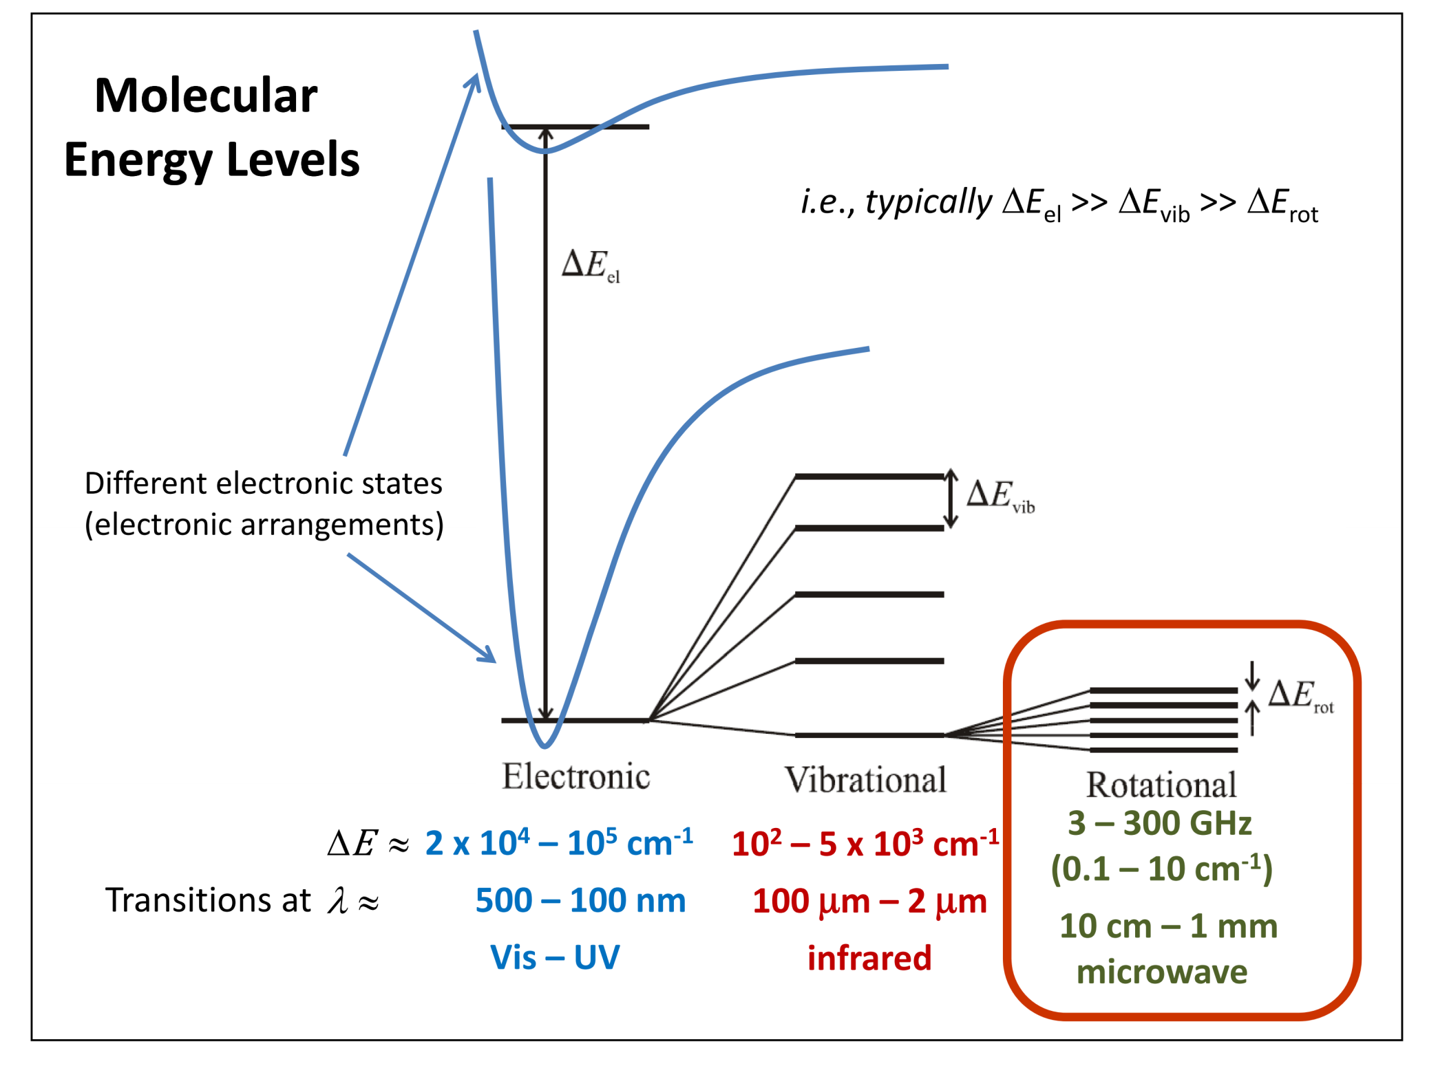

Slide 11
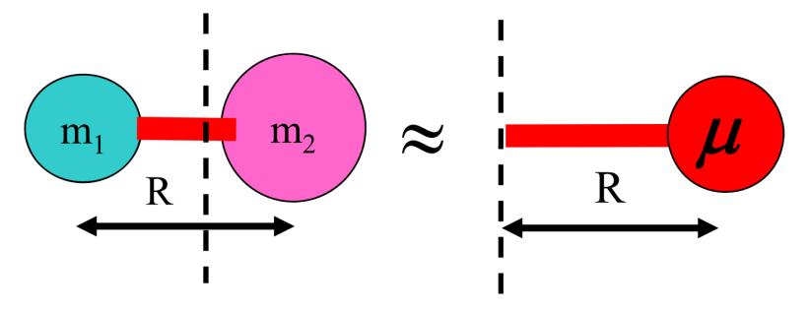
Moment of inertia
m_{i} – particle mass, r_{i} – perpendicular distance to the axis going through the centre of mass
for diatomi molecule:
impulsemoment:
Rotational kinetic energy:

Slide 12
Rigid rotor approximation
From Schrodinger equation (kinetic energy only):
r constant (rigid rotor)
solution in form of spherical harmonics and enerrgy:
J = 0,1,2,3...
m_{J} = 0, ±1, ±2,..., ±J

Slide 13
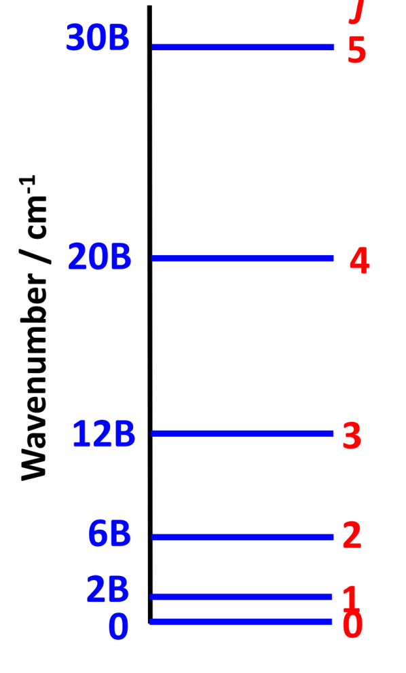
Diatomic molecule, rigid rotor
J – rotational quantum number, J = 0, 1, 2, ...
B – rotational constant
rotational terms in wavenumbers:
H₂ 60.85 cm⁻¹
CO 1.93 cm⁻¹
HCl 10.59 cm⁻¹

Slide 14
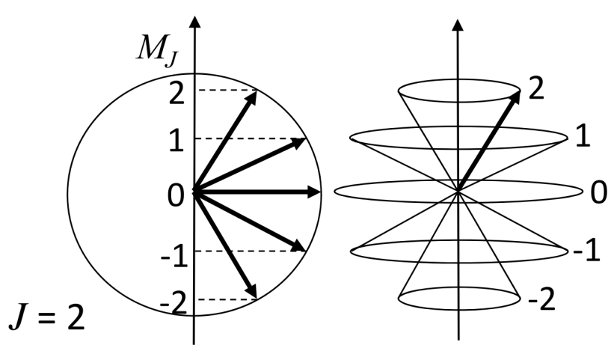
Diatomic molecule, rigid rotor
the rotational constant links spectroscopic observations to the geometric structure of the molecule
For diatomic molecules, the interatomic distance can be calculated from the rotational constant to a first approximation
- isotopic effect – R constant, μ different -> B will be different
Degenerace rotačních hladin
In the absence of an external field, each rotational level described by the quantum number J is degenerate (2J+1) times (due to the projection quantum number M)

Slide 15
Occupancy of individual rotational levels
The level with the largest population is found from:
The influence of the nuclear spin (nuclear spin degeneracy factor) is not taken into account here. E.g. for H₂, ortho and para states have different statistical weight (3:1)

Slide 16
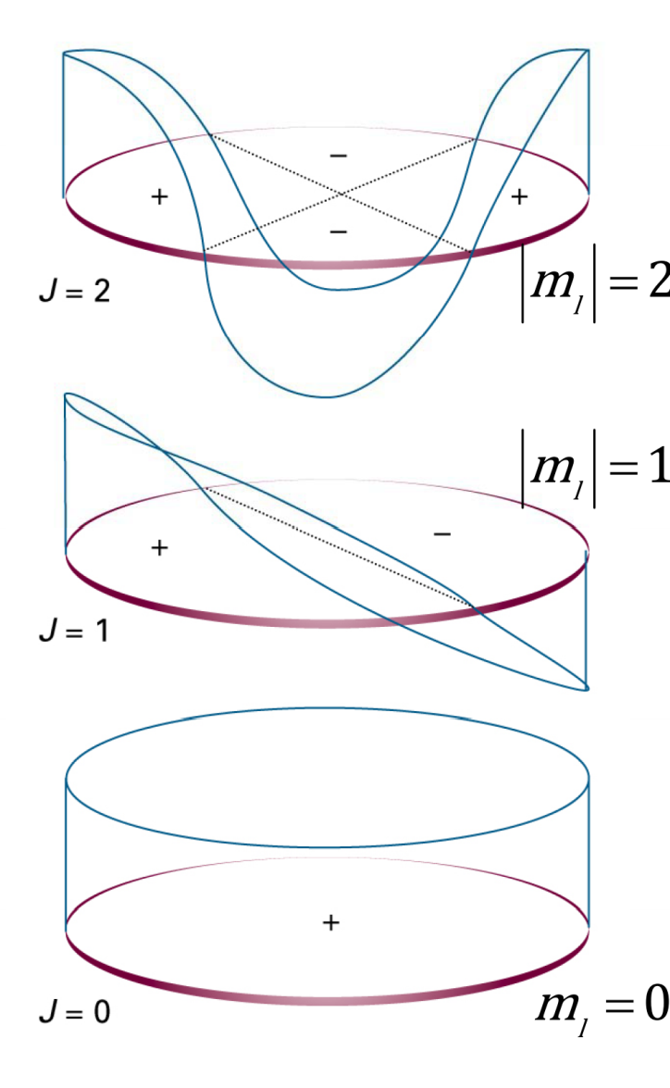
Wavefunction
General solution: Sphericl harmonics
Normalisation
Legendre polynomial (associated)
Due to cyclic boundary conditions:
M_{J} = 0, ±1, ±2,...
Their symmetry can be seen on the real parts of these functions (even and odd levels have the opposite parity).
Parity = (-1)^{J}

Slide 17
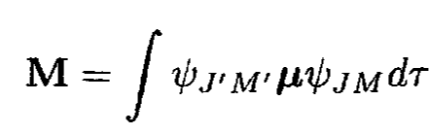

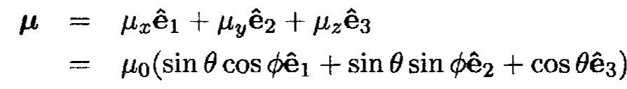
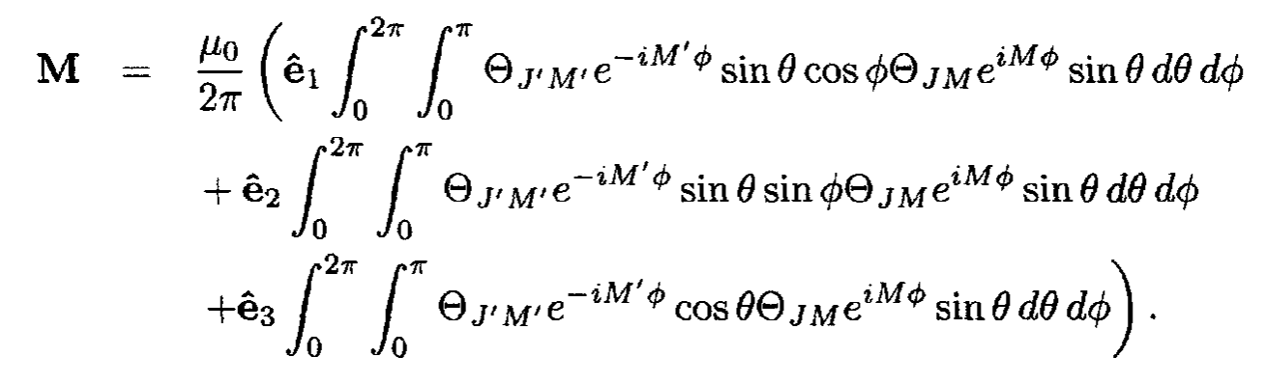
Rotational spectroscopy
Selection rules
The intensity of a purely rotational transition is given by the transition dipole moment:

Slide 18
Rotational spectroscopy
Selection rules
For Legendre polynomials:
And:

Slide 19
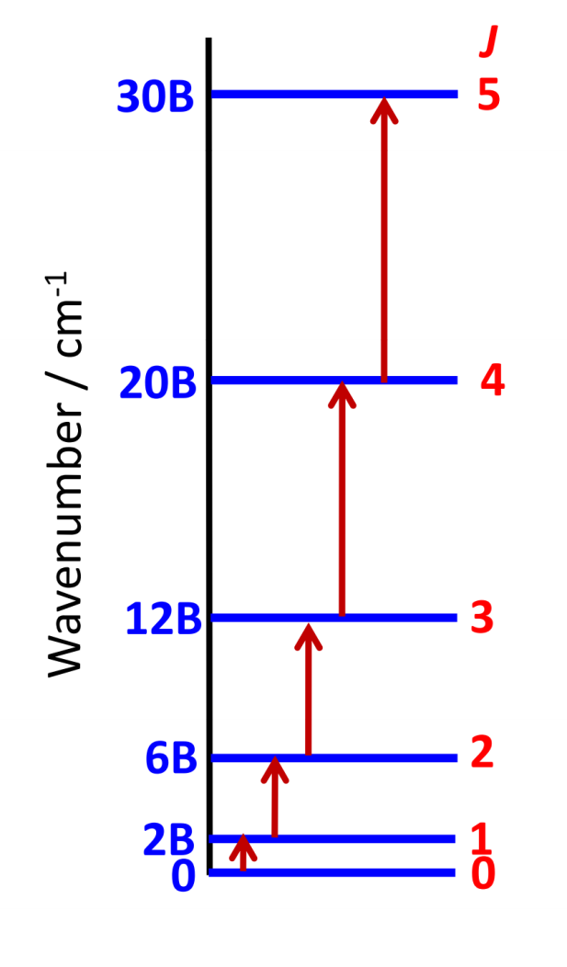
Rotational spectroscopy
Selection rules
In order for a molecule to exhibit a pure rotational spectrum, it must contain a permanent dipole moment
e.g. the molecular ion H₃⁺ does not have a permanent dipole moment (see the previous lecture on the symmetry of molecules) -> it does not have a purely rotational spectrum
2) ΔJ =± 1, ΔM =0, ± 1
- conservation of angular momentum, the parity of the wave function must change during a rotational transition
Rotational spectroscopy performed in the laboratory uses absorption because spontaneous emission is slow (A ≈ ν³, see the first lecture)

Slide 20
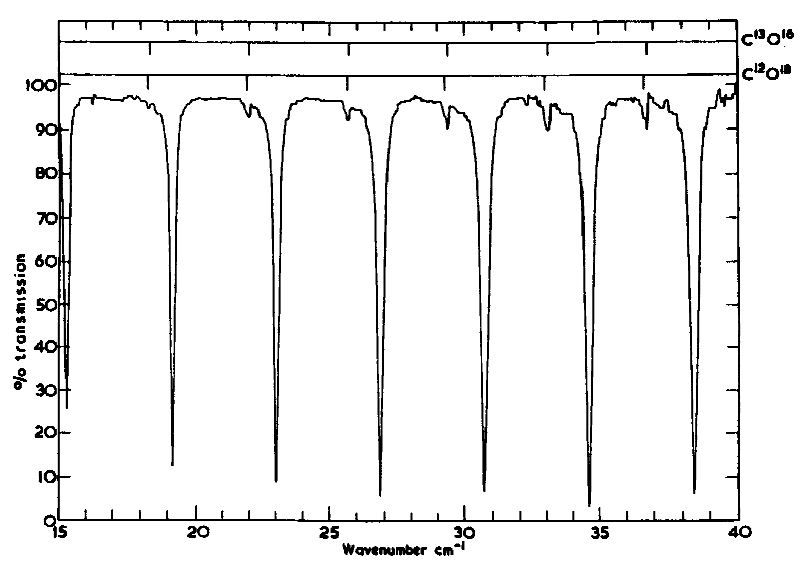
Rotační spektroskopie
isotopes
Absorption spectrum of CO molecule, transitions from J = 4←3 (15.38 cm⁻¹) to J = 10 ←9 (38.41 cm⁻¹)

Slide 21
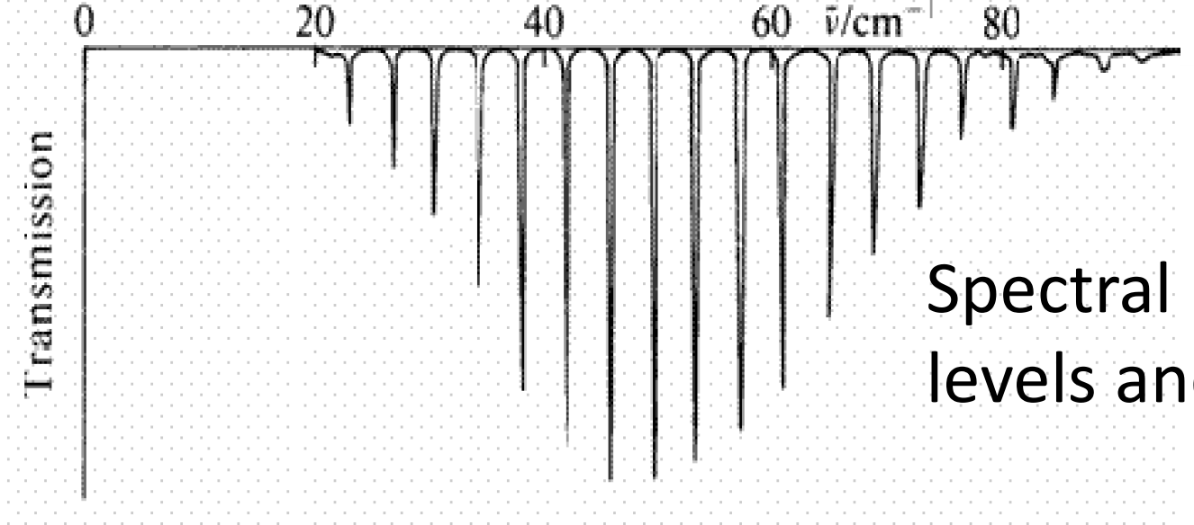
Rotační spektroskopie
Again rotational spectrum of CO at 300 K
The spectrum profile depends on the population of the lower levels and the dependence of the transition strength on J (more on that later)
Transitions in the microwave region: 1 – 100 cm⁻¹ (λ = 1 cm - 100 μm)
The spacing between the absorption lines is

Slide 22
Classification of molecules
Moment of inertia:
The classification of polyatomic molecules is based on their moments of inertia (I_{a}, I_{b}, I_{c}) about three mutually perpendicular axes (a,b,c) passing through the center of mass (principal axes).
It applies I_{c} = I_{max} a:

Slide 23
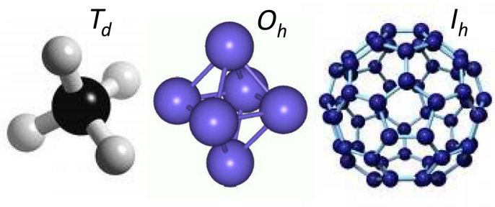
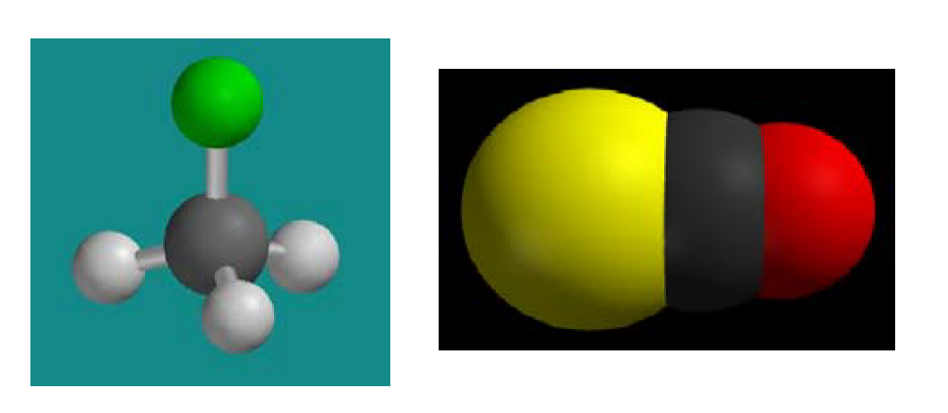
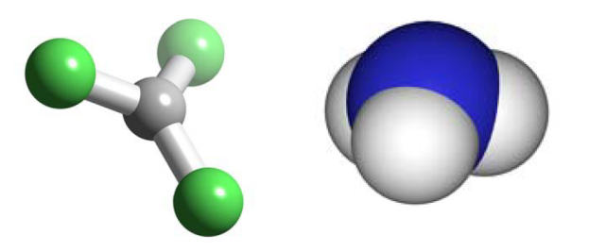
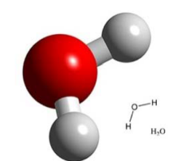
Classification of molecules
Spherical tops
Symetric tops (two I_{i} the same)
  Prolate tops
  Oblate tops
Asymmetric tops:
CH₄ SF₆ Fullerene
CH₃F
H₃⁺ BF₃
H₂O

Slide 24
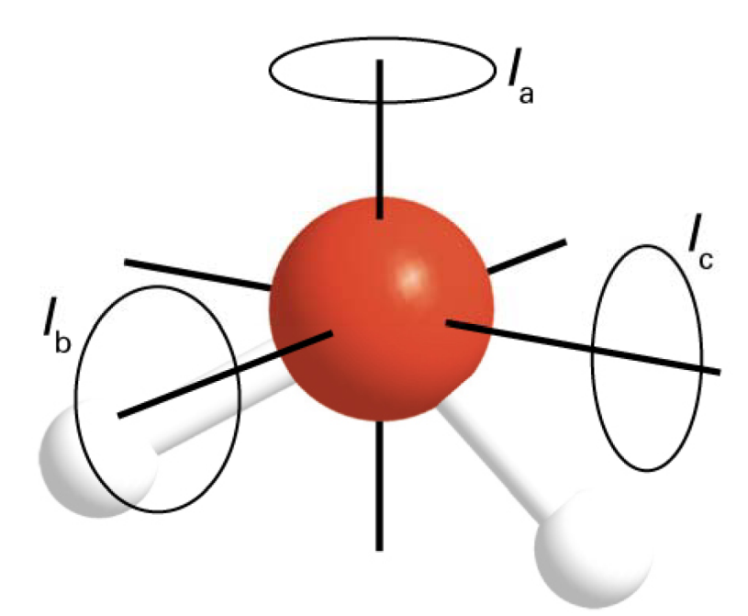
Rotational terms
For diatomic molecules:
In general, 3 such constants are needed:
In units of cm⁻¹:
Example: H₂O
These numbers are no longer directly related to the individual bond distances in the molecule

Slide 25
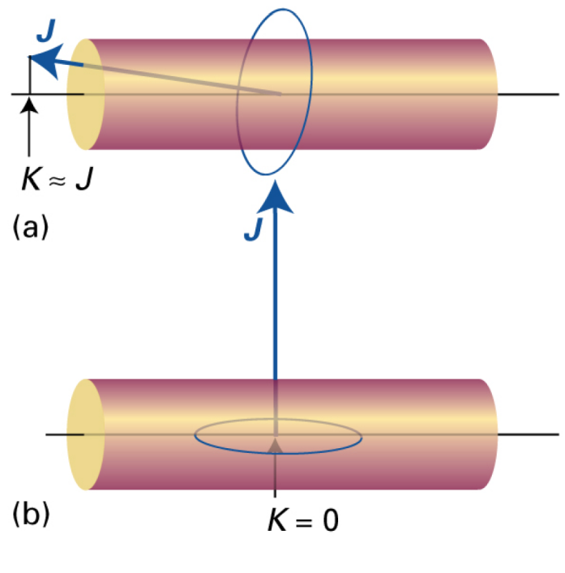
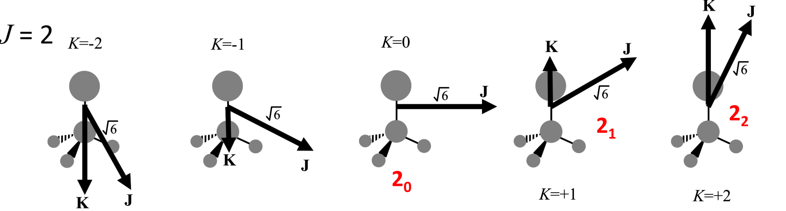
Prolate tops
levels denoted J_{Ka}
J –total angular momentum, rotational quantum number
K_{a} – projection quantum number (projectiom of J a axis)
Each level is 2J+1 fold degenerated due to M_{J} and for K > 0 additionally twice degenerate due to ± K

Slide 26
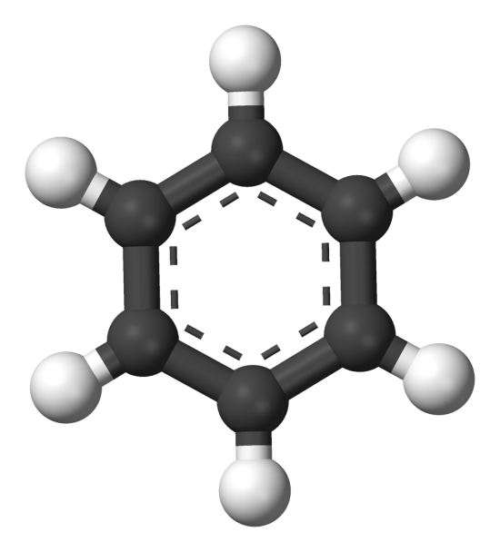
Oblate tops
levels denoted J_{Kc}
J –total angular momentum, rotational quantum number
K_{c} – projection quantum number (projection of J na c axis)
These are typically flat molecules (benzen, H₃⁺)
Each level is 2J+1 fold degenerated due to M_{J} and for K > 0 additionally twice degenerate due to ± K

Slide 27
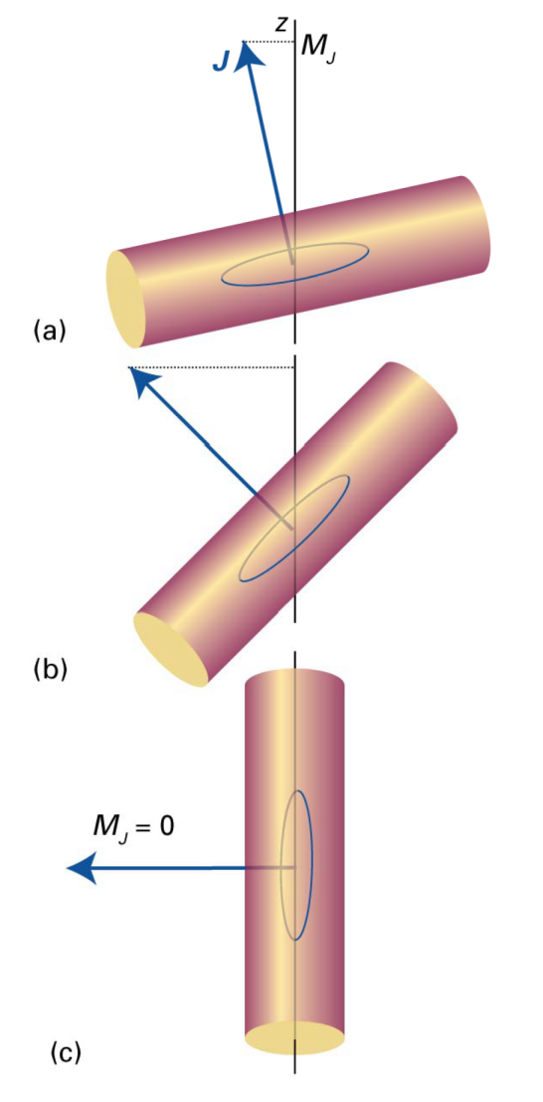
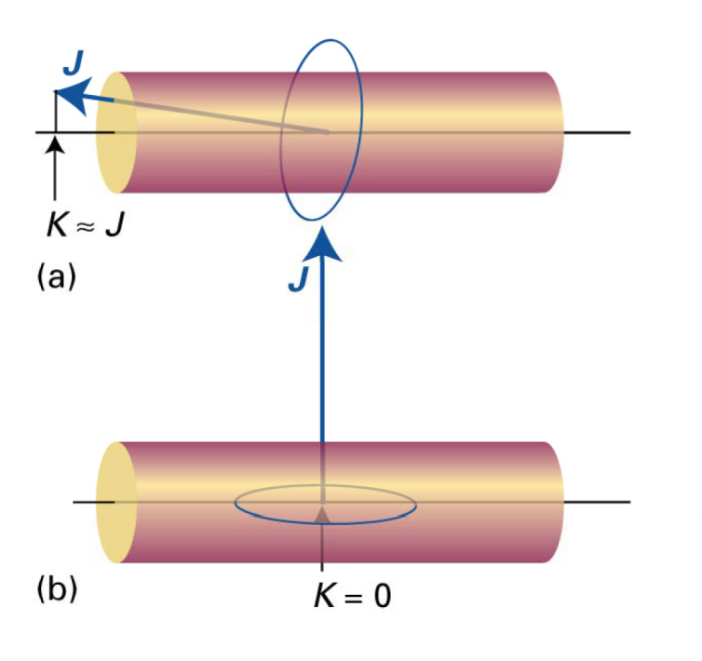
To the various projections mentioned
K refers to the projection of J onto an axis fixed to the body of the molecule (for a prolate top it is the a axis)
M_{J} refers to the projection of J onto the coordinate (z) axis

Slide 28
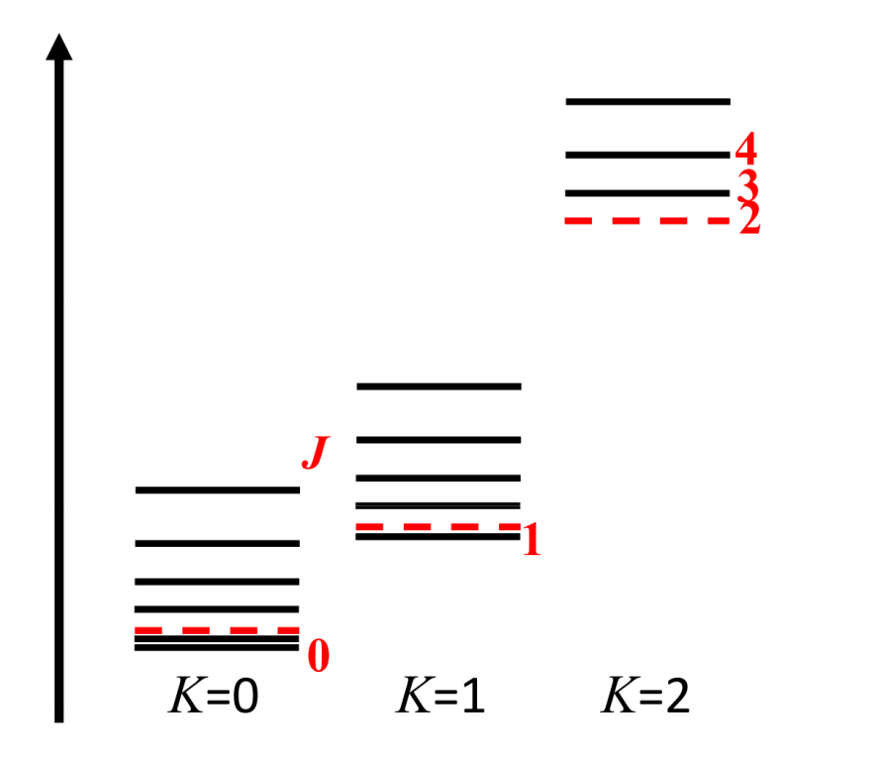
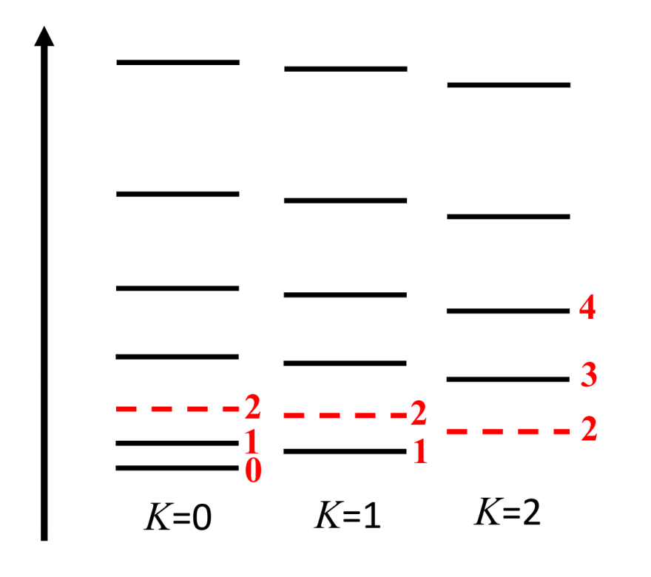
Energy levels for symmetric tops
Rotational terms: Prolate tops Oblate tops
>0
<0
For given J, energy increases with K
For given J, energy decreases with K

Slide 29
Energy levels for symmetric tops
Example: H₃⁺
Oblate top
For given J, energy decreases with K

Slide 30
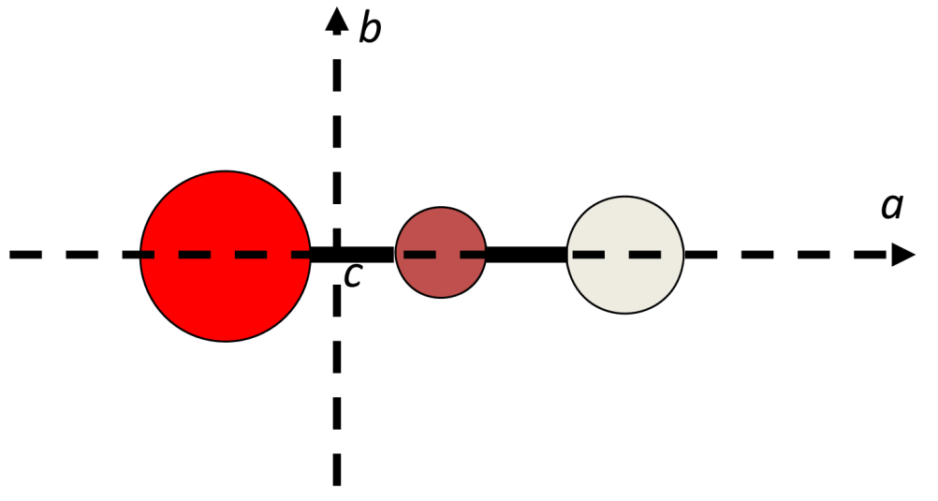
Linear molecules ( )
Limiting case of symmetric oblate top
There is only K = 0:
Similar to a diatomic molecule.
Example: HCO⁺

Slide 31
Spherical tops (T_{d}, O_{h}, I_{h})
CH₄ SF₆ Fullerene
Attention: (2J+1)² fold level degeneration

Slide 32
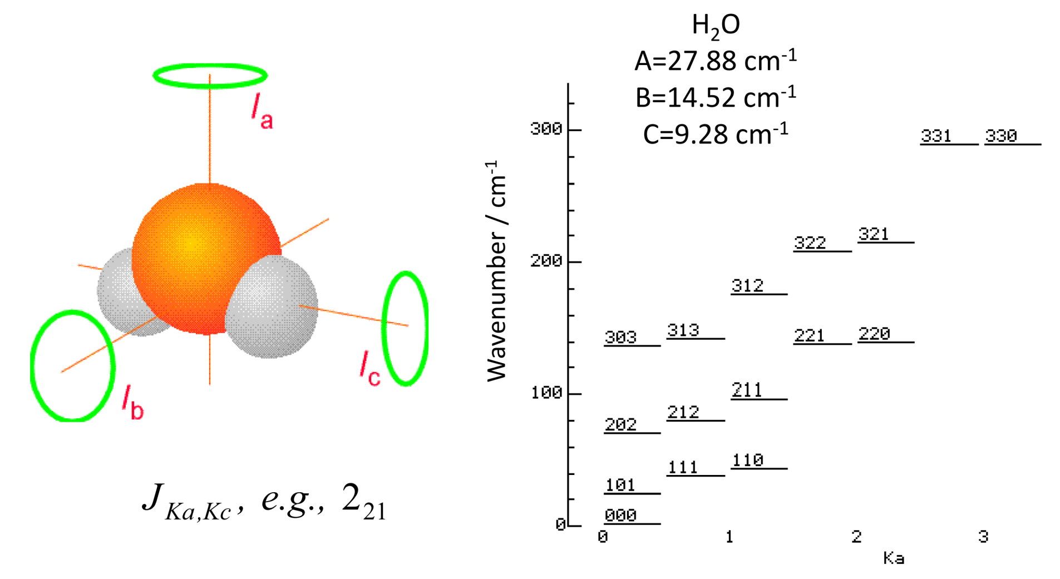
Asymmetric tops
For most molecules, there is no simple analytical expression for the energy of the rotational levels. Some molecules are described as being "near prolate" or "near oblate" tops. In general, it is possible to derive the values ​​of rotation terms by numerical methods.

Slide 33
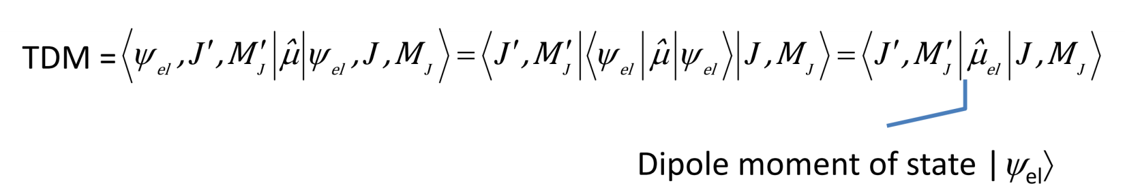
Rotational spectroscopy
Výběrová pravidla
In order for a molecule to exhibit a pure rotational spectrum, it must contain a permanent dipole moment
ΔJ =± 1 ΔK = 0
- it follows from TDM, these conditions can be thought of as the need to preserve the angular momentum and change the parity of the wave function during a rotational transition

Slide 34
Spectra of symmetric top molekules
prolate oblate
rotational terms:
Allowed transitions:
In the rigid rotor approximation, the spectra of prolate and oblate tops are the same as the spectra of linear molecules and spherical tops -> the distance between individual absorption lines is
Thus, we do not obtain information about other rotational constants from the spectrum.

Slide 35
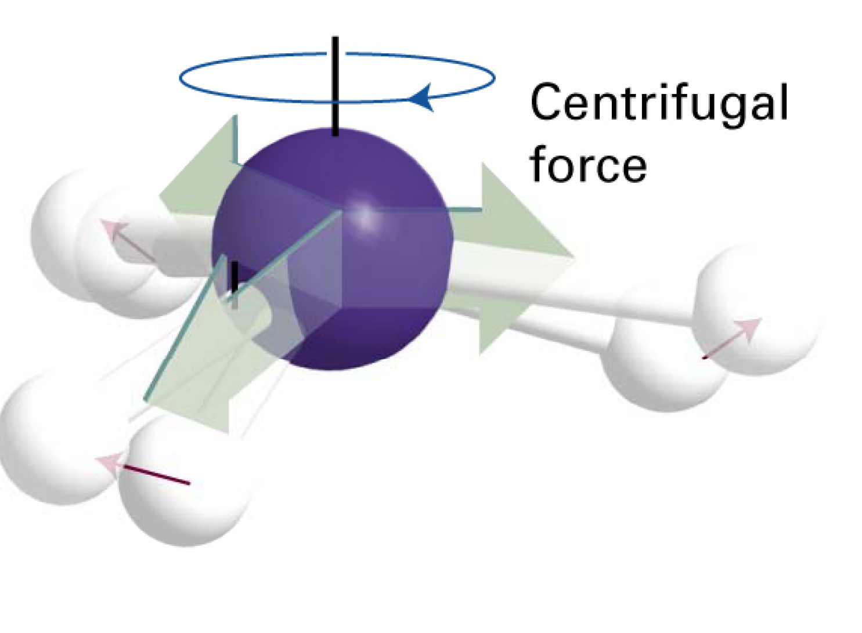
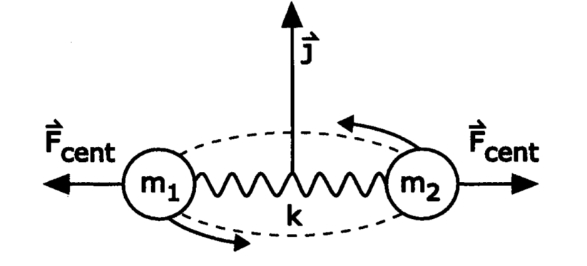
Centrifugal distortion
Molecules do not behave like completely rigid rotors. Their bonds are stretched during rotation -> the individual moments of inertia (and thus the rotational constants) change with J
The effect of centrifugal distortion on the rotational terms is calculated as a perturbation of the rigid rotor terms.

Slide 36
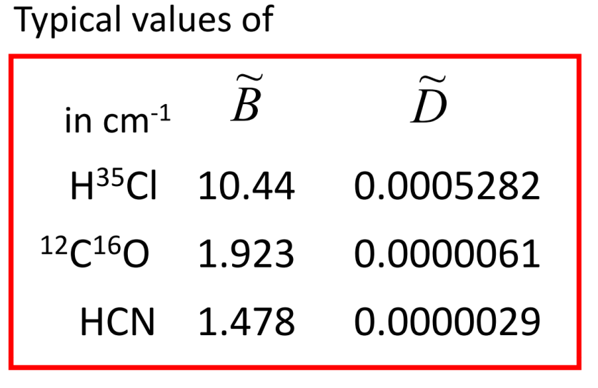
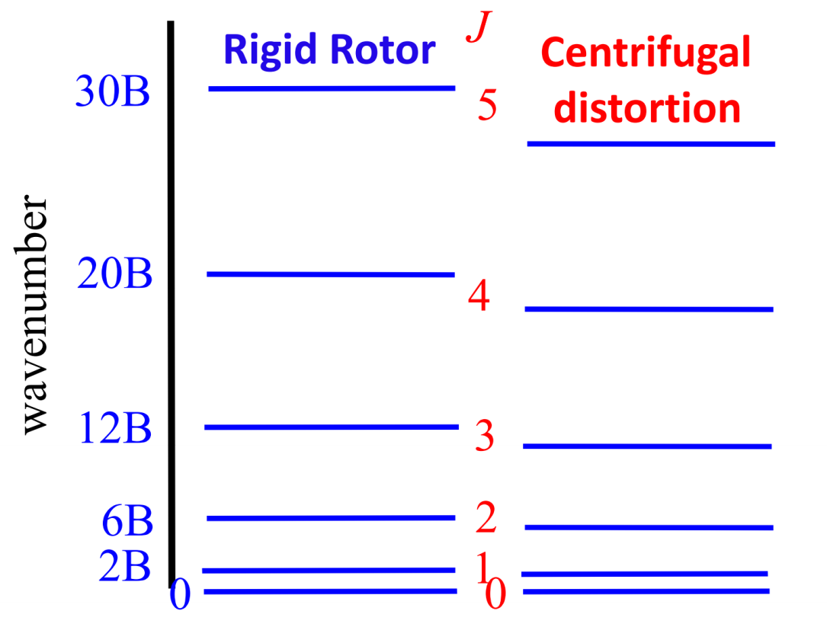
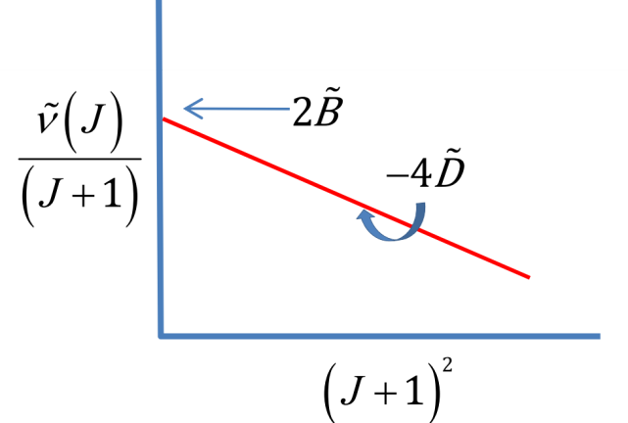
Centrifugal distortion
D is centrifugal distortion constant (v cm⁻¹)

Slide 37
Centrifugal distortion
Higher order corrections can be found in literature:

Slide 38
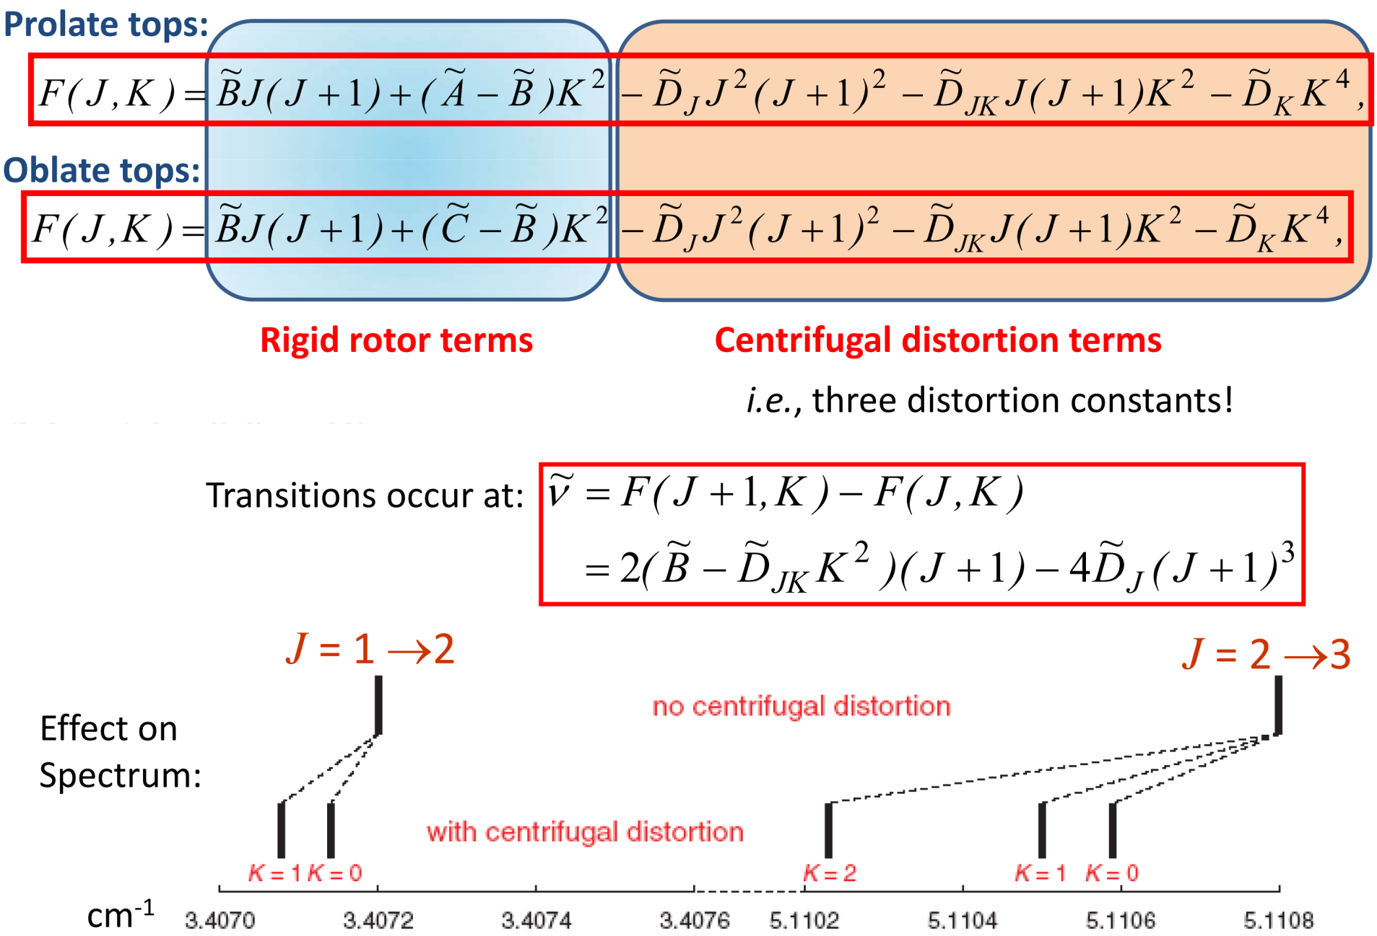
Centrifugal distortion – symmetric tops

Slide 39
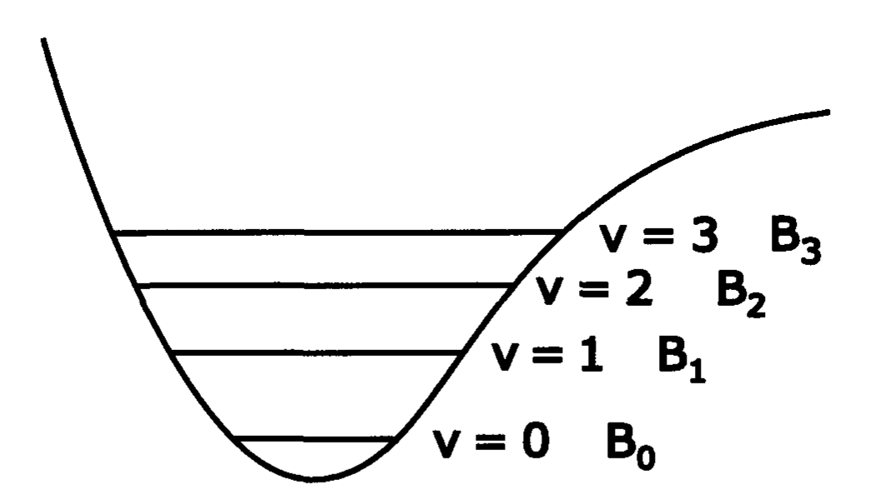
Dependence on vibrational quantum number
For diatomic molecules
Each vibrational level of a diatomic molecule has its own rotational constant B_{v}

Slide 40
Dependence on vibrational quantum number
For polyatomic molecules:
Degeneration i-th vibrational mode

Slide 41
Intensity of transitions
for the line strength (see first lecture) of symmetric top molecules:
ΔJ =± 1 ΔK = 0
Honl-London factors
dipole moment
The spectrum is, however, additionally complicated by the influence of nuclear spin statistics on the population of individual states

Slide 42
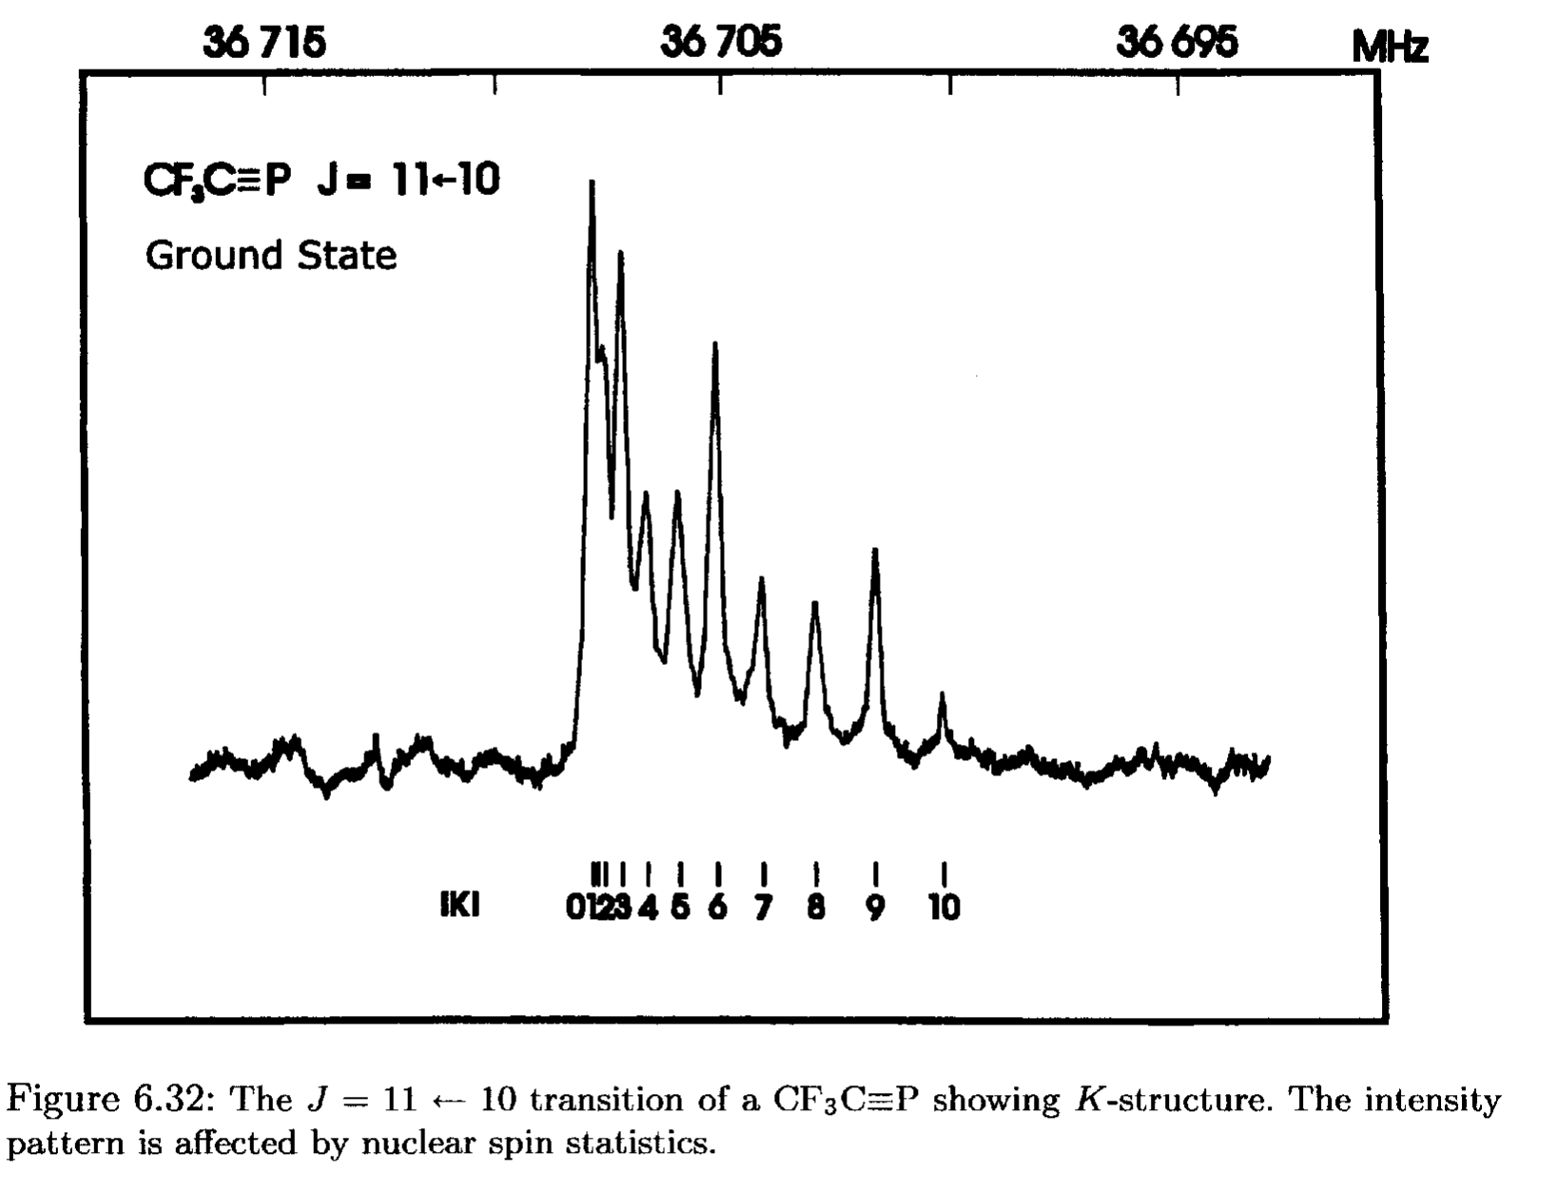
Intensity of transitions

Slide 43
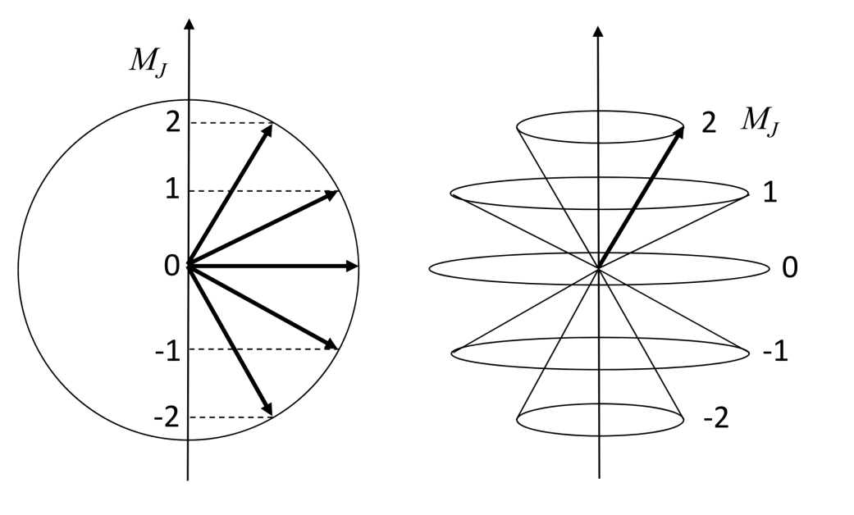
Splitting of spectral lines due to external field – Stark effect
Each rotational level with quantum number J is (2J+1) times degenerate due to M_{J}
e.g. J = 2
M_{J} = -2, -1, 0, 1, 2
Under the action of an external field (electrical or magnetic), the energy levels are split.

Slide 44
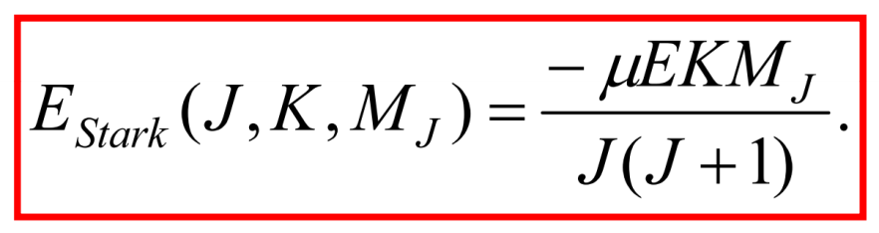
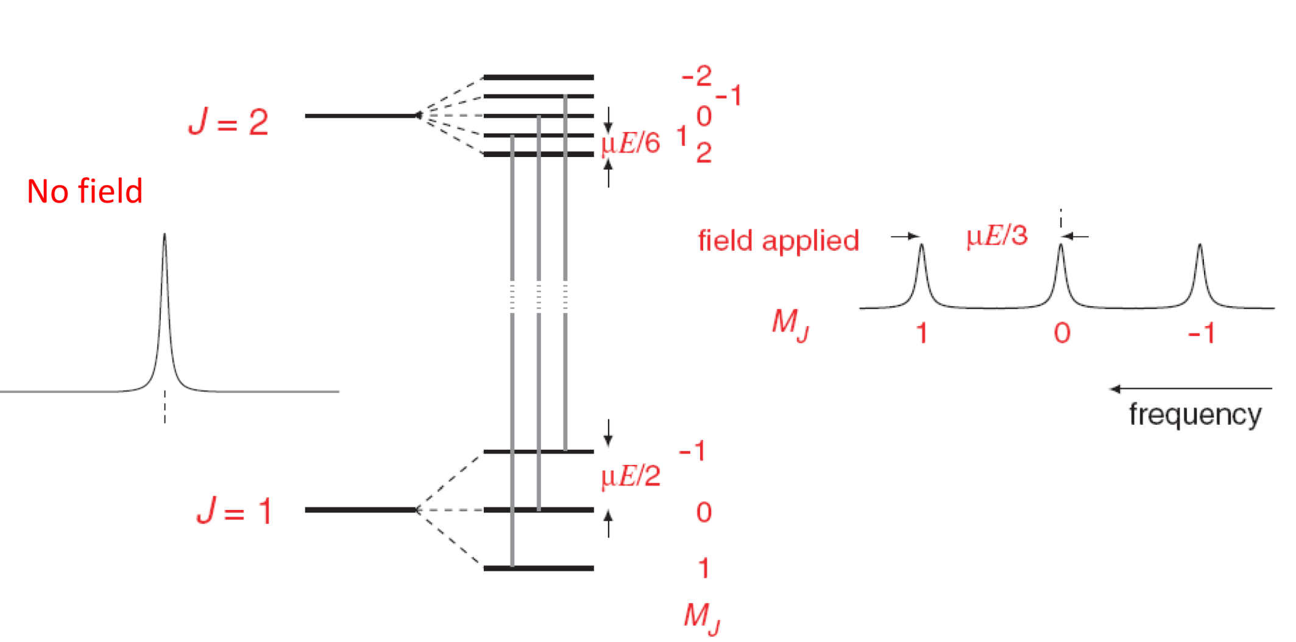

Stark effect
For symmetric top molecules:
Selection rule ΔM_{J} = 0.
Transition
Can be used to determine the absolute value of J in more complex spectra.

Slide 45
Influence of nuclear spin
Nucleons (protons, neutrons) are fermions and have a nuclear spin moment I with a corresponding quantum number I.
Even mass number-> bosons -> I is an integer
Odd mass number -> fermions-> I is a half integer
Influence on rotational levels:
Nuclear spin can interact with external magnetic fields (this is what NMR is based on) or internal magnetic fields -> hyperfine structure of spectral lines
Influence on whether a given rotational level exists in the molecule (a consequence of nuclear spin statistics) and on its weight (example H₂).
Pauli principle:
The wave function is antisymmetric with respect to the exchange of two identical fermions and totally symmetric with respect to the exchange of two identical bosons.

Slide 46
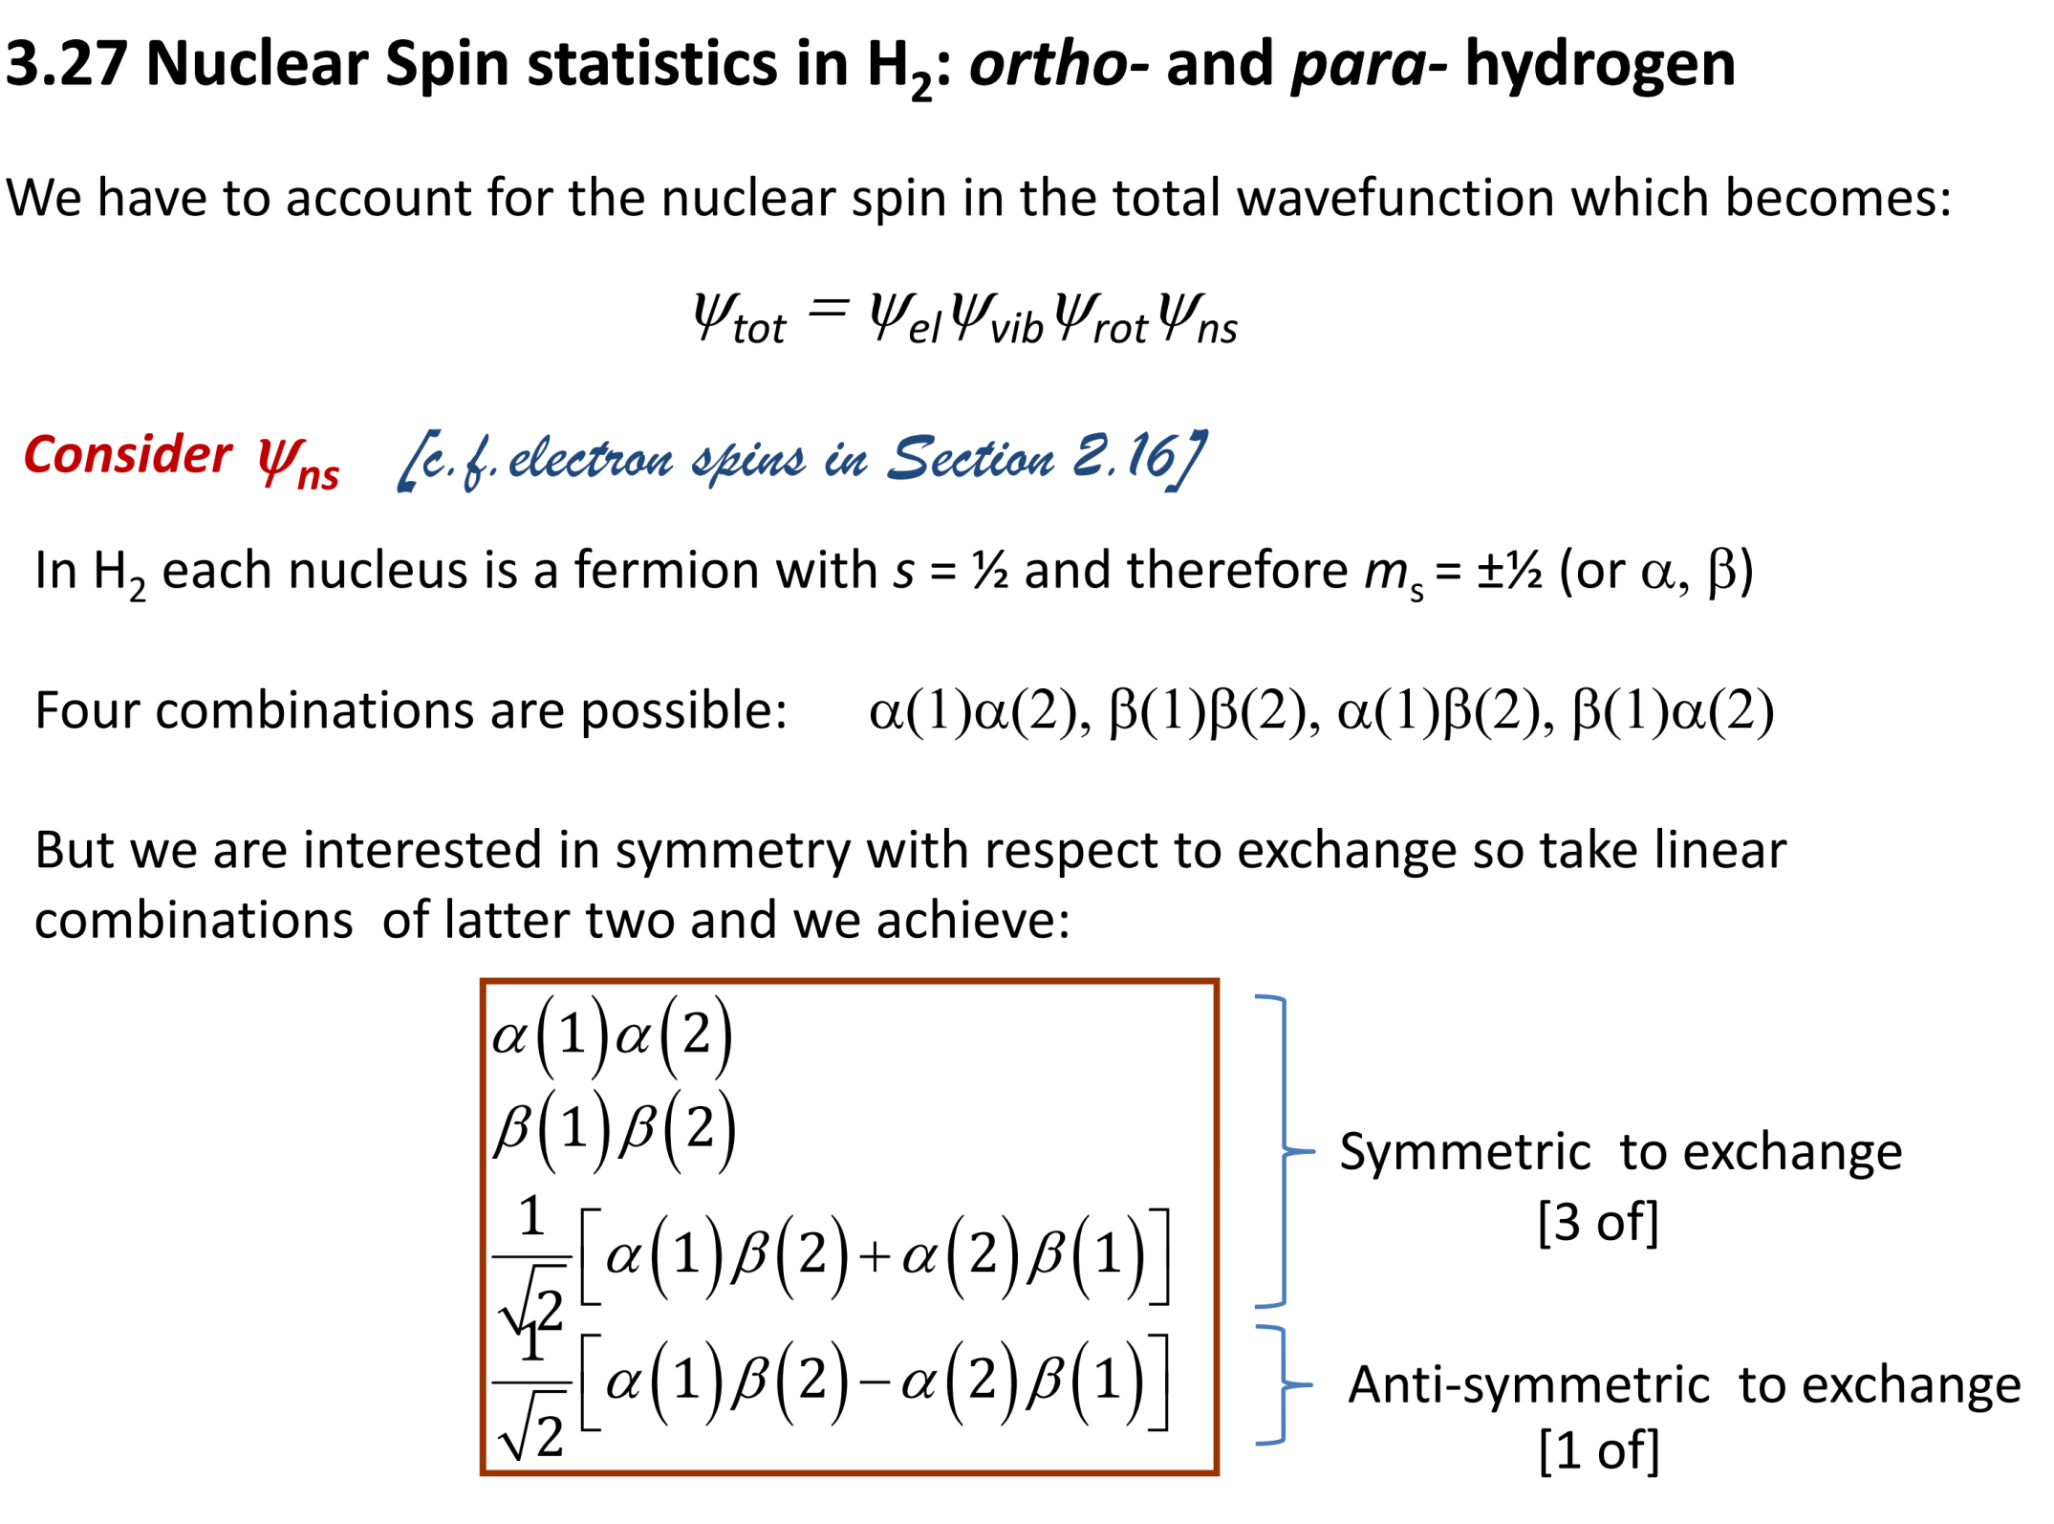

Slide 47
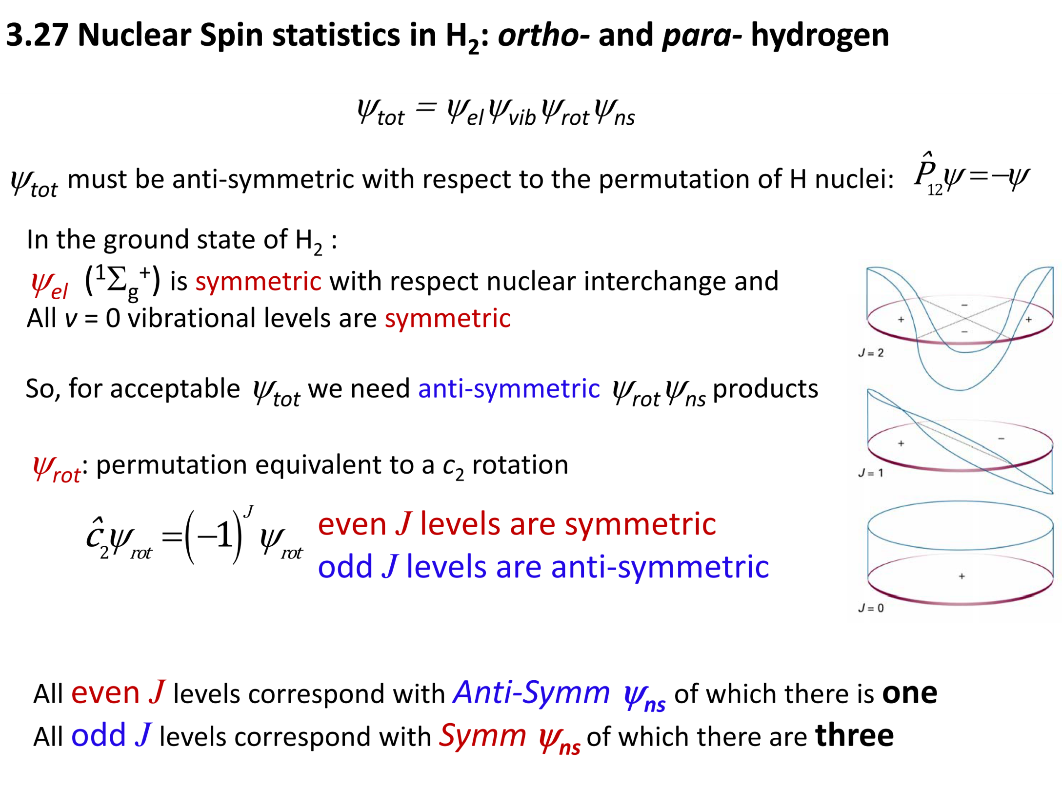

Slide 48
