Slide 1
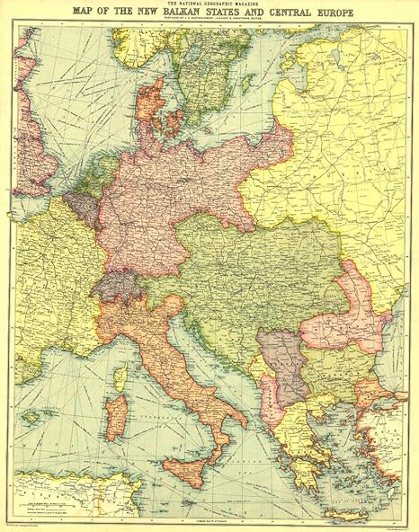
Historical Research on Transnational Spaces
Transnational History of Contemporary Europe
Seminar
Tereza Juhászová

Slide 2
Historical Research On Transnational Space
Illuminating processes of production and construction of spaces
Examining cultural practices
Identifying differences and relations of co-existence of spatial representations
Observing the spatialization and localization of social relations
Analysing the spatial self-representations and configurations of groups and societies as well as their consequences
Ángel Alcalde, “Spatializing Transnational History: European Spaces and Territories,” European Review of History: Revue Européenne d’histoire 25, no. 3–4 (July 4, 2018): 559.

Slide 3
Historical Research On Transnational Space
Spatial dynamics (emergence, change and dissolution of spaces),
Spatial perceptions (including memories, representations and mental maps)
Spatial practices and uses
Ángel Alcalde, “Spatializing Transnational History: European Spaces and Territories,” European Review of History: Revue Européenne d’histoire 25, no. 3–4 (July 4, 2018): 559.

Slide 4
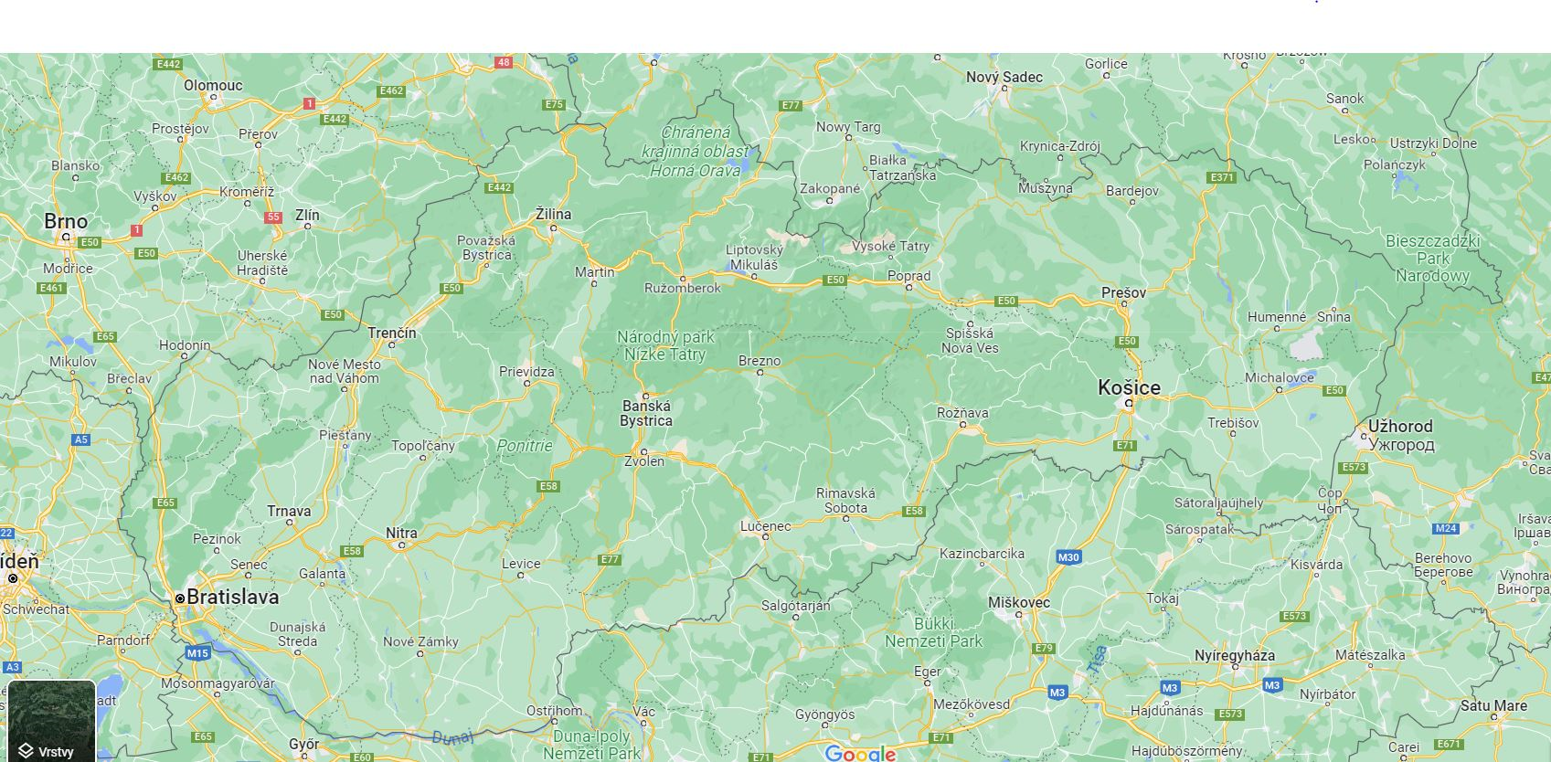

Slide 5
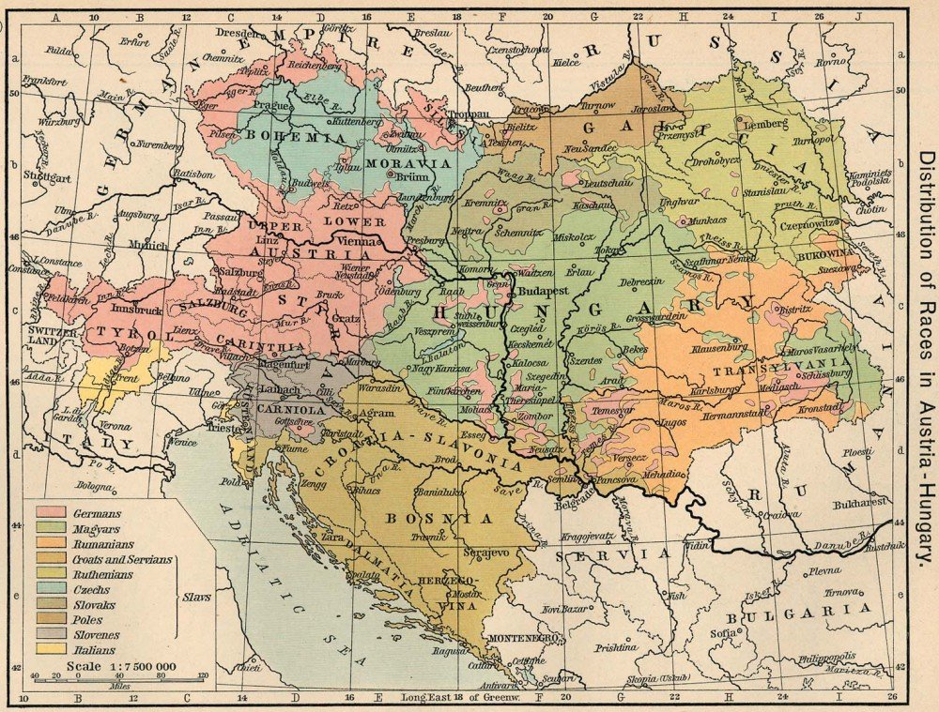

Slide 6
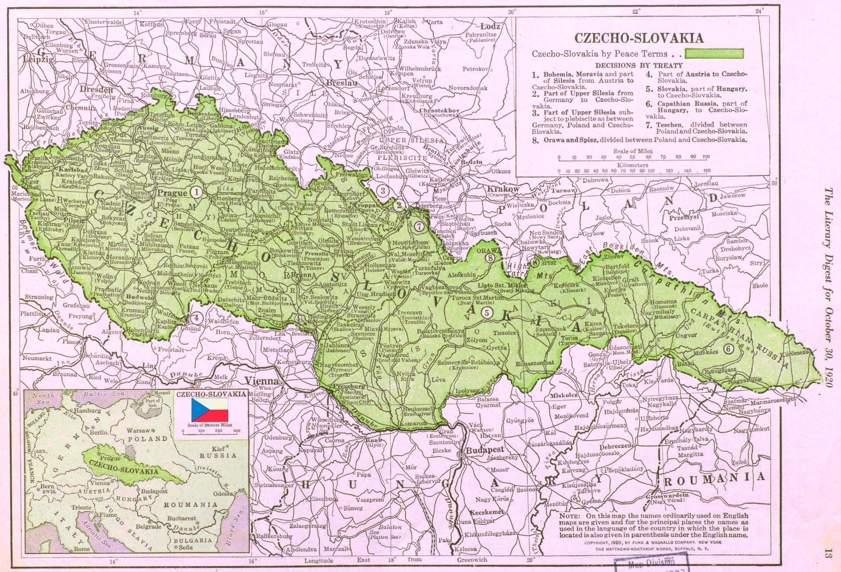

Slide 7
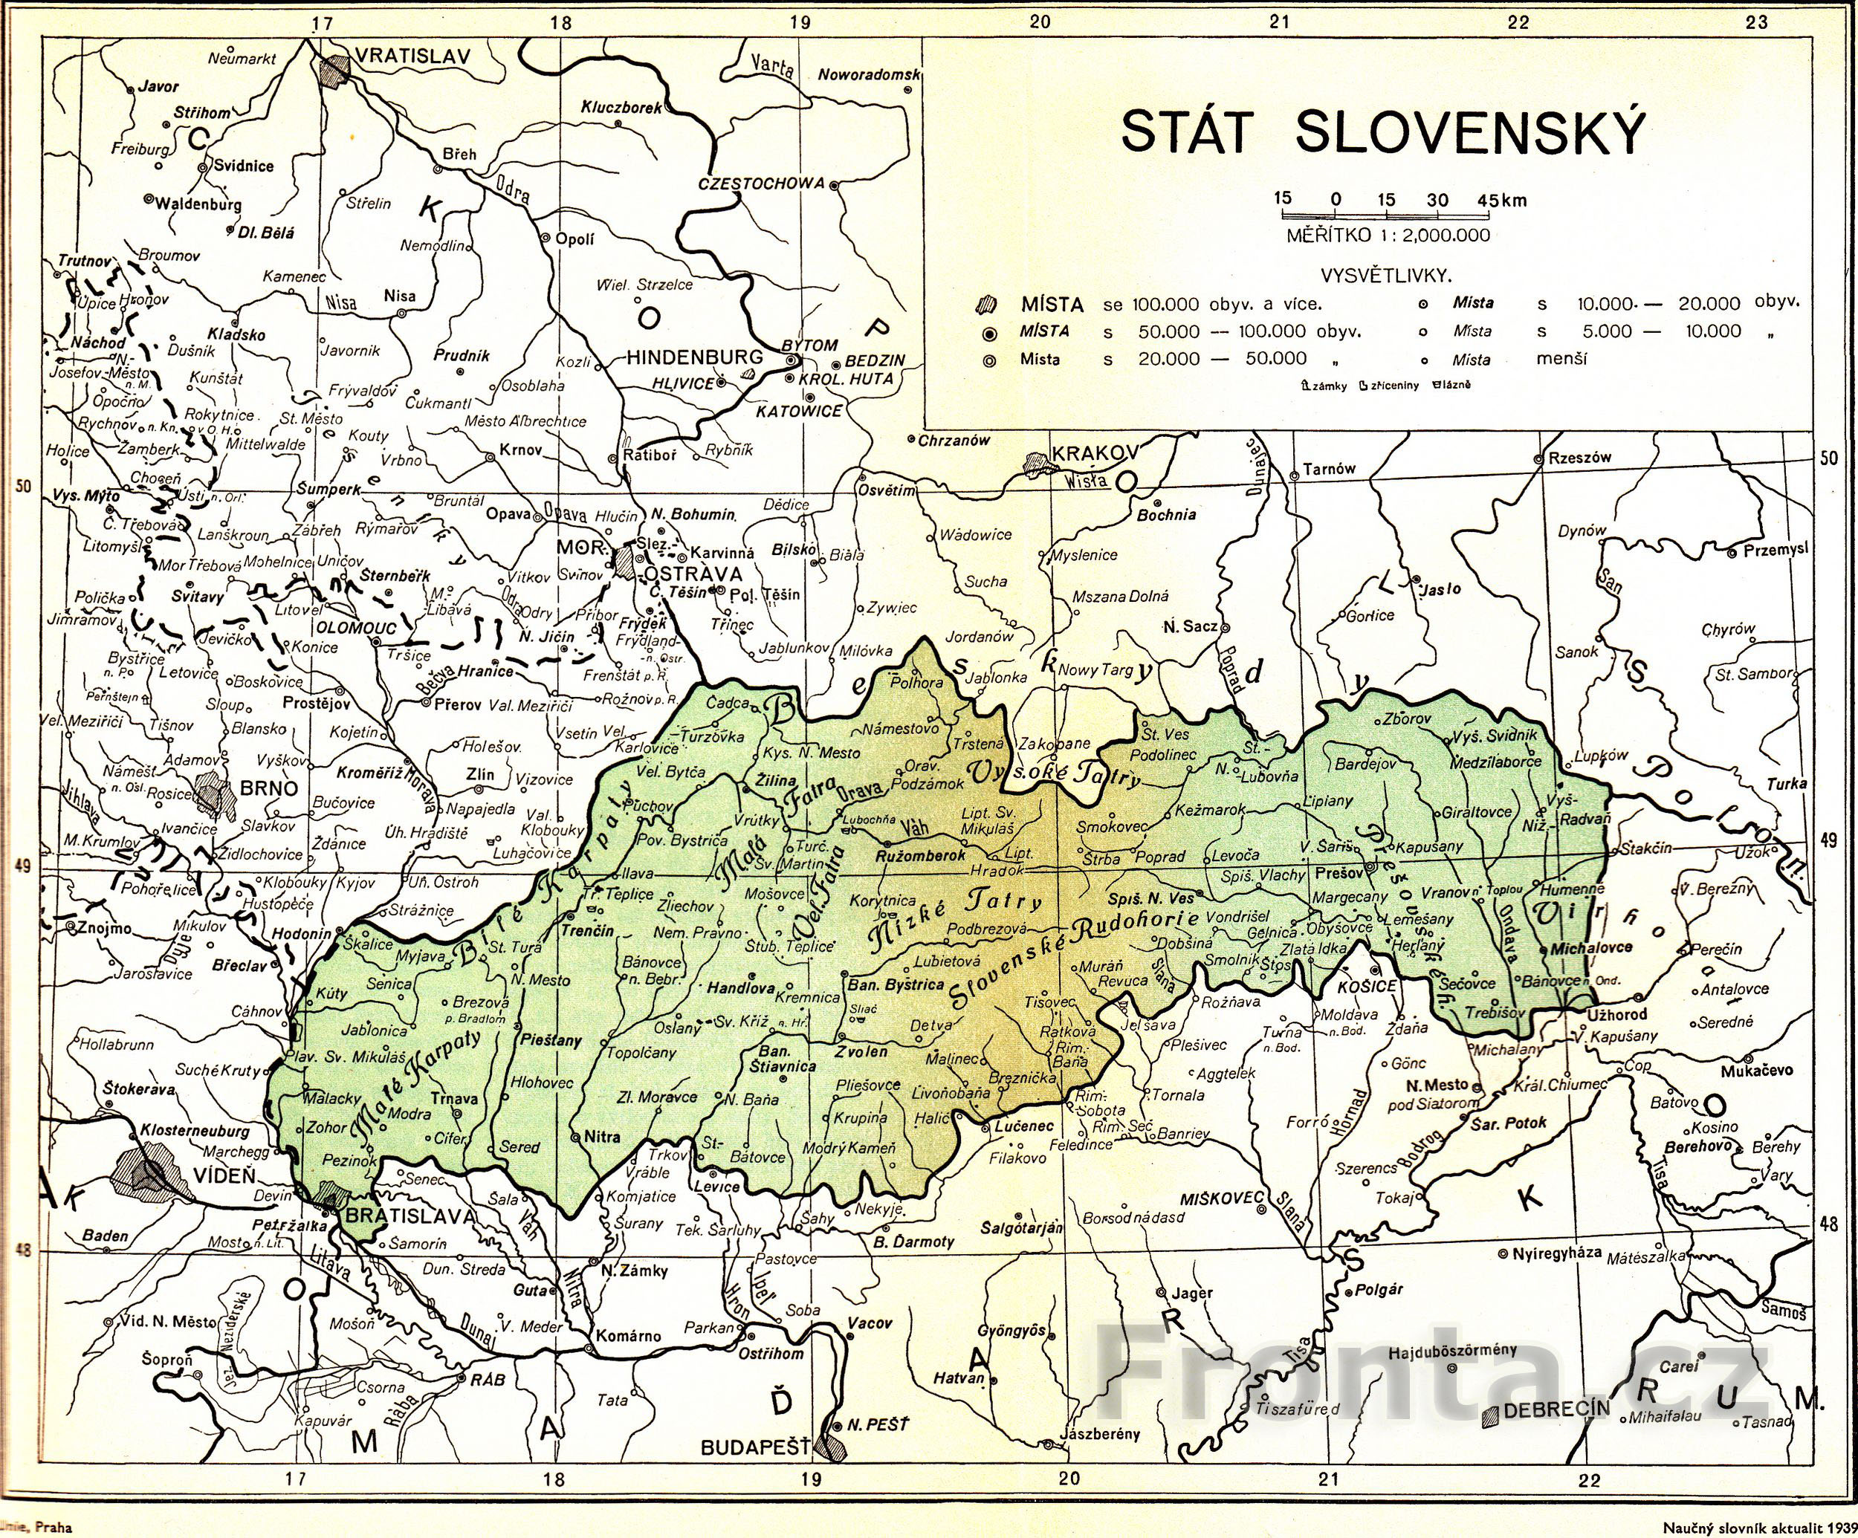

Slide 8
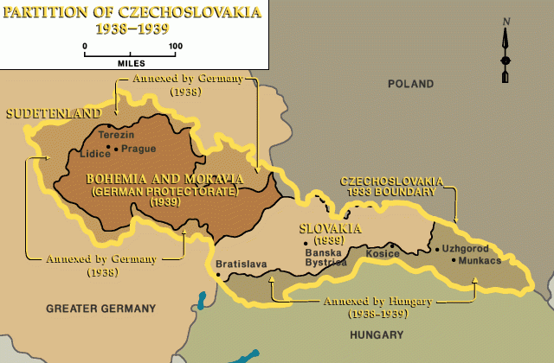
https://encyclopedia.ushmm.org/content/en/gallery/czechoslovakia-maps

Slide 9
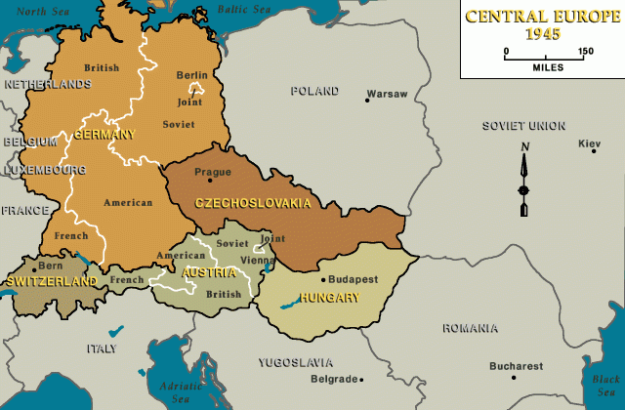
https://encyclopedia.ushmm.org/content/en/gallery/czechoslovakia-maps

