Slide 1
Rickettsia and related organisms, Chlamydia, Mycoplasma and Bacillus anthracis
Ústav lékařské mikrobiologie 2. lékařské fakulty UK a FN Motol

Slide 2
Rickettsial and related organisms -taxonomy
phylum PROTEOBACTERIA
class Alphaproteobacteria
order Rickettsiales
family Rickettsiaceae – genera Rickettsia, Orientia
family Anaplasmataceae – genera Anaplasma, Ehrlichia, Neorickettsia
order Rhizobiales
- family Bartonellaceae – genus Bartonella
class Gammaproteobacteria
- family Coxiellaceae – genus Coxiella

Slide 3
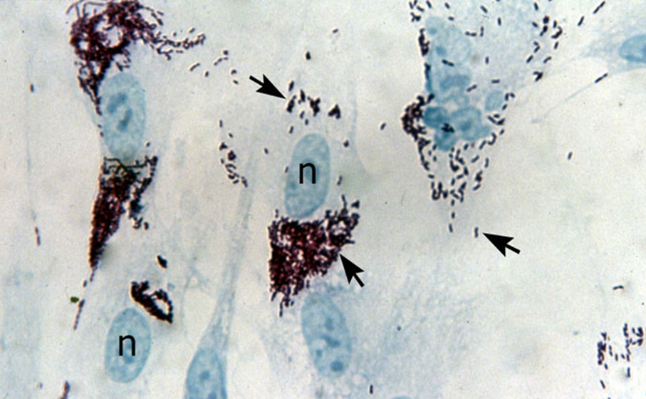
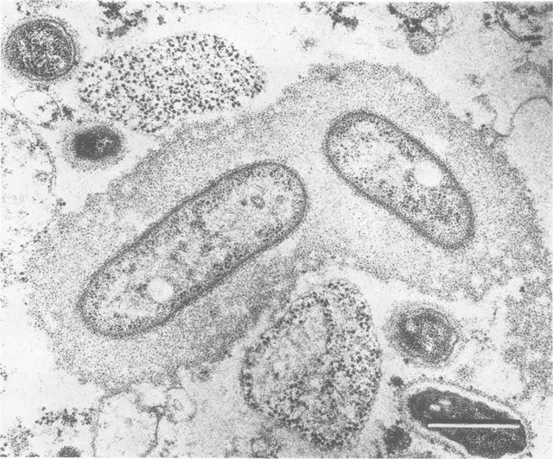
Rickettsia prowazekii bacteria growing inside human fibroblasts. The black arrows point to the bacteria and the 'n' indicates host cell nuclei.
Thin section of the Breinl strain of R. prowazekii similar to that shown in Fig. 2. Two rickettsiae appear to be embedded in the large, slime-like layer.
Reference: https://www.researchgate.net/publication/23052029_External_layers_of_Rickettsia_prowazekii_and_Rickettsia_rickettsii_Occurrence_of_a_slime_layer/figures?lo=1
Reference: https://ppdictionary.com/bacteria/bwum/prowazekii.htm

Slide 4
Rickettsiosses
Typhus group – epidemic typhus (Rickettsia prowazeki), murine typhus (R. typhi), cat-flea typhus (R. felis), susceptible to environmental conditions (exception R. prowazeki – survive for months in lice excrements)
Spotted fever group – other rickettsial agents (e.g. R. rickettsii causing Rocky Mountain spotted fever)
Scrub typhus group – Orentia tsutsugamushi, transmitted by mites, symptoms – fever, headache, inoculation eschar, lymphadenopathy, multiple-organ dysfuction sy (fatality 3-60%)
Epidemiology – animal hosts (man), vectors – arthropods
Patogenesis – affinity to vessel endotel – vasculitis (skin/exantema, organs/meningoencefalitis, intersticial pneumonitis, pericarditis), using phospholipase – relased from phagolysosome to cytoplasm, direct cell injury – vascular permeability – edema, hypotension…
Symptomys– fever, skin eflorescences (hemorrhagic maculopapular exanthema), (regional lymfadenitis close to infestation site), neuropsychic symptoms

Slide 5
Rickettsial infections
Diagnosis – anamnesis, epidemiology, symptomatology
Microbiological diagnosis
Direct detection blood - rare, cultivation (egg yolk), amplification using PCR
Serologic diagnosis – significant for dg of rickettsial infections, CFR or Weil-Felix reaction (reaction with O antigens of Proteus vulgaris)
Therapy – tetracyclines (doxycycline) 7-14 d, (macrolides, fluorochinolones, chloramphenicol)

Slide 6
Epidemic typhus
Synonyms - typhus exanthematicus
Agent – R. prowazeki (1913 – described by Stanislav Prowazek)
Pathogenesis - rickettsia lives in the alimentary tract of the louse. Louse bites harboring Rickettsia causes a pruritic reaction on the host's skin. The louse defecates as it eats; when the host scratches the site, the lice are crushed, and the rickettsia- laden excrement is inoculated into the bite wound.
Lice infected with R. prowazeki excrete organisms in the feces after 2 to 6 days and die prematurely within 2 weeks. Bacteria can survive in the feces and the dead lice for weeks.
The Rickettsia travel to the bloodstream and rickettsemia develops. Affected brain (encefalitis), heart (myocarditis), source – man, vector – louse (Pediculus humanus)

Slide 7
Epidemic typhus
Symptoms – fever, neuropsychic symptoms, skin – rash, more on trunk, cardiologic, fever begins with chill (40 C), strong head and body pain, tachycardia, spasms, paralysis, rash 3-7d, typically – after 2 weeks recovery, complications – superinfections with other bacteria and sepsis
Brill-Zinsser disease (recrudescent typhus) – milder form, 10-40 years after primary infection, maintained in reticuloendothelial system, serves as a reservoir for the organisms in interepidemic period
The overall case fatality rate for untreated infections is 10 to 40%; the mortality rate increases with age. Infections are rarely fatal in children less than 10 years old; in people over 50 years old, the mortality rate can be as high as 60% without treatment.
Diagnosis – significant anamnesis, epidemiology (war conflicts – lice infestation), symptomatology

Slide 8
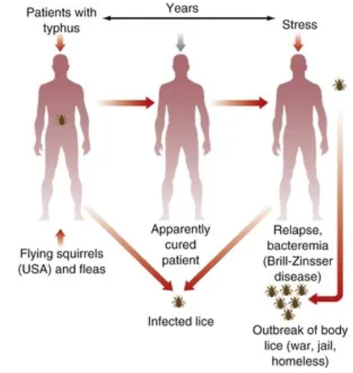
Epidemic typhus epidemiology

Slide 9
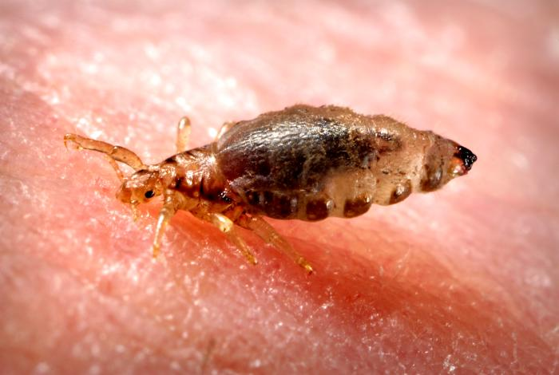


Usual R. prowazekii cycle
R. prowazekii
Note: Could be also sylvatic cycle of typhus after contact with flying sqiurell (source of the infection – probably aerosol from infected ectoparasites)

Slide 10
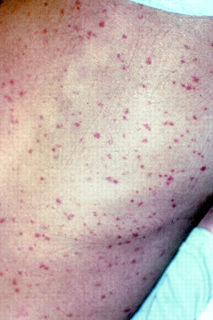
Symptomatology
Epidemic typhus typically presents with rapid-onset of headache, myalgia, rash, rerely trombosis – ischemic necrosis, hypotension, mental confusion, sensitivity to light, coughing, chills, and an ongoing high fever. The rash first appears as a macular errupution on the chest usually about five days after the appearance of fever and initial symptoms. From the chest the rash spreads to the rest of the trunk and the periphery extending down the legs and arms, but usually excluding the plantar and palmar surfaces and the face.
If the person survives the infection, symptoms abate just as rapidly as the onset, with a break in fever that typically occurs roughly two weeks after the onset of clinically apparent disease. Untreated, the case-fatality associated with epidemic typhus ranges from 10% to 40% (can be up to 40%, so outbreaks are of considerable concern.

Slide 11
Epidemic typhus
Microbiology diagnosis
Direct detection in blood - rare, cultivation (egg yolk sack), PCR
Serological diagnosis – most significant in diagnosis of rickettsial infection, CFR or Weil –Felix reaction (reaction with O antigens of Proteus vulgaris)
Prevention – delousing
Therapy – tetracyclines - doxycykline, (chloramphenicol)

Slide 12
Q fever (query – question mark)
Q fever – acute febrile illness occurs worldwide, zoonosis (source – domestic ungulates – sheep, goats, cattle, mild disease in ruminants, but can cause abortions and still births in cattle, sheep, and goats)
Coxiella burnetti – resistant to environmental conditions, source – most typically milk - ingestion, placenta released by infected animals during delivery - inhalation, or ticks – tick borne infection
Patogenesis – survive in macrophages (using phoosphatase inactivating enzymes of phagolysosomes), atypical (intersticial) pneumonia, liver (hepatitis) and spleen – granuloma, flu-like illness, gastroenteritis, complications – meningoencefalitis, endocarditis
Diagnosis – direct – cultivation using tissue culture, PCR, undirect – serology: Weil-Felix reaction
Therapy – doxycycline combined with rifampicin, (fluorochinolones)
Prevention – prevention in farm animals, and heat-trated milk products and meat products

Slide 13
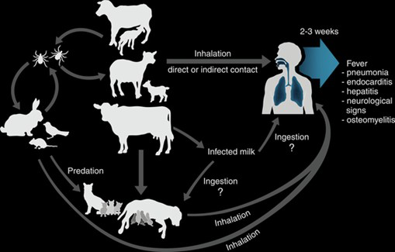
Q fever epidemiology
https://refitanimalcare.com/blog/what-is-q-fever/

Slide 14
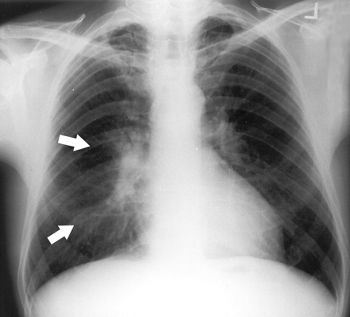
Q fever pneumonia
Right perihilar opacity in a patient with Q fever pneumonia (arrows).

Slide 15
Bartonellla and infections

Slide 16
Bartonella (family Bartonellaceae) 5 original properties
1. Agents of emerging infections 2. Small genome (<2 Mb) – intracellular, hemotropic agents 3. Local or serious systemic infections 4. Long cultivation, tricky to diagnsose 5. Long antibiotic treatment

Slide 17
Agents
until 1990 only B. bacilliformis: endemic - Andes, rezervoir – man, vector – mosquito (Brenner, Journal of Clinical Microbiology, 1991)
• Today 25 species tzv. modern bartonellae originated from B. bacilliformis as adaptation to mammals as reservoir, vectors – ectoparasites (Euzéby, List of prokaryotic names, 2014)
Most fre quent
B. henselae, reservoir – cat, wound/vector B. quintana, reservoir – man, vector – Pediculus humanus (Anderson, Clinical Microbiology Reviews, 1997)

Slide 18
Felinosis and systemic infections
B. henselae | • Felinosis, cat scratch disease • Endocarditis and bacteremia • Bacillary angiomatosis • Peliosis • Osteomyelitis • Glomerulonefritis
B. quintana | Endocarditis and bacteremia • (Urban) Trench fever • Bacillary angiomatosis • Peliosis
Chomel B. et al. Bartonella spp. in pets and effect on human health, Emerging Infection Diseases, 2006

Slide 19


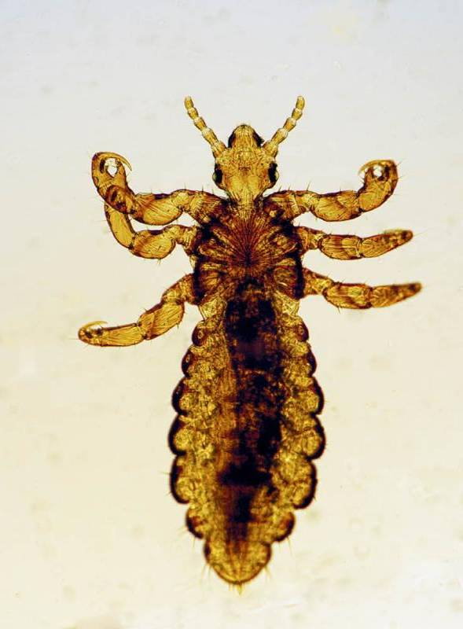
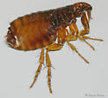
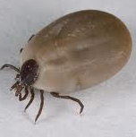
Infectious cycle
B. henselae
B. quintana
INFESTATION
INFESTATION
Cat flea
BODY LUSE
např. klíště
WOUND

Slide 20
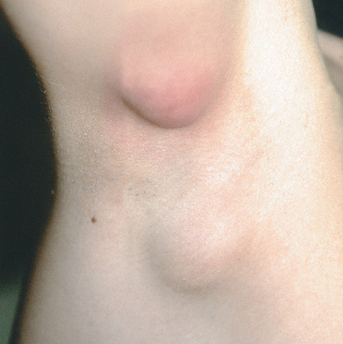
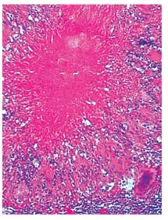
Symptoms and pathology
B
A
Felinosis axillary lymphadenitis Fitzpatrick´s Dermatology in General Medicine, 7th edition, 2007
Felinosis lymphadenitis atrophicans
Hematoxylin-eosin Manfredi et al. Braz. J. Inf. Dis., 2006
Endocarditis valve A. calcification B. fibrotisation Modifikace hematoxylin Lepidi et al., Am. J. Clin. Pathol., 2000

Slide 21
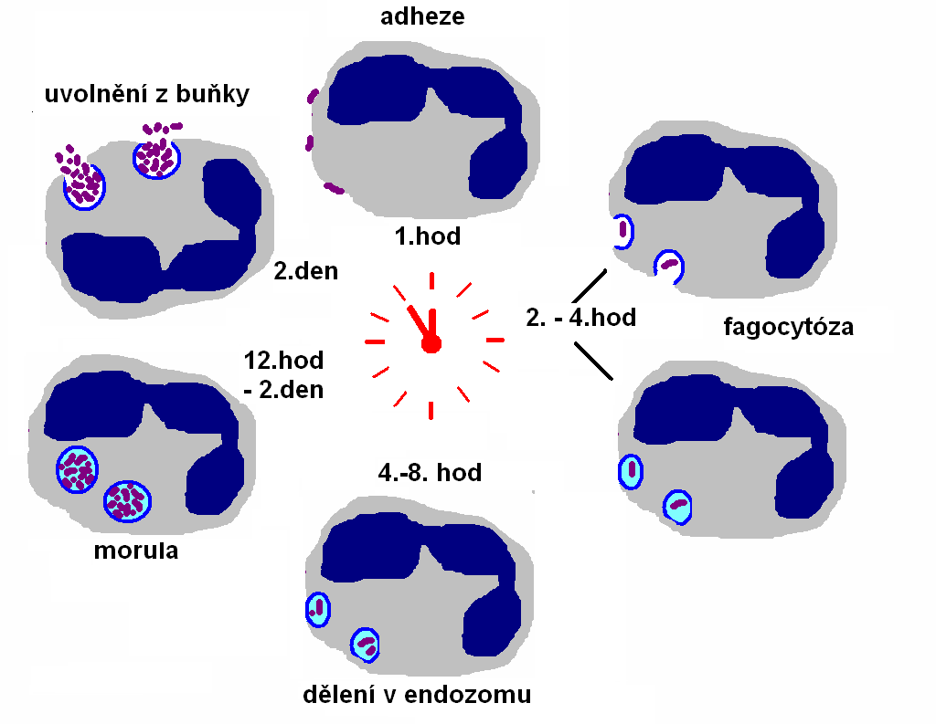
Cell cycle of Anaplasma phagocytophilum

Slide 22
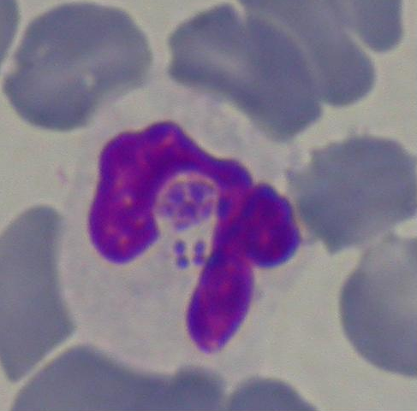
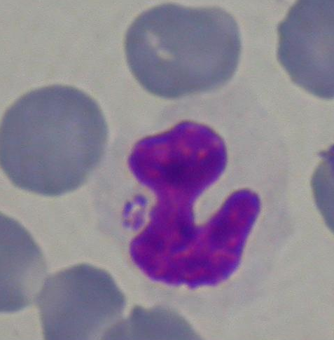
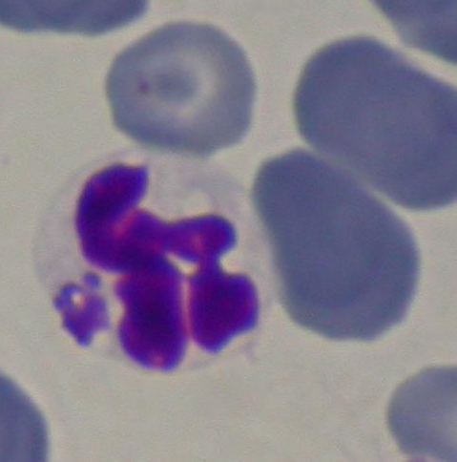
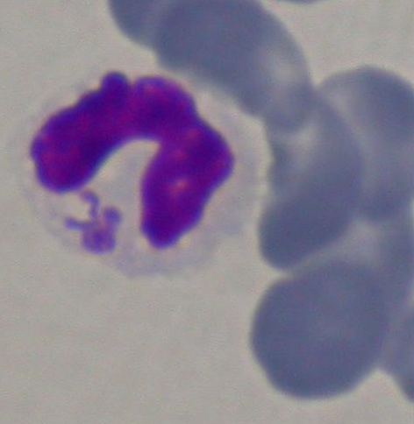
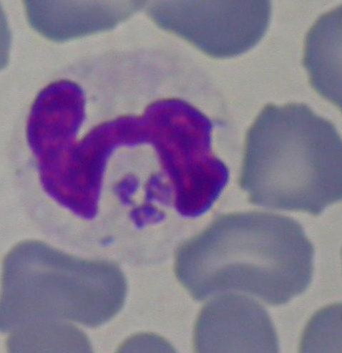
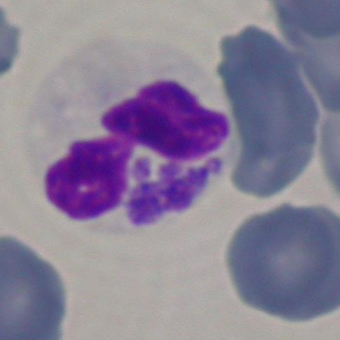
Acute infection, blood smear, Giemsa staining

Slide 23
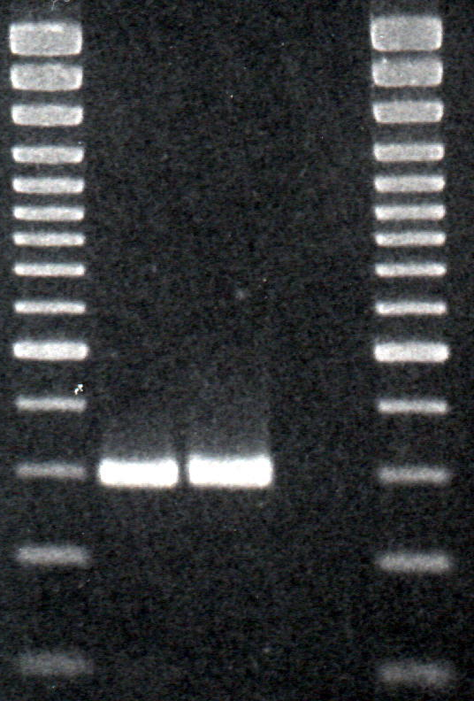
Amplification of 16S rRNA gen
M 1 2 3 M
400 bp
300 bp
200 bp
100 bp
Species specific PCR for Anaplasma phagocytophila, primers EHR521 a EHR790. Amplicons of A. phagocytophila from patient blood (1) . Positive (2) and negative (3) controls. Marker 100 bp (M)

Slide 24
Serological analysis
Collection within 2-3 weeks
Anaplasma IgM, IgG, IFA – important seroconversion
febrile illness, weakness….
thrombocytopeny
lymphopeny
elevated liver enzymes
anaemia

Slide 25
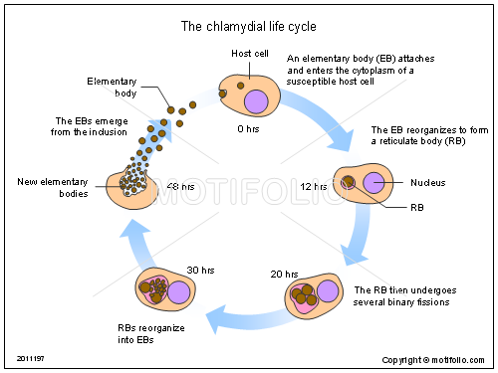
Chlamydia – intracellular cycle

Slide 26
Chlamydia
Defect metabolism – intracellular bacteria
genera – Chlamydia (C. trachomatis), Chlamydophila (C. pneumoniae, C. psittaci)
C. trachomatis – different serotypes – different diseases
trachoma: developing countries, transmission – directly and undirectly, chron. inflamation of cornea, blindness, transmission – contaminated water
Oculogenital chlamydiosis: most frequently STD (asymptomatic, uretritis, cervicitis, newborns – conjunctivitis, if spread – salpingitis, sterilitis)
Lymfogranuloma venereum – STD, inguinal lymphfadenitis, hemorragic ulcerative proctitis

Slide 27
Chlamydia
C. psittaci infections – source – birds,
Atypical pneumonia – can be serious, fever, dry cough, head and joint pain, complication – peri-, endo- myocarditis
C. pneumoniae infections – frequent community pneumonia – children and young adults (after Mycoplasma pneumoniae), laryngotracheitis, bronchitis, atypical pneumonia, usually mild or asymptomatic)

Slide 28
Chlamydia
Diagnosis – C. trachomatis: direct detection PCR, antigen (swab uretra, cervix, urine), undirect method – serology only in systemic diseases, dif.dg – other STD, C. psittaci – the best 4 fold titre increase, C. pneumoniae – increasing of antibodies (direct detection PCR, Ag)
Therapy – macrolides, tetracyclines

Slide 29
Mycoplasma
genera – Mycoplasma and Ureoplasma
Small organisms (up to 250 nm), smallest genome – fastidious, cultivation is not relevant for dg
Cell wall free organisms – inactive cell wall active antibiotics
Epidemiology – M. pneumoniae – most frequent – children and young adults, spread- secretion of upper resp.tract, M. hominis, Ureoplasma genitalium, U. urealyticum – urogenital infections
Patogenesis – host cell is essential, adherence and using nutrients, peroxides and superoxides – harm affected tissue

Slide 30
Mycoplasma
Symptoms M. pneumoniae infections – incubation period around 21d, usually mild, infection of upper resp.tract, cca 10% pneumonia – without alteration of total status (polymorbid patients – serious course), complication – peri- a myocarditis, meningoencefalitis
M. hominis, M. genitalium and Ureoplasma ureolyticum infections – uretritis, cervicitis apod.
Diagnosis – M. pneumoniae – undirect detection – most frequently – IgA after 1 weak, since 10d IgM, also CFR, direct detection – nasopharyngeal swab, sputum, BAL – PCR, or CRP, dif.dg – chlamydiosis, Q fever, legionelosis, M. hominis, M. genitalium a Ureoplasma – direct detection – uretral swab, cervix, dif. dg – Neisseria gonorrhoeae, Trichomonas vaginalis
Therapy – betalactam antibiotics not effective, macrolides, tertracyclines (fluorochinolony)

Slide 31
Bacillus anthracis
Clinical Manifestations
Anthrax is caused by Bacillus anthracis. Humans acquire the disease directly from contact with infected herbivores or indirectly via their products. The clinical forms include ( 1 ) cutaneous anthrax (eschar with edema), from handling infected material (this accounts for more than 95 percent of cases); (2) intestinal anthrax, from eating infected meat; and (3) pulmonary anthrax, from inhaling spore-laden dust.

Slide 32
Bacillus anthracis
Pathogenesis
The virulence factors of B anthracis are its capsule and three-component toxin, both encoded on plasmids.
Host Defenses
The reasons for marked differences in susceptibility to anthrax among different animal species are not known. The protective actions of the live-spore animal vaccine or the human chemical vaccines are based on induction of humoral and cell-mediated immunity to the protective antigen component of anthrax toxin.
Epidemiology
Individuals at risk for anthrax include those in contact with infected animals or animal products.

Slide 33
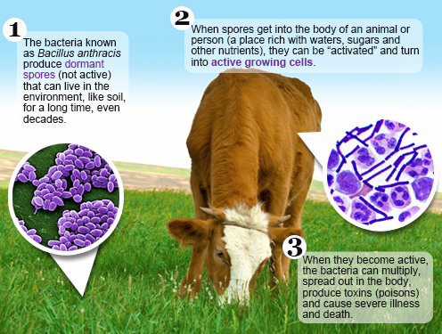
Anthrax epidemiology
References: https://www.cdc.gov/anthrax/basics/index.html

Slide 34
Structure and classification
Bacillus species are rod-shaped, endospore-forming aerobic or facultatively anaerobic, Gram-positive bacteria; in some species cultures may turn Gram-negative with age. The many species of the genus exhibit a wide range of physiologic abilities that allow them to live in every natural environment. Only one endospore is formed per cell. The spores are resistant to heat, cold, radiation, desiccation, and disinfectants. Bacillus anthracis needs oxygen to sporulate; this constraint has important consequences for epidemiology and control. In vivo, B anthracis produces a polypeptide (polyglutamic acid) capsule that protects it from phagocytosis.
The genera Bacillus and Clostridium constitute the family Bacillaceae. Species are identified by using morphologic and biochemical criteria.

Slide 35
Bacillus anthracis
Anthrax
Anthrax is primarily a disease of herbivores. Humans acquire it as a result of contact with infected animals or animal products. In humans the disease takes one of three forms, depending on the route of infection. Cutaneous anthrax, which accounts for more than 95 percent of cases worldwide, results from infection through skin lesions; intestinal anthrax results from ingestion of spores, usually in infected meat; and pulmonary anthrax results from inhalation of spores.
Cutaneous anthrax usually occurs through contamination of a cut or abrasion, although in some countries biting flies may also transmit the disease. After a 2- to 3-day incubation period, a small pimple or papule appears at the inoculation site. A surrounding ring of vesicles develops. Over the next few days, the central papule ulcerates, dries, and blackens to form the characteristic eschar (Fig. 15-1). The lesion is painless and is surrounded by marked edema that may extend for some distance. Pus and pain appear only if the lesion becomes infected by a pyogenic organism. Similarly, marked lymphangitis and fever usually point to a secondary infection. In most cases the disease remains limited to the initial lesion and resolves spontaneously. The main dangers are that a lesion on the face or neck may swell to occlude the airway or may give rise to secondary meningitis. If host defenses fail to contain the infection, however, fulminating septicemia develops. Approximately 20 percent of untreated cases of cutaneous anthrax progress to fatal septicemia. However, B anthracis is susceptible to penicillin and other common antibiotics, so effective treatment is almost always available.

Slide 36
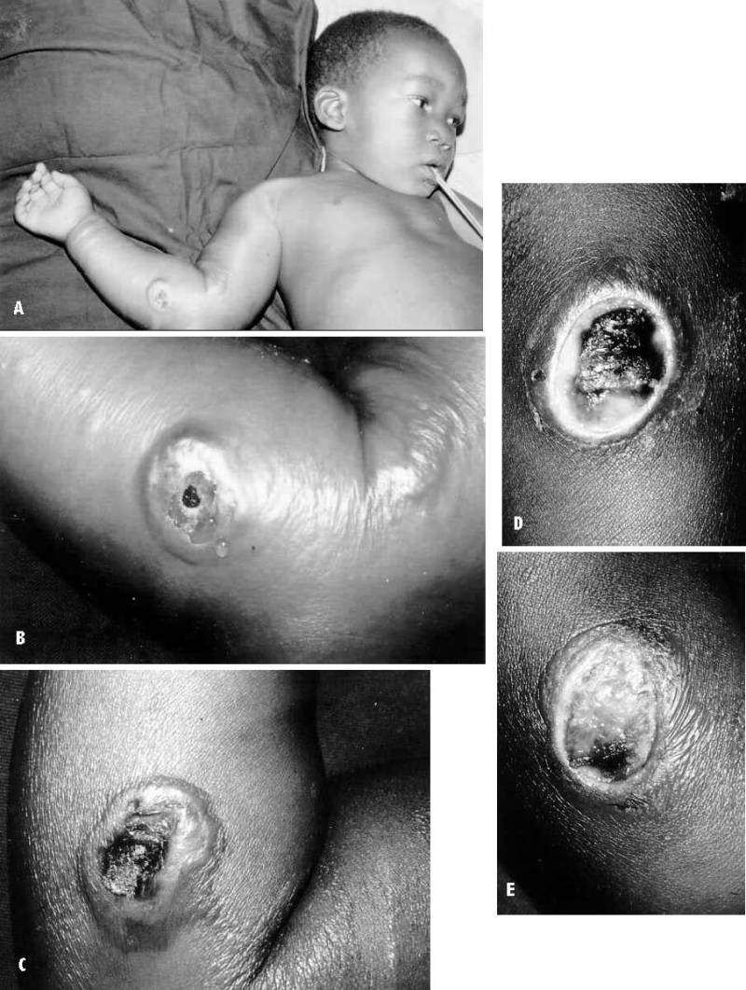
4 year old boy. (A&B) the lesion when first seen (day 0). Note the arm swollen from the characteristic edema. (C) Day 6. (D) Day 10. (E) Day 15. Although penicillin treatment was begun immediately and the lesion was sterile by about 24 hours, it continued to evolve and resolve as seen. (Turnbull, Medical Microbiology. 4th edition)

Slide 37
Intestinal anthrax is analogous to cutaneous anthrax but occurs on the intestinal mucosa. As in cutaneous anthrax, the organisms probably invade the mucosa through a preexisting lesion. Generalized disease develops when the organisms spread from the mucosal lesion to the lymphatic system. In pulmonary anthrax, inhaled spores are transported by alveolar macrophages to the mediastinal lymph nodes, where they germinate and multiply to initiate systemic disease. Gastrointestinal and pulmonary anthrax are both more dangerous than the cutaneous form because they are usually identified too late for treatment to be effective.
Herbivorous animals, the primary hosts of B anthracis, contract the infection by ingesting spores on forage plants; the spores are derived from soil or dust or are deposited on leaves by flies after feeding on an anthrax-infected carcass. If the spores enter a lesion in the gastrointestinal mucosa, they germinate and are taken into the bloodstream and lymphatics, finally producing systemic anthrax, which is usually fatal.
Symptoms prior to fulminant systemic anthrax may be absent or mild, consisting, for example, of malaise, low fever, and mild gastrointestinal symptoms in the case of gastrointestinal disease. During this phase the organism is multiplying and producing toxin in the regional lymph nodes and spleen. Released toxin causes breakdown of these organs probably of the spleen in particular. This causes the sudden onset of hyperacute illness with dyspnea, cyanosis, high fever, and disorientation, which progress in a few hours to shock, coma, and death. Although symptoms vary somewhat with the host species, this final acute phase is marked by a high-grade bacteremia. In humans, blood cultures are not always positive.

Slide 38
The clinical diagnosis of anthrax is confirmed by directly visualizing or culturing the anthrax bacilli. Fresh smears of vesicular fluid, fluid from under the eschar, blood, lymph node or spleen aspirates, or (in meningitic cases) cerebrospinal fluid are stained with polychrome methylene blue (M'Fadyean's stain) and examined for the characteristic square-ended, blue-black bacilli surrounded by a pink capsule. (It should be remembered that B anthracis organisms are not invariably detected in stained blood smears of humans dying of anthrax.) Alternatively, the bacilli may be cultured from these specimens and checked for sensitivity to the anthrax gamma phage, for penicillin sensitivity, and for capsule formation. Colonies grown overnight at 37°C on blood agar are gray or white, nonhemolytic, with a dry, ground-glass appearance; they are at least 3 mm in diameter and sometimes have tails. Capsules can be seen in polychrome methylene blue-stained smears of cultures grown on nutrient agar containing 0.7 percent sodium bicarbonate and incubated overnight under CO₂ (e.g., in a candle jar); encapsulated colonies are mucoid. Alternatively, 2 ml of blood (such as commercial defibrinated horse blood) inoculated with a pinhead quantity of material from a suspected colony and incubated at 37°C yields readily demonstrable encapsulated bacilli in 6 hours. Culturing may be unsuccessful if the patient has been treated with antibiotics.
PCR is valuable from local affection or venous blood.

