Slide 1

Local government in the Czech Republic
April 16

Slide 2
Changes in the number of municipalities

Slide 3
Size of municipalities

Slide 4


Different size of munipalities
two main association of municipalities
dual mandates, mayoral initiatives

Slide 5

Failed municipalities

Slide 6


Party system at the local level

Slide 7
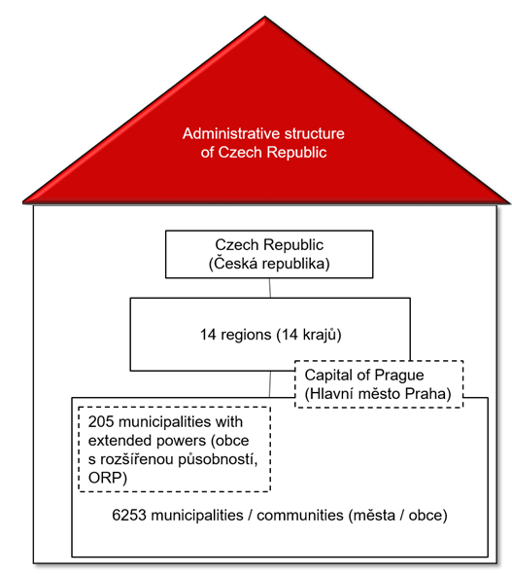
System of multilevel government

Slide 8
System of public administration

Slide 9
Executive model at the local level 1/2

Slide 10
Executive model at local level 2/2

Slide 11
Executive model at the local level in detail

Slide 12
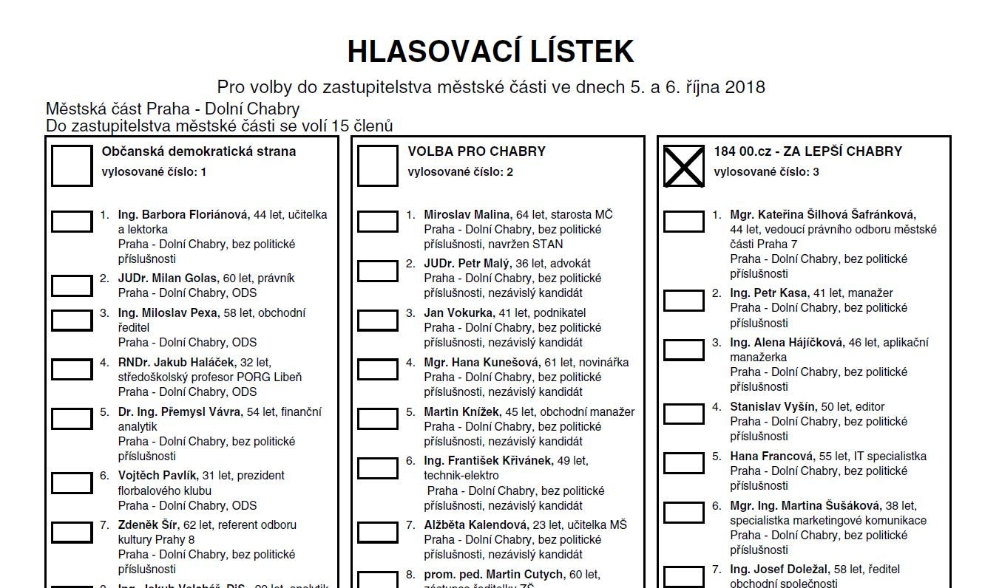
Electoral system

