Slide 1
Measuring similarity

Slide 2

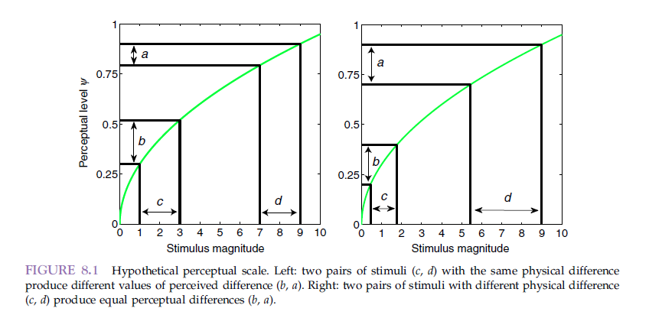
Scaling
Sometimes we wonder how we can scale the intensity of a stimulus to the perceptual level. For one particular threshold level, we can do this with PF
Steven’s law

Slide 3
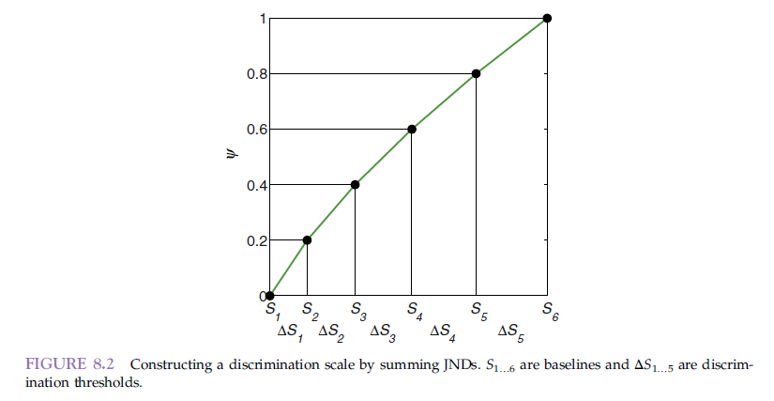
Discrimination scaling
We start at some baseline S1, find the JND at level S2, and this is how we get the whole relationship

Slide 4
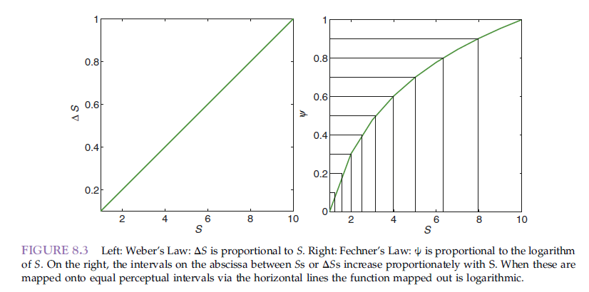
Weber’s law

Slide 5
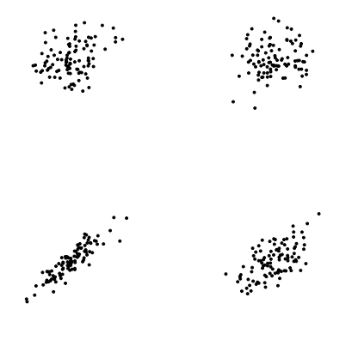
Maximum Likelihood Difference Scaling (MLDS)
Complex method for scaling
Eg - how do we recognize correlation coefficients?
Always display two pairs of stimuli and compare which pair has the greater perceptual distance

Slide 6
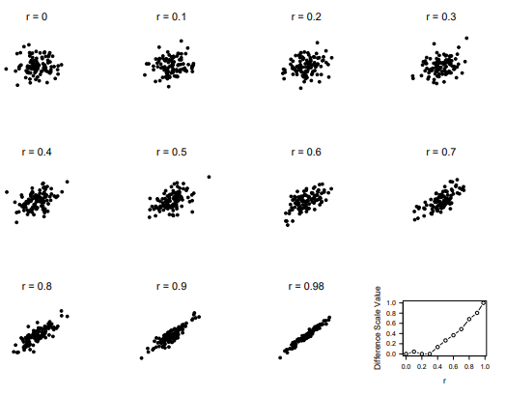
MLDS
The number of pairwise comparisons increases rapidly (even if only non-overlapping pairs are used, in which case 330 comparisons need to be made - about 10-12 minutes)

Slide 7
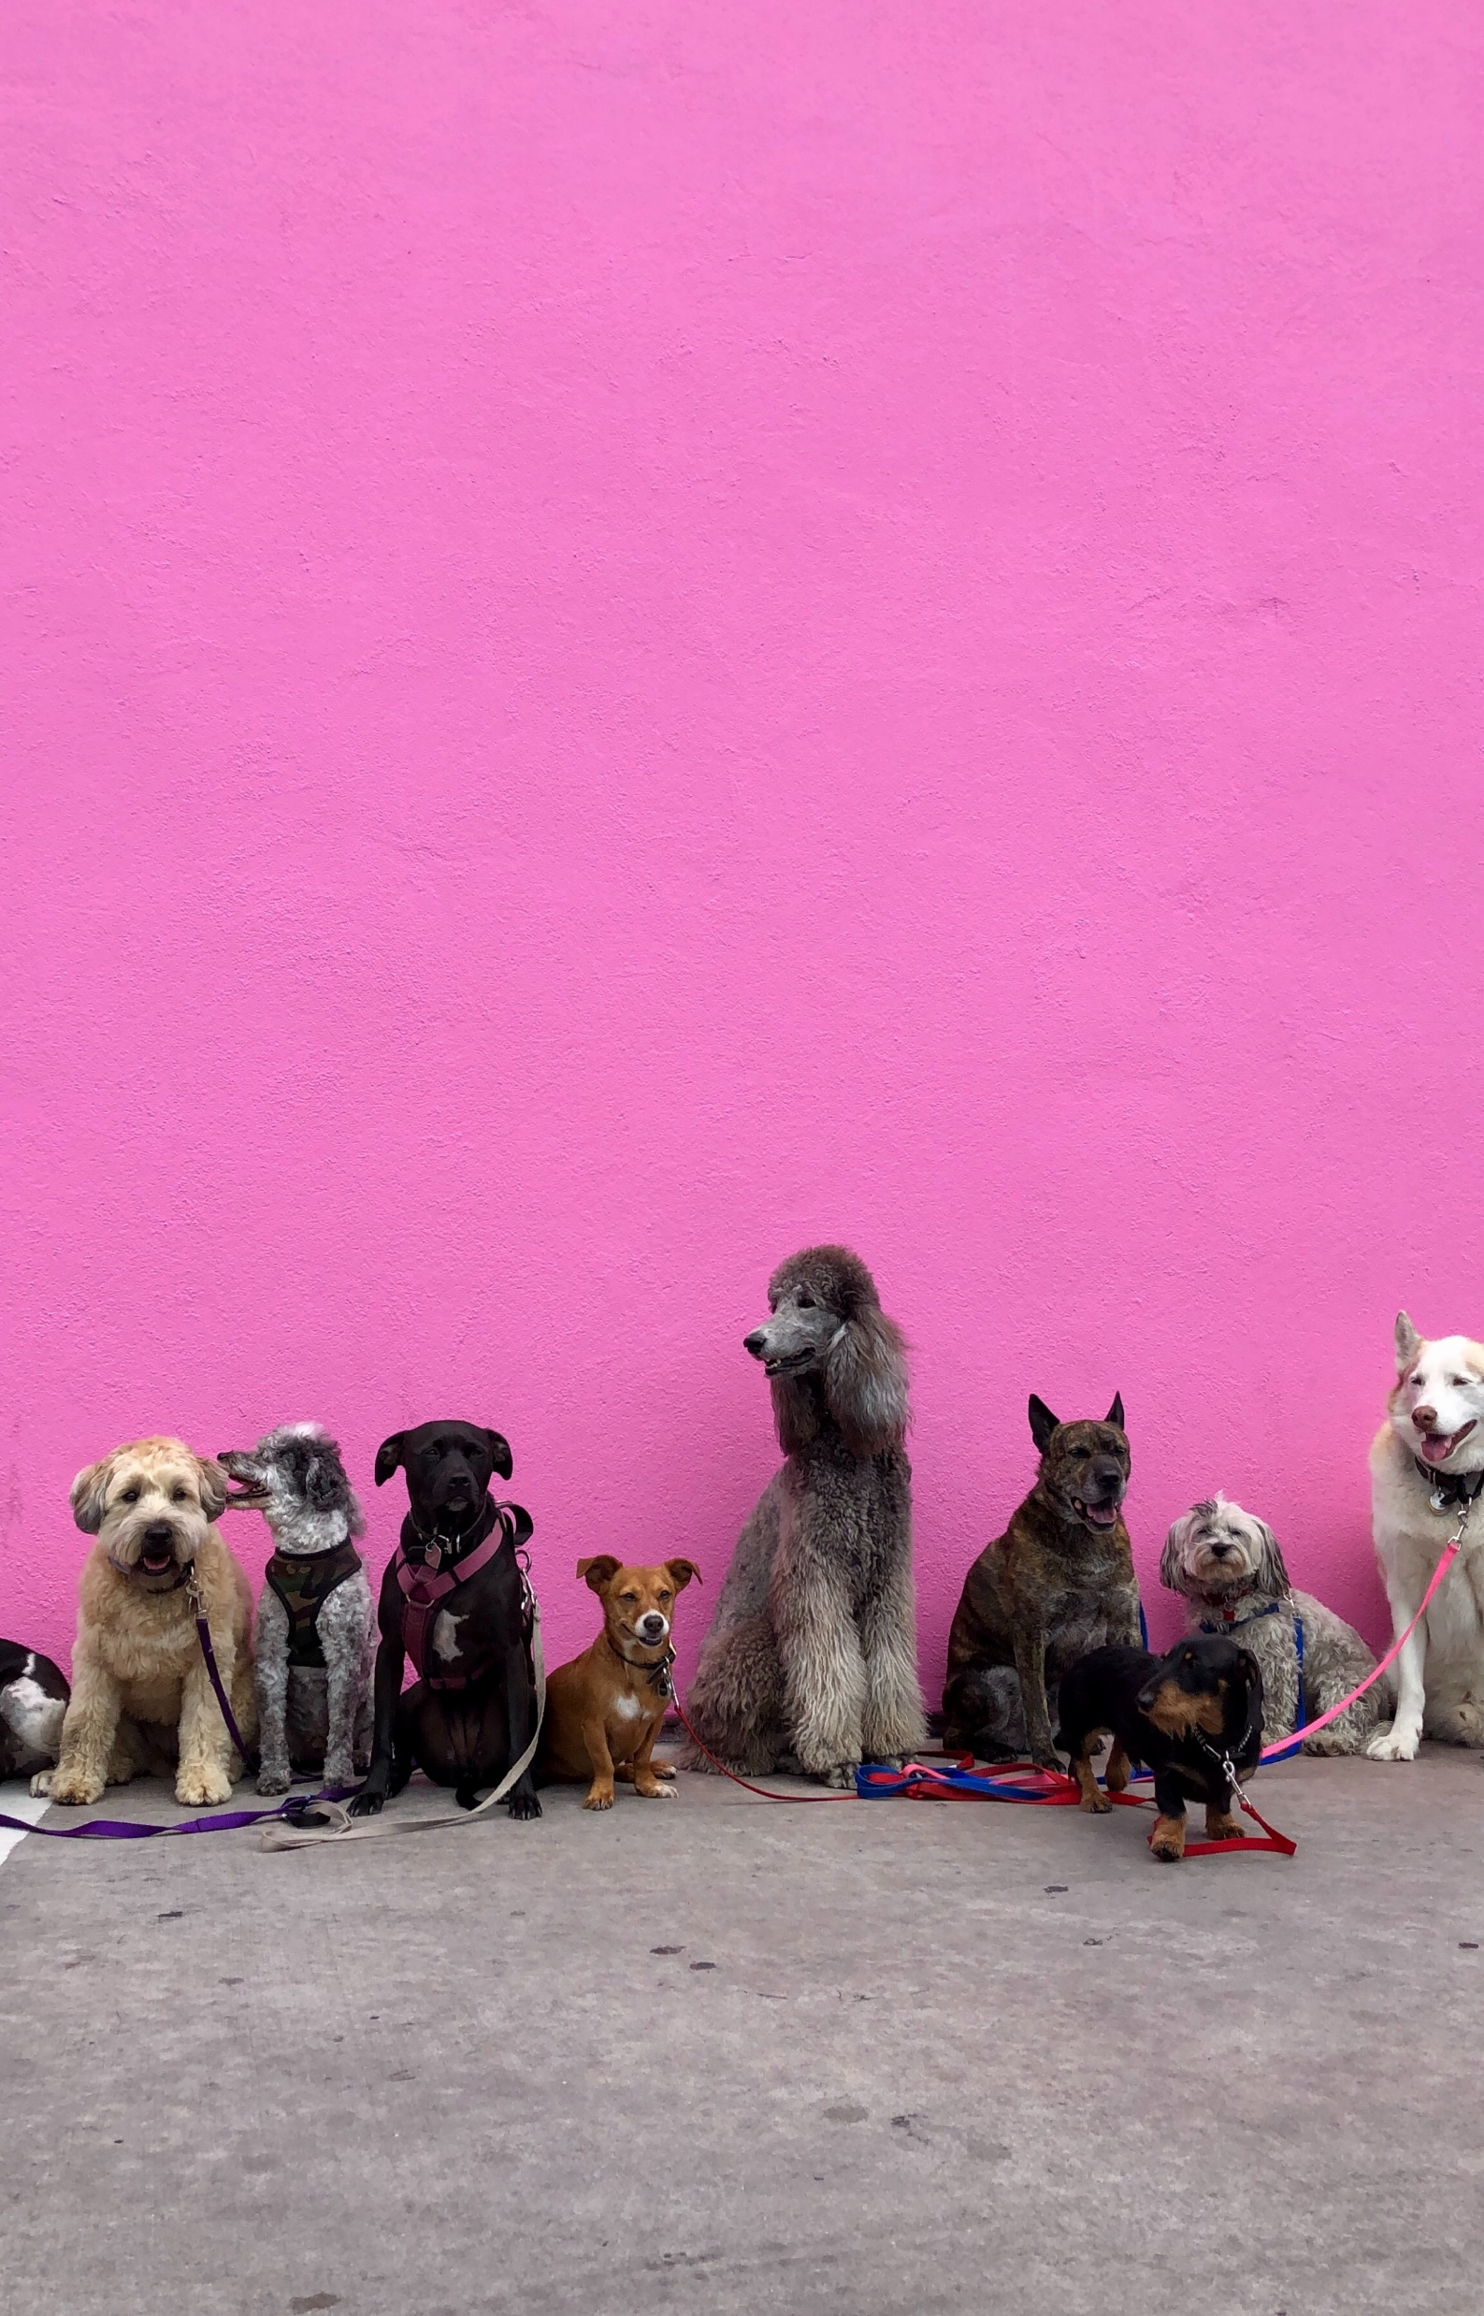




Scaling for complex stimuli
vs

Slide 8
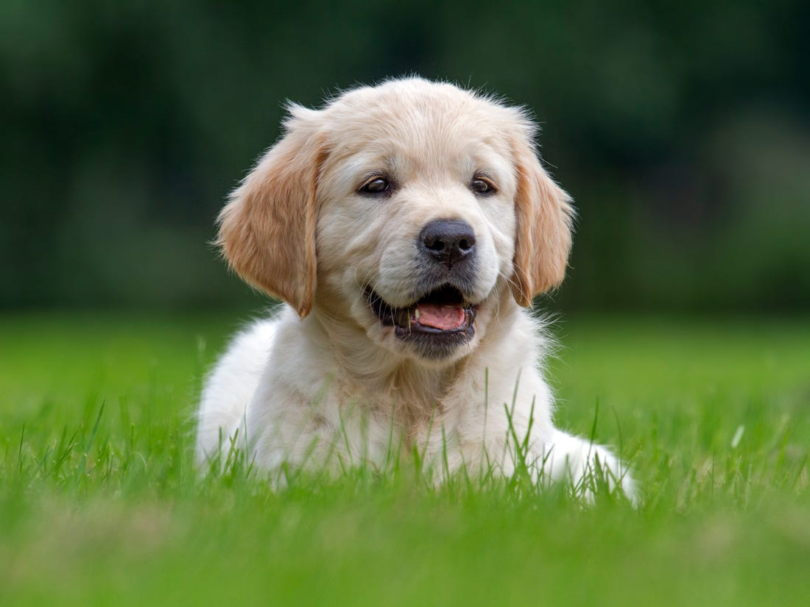
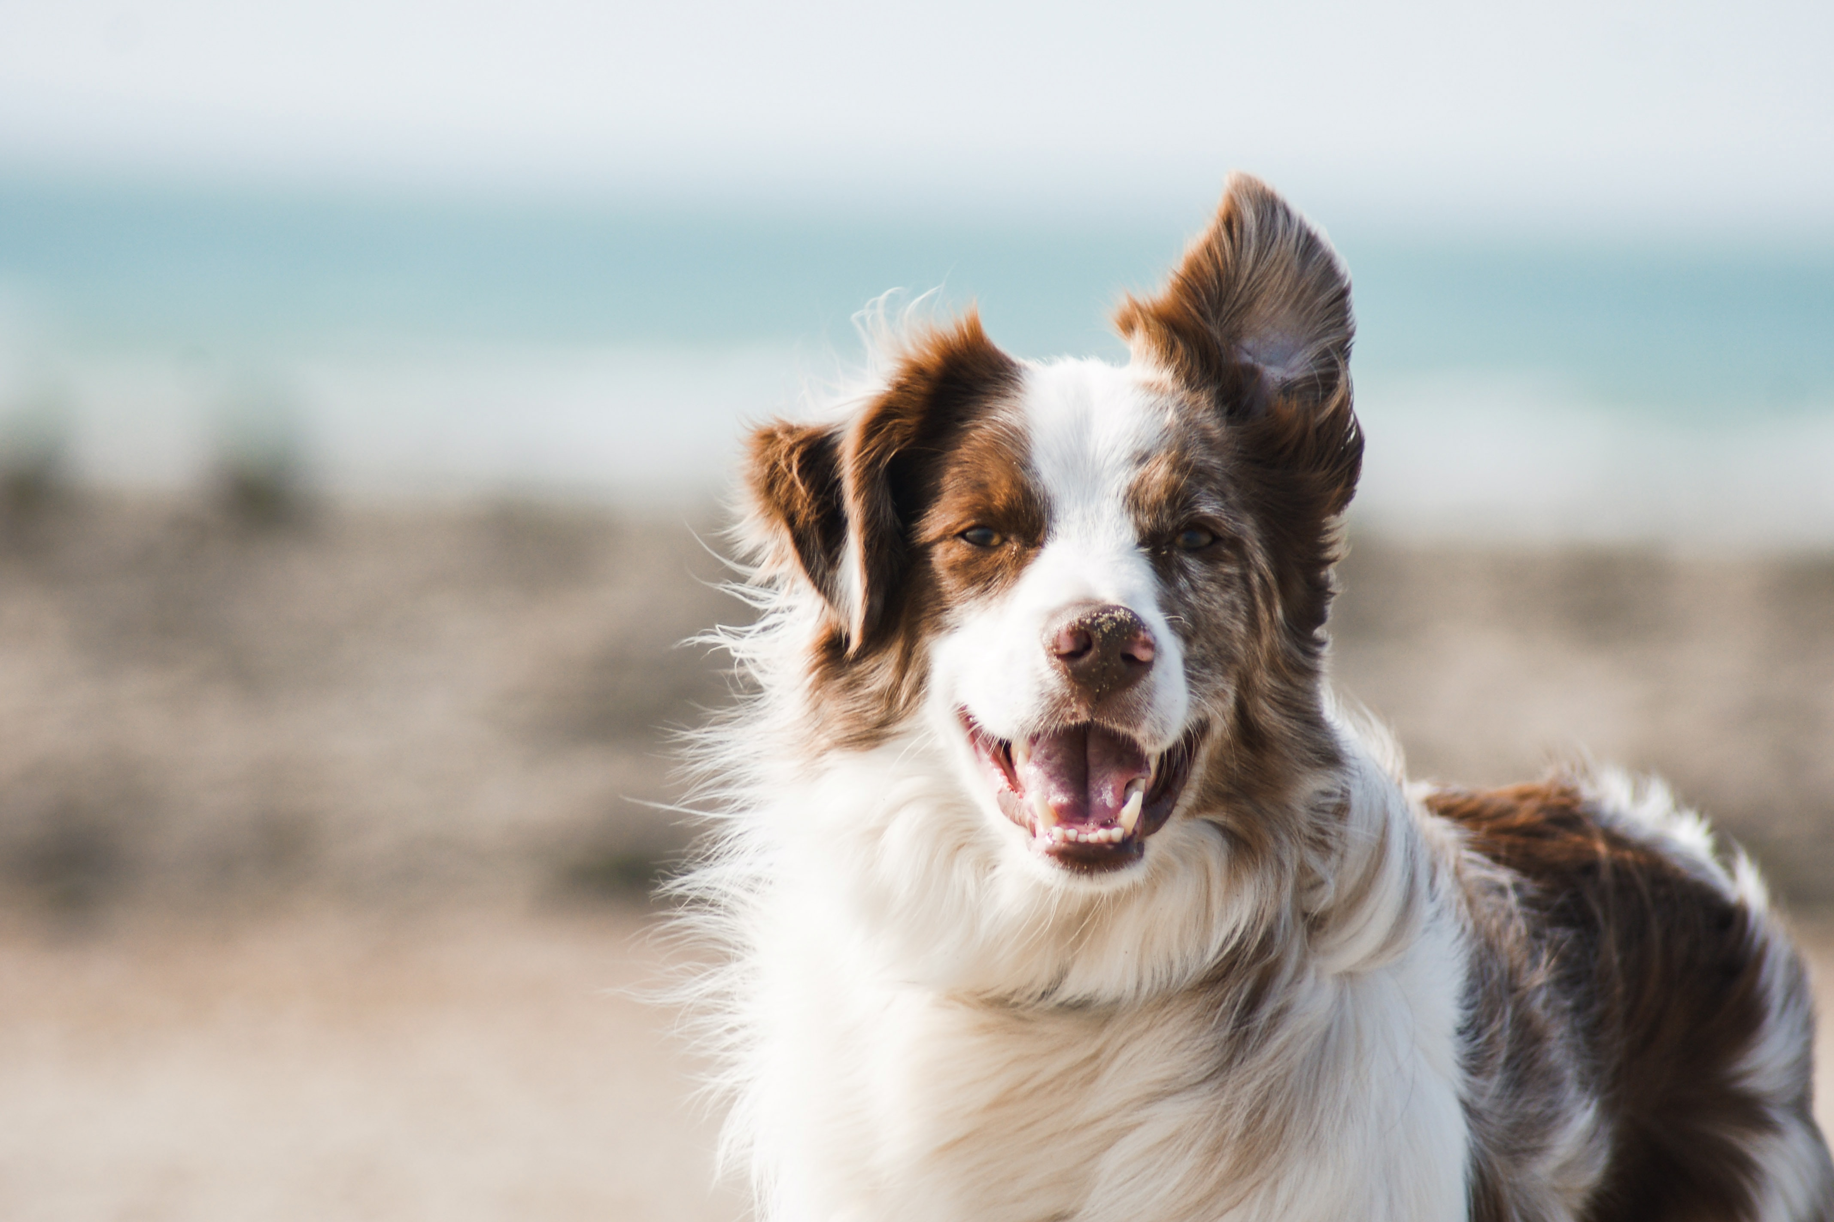
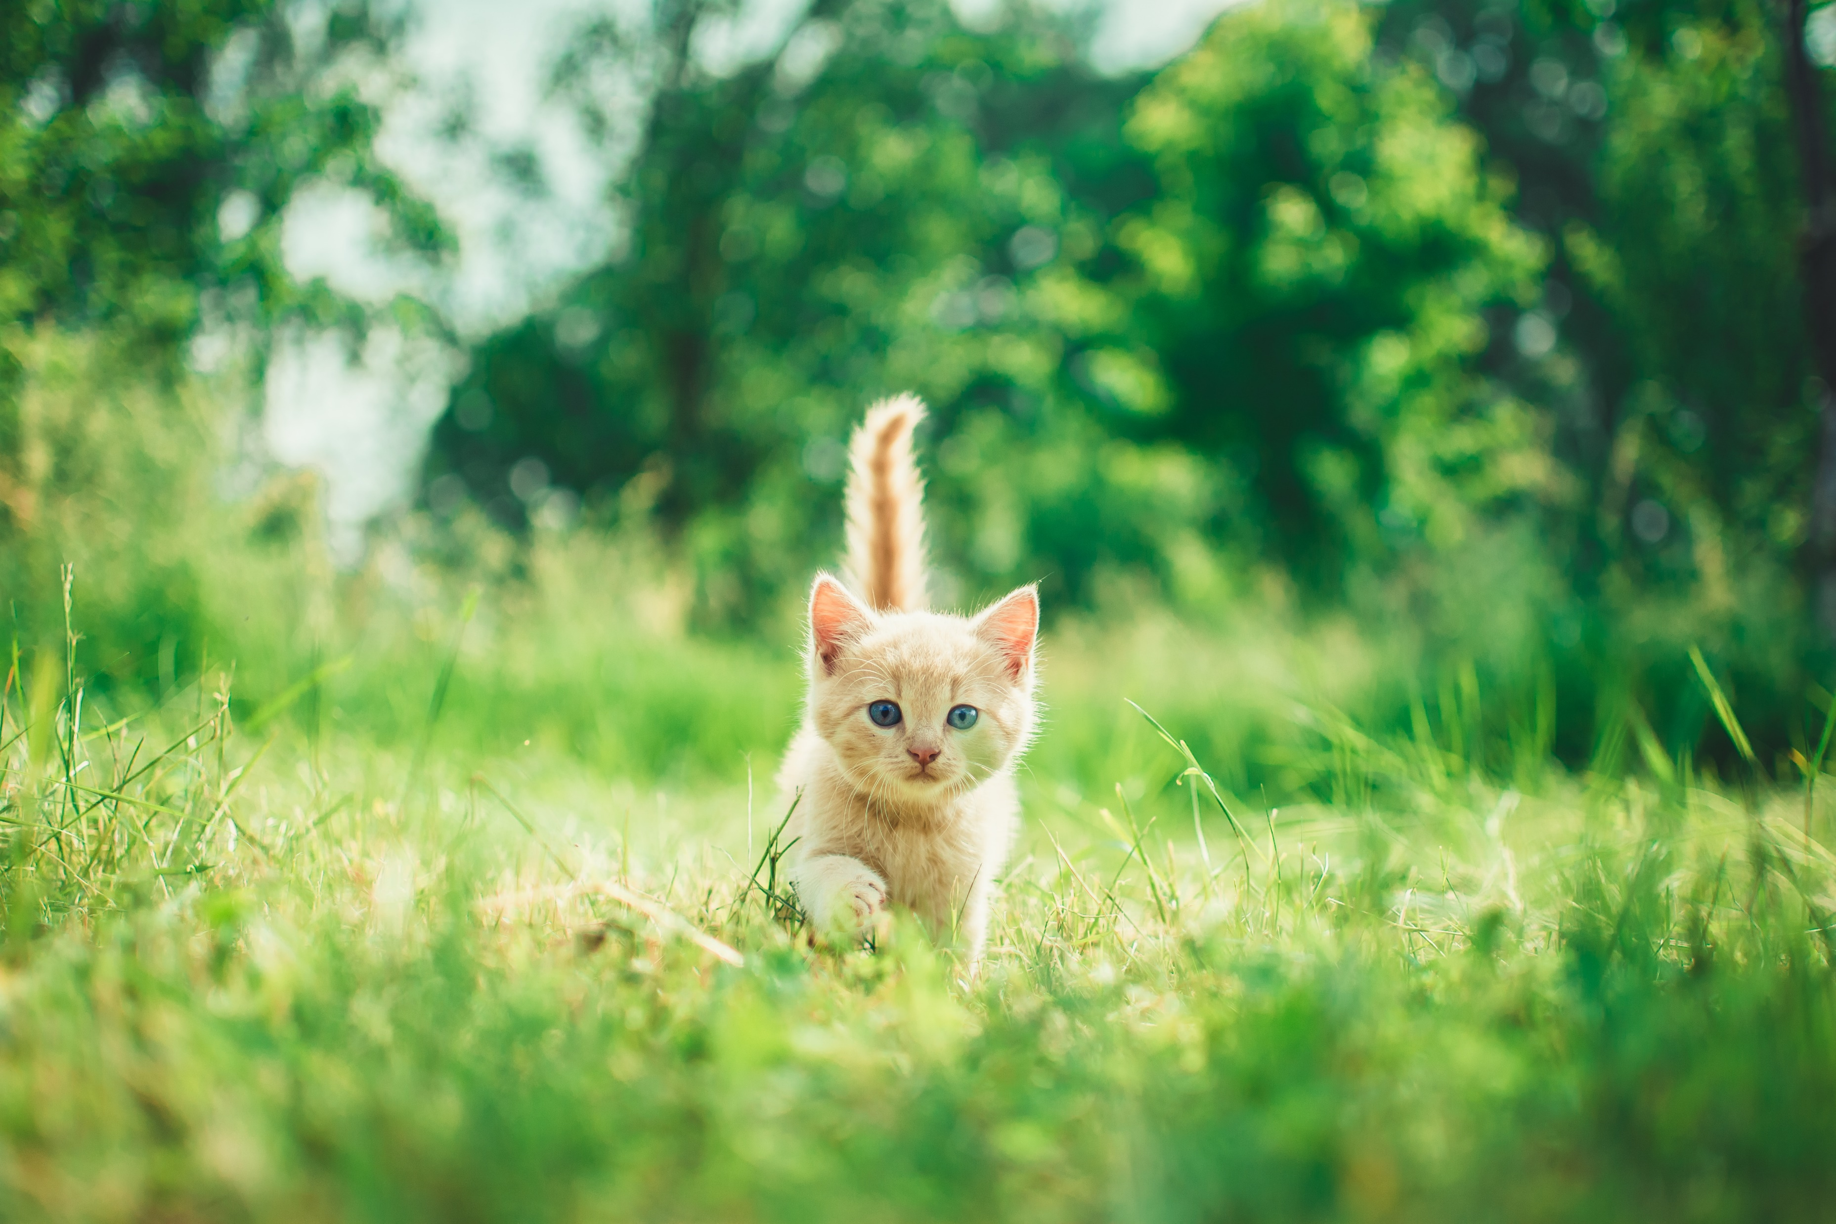
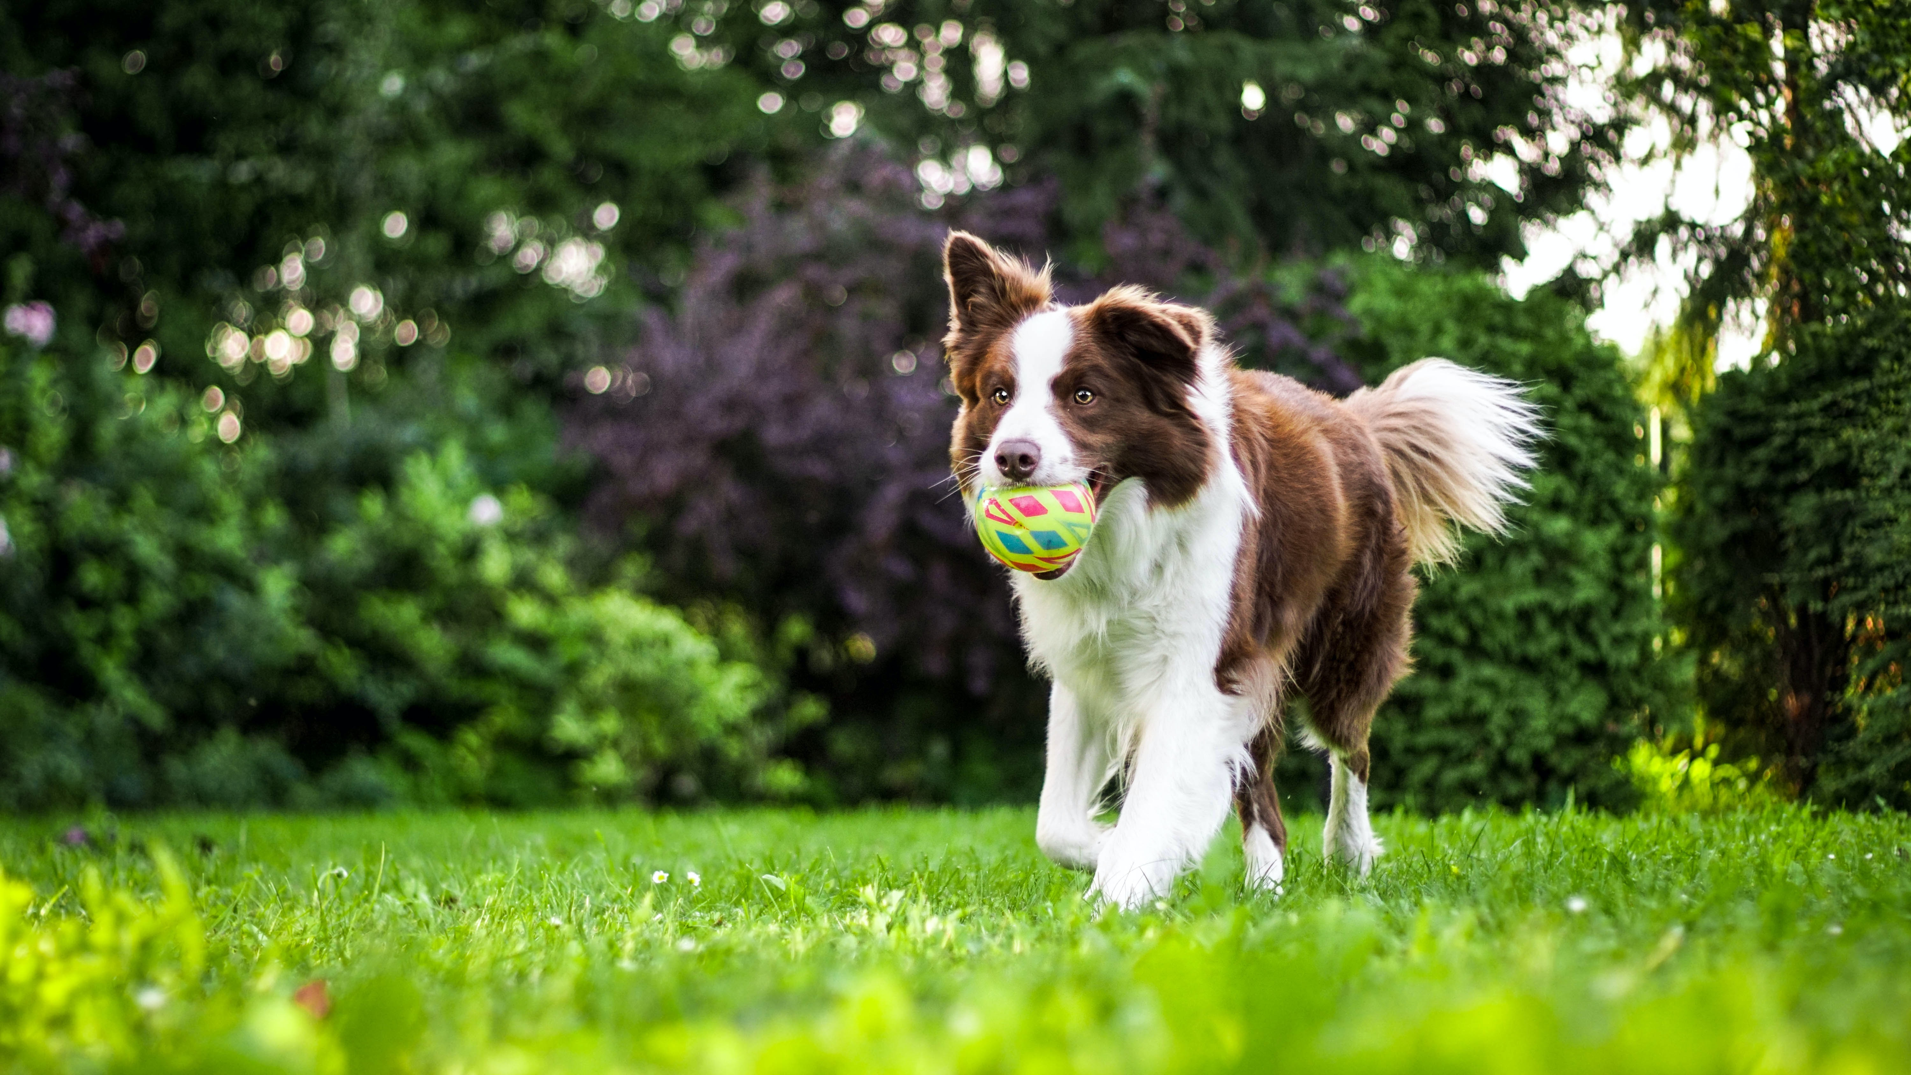
Which pair is more similar?

Slide 9
How would you measure similarity?

Slide 10
How would you measure similarity?
„subjective“ – ask about similarity
„objective“ – quantify somehow each stimuli and compute similarity between them

Slide 11
How would you measure similarity?
How similar are these images? (these dogs)
1 - very disimilar
7 - very similar

Slide 12
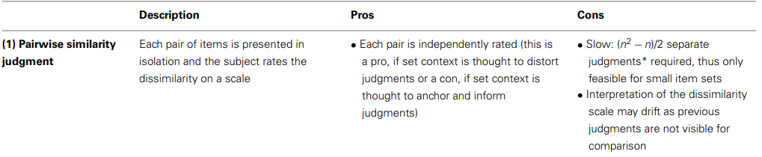
How would you measure similarity?

Slide 13
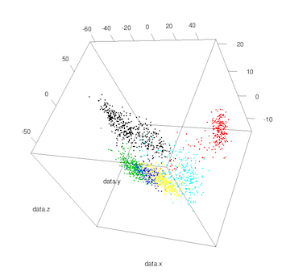
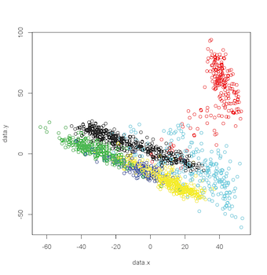
Sidenote - MDS
We assume that similarity is multidimensional, but it is difficult to visualize
We can reduce the complexity for visualization and multidimensional scaling technique

Slide 14
How would you measure similarity?
1 comparison

Slide 15
How would you measure similarity?
3 comparisons

Slide 16
How would you measure similarity?
6 comparisons

Slide 17
How would you measure similarity?
10 items - 45 comparisons
100 items – 4950 comparisons

Slide 18
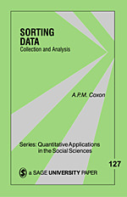
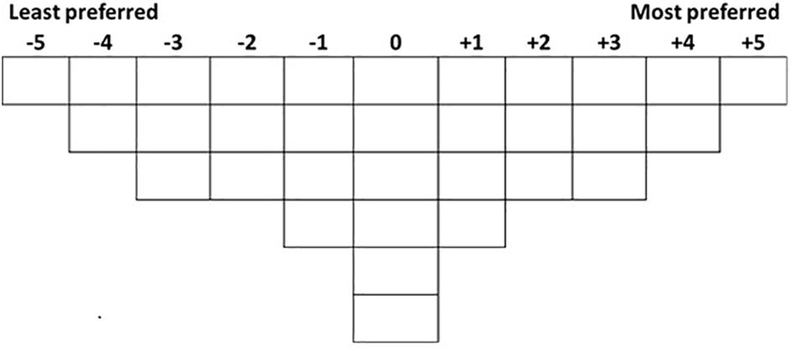
Sorting methods
Subjects sort stimuli into piles based on given criteria
  Q sorting
  Similar/dissimilar piles
  Hierarchical ranking

Slide 19
Sorting methods
Subjects sort stimuli into piles based on given criteria
  Q sorting
  Similar/dissimilar piles
  Hierarchical ranking
better
worse

Slide 20
Sorting methods
Subjects sort stimuli into piles based on given criteria
  Q sorting
  Similar/dissimilar piles
  Hierarchical ranking
1.
2.
4.
3.

Slide 21
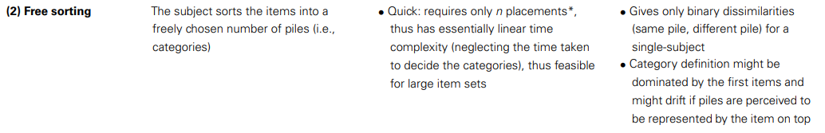
Sorting methods
Subjects sort stimuli into piles based on given criteria
  Q sorting
  Similar/dissimilar piles
  Hierarchical ranking

Slide 22
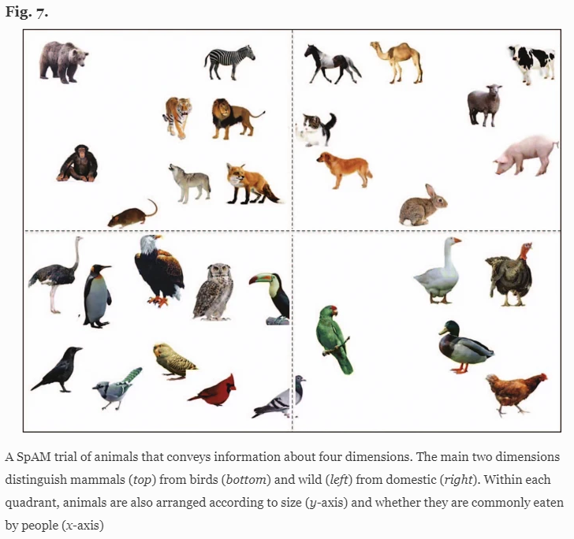
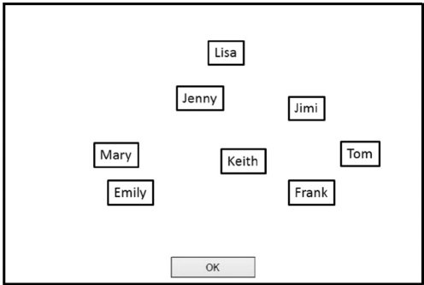
Single arrangement
Spatial Arrangement Method (SpAM)
Alves, H., Koch, A., & Unkelbach, C. (2016). My friends are all alike—the relation between liking and perceived similarity in person perception. Journal of Experimental Social Psychology, 62, 103-117.
Richie, R., White, B., Bhatia, S., & Hout, M. C. (2020). The spatial arrangement method of measuring similarity can capture high-dimensional semantic structures. Behavior research methods, 52, 1906-1928.

Slide 23
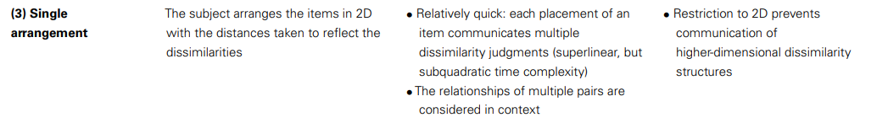
Single arrangement
Spatial Arrangement Method (SpAM)

Slide 24
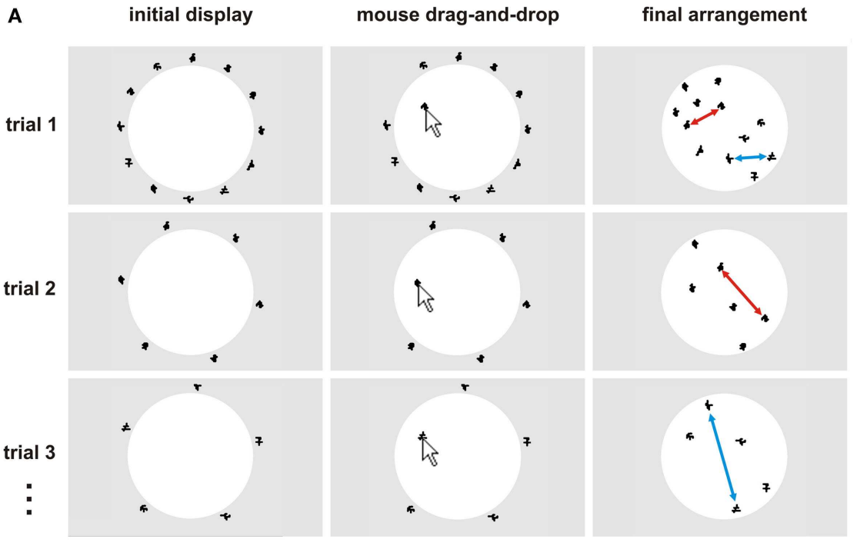
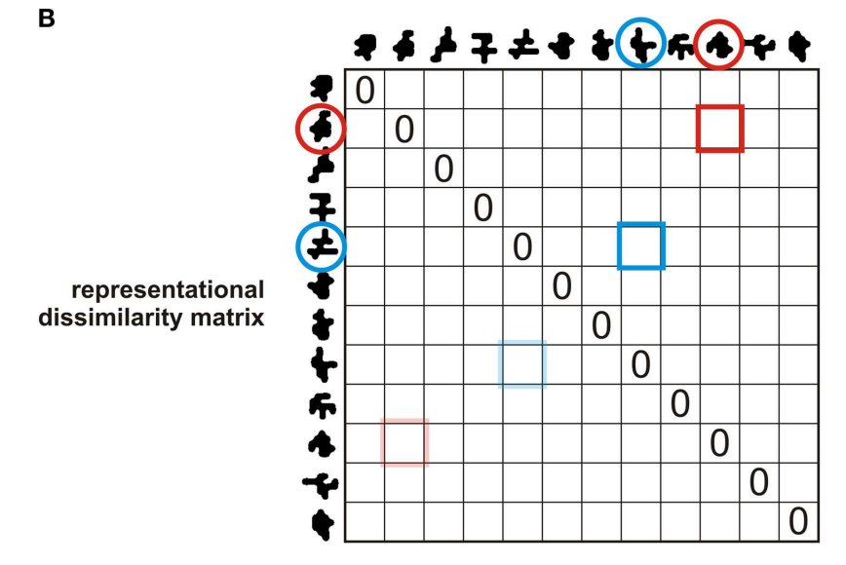
Multiple arrangement
Kriegeskorte, N., & Mur, M. (2012). Inverse MDS: Inferring dissimilarity structure from multiple item arrangements. Frontiers in psychology, 3, 245.

Slide 25
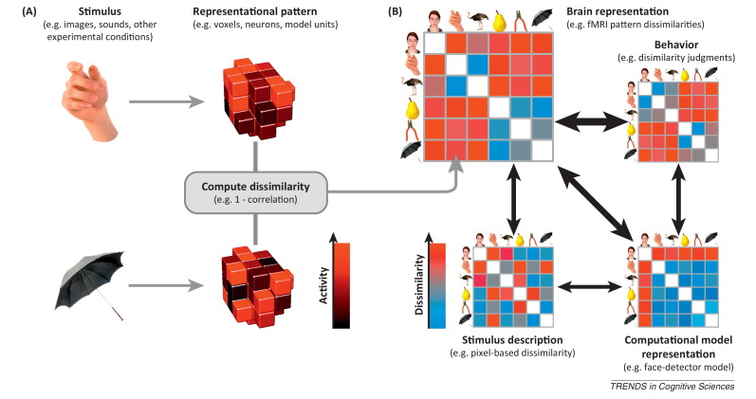
Representational dissimilarity matrix (RDM)
Commonly used to compare behavior and neural response
Kriegeskorte, N., & Kievit, R. A. (2013). Representational geometry: integrating cognition, computation, and the brain. Trends in cognitive sciences, 17(8), 401-412.

Slide 26
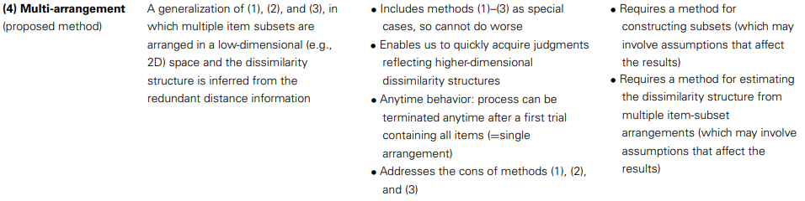
Multiple arrangement

Slide 27
Stimuli in similarity space
Although we have measured similarity, there are some features that could describe each stimulus
E.g.: number of sides, colour
But what should we use for complex stimuli?

Slide 28
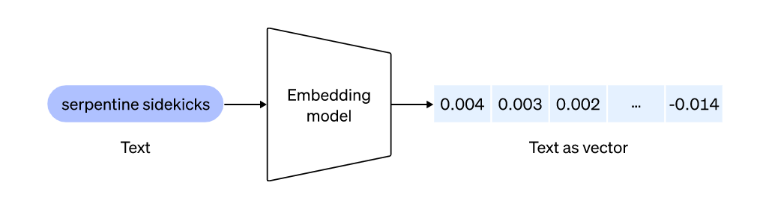
Representational embeddings
Reduce complex stimuli into several continuous variables

Slide 29
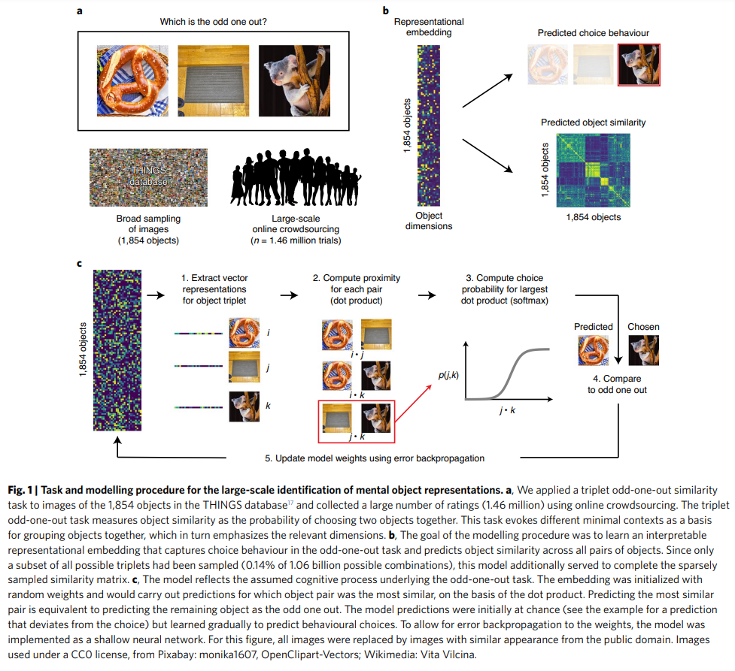
Embeddings of similarity space
Pairwise comparisons are “expensive”
Idea: measure subset of data and fill the missing values
Hebart, M. N., Zheng, C. Y., Pereira, F., & Baker, C. I. (2020). Revealing the multidimensional mental representations of natural objects underlying human similarity judgements. Nature human behaviour, 4(11), 1173-1185.

Slide 30
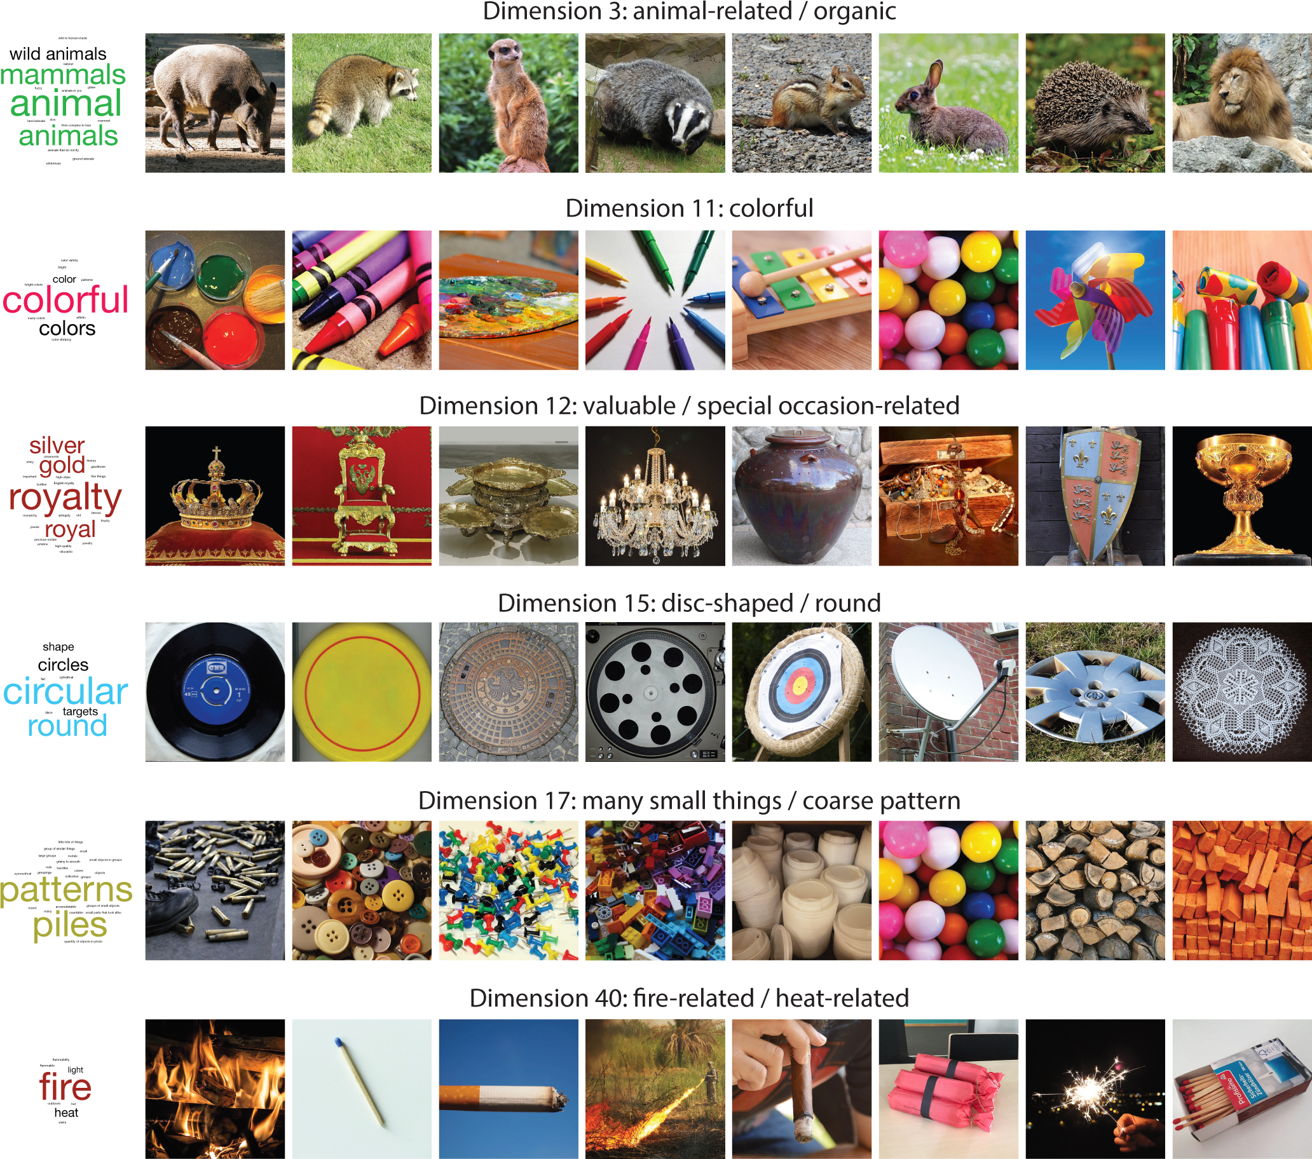

Slide 31
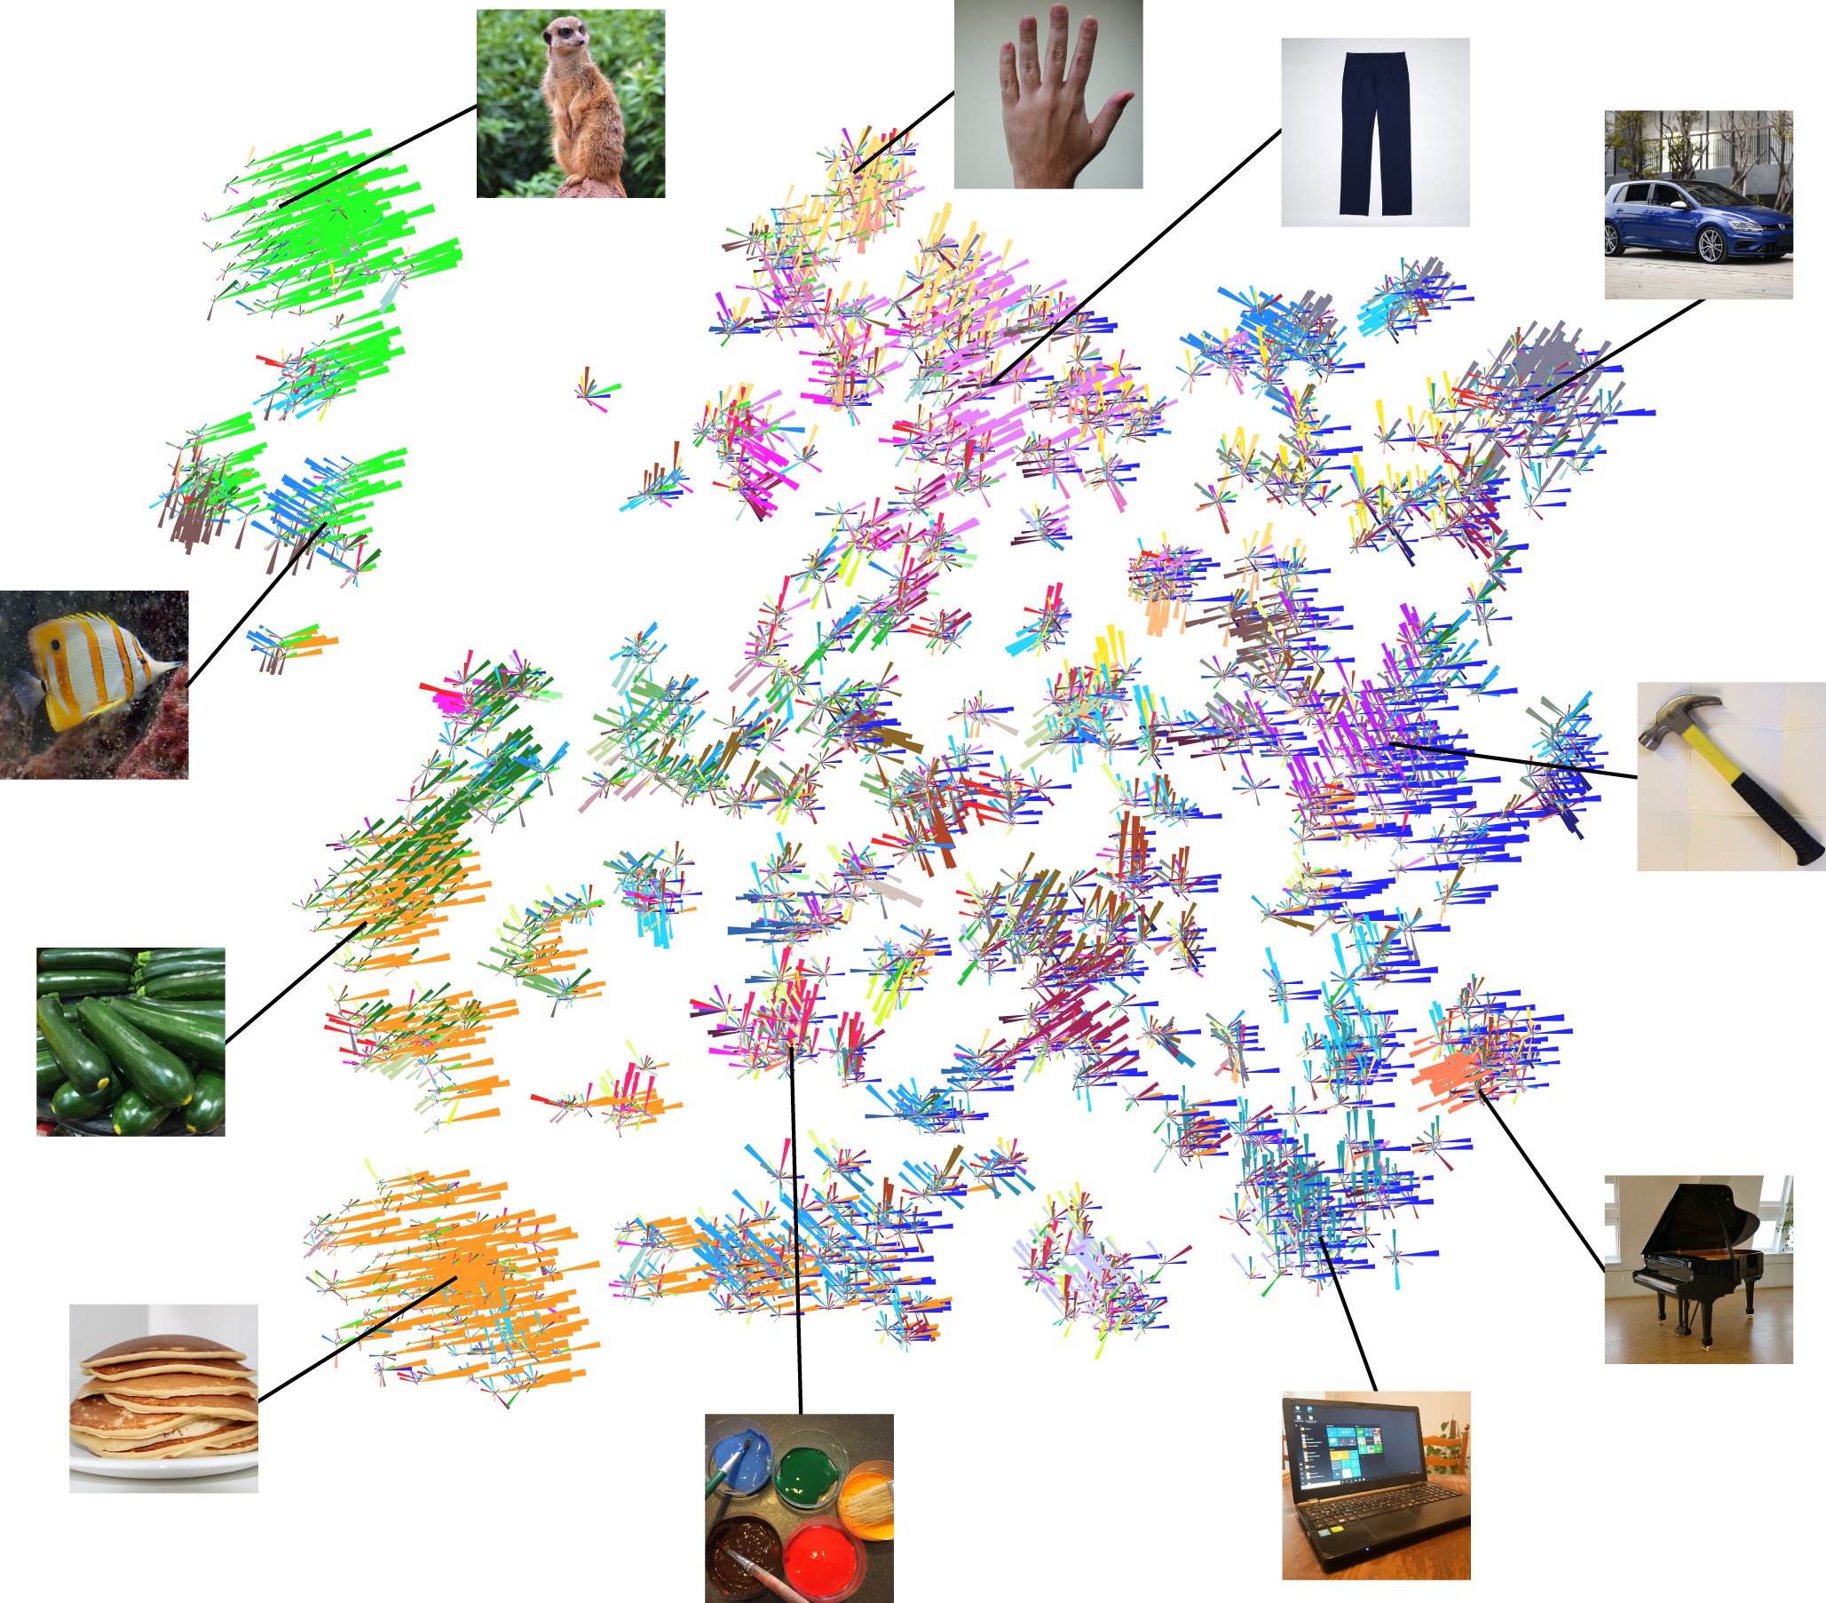

Slide 32
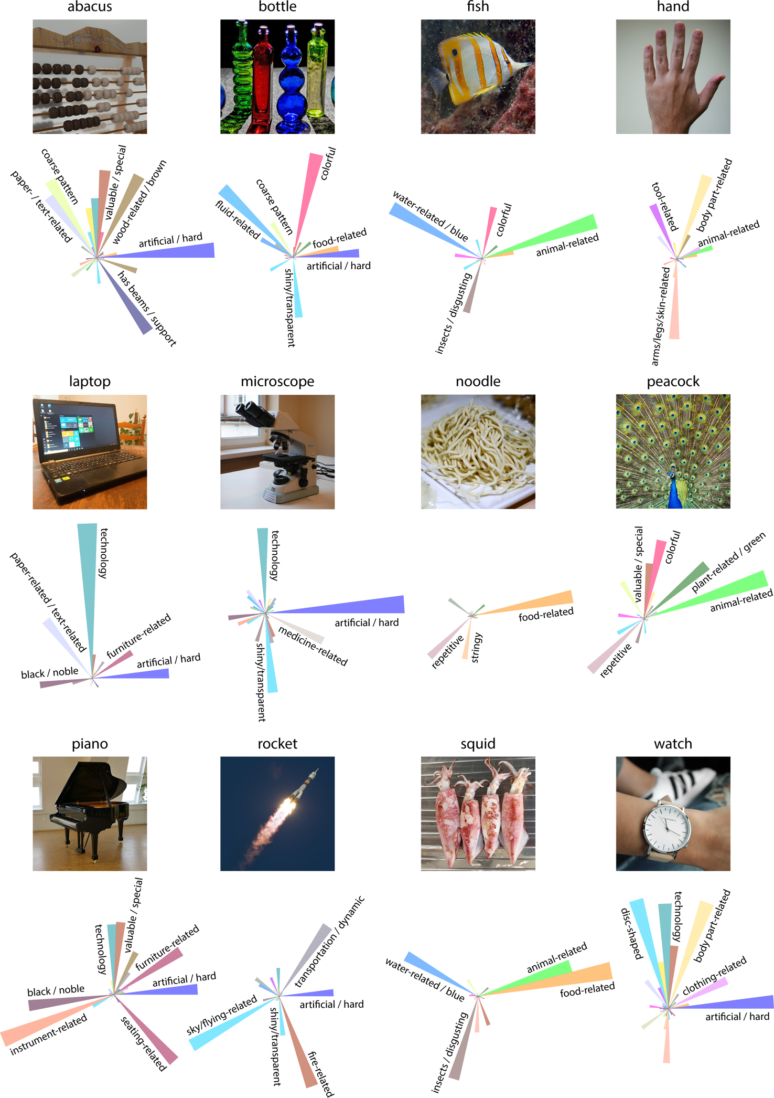

Slide 33
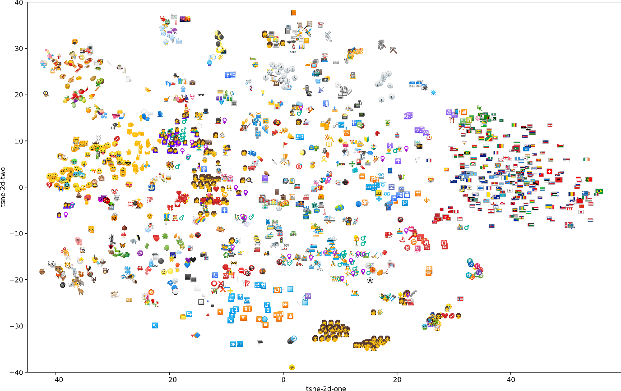
Pairwise similarity
How to compare similarity of individual items?

Slide 34

How to measure pairwise similarity
Stimuli 1
Stimuli 2
Any ideas?

Slide 35
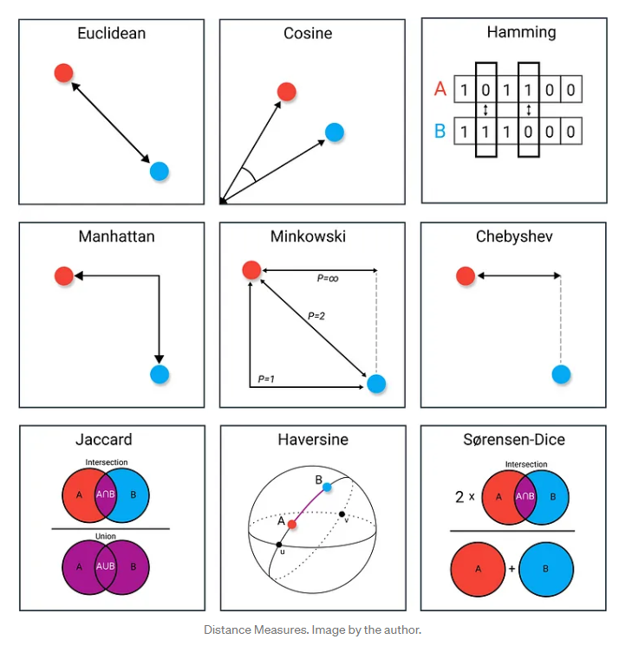
Pairwise similarity metrics

Slide 36
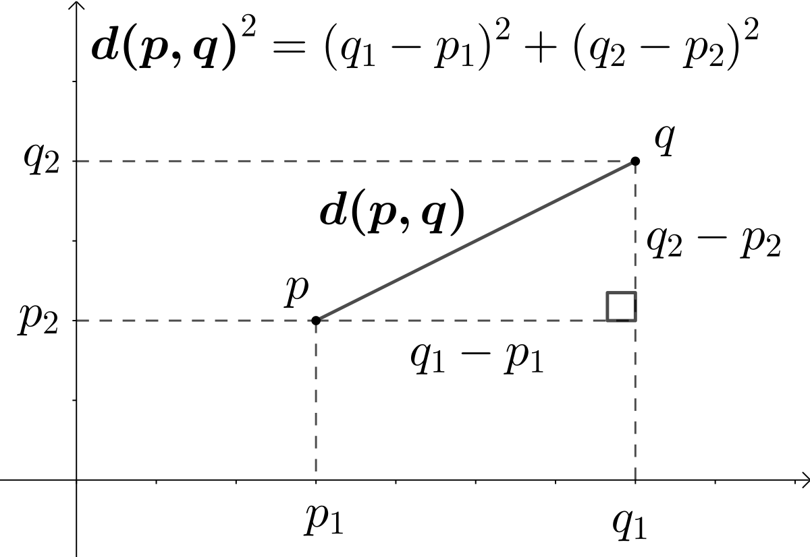
Pairwise similarity metrics

Slide 37
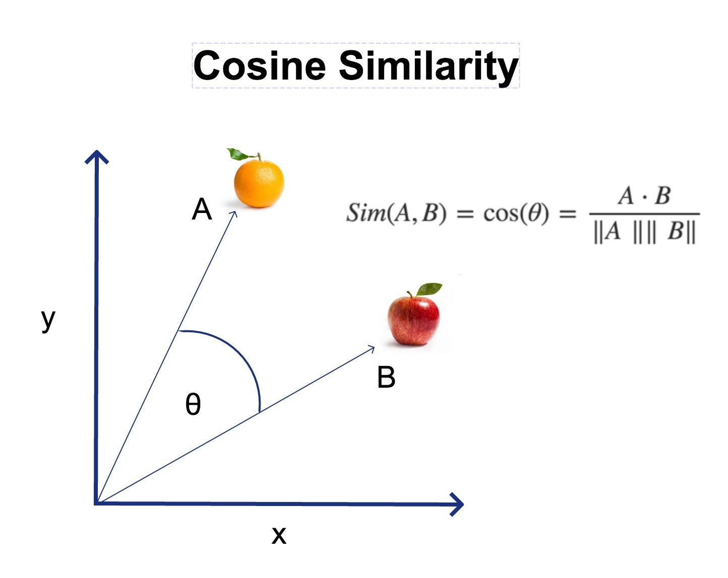
Pairwise similarity metrics
Often used with text
https://aitechtrend.com/how-cosine-similarity-can-improve-your-machine-learning-models/

