Slide 1
European social policy 2
Walter Lorenz

Slide 11
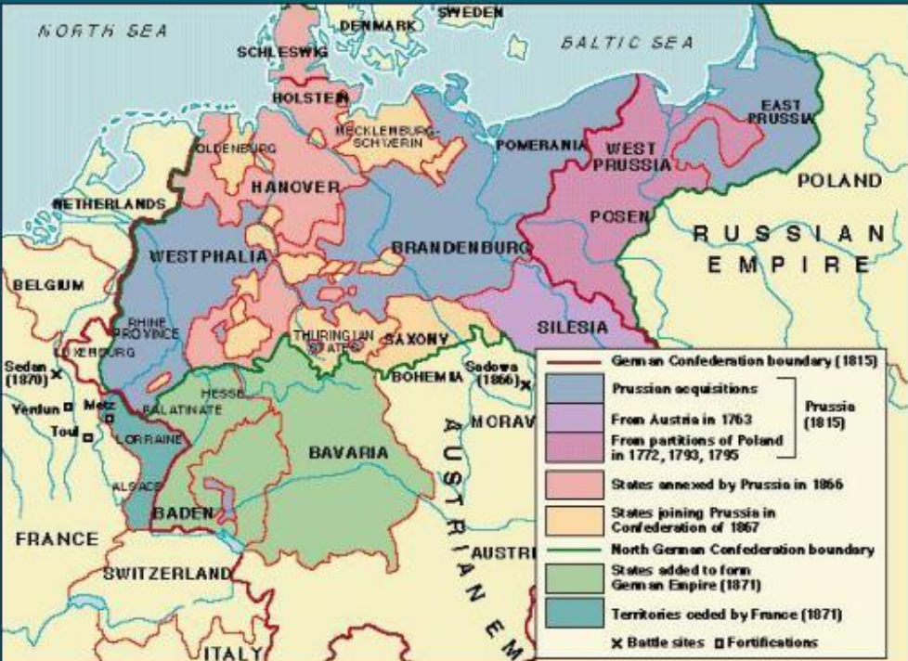

Slide 12
German unification
External measure:
War with France 1871 unites all the kingdoms of Germany under Prussian leadership against a common enemy : Revival of the „Heiliges Romisches Reich Deutscher Nation“,
Deutscher Nation“, Wilhelm I crowned in Versailles
National unity with retrospective orientation
Internal mesures:
- Abolition of internal tarifs boosts industrualisation
Declares Social-democratic Party (SPD) illegal 1878
Problems of industrialisation arise: migration to urban centres
Takes social-demicratic principles of social welfare to unite the social classes and avoid class divisions
Expels Jesuits but invents „subsidiarity“

Slide 13
Compulsory (private) insurance in Germany (first world-wide) “to reconcile the working classes to the authority of the state.”
1883: sickness insurance (2/3 contribution by employer, 1/3 by worker)
1884: accident insurance law
1889: old age insurance (including invalidity)
(unemployment insurance only in 1927!!!)
Social Democratic Party (SPD) since 1875 practically banned from participating in public politics

