Slide 2
Social welfare systems in Europe
Walter Lorenz

Slide 3
The political challenge of modernity: capitalism creates the unequal distribution of all forms of capital
For the middle classes financial capital (property, ownership of the means of production) ensured also the acquisition of human capital (servants, labourers) so that they were free to accumulate social capital: leisure time in clubs, hobbies, trade fairs, commercial partners… political parties.
For the working classes this means not only less financial capital but also restrictions on social capital

Slide 4
central question: who is now responsible for solving social problems?
individuals – in which case they need to be made aware of their responsibility, probably through deterrents (threat of the workhouse)
volunteers (the churches, humanitarian projects, philanthropy) by helping ‘informally’
public organisations – police, institutions (schools, hospitals, asylums), social workers.

Slide 5
 |  | State
Civil society (community) |  |  |  | Private sphere (individuals, market)

Slide 6
European welfare developments before World War II
Largely responses to crises (war-effects, pandemic!, unemployment, poverty, class division): uneven development, political compromises.
In post-Habsburg countries, the social institutions created were directed at mitigating needs of people who were in particularly difficult situations.
Law on social care passed in Poland in 1923 endured until 1990, typical for Central and Eastern European countries (Zalewski 2005).
Social assistance was based on the local authorities' cooperation with local civic organisations responsible for the fate of the poorest people. In Poland mainly religious organisations (Caritas), benefits predominantly in kind: food, accommodation, fuel in winter …
Reliance on “container institutions” (asylums for poor, disabled, mentally ill, orphaned people)

Slide 7
Czechoslovakia - Social policy during the first republic
After the end of World War I, laws on unemployment benefits,eight-hour working hours and the disbursement of pensions to disabled veterans and the bereaved of the fallen.
In 1924, sickness insurance was reformed, and disability and old-age insurance of the workers employed in the private sector was codified. The economic crisis of the 1930s decreased social activities: e.g. the state aid scheme for the unemployed was modified so that only union members were entitled to the benefits; the
housing protection programme was gradually reduced until 1937 when it was completely abolished.

Slide 8
Czechoslovakia after 1945
In 1947,a comprehensive social insurance scheme was adopted for all employed persons and the National Insurance Company was founded.
4 types of insurance: accident, old-age, sickness and unemployment insurance.
old-age pensions, 3 categories according to the sector in which they worked (the retirement age differed).
Since “poverty was abolished”, benefits for the poor did not exist; although, they were later reintroduced but without legal support, which means that they did not officially exist until 1991 (Kvapilová, 2010).
From the 1950s to the 1980s, the state-funded social services were distributed through employers.
In 1974, the family policy was reformed to promote a higher natality rate (the so-called Husák’s children). “Leninist model of the welfare state”

Slide 9
History of Soviet welfare measures 1917-1992
Utopian era (post 1017 revolution): Lenin promises comprehensive social security measures (income maintenance) – cannot be kept because of economic difficulties
Realism: 1920s – limited protection for skilled workers, investment in health and education, concentrated on urban areas (solidarity of workers)
Industrial emphasis (1928): unemployment benefits abolished by Stalin, work a civil duty, doctors mainly attached to hospitals (control of “real illness”); investment in education (future labour force) housing, disability, pensions neglected.
1950s Khrushchev reaffirms original social policy commitments: equality, public housing, workers’ access to higher education, old-age pensions doubled.
Constant threat: only economic growth can guarantee the realisation of the plans – state is forced to become practically a capitalist entrepreneur (workers do not receive the full benefit of the surplus they produce).
Social policy is used to support the economy primarily, not the needs of the population.

Slide 10
Fundamental, contrasting notions of welfare
 | Socialist welfare | Marketised welfare
Core principles | Equality: „to each according to their needs“ | Liberty: „to each according to their abilities / efforts“
Anthropology | Humans are inseparable of community (the collective creates individuals) | Humans are free agents making rational choices in their own interest, individuals choose groups
Provider of main support | „the collective“ (the state) | The individual (as entrepreneur)
Process | Social planning (collective targets) | Market as efficient distributor of goods according to demand
Dangers | Loss of freedom, state control | Deep social divisions

Slide 11
Renewed support for public welfare after World War II in Western Europe – motives:
Reward for returning soldiers (“a country fit for heroes”, Britain) – war bonus
Anti-fascism, anti-Nazism bonus: promoting a voluntary commitment to the nation, de-centralised organisation
Anti-communism (Cold War bonus): The West has to look after citizens better than the East; German model: Social Market Economy
Trend towards “de-commodification” : everybody should be able to benefit from support irrespective of personal financial resources – social class equality bonus

Slide 12
Principle of “De-commodification” (Esping-Andersen)
“De-commodification occurs when a service is rendered as a matter of right, and when a person can maintain a livelihood without reliance on the market. De-commodification strengthens the worker and weakens the absolute authority of the employer.”
- Which social services today are de-commodified and to what extent?

Slide 13
Main welfare concerns in the first decades after World War II
secure growth,
full (male) employment,
predictable welfare needs (education, health, pensions, housing)
homogenous societies,
dominance of class over identity-politics ad
national political-economic independence

Slide 14
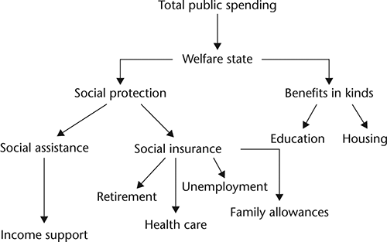

Slide 15
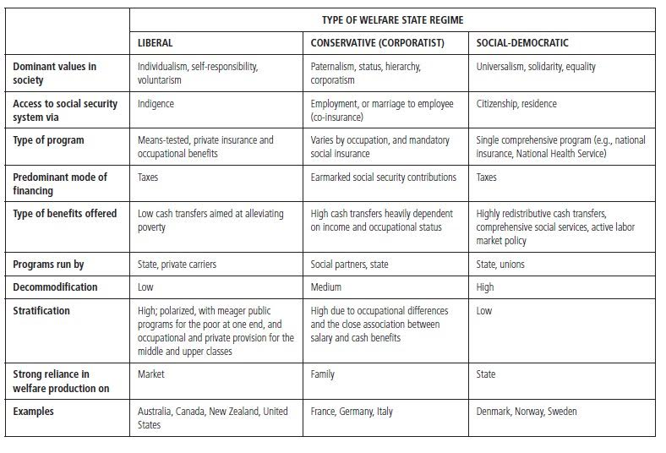

Slide 16
How many of those bonuses are still valid today after 1989?
War – a long time past
Fascism and Nazism – not seen as an issue of social policy
Cold War – „resolved“ after 1989
Class differences – stimulus for individual effort (activation)

