Slide 1
qualitative research (4)
Walter Lorenz

Slide 2
Instrument: Focus groups
Purpose: deepening the understanding of the deeper meaning of an issue that emerged in research; testing (previous, preliminary) findings with a view of finding consensus;
Establishes group members as “experts” in their fields of experience
Forms the basis of further questions to be explored and verified

Slide 3
Method D: Grounded Theory (Glaser & Strauss, 1967)
Grounded theory is a method of qualitative research in which data collection and analysis reciprocally inform and shape each other through an emergent interactive process.
Grounded theory is a complex iterative process. The research begins with the raising of generative questions which help to guide the research but are not intended to be either static or confining. As the researcher begins to gather data, core theoretical concept(s) are identified. Tentative linkages are developed between the theoretical core concepts and the data. This early phase of the research tends to be very open and can take months. Later on the researcher is more engaged in verification and summary. The effort tends to evolve toward one core category that is central.

Slide 4
Steps in following a Grounded Theory approach
Identify field of study / sampling; general orientation, observations
Collect information from oral and written sources in the form of texts / transcripts
Code the texts by
Reading them carefully
Grouping key ideas together under detailed headings (coding proper)
Re-read codes to formulate general categories (“theoretical sampling”)
Integrate relevant literature
Test the emerging categories against the data /texts again and again
Theorise interrelationships between codes / categories; form hypotheses
Test hypotheses through further sampling or focus groups

Slide 5
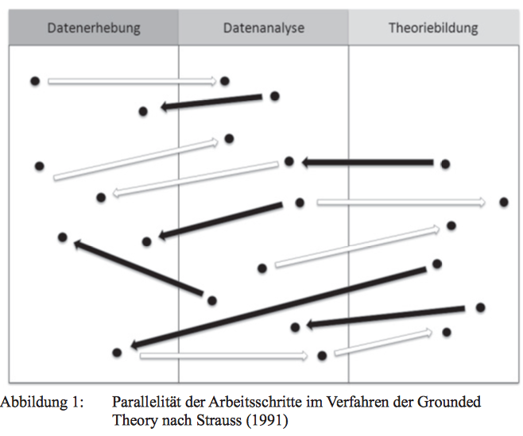

Slide 6
Outlook: Transformative research – taking the example of :
disability studies
Violence against women
Roma women research

Slide 7
Historic warning examples of ‘objectifying research’ (on disability)
Seclusion (in the name of ‘protection’)
Sterilisation (as a preventative social policy measure)
Chemical and physical straitjackets
Change in orientation only after campaigning for the “social model of disability”
Linking research models to emancipatory movements (civil rights, women’s emancipation, gay rights)
Distinction between inherent characteristics of the person and the societal responses; perspective of positive evaluation of diversity as pre-condition for paradigm change in research

Slide 8
For example “disability research”
Even with the (good) intentions of constructivist models of research, the benefits of such research for the people concerned with disability can be dubious:
a) Strengths and coping skills by people with disability often get forgotten
b) researchers construct ‘benefits’ for them but then move on to other fields and build their career, leaving disabled people to work for the implementation or results.
Crucial difference: consideration of the power differential between researcher and research “subjects”: who has control over the findings?

Slide 9
Emancipatory and transformative research
 | emancipatory | transformative
Focus | Exclusively on disability as central issue
Role of researcher / participant | Assumes “participants are conscious of their situation and ready to take leadership
Model of research | Participatory action research, interpretative approaches
Tone | Sets up “us” against “them” tone

Slide 10
Emancipatory and transformative research
 | emancipatory | transformative
Focus | Exclusively on disability as central issue | Various dimensions of diversity associated with differential access to power and privilege (gender, race, class, sexual orientation)
Role of researcher / particpant | Assumes “participants are conscious of their situation and ready to take leadership | Team approach, capacity building as part of research process
Model of research | Participatory action research, interpretative approaches | Multiple and mixed methods, culturally respectful, supportive of diverse needs
Tone | Sets up “us” against “them” tone | Acknowledges need for real collaboration to challenge oppressive structures

Slide 11
“Disability” - terms of reference
The authority for the construction of meaning within the disability community rests with the community’s members
Investigators should acknowledge that disability community members have the right to have those things that they value to be fully considered in all interactions
Investigators should take into account the worldviews of the disability community
In the application of these terms of reference, investigators should recognise the experiences, understandings and ways that reflect their contemporary cultures
Views and perceptions of the critical reference group to be reflected in any process of evaluating results
Investigators should negotiate within the disability groups the criteria for deciding how to meet cultural norms, social needs and priorities

Slide 13
