Slide 1
qualitative research (2)
Walter Lorenz

Slide 2
Inquiry paradigms
Item | Positivism | Postpositivism | Critical theory | Constructivism /participatory
Ontology | Naïve realism
Epistemology | Dualist, objectivist
Methodology | Experimental, verification of hypotheses, chiefly quantitative

Slide 3
Inquiry paradigms
Item | Positivism | Postpositivism | Critical theory | Constructivism /participatory
Ontology | Naïve realism | Critical realism - “real” reality only imperfectly knowable
Epistemology | Dualist, objectivist | Modified dualist, community dependent, probable truth
Methodology | Experimental, verification of hypotheses, chiefly quantitative | Modified experimental, falsification of hypotheses, quantitative /qualitative

Slide 4
Inquiry paradigms
Item | Positivism | Postpositivism | Critical theory | Constructivism /participatory
Ontology | Naïve realism | Critical realism - “real” reality only imperfectly knowable | Historical realism, reality shaped by social, cultural etc. values
Epistemology | Dualist, objectivist | Modified dualist, community dependent, probable truth | Transactional, subjectivist
Methodology | Experimental, verification of hypotheses, chiefly quantitative | Modified experimental, falsification of hypotheses, quantitative /qualitative | Dialogic / dialectical

Slide 5
Inquiry paradigms
Item | Positivism | Postpositivism | Critical theory | Constructivism /participatory
Ontology | Naïve realism | Critical realism - “real” reality only imperfectly knowable | Historical realism, reality shaped by social, cultural etc. values | Relativism, local specific, co-constructed realities
Epistemology | Dualist, objectivist | Modified dualist, community dependent, probable truth | Transactional, subjectivist | Transactional, subjectivist, created findings
Methodology | Experimental, verification of hypotheses, chiefly quantitative | Modified experimental, falsification of hypotheses, quantitative /qualitative | Dialogic / dialectical | Hermeneutical / dialectical

Slide 6
Examples:
Research position | topic | method
positivism | Relationship between Covid isolation and mental health | Questionnaires, online survey, look at statistics (psychiatric admissions)

Slide 7
Examples:
Research position | topic | method
positivism | Relationship between Covid isolation and mental health | Questionnaires, online survey, look at statistics (psychiatric admissions)
postpositivism | Differential effect of home-working on women and men | Questionnaire, structured interviews, survey of newspaper reports, social media topics, „overview“

Slide 8
Examples:
Research position | topic | method
positivism | Relationship between Covid isolation and mental health | Questionnaires, online survey, look at statistics (psychiatric admissions)
postpositivism | Differential effect of home-working on women and men | Questionnaire, structeured interviews, survey of newspaper reports, social media topics, „overview“
Critical theory | Effects of home-schooling on children with disability | Narrative interviews, statistics, focus groups, campaigning to test inclusive suggestions by participants

Slide 9
Examples:
Research position | topic | method
positivism | Relationship between Covid isolation and mental health | Questionnaires, online survey, look at statistics (psychiatric admissions)
postpositivism | Differential effect of home-working on women and men | Questionnaire, structeured interviews, survey of newspaper reports, social media topics, „overview“
Critical theory | Effects of home-schooling on children with disability | Narrative interviews, statistics, focus groups, campaigning to test inclusive suggestions by participants
constructivism | Employment visions of 16-18 year old pupils | Semi-structured qualitative interviews, focus groups, cross –generational comparisons

Slide 10
Reflectivity - a central tool to accompany all research
(best done in dialogue with a “critical friend” – supervisor?!)
Reflectivity is an attitude of attending systematically to the context of knowledge construction, at every step of the research process.
The process means reflecting critically on the “self” of the researcher,
  on the “human instrument” (own background, preferences, feelings, sources of knowledge, position in society etc. );
  On the conscious experiencing of the (multiple) self of the researcher as both inquirer and respondent, as teacher and learner,
  as the one coming to know the self within the processes of research itself (doing research alters not just what you know but who you are).

Slide 11
Steps in reflectivity
1. Reflectivity: awareness of specific perceptions, meanings, behaviours
2. Affective reflectivity: awareness of how the individual feels about what is being perceived, thought or acted upon
3. Discriminant reflectivity: Assessing the efficacy of perception
4. Judgmental reflectivity: Making and becoming aware of the value of judgements made (in a negative and positive sense)
5. Conceptual reflectivity: assessing the extent to which the concepts employed are adequate for the specific position taken
6. Psychic reflectivity: recognition of the habit of making percipient judgements on the basis of limited information (“intuitions”)
7. Theoretical reflectivity; awareness of why one set of perspectives is more or less adequate to explain personal experience than another.

Slide 12
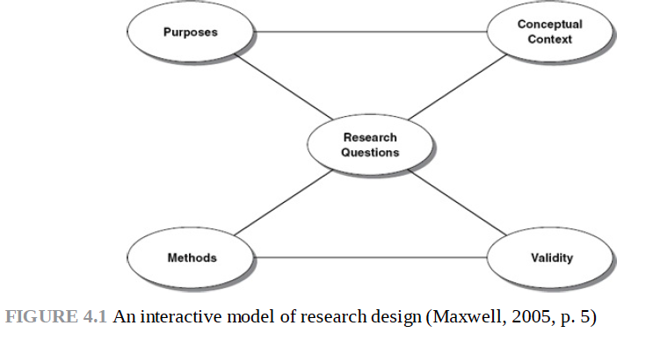
Planning a research project- general considerations

Slide 13
