Slide 1
Chemical equilibrium
Gibbs reaction energy, Le Chatelier principle, van‘t Hoffova equation

Slide 2


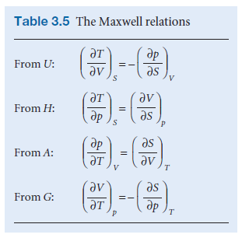


Thermodynamic potentials
Internal energy
Criterion (mathematical) for df to be a complete differential (integral does not depend on path):

Slide 3


Thermodynamic potentials
Entalphy
The change in enthalpy is equal to the energy supplied as heat at constant pressure (assuming the system is not doing any other work)

Slide 4
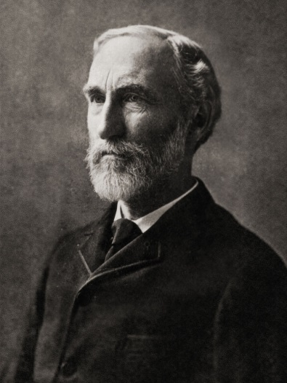


Thermodynamic potentials
Gibbs energy
Josiah Willard Gibbs
(1839 – 1903)
Closed system
Closed system, no change of composition

Slide 5

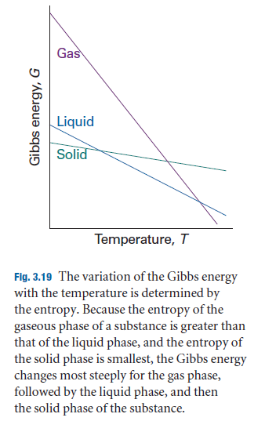
Thermodynamic potentials
Gibbs energy
Since S > 0 for all substances, G always decreases as the temperature increases (at constant pressure and composition)
Since (∂G/∂T)p becomes more negative as S increases, G decreases sharpest when the system's entropy is large (more in gases than in liquids and solids).
Since V > 0 for all substances, G always increases when the pressure in the system increases (at constant temperature and composition).

Slide 6
Chemical equilibrium
Atkins, Physical Chemistry, Chapter 7
Chemical reactions tend towards a dynamic equilibrium in which both the reactants and the products are present but have no further tendency to undergo net change. In some cases, the concentration of products in the equilibrium mixture is so high, significantly greater than that of unchanged reactants, that for all practical purposes the reaction is complete. However, in many important cases, the equilibrium mixture has significant concentrations of both reactants and products.

Slide 7



Minimum of Gibbs energy
Reaction Gibbs energy:
Extend of reaction
Molar Gibbs energy (chemical potential)

Slide 8
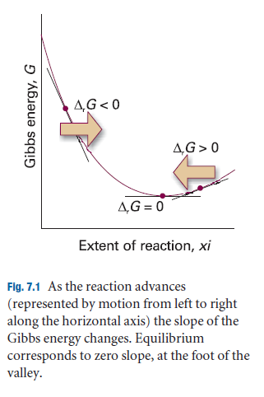
Minimum of Gibbs energy
Reaction Gibbs energy:
the difference between the chemical potentials (partial molar Gibbs energies) of the reactants and products at a given composition of the reaction mixture.
Chemical potentials change with a change in the composition of the mixture -> the slope of the Gibbs energy with respect to the reaction extend changes during the reaction
Reaction
is spontaneous for
The opposite reaction is spontaneous for

Slide 9
Minimum of Gibbs energy
Reaction Gibbs energy:
Reaction
is spontaneous for
The opposite reaction is spontaneous for
The reaction is not spontaneous in either direction
If we find the composition of the reaction mixture that provides this, then we can identify the composition of the reaction mixture in equilibrium.

Slide 10

Classification of reactions
The spontaneity of a reaction at constant temperature and pressure can be expressed in terms of the reaction Gibbs energy:
Exergonic
Endergonic
Beware, the terms exothermic and endothermic are related to the change of enthalpy!

Slide 11



Equilibrium: Ideal Gas
Both A and B ideal gases
Reaction quotient
Derivation
Difference of Standard Gibbs Energies of Reactants and Products

Slide 12


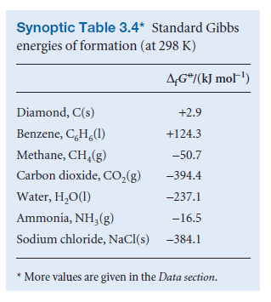
Equilibrium: Ideal Gas
Both A and B ideal gases
Difference of Standard Gibbs Energies of Reactants and Products
Stoichiometric coefficients
Standard Gibbs energies of formation for reactants and products
An atom in the ground state has a Gibbs energy of formation equal to zero

Slide 13

Equilibrium: Ideal Gas
Both A and B ideal gases
Difference of Standard Gibbs Energies of Reactants and Products
Difference of standard Gibbs energies of formation of reactants and products

Slide 14


Equilibrium: Ideal Gas
Both A and B ideal gases
In equilibrium:
Pro
in equilibrium, the partial pressure A exceeds the partial pressure B
in equilibrium, the partial pressure B exceeds the partial pressure A (equilibrium favors the products)

Slide 15
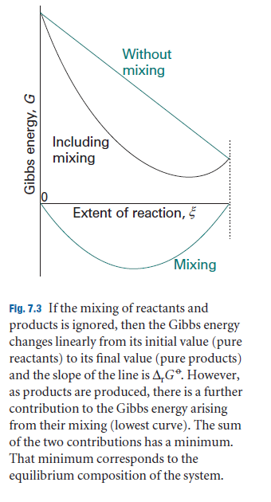


Minimum of Gibbs energy due to mixing of gases

Slide 16







General reaction
Compounds in the reaction
Stochiometric numbers
When changes by J changes by (mol)
Again, the reaction Gibbs energy is:
Activities of Solids and Liquids 1
Reaktion quotient:

Slide 17


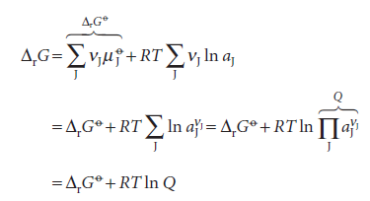


General reaction
Reaktion quotient:
Activities of Solids and Liquids 1, for an ideal gas
At constant temperature and pressure
In equilibrium:

Slide 18
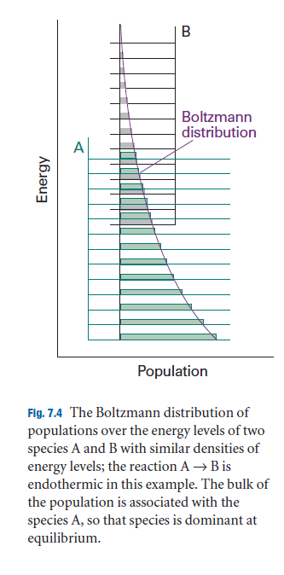
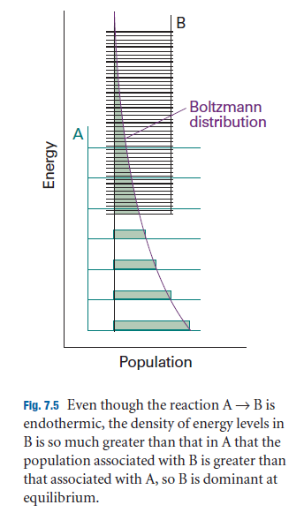

Effect of entropy
The energy levels of B lie higher than A, but their distances are much smaller. As a result, their total population can be substantial, and B can even dominate the reaction mixture in equilibrium at a given temperature. Nearby energy levels correlate with high entropy, so in this case we see that entropic effects can outweigh adverse energy conditions.

Slide 19
Effect of entropy
A positive reaction enthalpy results in a decrease in the equilibrium constant (that is, an endothermic reaction can be expected to have an equilibrium composition that favors the reactants). However, if the reaction entropy is also positive, then the equilibrium composition may favor the products, despite the endothermic nature of the reaction.

Slide 20
Influence of temperature and pressure on reaction equilibrium

Slide 21
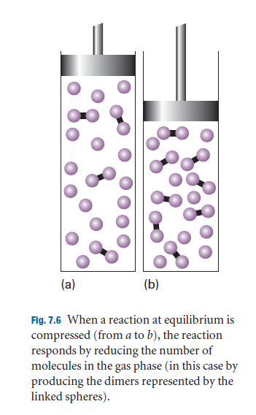


Pressure Change Response
The equilibrium constant depends on the value that is defined for a single, standard pressure. The value of , and therefore K, is therefore independent of the pressure at which the equilibrium is actually established.
But the partial pressures of the reactants in equilibrium
can vary
Dissociation
the contribution from B grows in square. The partial pressure of A must increase relative to B
The balance shifts in favor of A

Slide 22
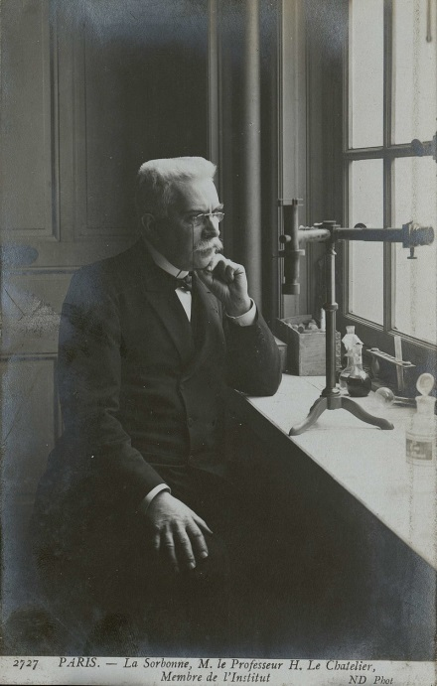
Le Chateliér's principle
A system in equilibrium, when subjected to disturbance, reacts in a way that tends to minimize the effect of interference
Henry Louis Le Chatelier
(1850 - 1936)

Slide 23

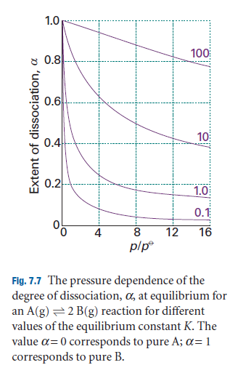


Pressure Change Response
α – degree of dissociation

Slide 24
Temperature Change Response
Le Chatelier's principle predicts that a system in equilibrium will tend to shift in an endothermic direction if the temperature increases – then the energy is absorbed as heat and the temperature increases, and the system resists the temperature increase. On the contrary, a shift in the equilibrium in the exothermic direction can be expected if the temperature decreases, because then the energy is released and the system resists the decrease in temperature.
These conclusions can be summarised as follows:
Exothermic reactions: elevated temperature favors reactants.
Endothermic reactions: increased temperature favors products

Slide 25








van't Hoff's equation
derivation:

Slide 26




van't Hoff's equation
derivation:

Slide 27


van't Hoff's equation
For exothermic reactions
The equilibrium constant decreases as the temperature increases – the equilibrium shifts in favor of the reactants
The opposite is true for endothermic reactions

Slide 28
van't Hoff's equation
Thermodynamic point of view:
In the case of an exothermic reaction, the
Corresponds to a positive change in the entropy of the surroundings
Preferred product formation
When the temperature increases, it decreases, and the increasing entropy of the surroundings plays a less important role. As a result, the equilibrium lies more towards the reactants. When the reaction is endothermic, the main factor is the increasing entropy of the reacting system. The significance of the adverse change in entropy of the surroundings is reduced if the temperature increases (because then is smaller), and the reaction can move on to products.

Slide 29
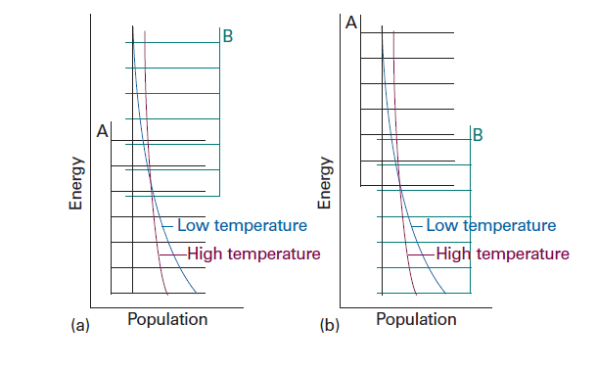
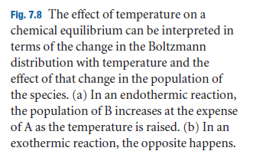
van't Hoff's equation
When the temperature increases, the Boltzmann distribution adapts and the population changes. The change corresponds to an increased population of higher energy states at the expense of a population of lower energy states. The states of the B molecule become more populous at the expense of the A molecules. Therefore, the total population of B states increases and B becomes more abundant in the equilibrium mixture. Conversely, if the reaction is exothermic, then an increase in temperature increases the population of states A (which start at higher energy) at the expense of states B, so that the reactants become more abundant.

Slide 30
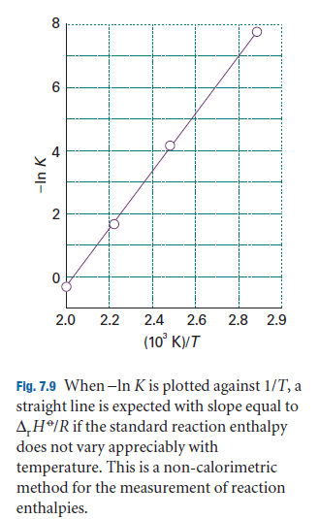
van't Hoff's equation
Under certain conditions, it is possible to obtain the reaction enthalpy from the temperature dependence of the equilibrium constant

