Slide 1
Reaction dynamics
Collisions, cross-section, PES
Based on Lecture notes by Claire Vallance

Slide 2
Collisions
Elastic – the total kinetic energy of the reactants is conserved Inelastic – part of the energy is converted into the internal energy of the reactants (rotation, vibration) during the collision Reaction (a special case of inelastic) – during a collision, chemical bonds are broken or formed

Slide 3
Collisions
relative velocity:
determines the energy available in the collision and usable, for example, to overcome the activation energy of the reaction
Total kinetic energy of the reactants:
Center of Mas Speed
Reduced mass

Slide 4
Collisions
Total momentum is conserved during a collision:
The kinetic energy associated with the center of gravity must be conserved during a collision
Only the kinetic energy arising from the relative velocity of the particles is applicable, for example, to overcome the activation energy of the reaction, internal excitation, etc.
Srážková energie

Slide 5
Collisions
The total energy is conserved – before the collision, it is the kinetic energy + internal energy of the ractants
Enthalpy change of the reaction at 0 K
Positive if energy is consumed in the reaction (endoergic reaction)
negative if energy is released during the reaction (exoergic reaction)
When talking about individual reactive collisions, the terms endoergic and exoergic are used instead of endothermic and exothermic

Slide 6
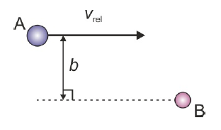
Impact parameter
The probability of a reaction as a function of the collision parameter is called the opacity function

Slide 7
Cross section (collisional)
In the case of attractive action between the reactants, collision parameters greater than d can lead to collision – in this case, the collision effective cross-section will be larger than in the case of this model of "billiard" balls

Slide 8
Cross section (collisional)
Not every collision leads to a reaction
For biliard balls

Slide 9
Dependence on collision energy
The higher the velocity of the reactants, the less time they have to interact with each other, the limit is
Often a very small value – the effective cross-section decreases with increasing energy

Slide 10
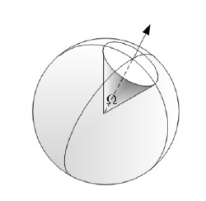
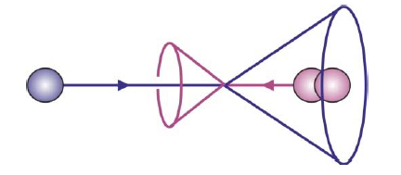
Differential cross section
Probability of scattering into a given cone angle
Effectively, the probability of scattering to a given angle with respect to the relative velocity vector

Slide 11
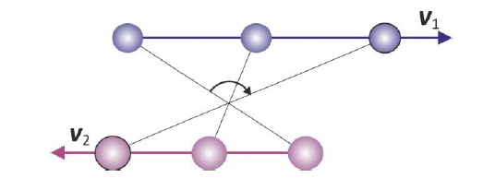
Angular momentum
(orbital) angular momentum
For large b
Total angular momentum (orbital + rotational) is conserved during the reaction

Slide 12
PES – Potential Energy Surface
billiard balls

Slide 13
PES – Potential Energy Surface
Lenard - Jones potential
Attractive interaction
Repulsive interaction

Slide 14
Interactions between atoms, molecules and ions

Slide 15
PES – polyatomic systems
3N-6 (3N-5) souřadnic

Slide 16
PES – polyatomic systems
The shape of the PES influences the dynamics of the reaction
PES from quantum mechanical calculations

Slide 17
PES – polyatomic systems
Let the atoms lie in a straight line during the reaction
Section for fixed

Slide 18
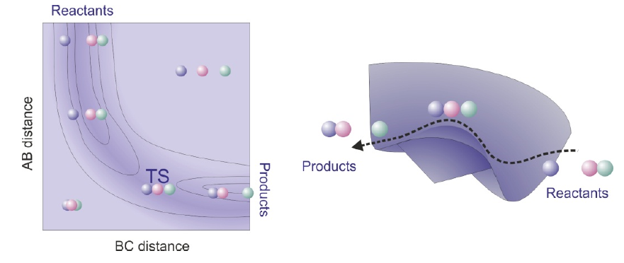
PES – polyatomic systems
Let the atoms lie in a straight line during the reaction

Slide 19
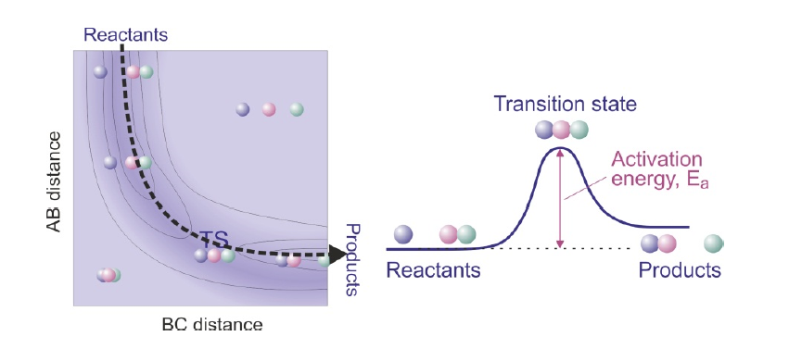
PES – polyatomic systems
Let the atoms lie in a straight line during the reaction
The trajectory with the lowest energy is called the reaction coordinate

Slide 20
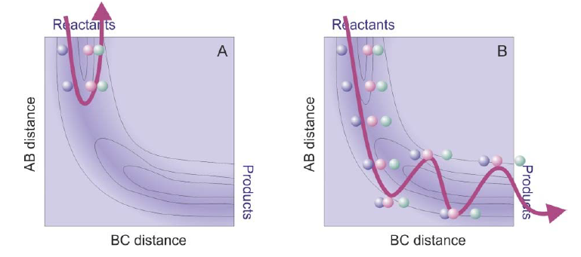
PES – polyatomic systems
Let the atoms lie in a straight line during the reaction
The reactants have enough energy to overcome the barrier. part of the energy is converted into the vibration of the AB product
The reactants do not have enough kinetic energy to overcome the activation energy (elastic collision)

Slide 21
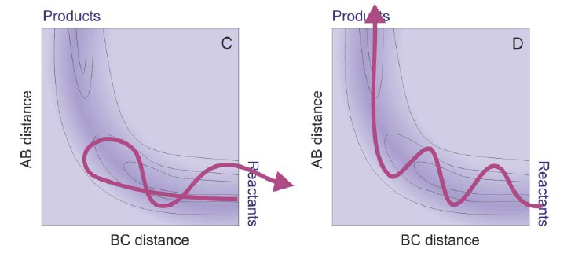
PES – polyatomic systems
Let the atoms lie in a straight line during the reaction
The reactants do not overcome the barrier, they "bounce" and part of their kinetic energy is converted into vibrational (inelastic collision)
The reactants have kinetic and vibrational energy, the products are not vibrationally excited

Slide 22
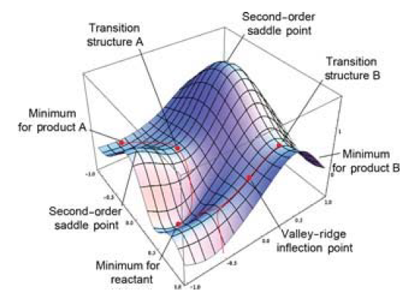
PES - characteristics
Stable states are the lows on PES
Transition states are saddle points

Slide 23
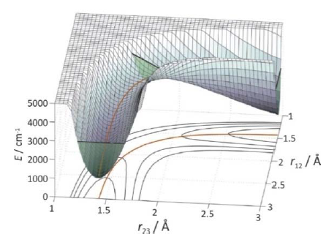
PES - Examples
PES is symmetrical, the transition state is exactly in the middle

Slide 24
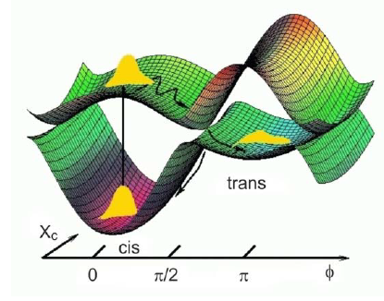
PES - Examples
Cis – trans isomerization of retinal induced by photon impact
The electronically excited state can undergo a torsional motion around the double bond – the equilibrium geometry is around 90° – then pass through the conical intersection to the ground state (trans)

Slide 25
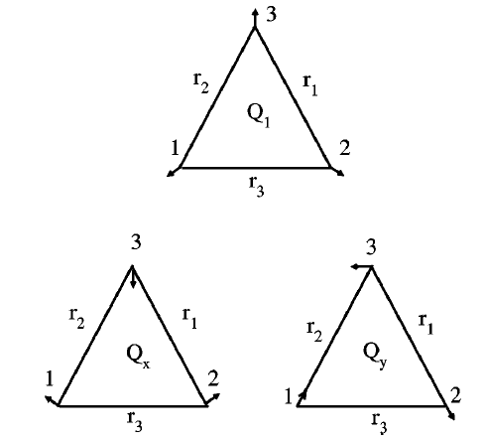
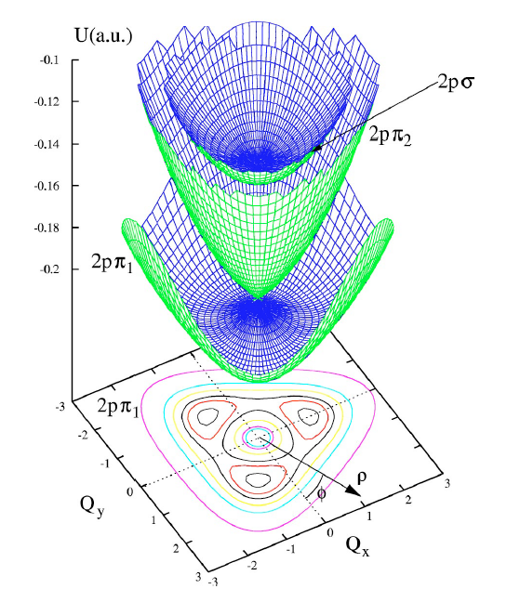
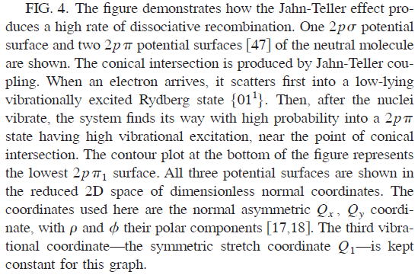
PES - Examples
Recombination of H₃⁺ with electrons

Slide 26
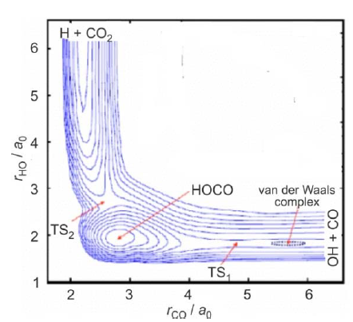
PES - Examples
A relatively stable HOCO molecule is formed. The energy available to the system can be statistically distributed among different internal degrees of freedom, resulting in a characteristic "statistical" distribution of populations in reaction products. Newly formed ("nascent") products of direct reactions often have a highly non-statistical distribution of quantum states.

Slide 27
Mass weighted coordinates, skew angle
Coordinates
Collinear geometry
Reduced mass of products
It is not possible to imagine the process as the movement of a single particle of mass μ on a PES!

Slide 28
Mass weighted coordinates, skew angle

Slide 29
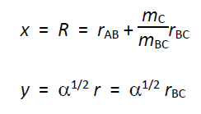
Mass weighted coordinates, skew angle
i.e. particles of mass μ moving along the PES in mass weighted coordinates:
X and Y are a linear combination of the original coordinates. This is equivalent to a figure where the PES is in the original coordinates that make a β skew angle

Slide 30
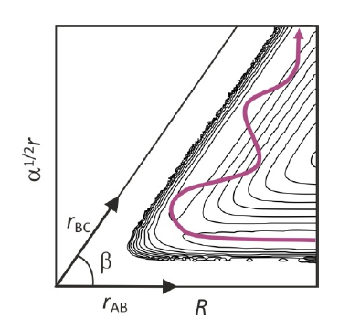
Mass weighted coordinates, skew angle
If A or C are light atoms, cos β is small and β is close to 90 degrees

Slide 31
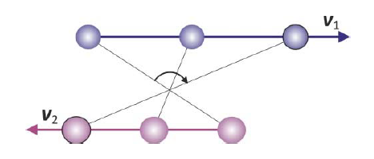
Orbital angular momentum, centrifugal barrier
kinetic energy of orbital motion – not available to overcome the reaction barrier (effectively reducing the energy available for the reaction)
A portion of the kinetic energy associated with the motion on a straight line between the centers of the particle

Slide 32
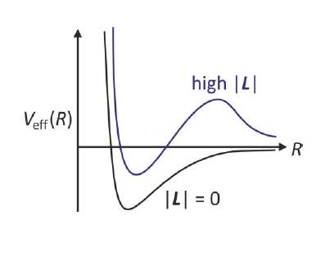
Orbitální moment hybnosti, centrifugální bariéra
This term is often added to potential energy (centrifugal barrier)
Effective potential
With a higher b, a higher barrier, often a lower cross-section

