Slide 1
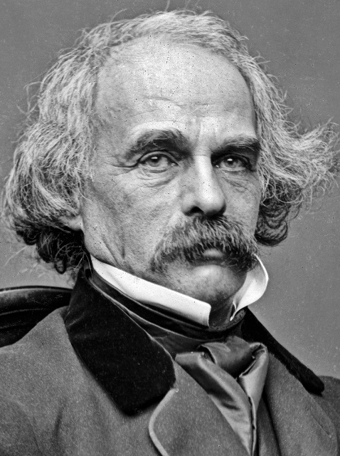
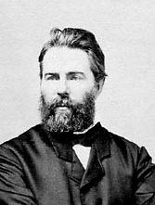
Late Romanticism: Hawthorne and Melville
Introduction: Features of American Late Romanticism
The revaluation of earlier features and forms of American and European Romanticism.
In America, these are:
the historical romance (James Fenimore Cooper’s Leatherstocking Tales), which established a national myth of the Frontier,
the Gothic fiction of Charles Brockden Brown and Edgar Allan Poe,
the optimistic aspects of Transcendentalism, especially
the faith in the perfectibility of humankind
the understanding of nature as a mediator between humankind and the spiritual essence of being (the Over-Soul).
In European Romanticism:
“truth to nature” and sincerity (William Wordsworth),
notion of “noble savage” (Jean-Jacques Rousseau)
the elevation of folklore and primitive cultures (James Macpherson, William Wordsworth, Lord Byron)
Above: Nathaniel Hawthorne (1804-64); Below: Herman Melville (1819-91)

Slide 2
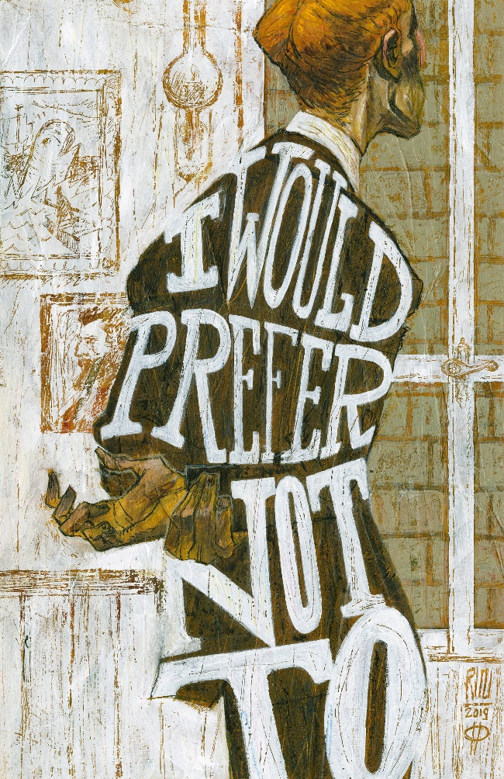
Introduction: The Art of American Late Romanticism
The artistic means by which these re-evaluations are effected:
Irony, distancing the imagery and ideals of earlier romantics, and playing with them.
Interest in moral and historical aspects of American tales which was not typical of some authors of the Gothic genre (Edgar Allan Poe).
Nathaniel Hawthorne (1804-1864) wrote a frontier tale “Roger Malvin’s Burial” treating ironically the myth of an intrepid frontiersman, a fighter against “bloodthirsty” Indians. Simultaneously, he wove in a moral theme of human responsibility for the life of another.
The interplay of allegorical, symbolic and “realistic” features
The interpenetration of the traits of the romance, novel and essay
Hawthorne often used allegory as a typical form of the Puritan literature that interested him. Unlike the Puritans, he transformed allegories into symbols of an uncertain and enigmatic human existence. Allegory, and its recognitions and misrecognitions of reality was one of Hawthorne’s main themes.
In contrast to Hawthorne’s allegories, Herman Melville (1819-1891) developed romantic symbolism in order to problematize the American dream and the nineteenth century myth of progress.
Metafictional nature of some works, which include the accounts of the problematic aspects of their representation of reality
Hawthorne: short story “Main Street” (1849) ironically describing his historical fiction as a mechanical puppet theatre propelled by a crank and loudly criticized by some spectators.
Melville: short story “Bartleby the Scrivener” (1853) using the symbol of the Dead Letter Office for the fiction which cannot find its readership; chapter “The Affidavit” in Moby-Dick (1851) where the author swears that he will speak the truth but immediately admits that this “truth” is based on the myths mariners narrate about whales.
Roberto Ricci:
Bartleby, the Scrivener

Slide 3
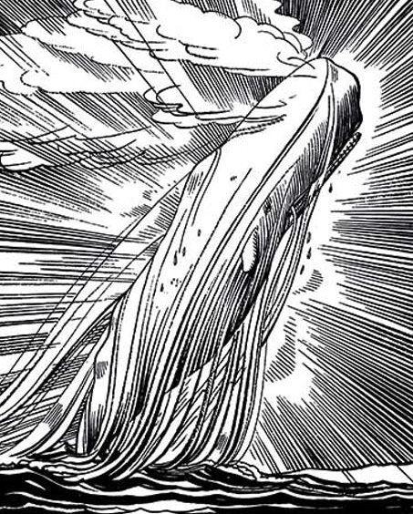
Introduction: Historical Significance of
Hawthorne and Melville and Their Major Differences
Historical Significance
Some works by Hawthorne and Melville, especially The Scarlet Letter (1850) and Moby-Dick (1851) close the period of American literary history from the Revolution to the Civil War.
They also foreshadow later developments:
Hawthorne’s last completed novel The Marble Faun (1860) - the theme of Americans in Europe developed from the 1870s in the psychological novels of Henry James.
Melville’s allegory and symbolism in Moby-Dick reveal - in the course of the transformation of the Puritan myth and typological view of history - possibilities for new and much more disquieting projections of American identity (e.g., in the late work of Mark Twain).
Differences between the two authors lie in their thematic - cultural and philosophical - focus.
Hawthorne: focusing on the Puritan origins of American culture and the ways American colonial past is related to his present.
Melville: focusing on the horizon of American experience. What happens if
- this horizon disappears: “Bartleby the Scrivener” and symbolically in Mardi (a philosophical novel criticizing American utopia by transposing it among the nations of Polynesia),
- it is shifting continually like the mysterious whale of Moby-Dick, and thus avoids our grasp.
As a result, both authors have different approaches to time and temporality.
- Hawthorne: the Puritan past of America can still foreshadow the future (e.g., in The Scarlet Letter), which is a view of time analogous to those of many other romantics.
- Melville: time becomes random and erratic: it can be related neither to the origins nor to the objectives of humankind. This is reflected in the narrative structure of Moby-Dick.
Rockwell Kent (1882-1971),
Moby Dick Transcendent (1940).
Illustration for the Lakeside
Edition of Melville‘s works.

Slide 4
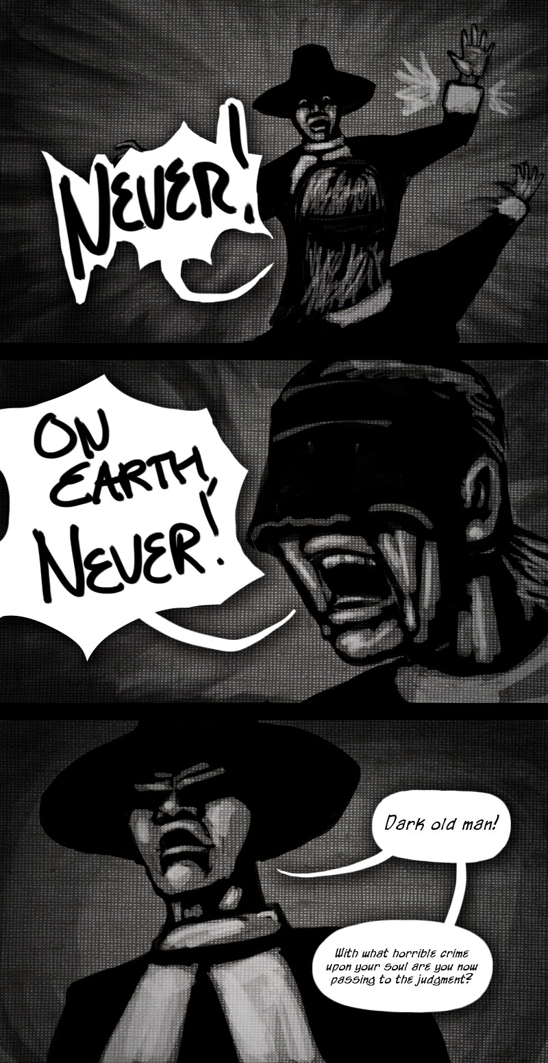
Nathaniel Hawthorne: Tales of Colonial History
Specific Representation of History:
Twice-Told Tales (1837), Hawthorne‘s first collection of short stories appeared after two abortive attempts to write a series of tales from New England, and after years of seclusion and hard thinking over the individual stories.
The title reveals Hawthorne’s pessimistic view of life (it is an allusion to a line from Shakespeare’s King John 3.4 - “Life is as tedious as a twice-told tale” but also points to the fundamental difference of Hawthorne’s approach to history from his predecessors and contemporaries.
For Hawthorne, history is no general drama of humanity. Such opinions are treated ironically in later stories, such as “The Procession of Life” or “Earth’s Holocaust.” History is concrete and individual mainly because it includes stories that cannot be treated as mere historical sources but incorporate also invented narratives, elements of folktales or myths.
In historical fiction, these stories are necessarily retold, and thus their relationship to historical facts is changed.
These changes are also caused by
the projection of Hawthorne’s moral feelings
the persistent tendency of his narratives to transform their events and motives into allegories and symbols, thus stressing their meaning as signs.
problematization, deconstruction, and destabilization of allegorical conventions: “The Minister‘s Black Veil” – the impossibility to represent truly the Puritan mind,
interpenetration of allegory and realistic historical narrative: “Young Goodman Brown”: the impossibility to distinguish between the hero‘s hallucination and the “true story”.
A scene from the conclusion
of “The Minister‘s Black Veil”
in a recent comic strip

Slide 5
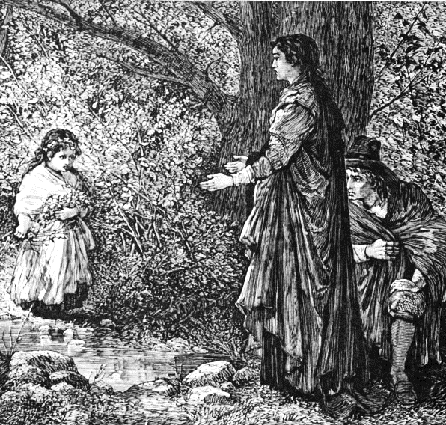
Nathaniel Hawthorne: The Scarlet Letter
Often called an historical romance. This is correct only partly with respect to the character of Hester Prynne’s former husband Roger Chillingworth (features of a magician), and some very rare miraculous events, such as the appearance of the stigma on the breast of Arthur Dimmesdale, or the visions of the Puritans in the night sky.
Neither it is a historical novel: it does not deal so much with the life of the early Puritan settlement, as with the differences between Puritan and nineteenth-century reading of signs.
Hester is condemned to wear the garment with the scarlet “A” and thus to become an allegory of adultery.
But she managed to change the imposed meaning of the letter by her behaviour and skills. “A” came to be understood as a sign for “able” and “admirable.”
When it appeared as a sign on the night sky, it could mean both “Apocalypse” and “America” (a revelation of America‘s mission in Hester‘s good acts).
On the other hand, “A” became a sign of shame connected with the secrets of privacy when discovered on Dimmesdale’s body.
The final meaning of “A” is deferred as the biblical Apocalypse:
- creates a space for Hester‘s authentic life and her help to women wronged by men,
- moves the boundary between nature and culture: Hester‘s daughter Pearl‘s “kindred wildness” establishes a different reading of signs, a different understanding of culture than that of the colonists.
Mary Hallock Foote (1847-1938),
an illustration to The Scarlet Letter.
Hester, Dimmesdale and Pearl in
the wood – Pearl separated from
her parents by a brook – symbol
of the division between nature
and culture, American future and
past.

Slide 6
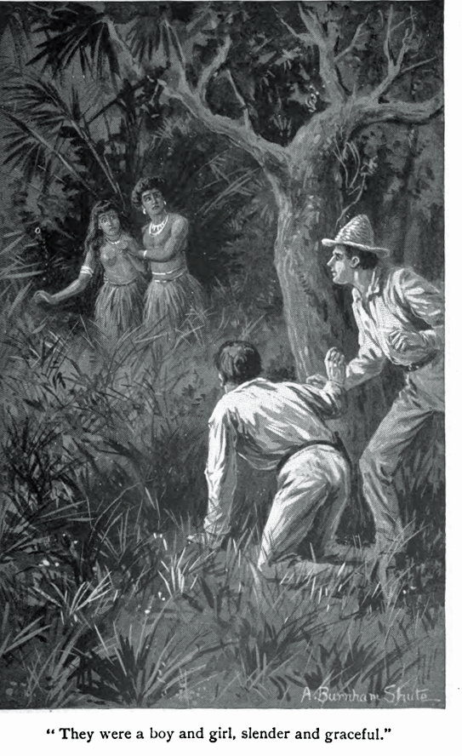
Herman Melville: Introduction and Early Works
Melville left school at the age of eleven and became first a bank clerk and then worked in his brother’s store. Later he taught in a country school and took a course in surveying and engineering but found no work.
This made him think of going to sea. His first voyage to Liverpool in 1839 later became a model for his least complicated naval novel Redburn (1849).
After his return he decided in despair to sail on a whaling ship to the South Seas. In the summer of 1842 Melville and his shipmate deserted from the whaling crew in the Marquesas (in the Pacific) and spent some time with the aborigines. When they found that the natives were cannibals, they escaped on board an Australian whaler.
All these events became the basis of Melville’s first semi-autobiographical novel Typee (1846) (named after the tribe). Main features: sharp observation of the social, religious and moral customs of the aborigines and the skillful use of suspense. The aborigines no longer constructed as noble savages facing extinction or degeneration (as in Cooper’s novels), but became representatives of another, hardly imaginable world, that was a counterpart to the visions of the American Dream.
The next novel, Omoo (1847) is based again on naval experiences, Melville‘s voyage on the Australian whaler, the sailors’ mutiny and the subsequent explorations at Tahiti and Imeeo in Polynesia. Deeper interest in aboriginal life and wild nature and a genuine concern for some members of the crew among whom a learned man and a philosopher, nicknamed Dr. Long Ghost, becomes the narrator’s companion and mentor.
This foreshadows further transformations of the literary genre: from the next novel, Mardi (1849), Melville starts to experiment in combining the tale of adventure and the philosophical essay. Also, the ship and its crew become symbols or allegories of humankind and its condition.
A.B. Shute (1851-1906),
an illustration to Typee (1892)

Slide 7
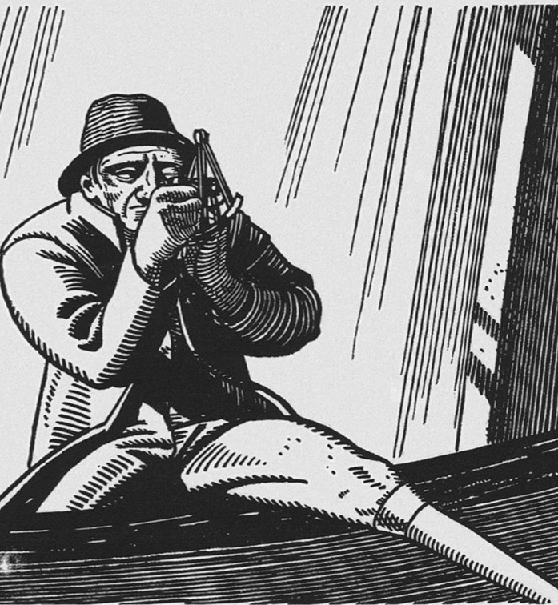
Herman Melville: Moby-Dick / The Whale
The Story and Some Characters
The main plot narrates about the monomaniac, demonic Captain Ahab (the name of the greedy, base and godless king who “led Israel into sin”- 1 Kings 21:23) and of his unsuccessful hunt for the fierce and cunning white whale nicknamed Moby Dick (the origin of this name can be found in the legend about an actual whale known as Mocha Dick which in the 1830s and 1840s killed about thirty men, drowned five whalers and fourteen boats).
The long voyage of Ahab’s whaling ship, the Pequod (named after an Indian tribe Pequot, exterminated by the Puritans in 1637), symbolizes the expansion of American civilization, led by corrupt, self-centred leaders and dominated by the desire to master and control nature and other cultures.
This desire is not shared by all members of Ahab’s crew: especially by the First Mate, Starbuck (whose religious and moral reproaches do not have any effect on Ahab), and is entirely alien to the harpooner Queequeg (the son of a Polynesian king) and his friend and counterpart, the philosophizing autobiographical narrator Ishmael, whose name (“God heard”) - originally given to the first but disinherited son of Abraham rescued by God - signifies his exile from the American tradition established by the Puritans.
The uncanny yet suggestive narrator ironizes Emersonian notions of self-reliance and Man-Thinking (see the previous lecture) and is the only person who escapes the general disaster of the Pequot whose crew was manipulated by Ahab and driven into a mad chase of Moby Dick (Ahab wants to revenge on the whale for the loss of his leg in an earlier encounter with it).
Rockwell Kent, an illustration
to Moby-Dick (1940).
Captain Ahab with his ivory leg
and a quadrant in pursuit of
Moby-Dick

Slide 8
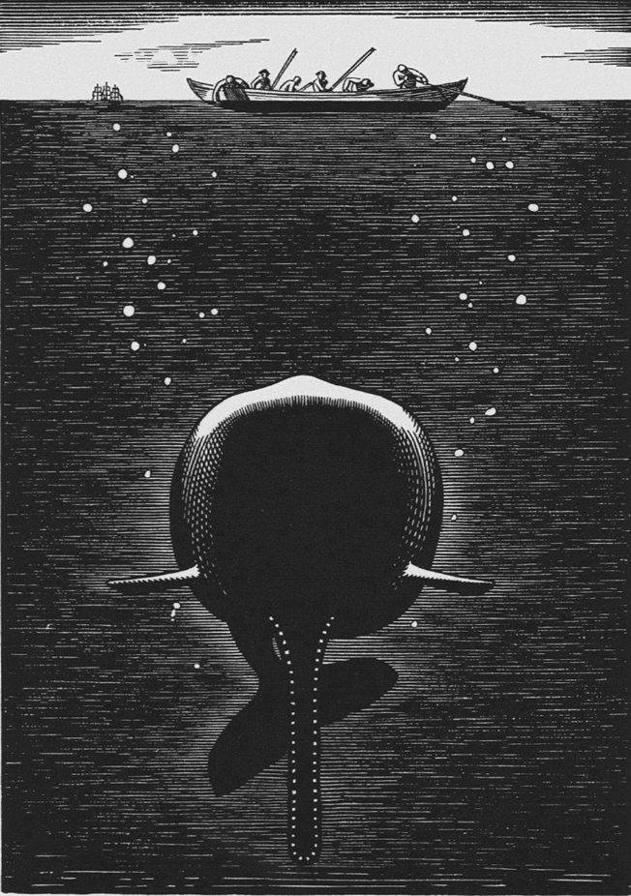
Herman Melville: Moby-Dick / The Whale
Meaning and Symbolism
Refusal of Encyclopaedic Knowledge and Principles of 19th Century Science: A great part of the book consists of essay chapters which deal with the classification, representation, life-span, pursuit, processing and use of whales. This account mocks and disrupts traditional structures of encyclopaedic knowledge and puts in doubt the optimism of 19th century science.
Comparison with the Bible: Melville ironically calls his book, “a veritable gospel cetology” (i.e., science about whales which is like the Gospels - the most important part of the New Testament). Referring to his book as an unfinished sacred text, Melville undermines traditional patterns of authority and opens his writing to the Other: the future, the sea and the world of whales. Whales will be here, when the empires collapse. Then the earth will belong to them. Their world is more wonderful, inscrutable and permanent than any human “reality.”
Thus Moby-Dick:
disputes the claims of modern civilization to global power,
condemns the political claims of U.S. expansionism at the time of the Mexican War, especially of the doctrine of “Manifest Destiny”
fundamentally revalues human relationship to nature.
Moby-Dick was published ahead of time. While it almost destroyed Melville‘s contemporary literary reputation, it became admired in the latter half of 20th century: e.g., by Charles Olson (a poet and founder of the Black Mountain School) – Call Me Ishmael (1947).
Rockwell Kent, an illustration
to Moby-Dick (1940). Symbolic
representation of the unknown
world of whales

