Slide 1
Clusters

Slide 2
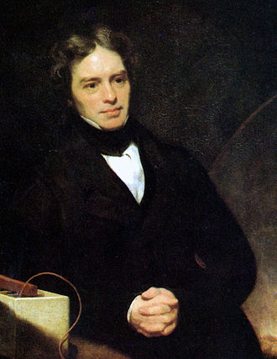
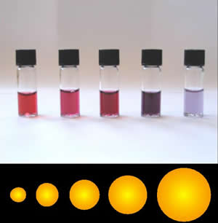
History
Experimental Relation of (Colloidal) Gold to Light (Faraday 1856)
He discussed aerosols and optical properties
Michael Faraday
(1791 – 1867)

Slide 3
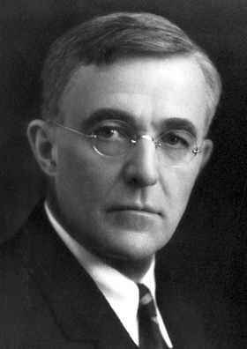
History
During the First World War, the study of fog and smoke formation
Since the 1930s, Irving Langmuir has been researching what substance to add to clouds to make them disperse/start raining
Irving Langmuir (1881–1957)
Nobel Prize in Chemistry 1932
40/50 Years – Molecular Beams and Supersonic Jets Contain Clusters
Since the 1970s, the use of lasers to study cluster structure

Slide 4
Cluster sources
Supersonická expanze

Slide 5
Cluster sources
MOLECULAR DYNAMICS IN FREE CLUSTERS AND NANOPARTICLES STUDIED IN MOLECULAR BEAMS, DSc. Thesis in Physical Chemistry by Michal Fárník

Slide 6
Klusterové ionty
iont
ligand
Third particle required for stabilization

Slide 7
Klusterové ionty
Equilibrium constant
Concentration of a larger cluster
Concentration of a smaller cluster
Gibs free energy
Enthalpy change
Entropy change

Slide 8
Clusters – example H⁺(H₂O)_{n}
Relative Binding Energies

Slide 9
These clusters are stable only from a certain n

Slide 10
Magic Numbers

Slide 16
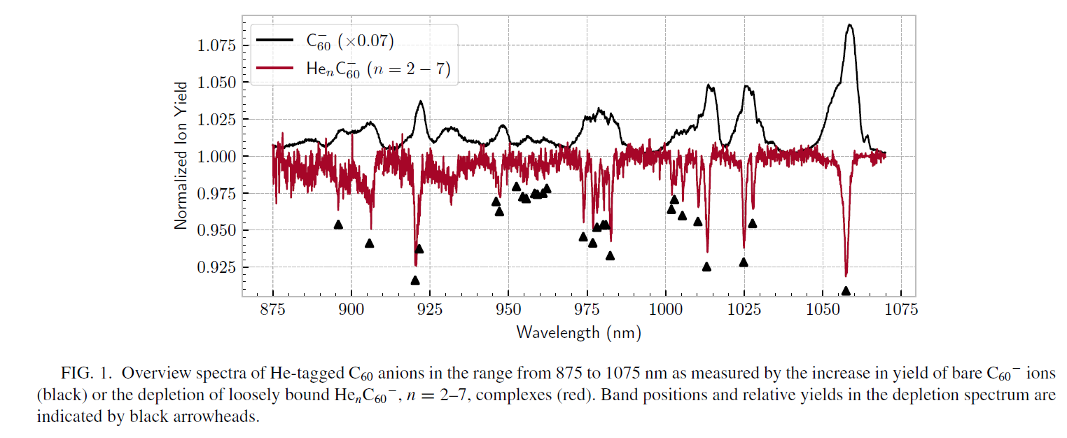
Spectrum of C₆₀⁻ is from photodissociation

Slide 21


Slide 22
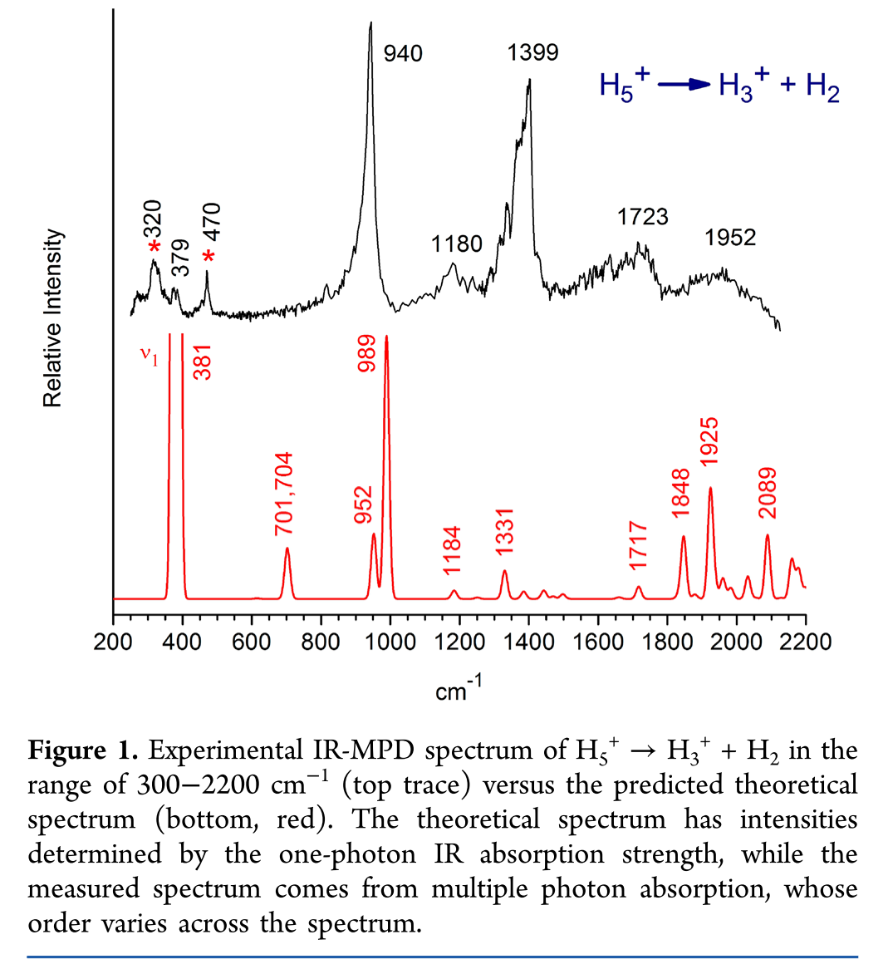
They measured products produced by H₅⁺ photodissociation
Theoretical calculations are not always perfectly accurate
T. C. Cheng, J. Phys. Chem. Lett. 3, 3160, 2012

