Slide 1
Florescence and Phosphorescence, Chemical Kinetics

Slide 2
Florescence and phosphorescence
In fluorescence, the spontaneous emission of radiation occurs within a few nanoseconds after the excitation radiation has been switched off (Fig. 14.20).
In phosphorescence, spontaneous emission can persist for a long time (even hours, but characteristically seconds or fractions of seconds). The difference suggests that fluorescence is the rapid conversion of absorbed radiation into re-emitted energy, and in phosphorescence, energy is stored in a "reservoir" from which it slowly escapes.

Slide 3
Florescence
It transfers energy to the surrounding molecules
The shape of the absorption spectrum is given by the Franck-Condon overlap between the ground vibrational state of the lower electronic state and the vibrational states of the upper electronic state
In the case of emitted light, on the other hand, the profile is given by the overlap between the lowest vibrational state of the upper electronic state and the vibrational states in the lower electronic state.

Slide 4
Notes
In liquids, absorption and emission can be shifted from the gas phase due to the action of surrounding molecules.
Fluorescence occurs at lower frequencies than the excitation radiation.

Slide 5
Phosphorescence
Intersystem crossing (more likely for heavier atoms)
Transition from Singlet to Triplet

Slide 6
Dissociation of excited electronic state into fragments
It corresponds to the different kinetic energy of the fragments

Slide 7
Presociation
Loss of vibrational structure that recovers at higher frequencies
The dissociating state crosses the excited bound state

Slide 8
Photodetachment
OH⁻ + hv → OH + e⁻
v (cm⁻¹)

Slide 9
Reaction Rate Constants – Chemical Kinetics
Rate of reaction
Stochiometric number

Slide 10
Reaction Rate Constants – Chemical Kinetics
Například:
Rate of reaction
Reaction rate constant
Obecně:
Stochiometric number

Slide 11
Order of reaction
First-order reactions in [A] and first-order reactions in [B], together second-order.
Overall order of reaction:
The reaction does not have to be of integer order. There are also zero-order reactions (not dependent on the concentration of the reactant)
However, it is not always possible to determine the order of the reaction:
Experimentally determined

Slide 12
First-order reactions
Note. A second-order reaction, if one reactant practically does not decrease, behaves as a first-order reaction (pseudo first order reaction)
The time it takes for the concentration to reach one half
Exponential Decay Time Constant

Slide 13
Second-order reaction
Can you think of a plasma process that describes this?
Depends on the initial concentration
(For higher orders)

Slide 15
Reaction equilibrium
First-order reactions
Forward and backward response at the same time
At the beginning [B] = 0
Equilibrium constant of reaction
In equilibrium

Slide 16
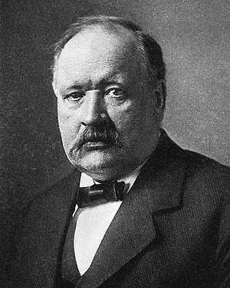
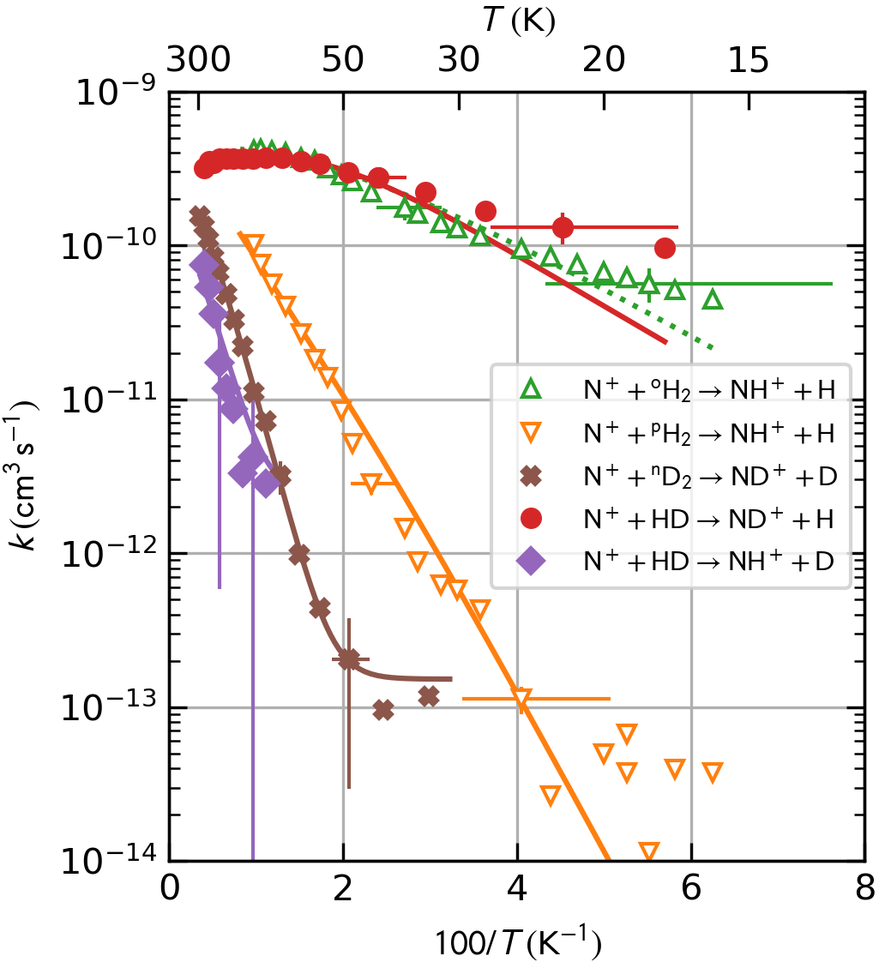
Temperature dependence of reaction rates
Arrheniova rovnice
Aktivační energie
Svante Arrhenius
(1859-1927)
Nobelova cena 1902
Figure 12. Arrhenius plot of the reaction rate coefficients k^{HDa}_{N+}, k^{HDb}_{N+}, k^{D2}_{N+} obtained in the present work in comparison with k^{pH2}_{N+} and k^{oH2}_{N+} derived from the data by [Zymak 2013]. The corresponding rate coefficients obtained from the fitted global model (model C in Table 2) are indicated by the solid curves (only the model values of k^{oH2}_{N+} are indicated by a dotted line to differentiate them from the nearly identical k^{HDa}_{N+} curve).

Slide 17
Arrhenius equation
Activation energy is the minimum kinetic energy of the reactants required to form products

