Slide 1
Topics
Democracy and corruption
How corruption affects voting behaviour/ corruption reduces public trust on government officials
Role of media to mitigate corruption
Corruption effects public spending and failure of foreign aid

Slide 2
Corruption and democracy
Merkel (2014 ) Multidimensional definition of democracy: At the core of this concept there are five interdependent components: The competitive electoral process is at the heart of modern democracies
i) Democratic election: The democratic election component refers to the electoral game, it is equivalent to the “electoralist” democracy definition
ii) Political participation rights: This includes freedom of speech, association and protest
iii) Civil rights: Include protection from illegitimate state interference into the life of an individual and are therefore linked to the protection of minorities, individual liberty and property

Slide 3
iv) Horizontal accountability: Ensures the mutual interdependence and autonomy of the legislative, executive and judicial power as well as the functioning of oversight institutions such as audit and ombudsmen (checks and balances).
v) Effective power to govern: Finally, the effective power to govern ensures that only "those elected are entitled to make binding political decisions without the interference of other actors or interest groups, for example, military
For instance, according to Rothstein (2017) independent tribunals and administration act as effective controls of politicians and ensure the correct and impartial implementation of public policies and redistribution of public resources

Slide 4
Can democracy contribute to tackling corruption?
Democracy is perceived to be the least corrupt form of government
Most scholars find democratic countries successful at curbing corruption
Frequent and competitive elections work as a mechanism for the selection of better candidates
The principal democratic mechanism that can contribute to curbing corruption is the democratic electoral process, yet there are limitations of democracy
There are other factors (historical legacy, level of education) that matter too, to load too many expectations on democracy and to imagine that by attaining democracy, society will resolve political, social and economic problems, is tempting
Can electoral competition work as a sanctioning mechanism to vote out corrupt politician?

Slide 5
The corruption scandals Brazile, Italy, and Spain, India, Pakistan and elsewhere show that democracies still suffer from corruption
As democracy is a multidimensional concept, not all aspects of democracy are equally consolidated in country
There exists a possibility of crisis/deficiency of different democratic components
(Merkel, 2014)

Slide 6
Impact of corruption on voting behavior
Most models of retrospective voting postulate that informing voters on the quality of politicians performance enhances the likelihood that well-performing incumbents retain their position and that poorly performing incumbents are ousted (Manin, Przeworski, and Stokes 1999).
Information on incumbent corruption, purportedly a measure of quality, should help challengers, by either shifting votes to the challenger or engaging individuals who would otherwise abstain

Slide 7
However, information about corruption could lead to less voting, for example previous work of (Bowler and Karp 2004; Clausen, Kraay, and Nyiri 2011; della Porta 2000) suggests that perceptions and experiences of corruption undermine voters’ confidence in public institutions, erode the legitimacy of the political system, and reduce trust in politicians and civil servants
Also, lower voters’ confidence in their government’s ability, exposing high levels of corruption leads to larger behavioural effects than exposing low levels of corruption
Similarly, if the exposure of corruption leads voters to believe that voting will not benefit them; either because they lose trust in governments or those governments’ ability to respond to constituents’ needs; then they are likely to abstain

Slide 8
How corruption information changes voter engagement, choice, and party identification?
It depends on key factors, such as voters’ prior knowledge and awareness, their choice set, and their ability to influence government actions
(Chong, A. et al, 2015)

Slide 9
Media and it Role in curbing corruption
Definition: Media can be broadly defined as the communication outlets used to deliver information to large audiences
Status of media in democracy: Media is considered as the fourth estate of democracy
Various International human rights instruments including UDHR, the ICCPR and the CRC, guarantee the freedom of the media
For a vibrant democracy it is important that its citizens are well informed; access to information facilitates active participation
However, citizen holds the right to information, to access information held by or under the control of public authorities, can thus be an effective tool for ushering in good governance

Slide 10
The three anti-corruption functions of media
Being a watchdog (checks and balances)
Promoting integrity
Mobilizing citizens in anti-corruption efforts
Media plays a significant role in raising voice to unveiling corrupt practices, empowering citizens to fight against corruption; media acts as a watchdog and monitors the working of various private and government institutions and lends us voice to an extensive kind of perceptions and arguments
Example: 2019 a year of protests

Slide 11
Investigative journalism
For more than a century, investigative reporting has had a significant impact against corruption, human rights abuses and corporate exploitation
Conducting interviews with political officials, validating information and in-depth research counts as investigative practice, and ground-breaking uncovering of yet unknown connections are believed to be the main characteristic of the profession (Drüeke 2018)

Slide 12
Effects of investigative journalism
For example, the 2011 exposure of the local government official's involvement in human trafficking in China, the investigative journalist (Pang Jiaoming) was detained on false charges; still, his story was widely shared via social media and picked up by a state-run magazine. Three months later, 12 officials were forced to resign from office (Ni 2014)
In Brazil, the former President Rousseff’s chief of staff was released from office and subjected to legal investigations after three investigative journalists exposed involvement in illicit enrichment practices (Transparency International 2012)

Slide 13
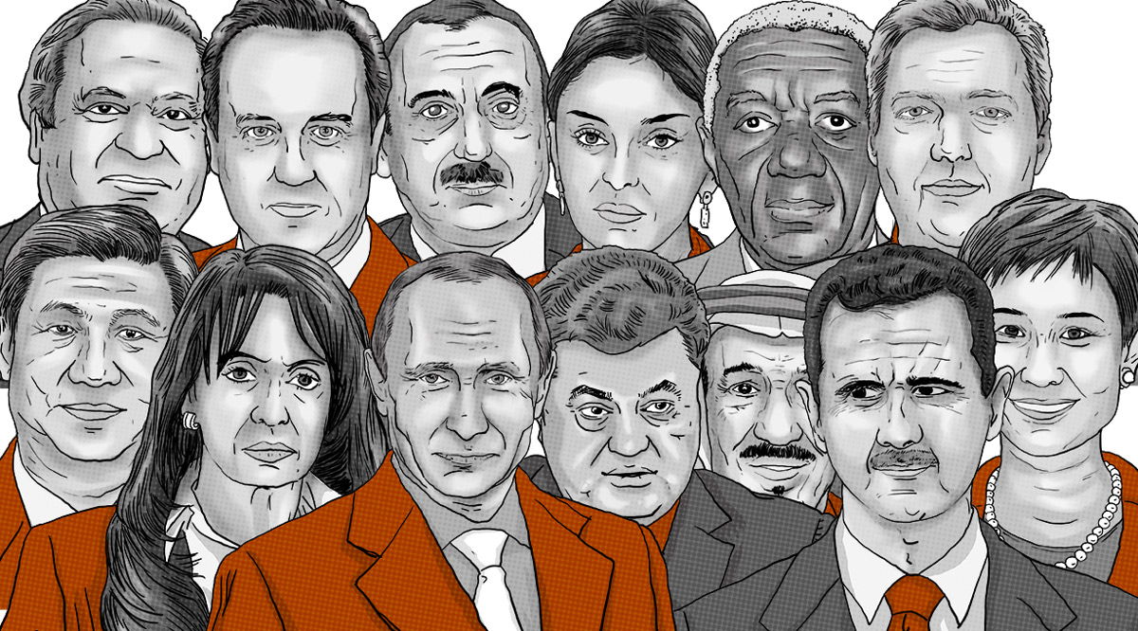
Panama case
A giant leak of 11.5 million financial and legal records exposes a system that enables crime, corruption and wrongdoing, hidden by secretive offshore companies
Involve 140 politicians from more than 50 countries
Head of states, their associates, ministers and elected officials
Connected to offshore companies in 21 tax heavens

Slide 14


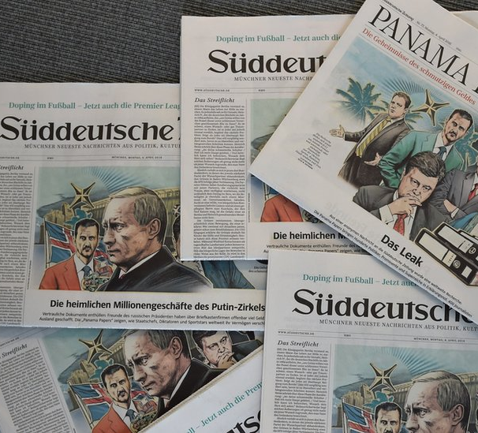
Threats to investigative journalism
The Daphne Caruana Galizia who led the Panama papers investigation into corruption in Malta, was killed in October 2017, in a car bomb near her home

Slide 15
Criteria of media being effective against corruption
Professional ethics and skills: credibility, transparent, accuracy, and unbiased and credible information and reporting on corruption
Media independence: Media independence is determined by the legal framework i-e freedom of information laws, licensing laws; financial and economic and political pressures; concentration of media ownership; governmental ownership of the media
Accessibility: To fulfil its watchdog function of monitoring and scrutinising those in power, the information made available by the media must be accessible and understandable to the public

Slide 16
Challenges for media
The media has the potential to be an effective anticorruption tool, but at the same time is itself at risk from corruption. The media can sometimes be continuously targeted by undue interference from vested interests, abuses of power and corruption.
Being the most important source of information for most people, the media represents an important channel of manipulating public opinion in favour of vested interests. Different media channels can be used to cover up instances of malfeasance, clientelism and embezzlement, among others. Thus, attempts to capture the media for personal benefits are risk in developing and developed countries alike
Fertile grounds for corruption may be created through lack of journalistic training and technical skills, low professional and ethical standards, financial pressures on media outlets and individual journalists, which makes them susceptible to bribes, as well as ownership structures aligned with business interest (Mendes 2013; Schiffrin 2014; Ibelema 2008). Under such circumstances, the media media’s role in fighting corruption can be significantly undermined and highlighted

Slide 17
Impact of corruption on public spending
Corruption considerably reduces public spending, and the argument is contentious; one school of thoughts argues that corruption increases public spending as a percentage of GDP while another school of thought believes that corruption has no effects on public spending
Public spending in corruption prevalent countries are believed to be less effective, involved corrupt agents nominate projects which give them more financial benefits in forms of bribes and kickbacks
Data available on Business International for 68 countries shows that Investment on human capital is distorted as a result of corruption, specifically education
Mauro (1996), Tanzi (1998), Shleifer and Vishny (1993)

Slide 18
A failing market in emerging economies absolutely needs government intervention, yet the level of corruption in these economies is undoubtedly sky-rocketing, corruption is inevitable during policy implementation, it negatively affects health, education, and social protection
Considering governmental policies effectiveness, corruption is one of the key constraints which makes government policies ineffective and pushes all investments away from lucrative projects; also, it promotes and safeguards Mafia
Public spending is the main tool for human development; curbing corruption must be the main goal of emerging economies to ensure securing an applaud-able place in HDI ranking
Sen (1999, p. 275), Delavallade (2006),

Slide 19
Failure of foreign aids
Foreign aid is a significant source of income for national gov’ts of low-income countries and developing countries, tens of billions of dollars are being funneled from IMF and WB
In 2014 dozens of countries in Africa, Asia, and Middle east each received more than 1 billion dollars in bilateral and multilateral aid
Countries like Afghanistan, Vietnam, Syria received more than $4billion in foreign aid
Source: (data.worldbank.org/products/wdi)

Slide 20
The economic and political criteria of a qualifier for foreign aid does not give priority to the capacity of the recipient to spend it free of corruption
Often aid is given to countries where there is visible evidence of poor governance

Slide 21
Case study of Afghanistan
The story of Ismail khan: a famous warlord and member of then Afghan gov’t

Slide 22
References
Drapalova, E. (2019). Corruption and the crisis of democracy: The link between corruption and the weakening of democratic institutions. Transparency International.
Chong, A., De La O, A. L., Karlan, D., & Wantchekon, L. (2015). Does corruption information inspire the fight or quash the hope? A field experiment in Mexico on voter turnout, choice, and party identification. The Journal of Politics, 77(1), 55-71.
Robinson, J. A., & Acemoglu, D. (2012). Why nations fail: The origins of power, prosperity and poverty. London: Profile.
Srivastava, M. C. (2016). Role of Media in Preventing and Combating Corruption. Imperial Journal of Interdisciplinary Research, 2(2), 170-180
Delavallade, C. (2006). Corruption and distribution of public spending in developing countries. Journal of economics and finance, 30(2), 222-239
Mauro, M. P. (1996). The Effects of Corruptionon Growth, Investment, and Government Expenditure (No. 96-98). International Monetary Fund.
Shleifer, A., & Vishny, R. W. (1993). Corruption. The quarterly journal of economics, 108(3), 599-617.
Tanzi, V. (1998). Corruption around the world: Causes, consequences, scope, and cures. Staff Papers, 45(4), 559-594.
Sen, A. (2001). Development as freedom. Oxford Paperbacks.

