Slide 1
Is Prejudice Measurable?
Social Dominance orientation, Stereotype Content Model and more

Slide 2
How to choose the right method for your (immigrant-attitude)research?
What is the aim of my research?
What is my research question?
Which categories/concepts do I need for it?
Which theoretical explanations fit my research best?
... THEN
How to measure it?
Should I ask (measure) implicit or explicit?

Slide 3
THE APPROACHES TO THE MEASURMENT
Explicit attitude measure
- Respondents are aware of the aim of the research
- Answers can be controlled or modified
- Likert scale, Thurstone attitude scale
Implicit attitude measure
- Assess people's feelings without having to ask them directly
- Focus also on those who live in a climate of political correctness
- Usage of computers presenting short stimuli to respondents

Slide 4
Social Dominance Orientation
Expressing preference for unequal relationships
People with high score in SDO believe that;
Group hierarchies are natural and desirable
World requires group competition
16- item SDO scale elicits agreement- disagreement with alleged statements
SDO assesses social dominance as opposed to individual dominance or self-esteem
Correlates with: Protestant work ethic (PWE), Right wing authoritarianism (RWA)
Proves group-level resource inequality, superiority, ethnocentrism

Slide 5
Example of SDO statements in survey questionnaire

Slide 6
Symbolic (Modern)Racism Scale
Symbolic racism theory
-based on „new racism“ (x old-fashioned racism)
Measure opposition to Black politicians and policies, designed to explain White racial policy attitudes
Racially based pattern of policy preferences (rather than prejudices against Black people as a group
8 item measure with several response modes
„How much discrimination against blacks do you feel, limiting their chances to get ahead?“

Slide 7
SRS An example of survey questions

Slide 8
Social Privilege and Assessment of Privilege Awareness
Some groups are privileged, and some are oppressed
The awareness of privilege could lower the social inequality

Slide 9
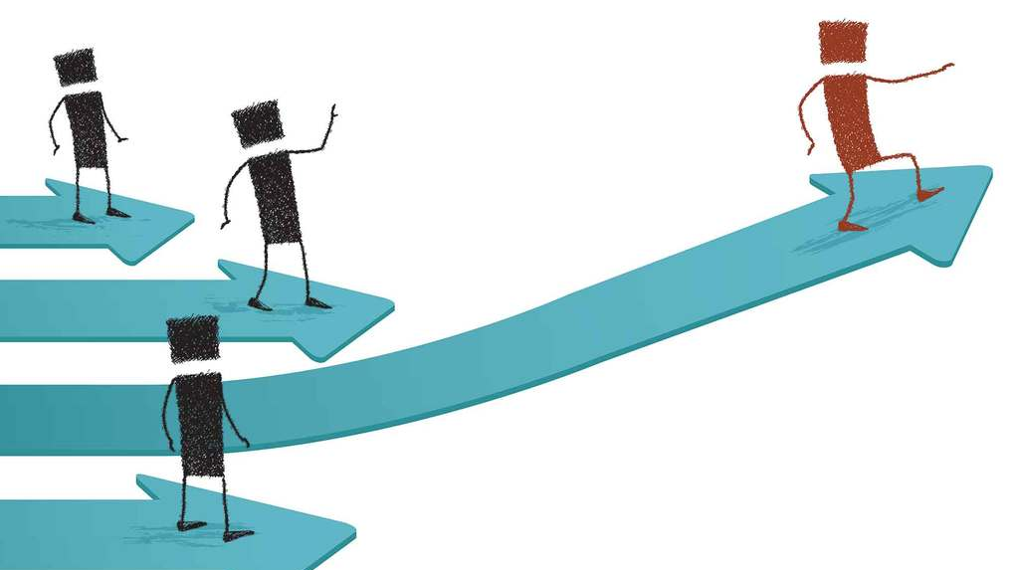
DISCUSSION
Do you feel privileged?
Have you realized in your daily interactions that some social groups are less privileged or even oppressed?
Do you think that to be an immigrant or having immigrant background automatically means that you are less privileged?
If yes, do you consider it as a problem?

Slide 10
Implicit association test (IAT)
Intended to detect the strength of a person's subconscious association between mental representations of objects
Identifies traces of the past experiences that mediate favorable or unfavorable feeling, thought, or action toward social objects
Race IAT: Respondents are asked to pair 25 for example typical White names (Adam, Harry, Joe) and 25 ethnic names with 25 words with positive and 25 negative associations
A bit controversial but still widely use
IAT race-prejudice scores decrease with exposure to positive role models, counter-stereotypic images, social influence
Online examples: https://implicit.harvard.edu/implicit
https://faculty.washington.edu/agg/iat_materials.htm

Slide 11
Stereotype Content Model
Measures specific biases directed toward systematic clusters of groups across society
2 dimensions:
Warmth; reflects the group´s apparent intention for good or ill
Competence; reflects the group´s apparent ability to enact the intent
Liking (warmth) X Respect (competence);
high on both (middle class citizens)
low on both (homeless people)
high on one but low on the other (rich people/disabled people)
Specific combinations predict emotional prejudices of pride, pity, disgust and envy
Emotions in turn predict active and passive help or harm

Slide 12
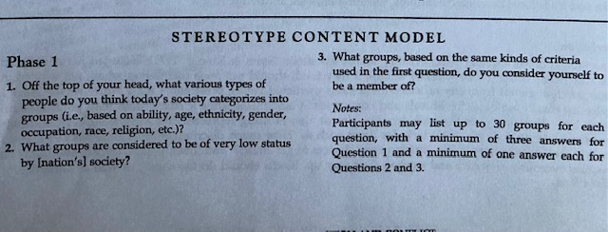
SCM An example of possible questions used in survey questionnaire

