Slide 1
Introduction to molecular structure II
Hückel aproximation, Hartree-Fock equations, Density functional theory

Slide 2
Molecular orbitals
If any test wave function is used to calculate the energy, the resulting energy is never less than the actual one.
Use of variational methods.
Testing function:
A and B are the atomic orbitals of a diatomic molecule

Slide 3
Molecular orbitals
S – overlap integral
Coulomb integral – the energy of an electron when it occupies an atom A (α_{A}) or B (α_{B})
Resonance integral – if the orbitals do not overlap, it disappears

Slide 4
Molecular orbitals
Secular equations, non-trivial solution if determinant equals 0

Slide 5
Example: homonuclear molecule

Slide 6
Example: homonuclear molecule
To obtain the c_{A} and c_{B} coefficients, we need to normalize the total wave function:

Slide 7
Example: homonuclear molecule
Bonding orbital (lower energy)
Antibonding orbital

Slide 8
Example: heteronuclear molecule
Approximation: overlap integral S = 0
Resulting secular determinant:
Solution:

Slide 9
Example: heteronuclear molecule
If the energy difference between the interacting atomic orbitals increases, then decreases
If this energy difference is very large, that
, then the energies of the resulting molecular orbitals differ little from atomic ones
It has the greatest effect on the energy difference between the bonding and antibonding orbitals if the constituting atomic orbitals are energetically very close to each other.
Similarly, electrons in the lower atomic orbitals, whose energy is significantly different from the valence orbitals, will not have much of an effect on the energy of the molecular orbital.

Slide 10
Example: HF
F2s is energetically far from H1s, so we neglect its influence
We suppose that the Coulombic integrals α_{A} a α_{B} are approximately equal to the respective ionization energies
The ionization energy of HF is 16.03 ± 0.04 eV

Slide 11
Polyatomic molecules
Diatomical molecules are essentially linear, polyatomic molecules can take on a wide variety of shapes
Strictly speaking, σ and π orbitals are applicable only to a diatomic molecule, but this designation is also used in polyatomic molecules to indicate the symmetry of a bond between two molecules
Atomic orbital

Slide 12
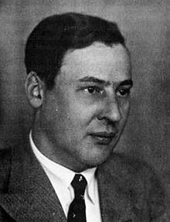
Hückel aproximation
For the construction of energy level diagrams π molecular orbitals
Within his theory, π and σ orbitals (which form the structure of the molecule) are solved in different ways
Erwin Hückel (1896 – 1980)
C atoms are considered to be identical -> Coulombic integrals α of atomic orbitals that contribute to the molecular π orbital are equal
Gar Manches rechnet Erwin schon
Mit seiner Wellenfunktion.
Nur wissen möcht' man gerne wohl
Was man sich dabei vorstell'n soll.

Slide 13
Example: ethylene
π orbitals are expressed as a linear combination of C2p orbitals lying perpendicular to the plane of the molecule
C2p orbital on atom A
Again, we will use the variational method to create a secular determinant:
We consider C atoms to be identical:

Slide 14
Example: ethylene
An approximate energy diagram can be constructed very quickly using Hückel approximations:
All overlapping integrals of S are zero All resonant integrals of β that do not involve neighboring atoms are zero All remaining resonant integrals have the same value
The secular determinant has then the following structure:
On the diagonal is Extradiagonal elements between adjacent atoms: β All other matrix elements are equal to 0

Slide 15
Example: ethylene
Hückel approximations
Highest Occupied Molecular Orbital (HOMO): 1π
Lowest Occupied Molecular Orbital (LOMO): 2π

Slide 16
Matrix formulation of the Hückel method
For a diatomic system:
We introduce the following matrices and vectors:
Overlap Matrix
Hamiltonian

Slide 17
Matrix formulation of the Hückel method
For a diatomic system:
In the Hückel approximation
Unit matrix, overlap integrals are zero

Slide 18
Example: π orbitals of butadiene
In the Hückel approximation
C2p atomic orbitals

Slide 19
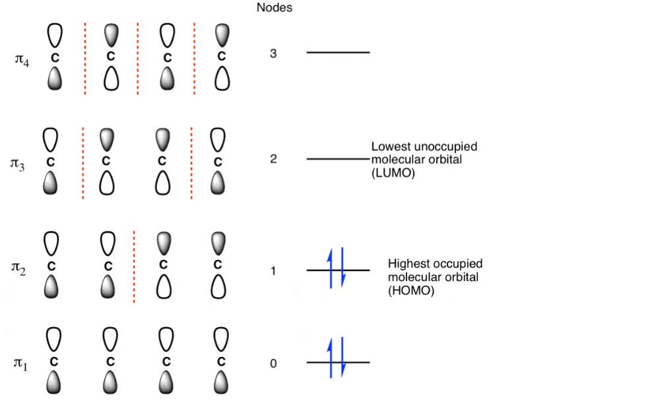
Example: π orbitals of butadiene
Note: for ethylene, the total binding energy of π electrons is:
In butadiene it is:
0.48β stronger bond than individual π bonds
Delocalization energy. An even more pronounced effect with aromatic hydrocarbons.

Slide 20
Hartree-Fock equations
The wave function of a molecule composed of single-electron wave functions (molecular orbitals), α, β denotes spin
To satisfy the Pauli principle (antisymmetry of the wave function when identical fermions are exchanged):
A determinant is a sum over all possible permutations. Abbreviated as:
The use of the variational principle then leads to the Hartree-Fock equations:
Fock operator
spin

Slide 21
Hartree-Fock equations
Fock operstor
Core Hamiltonian
Coulomb operator
Depends on the wave functions you are looking for
Exchange operator
A solution is estimated, substituted and a better estimate of the solution is obtained – a self-consistent method
SCF – Self Consistent Field

Slide 22
Density functional theory
Electron density
Exchange correlation energy
Total kinetic energy of electrons
Electron – electron potential energy
Potential energy of the electron - nucleus system
Kohn-Sham equations:
(like Hartree-Fock except Exchange correlation potential)
By solving this equation self-consistently, the respective molecular orbitals are obtained

