Slide 1
Introduction to molecular structure
Types of bonds in molecules, valence bond theory, hybridization, molecular orbital

Slide 2
Literature
P. Atkins, J. de Paula, Physical Chemistry, Oxford University Press, New York, 2006.
Peter F. Bernath, Spectra of Atoms and Molecules, 2nd ed., Oxford University Press, N.Y., 1995.
Good and comprehensible materials for a lecture on spectroscopy of electronic transitions in molecules at the University of Oxford athttp://mackenzie.chem.ox.ac.uk/teaching.html

Slide 3
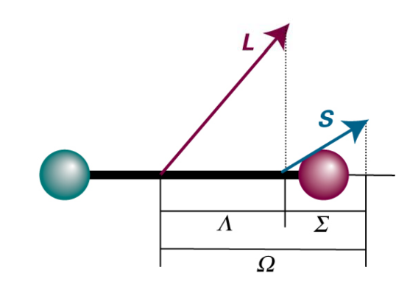
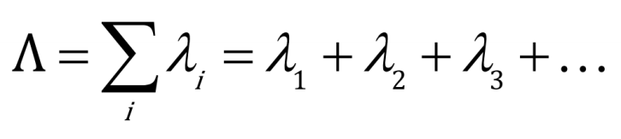
Labeling of electronic states of molecules
Molecules classified according to the projection Λ of their orbital angular momentum L on the axis of the molecule:
S – total spin quantum number
Λ – projection of orbital angular momentum L (orbital angular momentum) along the axis of the molecule
Ω – projection of total angular momentum along the molecular axis (internuclear axis) (maximum L + S)
u/g – parity
+/- mirror symmetry along the plane containing the axis of the molecule
Λ = 0, 1, 2, 3... -> Σ, Π, Δ, Φ...

Slide 4
Labeling of electronic states of molecules
X indicates that this is a basic state.
States with the same multiplicity (2S+1) as the ground state are denoted sequentially by capital letters A, B, C...
States with a different multiplicity than the ground state are denoted consecutively by lowercase letters a, b, c
Example of transition from the ground state of O2 (triplet) to the first excited state (singlet):

Slide 5
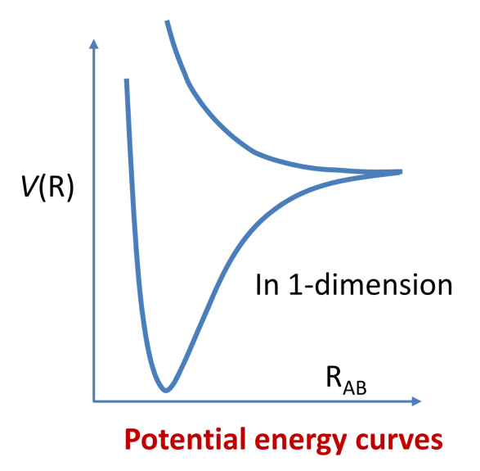

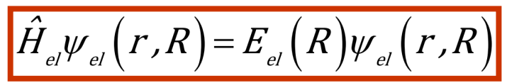
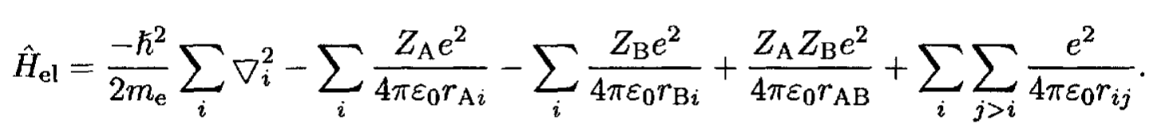
Born – Oppenheimer's approximation
In the Born-Oppenheimer approximation, the Schrödinger equation for a diatomic molecule has the form:

Slide 6
Valence bond theory
Wave function for two very distant hydrogen atoms:
Symmetric and antisymmetric combination (symmetrical has lower energy)
A σ bond is formed between the atoms – it has cylindrical symmetry along the axis connecting the atoms

Slide 7
Valence bond theory
Spin pairing:
The wave function must be antisymmetric when identical fermions are swapped (Pauli principle):
Thus, when a bond is formed, electrons pair with opposite spin

Slide 8
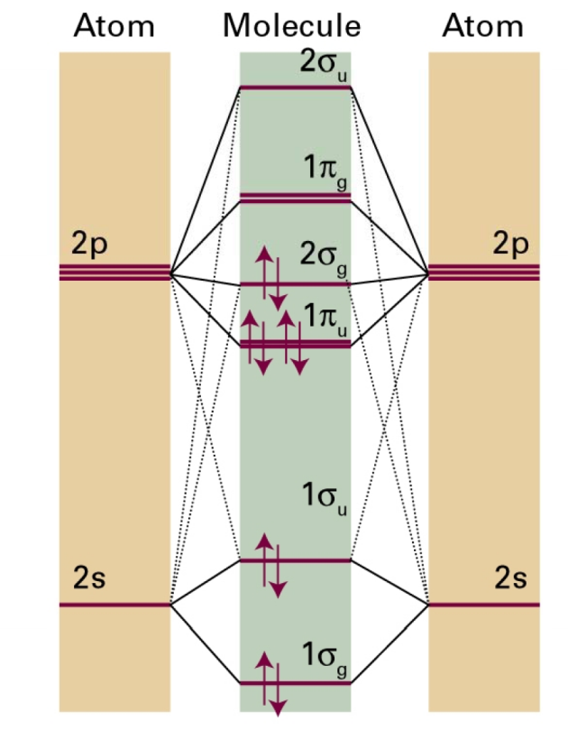
Example: N₂
The N atom has an electron configuration:
The z-axis will be the axis between the molecules, then the 2 p_{z} orbitals will form a σ bond
2p_{x} and 2p_{y} do not have cylindrical symmetry and will form 2 π bonds
Altogether 3 bonds between atoms

Slide 9
Example: H₂O
The valence configuration O is:
The valence configuration of H is:
Thus, the unfilled p_{y} and p_{z} orbitals can pair with the 1s orbitals of hydrogen atoms (forming σ bonds) and the resulting bonds should form an angle of 90° (in fact, it is 104.5°)
Exercise: According to the valence bond theory, what will the structure of the NH₃ molecule look like?

Slide 10
Four bonds of the C atom
The carbon atom has an electronic configuration:
So there should only be two bonds (in fact, carbon is four-bonded)
In valence bond theory, this problem is solved by injecting an electron from the s orbital into the empty p_{z} orbital
4 possible bonds

Slide 11
Hybridisation
The promotion of an electron in a carbon atom from s to p orbital is equivalent to the case where each electron occupies a hybrid orbital of sp³ which is formed by the interference of the 2s and 2p orbitals of the carbon atom.
Formation of 4 identical bonds (they differ in orientation in space and form a regular tetrahedron)

Slide 12
Hybridisation
Ethen:
Both carbon atoms promoted to the configuration
sp² hybrid orbitals are formed
Pointing to the points of an equilateral triangle – angle 120°
C atoms connected by σ bond from sp² orbitals and by π bond from non-hybridized p orbitals

Slide 13
Hybridisation
The triple bond in ethyne can be explained, similarly
In this case, it is a sp hybridization
The triple bond is then formed by σ bonds from the sp orbital and 2 π bonds from the non-hybridized p orbitals

Slide 14
Hybridisation
Other hybridization schemes are also possible, often involving d orbitals. Generally, hybridization of N orbitals will give rise to N hybrid orbitals.

Slide 15
Molecular orbitals
The theory of molecular orbitals is based on the assumption that the electron does not belong to one bond but is spread throughout the molecule
A molecular orbital is formed

Slide 16
H₂⁺ ion
Only one electron, Hamiltonian:
The single-electron wave functions produced by solving the Schroedinger equation are called molecular orbitals.
The molecular orbital (more precisely, the square of the respective wave function) gives the probability density of finding an electron in a molecule.

Slide 17


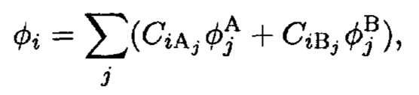
Molecular orbital
LCAO (Linear Combination of Atomic Orbitals) aproximation
The approximation is based on the assumption that the wave function is formed from molecular orbitals (MOs) and each molecular orbital is a linear combination of atomic orbitals
Molecular orbital
(Slater) determinant
Atomic orbital located on the A atom
Atomic orbital located on B atom

Slide 18
H₂⁺ ion
Where A and B are the wave functions of the 1s atomic orbitals of H
A² is the probability density of the electron being in the atomic orbital of A
B² is the probability density of the electron being in the atomic orbital of B
AB overlay density – an additional contribution to the probability density created by the overlapping of atomic orbitals
Bonding molecular orbital

Slide 19
H₂⁺ ion
Overlap integral
Antibonding molecular orbital

Slide 20
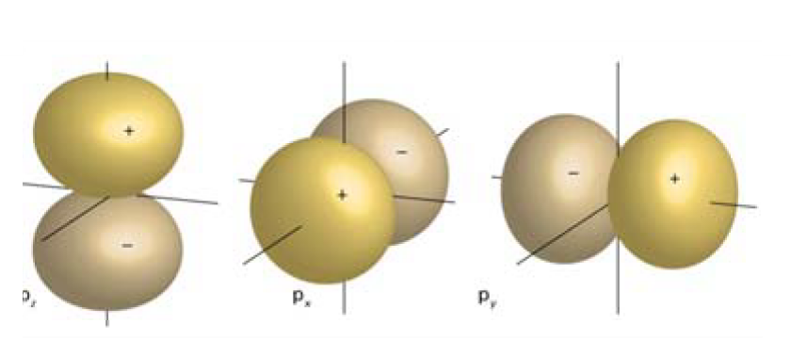
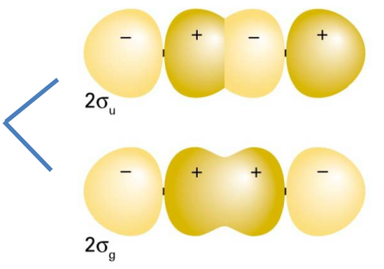
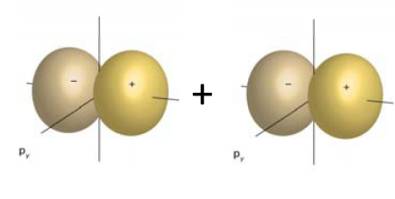
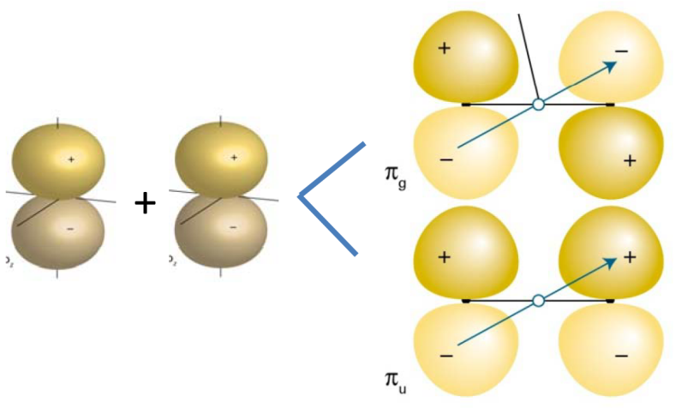
Classification of molecular electronic states
The thermals of diatomic molecules are classified based on the projection of orbital angular momentum onto the axis of the molecule
λ is analogous to m_{l} in atoms:
e.g. p orbital has l = 1, m_{l} = 0, ±1
Two p atomic orbitals are composed of σ and π molecular orbitals
p_{z}(m_{l}=0) are combined to form σ, σ* (λ=0)
p_{x,y} (m_{l}=±1) are combined to form π, π* (λ=±1)

Slide 21
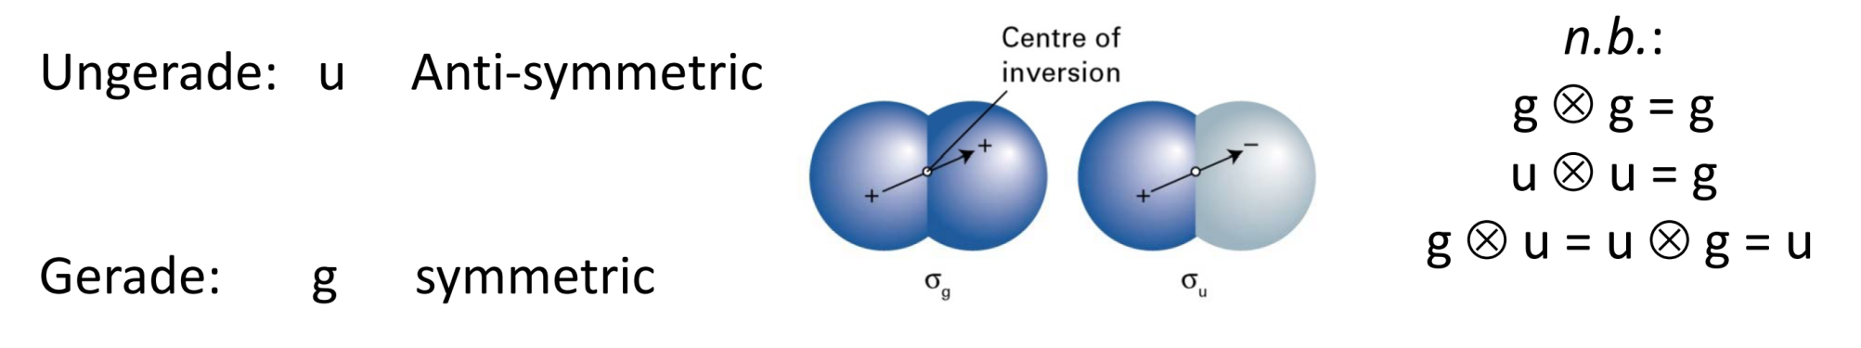
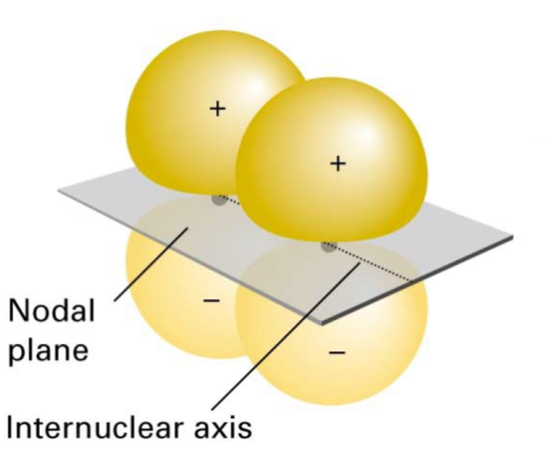
Other markings resulting from symmetry
For a two-atom molecule composed of the same atoms (O₂) or a symmetric linear molecule (CO₂), it is appropriate to denote molecular orbitals and terms in accordance with symmetry (g, u) at inversion along the center of symmetry
For Σ terms, symmetry (+/-) is denoted in a mirror operation along the plane containing the line connecting the two cores.

Slide 22
Molecular orbitals - examples
Electrons in molecular orbital only with paired spin
Electrons in both bonding and antibonding orbital - unstable

Slide 23
Molecular orbitals
In a diatomic homonuclear molecule, electrons in the s and p_{z} orbitals can form σ molecular orbitals – all orbitals that have the respective symmetry contribute to the formation of the molecular orbital
Thus, four atomic orbitals will give rise to four molecular orbitals
2s a 2p_{z} have different energies, so they can be viewed as separate groups:
2 molecular orbitals
and 2 molecular orbitals
For identical atoms (equal energies of 2s and 2p_{z} orbitals) it will be

Slide 24
Molecular orbitals
The 2s (and similarly the 2p_{z}) orbitals overlap on two atoms to give rise to bonding and antibonding orbitals

Slide 25
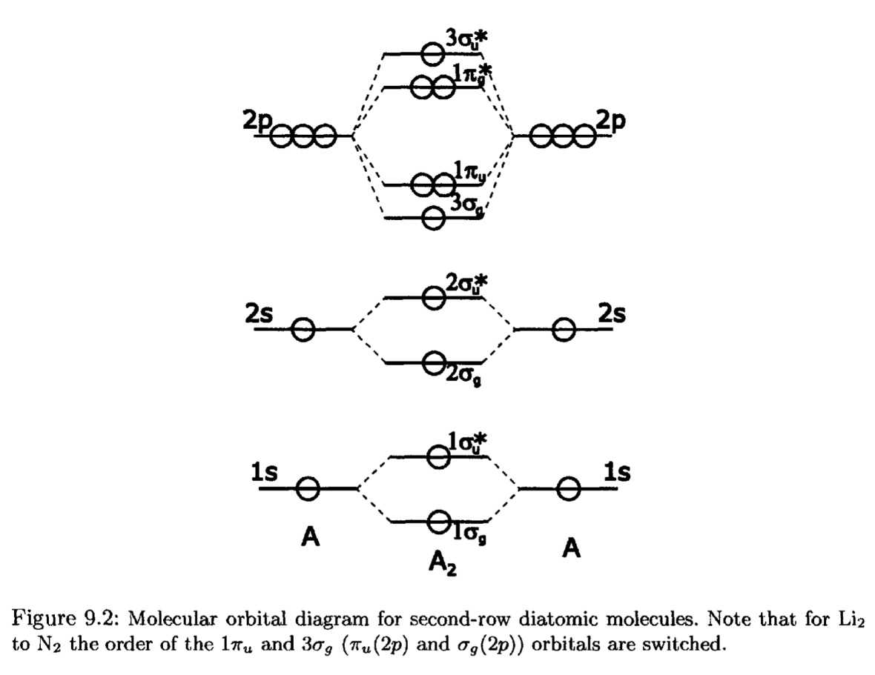
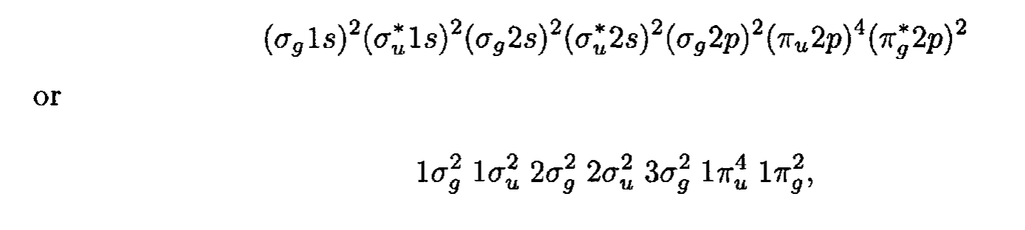
Molecular orbitals - examples
Ground state of O₂:

Slide 26
Molecular orbitals - examples

Slide 27

Examples of molecular terms
Ground state of N₂
Λ = 0 → Σ term
S = 0 (All electrons in pairs) → singlet
The filled orbitals are not listed here(1s)

Slide 28
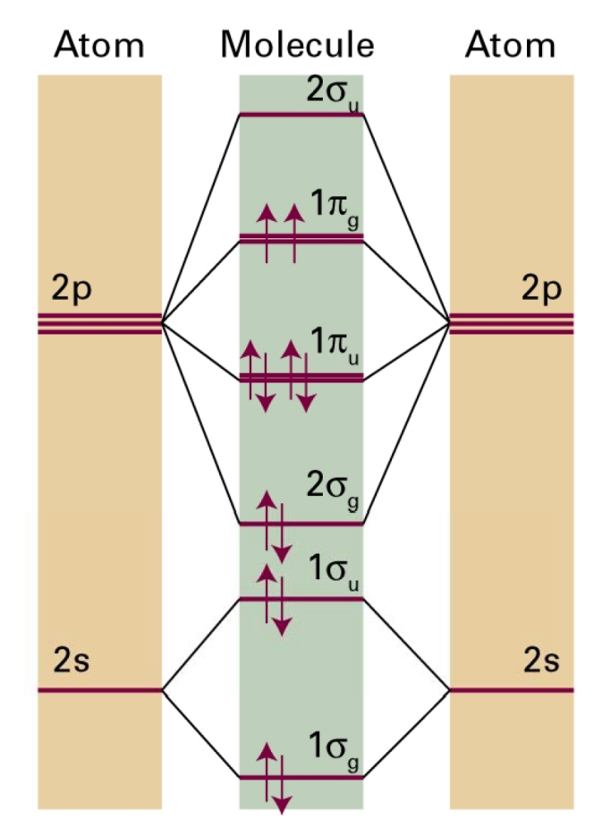
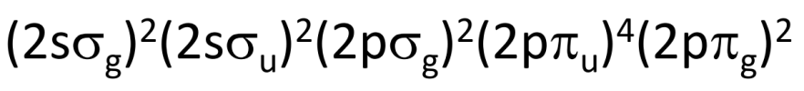
Příklady molekulárních termů
Ground state of O₂
Λ = 0 or ± 2 → Σ, Δ terms
S = 0 or 1 → singlets a triplets
g symetry
This would correspond to the terms:
¹Σ_{g}⁺, ¹Σ_{g}⁻, ³Σ_{g}⁺, ³Σ_{g}⁻, ¹Δ_{g}, ³Δ_{g}
The Pauli princip must apply:
"The wave function is completely antisymmetric when two identical fermions are exchanged"

Slide 29
Příklady molekulárních termů
Ground state of O₂
In singlet states is the spin wave function ψ_{spin} antisymetric → ψ_{space} must be symetric (g,+ states). Similarly for triplets ψ_{spin} is symetric and ψ_{space} must be antisymetric (g,- states).
¹Σ_{g}⁻ ³Σ_{g}⁺ ³Δ_{g} - all these states are contrary to the Pauli principle and do not exist
¹Σ_{g}⁺ ³Σ_{g}⁻ ¹Δ_{g} - These states exist. Triplet ³Σ_{g}⁻ has the lowest energy
The reasoning shown is valid for partially filled (not full) orbitals.

Slide 30
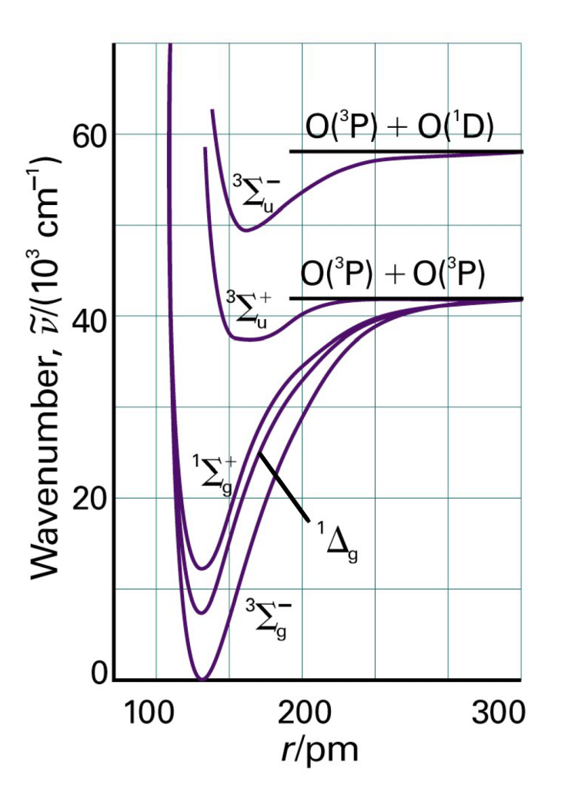
Electronic states of molecules
³Σ_{g}⁻, ¹Δ_{g} a ¹Σ_{g}⁺ states arisen from the lowest electronic configuration:
Each of these states is bound and contains a number of vibrational levels. They can be approximated, for example, by Morse potential.
Other configurations of electrons will give rise to other electronic states (dissociation products for large interatomic distances may vary from state to state).
The transitions between different electronic states exhibit the structure of vibrational bands.

Slide 31
Bond order
Example: H₂ b = 1
N₂ b = 3
He₂ b = ?
Number of electrons in bonding orbital
Number of electrons in antibonding orbital
The greater the order of the bond, the shorter the bond
The greater the order of the bond, the stronger the bond

Slide 32
Heteronuclear diatomic molecules
Polar Bond
For a non-polar bond
For an ionic bond
Example: HF
H 1s orbital is 13.6 eV from the dissociation limit
F 2p orbital is 18.6 eV from the dissociation limit
The bonding orbital of HF is mainly of F 2p and the antibonding orbital is mainly of H 1s character. Both electrons in the bonding electron will most likely be found around the F atom
There will be a partial negative charge on the F atom and a partial positive charge on the H atom

Slide 33
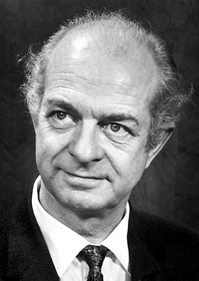
Heteronuclear diatomic molecules
1932
Elektronegativity χ
- A measure of an atom's ability to attract electrons in a compound
Energy required to dissociate the respective bond (eV)
Linus Pauling (1901 -1994)
Nobel prize in chemistry (1954)
Nobel Peace Prize (1962)
The greater the difference in electronegativity, the more polar the bond
The scale is dimensionless

Slide 34
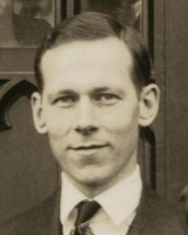
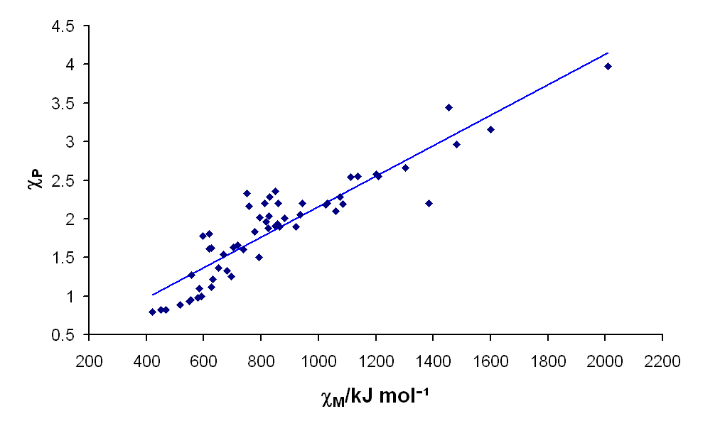
Heteronuclear diatomic molecules
1934
Elektronegativity χ
An element is electronegative if it has high ionization energy and electron affinity:
eV
Approximate relations between the Pauling and Mulliken scales:
Robert Mulliken (1896 -1986)
Nobel Prize in Chemistry (1966)
1 eV ~ 96.5 kJ mol⁻¹

Slide 35

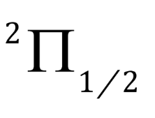
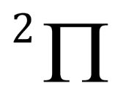
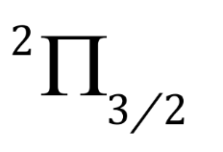
Examples of molecular terms
Ground state of NO
Asymmetric → there is no u,g symmetry
Λ = 1 → Π term
S = 1/2 (1 unpaired electron) → doublet

