Slide 1
3D front-projected holographic display
Future Media Experiences
Mgr. Ing. Jana Rosenfeldová
Xichong Wang 2021 22th Feb.

Slide 2
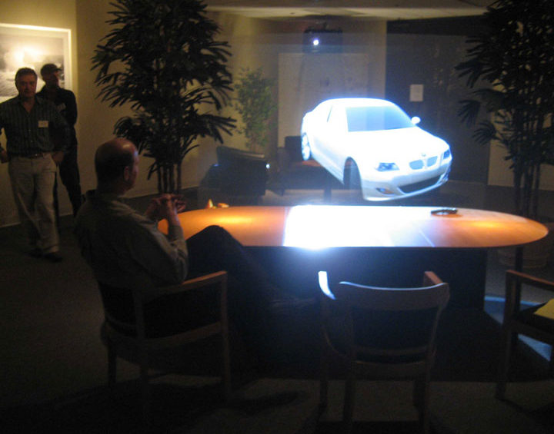
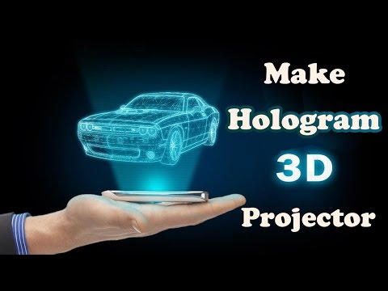
What is it?
∙ 3D front-projected holographic display so called virtual imaging technology, it is a technology that uses the principles of interference and diffraction (through computer operations) to record and reproduce the real three-dimensional image of an object.
∙ without any special glasses or external equipment

Slide 3
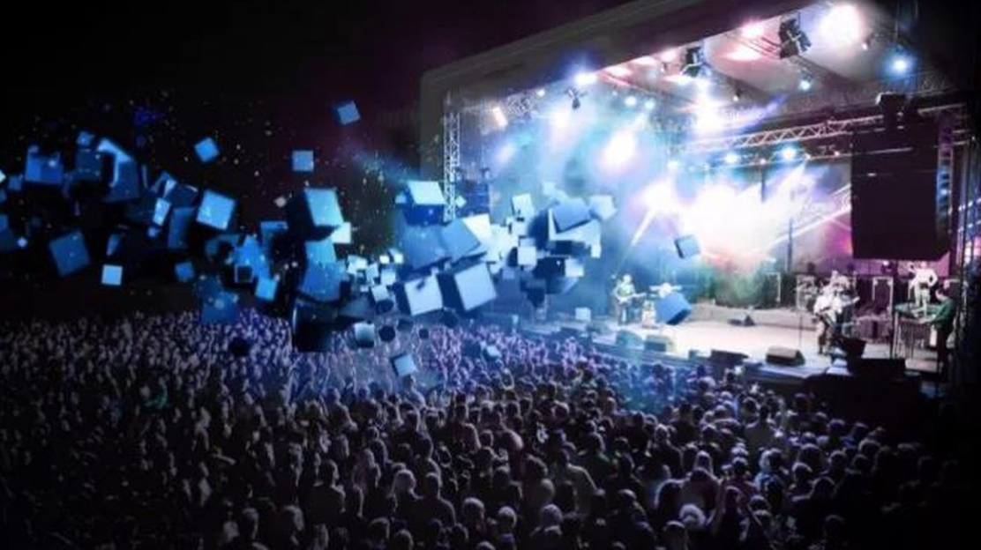
Development
1947 - Hungarian scientist Dennis Gabor first came up with the concept of a hologram . He derived the name for holography, with "holos" being the Greek word for "whole," and "gramma" which is the term for "message.”
1962 - Yuri Denisyuk invented the white-light reflection hologram which was the first hologram that could be viewed under the light given off by an ordinary incandescent light bulb.
1972 - Lloyd Cross produced the first traditional hologram by using white-light transmission holography to recreate a moving 3-dimensional image.
1989 - MIT spatial imaging group pioneered electroholography, which uses magnetic waves and acoustic-optical sensors to portray moving pictures onto a display.
2005 - The University of Texas developed the laser plasma display, which is considered the first real 3D holographic display.
2012 - The first holographic display is implemented in a car's interactive navigation display system. The technology was showcased through the exclusive luxury car, the Lykan HyperSport.

Slide 4
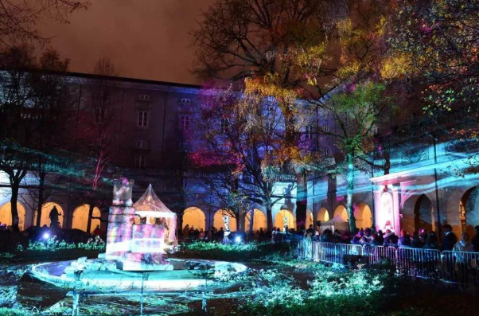
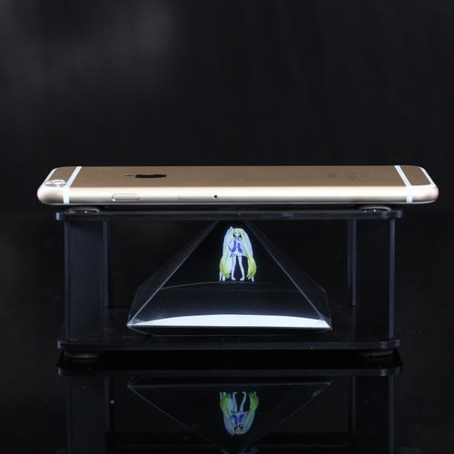
Application
Company annual meeting Wedding celebration
Party
Exhibition
Conference

Slide 5
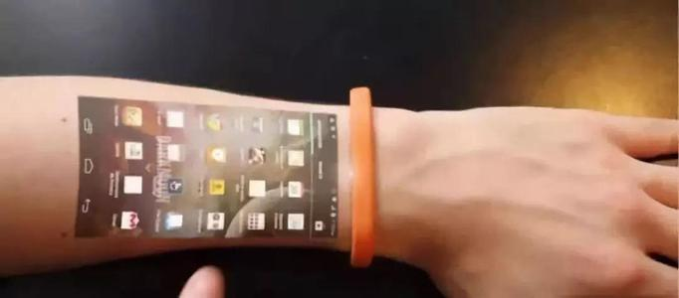
Advantage
• Without any special glasses or external equipment, Clear and intuitive, better visual experience
• Three-dimensional, strong sense of interaction, able to immerse people in virtual images
• Convenient, free from any space and site restrictions, it can emerge in mid-air, so there is no need to worry about site constraints

Slide 6
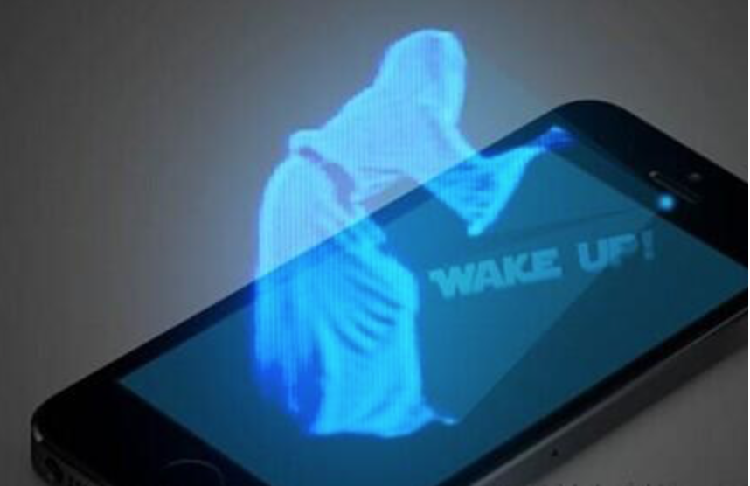
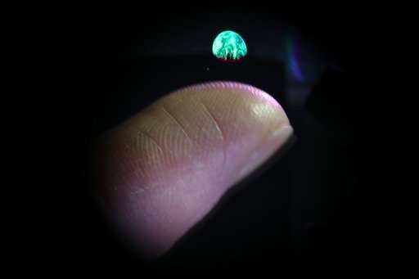
Disadvantage
High cost
Technology is not popular

Slide 7
Sources:
Ahmed Elmorshidy (2010) Holographic Projection Technology: The World is Changing
Eduardo Luévano (2015) Use of Telepresence and Holographic Projection Mobile Device for College Degree Level
Husain Ghuloum (2010) 3D Hologram Technology in Learning Environment
Jiono Mahfud; Takafumi Matsumaru (2016) Interactive aerial projection of 3D hologram object
Khushali Deulkar ,Aunsh Chaudhari, Keval Lakhani (2015) Transforming the World using Holograms
5 Amazing Holographic Displays, Technologies That Actually Exist Now https://www.techeblog.com/5-amazing-holographic-displays-technologies-that-actually-exist-now/
Sergey, Zharkiy. "History of the holography". www.holography.ru.

Slide 8
Thank You
For Your Attention

