Slide 1
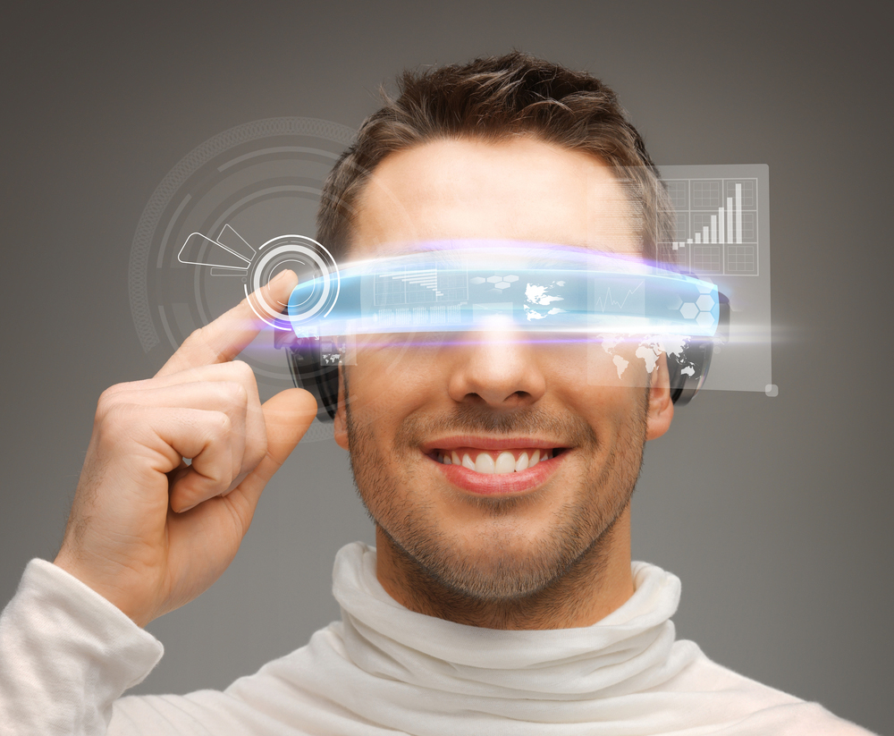
Wearable journalism
Anna Šotolová

Slide 2
What is wearable journalism?
„Wearable journalism“ = gadgets such as smart watches or smart glasses, which can either help journalists to easily collect data or provide a better and faster access to news.

Slide 3
Smart watches
Devices such as Apple Watch and Samsung Galaxy Watch provide news in shorter form for brief checks on the go.
Media have quickly adapted and produce content exclusively for these gadgets with only the core of the whole story.

Slide 4
Smart glasses
Google Glasses brought up new possibilities for journalists.
Built-in camera and microphone in smart glasses provide easier and faster recording a situation .
Smart glasses also support „citizen journalists“, regular people who can easily share breaking news.

Slide 5
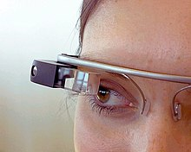
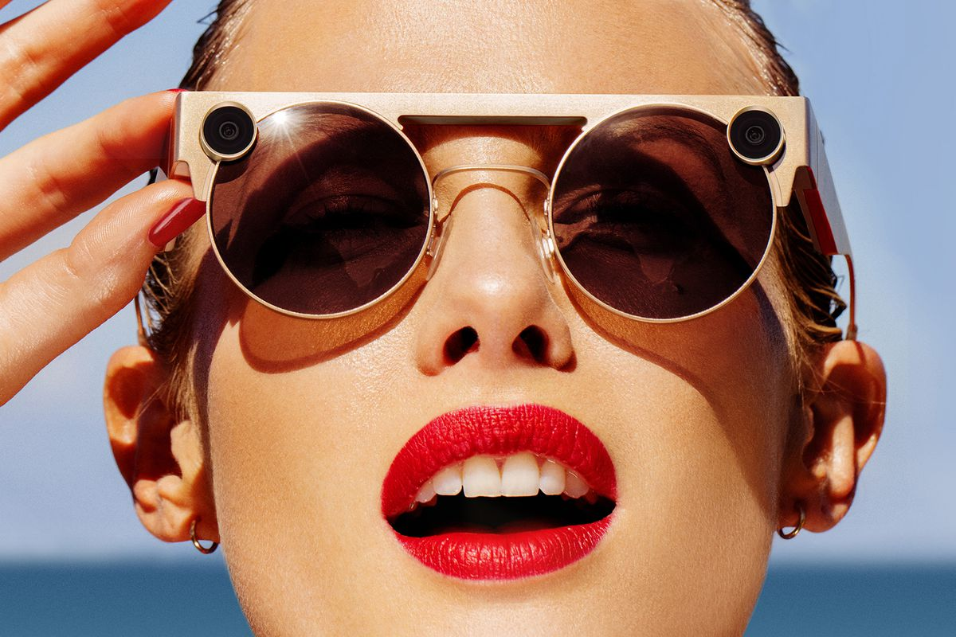
Smart glasses
CNN came up with several apps designed for smart glasses. They play a short video right in front of human eyes.
Howerever, smart glasses are still controversial.

Slide 6
Tato fotka od autora Neznámý autor s licencí CC BY-NC-ND

Slide 7
Sources
Villa, J. (2020, October 16). 10 examples of emerging technologies that are revolutionizing the media industry. Wibbitz. https://www.wibbitz.com/blog/examples-of-emerging-technologies-revolutionizing-media-industry/
Albeanu, C. (2014, September 22). How wearables are already delivering the news. Media News. https://www.journalism.co.uk/news/how-wearables-are-already-delivering-the-news/s2/a562539/
Saunderson, Z. (2020, January 14). Wearable technology is the future of journalism - Zoe Saunderson. Medium. https://medium.com/@zoesaunderson/wearable-technology-is-the-future-of-journalism-930c07324f38

