Slide 1
Smart contact lenses
Jan Darilek

Slide 2
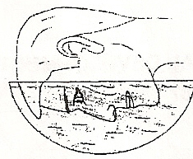
Origins
Leonardo da Vinci: introduction in 1508
1939: Fully plastic contact lenses
Otto Wichterle and Drahoslav Lím: breakthrough
1972: disponsable contact lenses
1998: first silicone hydrogel contact lenses

Slide 3
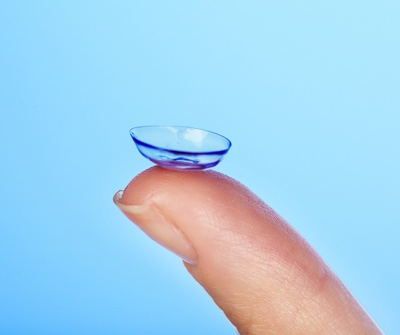
smart contact lenses
The fluid from our tear ducts serves as an informant
2014: Google announced a work on lenses with glucose sensor
2016: A contact lense with built in ultra-thin film
2019: A prototype of a device with a battery inside

Slide 4
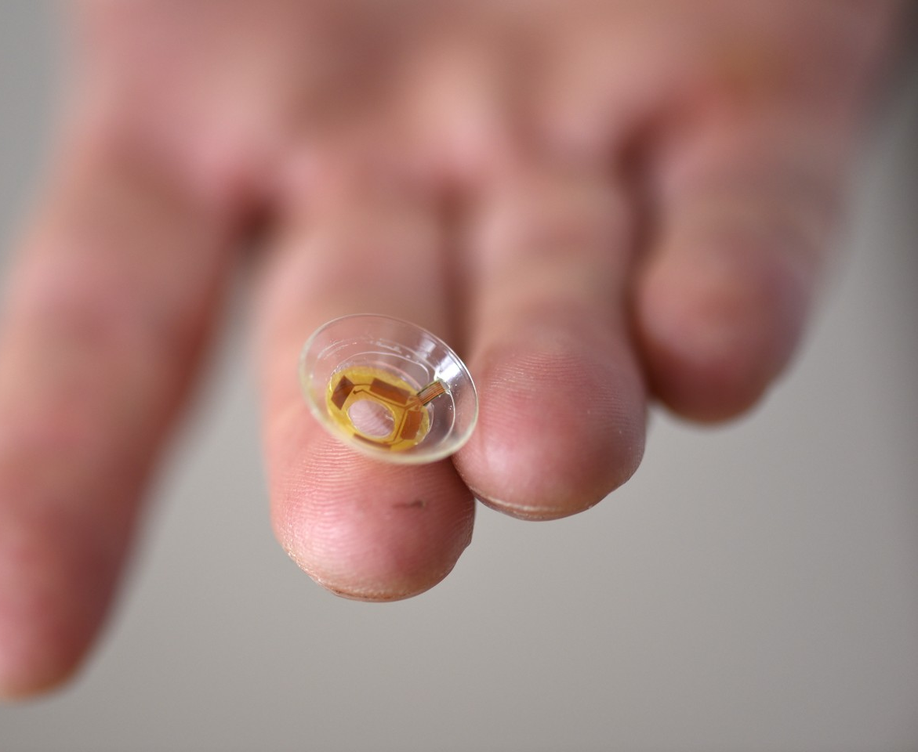
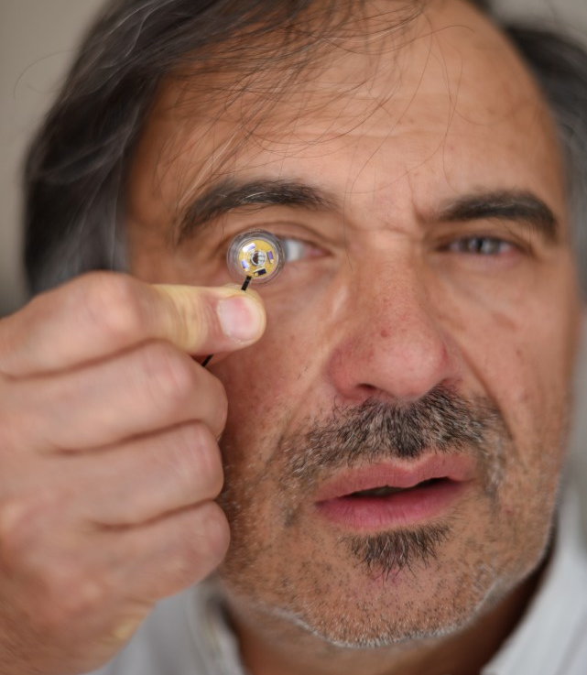

Slide 5
Nowdays possibilities
Main functions
Sensoring
Video
Augmented techs

Slide 6
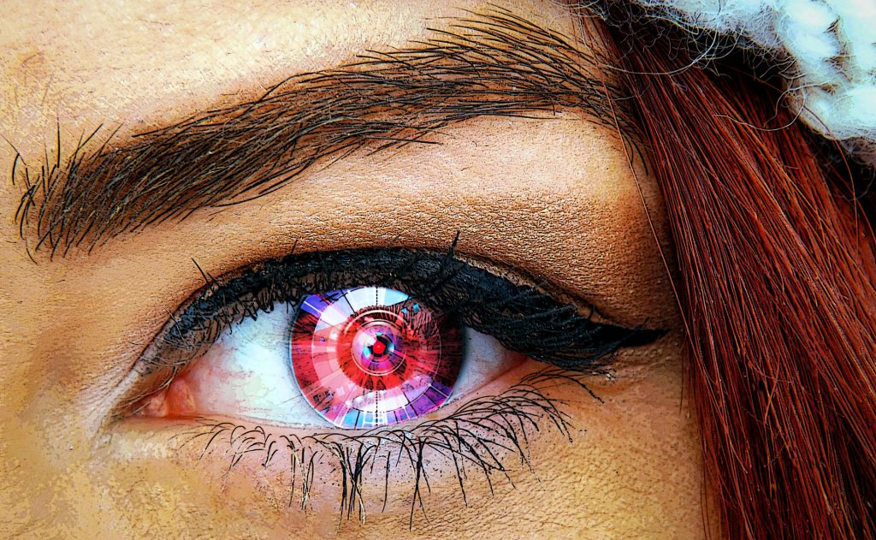
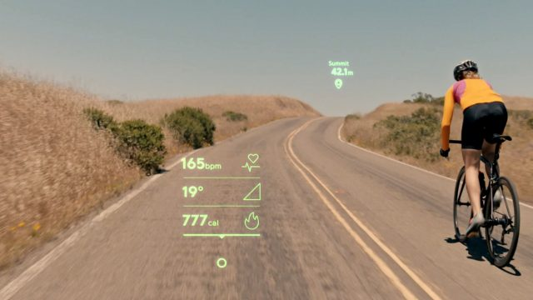
Near future
Assistive technologies for everything
Virtual reality
Photos and videos
Infromational functions
Leading players: Sony, Samsung, Google, Magic Leap

Slide 7
Not that distant future
Transparent, standalone contact lenses with onboard power supplies
Organic materials that can act as passive sensors embedded in the eyewear.
Part of the future warfare

Slide 9
Could the technologies effect the develompment of our brain?

Slide 10
Thank you for your attention

