Slide 1
Nature Language Processing
Future Media Experiences
Wang Yajing

Slide 2
Natural Language Processing or NLP is a field of Artificial Intelligence that gives the machines the ability to read, understand and derive meaning from human languages.

Slide 3
Machine
Human
Animal
01111010010
Hello
Woof

Slide 4
Hello
Translator
你 好
NLP
01111010010
Hello

Slide 5
Core part
Natural Language Understanding
Natural Language Generation
Training machines to have the ability to understand normal human language
Convert information from computer databases or semantic intents into readable human language.

Slide 6
MAJOR NLP Tasks
Morphological analysis
Text and speech processing
Syntactic analysis
Lexical semantics (of individual words in context)
Discourse (semantics beyond individual sentences)
Relational semantics (semantics of individual sentences)
Higher-level NLP applications

Slide 7
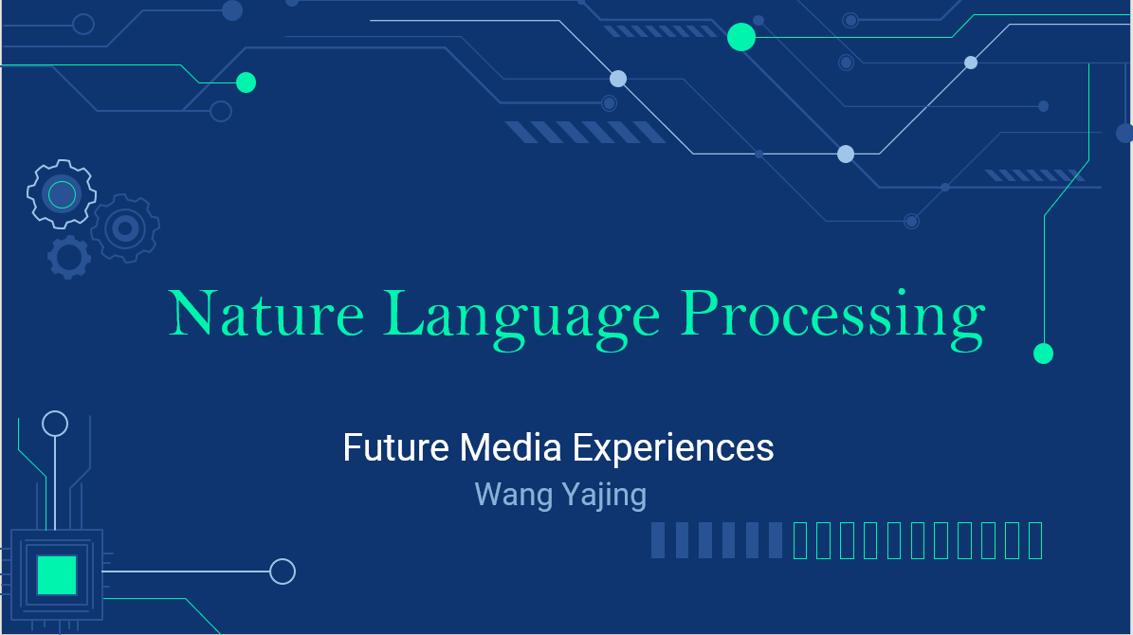
Range of applications
Automated Journalism
BI Interpretation and Report Generation
Chatbots
Smart Speakers
Machine Customer Service
Machine translation

Slide 8
Use Cases
Analytical Data Reports
Healthcare Industry
Identifying fake news
Customer Analysis

Slide 9
RESOURCES
BrownleeJason. (2019-8-7). What Is Natural Language Processing?
Source: Machine Learning Mastery:
https://machinelearningmastery.com/natural-language-processing/
easyAI. (2020-5-12). Natural language processing | NLP.
Source: easyAI: https://easyai.tech/ai-definition/nlp/
YseLopezDiego. (2019-1-15). Your Guide to Natural Language Processing (NLP).
Source:Towards Data Science:
https://towardsdatascience.com/your-guide-to-natural-language-processing-nlp-48ea2511f6e1

