Slide 1
Smartphones and m-commerce
Vojtěch Masařík

Slide 2
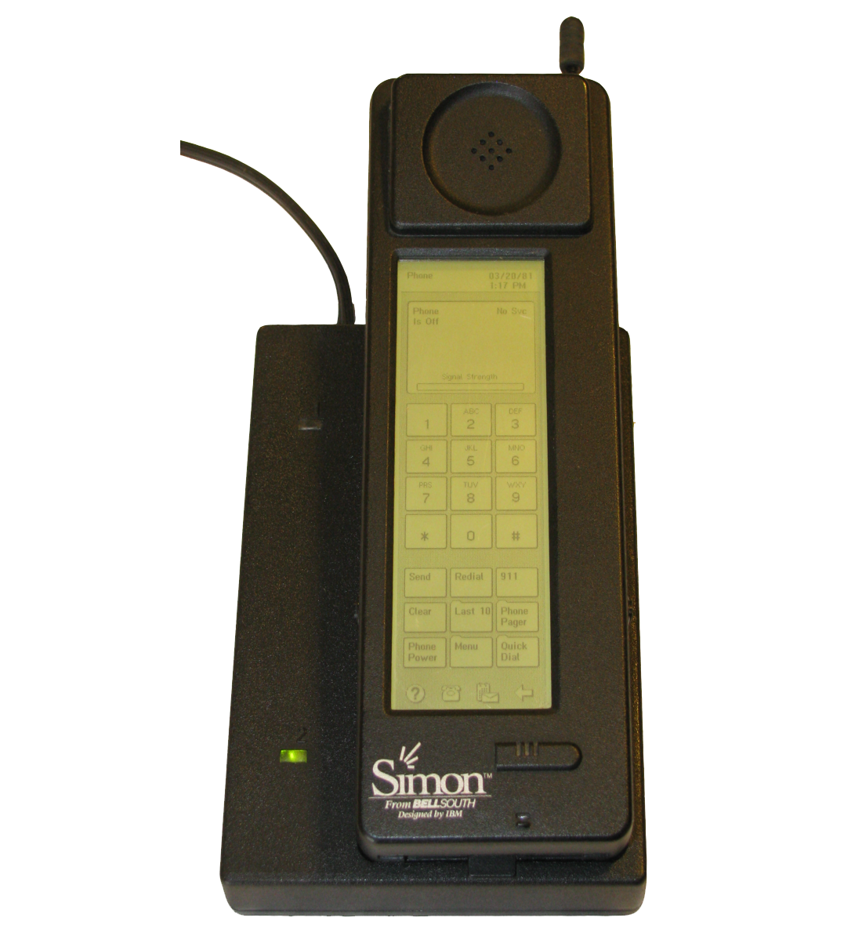
Smartphones
IBM Simon – introduced in 1994
Touchscreen
Basic apps – calculator, calendar, notepad
On the market for 6 months – 50k units sold

Slide 3
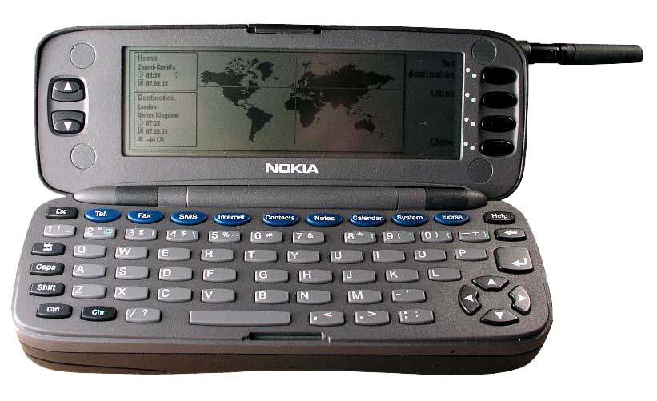
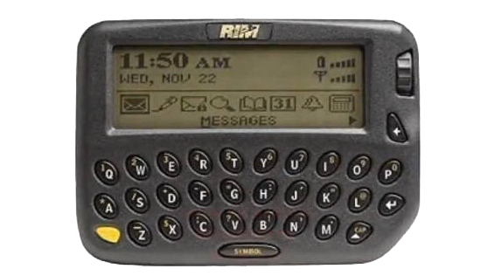
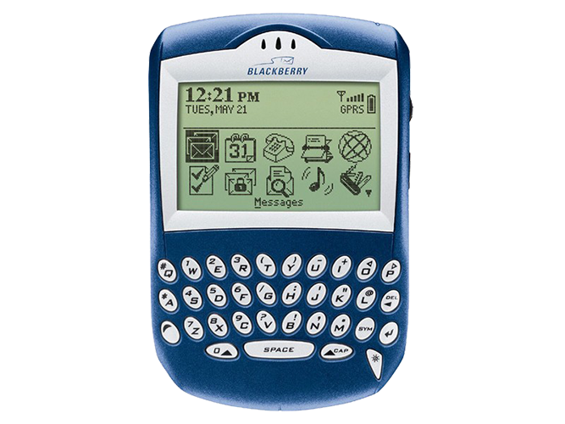
Smartphones – Late 90’s, Early 00’s

Slide 4
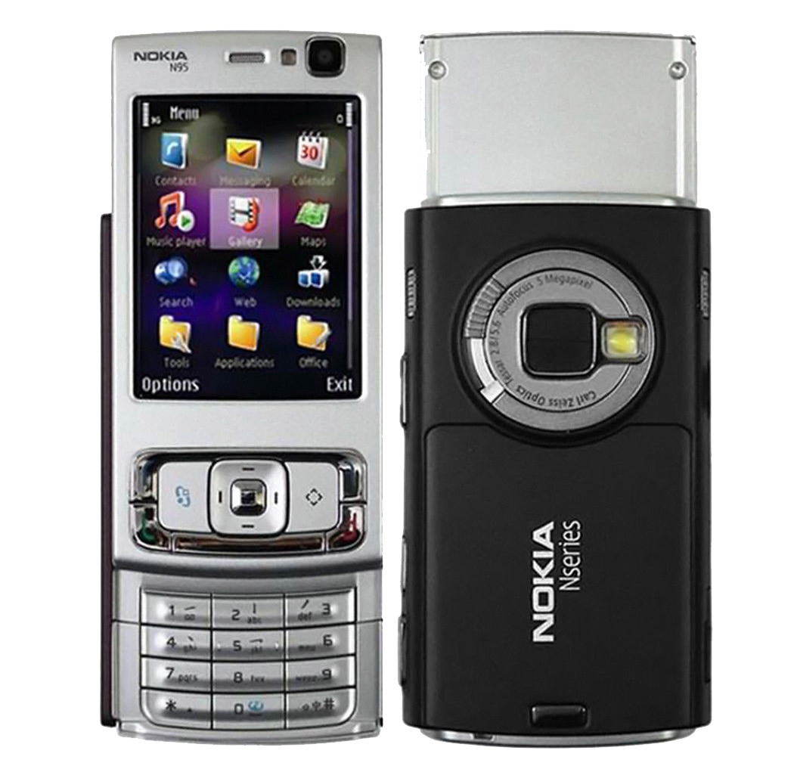
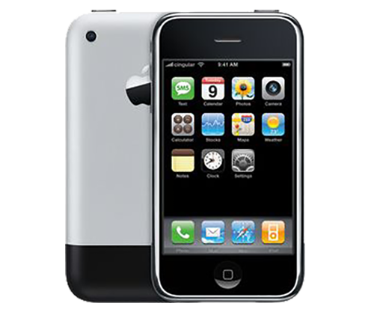
Smartphones – 2007

Slide 5
Smartphones – Today and tomorrow
Technical specifications of smartphones continue to improve
Apple iPhone 12, 12 Pro, 12 Pro Max
Samsung Galaxy S21, S21+, S21 Ultra
Xiaomi Mi 11, Mi 11 Ultra
Foldable phones, bendable screens, wearable phones

Slide 6
M-commerce
Mobile commerce
Shopping online via a mobile device
Smartphones are the most spread mobile devices – play a key role in m-commerce
First coined in 1997 by Kevin Duffey (CEO of the Global Mobile Commerce Forum)
1998 – ringtones sold

Slide 7
What makes m-commerce so popular?
Mobile apps – Brands and stores develop their own apps
Social media – buying items via Facebook and Instagram
Simple shopping process
Easy checkouts
Mobile walllets and contactless cards

Slide 9
Downsides of m-commerce
Privacy – personalized marketing comes at a price
”Phones read our mind, listen to us”
Smartphone addiction
Decline in B&M (instore) sales

Slide 10
Thank You!

