Slide 1
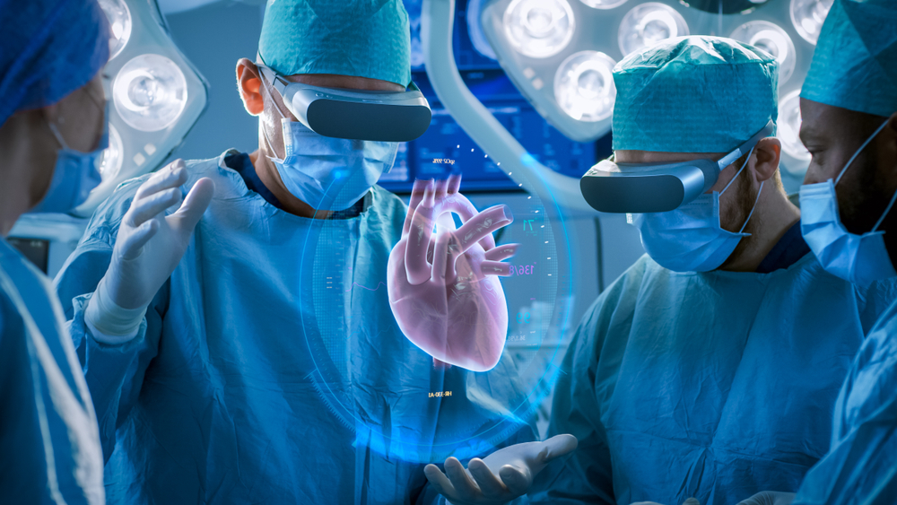
VR in medical training
Sylvie Rosová

Slide 2
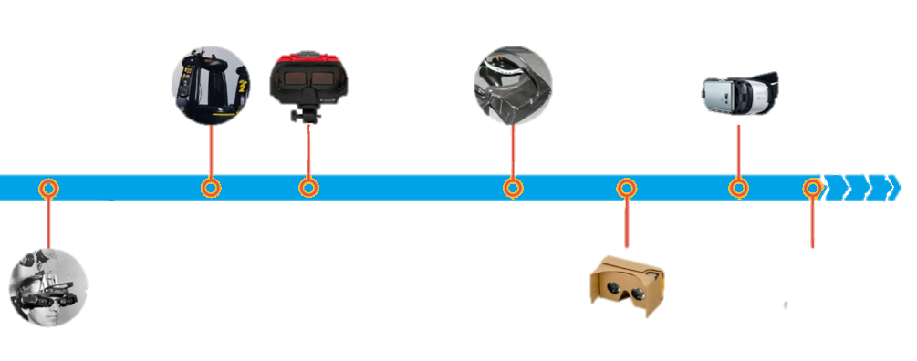
About VR
Computer technology creating a simulated environment
Usually through head-mouted display
VR places the user inside an experience
Ability to interact with 3D worlds
Stimulates as many senses as possible (even smell)
Virtuality, the first mass-produced VR arcade
Nintento Virtual Boy
First Oculus Rift prototype
Samsung Gear VR released, YouTube & Facebook support 360° video
1968
2014
2016
1991
1995
2010
2015
Sword of Damocles, the first VR & AR HMD system
Google Cardboard released, Facebook buys Oculus VR, Sony announces Gear VR
Oculus Rift & HTC Vice released

Slide 3
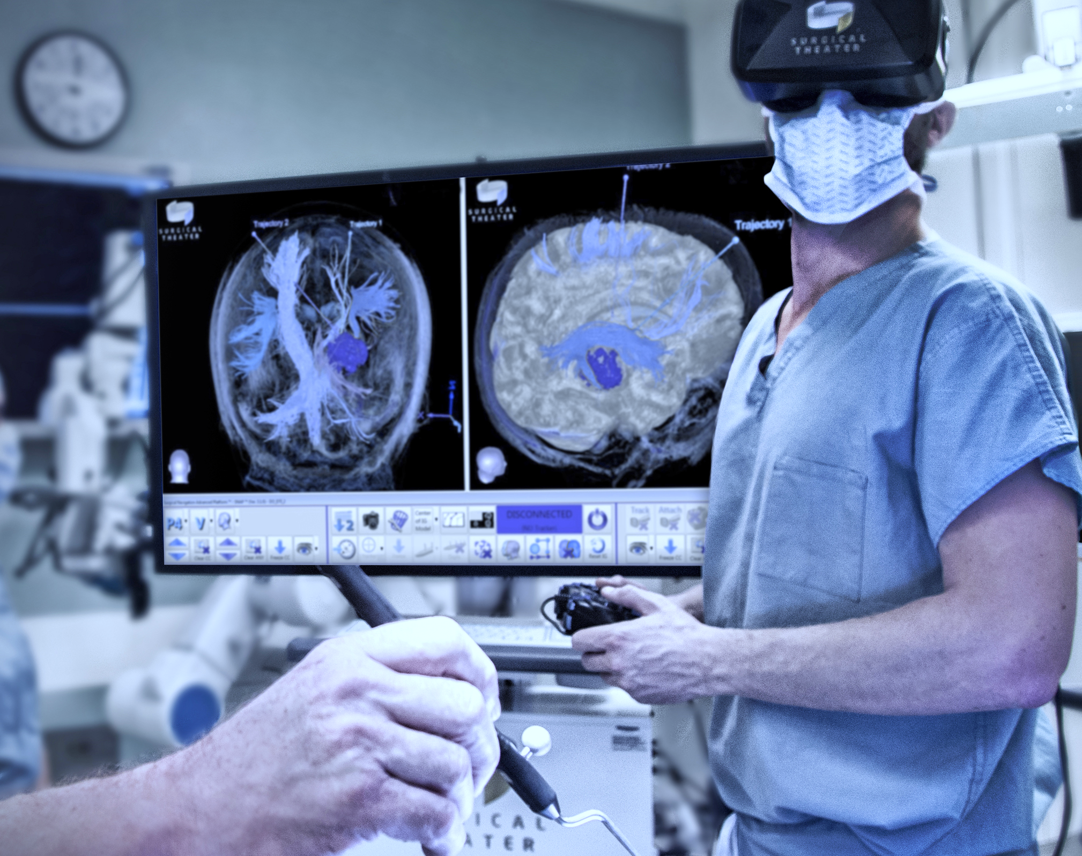
VR in medical training
New skills in interactive a safe environment
Possibility of multiple repetition
Preparation for complex medical situations
Risk-free

Slide 4
Psychological training
Practical skill training
Understanding of human anatomy
Cardiovascular system
Central nervous system
Muscles, bones
Routine procedures
Surgical training
Empathy
Chance to experience some of the patient‘s symptoms
Loss of vision/hearing, vertigo
High-pressure simulation
Emergency room treating
Focus on quick decisions, live saving procedures

Slide 5
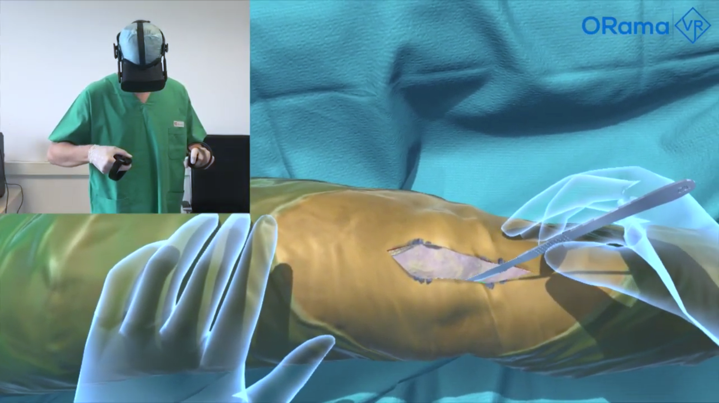
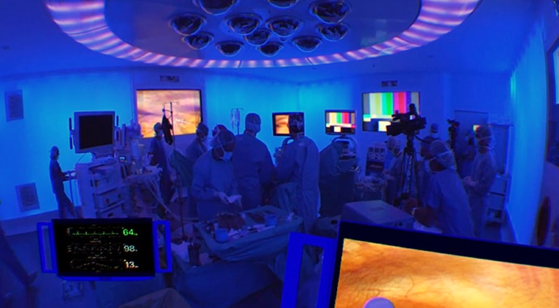
How does it work?
Special education materials with human anatomy
Medical procedures
VR interactive simulations
Using haptic technology for hand movements
Surgical training
One or a pair of cameras capture a situational view of the whole operating room
Microphones for sound and for commentary
Direct feed fro camera, patient data etc.

Slide 6
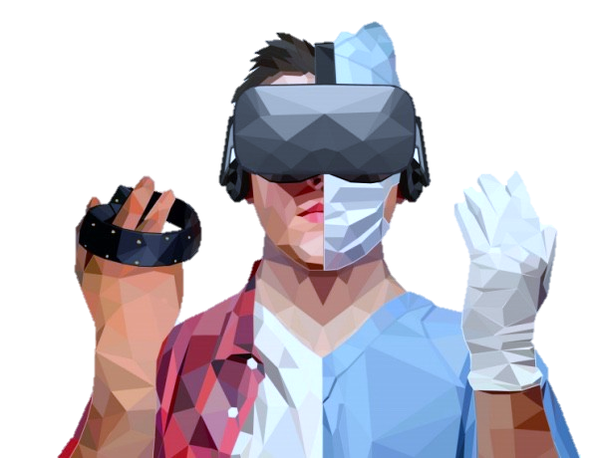
Limitations of VR in medical training
VR medical training can‘t replace traditional traning
Students performance needs to be evaluated by a specialist
Haptic technology is not evolved enough

Slide 7
References
https://pro.sony/en_CZ/insight/healthcare-imaging-innovations/vr-surgical-training-education
https://elarasystems.com/medical-training-advances-to-vr/#:~:text=With%20VR%20training%2C%20medical%20students,from%20a%20very%20early%20stage
https://www.scnsoft.com/virtual-reality/healthcare/medical-training
https://onix-systems.medium.com/implementing-virtual-reality-in-medicine-and-medical-training-848934194bba
https://medialist.info/en/2018/01/26/vr-healthcare-virtual-reality-in-medicine/
https://www.scnsoft.com/virtual-reality/healthcare/medical-training
https://www.ncbi.nlm.nih.gov/pmc/articles/PMC6039818/
https://www.healthysimulation.com/18769/vr-healthcare-training/

