Slide 1
Why talk anti-immigrant attitudes?
Introduction to the course, Explaining the Importance OF THE TOPIC, DEFINING BASIC TERMS

Slide 2
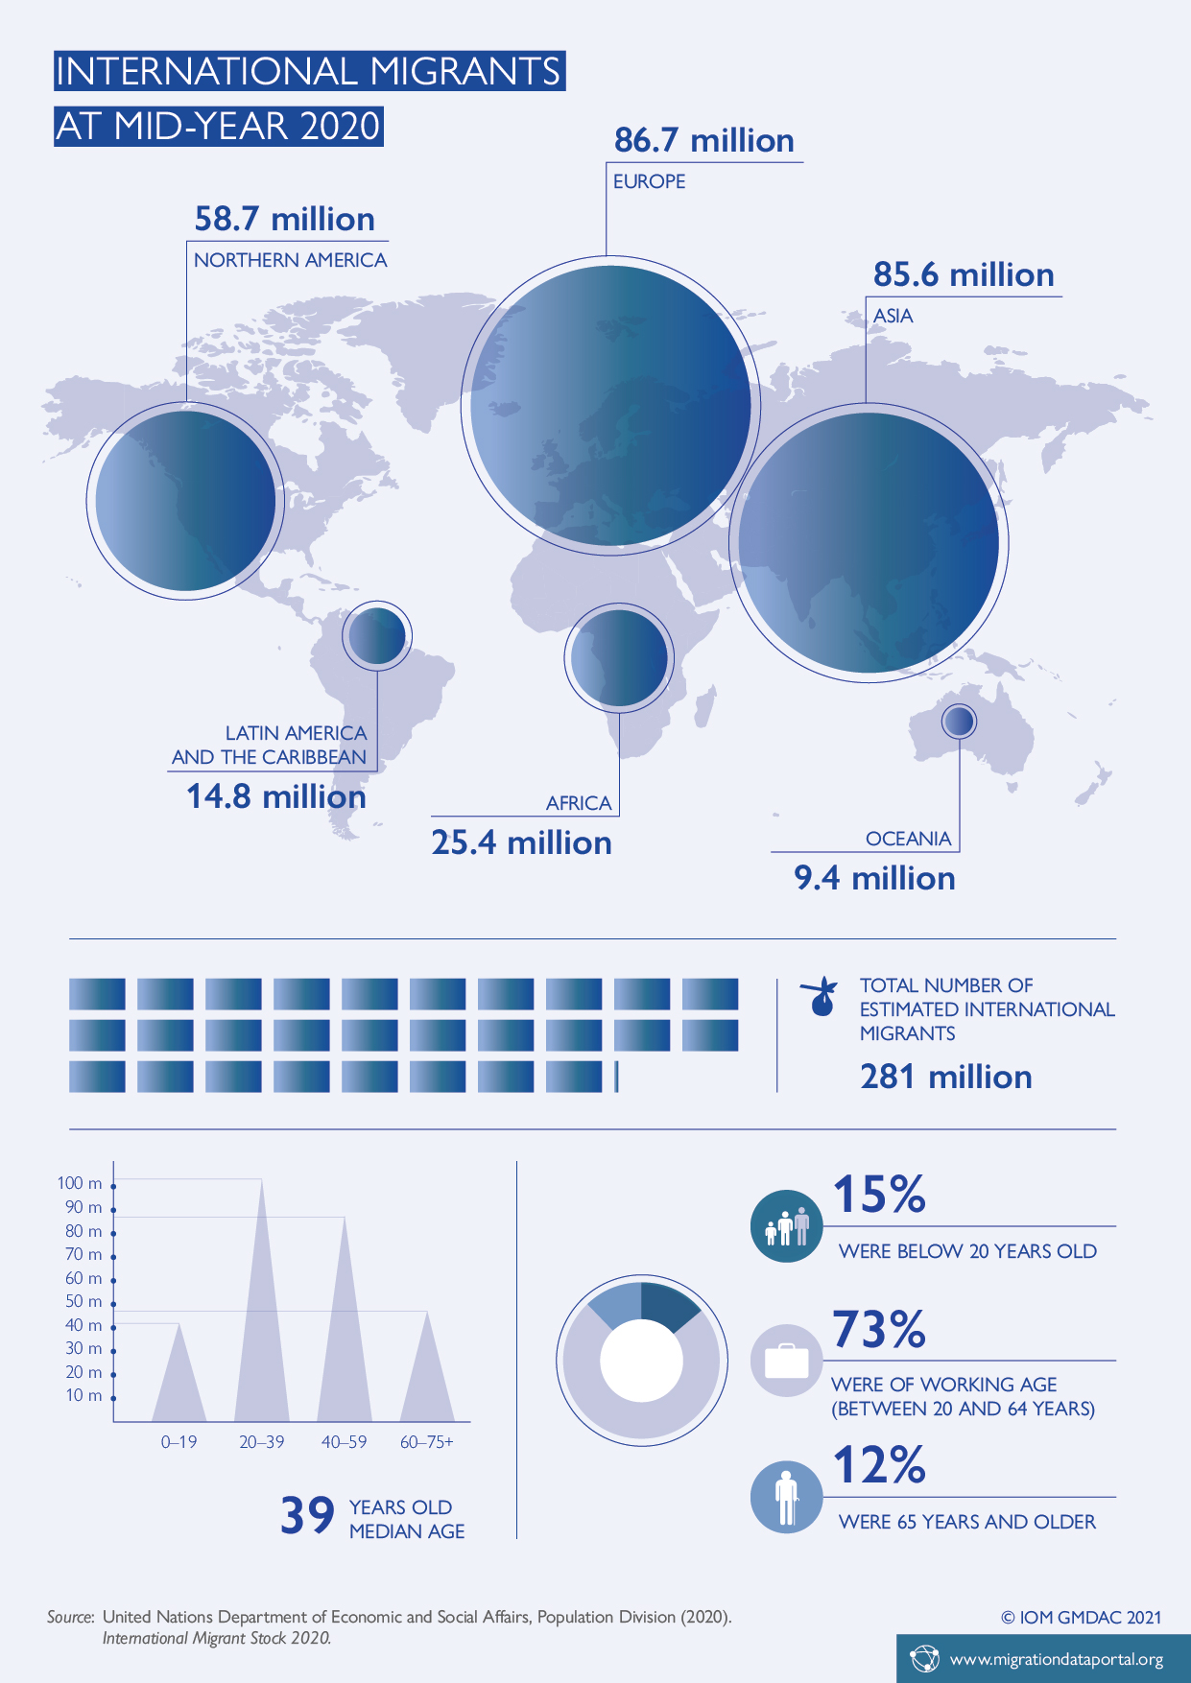
Data Resources
Global Migration Data Portal: https://migrationdataportal.org
United Nations: https://www.un.org/en/sections/issues-depth/migration/index.html
IOM’s Global Migration Data Analysis Centre: https://gmdac.iom.int/

Slide 3
Why people leave their homeland?
Economic migration: moving to find work or follow a particular career path
Social migration: moving somewhere for a better quality of life or to be closer to family or friends
Migration caused by environmental changes include natural disasters such as flooding, earthquake, desertification
Political migration: moving to escape political persecution or war
Religious intolerance, Modern nationalism, Political ideologies
Push and Pull factors

Slide 4
Specific cases of migration in recent history
Political instability
Economic problems
Others
Nazi regime and Jewish refugees
Palestine
Refugees from Vietnam
Cold war
Ethnic cleansing in the former Yugoslavia
Irish immigration to US
Transatlantic mass immigration
Turkish labor migration to Germany
Migration to Persian gulf
Post-soviet migration
British migration to Australia
Transatlantic slave trade
Prostitution and sex trade
Global diasporas

Slide 5
What does it mean to be an immigrant?
Immigrant vs Refugee
Migrants in vulnerable positions
Displaced persons
Do you know any famous persons with immigrant background?
Hannah Arendt
Madelein Albright
M.I.A.

Slide 6
Is it our right to choose a country to live in?
What are the implications of migration?

Slide 7
Images of immigrants Irish stereotypes in 19th century U.S.A.
Notes:
We know U.S. as a typical state of immigrants, nation built of many other nations which member came to US as immigrants. One of the such fundamental nation represented immigrants from Ireland running from famine in 1845- 1849, about 1 million died and 1 million left the country. These immigrants were typically very poor, unskilled, and illiterate. Significant numbers spoke little or no English. The United States was predominantly a Protestant country, and native whites often saw the Irish Catholics as a danger. In this cartoons we can see many of the stereotypes of the irishman of the 1800s. the association with drink, but also a flat nose, pronounced mouth and lips, low forehead, and general air of brutishness. the drunken, violent Irishman sits on a powder keg that threatens the US itself. Some historians have argued that the Irish were seen as not quite white--not black, exactly, but not quite "white" either.

Slide 8
Image of Chinese workers 19th century, California
John Chinaman, anonymous
John Chinaman, John Chinaman But five short years ago, I welcomed you from Canton, John— But wish I hadn't though;
For then I thought you honest, John, Not dreaming but you'd make A citizen as useful, John As any in the state.
I thought you'd open wide your ports And let our merchants in To barter for their crapes and teas, Their wares of wood and tin.
I thought you'd cut your queue off, John, And don a Yankee coat, And a collar high you'd raise, John, Around your dusky throat.
…
Notes:
This song, published in The California Songster (San Francisco: Appleton, 1855), became popular during the California Gold Rush. Chinese men arrived in significant numbers shortly after the Gold Rush began in California. Excluded from the best placer mines, Chinese miners frequently worked the "tailings" after Anglos and other European-Americans left a camp for better prospects elsewhere. Most Chinese, though, found work in services (cooking, laundering) and then in the construction of the transcontinental railroad during the 1860s. Anti-Chinese sentiment ran high in California: non-Chinese resented the "cheap labor" that Chinese men provided, while that same racism reinforced the very cheapness of Chinese labor.

Slide 9
The Poles in German minds 90`
“In the Polish tourist office, there is a poster: Come to Poland, your car is already there!”
“Never laugh: when a Pole hits a tree in a car, it could be yours.”
Notes:
When randomly Germans were asked what comes to mind when they hear the word "Poland", emerge associations like Poles steal, cannot park, are lazy and chaotic, very emotional, individualistic, ultra-Catholic and dishonest. Obviously many of these traces and images in people's minds are connected with social and material differences. This gap spurs migration; because why should people choose to migrate when things are better at home than elsewhere? Very few Poles have moved to Germany out of cultural interest, but for material reasons in order to work, very often for low wages.

Slide 10
Notes:
BREAKING POINT” screams the red lettering on an anti-immigration poster from the United Kingdom Independence Party (UKIP).
The poster was released days before Thursday’s EU Referendum, when Britons will decide whether to remain in or leave the European Union. Set over an image of thousands of refugees in Slovenia in 2015 who had just crossed the border with Croatia on their perilous journey, many of whom were fleeing war and persecution. A caption calling on voters to tick “Leave the European Union” on June 23 reads: “We must break free of the EU and take back control of our borders.”

Slide 11
Discuss the negative attitudes immigrants usually face

Slide 12
Main concepts
PREJUDICE
RACISM
DISCRIMINATION
Not based on experience
Refers to an unfair feelings someone holds about a group
Not necessarily specific to race
A stronger type of prejudice
To justify the belief that one racial category is somehow superior or inferior to other
Set of practices used by a racial majority to disadvantage a racial minority
Biased thinking or actions against a group of people
Can be based on age, religion, health
Forms: unfair housing practices, biased hiring system

