Slide 1
Techniques of the body: Body as a socio-cultural phenomenon
Body, Health and Society

Slide 2
Class outline
Finishing the introduction
Marcel Mauss
Reading reflections
Exercise
Discussion
https://performingbodies2015.wordpress.com/screenings/screening-zulawskis-possession-1981/

Slide 3
Body in social science (Lock 1993)
Body as a medium of social interaction might seem a core of anthropological research
17th cent + * modern science
Cartesian assumption – the world is made by the thinking nonmaterial element and by material substance, rationally accessible
objective vs. subjective
→ body falls into the domain of natural sciences
body = universal biological base for a cultural filling
from 20th cent 70’ - the interest from the area of social sciences
decentralization of the physical body from the domain of natural science question of the assumption of western epistemology – a basic for a production of natural facts
relativization of the dichotomies nature vs. culture, self vs. others, mind vs. body

Slide 4
Study of the body and praxis soacial changes that help to turn to body in social theory (Fraser, Greco 2005:2)
rise of „somatic society“ (Turner 1996: 6)
transition to post-industrial society
rise of opportunities for leisure
importance of consumption
erosion of „puritanical orthodoxy“ (Fraser, Greco 2005: 2)
legitimation of pleasure – bodily hedonism
transformation of intimacy (Giddens 1991a)
body as a vehicle of new emotional intensities in interpersonal interaction
shift in demographic structure of western societies
epidemiological shift
„no man`s land between health and disease“
still not possible curing conditions with life-threatening potential
illnesses integrated into patterns of work and leisure
living with illness makes body a problematic aspect of life
emphasis on prevention
the body no longer province of specialist
development of biomedical technologies
limits of human body, personhood and identity

Slide 5
Techniques of the body Reading: marcel mauss
How was the text for reading?
Situating the reading
time
space
methodology
mainstream? (p. 82 - 83)
What is the text about?
What is the main argument?
Questions/ Comments?

Slide 6
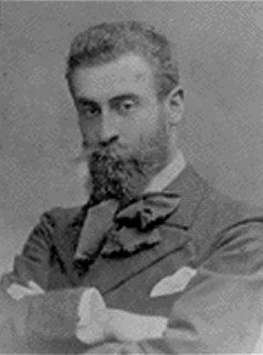
Marcel mauss (1872-1950)
French sociologist and anthropologist
regarded for a founder of French Social Anthropology
since1901 École pratique des hautes études „history of religion and primitive nations“
founder of a French Sociologist Institute (1924) and Institute of Ethnology (1926)
since 1931 professor of sociology - College de France
published and leaded L´Année Sociologique
background, work
Student of Durkheim, teacher of Lévi-Strauss
No own fieldwork – buil¨t on secondary data
Through the description and classification diverse societies and definition of theirs structural similarities the aim was
TO UNDERSTAND THE GENERAL DIMENSION OF SOCIAL LIFE
The Gift (Essai sur le don,1924)

Slide 7
Guiding questions Mauss, Marcel (2006) [1935]. Techniques of the body in techniques, technology and civilization by nathan schlanger. Pp. 77-96.
What are techniques of the body?
How they are acquired?
Are all the ways of handling body techniques? Which are not and how are they acquired?
Are they conscious / unconscious?
What is habitus?

Slide 8
Exercise 1.
techniques vs. tools (techniques vs. rites) (str. 82, 6-9)
techniques as one type of action (str. 82, 6-9)
techniques of body vs. other types of action (str. 83, 1)
How people know, how to use their bodies? – how to be a good man (str. 83, 3; 85, 3.odst.)
What is habitus? (80)
How are body techniques transmitted? (83, 3.; 92, 3., 5.)
What is „total man“? (77; 81, 3.; 83 – 2.)
How is body an instrument? (83)
Are body techniques conscious? (83, 4.; 93., 2-3.)
https://www.inverse.com/mind-body/exercise-coronavirus-how-to-workout-safely-in-a-pandemic

Slide 9
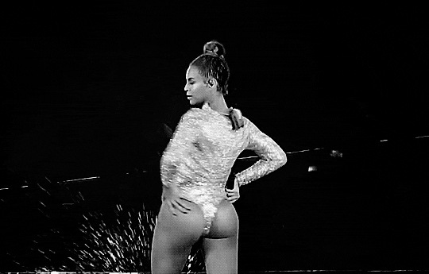
Techniques of the body
techniques vs. tools (techniques vs. rites) (str. 82, 6-9)
techniques as one type of action (str. 82, 6-9)
techniques of body vs. other types of action (str. 83, 1)
How people know, how to use their bodies? – how to be a good man (str. 83, 3; 85, 3.odst.)
habitus (80)
social character of habitus
habit / acquired / ability
key in social action/ socially coded
transmission
biggest influence – education = imitation (83, 3.; 92, 5.)
Of who? (92, 3.)
(Kaščák 2012)
https://giphy.com/gifs/beyonce-hair-flip-nSPEShm513TZ6

Slide 10
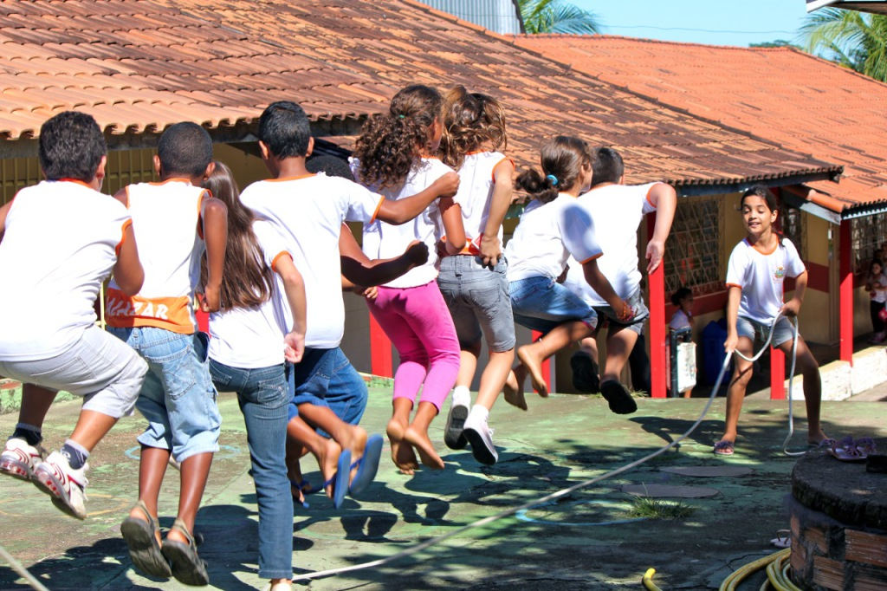
Body according to mauss?
„total man“ - connection of psychological, biological and social dimension of being
= first and most natural instrument of a man
conscious before unconscious
social character of handling the body
https://www.anthro.ox.ac.uk/social-body-lab

Slide 11
Homework feedback
Formal side
Length
Name
Content structure
Sourcing
Content side
What are guiding vs. discussion questions for?
What you do no have to write there

Slide 12
Exercise 2
Search for the technique of the body which was not mention in the text and which all of you have exercised in past 2 days.
Search for the technique of the body, which is specific to covid-19 pandemics.
Search for the technique of the body specific for the generation Z (people born between 1997 and 2012).
Explain how is it acquired? Who is the authority in this process?
Discuss the biological, psychological and social aspect of it.

Slide 13
classification
gender
age
biographical list
Obstetics
Infancy
Adolescence
Adult life
Sleep
Rest
Activities
Walking
Running
Dancing
Complex active techniques
Jumping
Climbing
Descent
Swimming
Forceful movements
Techniques of care for the body
Consumption techniques
Techniques of reproduction

Slide 14
application
Notes:
1972 and 1977
Wex began her artistic career as a painter. She eventually became interested in photography and body language. She started taking photographs around Hamburg. Eventually, these photographs developed into a collection of over 3,000 and would develop into her most notable work: "Let's Take Back our Space": 'Female' and 'Male' Body Language. The work is a collection of over 5,000 photographs that display different and similar forms of male and female body language in public, including public art in her examples. She collected these images between 1972 and 1977. The work, which was completed in 1979, has been exhibited internationally, and a book was published under the same title. Originally published in German, the book has since been translated into English and French. The work is cited as an important work in women's and gender studies, and feminist art.

Slide 15
Gendered ways of sitting?

Slide 17
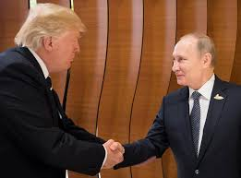
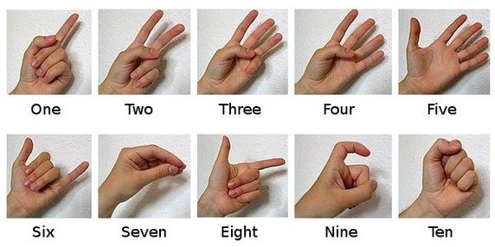
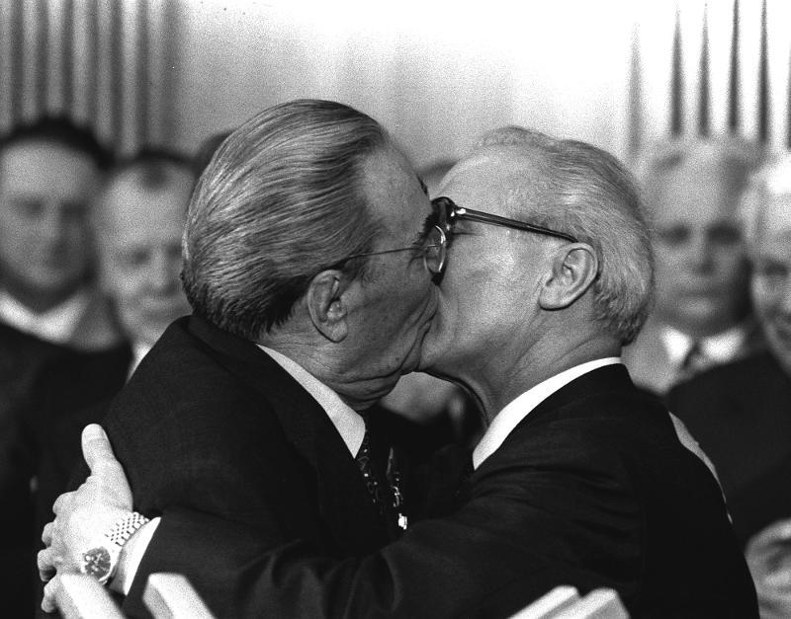
Culturally different communication?
https://www.youtube.com/watch?v=0RaBxH_MKQI

Slide 18
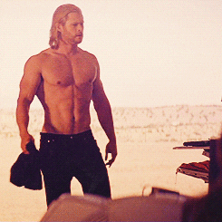
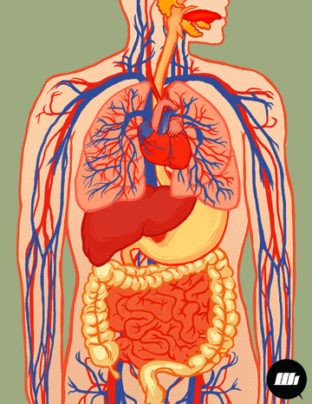
Body constructed? https://giphy.com/gifs/mSP38baPbhrIA
sexy
healthy
masculine
body

Slide 19
critique
Change?
„There is any such thing as natural behaviour“?
formulation which still draws a line between nature vs culture
Maybe we do not assume anymore, that bodies are for sociality impenetrable, but to think they are social only is similarly extreme position.
Meaning?

Slide 20
Discussion questions
Why are people handling their bodies the way they are?
What is the relationship between individual bodies and the society?
Can you think about a competing theory explaining this phenomenon?

Slide 21
Next class
The two bodies
Compulsory reading
Douglas, M. (2004) [1970]. The two bodies. In Douglas, M., Natural symbols, pp. 72-91. Taylor & Francis e-Library.
Guiding questions
Which two bodies are at stake?
What is the relationship between them?
What kind of role plays symbols in this relationship?
What kind of role plays control in it?
What is the role of understanding and experience in this process?
What is the purity rule?
Discussion questions
Can you think about more examples of these two bodies relationship expression?
In relation to gender, beauty, eating, illness, health, sexual behaviour, death?
What is the difference between the approaches to body-society relationships of Mauss and Douglas?

Slide 22
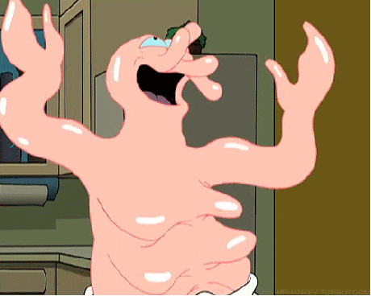
Thank you for your attention! https://giphy.com/gifs/mSP38baPbhrIA

Slide 23
literaTURE
Mauss, Marcel (2006) [1935]. Techniques of the body. In Schlanger, N. ed. Marcel Mauss, Techniques, technology and civilization. Berghahn Books, pp. 77-95.
Kaščák, O., Obertová, Z. (2012). Školská etnografia tela, jej východiska, podoby a potenciály. Český lid, 99 (1), pp. 1-22.

